Slide 1
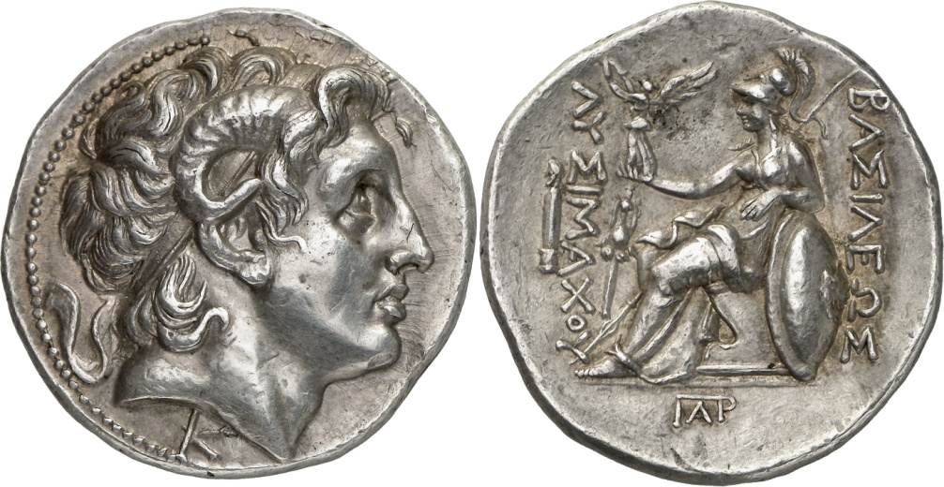
Hellenistic Coinage

Slide 2
Philip II and the Mines of Macedonia (Pangean mines)
‘...and he increased the output of the small and insignificant gold mines in the area so much by his improvements that they were able to bring him a revenue of more than a thousand talents. He soon amassed a fortune from them and began continually raising the Macedonian kingdom to a great position of superiority by means of this plentiful supply of wealth; for when he had struck the gold coinage which was called ‘Phillipic’ after him, he put together an impressive force of mercenaries and by means of this induced many of the Greeks to become traitors to their country’.
Diodorus Siculus 16.8.6-7 (Melville-Jones 414)

Slide 3
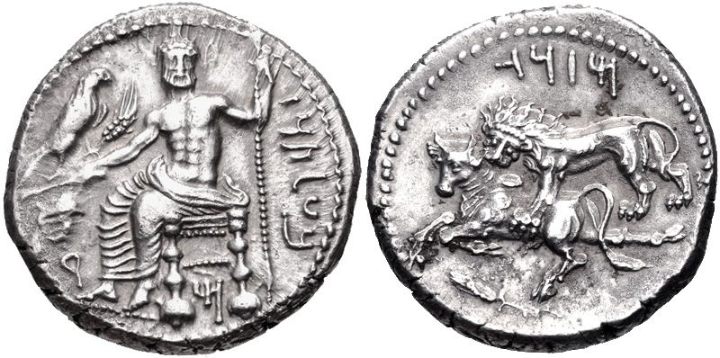
Persian Satrap Mazaeus, Tarsus
Baal of Tarsus (Baaltars) enthroned three-quarters left, head facing, right hand holding grain ear and vine branch on which eagle perched right, left hand resting on scepter. (Baaltars in Aramaic) / Lion left attacking bull left, grain ear and ankh below. (Mazaeus in Aramaic)
361 BC - 334 BC, AR stater (25mm, 10.9g)

Slide 4
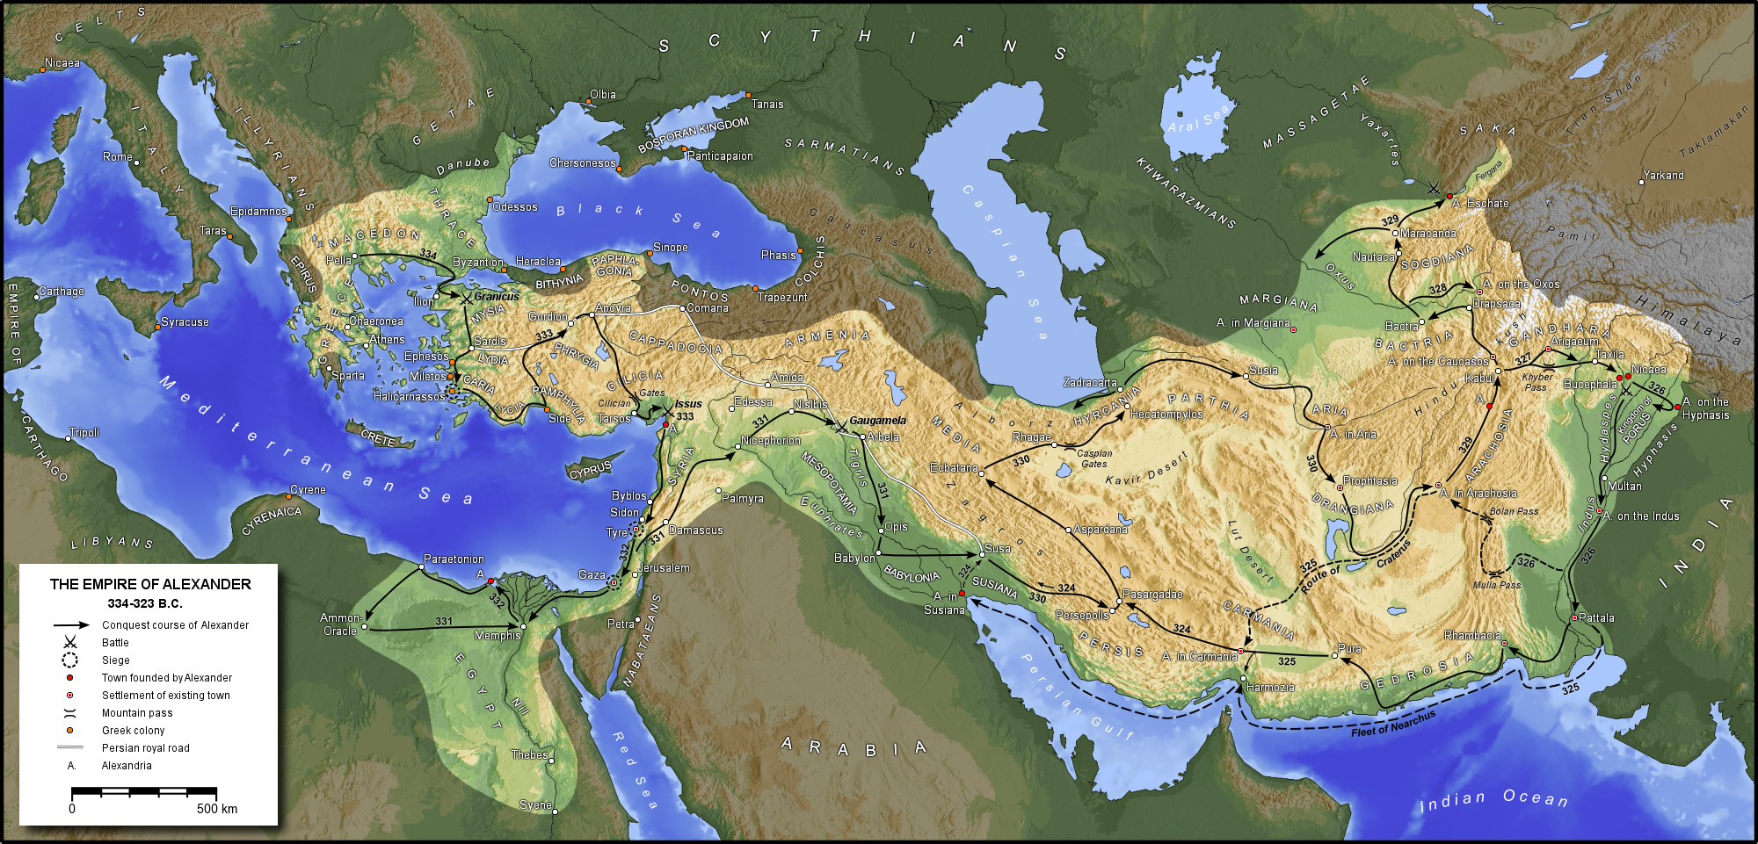

Slide 5
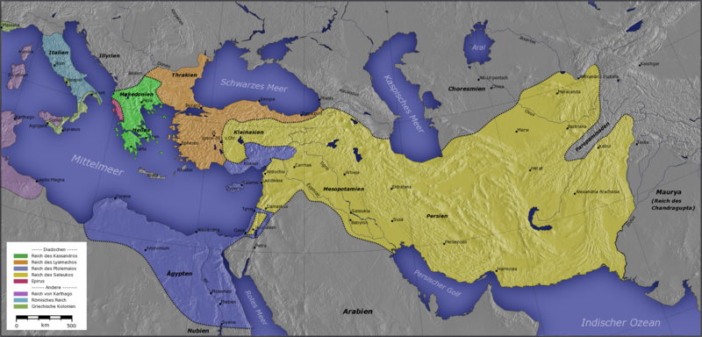
Cassander
Lysimachus
Seleucids
Ptolemies

Slide 6
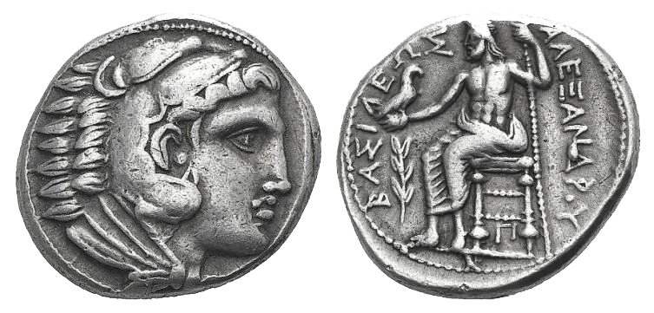
Posthumous Alexander
Macedon, in the name of Alexander the Great, Amphipolis Mint, AR Tetradrachm, 16.99g, c.318-317 BC. Price 124.
Obv : Head of Herakles right, wearing lion-skin
Rev: Zeus seated left holding sceptre and eagle, laurel branch in l. Field, letter pi under throne. BASILEUS ALEXANDROU.

Slide 7
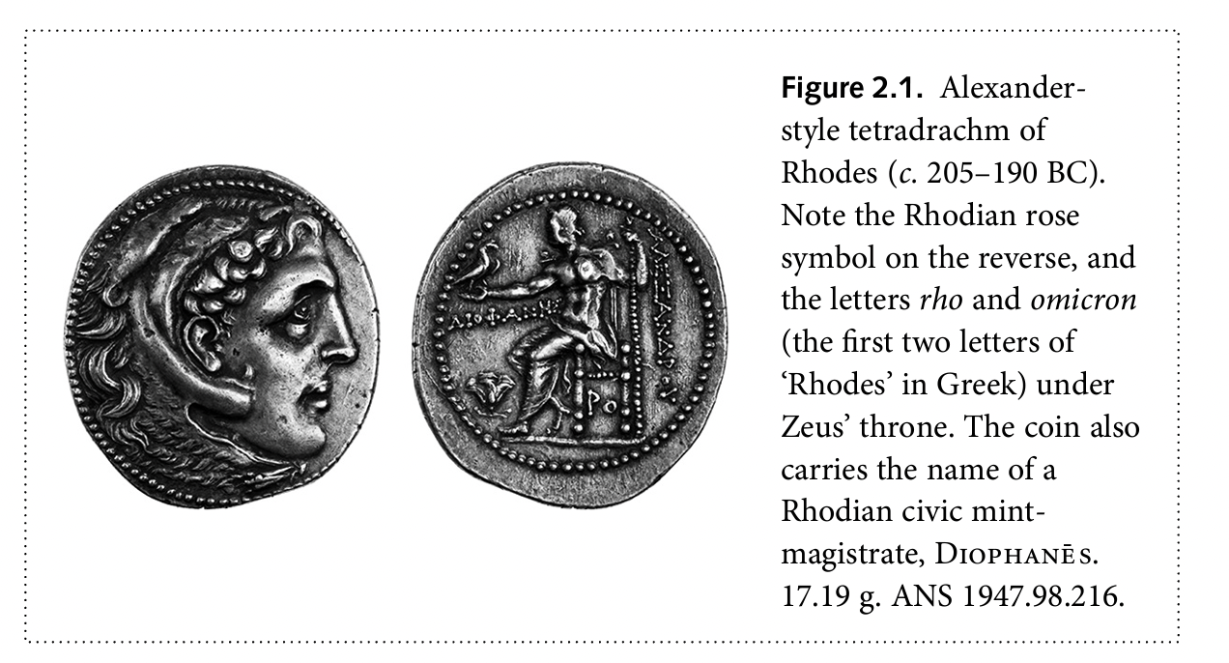
Notes:
Imitations all over the place. Here the date. Thre rose of Rhodes. Why strike this? A coin. On the correct standard that was accepted. Widely accepted international currency on the Attic standard.
‘Civic’ vs. ‘barbarous’ imitations (outside the Greek world.)

Slide 8
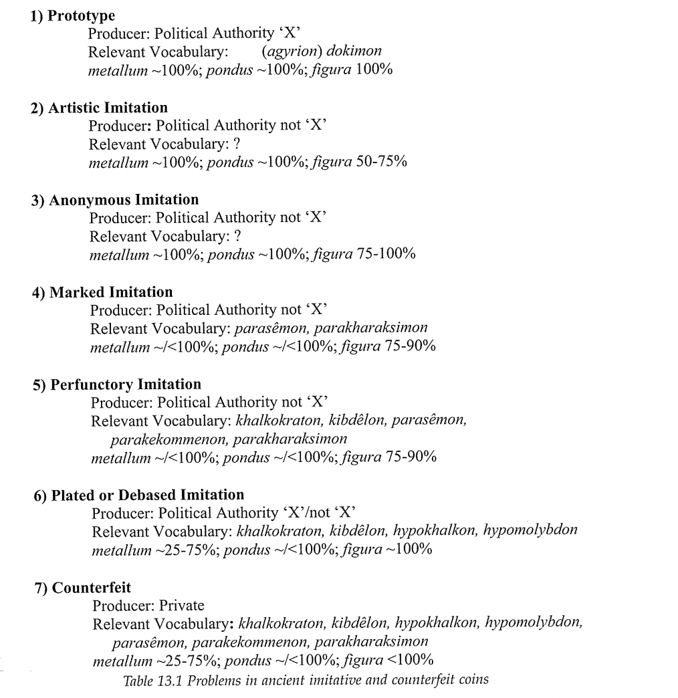
Notes:
Artistic imitation: did not always carefilly imitate prototype – major elements copied with bgreater or lesser attention opaid to replicating the design accurately. Design often only on one side of the coin, other side completely different.
Anonymous imitations: look identical, but pure metal so deceit not the aim.
Marked imitations: comtent/weight/design all like the original, but an obvious symbol or legend appears to preclude any confusion over who was responsible for the coin’s production.
Perfunctory imitations: not sure if producers familiar with the prototype. ‘Crude’ workmanship, garbled inscriptions, etc. e..g. Celtic types imitating Philip’s coins are puit here.

Slide 9
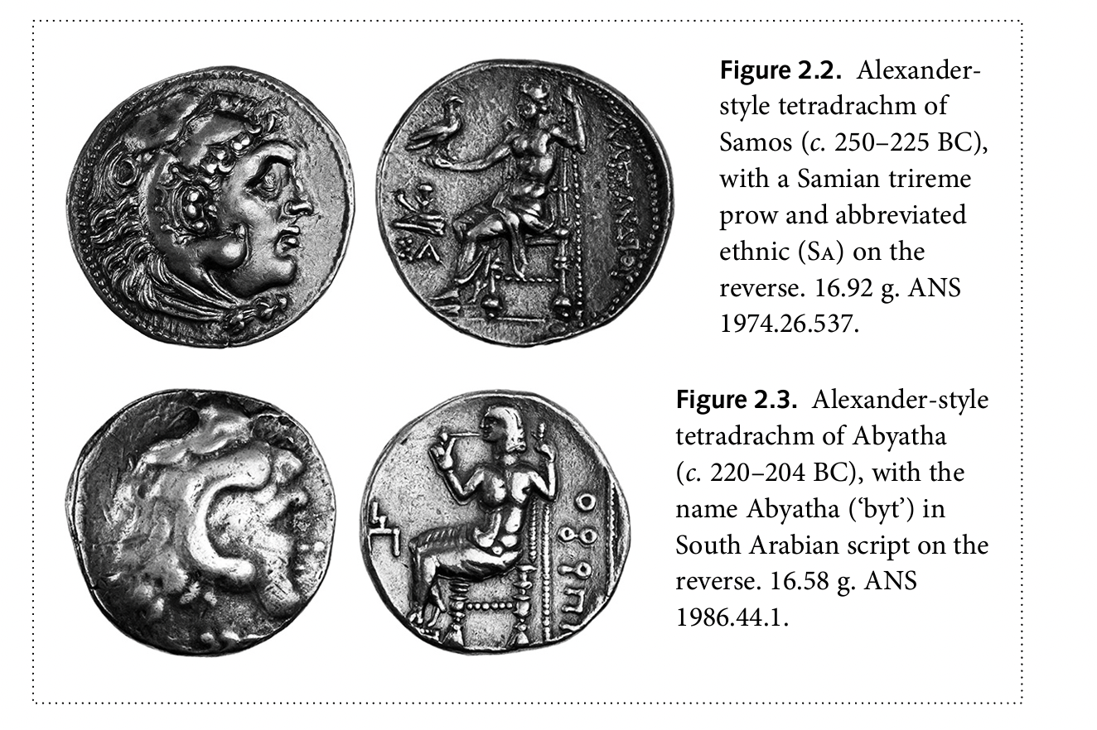
Notes:
Thinking about imitations – Opeter van Alfen.
’Marked imitation; - still of good silver, etc, but indicate they are the product of a distinct issuing authority.

Slide 10
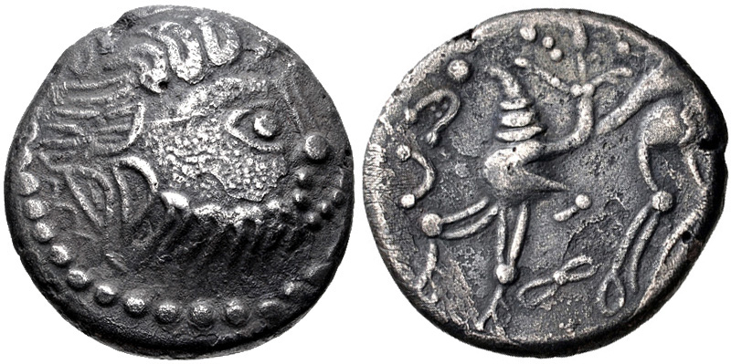
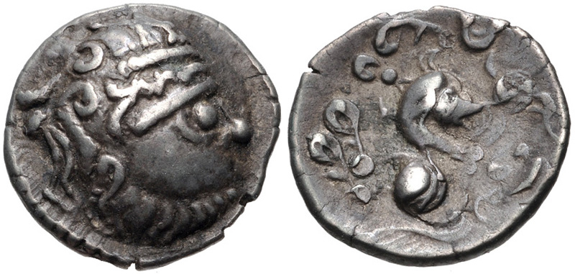
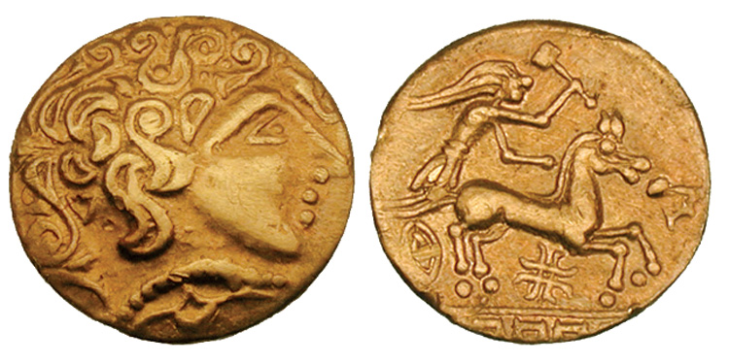
Eastern Europe, Imitation of Philip II.
Eastern Europe, Imitation of Philip II, 3rd century BC.
The Ambiani (?), Northern Gaul. Early second century BC.
Notes:
Not just slavish iomitatons, but adapted to Celtic tastes.

Slide 11
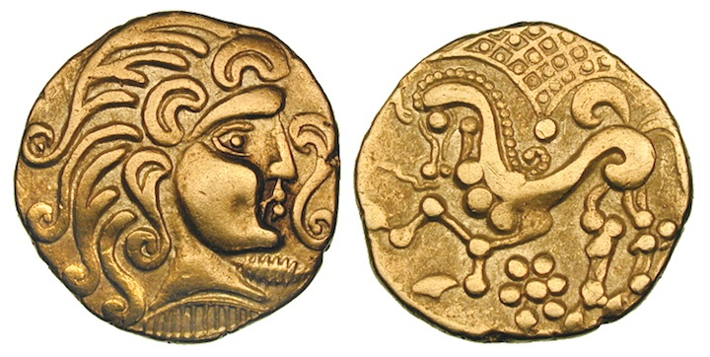
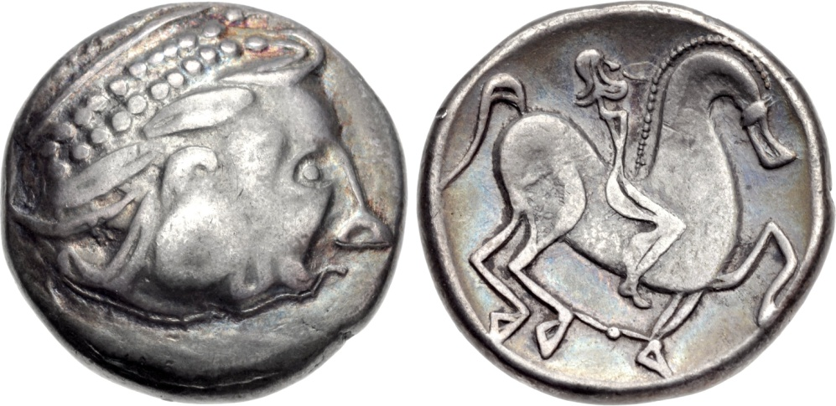
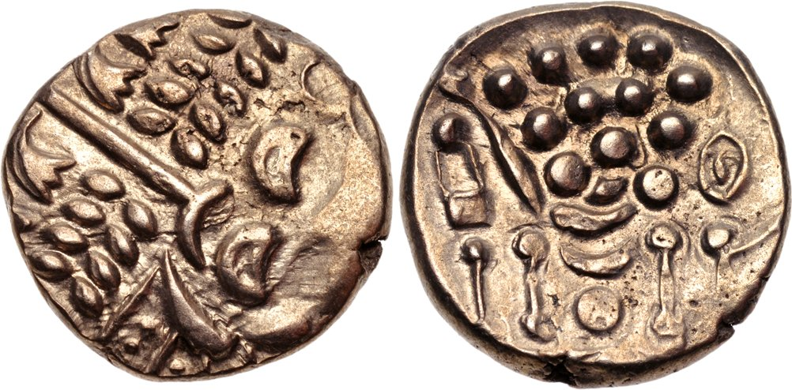
The Parisii, 2nd century BC
Mint in Carpathian region, 2nd century BC
Celtic Britain, the Durotriges, 30-10 BC
Notes:
Last one is head of Apollo / horse.

Slide 12
Civic identities (Western Asia Minor: Thonemann)
Persian rule – numerous cities striking local designs
Macedonian conquest of Asia Minor in later 4th century BC
Vast quantities of gold and silver coinages of Alexander struck (veterans, armies of the diadochoi)
c. 300 BC – the striking of local silver currencies with local designs had all but come to an end. (‘Civic’ Alexanders continued, and only some local issues, on the ‘Persic’ standard).
WHY?
- deliberate suppression of coinage by Alexander and his successors?
- royal coinage sufficient?
- civic identity/self representation changing
Notes:
Asia Minor – obviously each region different, but an interesting case study here.
Under Persian rule these cities had struck a lot.
a.) but the link between autonomy and striking coinage isn’t a strong one. Could stike under Persian control., Most cities self governing AND subordinate to a king. Each city’s status/rights subject to local negotiation.
b.) of course all those coinages of Alexander and his successors must have had an effect. But they must have entered circulation gradually. Hoards suggest the ‘trickle down’ effect rather slow. Inscriptions suggest the same.
c.) Civic Alexanders – the ideology of the imagfery had lost its effect – sheer abundance made it a relatively neutral ‘Hellenistic’ coinage. Civic symbols clearly showed who was responsible. This is a positive choice by Greek cities. Striking own coins = a ‘panhellenic’ type. Koine – common Greek, common visual language, etc. Membership of a cultural koine became a central part of the polis identity.
Persic weight counages for transactions between cities in the area, attic weight for larger transacrtions with Hellenistic kings, etc?

Slide 13
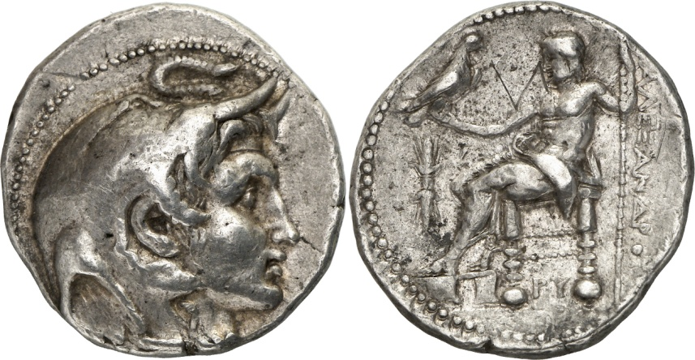
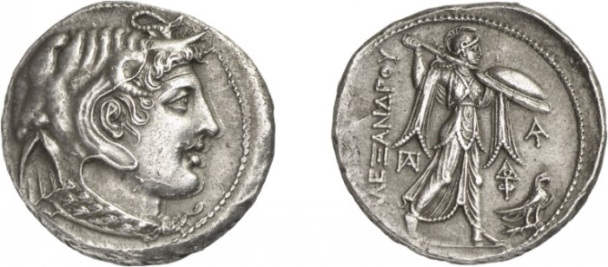
Ptolemy Soter
Ptolemy I Soter, in the name of Alexander the Great, Alexandria Mint, AR Tetradrachm, 15.63g, 310-305 BC, Svoronos 146
Obv: head of Alexander the Great wearing elephant skin, diadem and horn of Ammon, r.
Rev: Athena Alkidemos advancing r. To r., monograms, and eagle standing on thunderbolt. ALEXANDROU.
Notes:
c. 321 BC
Horn of Ammon, Siwa, elephant scalp is conquest of India, taina (Greek conquest and victory, symbol of Dionysius)
Alexander’s body
Suggestion not the head of Alexander, but rather a representation if the head of the Alexander statue erected at his grave in Alexandria. Thus not just Alexander’s conquests, but his grave and cult in Alexandria.
Apperance of a person revolutionary - only very rare before this point.

Slide 14
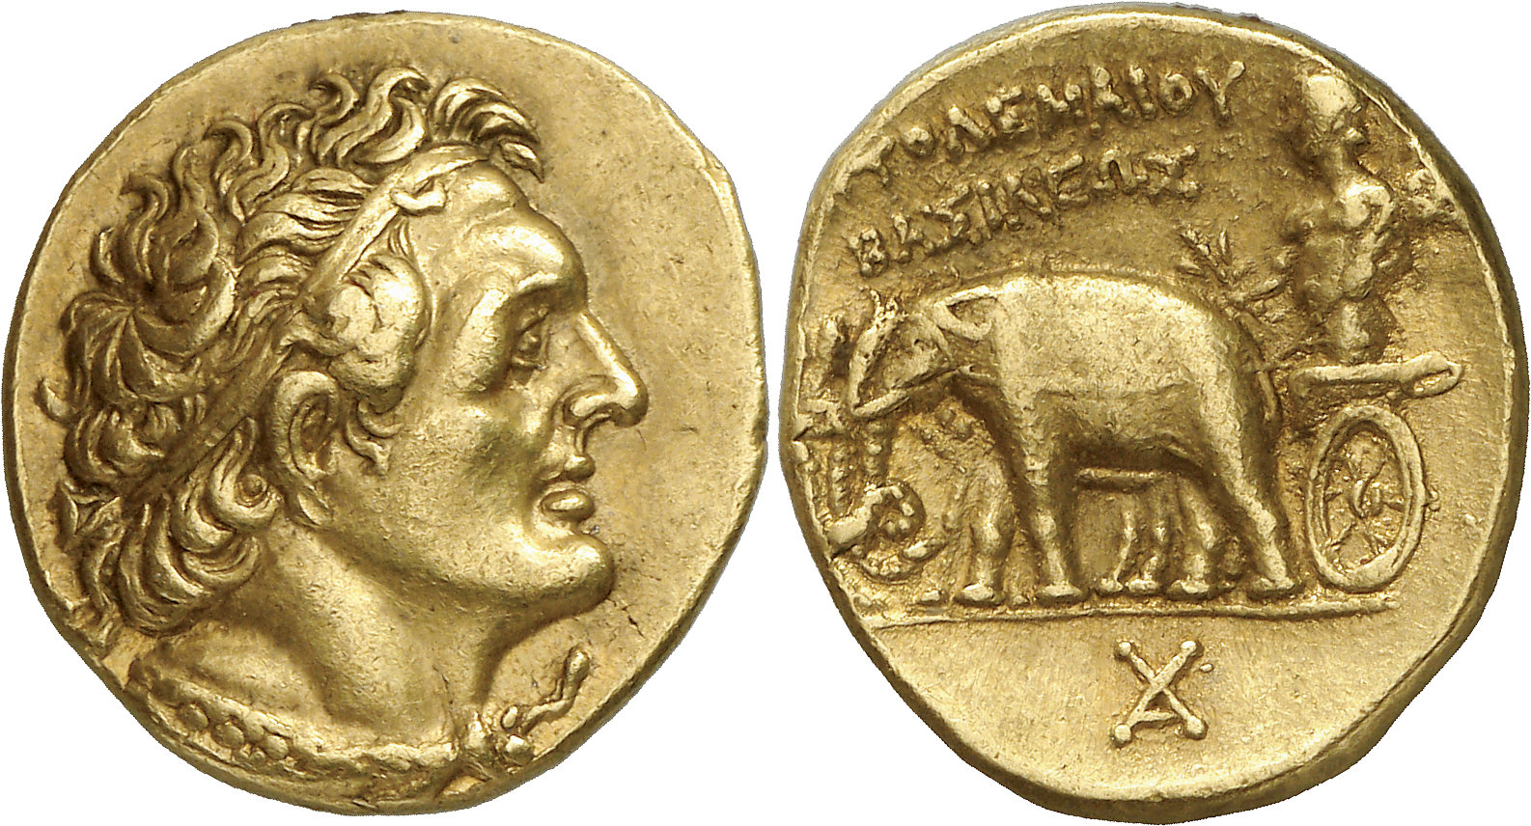
Ptolemy I Soter
Ptolemy I Soter, Egypt, Alexandria Mint, AV Stater, 7.11g, 298-294 BC. Svoronos 111.
Obv: Head of Ptolemy r., wearing diadem and aegis.
Rev: Charioteer (Alexander the Great?) in a quadriga of elephant holding thunderbolt and reins. Monogram in exergue. PTOLEMAIOU BASILEWS.
Notes:
Elephant quadriga also connected with Alexander cult in Alexandria.

Slide 15
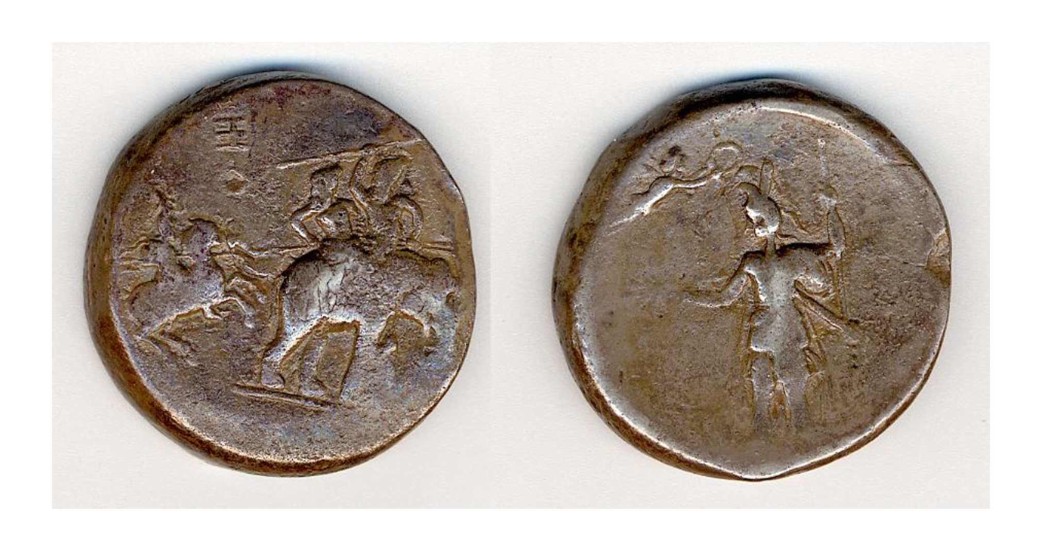
Poros medallion
BM 1926,0402.1. 30mm, 39.66g.
Alexander the Great, mounted on Bucephalus, horse rearing right, attacking two men mounted on an elephant with a spear. One of the men mounted on the elephant raises a spear towards the attacking horseman. / Alexander the Great (?) standing left weaing military attire and plumed helmet; in right hand, thunderbolt; in left hand, grounded spear; above, Nike flies to right crowning the figure.
Notes:
10 pieces known –a hoard in Iraq contained 7 of them.
Phrygian helmet with plumes is described by ancient historians as what Alexander wore.
Alexander with thunderbolt – a semi divine ruler here. Zeus said to be his father.
Battle against Poros is 326 BC.
Weight standard doesn’t correspond to any known Greek standard.
Small number of surviving specimens and dies.
Don;’t know from whom and for who these were produced.

Slide 16
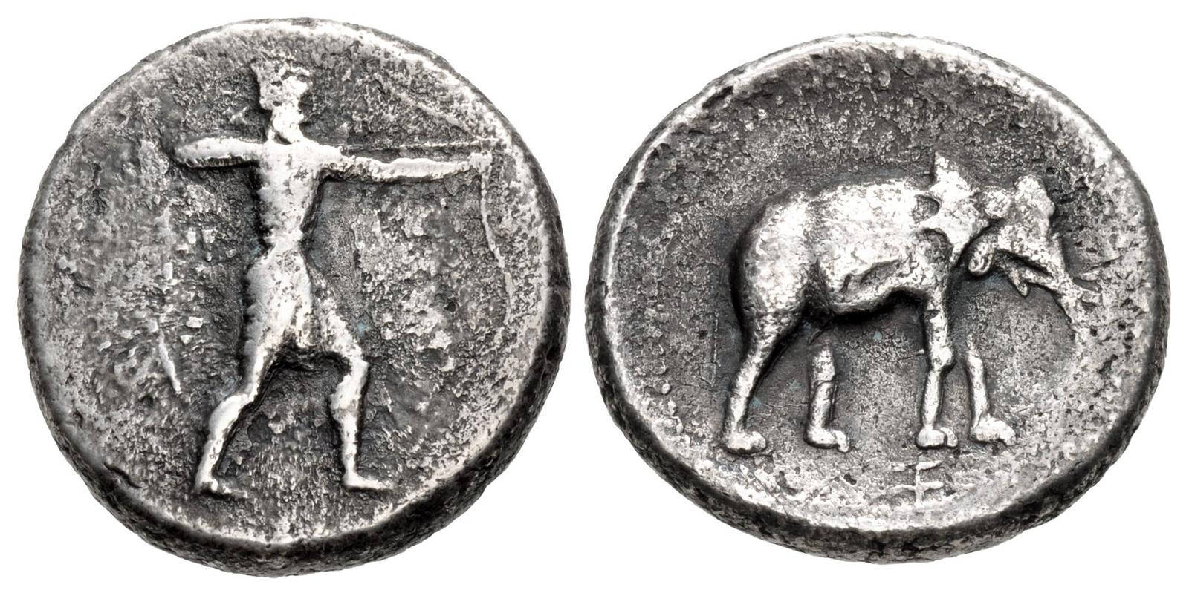
AR, 24mm, 15.35g
Notes:
Smaller tetradrachm / 2 shekel pieces found in the Iraw hoard. Style, fabric, monograms identical to the medallions.
Archer and standing elephant / chariot and elephant with his riders
Seem to suggest coins.
Also obvious signs of wear?

Slide 17
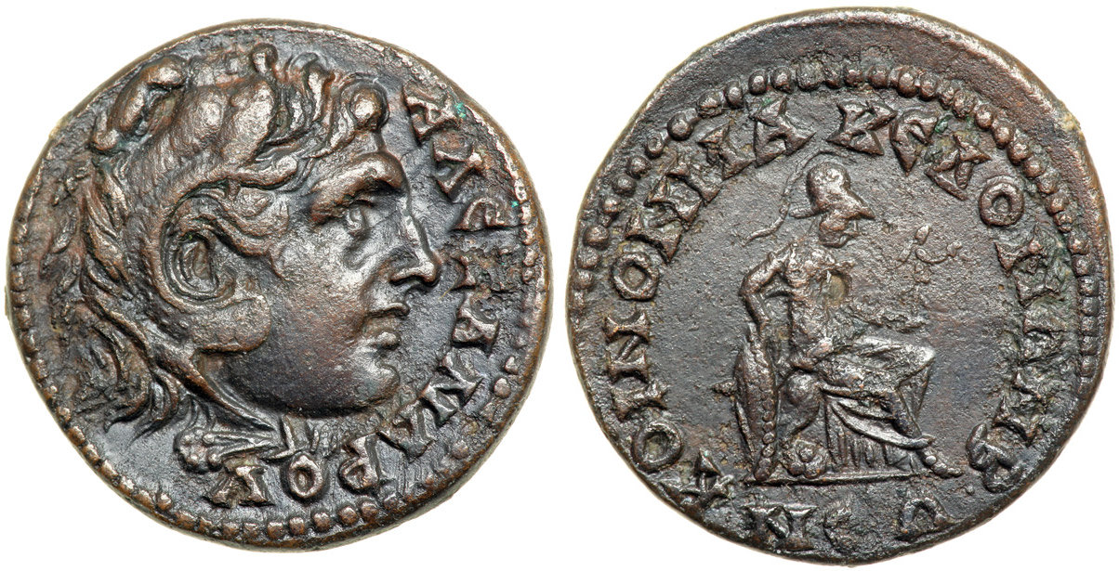
The Roman Province of Macedon
Macedon, Roman Province, Gordian III, AD 243-244. AE 26.5mm, SNG Evelpidis 1492
Obv: head of Alexander the Great as Herakles, ALEXANDROU
Rev: Pallas Nicephoros seated r. KOINON MAKEDONIAN

Slide 18
‘Afterlife’
‘What can one say of those who use spells and amulets, and bind bronze coins of Alexander the Macedonian on their heads and on their feet?’
St John Chrysostom,
Ad Illuminandos Catechesis II, 5
(Melville-Jones 490)
Notes:
Second half of fourth century AD, died in AD 407.

Slide 19
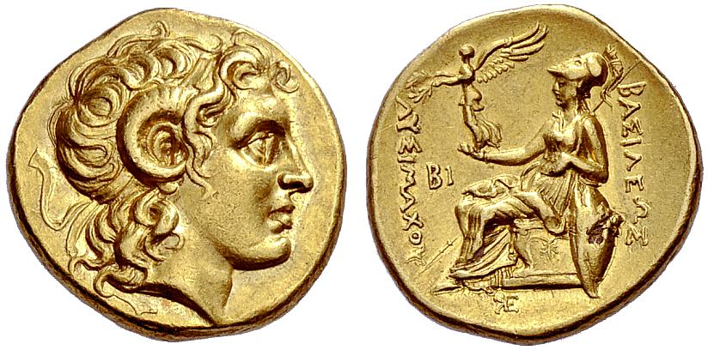
Lysimachus
Lysimachus, Thrace, Pergamum Mint, AR Tetradrachm, 17.12g, 287-282 BC, Thompson 222.
Obv: diademed head of Alexander with horn of Ammon, K below
Rev: Athena enthroned, holding Nike in r. Hand and resting l. elbow in shield,. Monogram in exergue. ΒΑΣΙΛΕΩΣ ΛΥΣΙΜΑΧΟΥ
Lysimachus, Thrace, uncertain mint in Western Asia Minor, AV Stater, 8.47g, Thompson p. 176
Obv: diademed head of Alexander with the horn of Ammon
Rev: Athena enthroned, holding Nike in r. Hand and resting l. elbow in shield,. In field, l. BI, monogram in exergue. ΒΑΣΙΛΕΩΣ ΛΥΣΙΜΑΧΟΥ
Notes:
Doesn’t put own portrait.

Slide 20
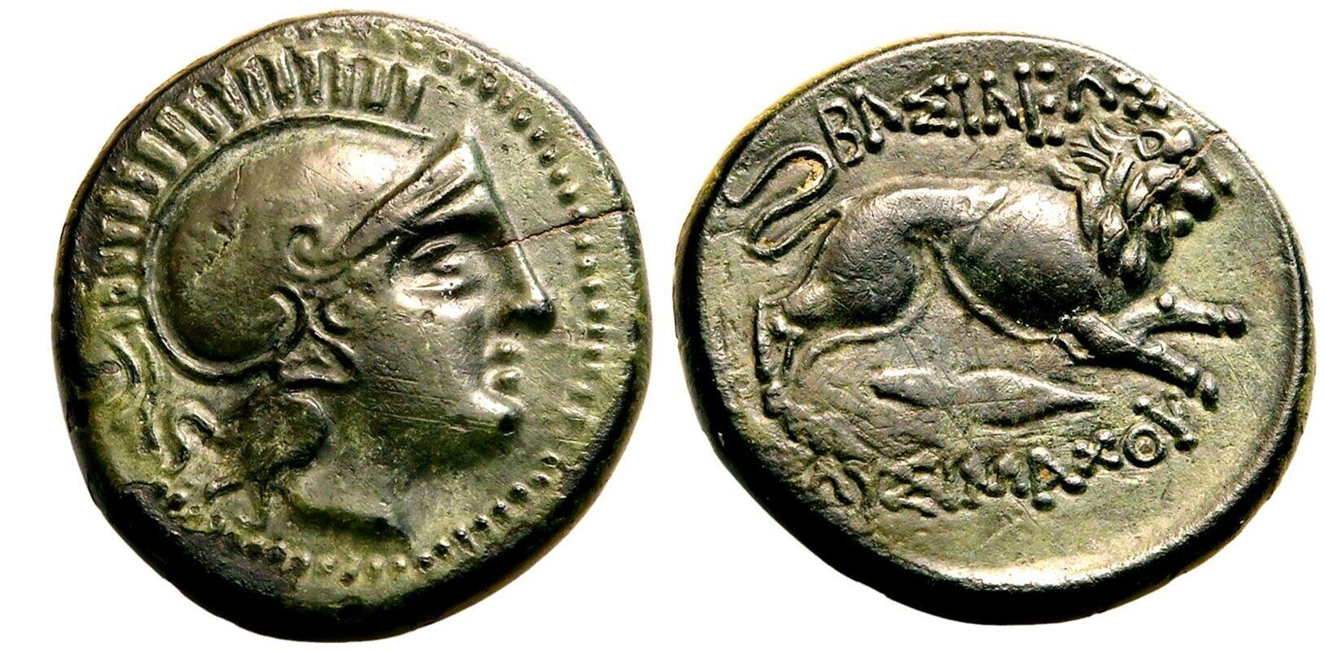
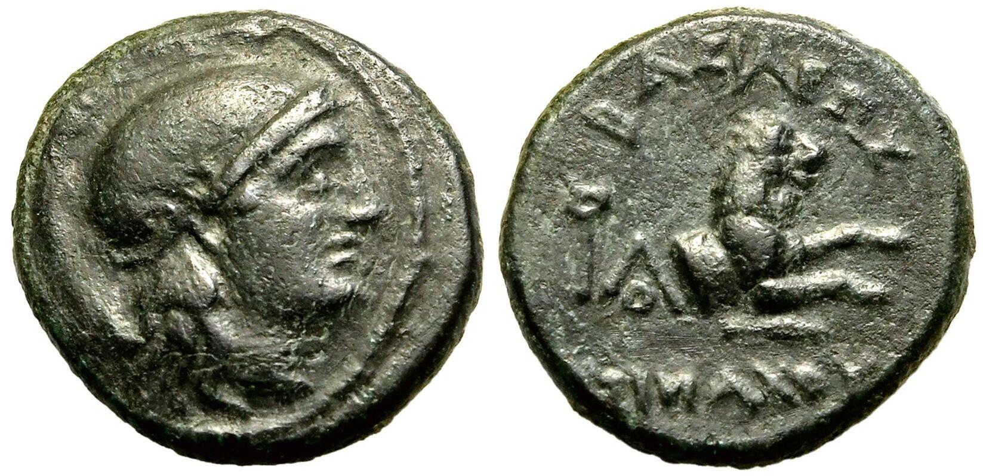
Bronzes of Lysimachus
20mm, 8h, 6.00g
14mm, 12h, 2.59g
Notes:
he reverse of the unit has a lion leaping right and a spearhead; the legend ΒΑΣΙΛΕΩΣ
ΛΥΣΙΜΑΧΟΥ can be found above and below the animal. The half abbreviated this reverse type, showing
only the forepart of a lion; some halves from the excavations show a monogram behind the lion. 15 Mørkholm
calls the attacking lion Lysimachus’s “distinctive badge,” but it might be remembered that this type was
already in use by the Sardis mint under the Lydians.16 Since these issues comprise the huge majority of
Lysimachean bronzes found in the excavations, I think we can now attribute some, at least, to the mint at
Sardis.
Story that he killed a lion (with his bare hands?)_
\The purpose of royal bronze issues is not nearly as clear. They were expensive to mint and have no
obvious use for the ruler. Most numismatists suggest that they were minted “by and for” the army. The
number of royal bronze coins coming from the mint was always smaller than the number of silver coins,
testifying to their relative unimportance to the ruler.20 They mostly did not travel far from the mint where
they were made, but as we can guess from their (sometimes) standardized types and from excavation results,
they could be used across the empire, just like the silver and gold coins.

Slide 21
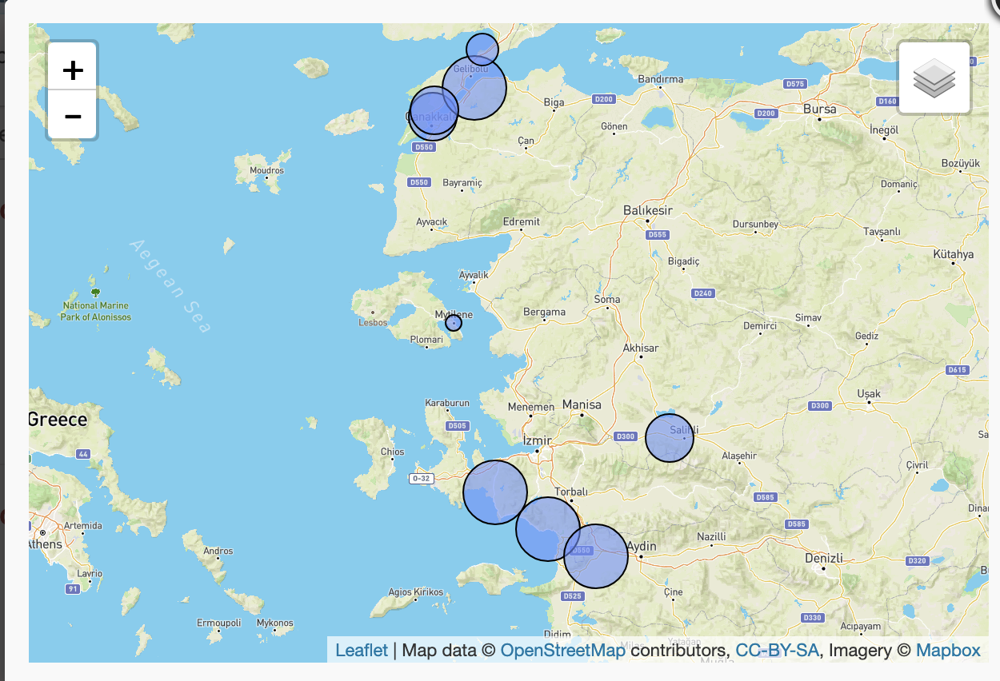
Mints of Lysimachus
Lysimachia
Lampsacus
Sestos
Abydos
Sardis
Teos
Colophon
Magnesia ad Maeandrum
Thompson: a travelling die cutter or central workshop among the mints (shared dies)
Thompson in Essays in Greek coinage, presented to Stanley Robinson
Notes:
Price disagreed over the attrributions./

Slide 22
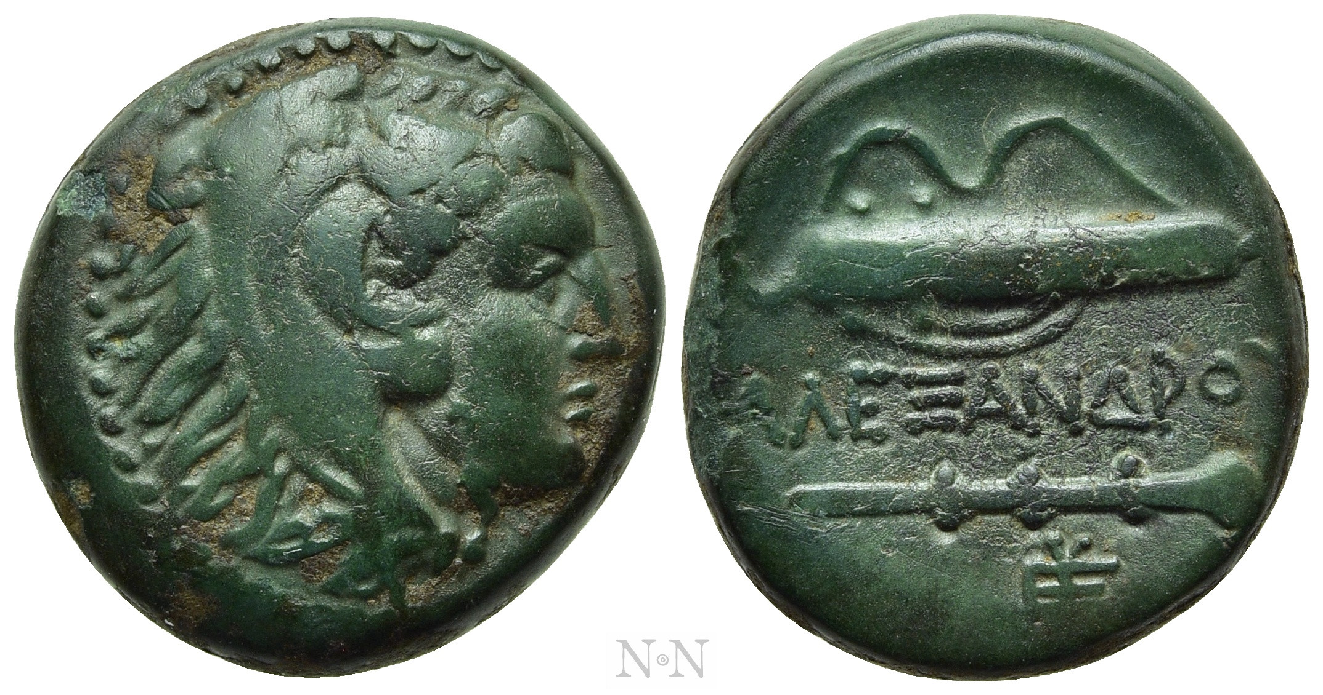
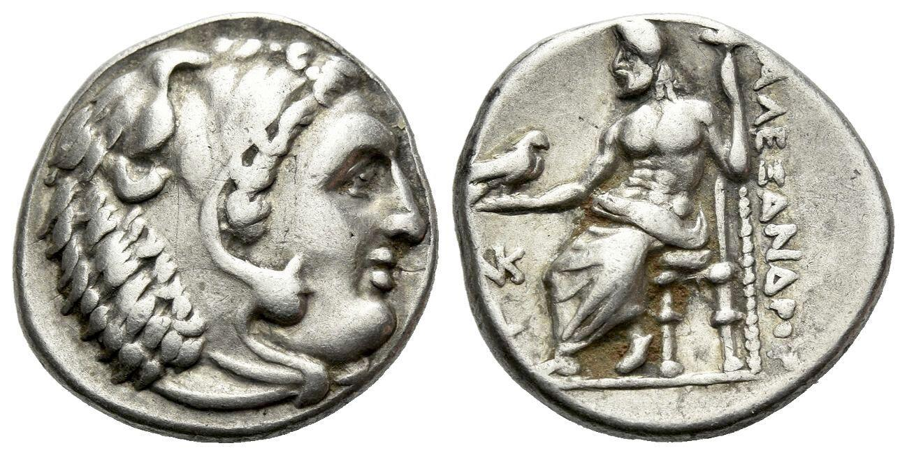
Mint of Sardis
Reopened c. 330 BC
Gold/silver/bronze
Attic weight standard
AE in ‘unit’, ‘half’ and ‘quarter’
Evans: ‘The Mint at Sardis’ in Spear-Won Land : Sardis from the King's Peace to the Peace of Apamea
Notes:
Darics now obsolete –visible change
Drachm
Margaret Thompson noted the presence of two,
possibly three, engravers at the Sardis mint, producing at least thirty-six obverse dies; the series was made in a
“brief period of concentrated coinage,” no more than three years, when gold coins were almost the entire pro-
duction of the mint. 5 Smaller issues of tetradrachms, drachms, and bronzes completed the trimetallic series
Excavations at Sardis revealed it’s a mint for at least some of the bronze coins

Slide 23
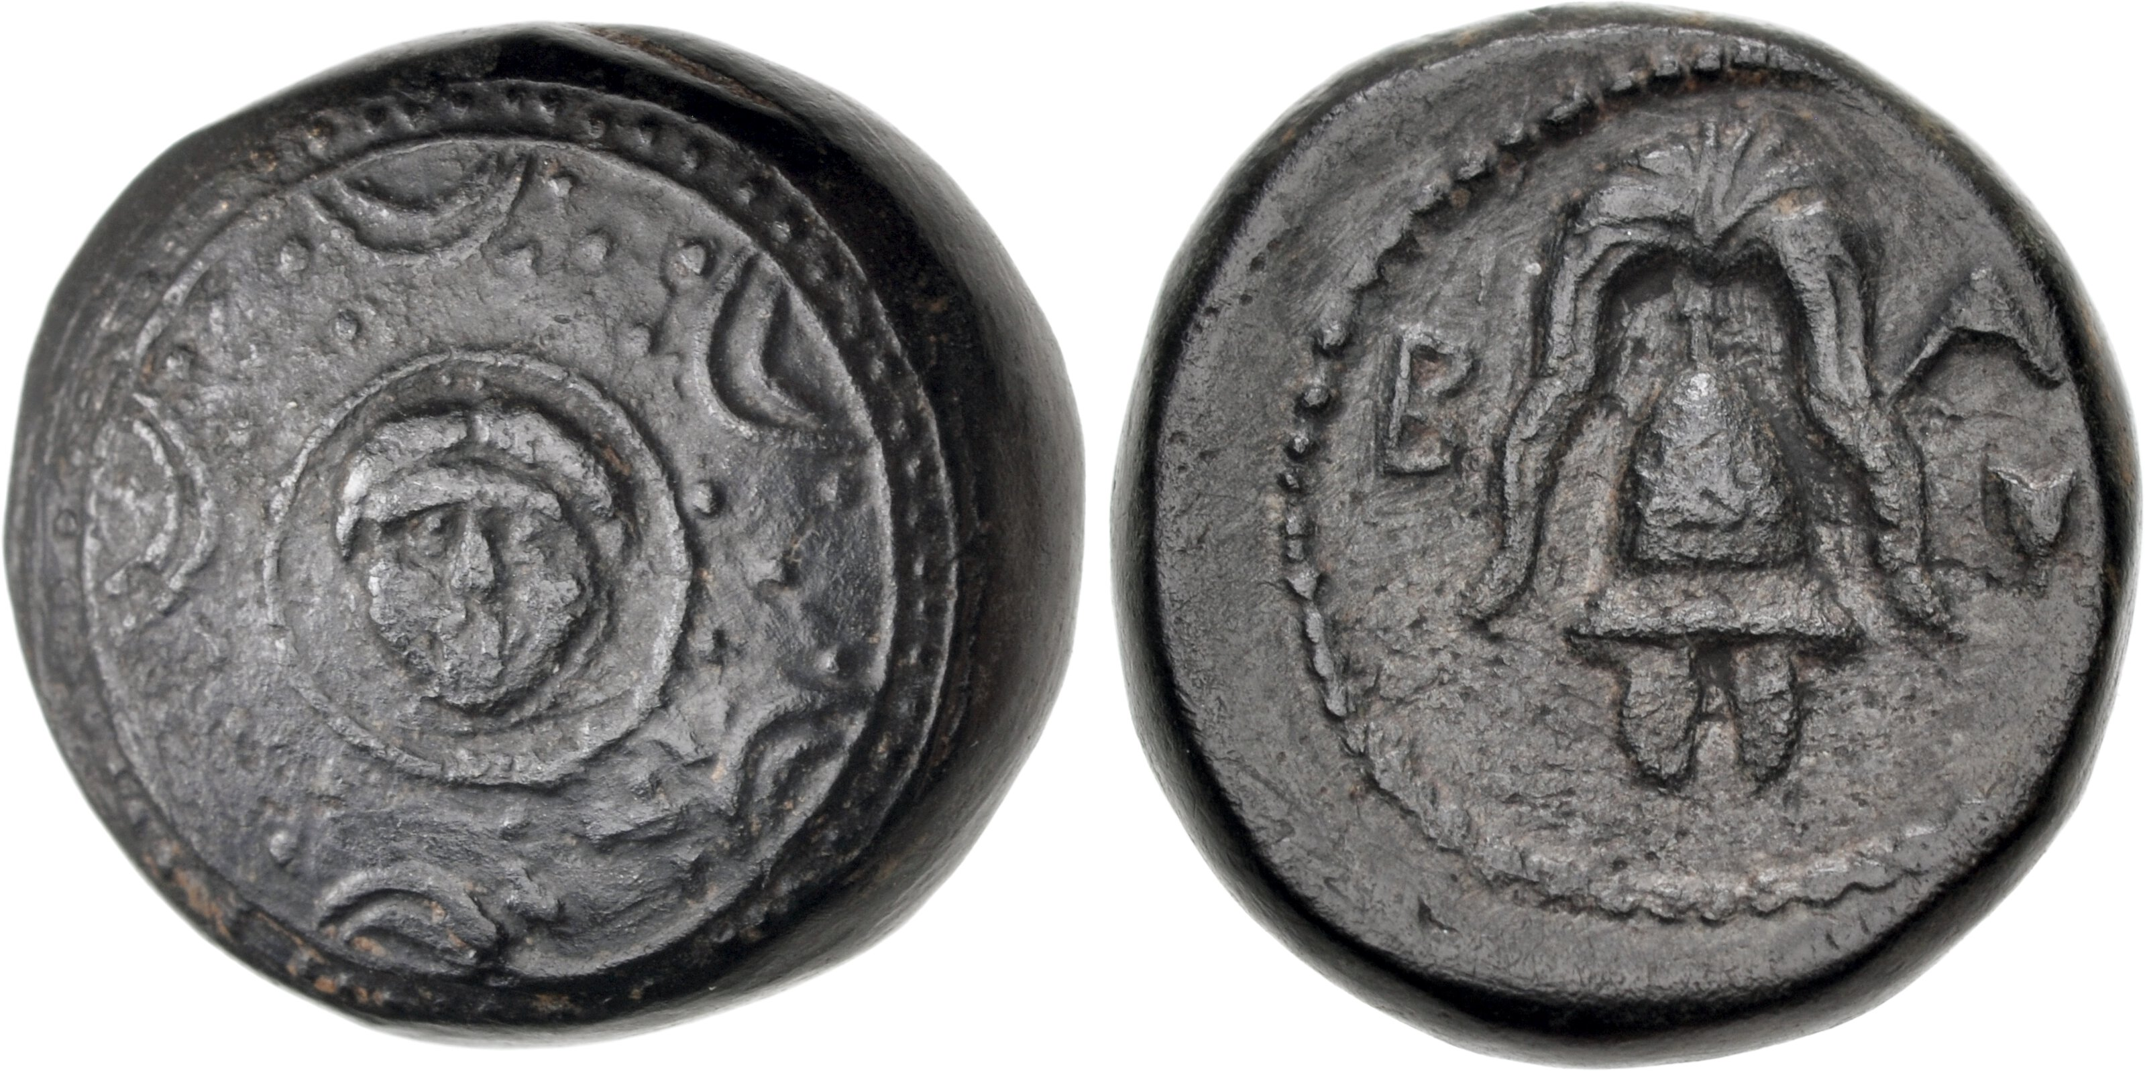
Sardis AE
Notes:
A number of units and some quarter units were found in the excavations, but the symbols or control marks
on them are rarely legible, which makes assigning them to a mint problematic.
Æ Half Unit (15mm, 4.65 g, 3h). Sardes mint. Struck under Menander, circa 324/3 BC. Macedonian shield; facing gorgoneion on the boss / Macedonian helmet facing; rose to right.
BA = basileus

Slide 24
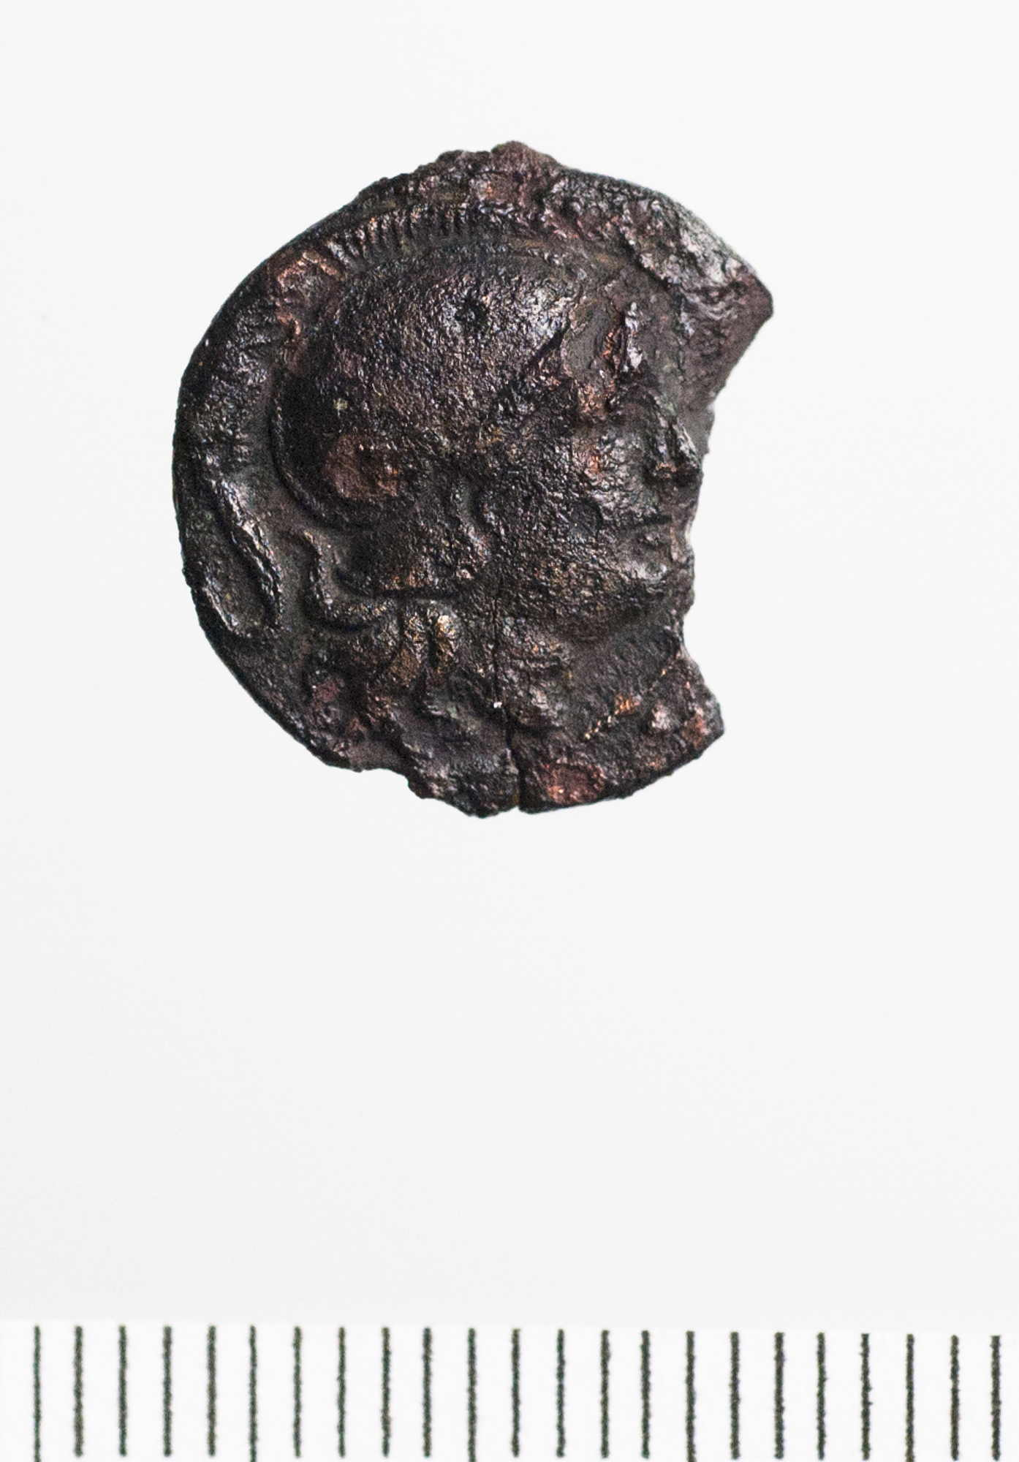
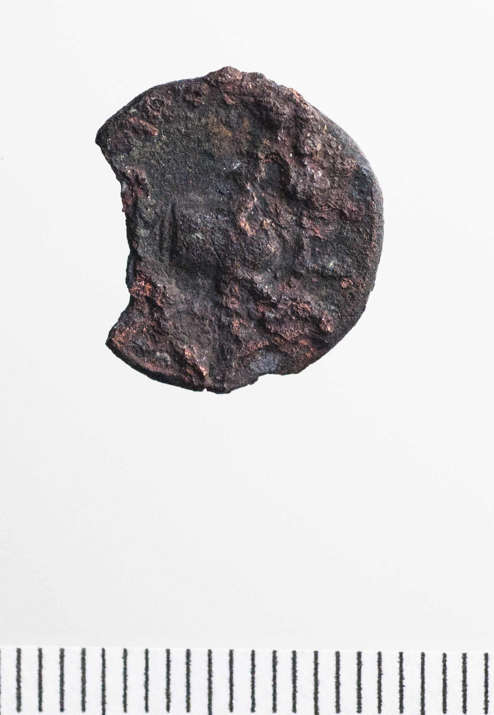
https://sardisexpedition.org/en
Notes:
Hald unit from Sardis – Lysimachius
This coin type: Obverse: Head of Athena in crested helmet r.; Reverse: Forepart of lion r. spearhead below, ΒΑΣΙΛΕΩΣ ΛΥΣΙΜΑΧΟΥ.

Slide 25
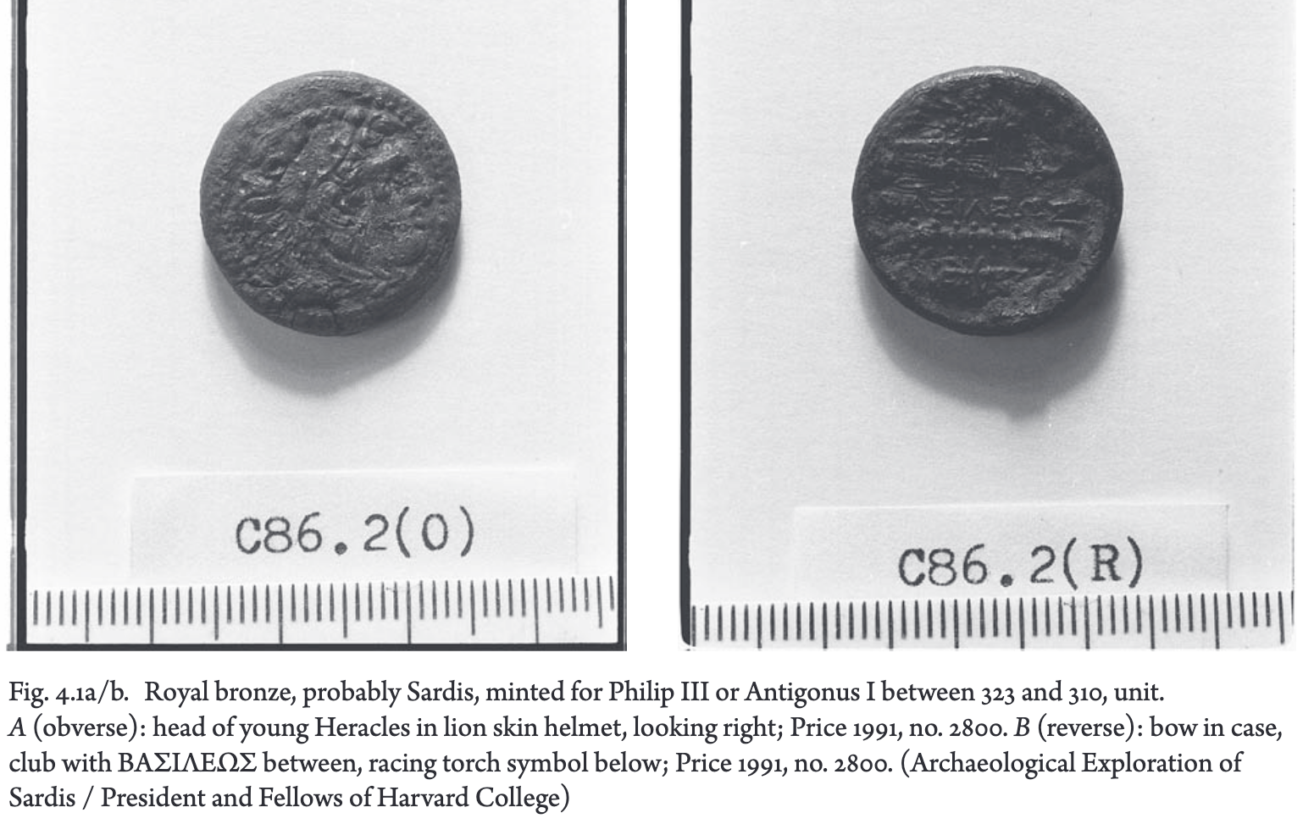
Notes:
9 quarters found at Sardis – same iconography as the unit

Slide 26
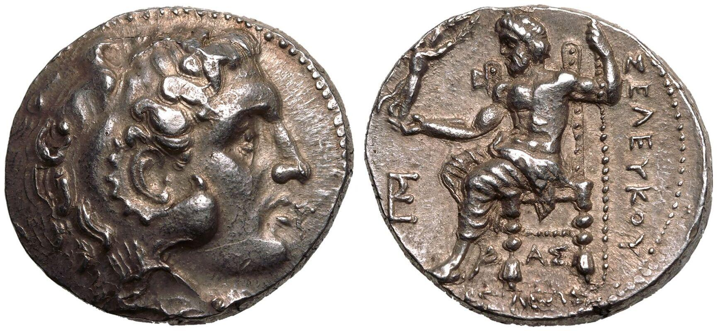
Sardis
Thompson: mint closes in c. 287 when Lysimachus loses the city to Demetrius Poliorcetes
Royal issues reappear under Seleucus (new mint staff) (282/281 for conquest)
AR tetradrachm
Notes:
The
monograms do not overlap with those on the tetradrachms of Lysimachus, and there is a stylistic shift in the
die cutting, in that dies are now aligned toward the vertical and have straight edges. These changes suggest
that new mint personnel had been put in place since the last issue of Lysimachus.
Seleucus puts his name on the Alexanders

Slide 27
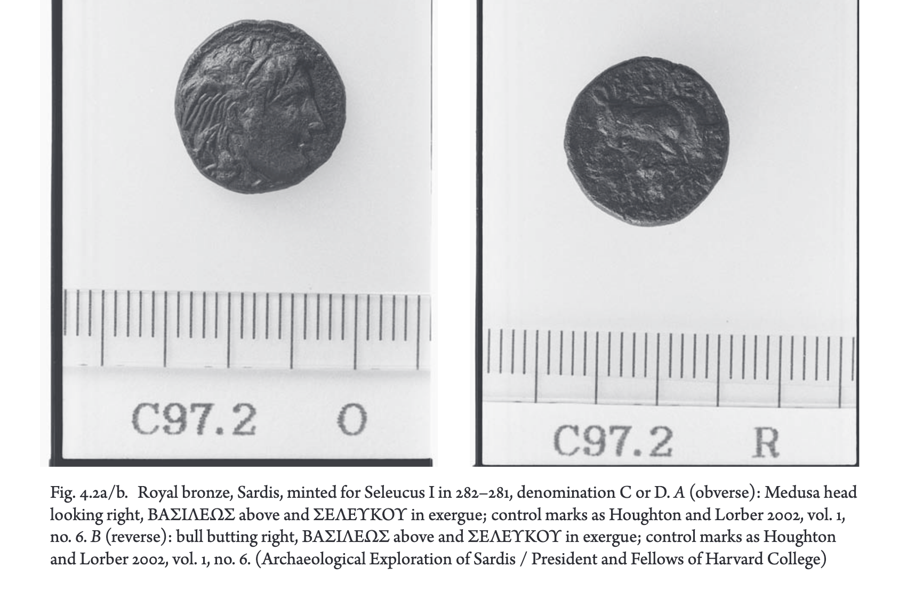
Notes:
102 Pa rt I. Cit y a nd Empir e
cracks or die breaks, yet they were still used, which suggests some pressure to produce coins quickly. Richard
Miller and Oliver Hoover think that Seleucus was preparing for the battle of Corupedium and the planned
invasion of Thrace.28 Hoard evidence indicates that the issues of Seleucus were produced through 280/279,
as his successor, Antiochus I, and Ptolemy II jostled for control of the area.
Under Seleucus only a few bronze coins were issued; their assignment to Sardis is due to the number
of finds from the Butler expedition and ten more from the modern excavations.29 They show the head of a
beautiful Medusa in profile on the obverse, and a butting bull or the forepart of a bull on the reverse, with the
title and name of the king over the bull and in the exergue (fig. 4.2). The types are a significant break from
those minted for Alexander or Lysimachus.
Seleucus said to have wrestled a bull to the ground before Alexzander – an omen of future rtule.
As noted
above, there were no parallels between the control marks on the bronze and the silver issues, implying that
even in this first royal coinage there were separate administrations involved in the production of precious-
metal coins and bronze coins.

Slide 28
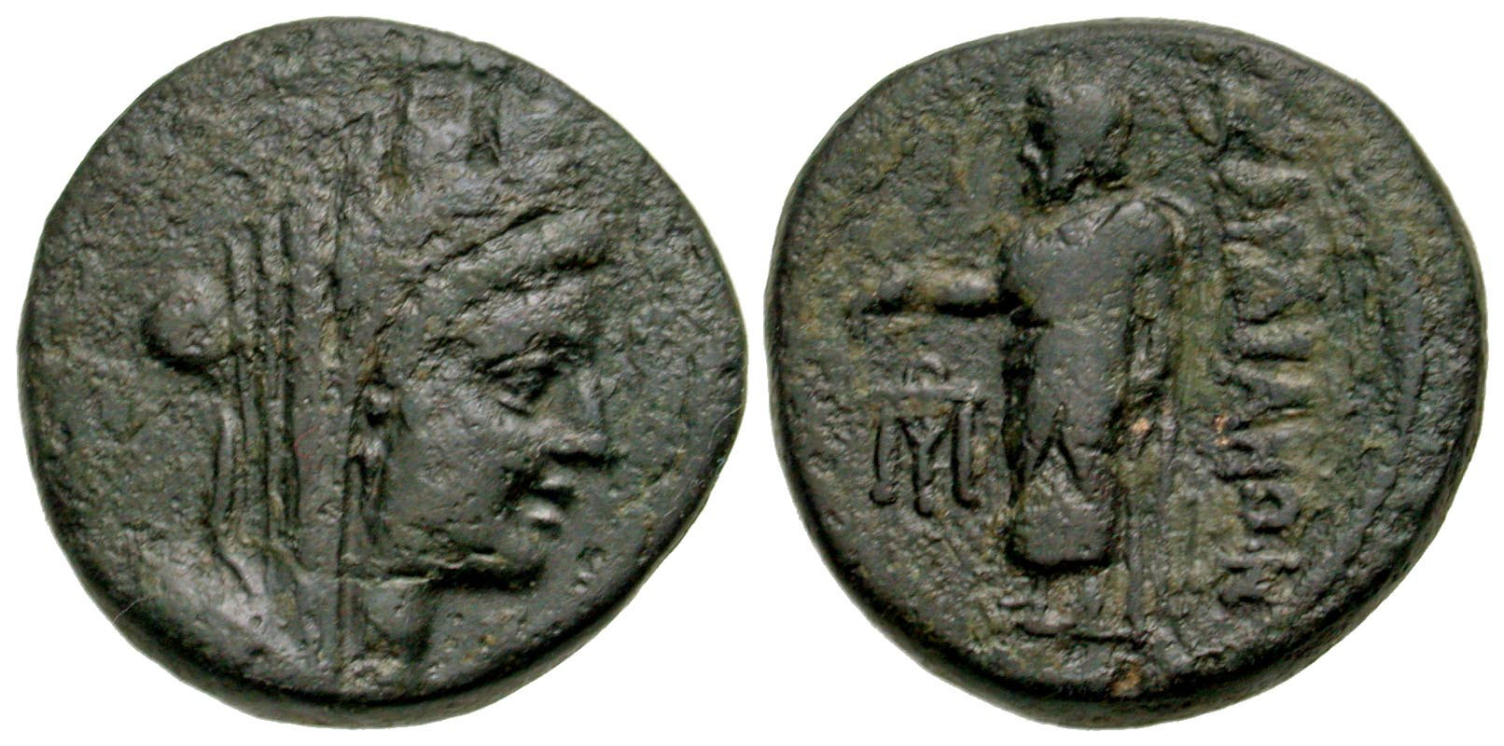
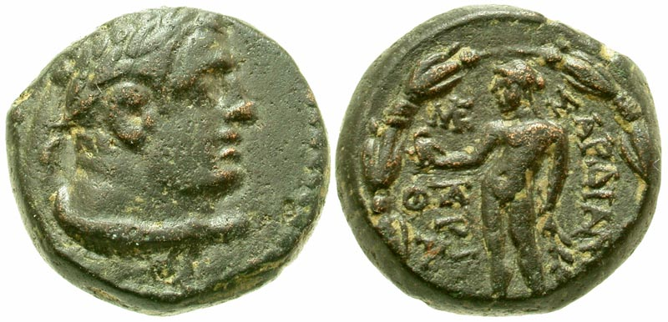
Sardian civic bronzes (under Seleucid rule)
Multiple
unit
Notes:
Sardian civic bronzes are differentiated from the Seleucid royal bronzes in weights and types. Struck
on local standards, they spoke to and were used by people close to the city where the coins were minted. In
their types, we may be able to read assertions of Sardian local identity in the face of what Ma has called the
“strong state-ness” of Seleucid power. 62 Thus, the moment at which these issues first appear is an important
one in the city’s history.
Their utility may be reflected in the fact that the city issued three denominations: a multiple, a unit, and
a fraction. The multiple, represented by nineteen examples from the modern excavations, carried the head
of Tyche with the reverse of the local version of Zeus, or Zeus Lydios, who stands wrapped in his himation,
with a staff under his left arm and his right arm outstretched to support an eagle (fig. 4.8). 67 On the right,
vertically, is the legend ΣΑΡΔΙΑΝΩΝ.
The unit, of which over 200 have been found in the modern excavations, carries the head of a young
Heracles, with his lion skin wrapped around his throat, not over his head; on the reverse is an Apollo stand-
ing in posture similar to that of Zeus Lydios, also elevating a bird (see fig. 4.7).
The fraction carries the head of Dionysus on the obverse and the forepart of a lion on the reverse; eleven
have been found in the modern excavations (fig. 4.9).73 Above the lion is the legend ΣΑΡΔΙΑΝΩΝ; behind
it is a monogram.

Slide 29
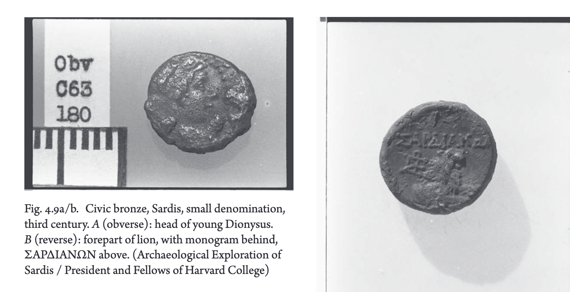

Slide 30
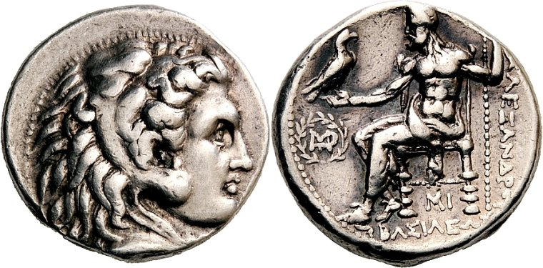
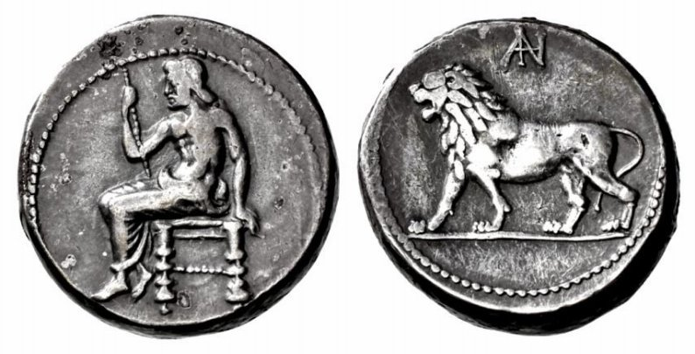
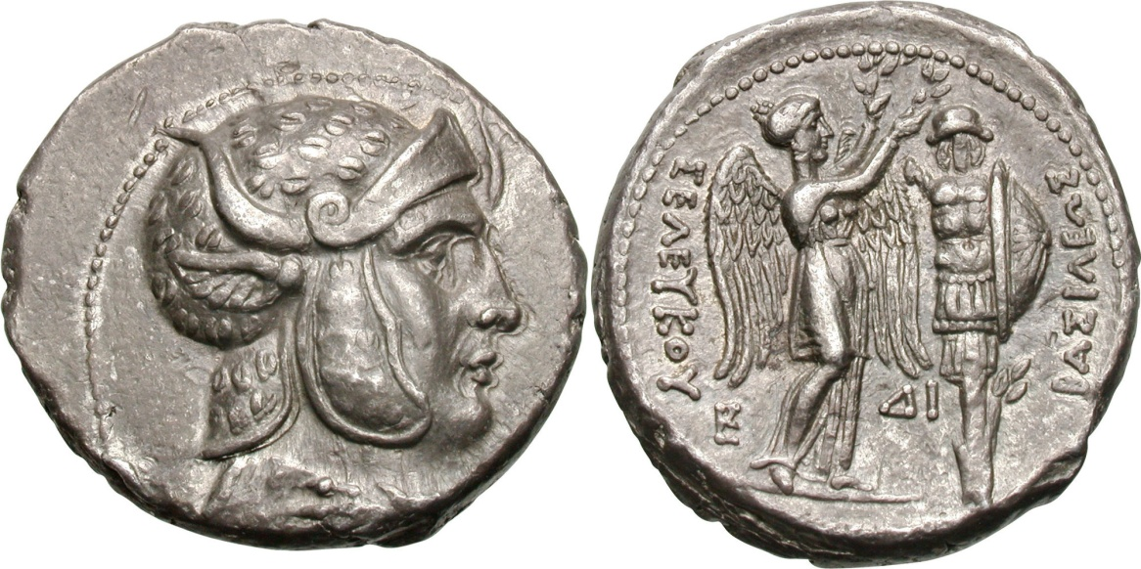
Seleucus I
Attic weight
Persic weight
Notes:
Gold and silver on persian standard for regional circulation. Coinage also struck on the Babylonian standard.
Portrait c. 305 BC. Prob. Portrait of Seleucus, his name on the reverse.
Alexanders, Lysimachi, Attalid tetradrachms all circlulated and used – quite a loose policy. Hoards show large ‘mixed’ international coinages in this period. All currencies on Attic standard circulated freely.
Some bronze production, but unlikely enough to serve local everyday needs. Large silber coins and bronzes (which don’t seem to have circulated beyond their place of issue) – nothing really mid tier.

Slide 31
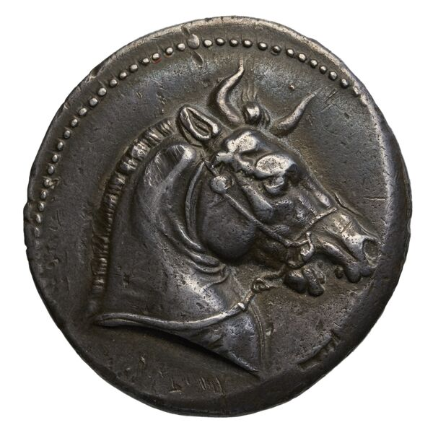
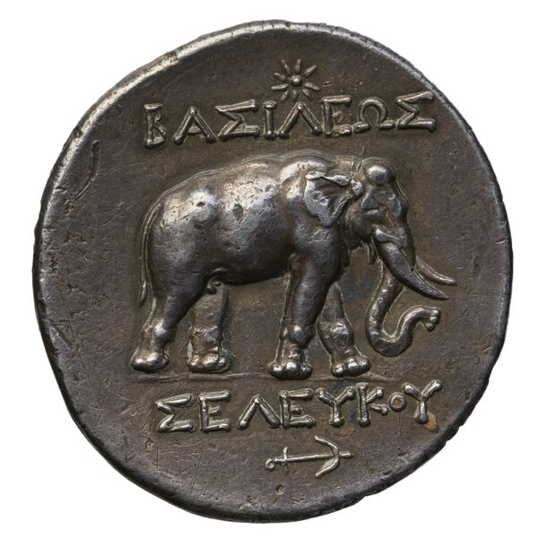
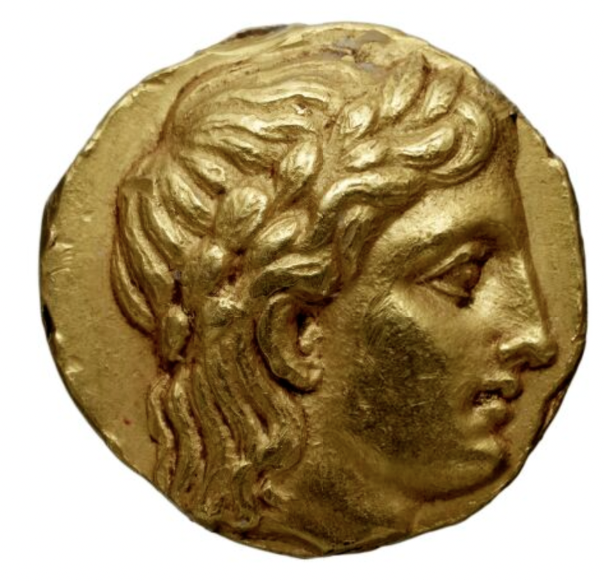
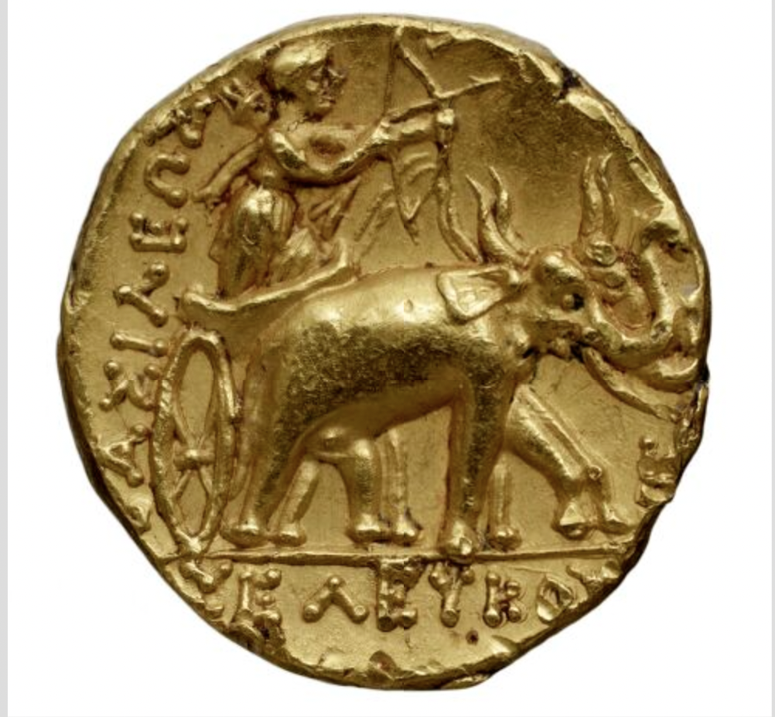
AR tetradrachm, Pergamon.
AV Stater, Susa
Notes:
Elephant symbolism greater in eastern mints of the Seleucid kingdom than the west.
Pergamon coin one of the rare issues from the West.
Horns – A Mesopotamian iconographic tradition. Symbols of supernatural power and divinity, given to both animals and humans.
Dionysiac symbol, conquest of the east?
Athena in elephant quadriga – AR tetradrachms also show the same thing (
Dionysus and elephants – conquest of the east (India the famous land of elephants). Wine given to sick elephants, elephants also given juice of grapes and mulberries before battles, reports of unmixed wine being fed to them before battle to make them more enraged.
Battle of Ipsos in 301 BC – ancient sources give a lot of credit to Seleucus’ elephants.
Elephant imagery falls iunder his successor Antiochus.
Anchor – Seleucus allegedly born with an anchor shaoped birthmark on his thigh – became symbol of the Seleucids.

Slide 32
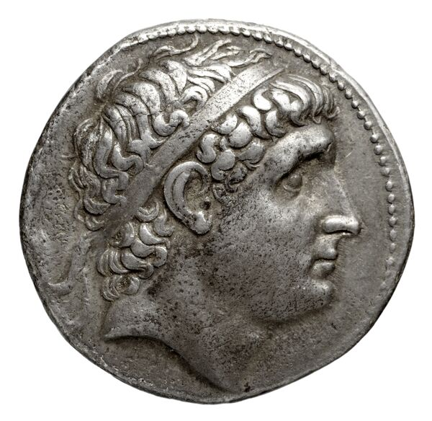
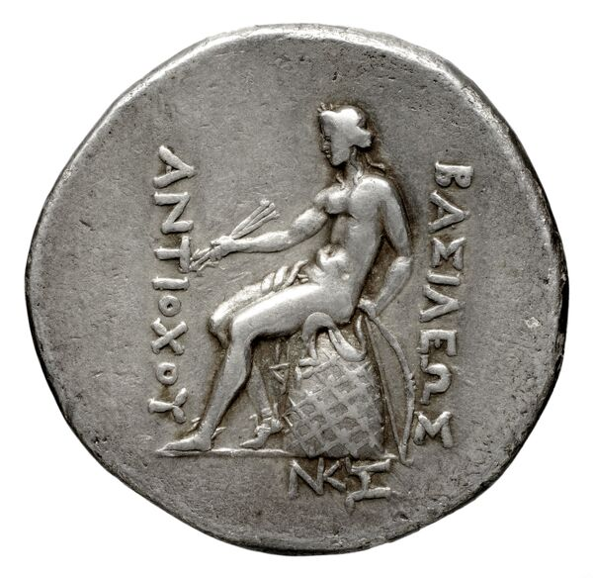
AR tetradrachm, Antiochus I, 268-261 BC, mint of Smyrna.
Diademed head of Antiochus I right, rejuvenated and idealized / Apollo seated left on omphalos, testing arrow and resting left hand on grounded bow, BAΣΙΛΕΩΣ ANTIOXOY
Seleucid Coins Part 1 311.4 (http://numismatics.org/sco/id/sc.1.311.4)
Notes:
Apollo – omphalos indicates Delphi. Apollo the mythical ancestor of the Sleucids and priests of Apollo had foretold the establishment of the kingdom.

Slide 33
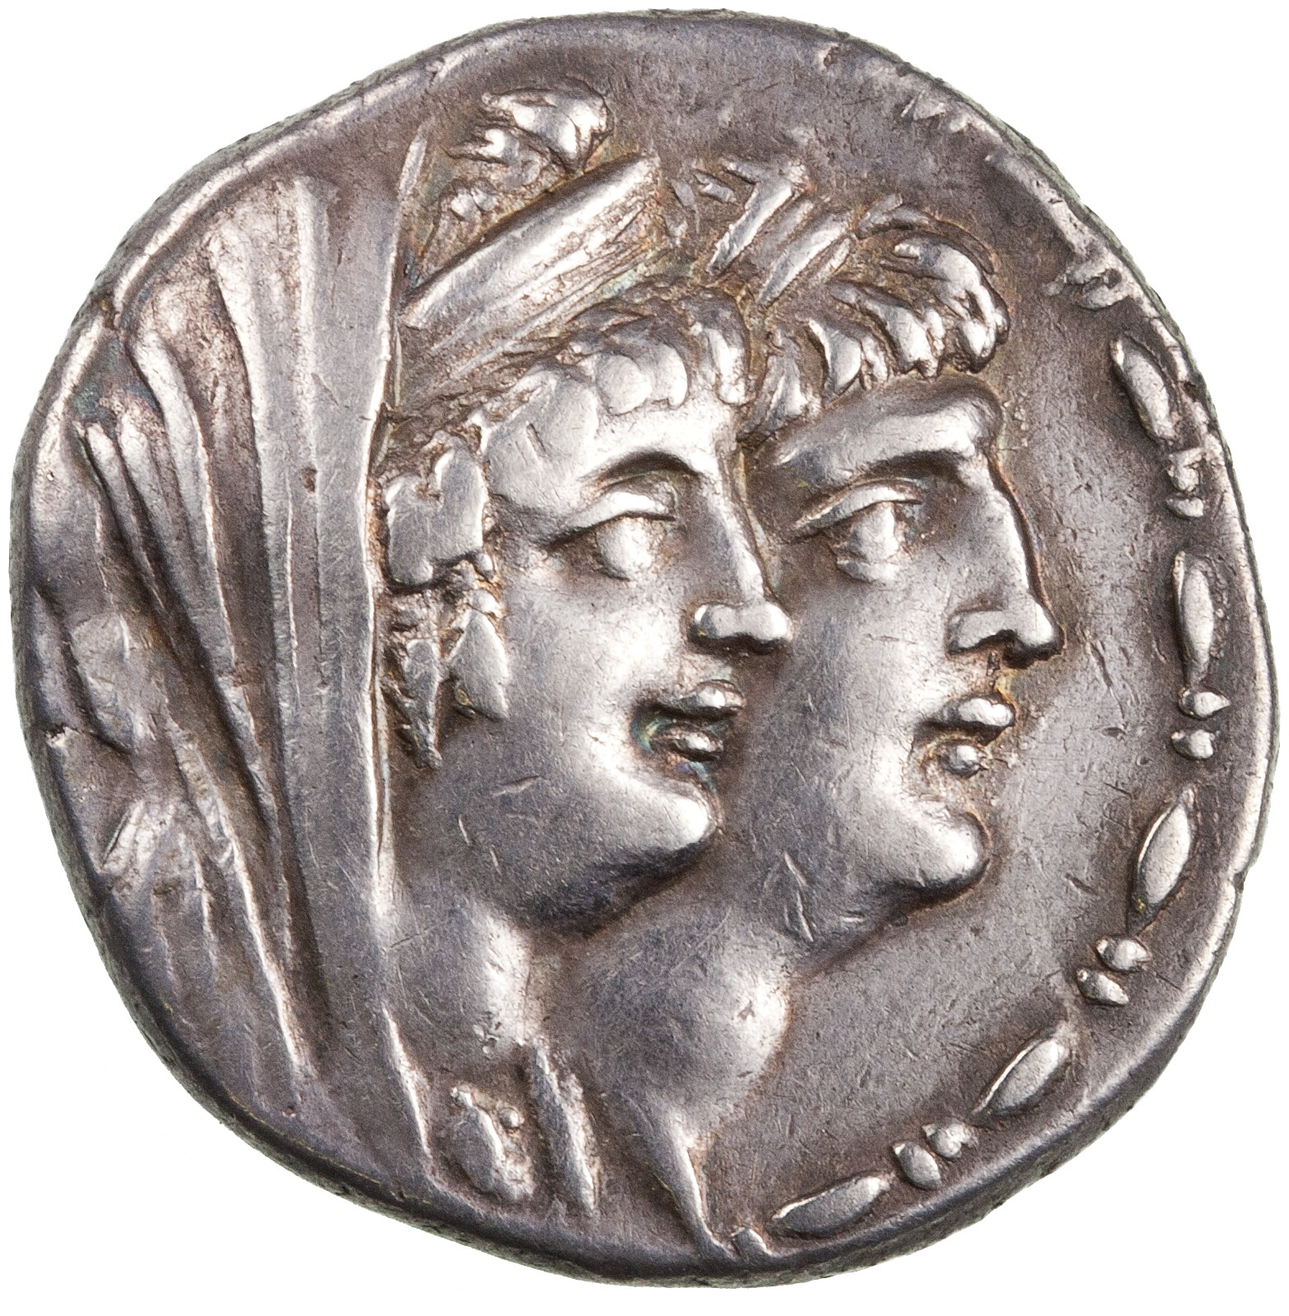
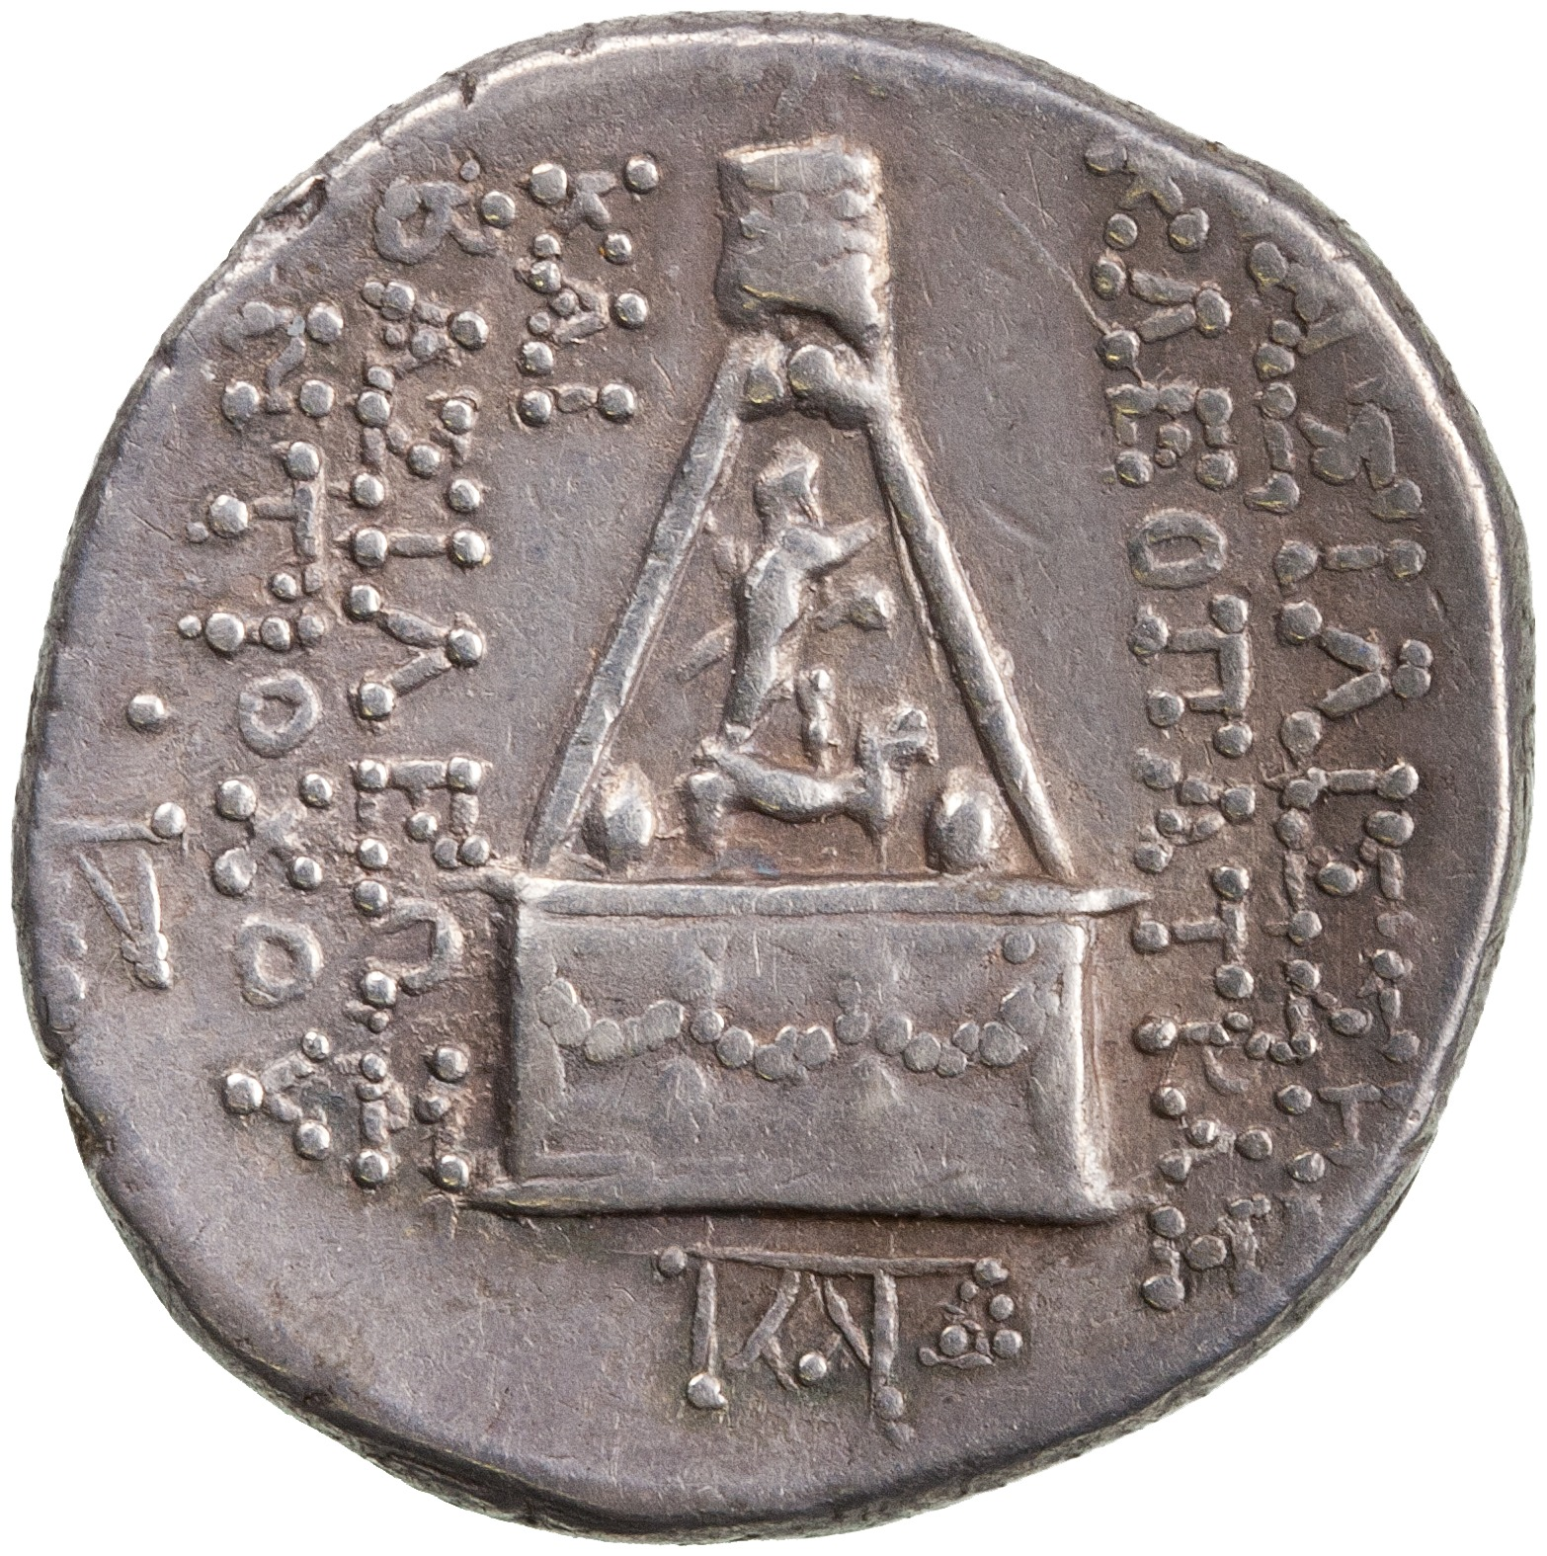
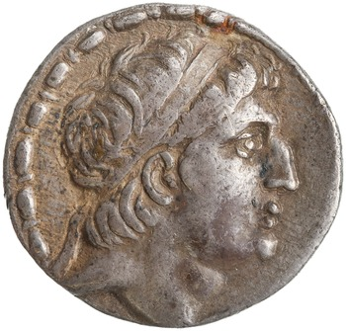
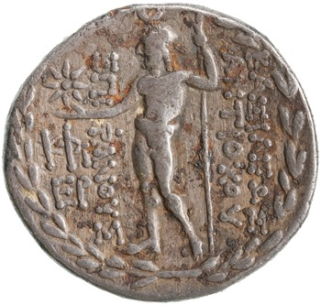
Antiochus VIII Grypus (125-96 BC)
https://numismatics.org/sco/id/sc.1.2260
Sandan – Luwian deity (Cilicia)
https://numismatics.org/sco/id/sc.1.2280
Zeus Uranius (Cilicia)
Notes:
As the dynasty continues, from Antiochus IV onwards, increasing local autonomy expressed in the presentation of local forms of deities on coinage. As territory shrank, the importance of those regions which remained increased. No over riding culture in terms of colonized or colonizer that we can see here – competing traditions alongside each other.
BAΣΙΛIΣΣHΣ KΛEOΠATPAΣ KAI BAΣΙΛΕΩΣ ANTIOXOY
Type: Garlanded altar with baldachin under which Sandan standing right on back of horned, winged lion-griffin right=
Lion god, shown as a horned lion.
Zeus Uranius – Baal – Hellenised version of the god.
King’s awareness of target audiences.

Slide 34
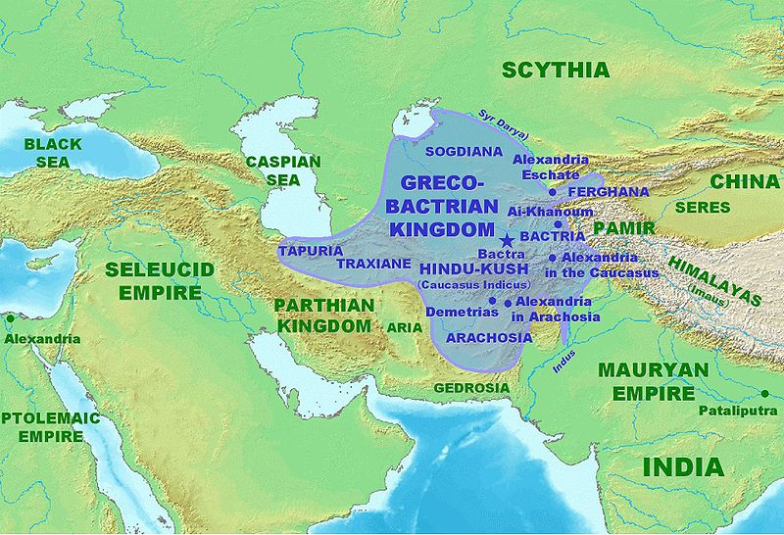
Graeco-Bactrian Kingdom
Notes:
c. 225BC - breaks away from the Seleucid Kingdom. Diodotus founder.
Map of the kingdom at its greatest extent, c. 180 BC
c. 205 BC - Indo-Greek kingdom. Most coins from this dynasty found in Afghanistan.

Slide 35
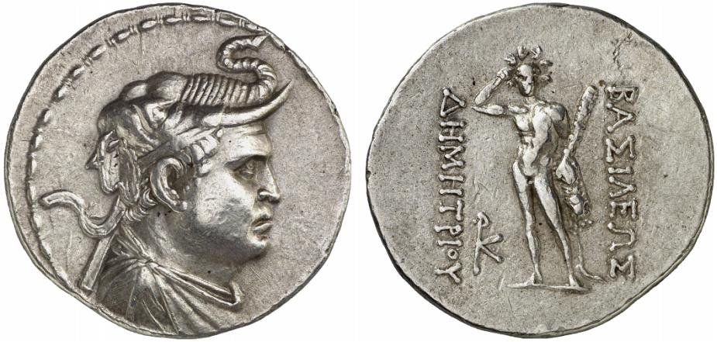
Demetrios I, Kingdom of Bactria, 200-185 BC, AR tetradrachm, 16.83g, SNG ANS 187
Obv: draped bust of the king with elephant scalp
Rev: Herakles standing with lion-skin and club, crowning himself. In field, l., monogram. ΒΑΣΙΛΕΩΣ ΔΗΜΗΤΡΙΟΥ.

Slide 36

Antialkidos Nikephoros, Indo-Greek Kingdom, Bactria, 130-120 BC, AR drachm, 2.24g, SNG ANS 1078-84
Obv: draped bust wearing helmet
Rev: Zeus Nikephoros seated holding Victory and sceptre; monogram to r., forepart of elephant to l.
Notes:
Indian standard.
Greek and kharosthi.

Slide 37

Philoxenos Aniketos, Indo-Greek Kingdom, c. 125-110 BC, AR drachm, 2.4g, SNG ANS 1188
Obv: diademed, draped and cuirassed bust wearing helmet.
Rev: King on horseback; monogram to lower r.

Slide 38


Indian die punched coinage
‘Bent bat’ currency
2007: Hoard in Pushkalavati (Shaikhan Dehri) in Pakistan
Coin of Athens dating from 500-480 BCE found alongside local currency.

Slide 39


Attalid Kingdom
Philetairos, Kingdom of Pergamum, 269-263 BC, AR tetradrachm, 16.9g, SNG France 1604
Obv: diademed head of Philetairos, r.
Rev: Athena seated r.; ivy leaf above knee, A on throne, bow to outer right.
Notes:
Philetairos was never a king, but shown with diadem.
Also shown to be quite fat! Realism.
Ruled kingdom of Pergamum after
These types would be struck as an immobilized type for a century, since Eumenes's successors adopted it without major changes. The long reigns of Eumenes I (263–241 B.C.), Attalus I (241–197 B.C.), and Eumenes II (197–160 B.C.) required the use of about 200 obverses, (p. 183) which means a yearly average slightly above two, a meager output compared with earlier ones. the death of Lysimachus.

Slide 40


Cistophori or ‘basket-bearers’ in the Attalid Kingdom
12.2g instead of 16.8g
Drachm of 3.05g
From 167 BC (Eumenes II). An ally of the Romans, was gifted a large territory by Rome after the peace of Apamaea, 188 BC.
Pergamon
Tralles
Notes:
With the gifting of the territory, suddenly became a large kingdom. Initially Philataerus coinage. Philaterus coinage, attic weight, slowly phased out.
Date of introduction controversial, but sometime after 180 or 170 BC. Hoards suggest before 160 BC. Perhaps 166 BC?
Eumenes II – Attalid king – Pergamum. 168 BC – Galatians ravage the territory of the Pergamenes, defeated by Eumenes II who is hailed as a defender of the Greeks.
Attalids claim descent from Dionysius and Herakles. Also cities struck on this standard – continuation into Roman period.
New metrological system intended to make exchange between different currencies easier.
Rhodes also striking coinage with a drachm weighing 3.05g.
Also surely to stop silver leaving the area. Cistophori rarely found outside the area of Asia Minor/the Attalid kingdom. Perhaps because supply of gold and silver drying up due to Roman influence in the area.
Cista mystica (used in bacchic rituals) / bow in case surrounded by serpents.
. These “cistophoroi” weighed only three-quarters of the Attic tetradrachm (c. 12.6 g in place of c. 16.8 g) but had to be changed and accepted by foreigners at the border for the same value.
NO ROYAL PORTRAIT. What is going on here??
Royal coinage ‘pretending to be a federal coinage’.
Eumenes had not won his empiure through war or prowess, as a gift. SO the idea of a ‘first ampng equals’ situation, pretence of Eumenes as a protector of the Greeks, an alliance of Greek cities..
Continued dowen into the Roman period.

Slide 41
Cicero, Att. 26 (=2.6.2)
But to come to business, I have written to the City Quaestors about Quintus’ affair. See what they have to say, whether there is any hope of denarii or whether we must let ourselves be foisted off with Pompey’s cistophorii.
Notes:
Allowances as governor.

Slide 42
Choose a Seleucid Mint on https://numismatics.org/sco/
What imagery/metrology exists there?
What coins beyond those we have looked at are present? Do they fit into what we have discussed to date in terms of Hellenistic coinage (especially in the Seleucid period – i.e. different audiences, increasing local imagery as time goes on)
Is there a different between precious metal coinage and bronze coinage?
Other observations

Slide 43
Further Reading
Bopearachchi, O. (1991). Monnaies grâeco-bactriennes et indo-grecques : catalogue raisonné. Paris, Bibliothèque nationale.
Houghton, A. and Lorber, C. (2002-). Seleucid Coins: A Comprehensive Catalogue. New York.
Mørkholm, O., Grierson, P. and U. Westermark. (1991). Early Hellenistic Coinage from the Accession of Alexander to the Peace of Apameia (336-188 B.C.), Cambridge.
Part II, The Hellenistic World, in Oxford Handbook to Greek and Roman Coinage, ed. W.E. Metcalf, Oxford.
Thompson, M. (1968). ‘The mints of Lysimachus’, in Essays in Greek Coinage Presented to Stanley Robinson, ed. C. Kraay and G. Jenkins, Oxford, pp. 16-22
Thonemann P. (ed.) Attalid Asia Minor: Money, International Relations, and the State. Oxford.
Thonemann, P., (2015). The Hellenistic World: Using Coins as Sources. Cambridge, Cambridge University Press.
van Alfen, P., (2005). ‘Problems in ancient imitative and counterfeit coinage’, in Making, Moving and Managing: the New World of Ancient Economies, eds. Z. Archibald, J. Davies and V. Gabrielsen, London, Oxbow, 322-54.
Wright, N., (2009/10). ‘Non-Greek religious imagery on the coinage of Seleucid Syria’, Mediterranean Archaeology 22/23, pp. 193-206.
Hellenistic Royal Coinages: http://numismatics.org/hrc/

