Slide 1
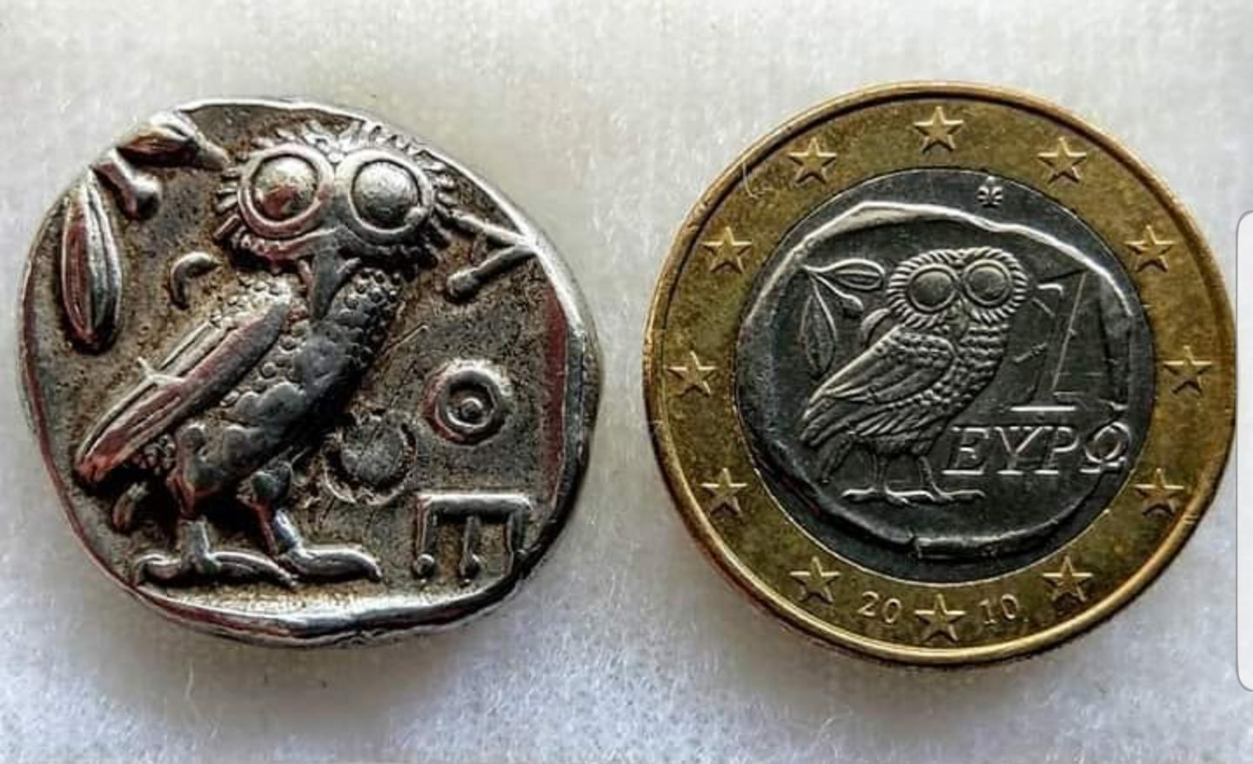
Greek coinage in perspective

Slide 2
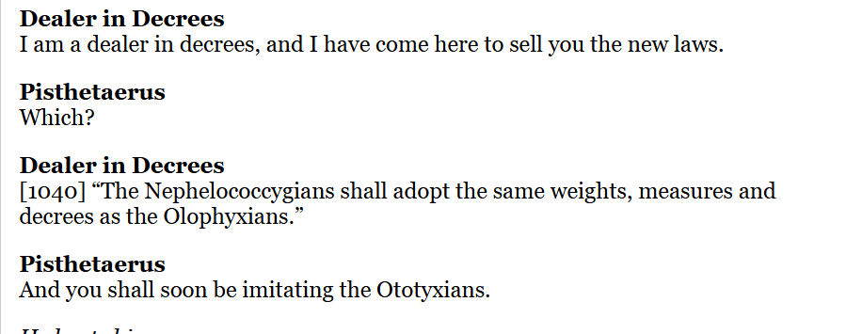
Aristophanes, Birds 1038-1041; Testimonia Numaria 77
Cf. IG I³ 1453; Testimonia Numaria 78

Slide 3
Olbia decree concerning local and foreign coinage
SIG³, 218; IOSPE I,11; Testimonia Numaria 349
‘… If any sale or purchase takes place in any other currency, the seller is to be deprived of whatever he is selling, and the buyer of the price that he pays for it…’
It is to be permitted to buy and to sell gold, the Cyzicene stater at at ten (?eleven) and a half staters, and no account at a higher price, and other gold and silver coinage of all kinds at any rate satisfactory to both the parties concerned’.

Slide 4
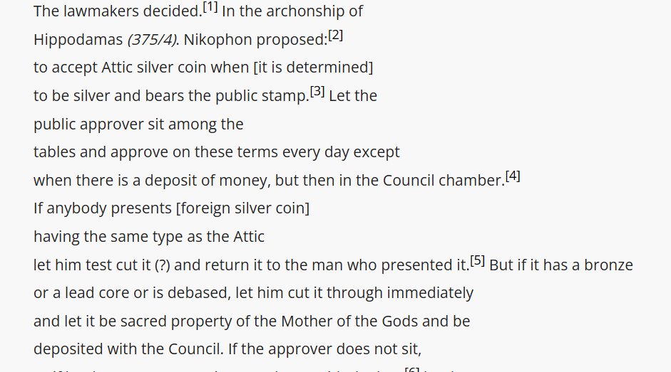
Law on inspectors (dokimastai) of silver coinage, 375/4 BC,
Hesperia 1974, 157-88; Testimonia Numaria 91; AIO 819

Slide 5
Attitudes to coinage/currency
Counterfeits and producing counterfeits condemned
Hoarding/ saving money
Spending money
Work/services being paid in money
Payment of fines
Appreciating an individual’s character in terms of his relationship to money , cf. Thephrastus, Charecters IV, 11 (Testimonia Numaria A24)

Slide 6
Practices connected to money unchanged from Antiquity to the Present
Counterfeits/forgeries and producing counterfeits/forgeries condemned
Selling and buying
Loans/ borrowing at an interest
Banks and the operation of banks
Fund raising
Accounts
Public expenditure
War reparations
Precious metal currency vs small change for every day transactions

Slide 7
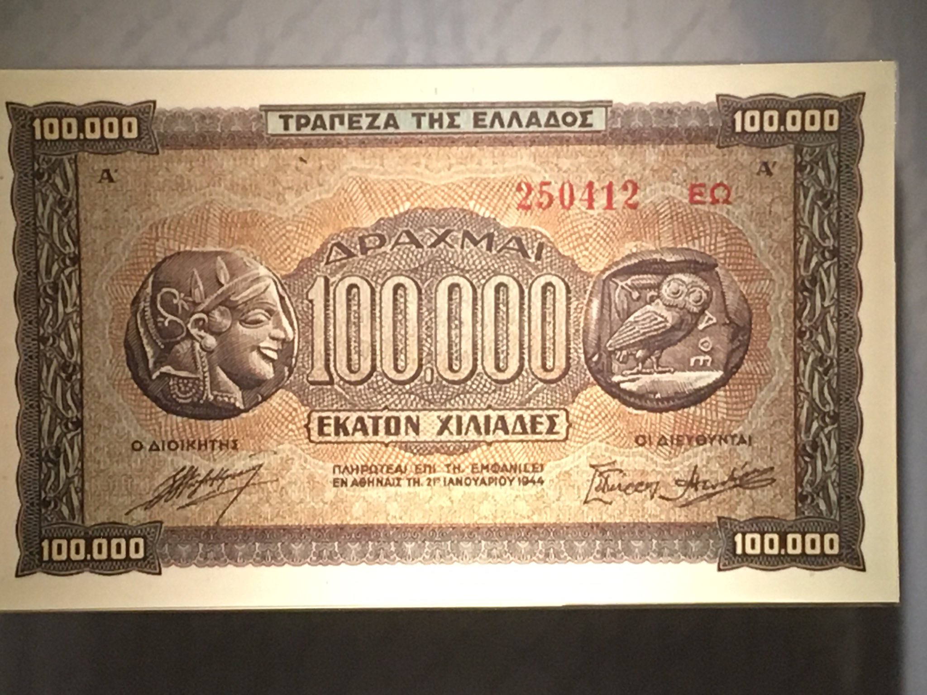
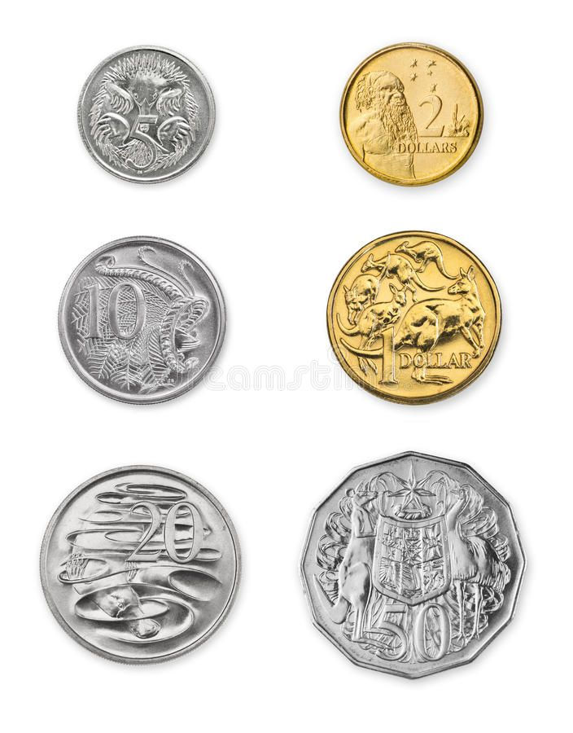
Type design
Notes:
National identity –antiquities as well as coins. Imagined community.

Slide 8
Money and propaganda
To enhance the moral – just as the images on the Greek banknotes during German Occupation
To commemorate historical events or anniversaries
To express common ethnic identity
Political propaganda, e.g. on RRC, the propaganda coins of Thomas Spense and his contemporaries
National policies, war propaganda, e.g. Propagand banknotes of the Vietnam war, the use of forged, parodied or overprinted currency to make a parody of the enemy
Forged currency in warfare. The Germans forged millions of British pounds during World War Two in an attempt to undermine the British economy.

Slide 9
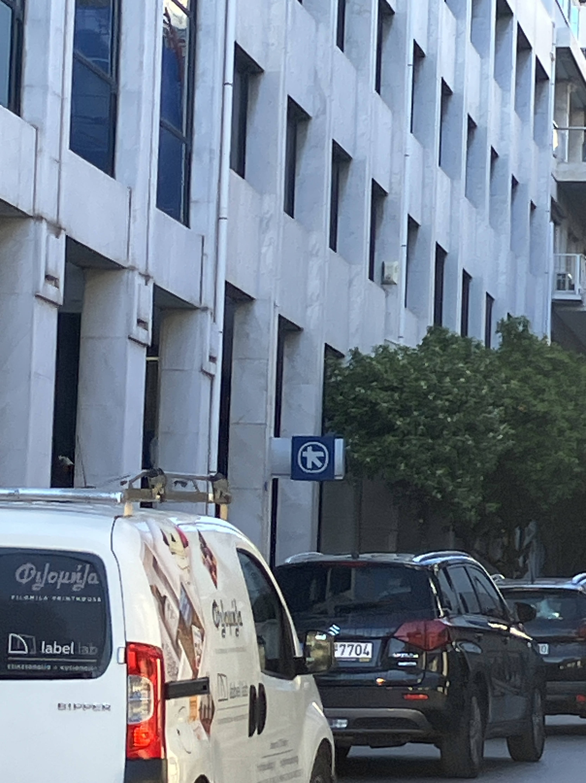

Slide 10
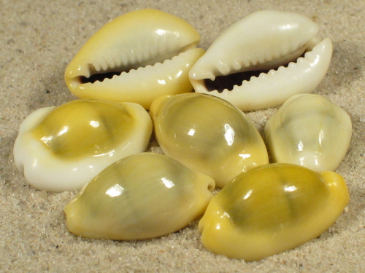
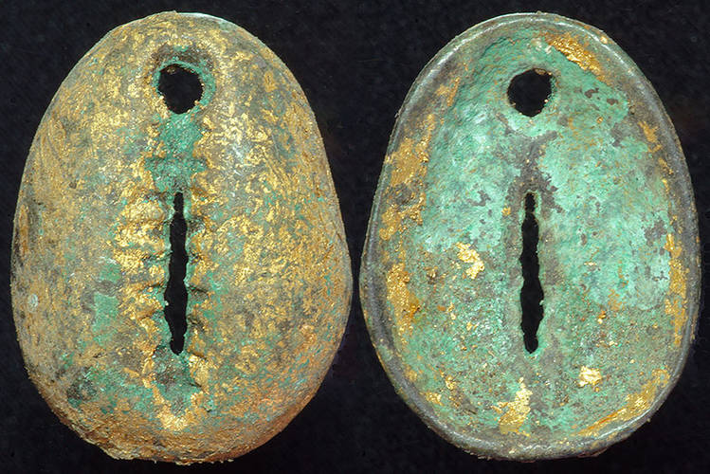
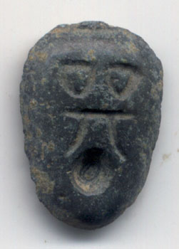
Chinese money
Cypraea moneta (money cowrie), Cypraea annulus (ring cowrie)
Bronze cowrie use during eastern Zhou period (770-222 BCE) (tong bei)
Chu state (475-222 BCE): cowrie money with inscriptions. Mould also found.
Qin unification in 221 BCE – standardized currency, removal of cowrie currency
Notes:
12 century BCE – cowrie shells found in enough quantity to act as money. Likely brought via the Indian ocean through trade.
Durable, portable, neither too rare nor too common.
Zhou period – 770 – 222 BCE – bronze cowries and moulds for casting bronze cowries. These carried inscriptionds and cleary functioned as currenct.

Slide 11
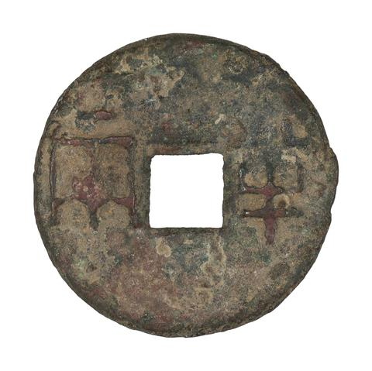
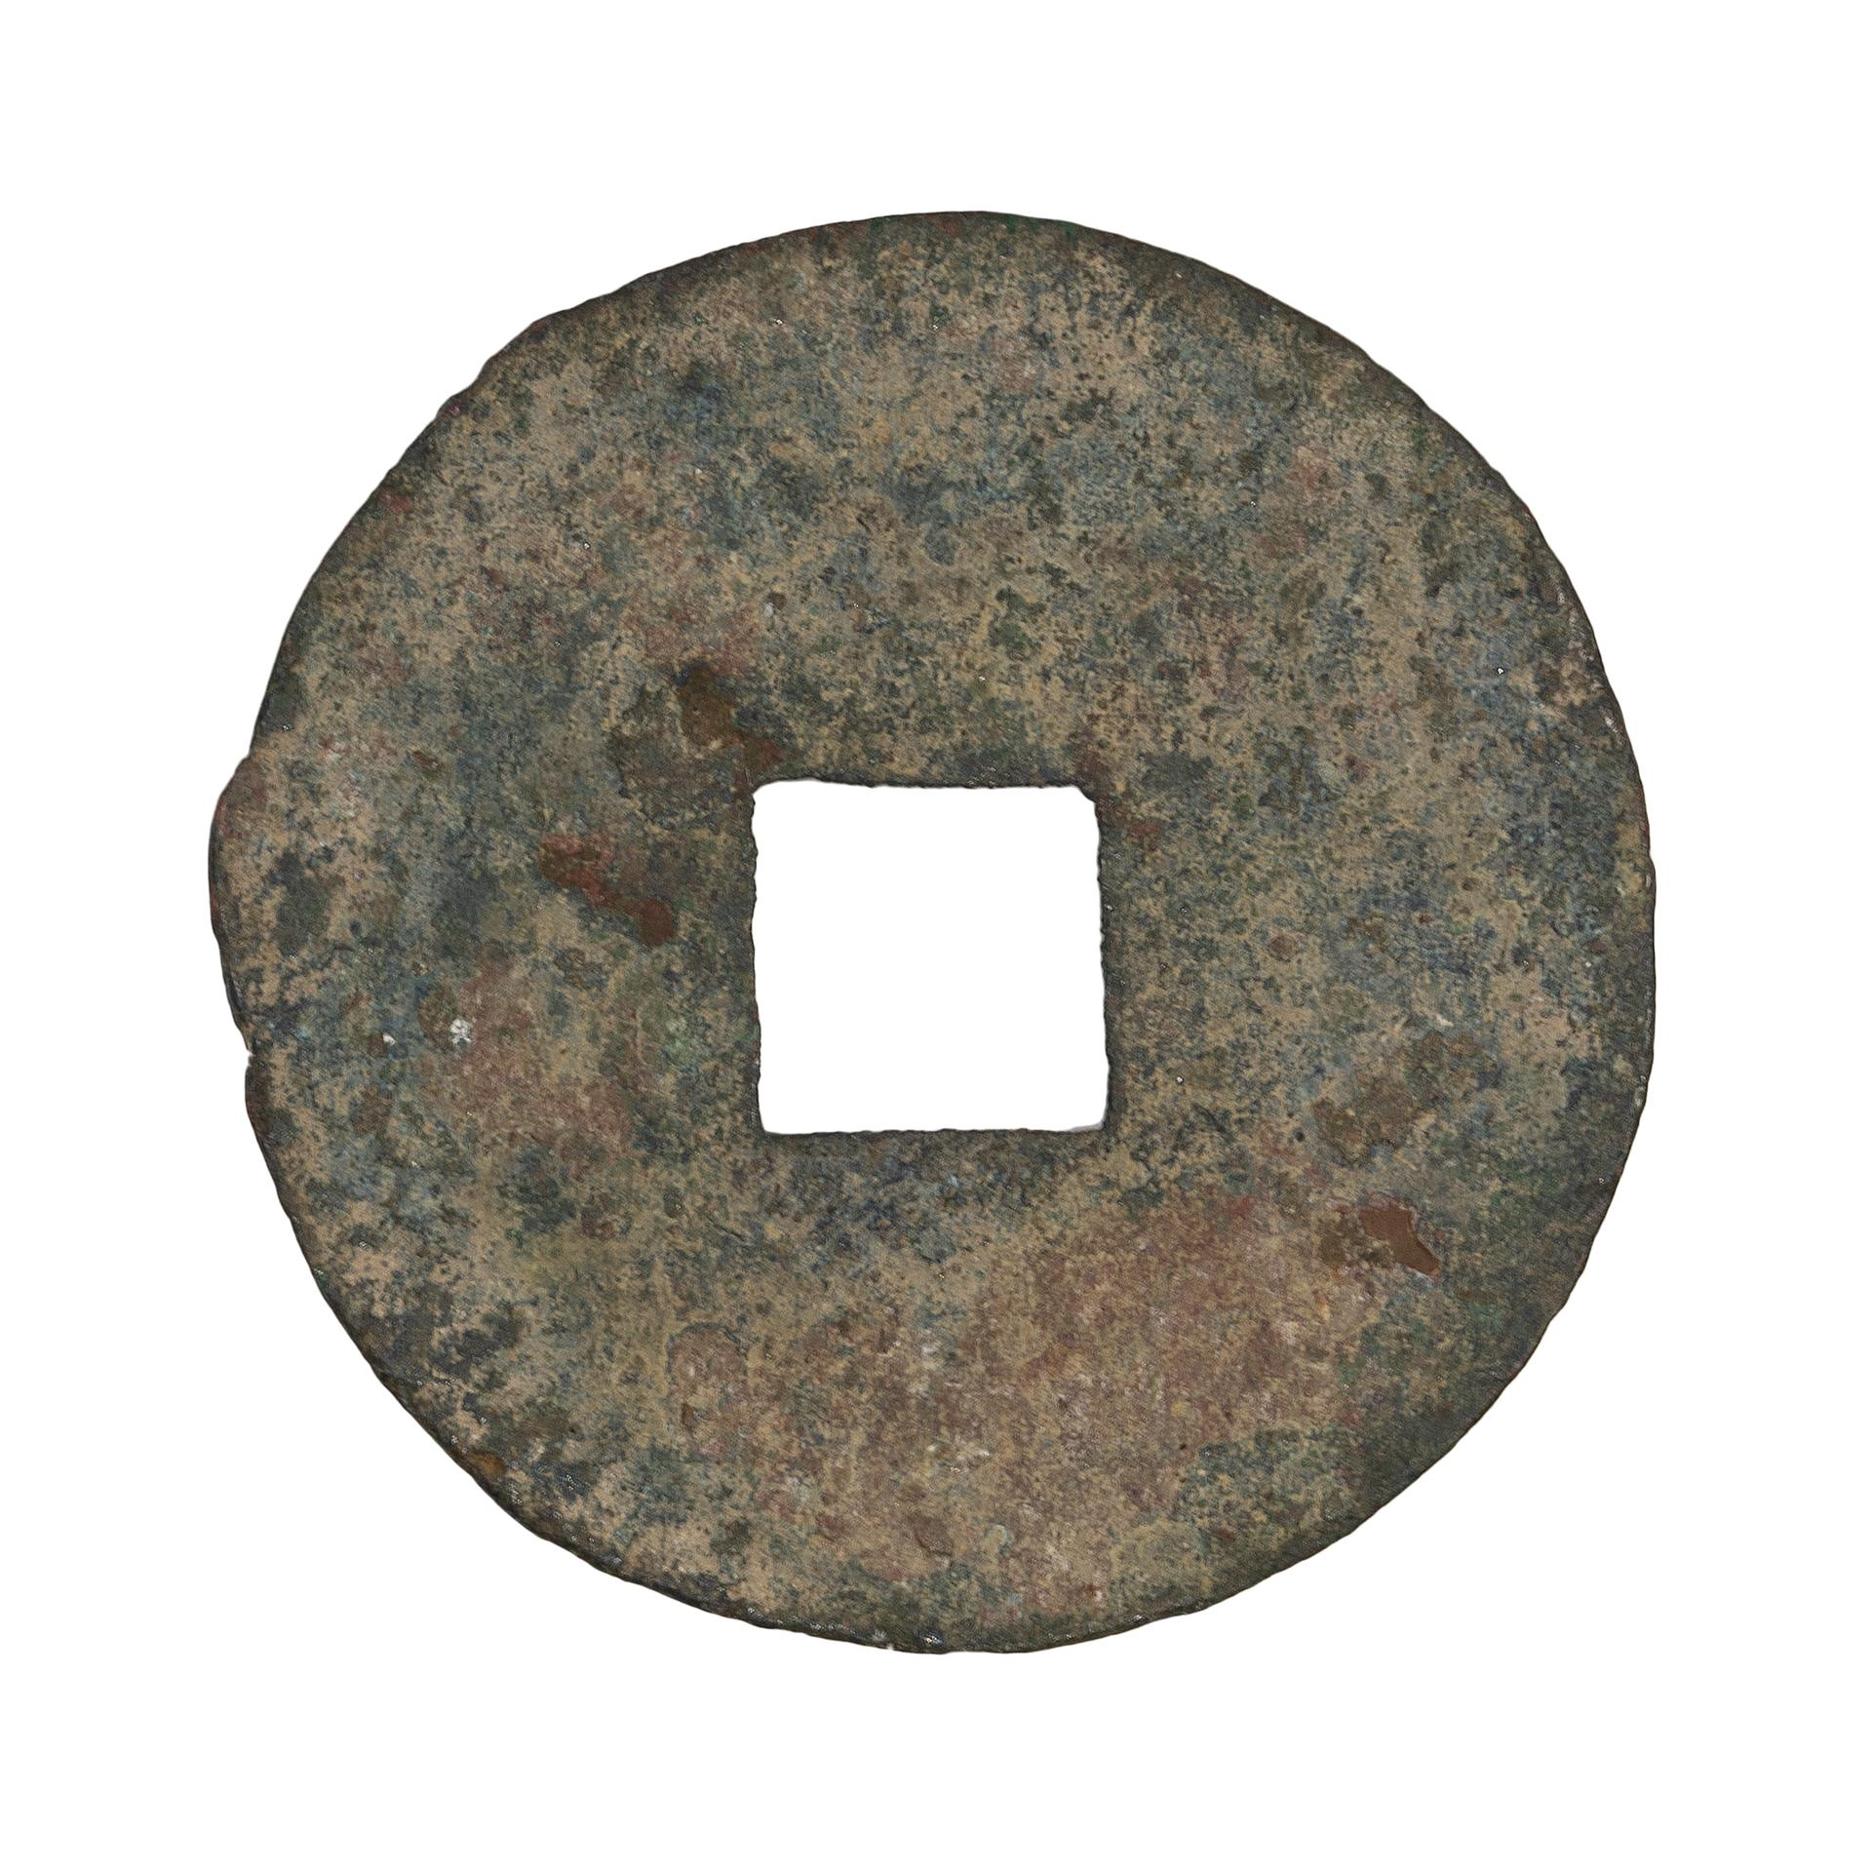
Bronze qin ban liang
400-100 BCE, Yale University Art Gallery 2001.87.45339. 6.43g, 32.28 mm
Notes:
Accepted currency until the end of imperial China.

Slide 12
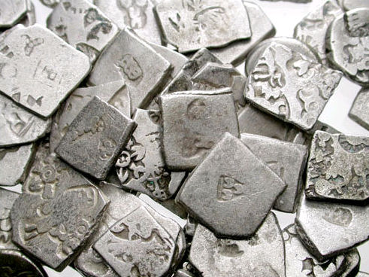
Money in India
Proto-coinage (bent silver bars) perhaps influenced by Greek coinage via Achaemenid Persia.
Achaemenid kings: Greek coins circulated as monetary bullion into Afghanistan. Coins of Alexander found in north Pakistan.
Gradual adoption of dies rather than punch striking.
Periplus of the Erythraean Sea (mid first century AD) refers to the circulation of coins of the Greek kings of the Punjab in western India.

Slide 13
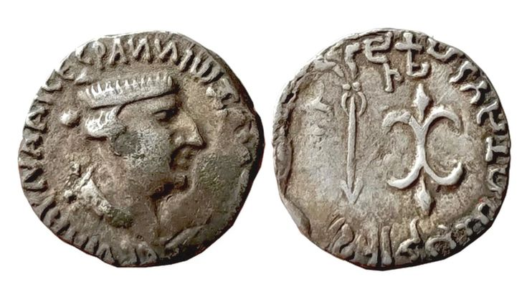
Silver drachm of Nahapana with Indian language written in Greek on the obverse naming him as ruler. Arrow and thunderbolt on the reverse with Kharoshthi and Brahmi inscription versions of the inscription written in Greek.
AD 30-70

Slide 14
Coinage –which appeared simultaneously in the Greek world as well as in at least two other parts of the world, in India and in China - is an unsurpassed invention. It can only be surpassed by the cashless payments of our modern, digital era.
Once invented, it has never been abandoned

Slide 15
A means of commensuration
A means to overcome the obvious difficulty deriving from the ‘double coincidence of wants’ – Money establishing fairness in transactions in a primordial level
Ascribing value in terms of its cost in money
A means of depositing wealth and a means of assessing the magnitude of wealth, e.g. the inventories of deposits in ancient Greek sancturies, estimating the cost

Slide 16
Numismatics in the Renaissance
Mørkholm 1979: ancient Greek numismatic scholarship begins in 1760.
Interest in Greek coins much less than Roman coinage (portraits of rulers) before 16th century. Some interest (Ciriaco d’Ancona and Ambrogio Traversari) but knowledge of ancient Greek limited during 15th century
Turkish conquest of Greece made it difficult to travel to Greece/Asia Minor to record antiquities
16th century: references to Greek coinage in Budé and Leonardo da Porto. Also knowledge of Greek increased.
Notes:
Morkholm’s date – Winckelmann, rediscovery of Greece, etc.

Slide 17
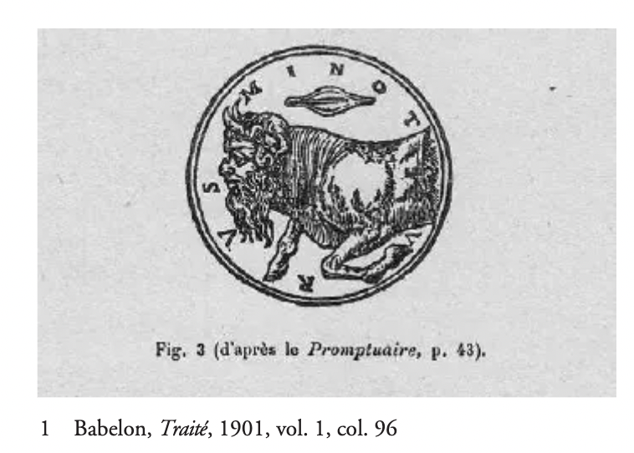
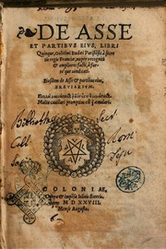
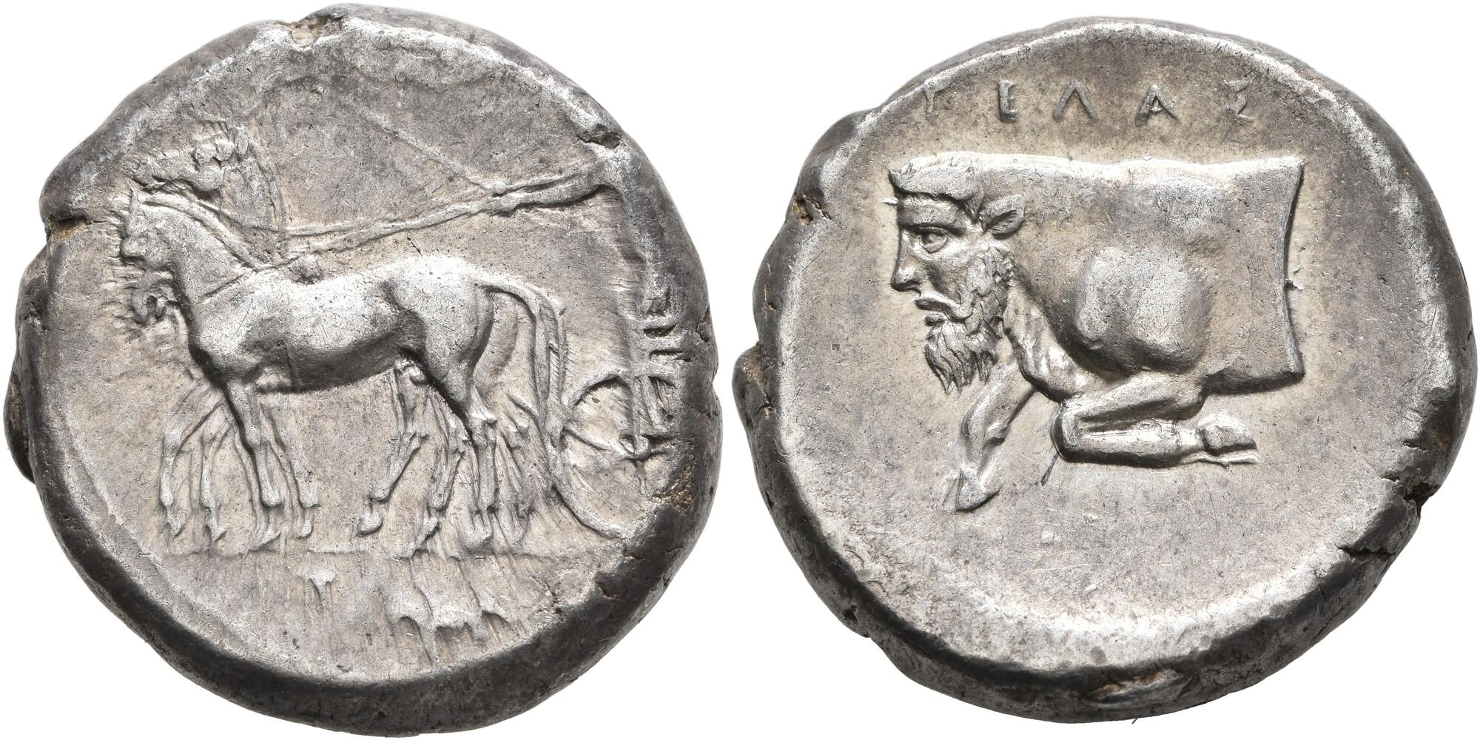
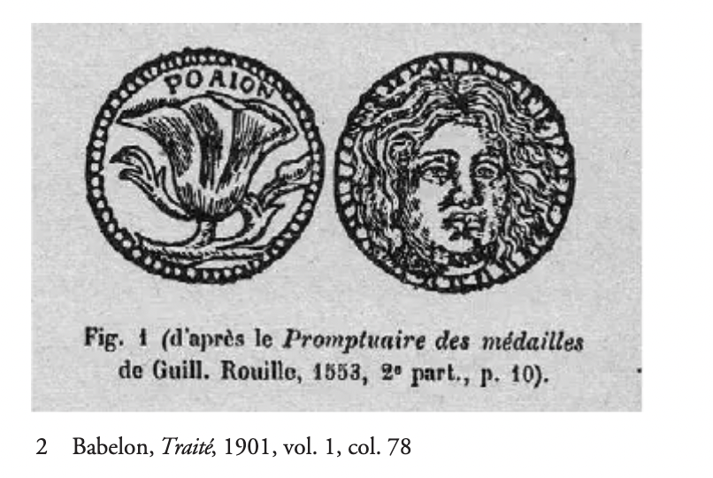
Promptuaire des Medalles des plus renommées personnes
Guillaume Rouillé
1581
De Asse et partibus, 1514. Guillaume Budé
Notes:
5th century coin of Gelas showing a river deity but here inscribed as Minotaur.
Rhodes coin presented as one of the 30 pieces of silver given to Judas.
The work of Rouille notoriously unreliable inn terms of images. Others at the time knew better!

Slide 18
Kagan: There has been an underestimation
Those knowledgeable about Greek coins in this period either didn’t try to publish or died while writing their works. E.g. Fulvio Orsini – letters, collection contained 800 Greek coins, known expertise
Wolgang Lazius, 1558, Commentarium rerum Graecarum libri duo

Slide 19
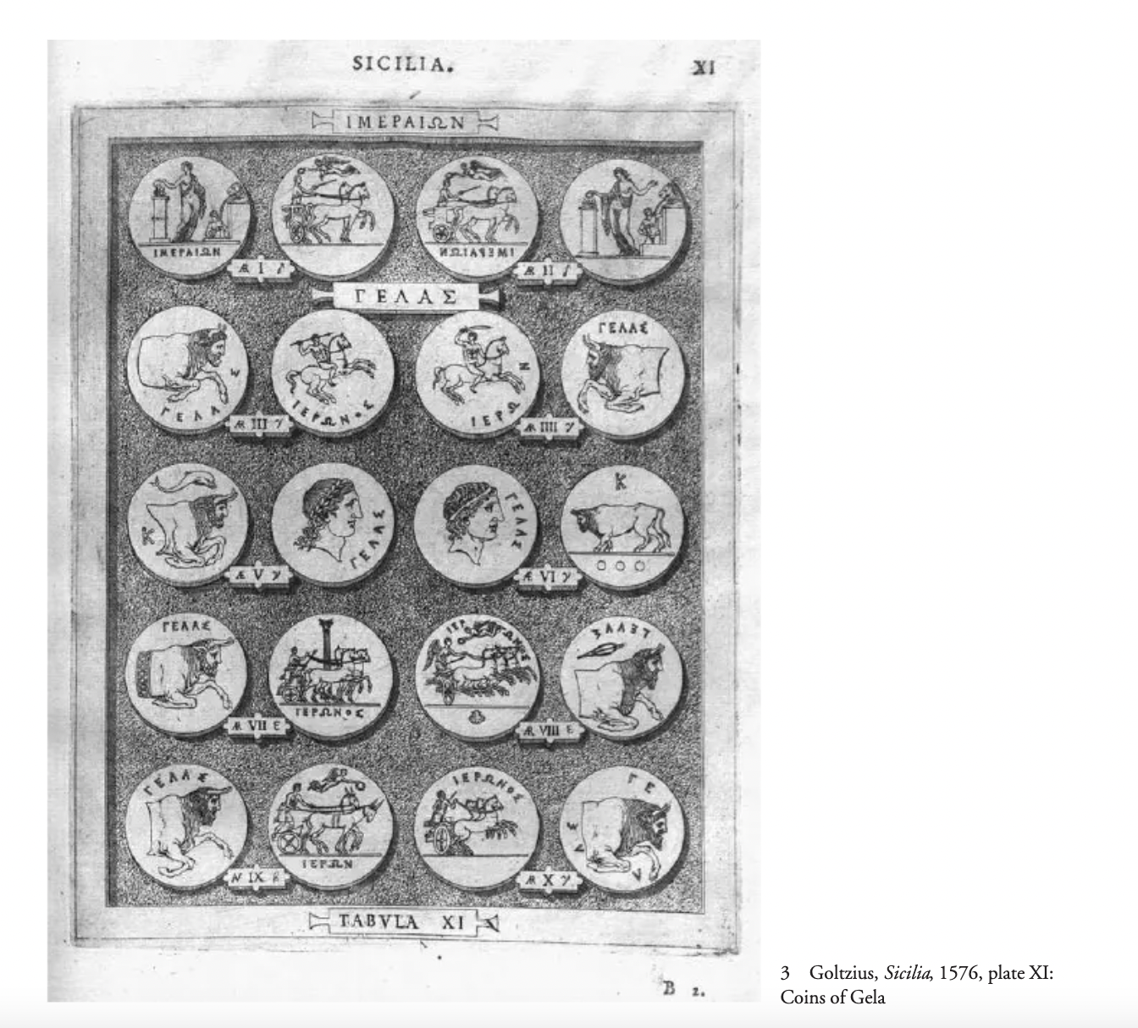
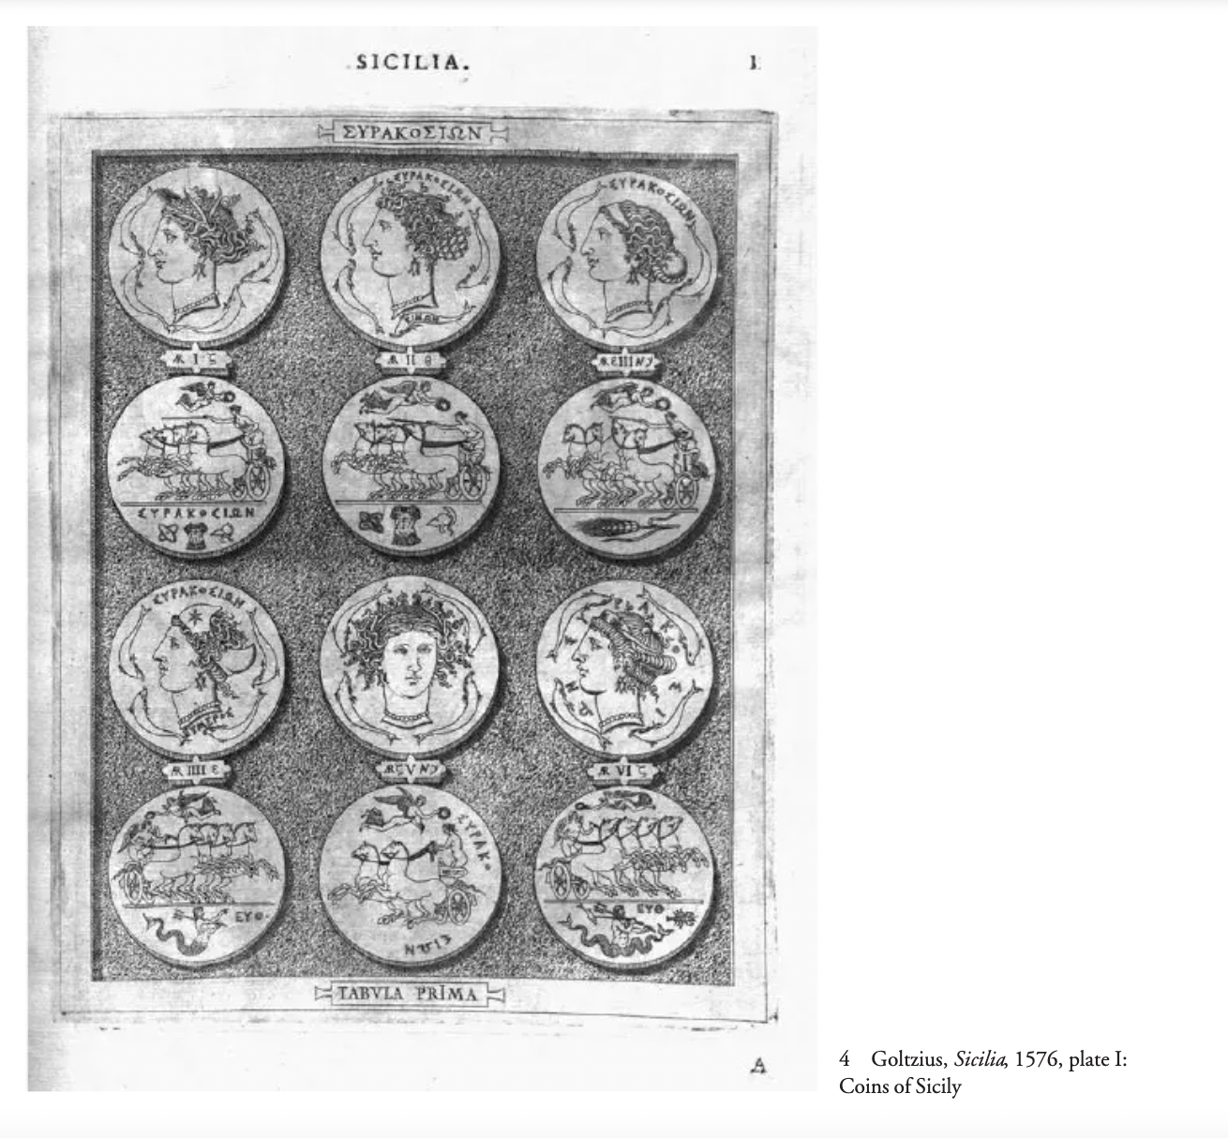
Wolgang Lazius, 1576, Sicilia et Magna Graecia
Notes:
Evidence for diffusion of Greekl coins into European collections.
First to organize Greek coins from west to east geographically
Engravings seem based on real coins, 90% correctly identified as Sicilian.
Coins catalogued by metal and size
Cimon engraver’s name on the coin shown

Slide 20
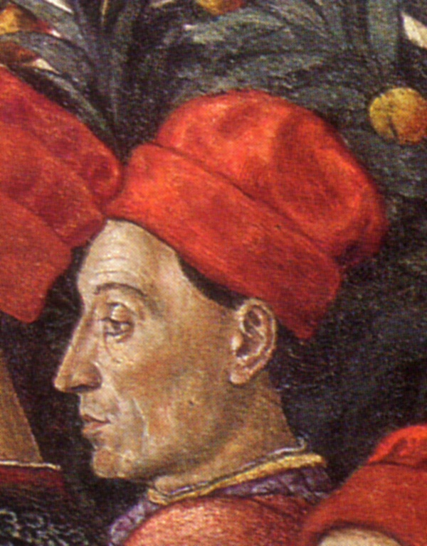
Cyriacus of Ancona
‘father of archaeology’
Rhodian coins – identified Apollo on obverse and knew the significance of the flower.
Evidence for Venetian trade in Greek coins in 15th century

Slide 21
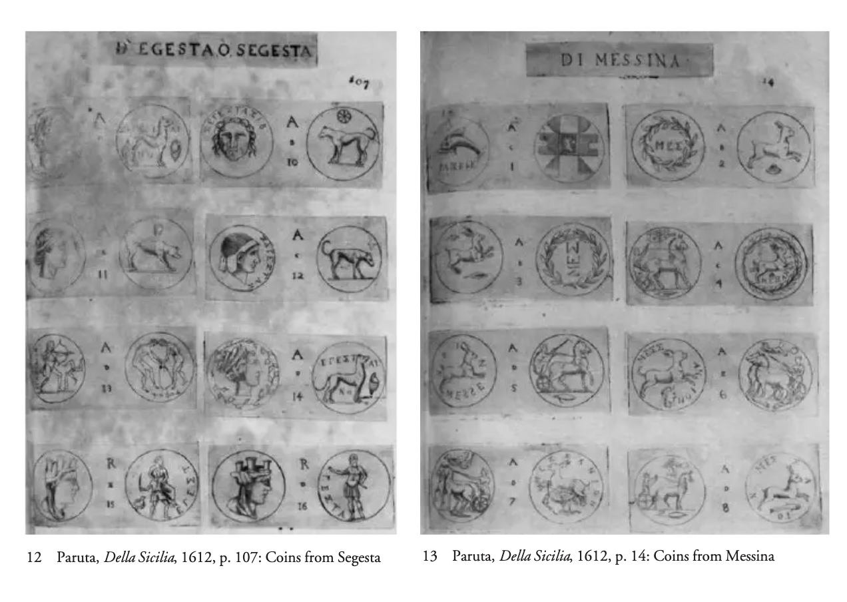
Filippo Paruta, 1612, Della Sicilia Descritta con Medaglie
Notes:
All periods of Sicily illustrated on 180 plates. First 144 plates are Greek Sicily. 1000 coins in this section.
Real coins properly iudentifiedd.
Provenance index indicating whether source was a local collection or printed work.

Slide 22
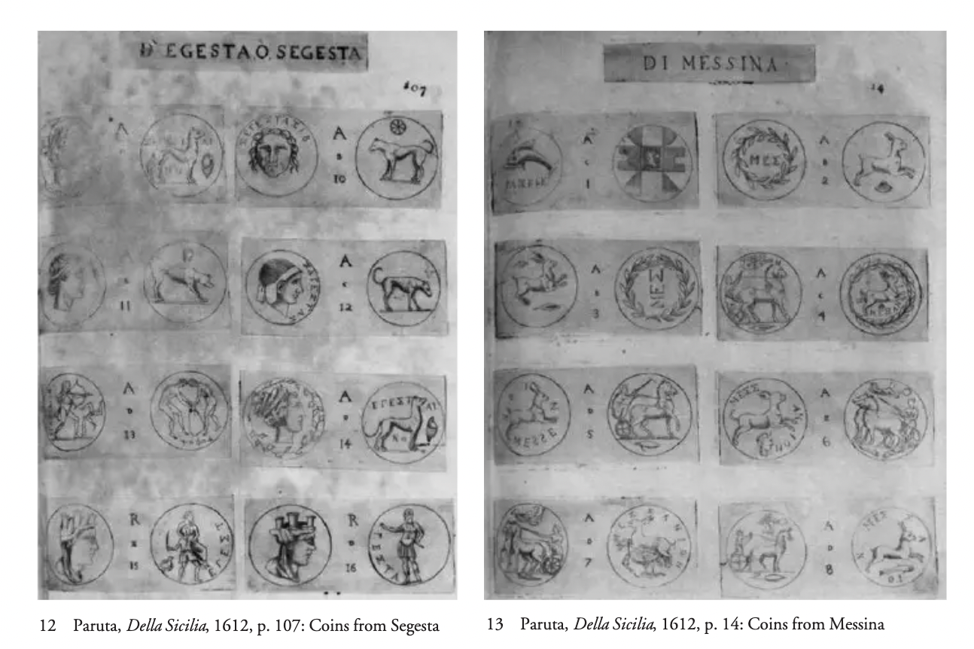
Notes:
Already knew back then the Zankle/Messana connection.

Slide 23
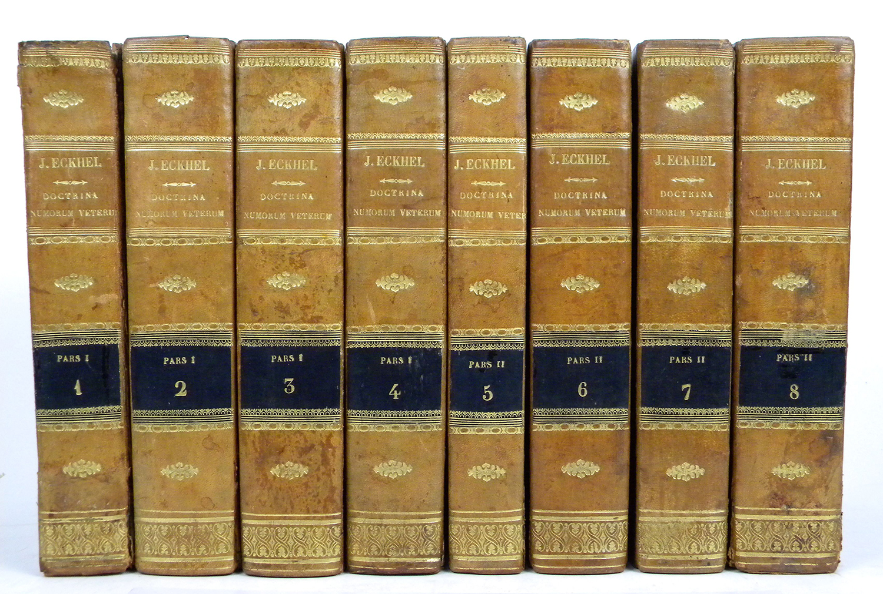
Joseph Eckhel
Doctrina numorum veterum (8 vols, Vienna 1792‒1798)
Notes:
Presented the geographical system in organizing Greek coins – what has influenced its adoption today.

Slide 24
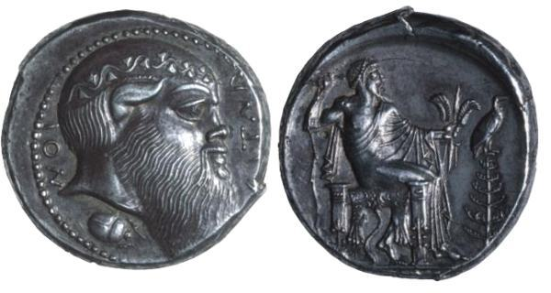
The market: the ‘coin of coins’
AR Tetradrachm of Aetna, from the same engraver as the Naxos series.
Aetna, Sicily, AR tetradrachm. 17.23 gr, 26mm. 476-431 BC. AITNAION, head of the satyr Silenos, bald and bearded, right, with pointed horse’s ear, and wearing a wreath of ivy wreath, beetle below / Zeus Aitnaios seated right on ornamented throne covered with a panther’s skin, himation draped over his left shoulder and arm, holding thunderbolt and a knotted vine staff bent into a crook at the top; to right a pine tree with an eagle perched on top. Hill, Coins of Ancient Sicily, P. 74 and Pl. 4, 13.
Now in Brussels coin cabinet, unique, said to be the most expensive/valuable coin in the world.
Notes:
In 476-475 BC, Hieron of Syracuse removed the inhabitants of Catana and Naxos from their homes, and replaced them by fresh citizens, drawn in equal proportions from Syracuse and Peloponnesus. The old inhabitants were removed to Leontini. Hieron renamed Catana Aetna
As B.V. Head wrote in 1883: >It can hardly be doubted that the Zeus here represented is the great god of Mount Aetna, the volcanic soil of which was especially favourable to the cultivation of the vine, whence perhaps the vine-staff on which te god rests his arm... It is noteworthy that across the throne of the god is spread the skin of a lion, or of some other mountain-bred beast of prey; but the most characteristic symbol on the reverse is undoubtedly the pine-tree with which, according to Diodorus, the slopes of Aetna were once richly clad... Seilenos, as we learn from Euripides satyric drama Kyklops, was enslaved by Polyhemos, and dwelt in the caves of Aetna with his savage master. More generally the head of Seilenos may be taken as pointing to the cultus of Dionysos, who, as we know from other coins, was especially revered at Catana; but, as if still further to specialise the locality, the artist has placed beneath the head of Seilenos one of those huge scarabei for which Mount Aetna was celebrated.

Slide 25
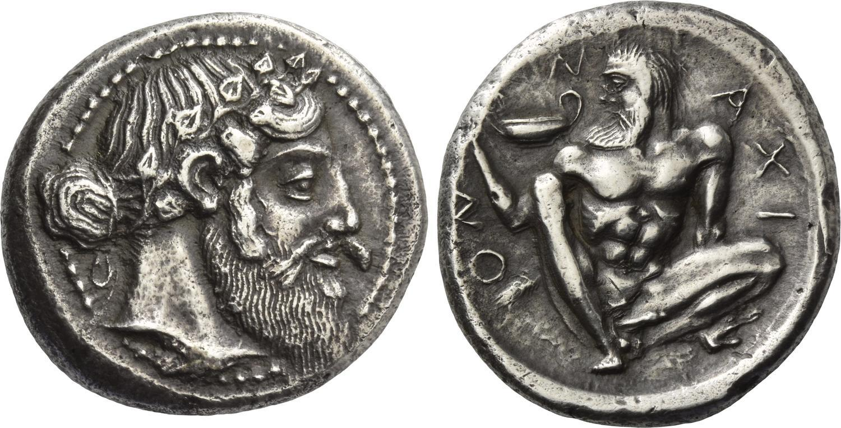
‘Aetna master’
One example sold $994,500 in early 2012 as part of the Prospero Collection sold Jan. 4 by the New York Sale consortium (Baldwin’s, Dmitry Markov and M&M Numismatics).

Slide 26
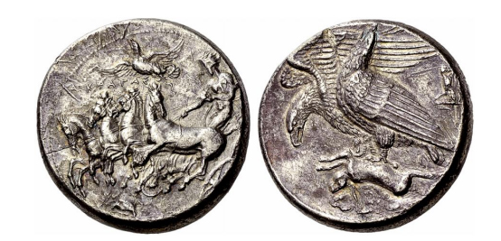
decadrachm of Agrigentum
$2,918,810 U.S

Slide 27
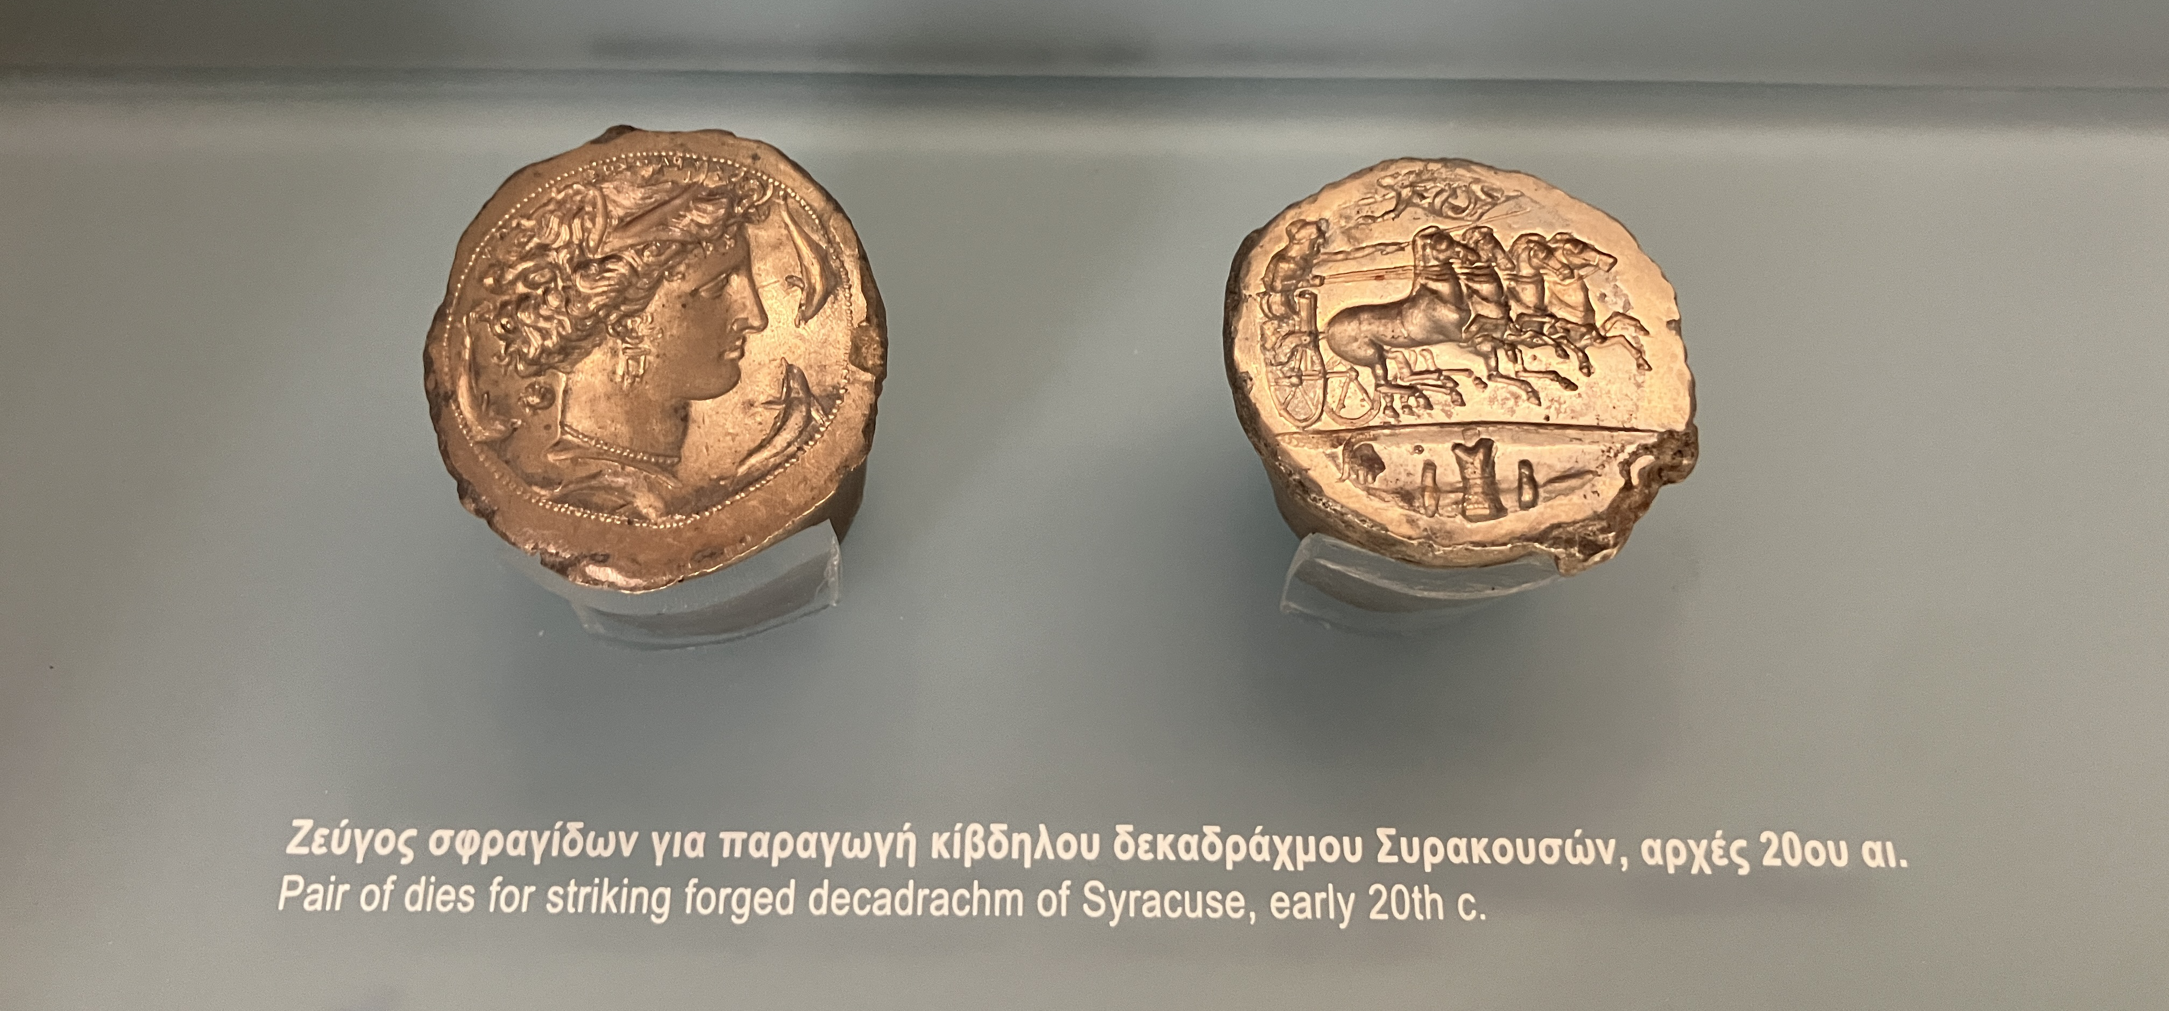

Slide 28
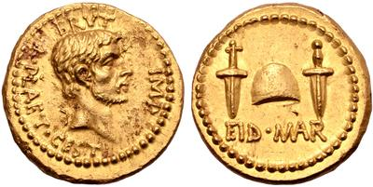
Gold EID MAR denarius
One of three examples known, said to have a pre WWII provenance – “From the collection of the Baron Dominique de Chambrier”.
May 31 by Numismatica Ars Classica - sold for $4,174,950.

Slide 29
Repatriation
The provenance found to be invented for the EID MAR gold coin and a Naxos tetradrachm that sold for $291,682. Both coins were given the same provenance:
‘From the collection of the Baron Dominique de Chambrier, original attestation of provenance included; ex collection of Bernhard de Chambrier (1878-1963) and Marie Alvine Irma von Bonstetten (1893-1968); ex collection of Baron Gustave Charles Ferdinand von Bonstetten, Chamberlain to Ferdinand I, Emperor of Austria’.
Richard Beale, Roma nunmismatics, arrested in New York: unlawful acquisition of coins from Italy, Greece and the Gaza strip. Italo Vecchi named as co-conspirator.
Naxos coin repatriated to Italy
EID MAR coin recently repatriated to Greece.
Notes:
Vecchi the one who gave Beale the coins in 2013 and 2014, Beale tried to sell them in 2015.
Why Greece? Thought to have been produced with a mint moving with Brutus so this region.\
‘is thought to have been looted from a field where an army loyal to Brutus camped during the struggle for control of Rome’.

Slide 30
Coins were and are still considered
Works of art
They are
Produced by engravers
It is derived from Greek antiquity
The expectation to have beautiful, well-worked and fine in their details coins

Slide 31
Political union
Materialised in the issuing and circulation of the same currency: common monetary zone
Monetary expansionism as a form of political prevalence, e.g. the dollar in the second half of the 20th century

Slide 32
Money and the state
State as a guarantor of the money: genuine, acceptance in the market
Mintmark or the signatures/signs of the mintmaster
Coinage and its imagery as symbols of power , cf. Mark XII, 13-17 = Testimonia Numaria A22
The image of sovereigns on the coins – even on Euro coins (!)

Slide 33
Blockchain, tokens, and ancient Greek tokens/democracy
Agora: voting papers registered on a blockchain which could then validate and tally the results. Sierra Leone for presidential election.
Explicit invocation of the governmental systems of ancient Athens
‘The story of fifth century Athenian tokens and voting by allotment is a story of aristocrats competing over the demos and the long hold of a politics of honour in the process of transforming into a politics of civic virtue. Blockchain projects, by misrecognizing their own nature and reading into themselves their own libertarian version of the Agora, miss the relationships of hierarchy subtending them. They thus also displace the possibility of virtue onto a flattened out idea of direct democracy which was never obtained in Athens in the way they imagine.’ Maurer p. 217
Notes:
Greek Agora as a ‘meeting and market place’

Slide 34
Other ideas?

Slide 35
Further Reading
Cribb, J., 2003. ‘The origins of the Indian coinage tradition’, South Asian Studies, 1-19.
DuPont, Q., Gkikaki, M., Rowan C. (2020). ‘DAO, Blockchain and cryptography: a conversation with Quinn duPoint’, Warwick Exchanges 7(3), 103-117
Kagan, J., (2013) ‘Notes on the study of Greek coins in the Renaissance’ in U. Peter and B. Weisser (eds), Translatio Nummorum. Römische Kaiser in der Renaissance, Berlin, 57-70
Mørkholm, O. 1979-80. ‘A history of the study of Greek numismatics’, Nordisk Numismatisk Årsskrift p. 5-21.
Maurer, B. 2019. The politics of token economics, then and now, in Crisà, A., Gkikaki, M.,and Rowan C., (eds),Tokens. Culture, Connections, Communities, London: Royal Numismatic Society Special Publication No. 57, pp.215-229. https://numismatics.org.uk/wp-content/uploads/2020/01/Tokens_ed_crisa_gkikaki_rowan.pdf
Rowan, C. (2019) ‘Money and the Issues of the Age’, in S. Krmnicek (ed.) A Cultural History of Money in Antiquity, Bloomsbury, London, 141-160
Yang, B., (2011) ‘The rise and fall of cowrie shells: the Asian story’, Journal of World History 22, pp. 1-25

