Slide 1
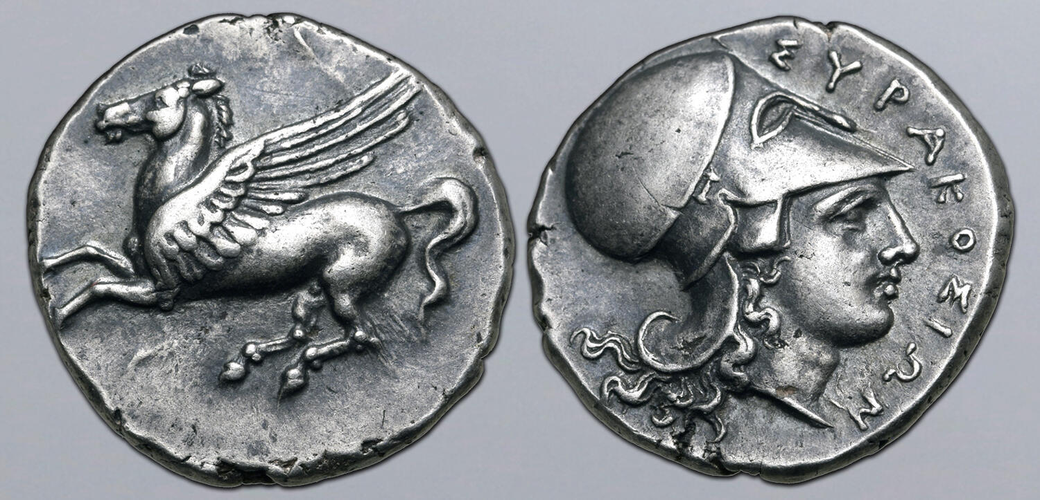
A numismatic orientation

Slide 2
What roles does money play in society?
Notes:
Unit of account
Store of value
Unit of exchange
Commensuration between cultures
Shaping community and identity
A democratic element?
Power relations / hierarchy
Shape society and structures

Slide 3
You have each received 2 coins….
Towards the end of the course you will need to make 2 x presentations of UP TO 5 mins (each presentation should be on one coin). In the presentation you should present:
The coin (identification and description)
Points of interest you have discovered from research the coin
NB: this is meant to be an opportunity to develop identification and research skills, and handle more coins – a relaxed exercise. :-)
There are two sessions in the programme for you to work on the presentation/identification.

Slide 4
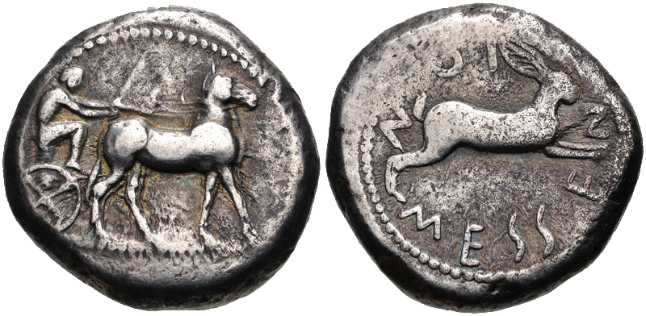
obverse
type
field
legend
exergue
reverse

Slide 5
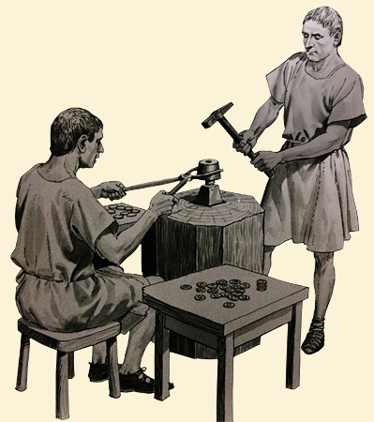
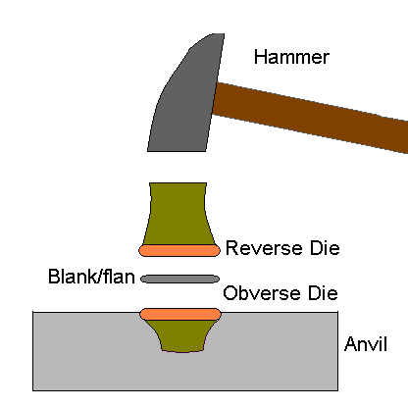

Slide 6
Describing a coin
Mint
Date
Authority
Denomination
Reference
Syracuse, Sicily, AR Stater, c. 343-317 BC.
Obverse: Pegasus flying l.
Reverse: Head of Athena r. wearing Corinthian helmet, ΣΥΡΑΚΟΣΙΩΝ around.
Weight: 8.56g
Diameter: 21mm
Die Axis: 12h
SNG Copenhagen 711-12, SNG ANS 494-5
Notes:
Why record the die axis? What would this reveal?

Slide 7
Abbreviations
AV: gold
AR: silver
AE: aes / bronxe
El: electrum
Bi: billon

Slide 8
Terminology
Authority: the formal guarantor of the value of a coin (e.g. city, king, governor)
Ethnic: a legend indicating a collective group of people (usually the citizens of a city) acting as the authority behind a coinage
Control Mark: a symbol indicating some aspect of coin production
Issue: a specific subsection of phrase of coin production (identifiable by a specific control mark or mint magistrate’s name)

Slide 9
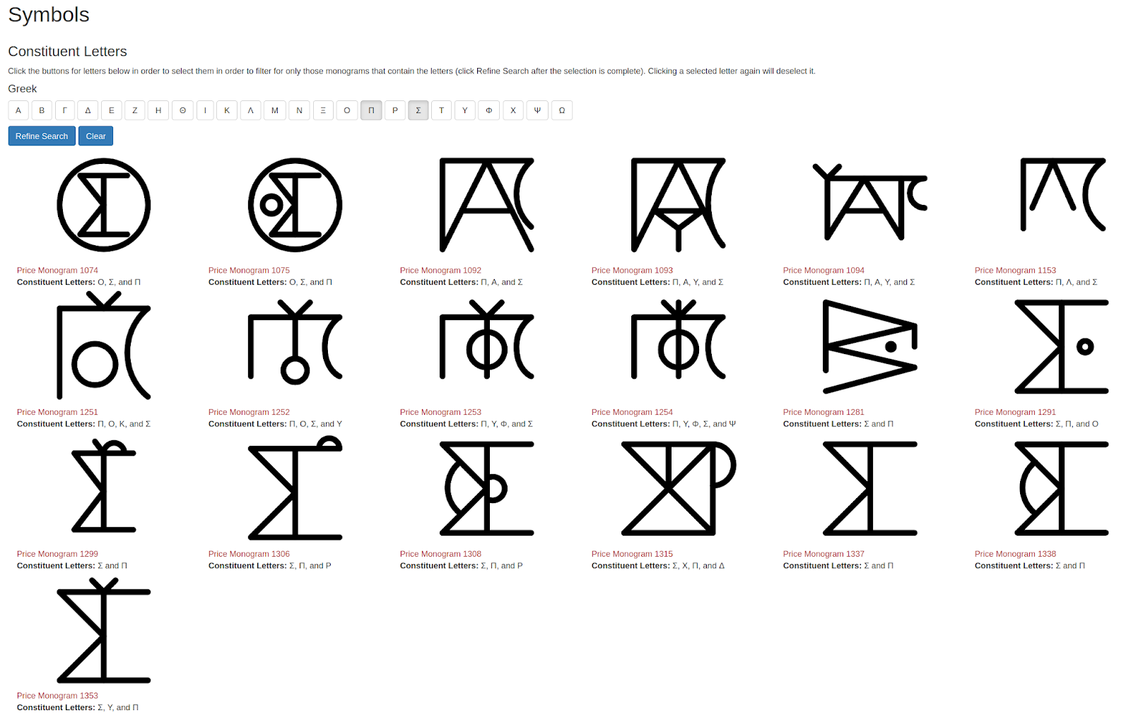
Monogram

Slide 10
Denominations and Weight Standards
Stater divided into halves, sixths, etc
Staters weighed different amounts in different weight systems (e.g. Euboean standard had a stater of 17.2, Milesian stater was 14.2g).

Slide 11
Standards
A standard coin unit and divisions.
5th century BC Greece: stater, divided into halves, sixths (hektai), twelfths, twenty-fourths, and (sometimes) forty-eighths.
e.g. Euboean standard: stater of 17.2g and hekte of 2.86g
Phokaian standard (electrum): stater of 16.1g and hekte of 2.68g
Aeginetan Standard: stater of 12.4g, half stater (drachma)
Attic Standard: tetradrachm of 17.2g with a drachma 4.3g, obols of 0.72g. Large monetary sums were expressed as mna (mina) or talents. At Athens the mina = 100 drachmas (435g) and talent was 60 minas (26.1 kg).
Notes:
Sometimes coin weights and weights for other goods the same, sometimes they diverged.

Slide 12
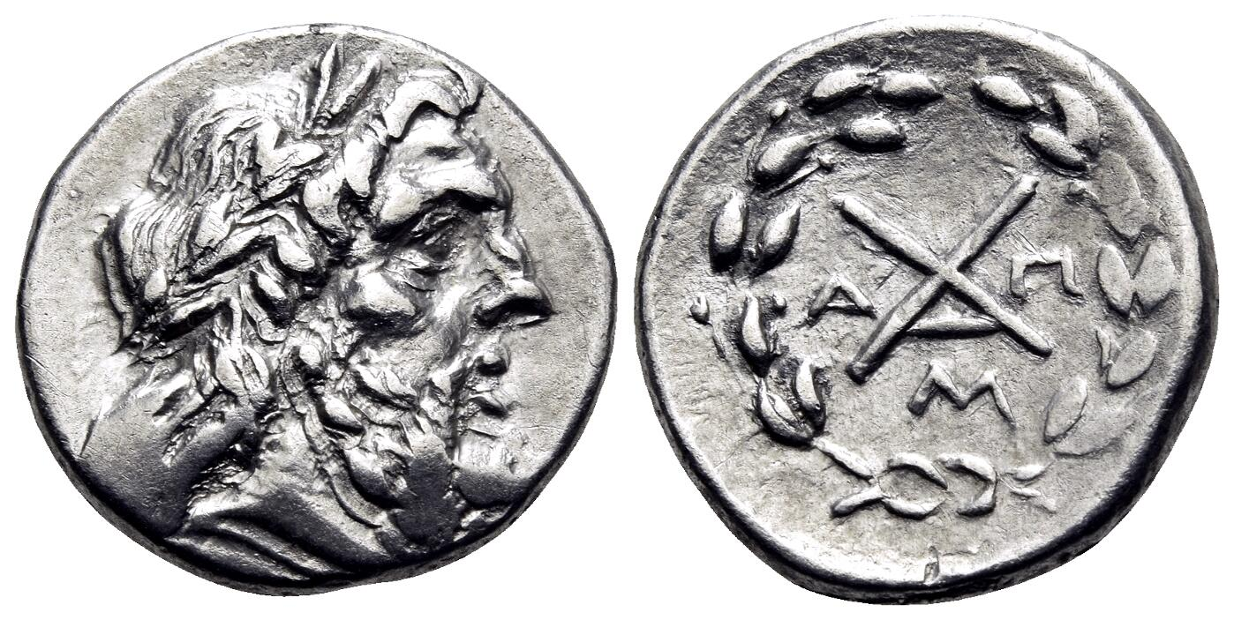
Polybius 2.37.10 (Achaean League)
For while many have attempted in the past to induce the Peloponnesians to adopt a common policy, no one ever succeeding, as each was working not in the cause of general liberty, but for his own aggrandizement, this object has been so much advanced, and so nearly attained, in my own time that not only have they formed an allied and friendly community, but they have the same laws, weights, measures and coinage, as well as the same magistrates, senate, and courts of justice, and almost the whole Peloponnesus falls short of being a single city only in the fact of its inhabitants not being enclosed by one wall, all other things being, both as regards the whole and as regards each separate town, very nearly identical.
Notes:
Monogram of Achaean League, This specimen from Messene.

Slide 13
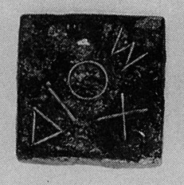
Weights at the Sanctuary of Zeus at Olympia
Initially Aeginetan weight standard (mina of 70 Aeginetan drachms = 435g) (commonly used in the Peloponnese)
Later weights on the Athenian standard added (mina of 105 Athenian drachms = 457g). 420 BC (connected to Elis’ relationship with Athens).
https://pondera.uclouvain.be/
Notes:
300 bronze balance weights excavated at the sanctuary, inscribed with the name of Zeus. Belonged to sanctuary, who rented them out to merchants during large festivals
Dios – of Zeus. Chi below added to Attic weights to distinguish them from those on the Aeginetan standard.
\Attic weight standards now being used at a large panhellenic festival. Easier/more welcoming for the merchants from the Athenian arche.

Slide 14
IG XII 2, 1 (Mytilene and Phocaea)
“...let what both cities agree to inscribe on the stele or erase, be valid. He one who mixes the gold is to be legally responsible in both cities. As judges there are to be for the one who mixes at Mytilene, more than half of the officials at Mytilene, and at Phokaia more than half of the officials at Phokaia, and an audit is to take place when a year has ended, within six months; and if anyone is convicted of mixing the gold too weakly willingly, he is to be punished with death, and if he is found not guilty of willingly erring, let the court decide what is a fitting penalty for him to suffer or pay, and the city is to be guiltless and free from penalty. The Mytilenaeans drew by lot the right to strike first, beginning in the prytany following that of Kolonos, and at Phokaia, following that of Aristarchos”
Notes:
Minting of coins co-operatively
EL hektai, minted 521-326 BC. But never shared designs. Economic reasons?
425-375 BC.

Slide 15
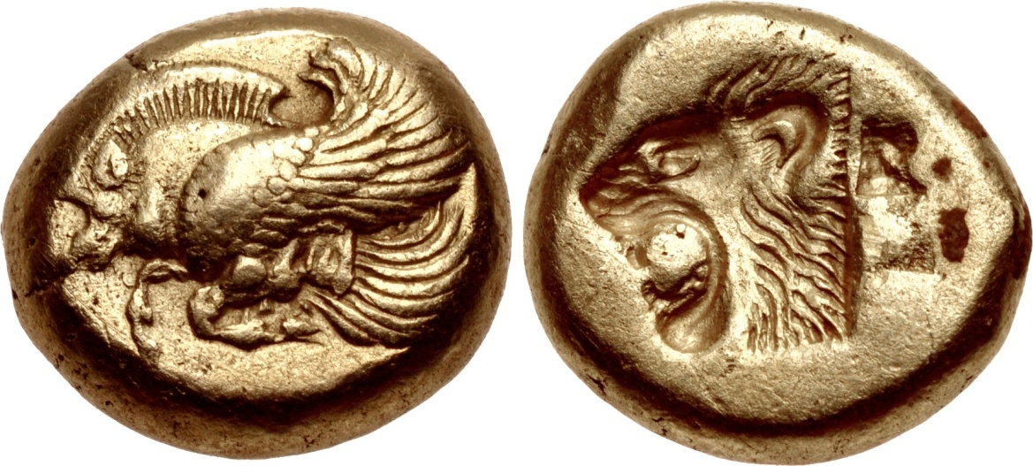
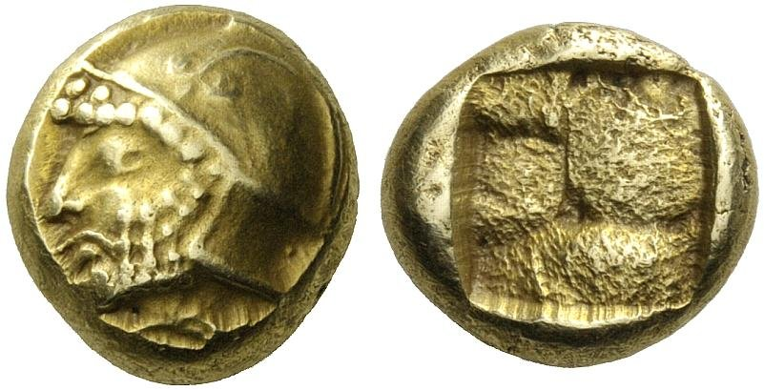
Mytilene, EL hekte, 2.49g, c. 521-478. Bodenstedt Em. 6 . Forepart of winged boar / incuse head of lion, rectangular punch behind.,
Phocaea, EL hekte, 2.6g, c. 521-478 BC. SNG von Aulock 2643.
Helmted head of Ares, seal below / incuse

Slide 16
Reasons for changes to (or continuing) metrology
Notes:
New markers/areas encountered – e.g. Carthage, golf for trade, silver for mercenaries
Power – e.g. Athenian empire
Make more money – economic issues.
Importing coinage/silver – e.g. overstrikes on Pegasi in southern italy

Slide 17
Standard Reference Works
HN (outdated but still comprehensive): Head, B.V. (1911, 2nd. ed.) Historia Numorum (Oxford)
HN³ Italy: Rutter, N.K. ed. (2001), Historia Numorum. Italy (London, British Museum Press)
SNG - Sylloge Nummorum Graecorum. (various museum collections) (e.g. SNG ANS 34) (http://www.unionacademique.org/en/publications?project=29)
http://www.sylloge-nummorum-graecorum.org/ (database of the coins in British collections)
BMC Italy (etc.). Poole, R.S. ed. (1873-1927 (Reprint Bologna 1963-1965) A catalogue of the Greek Coins in the British Museum, 29 vols (London).
Dictionary of terminology and references: https://www.forumancientcoins.com/numiswiki/view.asp
Notes:
Also books dedicated to various mints.

Slide 18
Online Resources
Auctions
Coinarchives https://www.coinarchives.com/a/
https://www.acsearch.info/
Museum catalogues online
ANS http://numismatics.org/search/
British Museum https://www.britishmuseum.org/collection
Münzkabinett Berlin https://ikmk.smb.museum/home?lang=en
Bnf: https://catalogue.bnf.fr/index.do (also Gallica)
IRIS (Greek coinage online): https://greekcoinage.org/iris/results

Slide 19
Online resources
To locate bibliography
https://donum.numismatics.org/
Published corpora online:
https://numismatics.org/resources/

