Slide 1
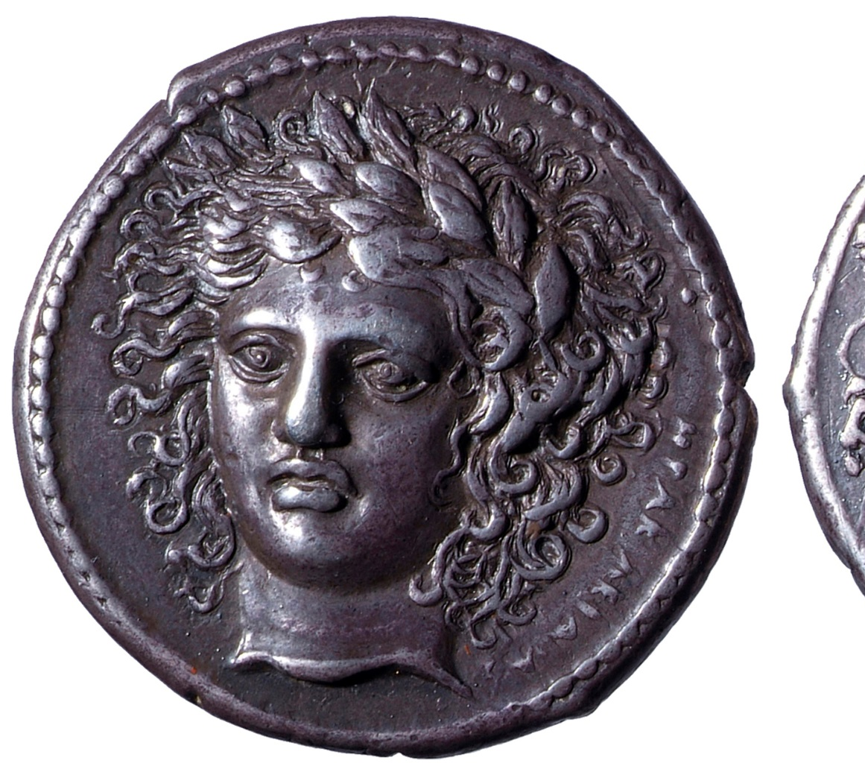

The ‘Signing Arists’ Coinage of Sicily

Slide 2
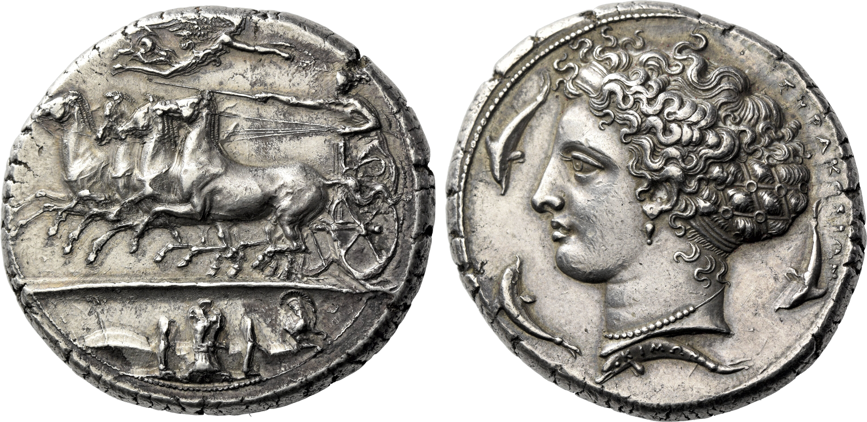
Decadrachm signed by Kimon circa 405-400, AR 36 mm, 43.34 g.
Notes:
Small size and hidden nature of some of the signstures suggest these are die engravers rather than magistrates.
Some signatures appear at more than one city – also in favour of die engravers rather than magistrates.

Slide 3
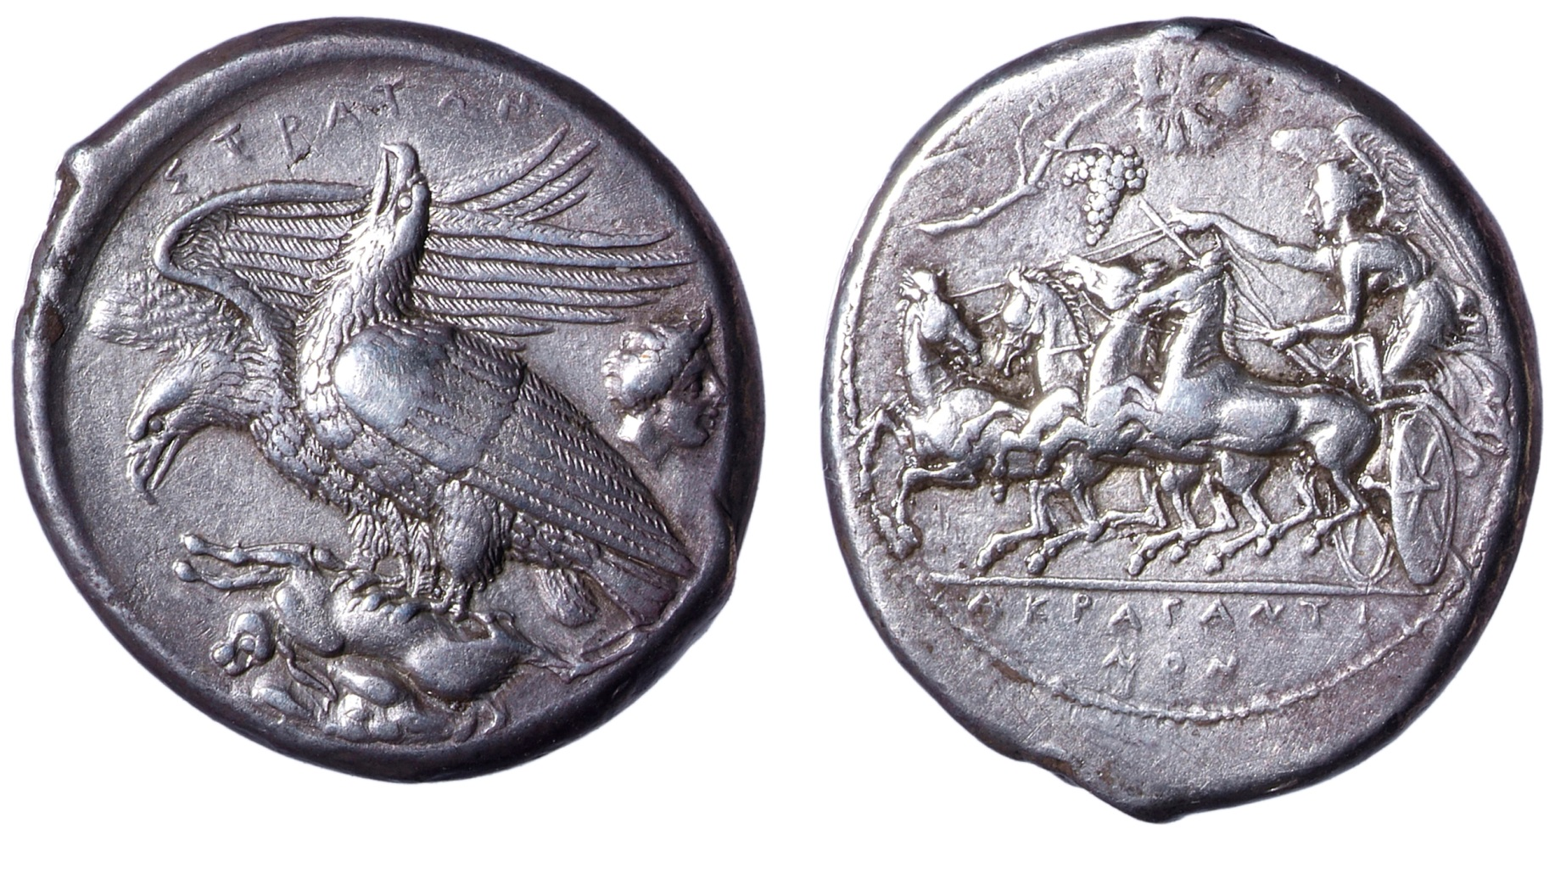
Akragas, Straton
Notes:
Bigger signature – could possibly be a magistrate. Also Silanos on the coins of Akragas.

Slide 4
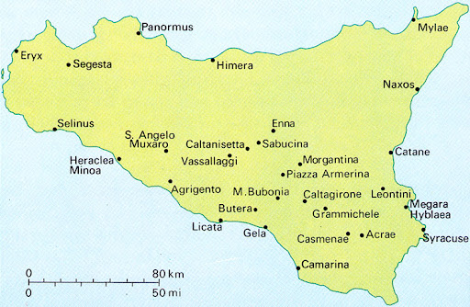
End of 5th century BC
Signing artists
Intensity of the phenomenon unique
Why?
Different contexts posited:
Defeat of Athenian invasion 413 BC + associated wealth. Date also matches Syracuse’s relationship with Kamaria.
Trophies associated with particular festival games
Style also used
Hoards and wear used for dating
Extensive die links suggest an intense and short period of minting in Syracuse
405 BC: Dionysus as tyrant
Katane, Kamarina, Syracuse, Himera, Akragas, Naxos, Messana
Notes:
But can we connect to historical events? So much going on i Sicily at this time.

Slide 5
How do we explain this phenomenon?
Historical context/impetus?
A ‘community’ of engravers?
Competition among engravers?
Exposure and openness to outside influences?
Sponsorship; the commissioning of works?

Slide 6
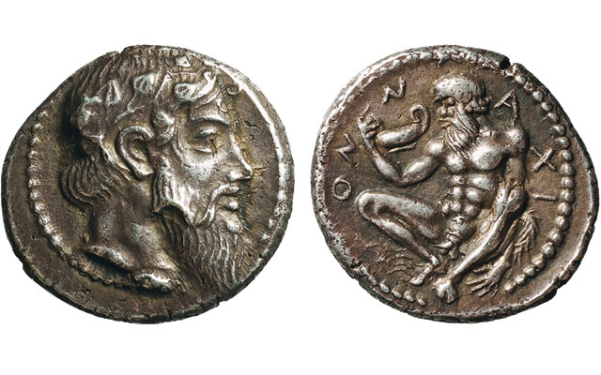
Community of craftsmen: ‘Aitna Master’, 460s
Notes:
High quality die engraving known before the emergence of the signing artists.

Slide 7
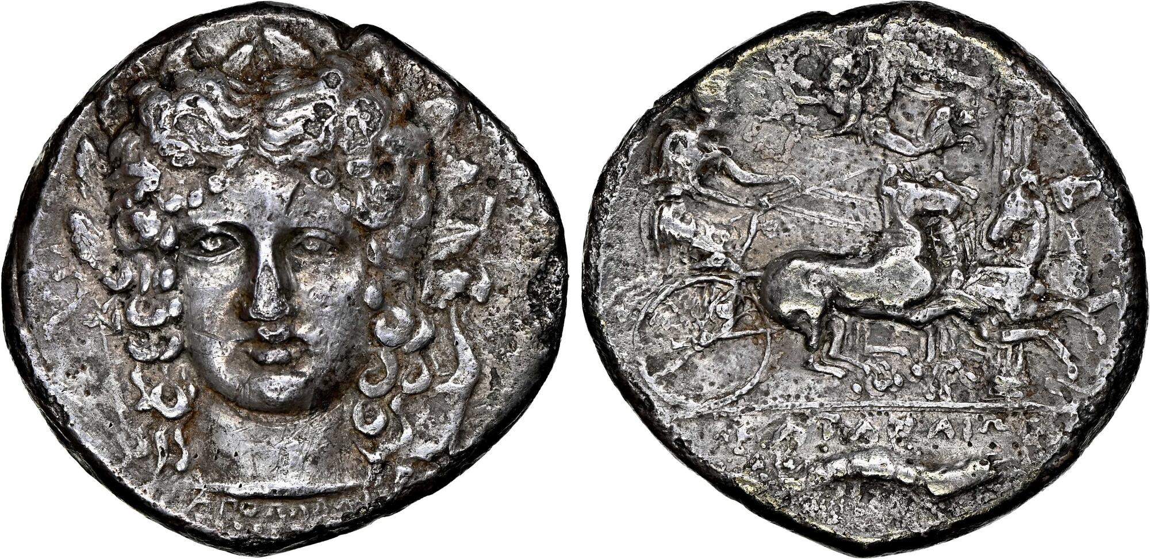
Katane destroyed in 402 BC
Ognina Hoard (IGCH 2120)
Buried 390 B.C.-380 B.C.
Rutter: buried shortly before 402 BC
Tetradrachms signed by Choirion had very little wear
Laureate head of Apollo facing very slightly left; [XOIPIΩN to outer left], bow to left, lyre to right / Charioteer, holding kentron and reins, driving quadriga right which begins to round column in background; above, crowning Nike flying left; in exergue, crayfish right.

Slide 8
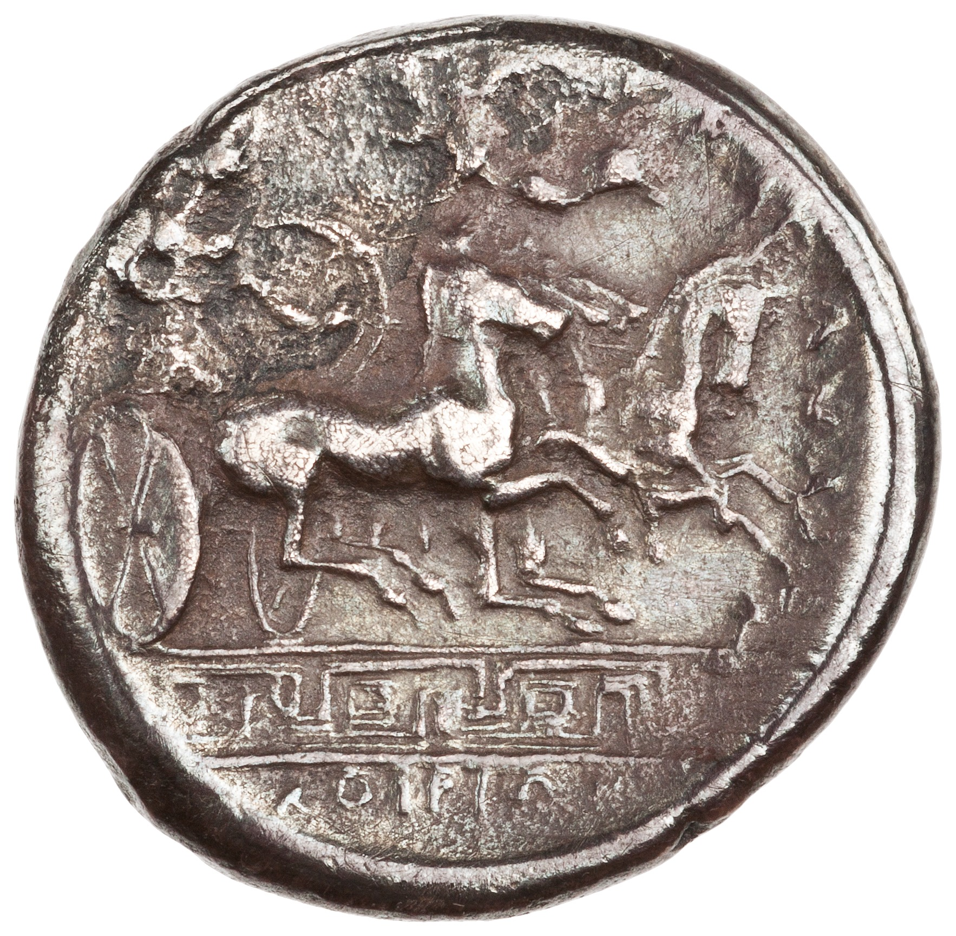
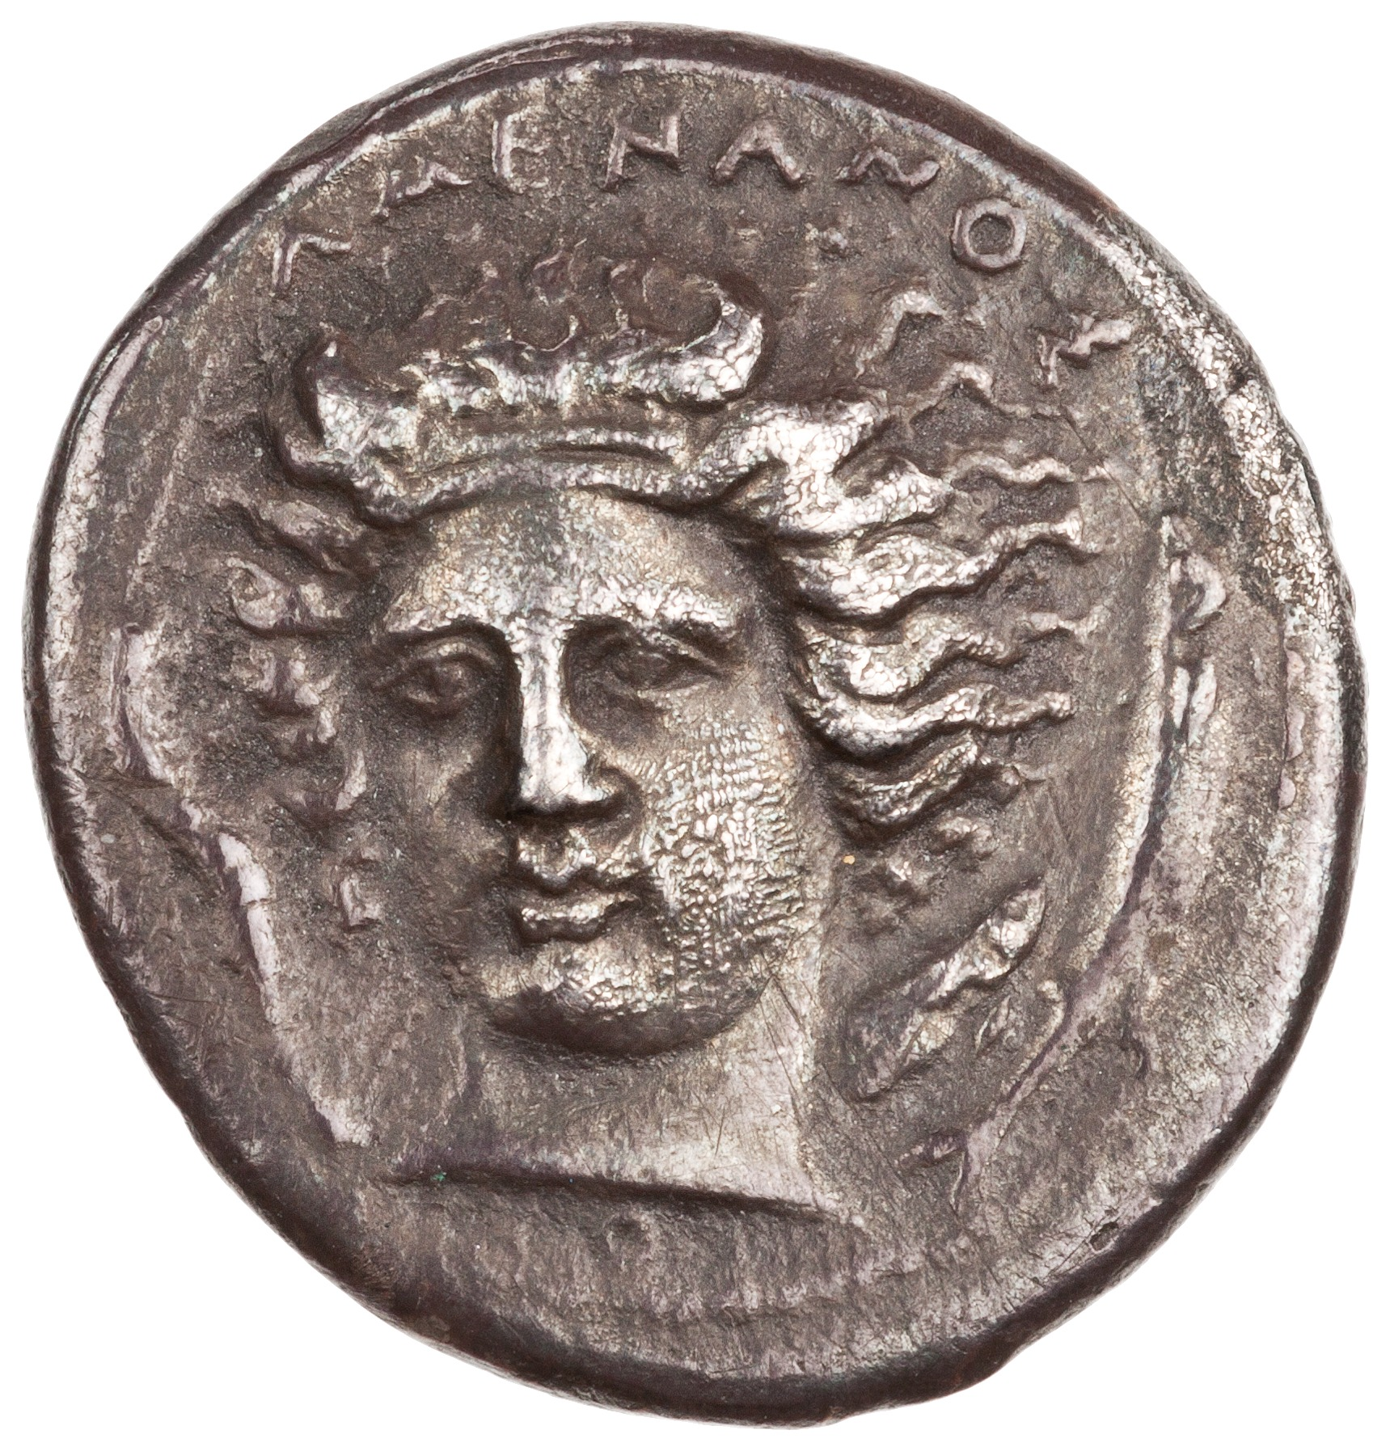
AMENANOS - Head of river-god Amenanos in three quarter view to l. flanked by two fish.
KAT...O... XOI - Athena in quadriga to r.; meander below exergue line; signature of Choirion below.
http://numismatics.org/collection/1997.9.85

Slide 9
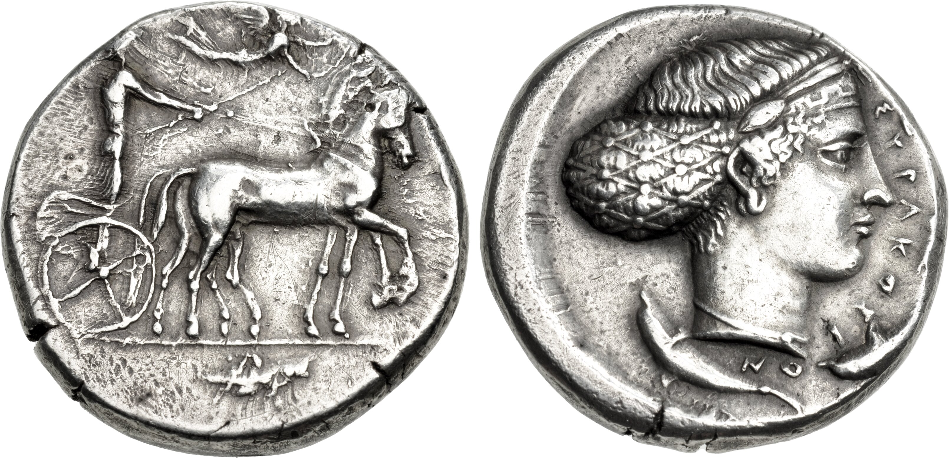
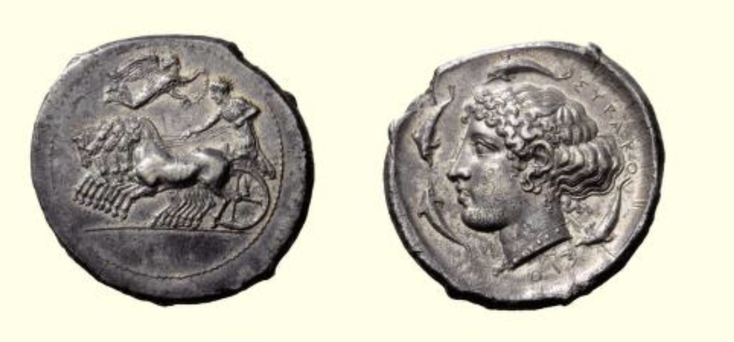
Sosion and Eumenes
AR tetradrachm, c. 420-415
AR tetradrachm, c. 415-405 BC, Syracuse.
Fast quadriga drivel left by charioteer, Nike flies above to crown him /
Head of Arethusa with necklace, earrings and ampyx, ΣΥΡΑΚΟ ΣΙΟ Ν, four dolphins around
Notes:
Horses now shown at a gallop, bujt the style is somewhat rigid still – the legs are all still together
The oldest coins of Syracuse copy an anonymous northern Greek coinage, which was once attributed to Olynthos. The imitation is not confined only to the coin's type—a quadriga—but adopts its weight standard as well, which corresponds to that of the Euboean stater and Athenian tetradrachm
Although a borrowed image, the quadriga on the coins of Syracuse is emblematic of the culture and self-image of the minting authorities of the city. Both the Gamoroi, the ruling class of large landholders, and later the tyrants considered and presented themselves as wealthy men of leisure with expensive predilections, horse-racing preeminent among them.
The horse-teams of several Sicilians, among them tyrants such as Hieron I and Dionysios I, won victories at the Olympic Games. The prestigious image of the quadriga was supplemented by a mythical figure, the fountain nymph Arethusa.
Collaboration? Or perhaps die engravers worked independently, unaware their creations would be paired in the mint.

Slide 10
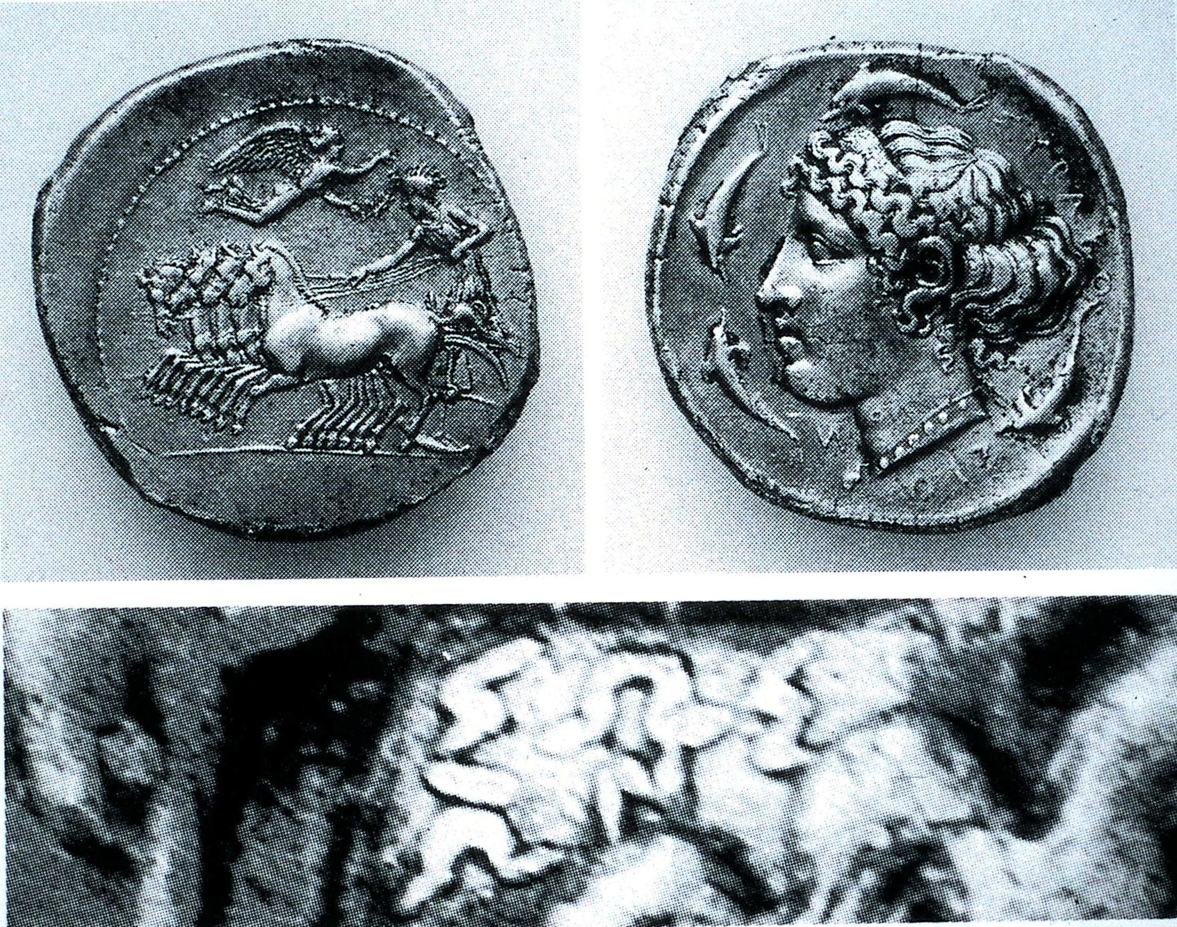

Slide 11
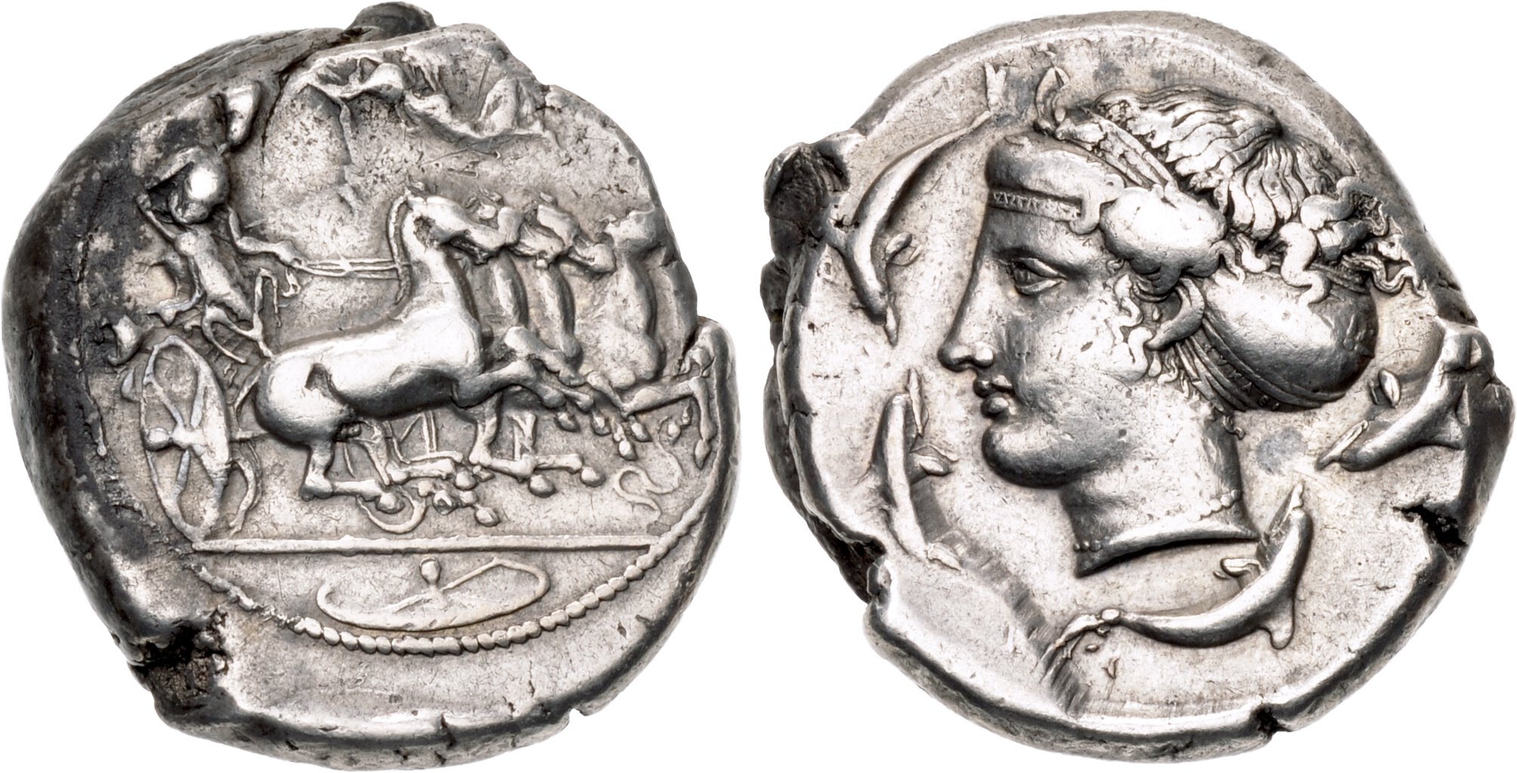
Euainetos and Euklei[das].
Notes:
EYAINETO in tiny letters on exergue line (only a trace visible)

Slide 12
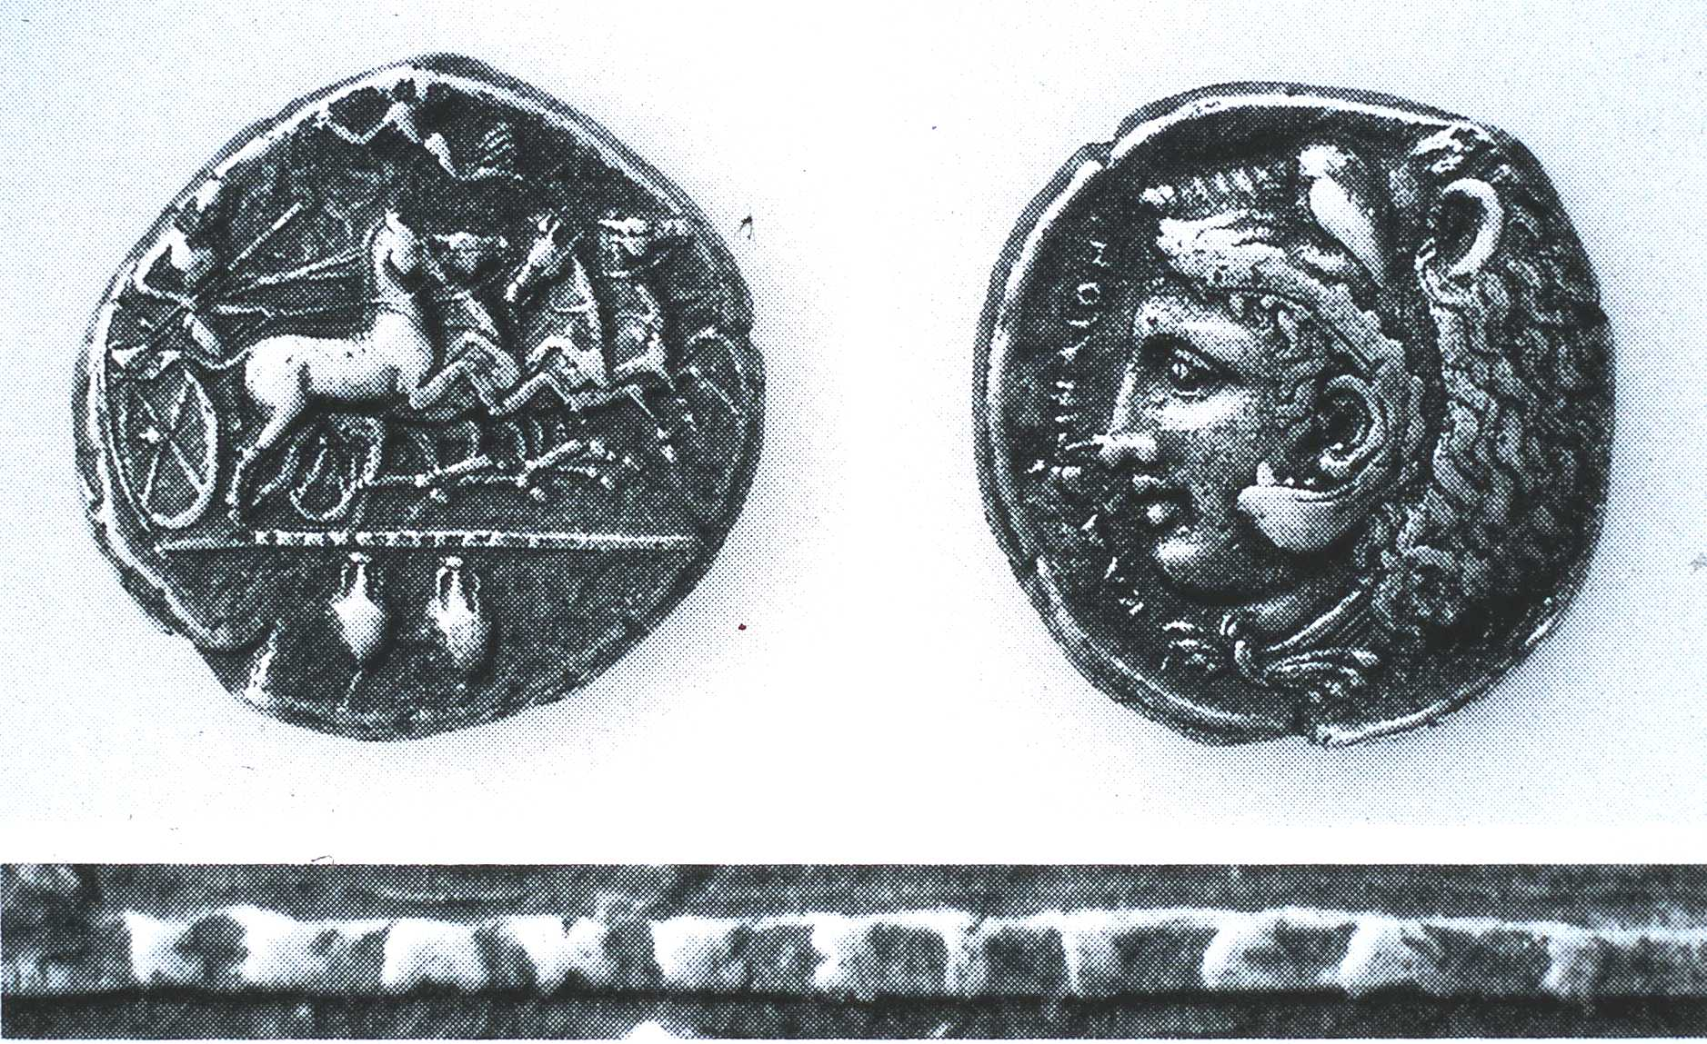

Slide 13
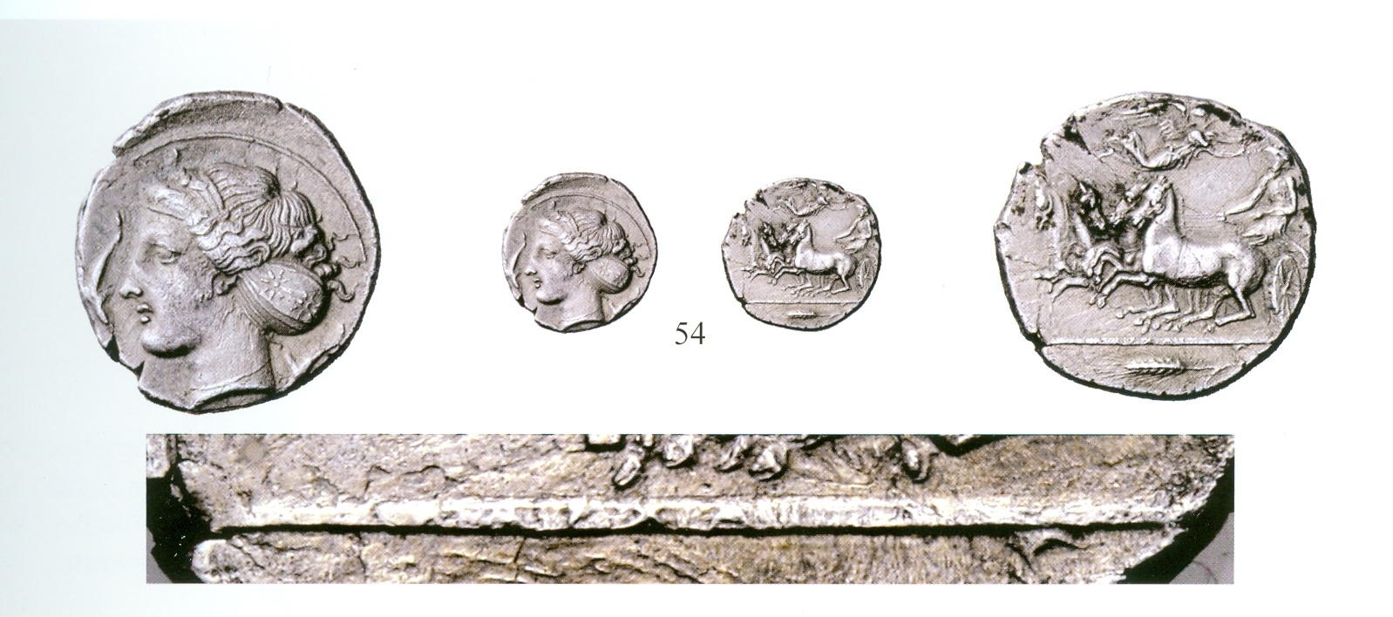
[EY]APXI[ΔAΣ]

Slide 14
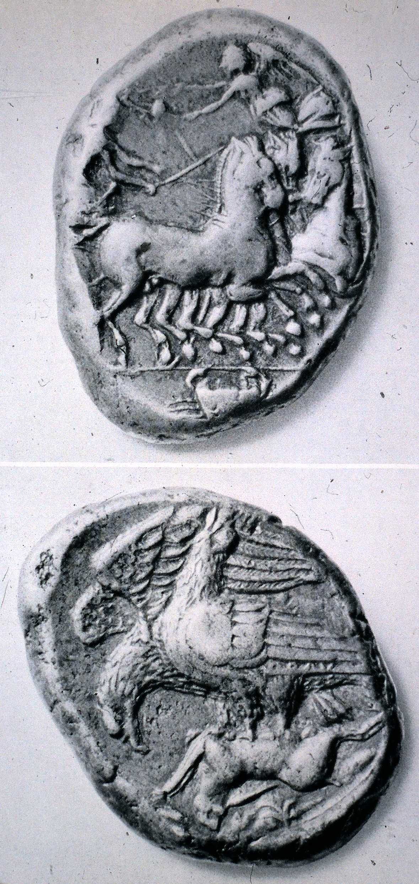
Notes:
If there were rules determining which dies could be signed and which not,
or when signatures could be written fully and when partially, or which could
be strongly cut and overtly displayed and which subtly cut and concealed, we
do not know them
No signed statues known from Sicily.
In the end, the conceit of
signing one’s name only to abbreviate it or virtually hide it in a headband or in
the ornaments of a helmet or on an eagle’s wing is charming but curious.
What,
after all, was the point of signing something with a name that is not all there or
that is deliberately hard to find, unless the practice reflects, paradoxically, not
only the impulse to sign and take credit for the work but also a reluctance to
be too bold in declaring one’s identity on a public instrument issued by or in
the name of the state? Pride may be tempered by prudence here. But perhaps
the real motive was to involve the owner of the coin by tantalizing him, by
encouraging him to complete the name or extract it from the image, evoking
an almost playful act of discovery that ultimately emphasizes the artist’s name
and the brilliance of his work rather than understates them.
Must have been civic pride in terms of having these die engravers working for them and producing pieces of this quality.

Slide 15
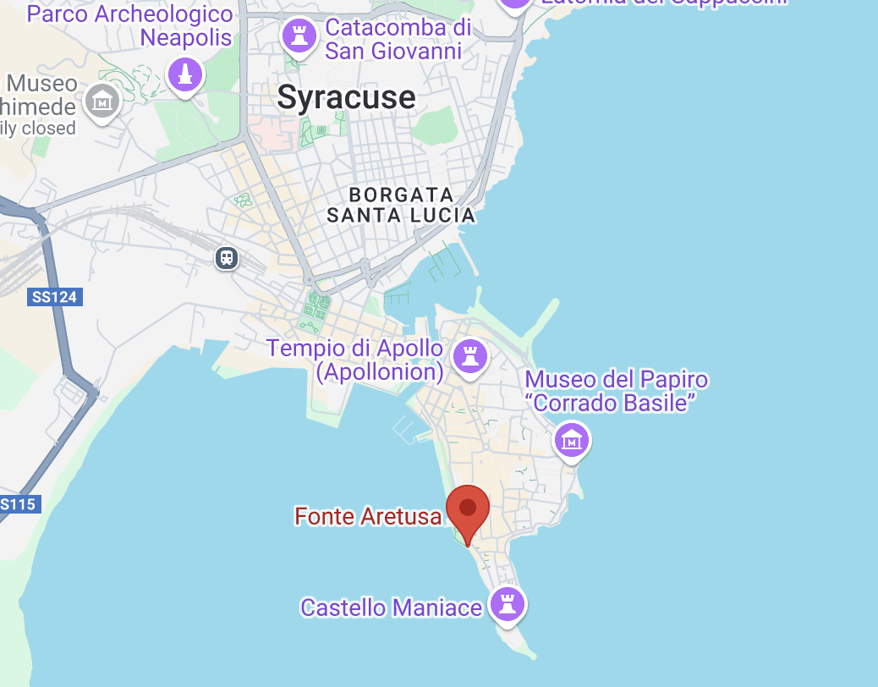
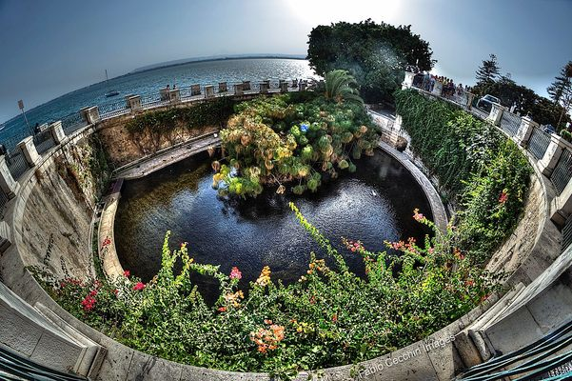
Arethusa
Notes:
Natural spring

Slide 16
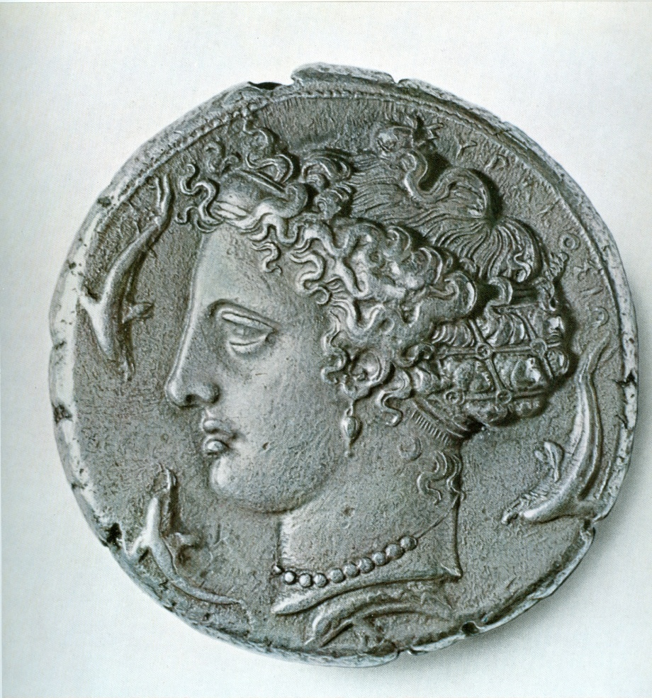
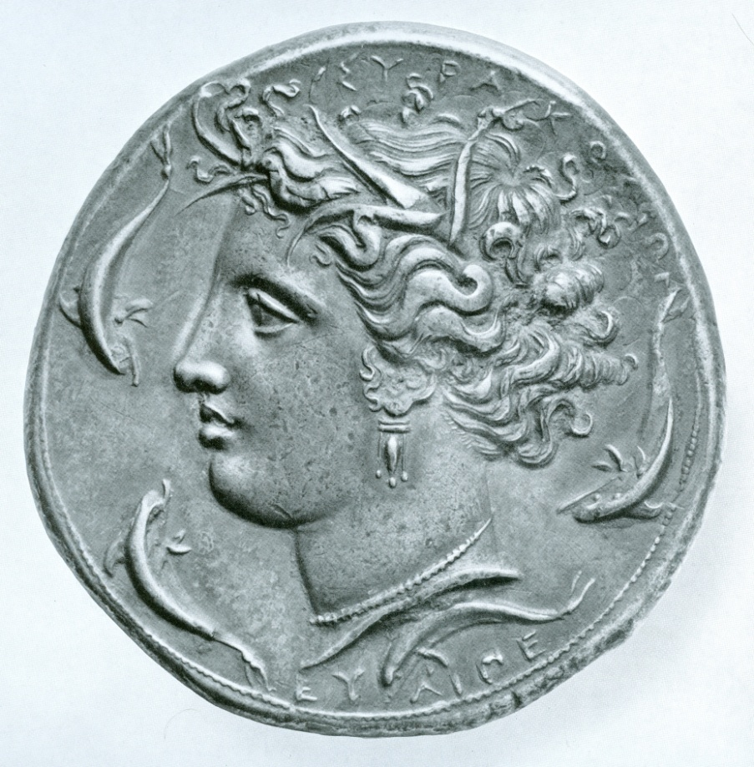
Competition among engravers?

Slide 17
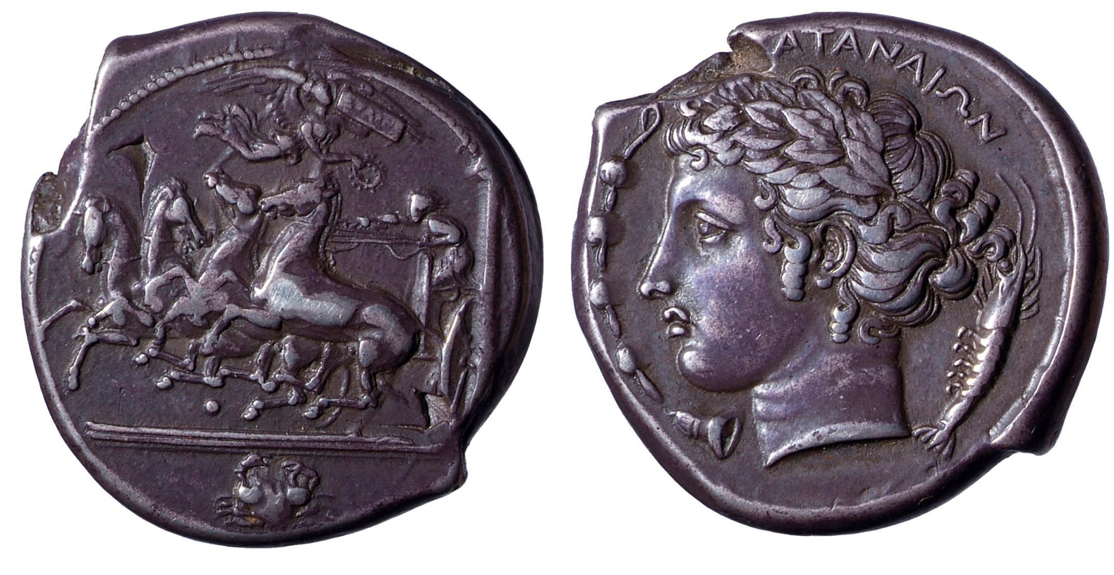
Euainetos, Katane
Notes:
Turning post

Slide 18
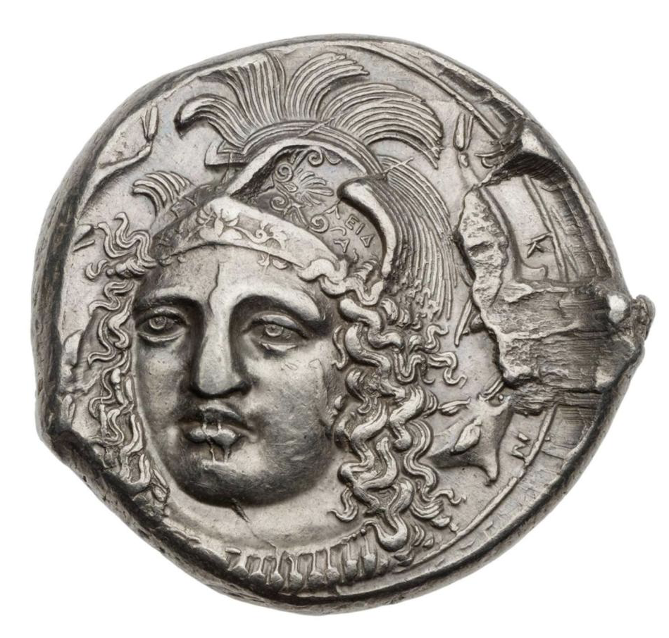
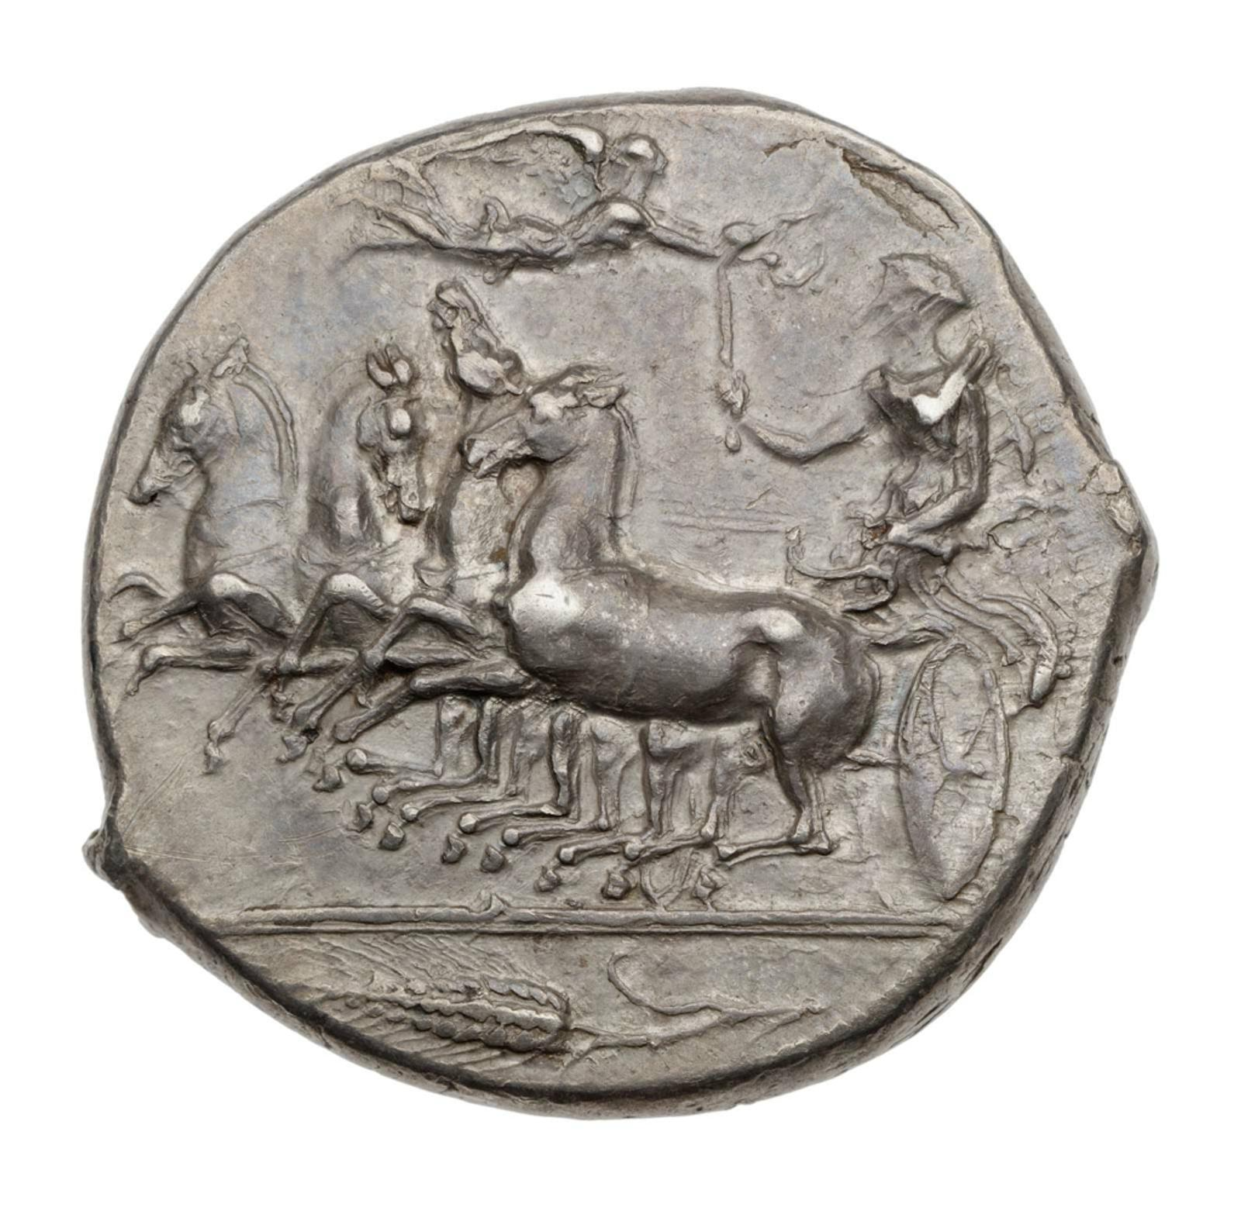
Syracuse, signed by Eukleidas. From Ognina Hoard, 1923, Noe, N.N.M., No. 78, p. 197, no. 749.
http://collections.mfa.org/objects/1195/tetradrachm-of-syracuse-with-quadriga-signed-by-eukleidas

Slide 19
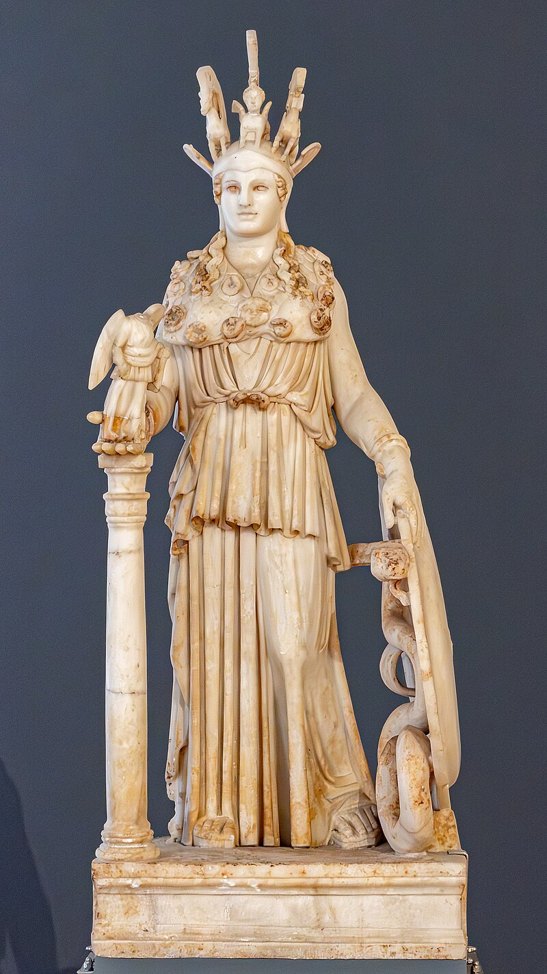
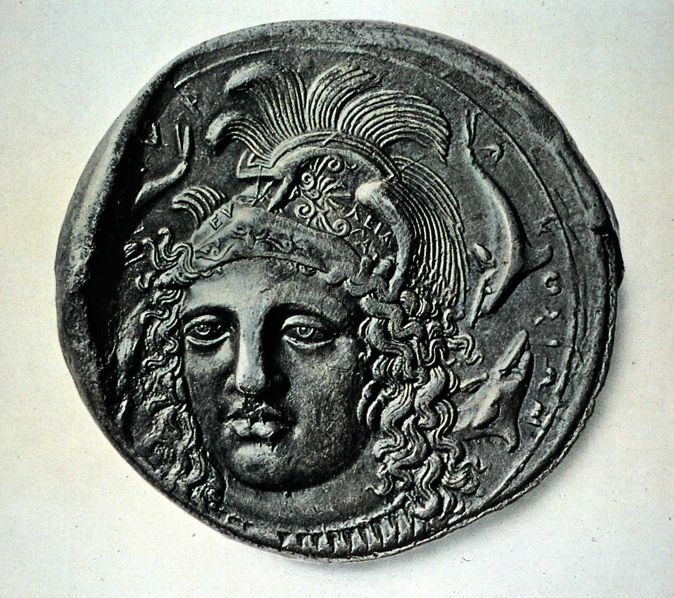
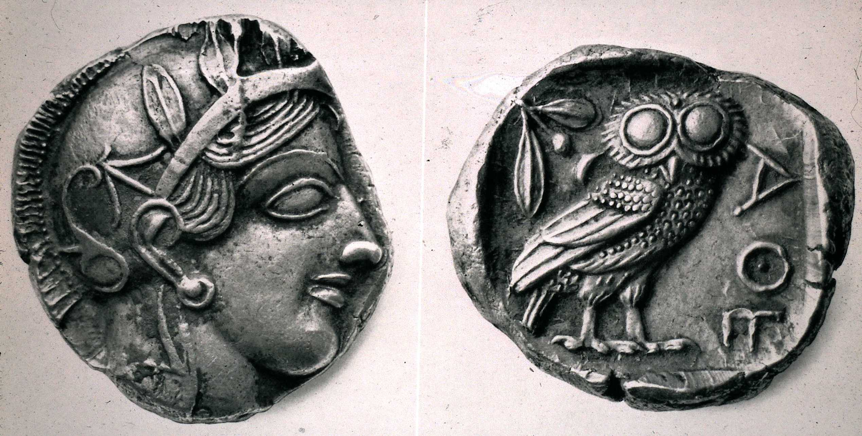
Competition with Athens + their unchanging coinage, after the Syracusan defeat of Athens
Varvakeion Athena
National Archaeological Museum, Athens
Notes:
It is generally considered to be the most faithful reproduction of the chryselephantine statue made by Phidias and his assistants, which once stood in the Parthenon.^{[1]} It is dated to 200–250 AD.^{[2]}
^{Also shows outside influence}
Holloway – Arethusa designed as Athena

Slide 20
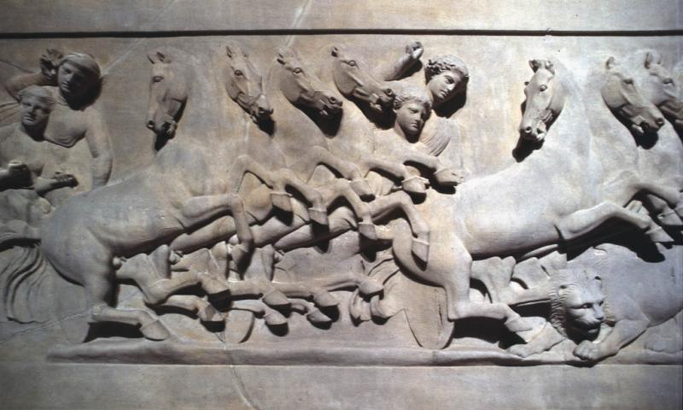
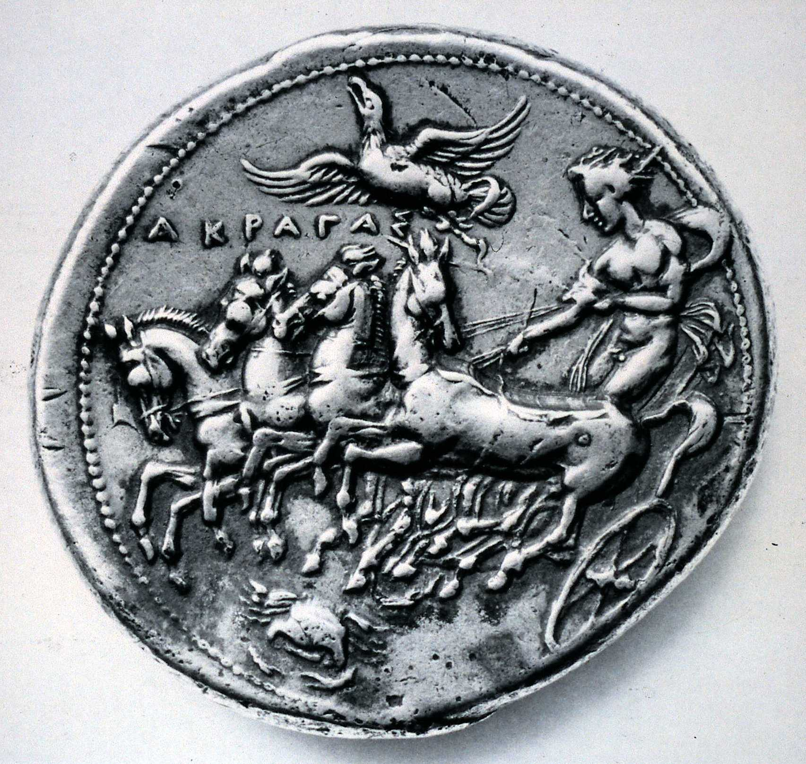
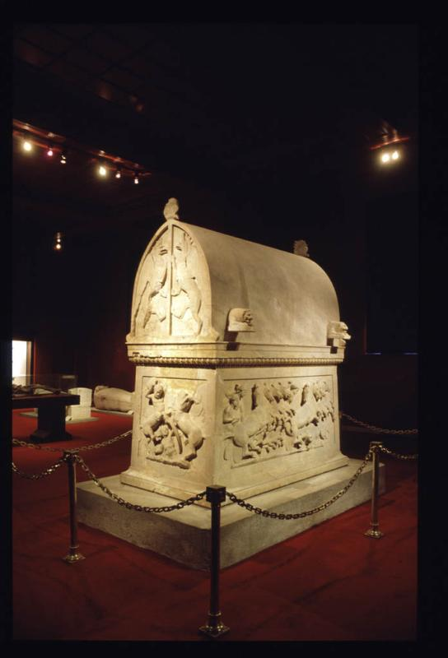
Lycian sarcophagus,
Royal necropolis of Ayaa (Turkey)
Notes:
Moving beyond the dotted borde3r on the right -= breaking through the border.
Some of the engravers may be Sicilian, others may have come from Athens or other cities.

Slide 21
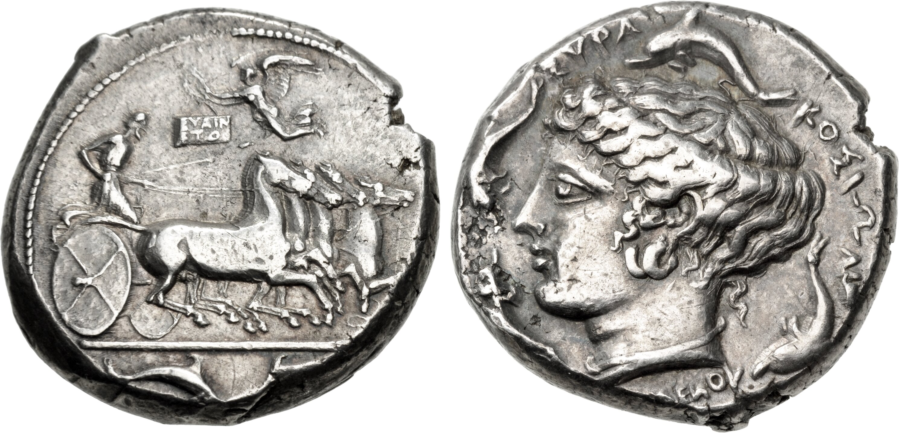
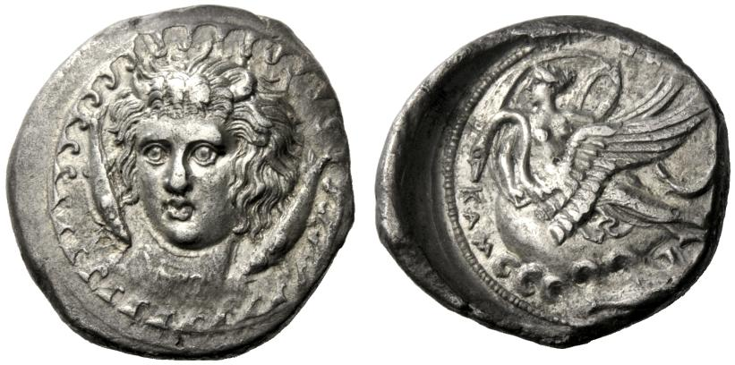
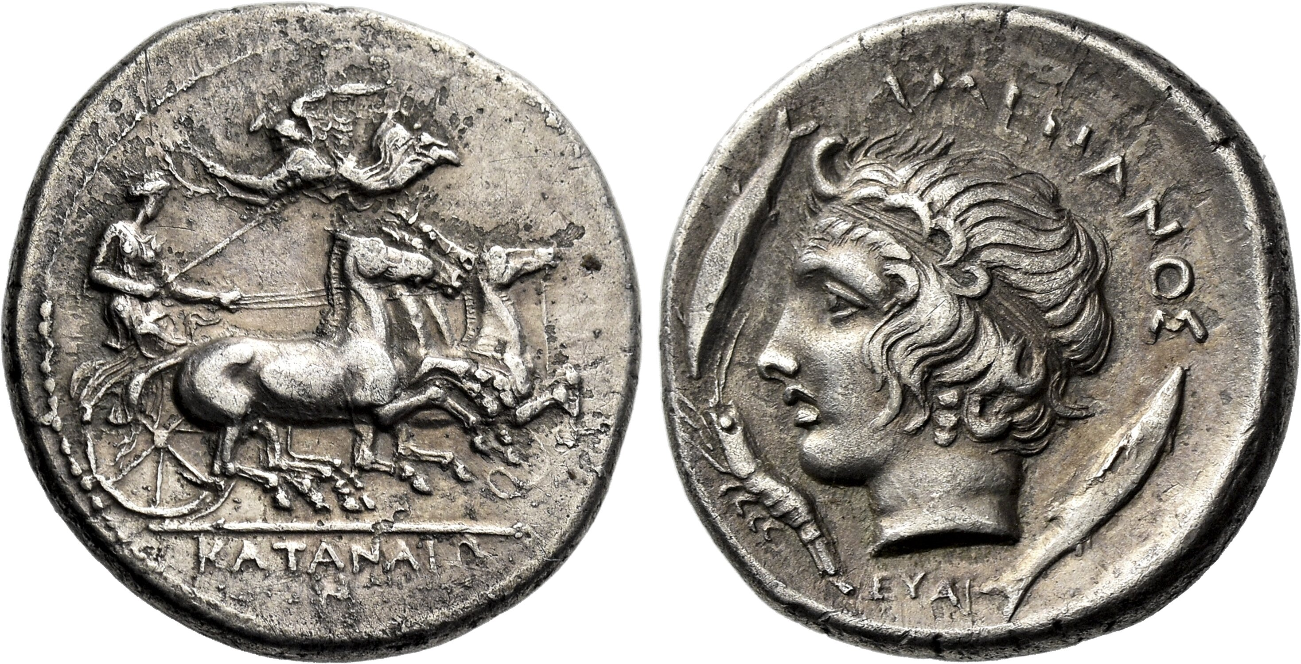
Euainetos
AR drachm, Katane
AR Tetradrachm, Syracuse
AR tetradrachm, Kamarina
Notes:
Think he is the one to begin the innovation with the more lively horses.
Diademed head l. of river-god Amenanos; at either side, two fish and below chin, crayfish on coin of Katane
Head of the young river god Hipparis facing, turned alight to the left, with horns on his forehead and long hair; one either side of his head, river fish swimming downwards and inwards, on the neck, just above the truncation, faint traces of the letters ΕΥΑΙ; all within a circle of stylized waves. Rev. [ΚΑΜΑΡΙΝΑ] (some traces visible) The nymph Kamarina seated on the back of a swan swimming to left; her right arm is curved around the swan's neck while she raises her left hand to hold her flowing veil; in the field to right, fish jumping to left; below, billowing waves .

Slide 22
Pairs of die engravers
AR Tetradrachm (24mm, 17.37 g, 8h). Obverse die signed by Euainetos, reverse die signed by Eumenes

Slide 23
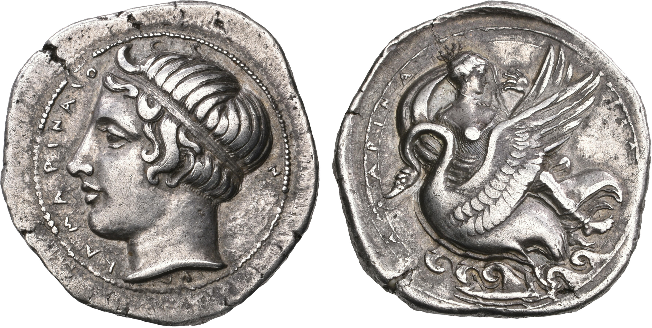
Kamarina
AR didrachm, signed by HYL
ΚΑΜΑΡΙΝΑΙΟ-Ν, diademed and horned head of the river-god Hipparis left /
ΚΑΜΑΡΙΝΑ-ΙΟΝ inscribed between double linear circles of border; nymph Kamarina wearing billowing veil seated right on swan flying left over waves; below, fish swimming left,

Slide 24
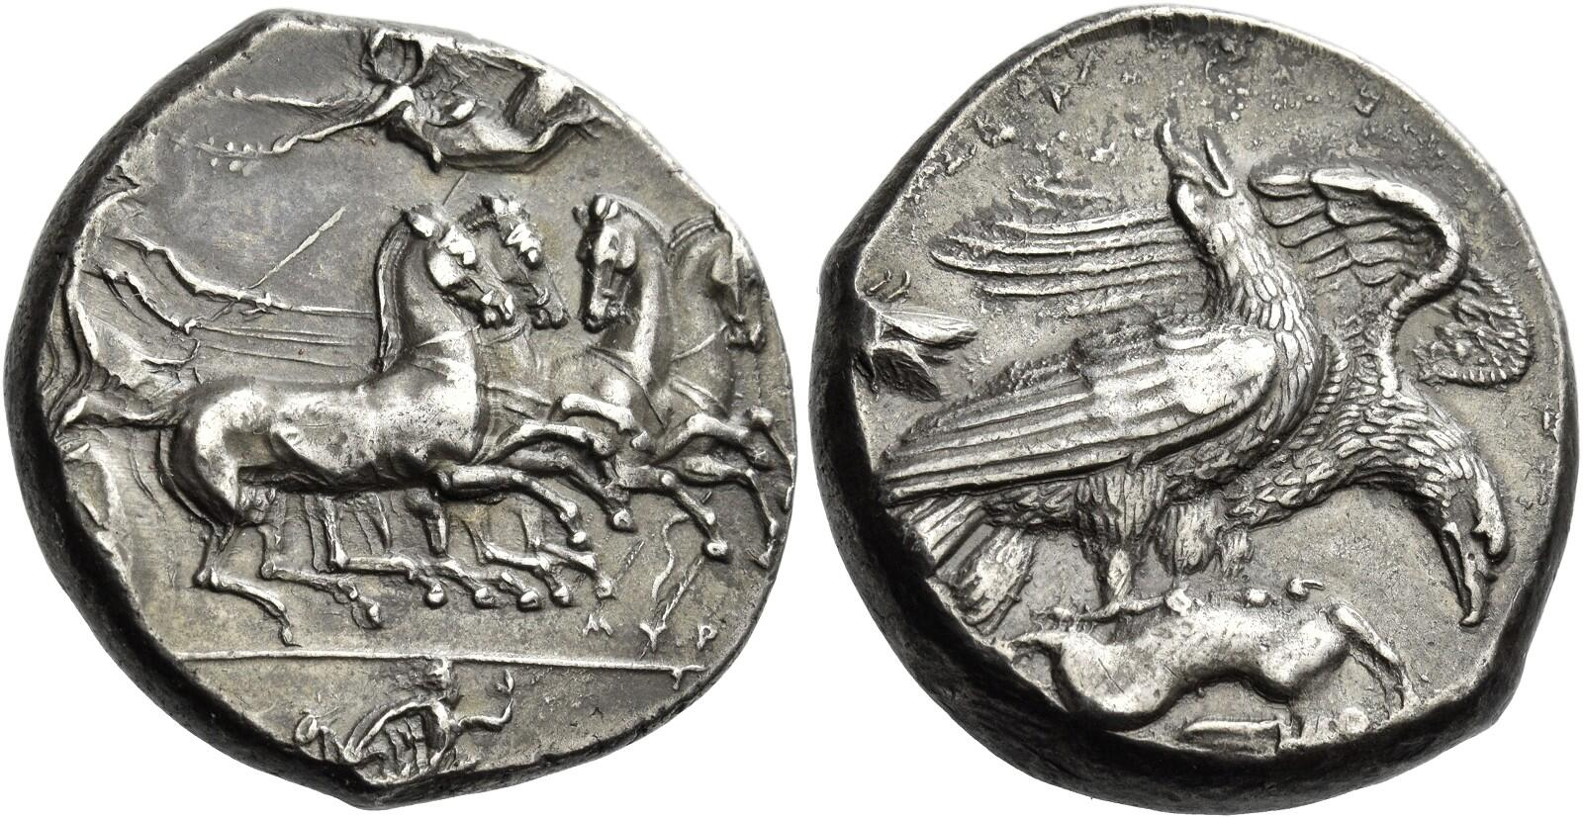
Akragas
AR tetradrachm, signed by engraver Myron.

Slide 25
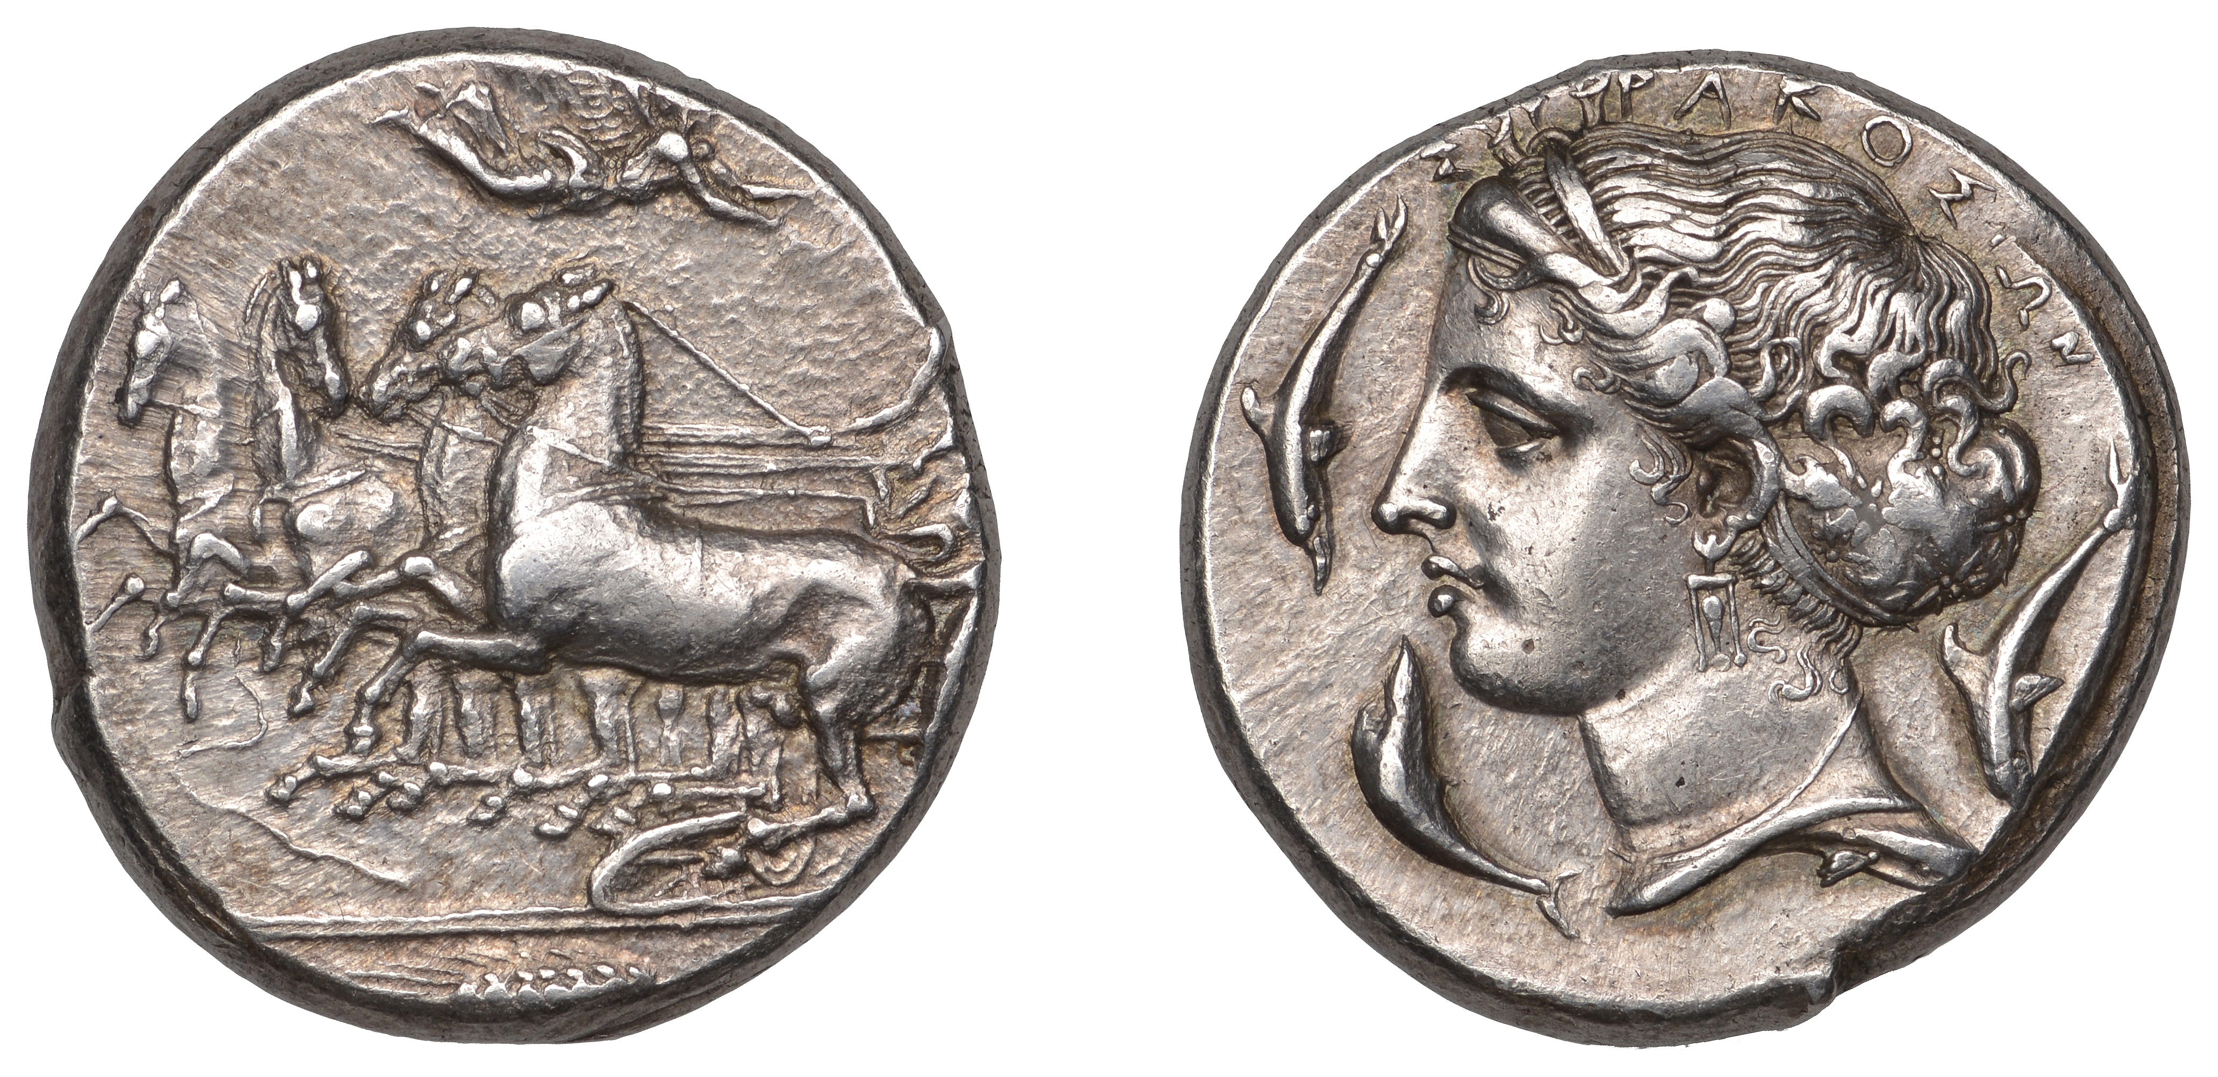
‘School of Parmenides’
Notes:
Only signed a small percentage of their production, similar to other Greek artists – one die for every 5-10,000 cut.

Slide 26
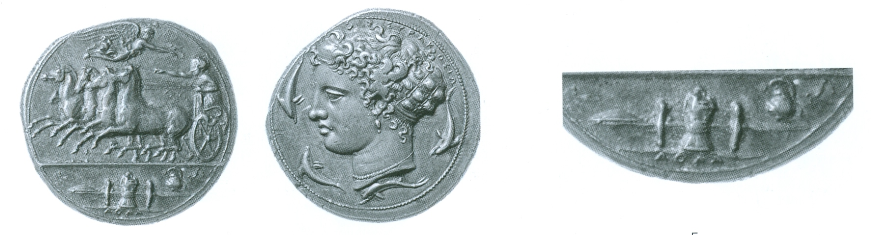
ΑΘΛΑ (prizes)
Decadrachm
Notes:
That would have
meant contests for contracts. The culture or ethos of late 5th-century Syracuse
was, perhaps, particularly agonistic – the word ATHLA (prizes) even appears
in the exergues of some dekadrachms below galloping racing chariots.2

Slide 27
Thoughts
Period lasted a bit over a decade
Historical context/impetus? Syracuse dominant?
A ‘community’ of engravers?
Competition among engravers? Officially sponsored competitions allowing engravers to compete?
Exposure and openness to outside influences?
Sponsorship; the commissioning of works?
Do the signatures reflect the die engravers taking pride in their work as ‘artists’ or is it the city’s pride for having employed a master?
Notes:
f 413; large amounts of silver known to have
been taken from six thousand Athenian prisoners of war would have provided
the initial resources necessary for the job;24 and perhaps, given political unrest
and uncertainty even under Dionysios, the state allowed private ateliers under
superb die-cutters to assume control over minting operations.
That would have
meant contests for contracts. The culture or ethos of late 5th-century Syracuse
was, perhaps, particularly agonistic – the word ATHLA (prizes) even appears
in the exergues of some dekadrachms below galloping racing chariots.2
officially sponsored competitions between die-engravers vying to outdo one
another, eager to declare their identities and so take credit for their skill

Slide 28
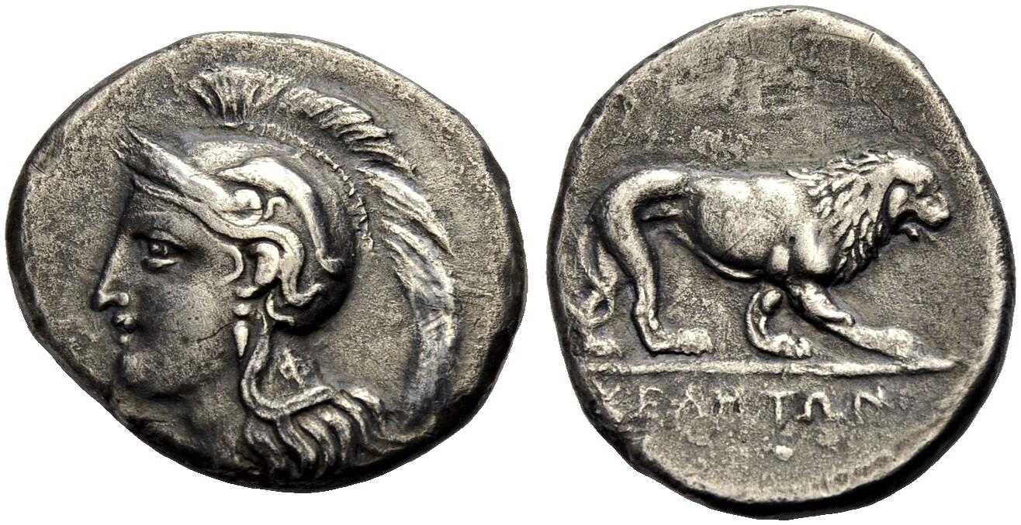
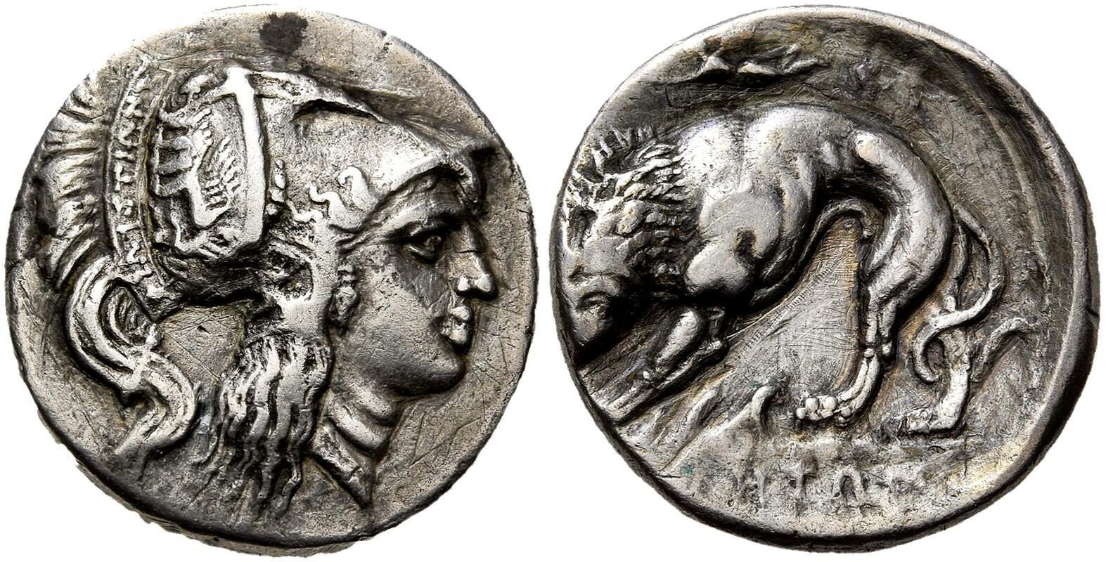
Velia and Philistion

Slide 29
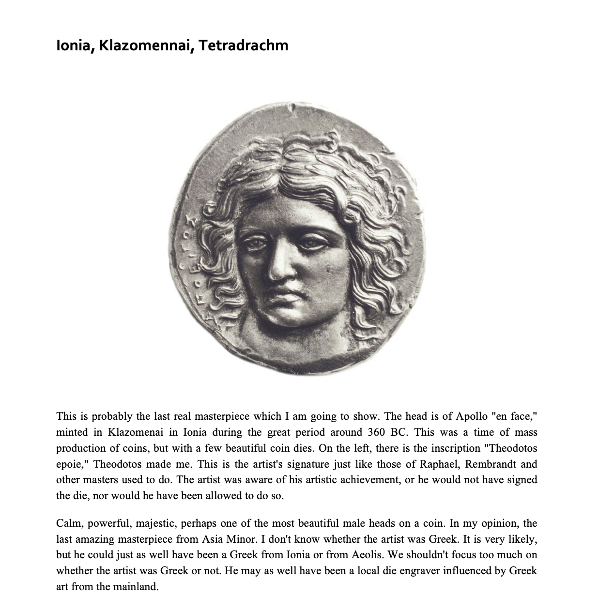
Theodotos, c. 380 BC
Leo Mildeberg, "From my Dream Collection of Early Greek coins"

Slide 30
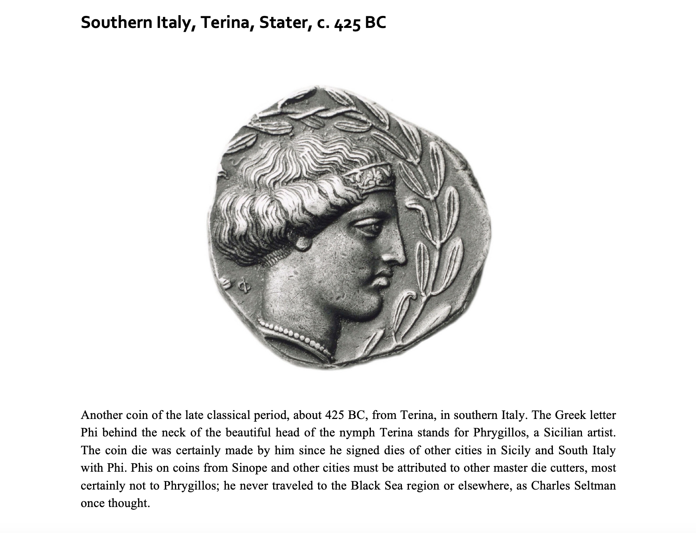

Slide 31
Bibliography
Hurwit, J.M., 2015. Artists and Signatures in Ancient Greece (Cambridge) Chapter 4.
Rutter, K., 2009. ‘Dating the period of the “Signing Artists” of Sicilian coinage’, in D.B. Counts and A.S. Tuck (eds), Koine. Mediterranean Studies in Honour of Ross Holloway (Oxford), pp. 125-30.
Rutter, K., 2012. ‘Artistic identity: the case of the ‘Signing Artists’ in Sicily, Numismatica e Antichità Classiche 41, pp. 71-90

