Slide 1


Small change and the beginnings of bronze coinage
Mairi Gkikaki
University of Warwick

Slide 2
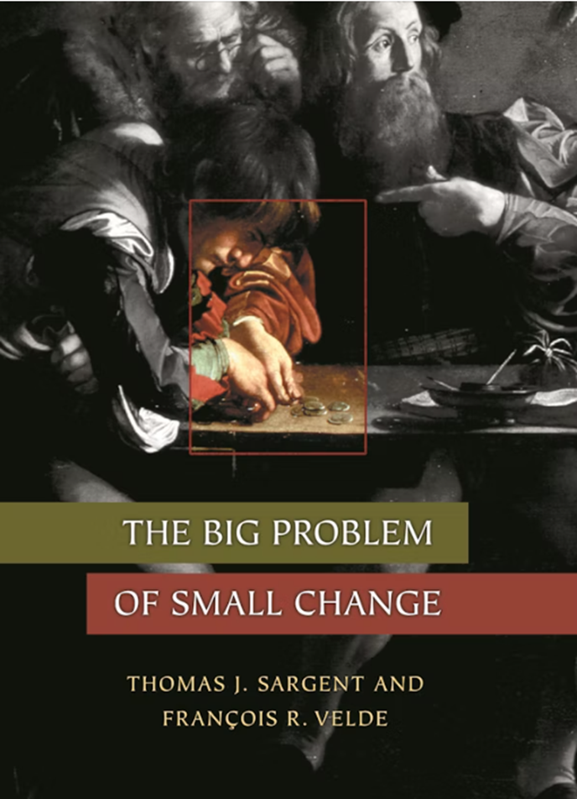
One of the classic problems of monetary history: the recurring scarcity and depreciation of small change

Slide 3
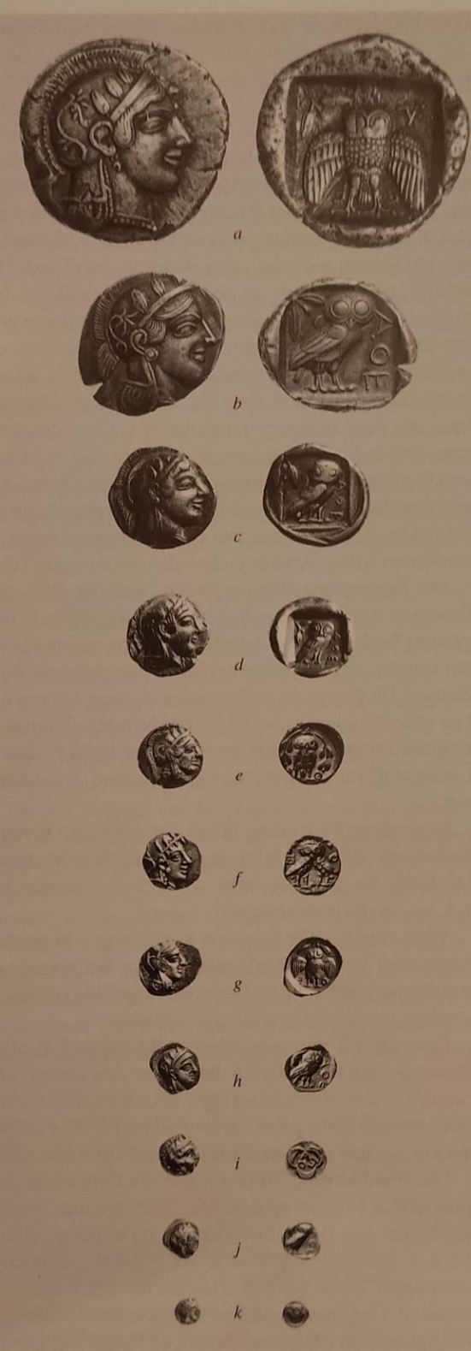
Athens third quarter of the fifth c. BCE
B. Weisser in the exh. Cat.
Die griechische Klassik, Idee oder Wirklichkeit

Slide 4
Κόλλυβος = grain of wheat
Κριθόκοκκον = grain of barley
As a standard of weight

Slide 5
Chalkous (pl. Chalkoi)
Chalkous weights 1,5-2 g in the weight standards of most Greek cities
1/12 of the obol in the Aeginetan weight standard
1/8 of the obol in the Attic weight standard

Slide 6
Chalkous
Chalkous approx. the weight of a silver obol. However its value was significantly inferior.
Ratio bronze: silver was 100 or 120 to 1 according to IG I² 371
Nominal value of the bronze coins was much more superior than their metallic value
The huge bronzes of Lipara suggest that the ancients were aware of the ratio

Slide 7
The introduction of the bronze coinage
Not a linear development
A whole phenomenon which appears sooner or later and at different points in time in various parts of the Greek world in a period covering roughly two centuries (fifth-fourth cent BCE): Black Sea (Sinope, Histria, Olbia), Magna Graecia, Sicily, Athens (Salamis and ΕΛΕΥΣΙ)
The phenomenon of experimental minting in bronze of a token coinage with not continuation: The coinage of the Athenians in Sybaris (446-444 BCE), the emergency coinage of Timotheus 364-362 BCE

Slide 8
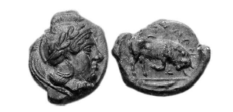
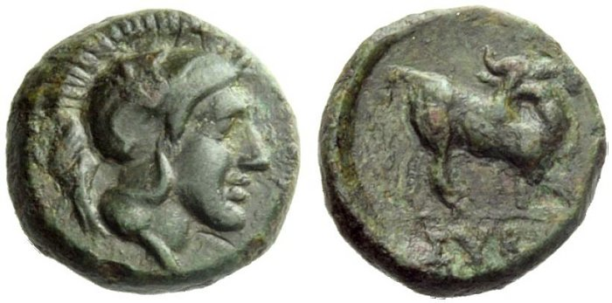
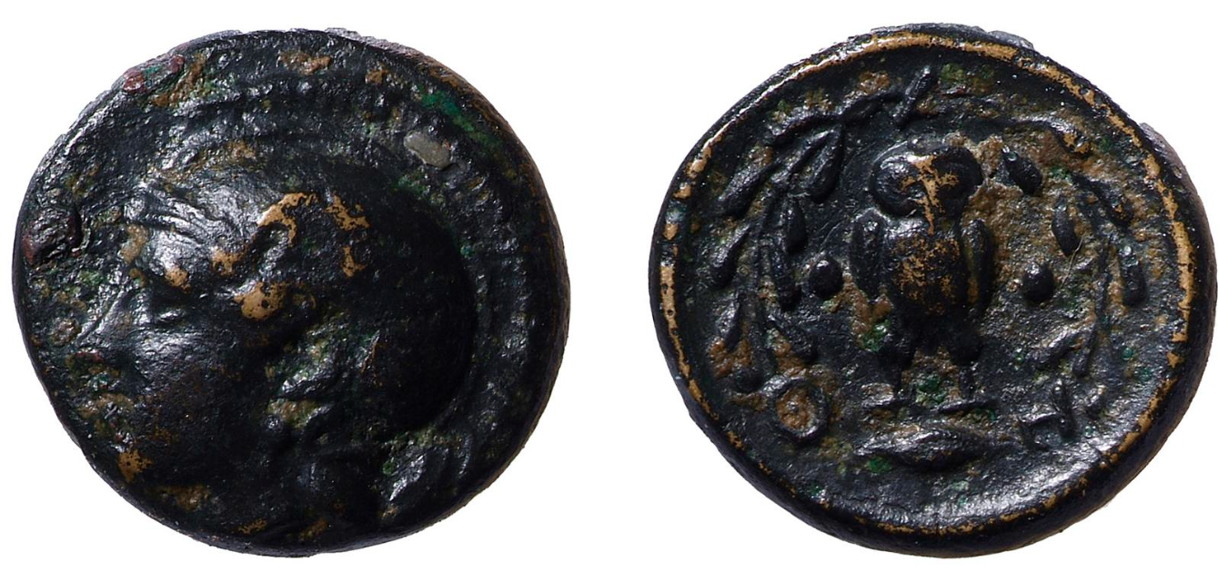
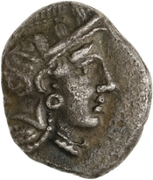
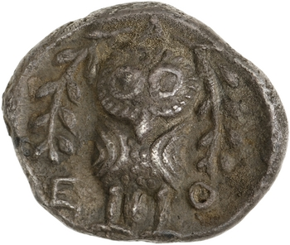
Sybaris and Thurii, Timotheus and Athens
AE Thurii
CNG (Lancaster and London),
73 (13 septembre 2006), n° 35.
AE Sybaris, 1.6g, NAC (Zürich), 52
(7 octobre 2009) lot 35.
AE 1.45g, 6h, Timotheus
British Museum 1845,0414.23
AR-triobol Athens
ANS1968.34.69, 2.03g, 9h

Slide 9
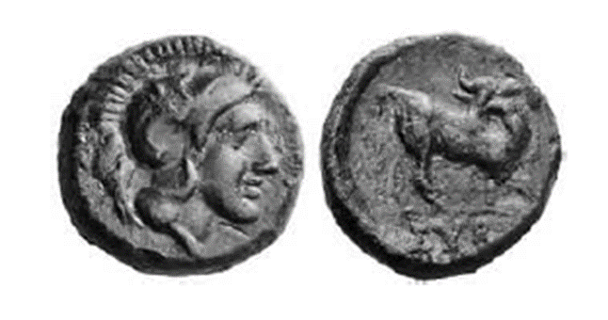

Sybaris
Timotheus’ coinage
Dionysiouc Chalkous (* 490/480 BCE advocated the minting and use of bronze coinage, participated in the re-foundation of Sybaris 446-444BCE)
Ath. X, 443; XIII, 602c; XV, 669d.
Aristotle, Oeconomica 2. 2. 23 (1350a)
Polyaenus, Strategemata in the second century A.D (3.10.1)
Polyaenus, Strategemata 3.10.14

Slide 10
Timotheus’ coinage
Timotheus, while making war on the Chalcidians together with Perdiccas, mixed copper from Cyprus with the Macedonian coinage, and struck stamped (coinage), so that the former pentadrachms had a fourth part of silver while the rest was of worthless copper. Now that he had plenty of money to pay his soldiers, he persuaded the merchants and those from the countrysidewhich were for sale with whatever bronze they might receive, and any booty which was brought to them, and then to bring any bronze which was let over to him, and receive silver for it.
Polyaenus 3.10.14
(Transl. Melville-Jones)

Slide 11
Bronze coins and historical considerations
Limited circulation – not always
The case of Susa where a great number of bronzes coming from Seleuceia on the Tigres have been excavated: merchants arriving at Susa in order to buy local products and merchandise from the Persian Gulf – G. Le Rider, Souse sous les Seleucides et les Parthes, les trouvailles monetaires et l’histoire de la ville, Memoires de la mission archeologique en Iran, 38, Paris 1965.

Slide 12
Bronze coinage in South Italy
Scarcity of precious metals
Second half of the fifth cent. BCE: Sybaris, Thurii, Rhegion (prior to 425/420 BCE, Poseidonia (ca. 420 BC), Metapontum, Hyele (Velia)
Minuscule coins, in a single module/ denomination
Iconography inspired from the contemporary silver coinage
The silver coinage remains the point of reference: Bronze and silver belong to the same system, the ratio sometimes escapes us
Around the middle of the fourth century BCE the Greek poleis of South Italy issue bronze coins in large modules: Poseidonia (26mm, c. 25g) Thourioi (33mm, c. 28-29g), Kroton 28-31mm, c. 24g
Legends denoting the nominal value are rare, instead the module and the types help the users identify the value

Slide 13
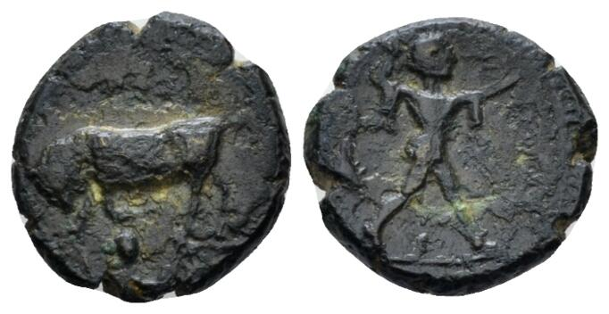
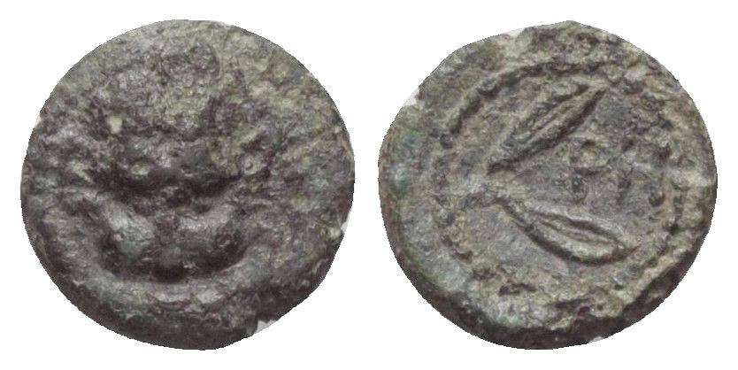
South Italian bronze coinages of the 5th c. BCE
AE Poseidonia, 12mm, 1.71g
Naville Numismatics Ltd. Auction 70, Lot 14
AE Rhegion, 10mm, 0.74g, 425-410 BCE
Solidus Numismatik - Auction 109, Lot 1016

Slide 14
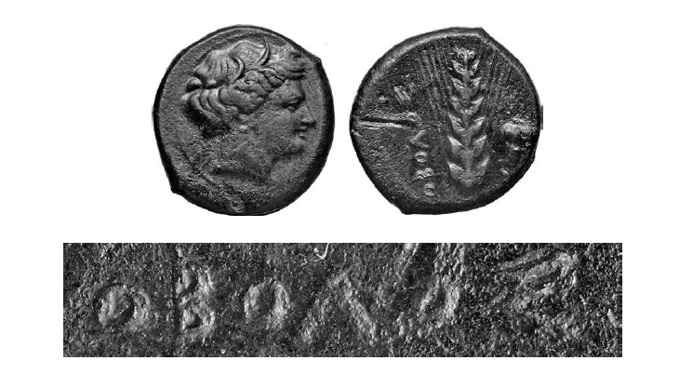
Metapontum
Obolos: The legend denotes the value of the coin
Bronze coins weighing usually 8-9g are the equivalent of the silver obol
Source: Brousseau 2013

Slide 15
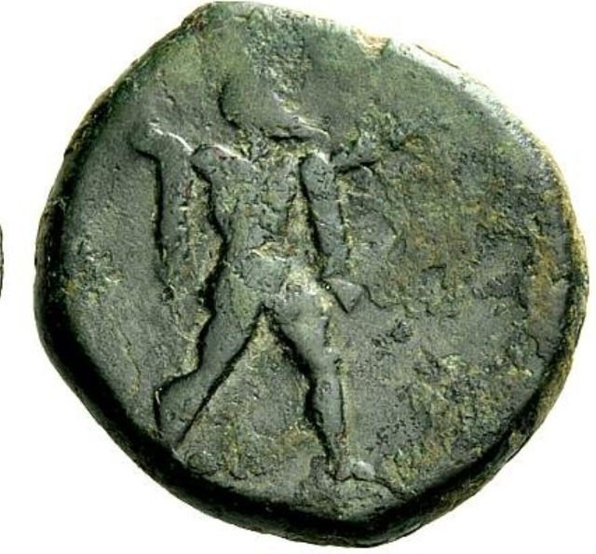
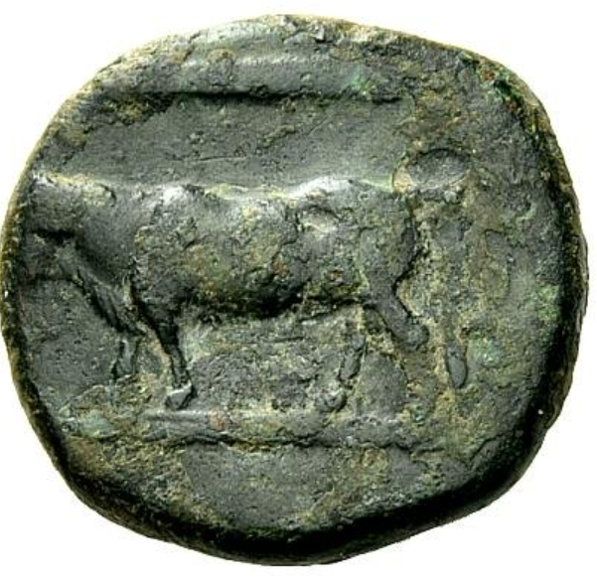
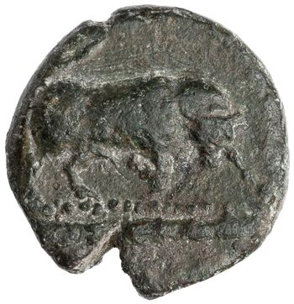
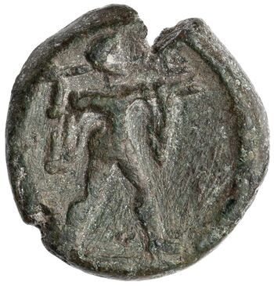
Bronze denominations of Poseidonia, fourth c. BCE
Hemiobol (Half-Obol), 3.34g
ANS 1944.100.5181= SNGANS 2.711
AE trihemiobol, 10.97g
Numismatica Ars Classica - Auction 64, Lot 2039
Approximate scale

Slide 16
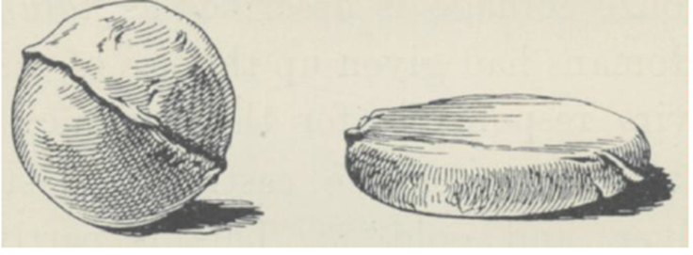
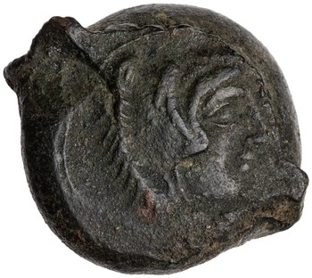
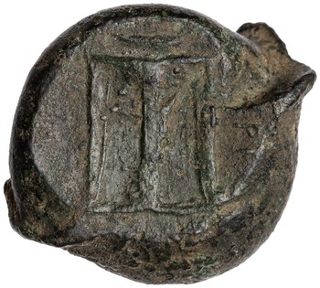
Croton, AE1, fourth cent. BCE
Hill NumChron 1922
Croton, 23.31g, ANS 1944.100.6958 = SNG 3.430
On the rev.: ΤΡΙ

Slide 17

Origins of the bronze coinage
Sicily. According to Aristotle (Constitution of Akragas and Himera) the Sicilian litra was divided to 12 onces. According to a theory the division of the Sicilian litra anticipates the division of the Aeginetan obol in 12 chalkoi (Psoma 1998)
Sybaris, re-founded as Thourioi on the Gulf of Tarent: a bronze fraction with Athena head on the o. and a bull on the r. inscribed ΣΥΒΑ (Brousseau 2010)

Slide 18
Bronze coinage as the outcome of a long process
Proficiency of the Greeks in processing artifacts made of bronze
Colonisation 8th cent. BCE probably contributed in restoring deficiencies in the metal market of mainland Greece
The losses and the crisis resulting from the Peloponnesian War
Knowledge exchange networks between Greece, Sicily, Italy and the Milesian colonies of the Black Sea

Slide 19
Bronge coinage on Sicily
The coins are cast and not struck
Bronze coinages are inaugurated in the second half of the 5th cent. BCE
Bullets as marks of value
Iconography inspired from the iconography of the silver coinage
Agrigentum strikes in four denominations: Once (onkion), Hexas, Tetras, Trias
Selinus strikes two series: a heavy one with onkion, Hexas, tetras, trias and a light one with two issues for tetras (a male head and a female head) and a pentokion (Lazzarini 2009; Gkikaki 2017-18)

Slide 20
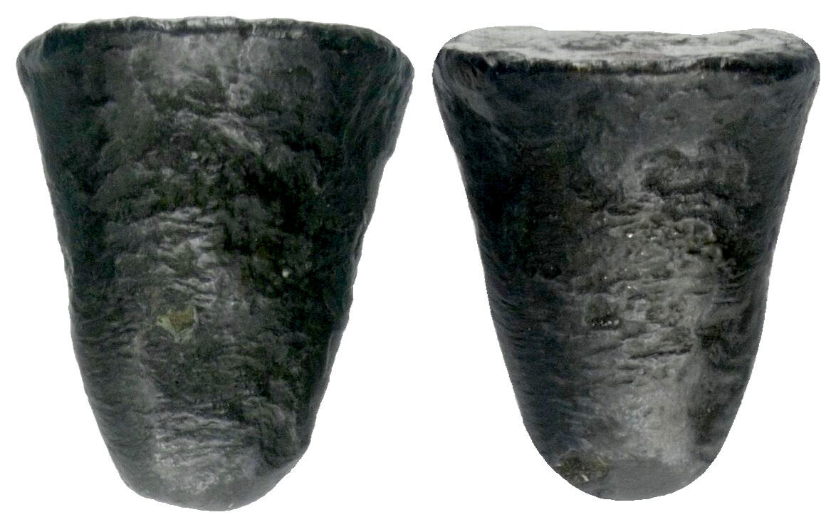
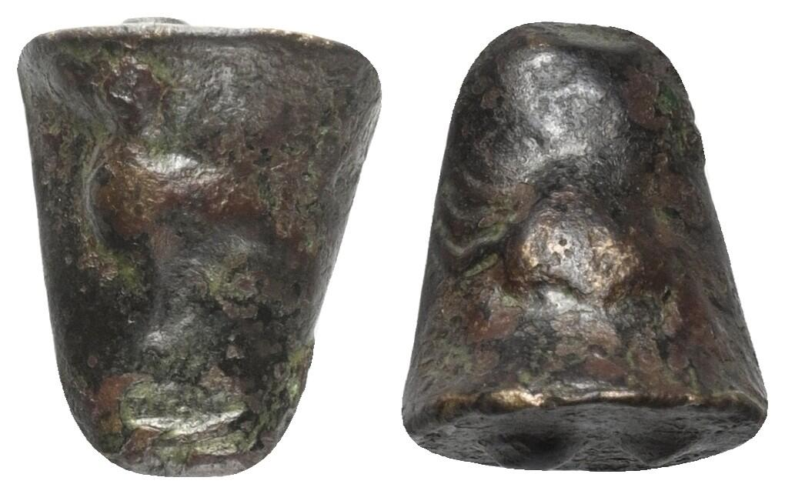
Agrigentum
Ex Solidus Numismatik - Auction 97, Lot 14
Sizilien. Akragas. Bronze (Hexas). Um 450 v. Chr. Vs: Adler nach links stehend. Rs: Krabbe. Us: Zwei Wertkugeln. 16 mm. 7,20 g.
Ex Solidus Numismatik - Auction 101, Lot 1018
Sizilien. Akragas. Bronze (Hexas). Um 450 v. Chr. Vs: Adler nach links stehend. Rs: Krabbe. Us: Zwei Wertkugeln. 16 mm. 6,24 g.

Slide 21
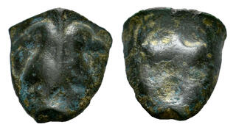
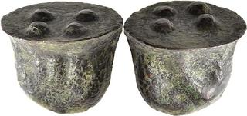
Agrigentum, trias, AE, cast, 13,70g
Dr. Busso Peus Nachfolger - E-Auction 420, Lot 5012
Agrigentum, tetras, AE, cast, 12.63g
Tauler & Fau - Auction 152, Lot 148

Slide 22
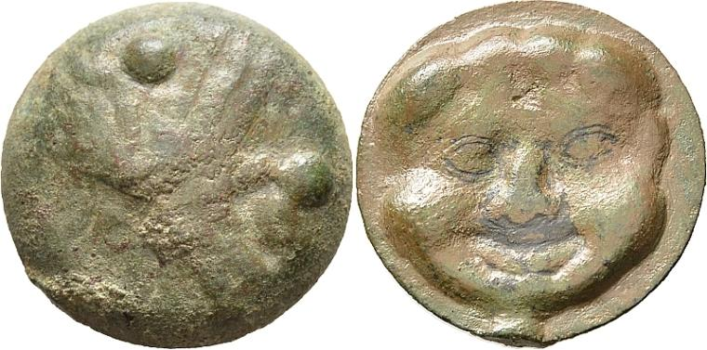
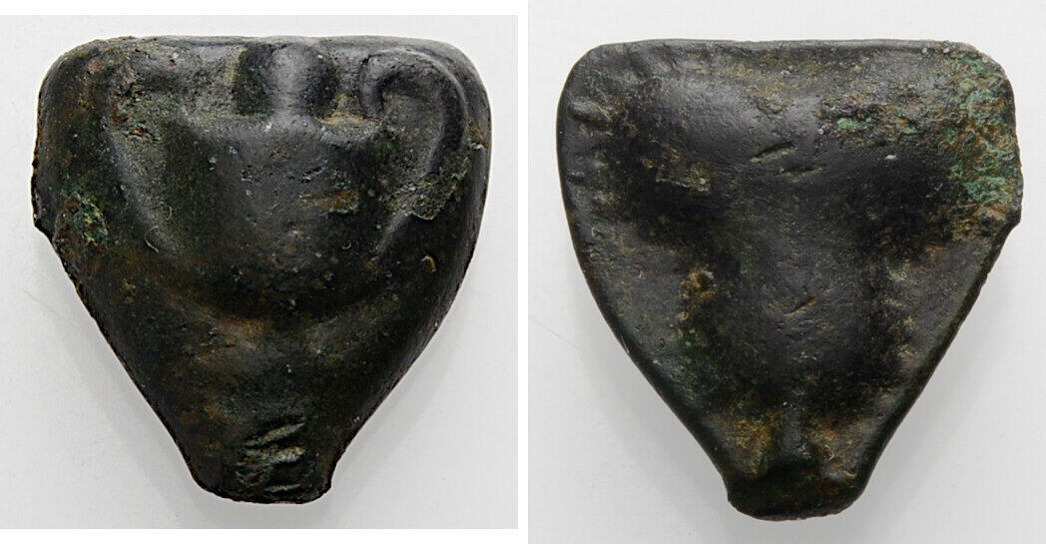
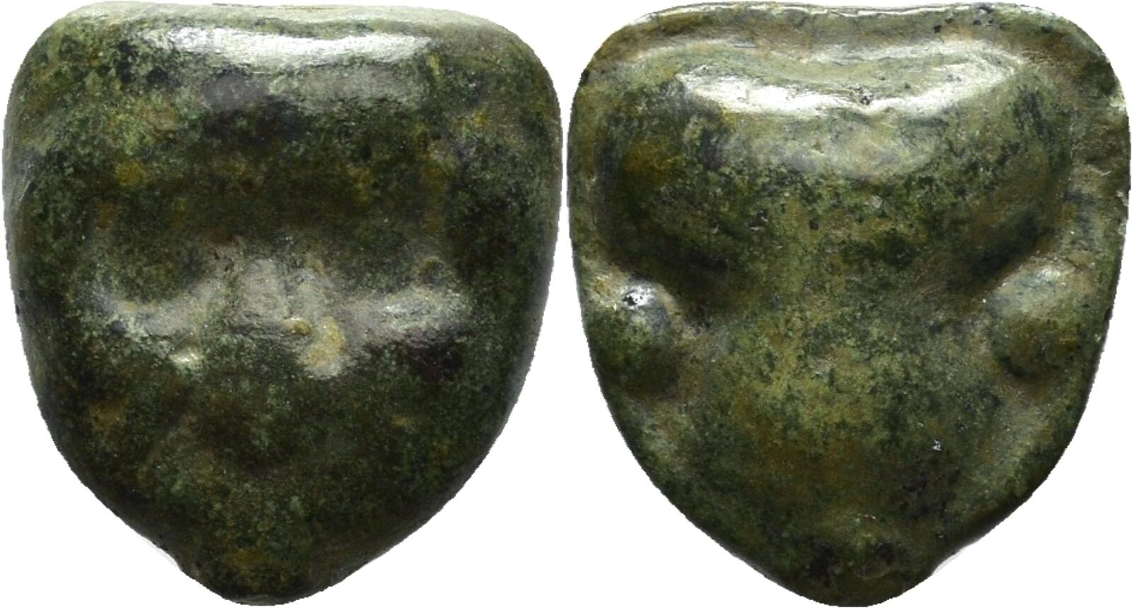
Selinous, Bronze, 450-440BCE
Heavy series
Ex Dr. Busso Peus Nachfolger - E-Auction 420, Lot 5016
Tetras, AE, 10.62g
Ex Münzen & Medaillen Deutschland GmbH - E-Auction 2, Lot 23. Once, 450-440 v. Chr. AE, 4.07g
E xDr. Busso Peus Nachfolger > Auction 430, lot 23. Hexas, AE, 4.56g

Slide 23
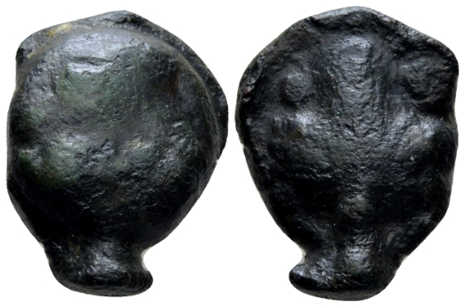
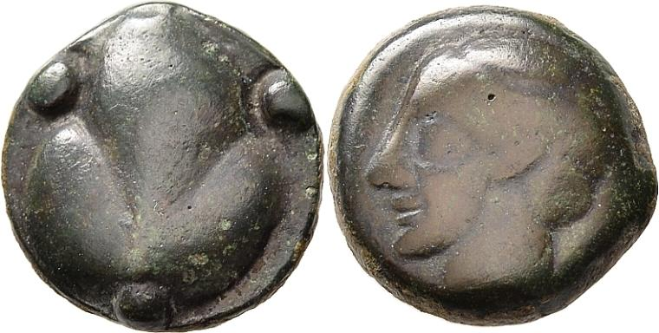
Selinous, Bronze light series
Tetras, Ex Dr. Busso Peus Nachfolger - E-Auction 420, Lot 5014
AE, 8.41g
Naville Numismatics Ltd. - Auction 43, Lot 25

Slide 24
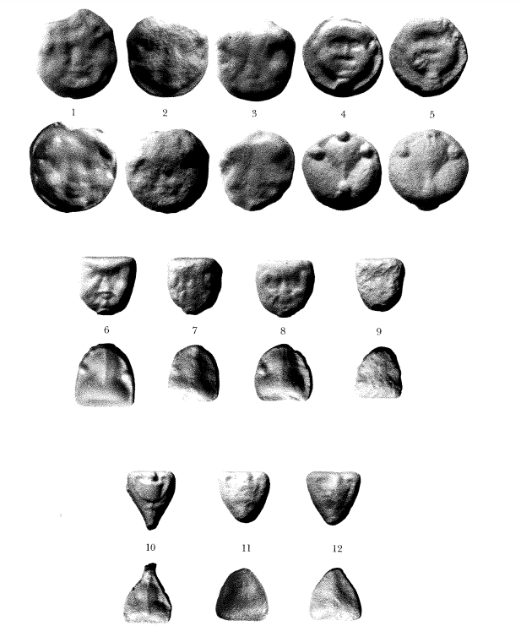
Selinous, the heavy series

Slide 25
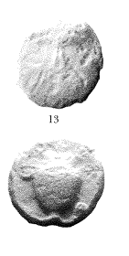
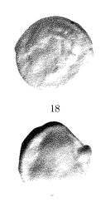
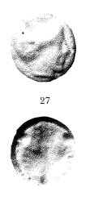
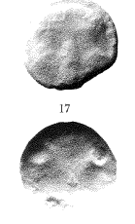
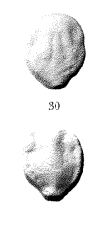
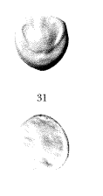
Selinous, the light series

Slide 26
Euxinus Pontus/ The Black Sea
First appeared in Borysthenes/Berezan and later in Olbia, Kerkinitis, Nikonion, Histros
Cast shapes/coins, struck coins
Arrow heads dated 7th c. / early 6th c. BCH

Slide 27
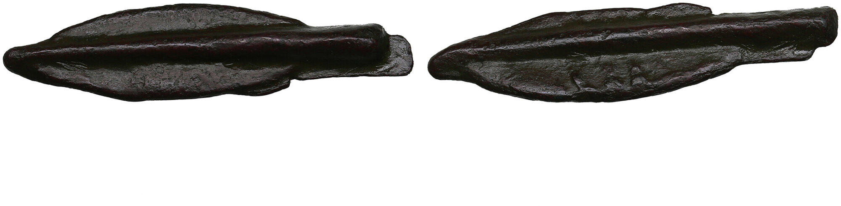
Arrowheads: early forms of currency which remained at use even after the invention of coinage (Stringl 2005)
Coins.ee OY > Auction 55, lot 177
Skythia, Olbia Æ Arrowhead. Circa 550-450/25 BC.
4.61g. 43x10mm. VF/VF Bilobate arrowhead with axial spine and ribs. / Bilobate arrowhead with axial spine. HGC 3, 1875.

Slide 28
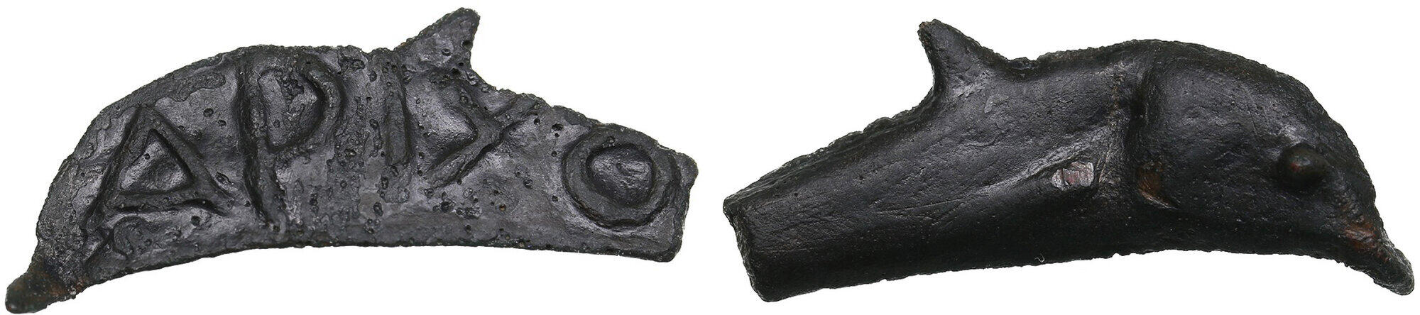
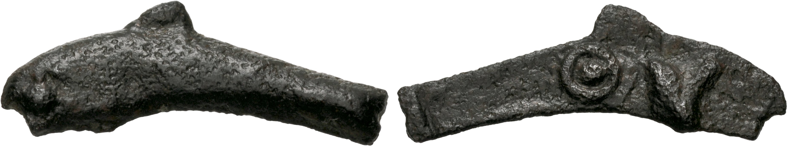
Olbia, Skythia
Ex Coins.ee OY > Auction 58, lot 54
Æ Dolphin 5th century BC
2.92g. 32x12mm.
Ex Classical Numismatic Group > Electronic Auction 531, lot 61. Olbia. Circa 437-410 BC. Cast Æ (26.5mm, 1.54 g).

Slide 29
Aristophanes, Ranae 724-26 (425 BCE)
‘Cunning Bronzes’
ἔν τε τοῖς Ἕλλησι καὶ τοῖς βαρβάροισι πανταχοῦ
χρώμεθ' οὐδέν, ἀλλὰ τούτοις τοῖς πονηροῖς χαλκίοις
χθές τε καὶ πρώην κοπεῖσι τῷ κακίστῳ κόμματι.
Transl. of the lines 718-726
Many times it seems to us the city has done
the same thing with the best and the brightest of its citizens
as with the old coinage and the new gold currency.
For these, not counterfeit at all,
but the finest it seems of all coins,
and the only ones of the proper stamp, of resounding metal
amongst Greeks and foreigners everywhere,
we never use, but the inferior bronze ones instead,
minted just yesterday or the day before with the basest stamp.

Slide 30
Demos of the Salaminioi or Demos the Athenians on the Salamis
Archaeological evidence (the child burial HS 12 and floor beneath the destruction debris of ca. 420 BCE) that the Demos of the Salaminioi minted bronze coins probably in the 430s
The Demos of the Salaminioi was a unique political entity within the state of Athens >> idiosyncratic and slightly detached status within the Athenian state

Slide 31
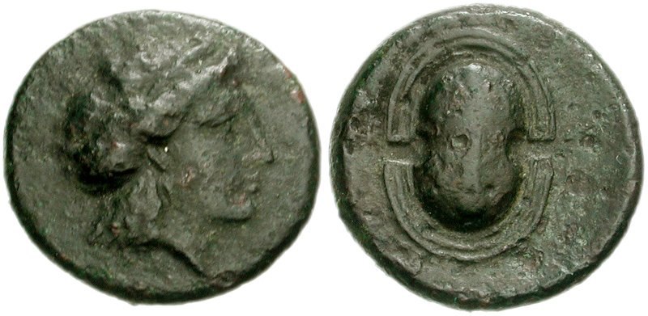
Demos of the Salaminioi
Salamis. 4th century BC. Æ 16mm (3.15 g). Ex Classical Numismatic Group - Electronic Auction 173, Lot 189
From the Christopher Morcom Collection of Greek coins

Slide 32
The ΕΛΕΥΣΙ bronze coins
The ΕΛΕΥΣΙ bronze coins were struck in a central Athenian mint alongside Athenian ΑΘΕ bronze coins with owl types.
The striking of the ΕΛΕΥΣΙ bronze coins was an affaire of the state

Slide 33
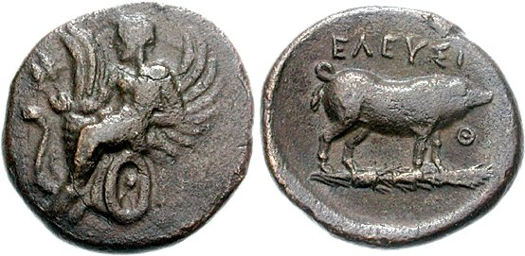
The ΕΛΕΥΣΙ coinage
Athens. Circa 340-335 BC. Æ 15mm (3.17 g, 7h), Ex Classical Numismatic Group > Mail Bid Sale 76, Lot 484

Slide 34
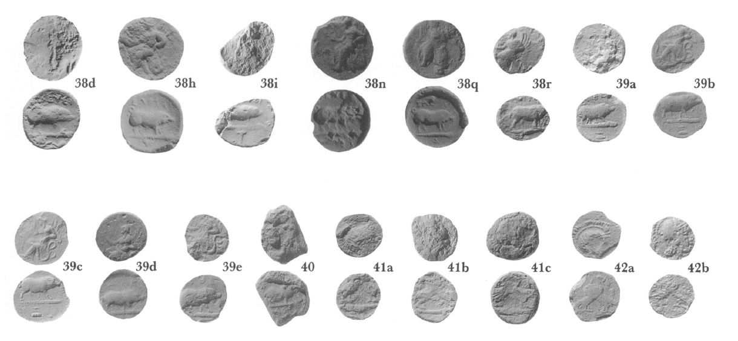

Slide 35
Bronze coinage - References
Brousseau, A., 2010, ‘Sybaris et l’origine de la monnaie de bronze, RBN 156, 23-34.
Gatzolis, C. 2013, New Evidence on the Beginning of Bronze coinage in Northern Greece, in in C. Grandjean and A. Moustaka (eds.) Aux origines de la monnaie fiduciaire, Bordeaux (2013), 117-127
Gkikaki, M., 2017/18, Some New Cast Bronze Coins from Selinus in Wuerzburg, Revue Suisse de Numismatique 96, 5-15
Grandjean, C., 2013, Une monnaie fiduciaire, issued du monde colonial, in C. Grandjean and A. Moustaka (eds.) Aux origines de la monnaie fiduciaire, Bordeaux (2013), 97-107.
Psoma, S. 1998, ‘Le nombre de Chalques dans l’obol, Revue Numismatique 19-29.
Kroll, J.H., 1993, The Greek Coins. The Athenian Agora vol. XXVI, Princeton, NJ.
Kroll, J.H., 2013, ‘Salamis Again’, in C. Grandjean and A. Moustaka (eds.) Aux origines de la monnaie fiduciaire, Bordeaux, 109-115
Sheedy, K., ‘The Emergency Coinage of Timotheus’, in U. Wartenberg and M. Amandry (eds.) KAIROS. Contributions to Numismatics in Honor of Basil C. Demetriadi, 203-223.
Stingl, T. 2005. ‘Frühe bronzene Geldformen im nordwestlichen Schwarzmeerraum’, in F. Fless and M. Treister (eds) Bilder und Objekte als Träger kultureller Identität und interkultureller Kommunikation im Schwarzmeergebiet. Kolloquium in Zschortau/Sachsen vom 13.2.–15.2.2003. Internationale Archäologie, Arbeitsgemeinschaft, Symposium, Tagung, Kongress, Band 6. Rahden/Westfalen: Marie Leidorf, 119–23.

