Slide 1
Classics First Year Students
Welcome to the Library!
University of Warwick Library Introduction
October 2016
Helen Ireland, Academic Support Librarian
h.ireland@warwick.ac.uk

Slide 2

Finding Information in the Library – the Old and the New

Slide 3

Most of an iceberg is below the water…so the Library has more than what you see on the shelves

Slide 4
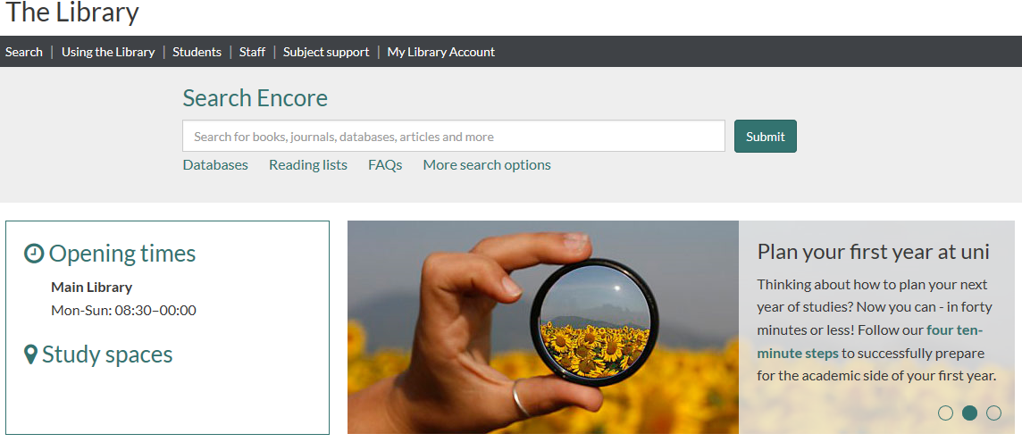

Slide 5
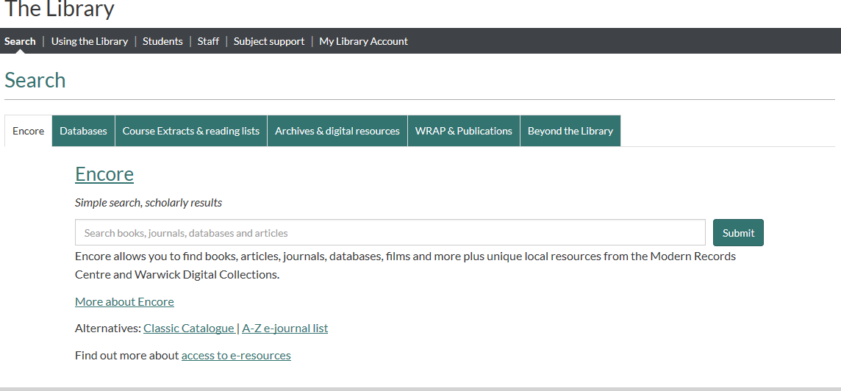

Slide 6
Books
Reading lists or supplementary reading
Use Encore, the Library catalogue, to find them
Increasingly, books are now available electronically (E-books)
Loeb Digital Library
Buy books which you are going to need to refer to regularly – be guided by your tutors.
Look for books in other libraries.

Slide 7
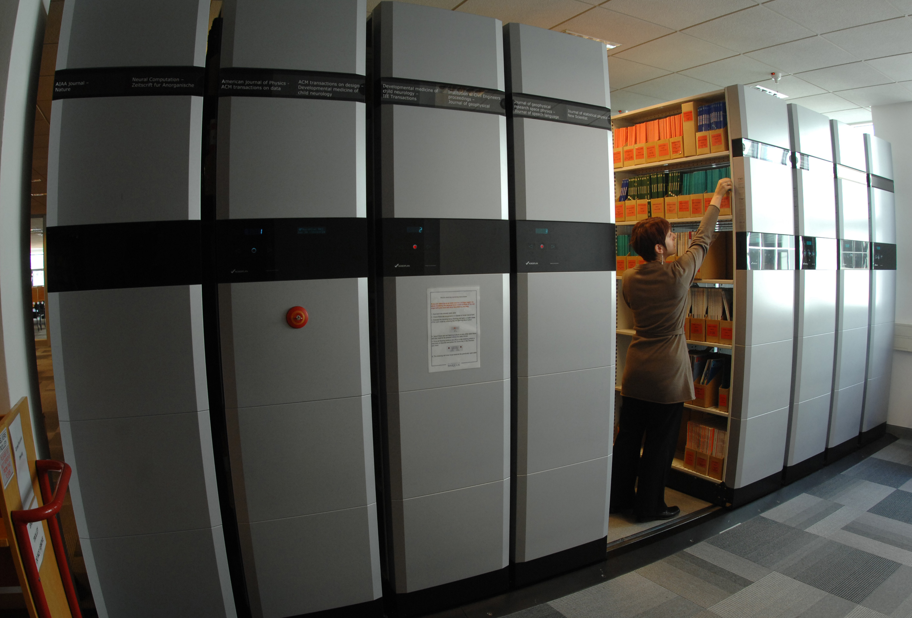
Books
PA Latin and Greek Literature
DE-DG Greek and Roman History
N-NX History of Art
B-BJ Philosophy
C-CN Archaeology, Numismatics, Epigraphy
Floor 3 and Floor 3 Extension
Reference books (Mobile shelving)
Oversize books (Mobile shelving)
Short Loan Collection and Learning Grid
Electronic books (E-books)

Slide 8
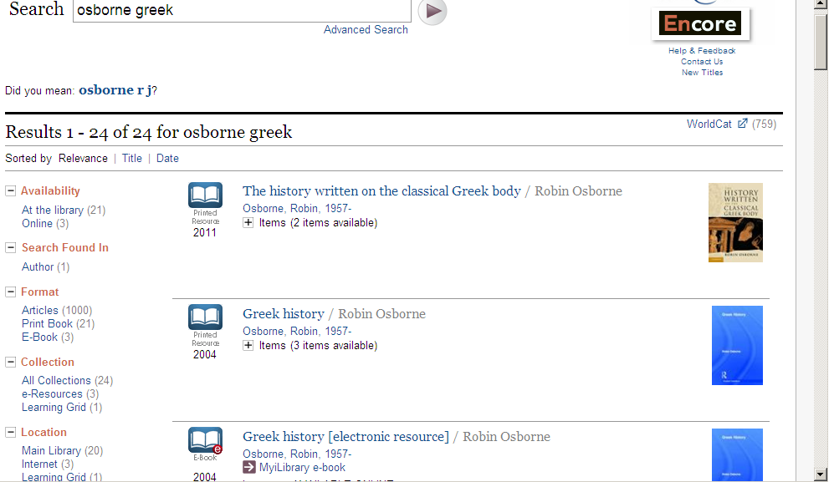

Slide 9
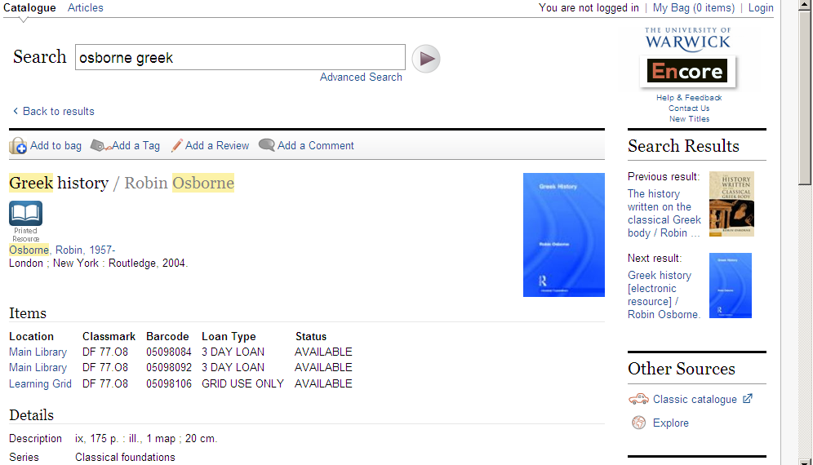

Slide 10
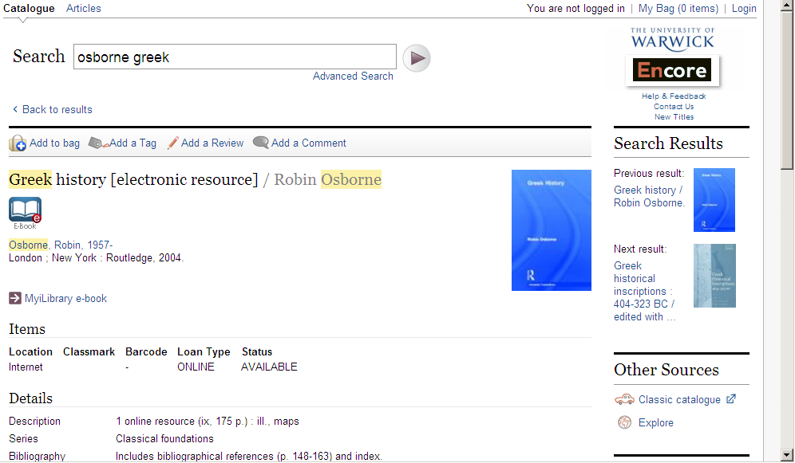

Slide 11
Finding Journal Articles
Howgego, C. (1992) ‘The supply and use of money in the Roman world 200 B.C. to A.D. 300’, Journal of Roman Studies 82: 1-31

Slide 12
Print Journals
Mobile shelving in Floor 3 Extension
A-Z by title of journal or publisher
Some early volumes in Store – fetched on request
Online request form

Slide 13
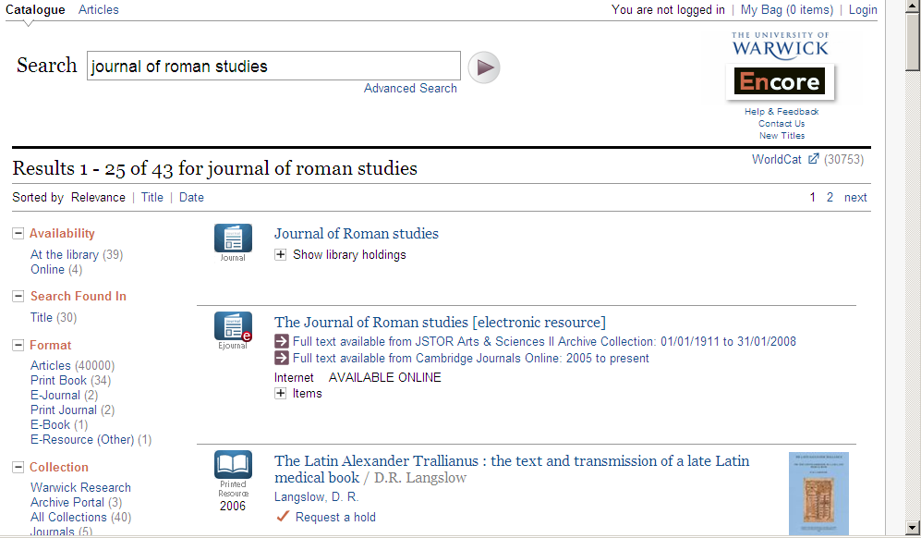

Slide 14
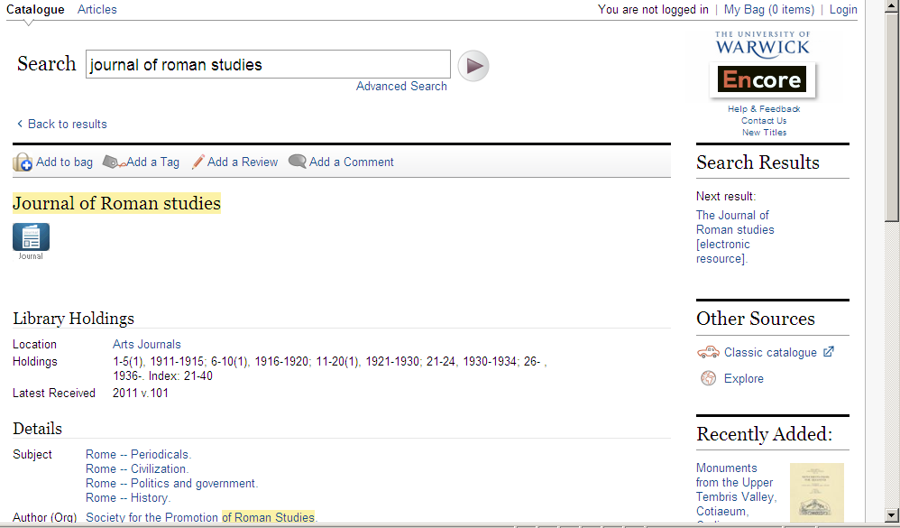

Slide 15
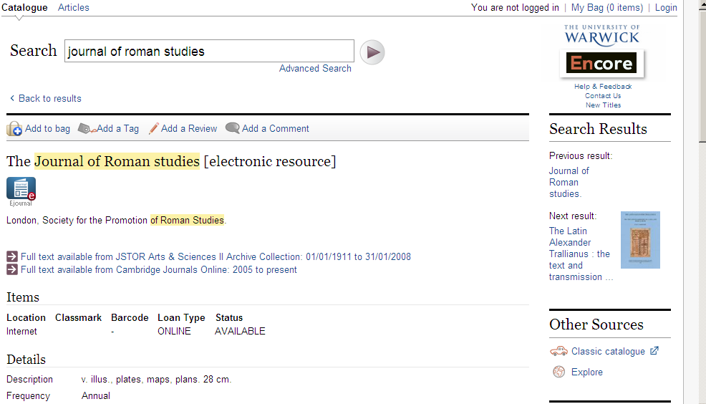

Slide 16
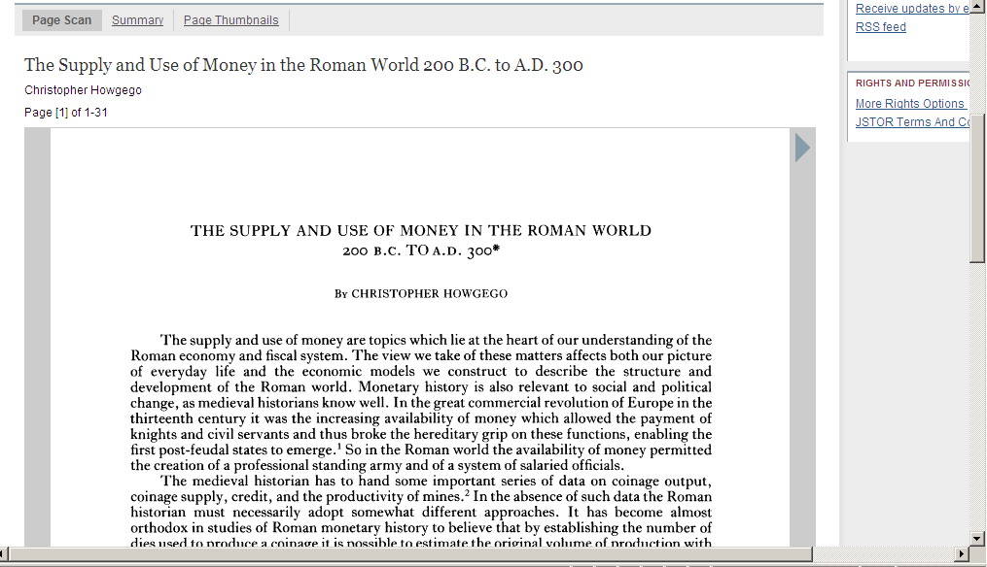

Slide 17
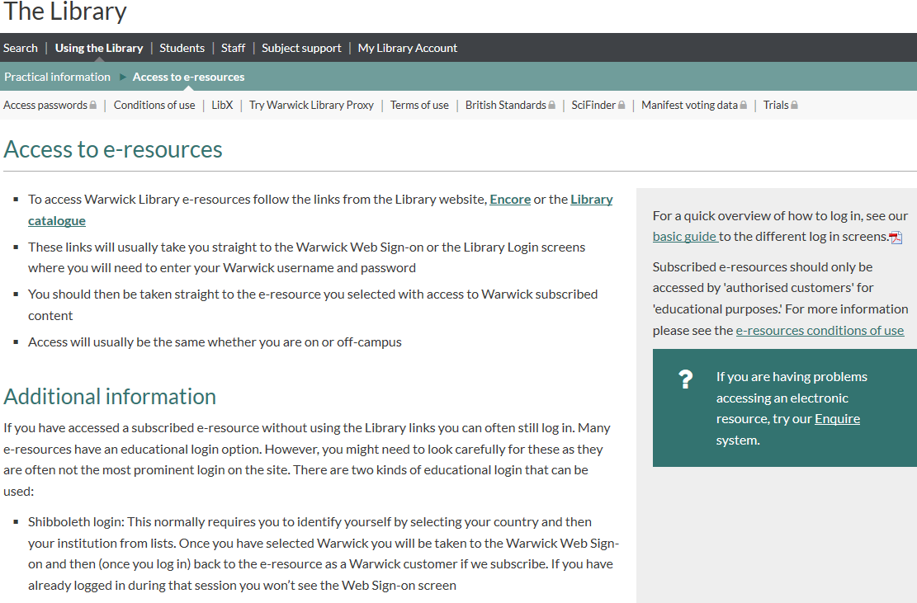

Slide 18
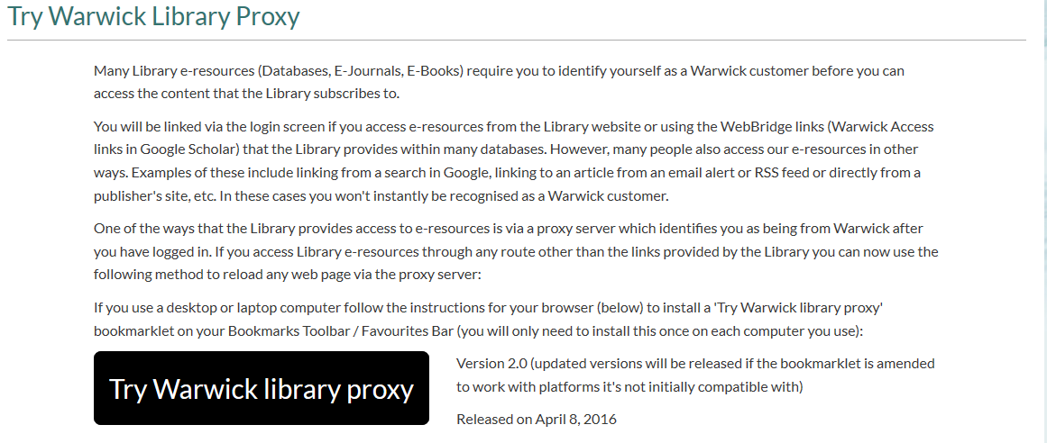

Slide 19
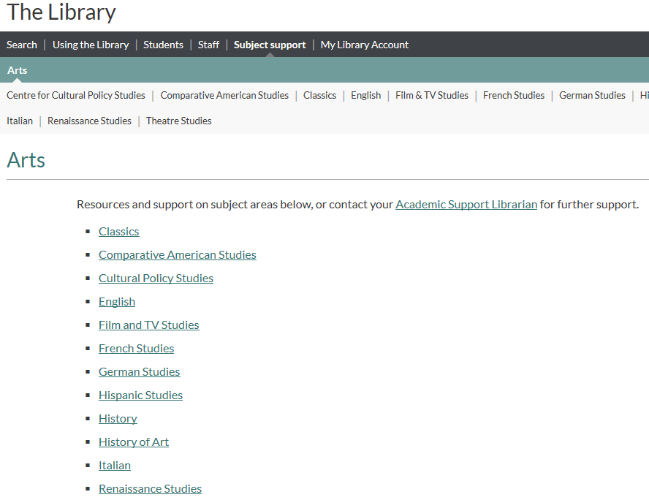

Slide 20
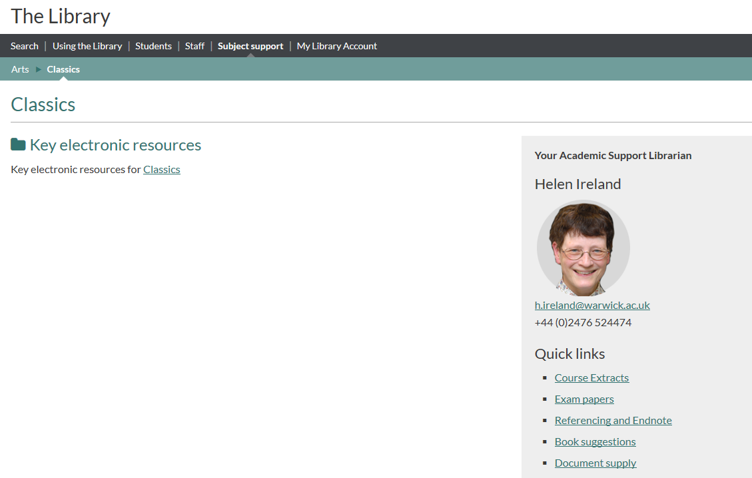

Slide 21
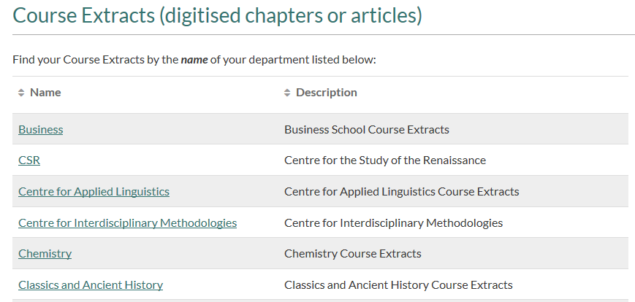

Slide 22
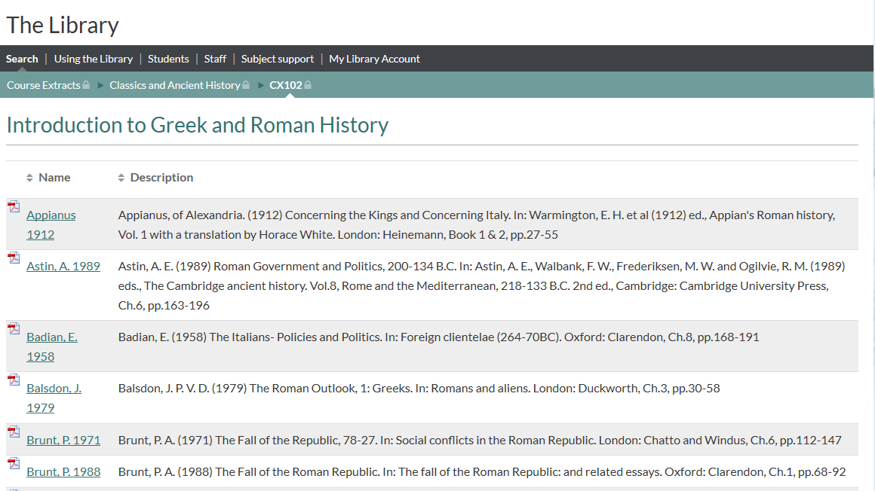

Slide 23
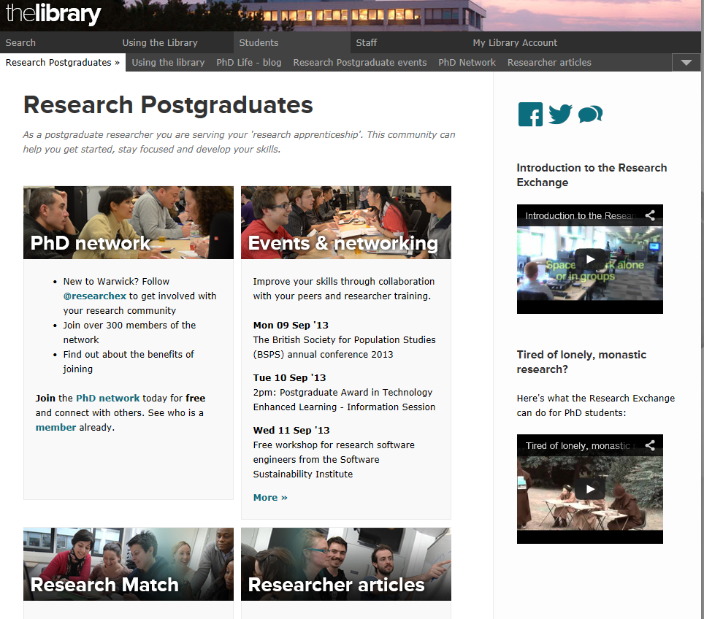
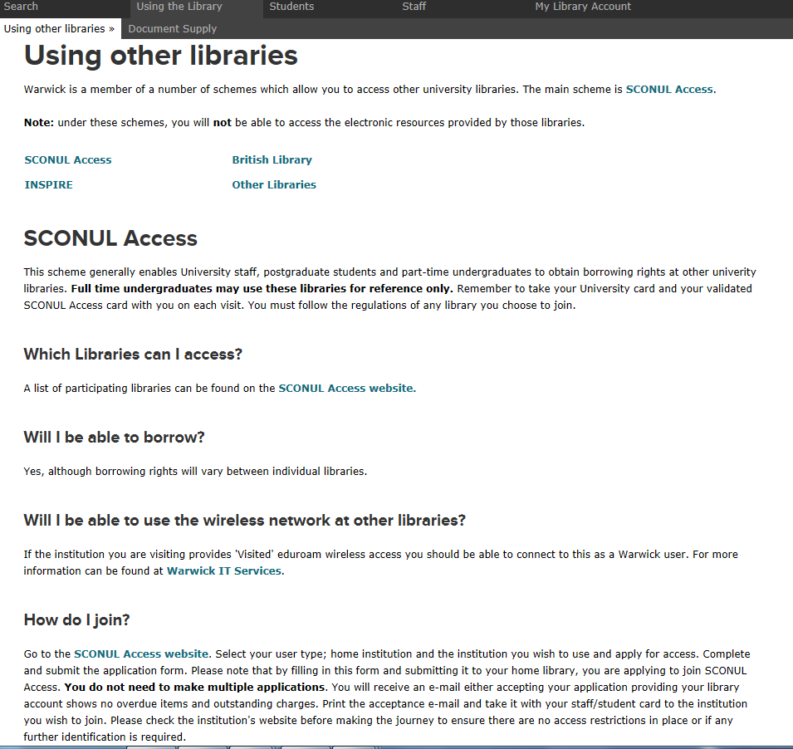

Slide 24
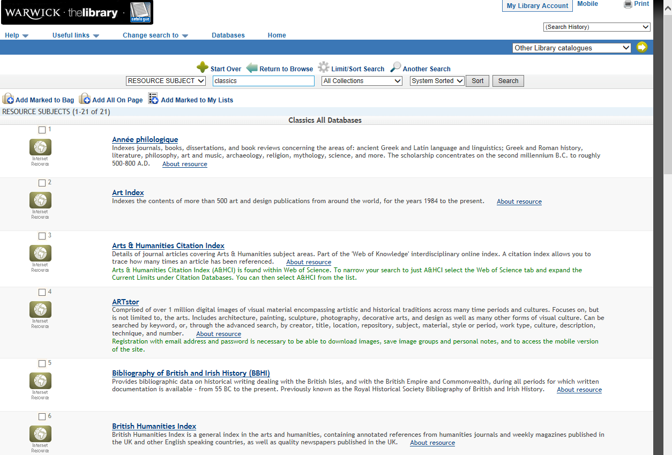

Slide 25
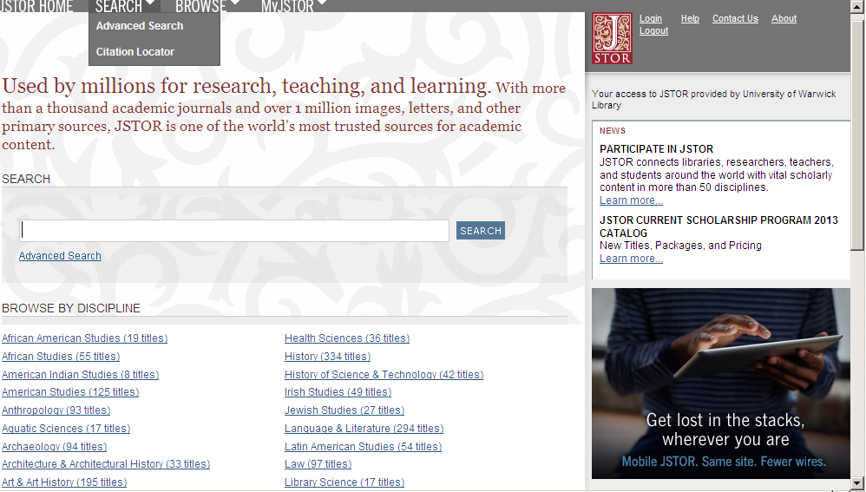

Slide 26
Evaluating Internet Resources
Who has written it? Bias and authority.
When was it written?
Are there contact details on the site?
Is there any way of validating the information?

Slide 27
Referencing
Departmental guidelines
Library online tutorial on referencing
http://www2.warwick.ac.uk/services/library/students/referencing
GetWISE module on Referencing and Avoiding Plagiarism
Reference Manager software such as EndNote Online

Slide 28
Further Help

Slide 29
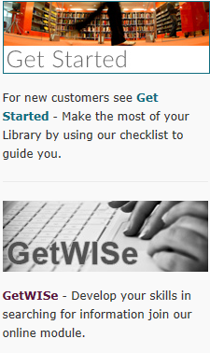
Further Help

Slide 30
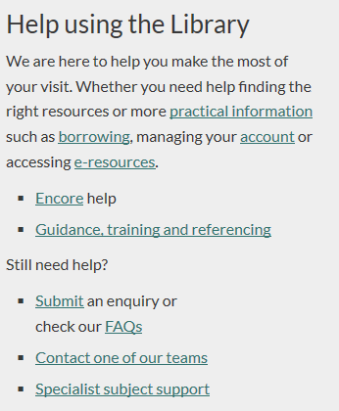

Slide 31
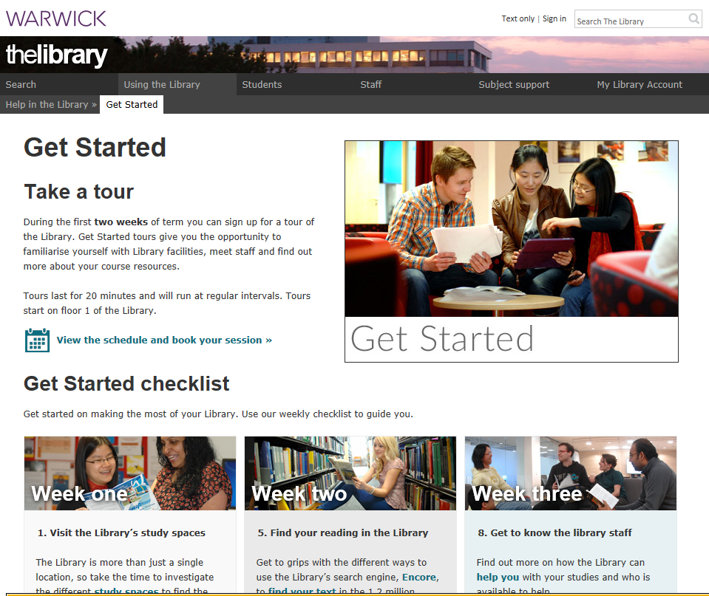

Slide 32
GetWISE and Study blog
GetWISE is a Moodle course, designed to cover finding information beyond the basics, including advice on developing your research skills, referencing and avoiding plagiarism
The Study Blog offers tips and advice to enhance your study experience at Warwick
http://studyblog.warwick.ac.uk/

Slide 33
Specific queries
Email h.ireland@warwick.ac.uk
Phone: 024 76 524474
Good Luck!

