Slide 1
Department of Classics and Ancient History
Style Guide-SSLC Feb 2024

Slide 2
General points
Use Microsoft Word
Page Numbers: Include a page number in the footer of your essay
Fonts and Spacing: Use a 12-point clear font (such as Times New Roman); 1.5 or double line spacing and clearly delineate paragraphs. Use the same font type and size throughout.
Quotations: The use of quotations from primary sources is strongly encouraged, whilst direct quotations from scholarship should be used sparingly and only if necessary to your argument. Paraphrasing scholarship with acknowledgement given in a footnote is preferable. Quotations may be given within a sentence and must always be enclosed by quotation marks “like this”.
Greek & Latin words: These should be given in italics. Be consistent in translating Greek names, preferably using Latinised forms of names, e.g. Aeschylus.
Use of Ibid: This is not recommended.

Slide 3
Footnotes

Slide 4
Footnotes
Footnotes are used throughout your essay to show where you got your information from. Use footnotes when quoting both primary source material or ideas taken from secondary scholarship. Footnotes can also include more than one citation in each reference. All works cited in footnotes must also appear in your bibliography
When referring to secondary source from a book, include the author’s surname, the publishing date and page number
Example: Bowman (1994) 93-95.
If two authors: Cooley and Cooley (2014) 67-80.
If multiple authors Morford et al (2011) 110.
When referring to primary sources, include the author’s name, the work in Italics and the book/line etc
Example: Homer Iliad 22.131-135

Slide 5
When referring to a chapter from an editing volume, use the name of the writer rather than the editor (who you can include in the bibliography)
Example: Purcell (1995) 150-79.
When referring to journal articles, use the name of the writer, the same as single-author books
Example: Rowan (2016) 30-25.
Looks the same as a single authored book!

Slide 6
When referring to an online version of a printed source, do the same as you would with physical copies
For images, include the URL of the source and if possible a title in the footnote and the bibliography
Example: British Museum, “Explore: The Rosetta Stone”: www.britishmuseum.org/collection/egypt/explore-rosetta-stone.
When referrng to multiple sources in a footnote, insert a semicolon between each source used. Put any classical text used first, and then secondary texts in the order they were written (earliest -> latest)
Example: Tacitus Annals 13.39; Bowman (1994) 93-95; Cooley and Cooley (2014) 67-80.

Slide 7
Primary Sources Classical Texts

Slide 8
Classical Texts
They should be given as the original classical author’s name, title of the work in italics. And finally a book/chapter/section/line number. Use the Loeb Classical Library (available online via the library.)
Examples
Tacitus, Annals 13.39 (this refers to Book 13, chapter 39)
Homer, Iliad 22.131-135 (this refers to Book 22, lines 131 to 135)
Horace, Odes 3.2.1-4 (this refers to Book 3, poem 2, lines 1 to 4)
:

Slide 9
Primary Sources
Inscriptions

Slide 10
If you include any published inscription in you work, this is how they need to be cited.
Give the abbreviation for the corpora to which they belong and their individual number.
An entry would appear for the abbreviation of the corpus (Example: RIB for Roman Inscriptions of Britain) in the List of Abbreviations for Standard Reference Works and Catalogues. (More information in the Bibliography section)
Example:
Inscription in text: “To the spirits of the departed (and to) Regina, his freedwoman and wife, a Catuvellaunian by tribe, aged 30, Barates of Palmyra (set this up).”
A footnote would be inserted after the second quotation mark and include: RIB 1065

Slide 11
Primary Sources
Coins

Slide 12
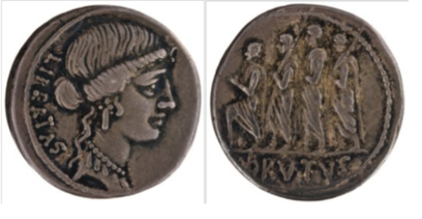
Primary Sources: Coins
When referring to a coin in the footnotes, add the standard catalogue abbreviation (e.g. RIC III Marchus Aurelius 754 OR RRC 433/1 OR RPC I 1305). When referring to a coin it is strongly suggested to include an image and the following information should be included:
the standard catalogue abbreviation, denomination, description, mint and date.
This should also appear in the List of Illustrations with further information. Information for this available in Bibliography and the abbreviation of the corpus should be mentioned in the Abbreviations of Standard Reference Works and Catalogues.
Fig. 1. RRC 433/1, Silver denarius, Brutus as moneyer, mint of Rome, 54 BCE.

Slide 13
Bibliography

Slide 14
Bibliography
All sources that you cite in a footnote must then be included in the bibliography in full. This should be included in a separate page at the end of your essay, organised in alphabetical order (by author’s surname). If there are multiple references to the same author, organise the sources by publishing date (earliest first)
Primary Sources
When putting primary texts in your bibliography, include the author, text name (in italics), translator (and the publishing details of the translated text)
Homer, Iliad, trans. R. Fagles (Harmondsworth: Penguin Classics 1990).
Horace, Odes and Epodes, ed. and trans. N. Rudd, Loeb Classical Library 33 (Cambridge, MA: Harvard University Press, 2004)

Slide 15
Secondary Sources 1
When putting secondary sources in the bibliography, include author, date, title (in italics) and publishing details
For a single authored book:
Bowman, A.K. (1994) Life and Letters on the Roman Frontier (London: British Museum Press).
For a jointly authored book:
Cooley, A.E. and Cooley, M.G.L. (2014) Pompeii and Herculaneum: A Sourcebook (Abingdon: Routledge).
Morford, M. P. O., Lenardon, R. J. and Sham, M. (2011) Classical Mythology (Oxford: Oxford University Press).

Slide 16
Secondary Sources 11
For a chapter in an edited book:
Purcell, N. (1995) ‘The Roman villa and the landscape of production’, in Urban Society in Roman Italy, eds T.J. Cornell and K. Lomas (London: UCL Press), 150-179.
For a journal article:
Rowan, C. (2016) ‘Ambiguity, iconology and entangled objects on coinage of the republican world’, Journal of Roman Studies 106: 21-57.
For an online source:
“Explore: The Rosetta Stone”: www.britishmuseum.org/collection/egypt/explore-rosetta-stone Accessed 06 June 2022.

Slide 17
List of Abbreviations for Standard Reference Works and Catalogues
This should be placed in the Bibliography under the above listed subheading.
Inscriptions
Coins
RIB Roman Inscriptions of Britain, Volume 1. Online at:
https://romaninscriptionsofbritain.org/ 2022.
RRC Roman Republican Coinage. Online at: http://numismatics.org/crro/
2022.

Slide 18
Images and Captions
Images can be placed either within the body of the text or as a separate series of figures at the end of the essay.
When used they should be referred to in text as (Fig. 1), given a caption, and included in a separate List of Illustrations.
Captions should include information as to what the image is and give the museum numbers where possible.

Slide 19
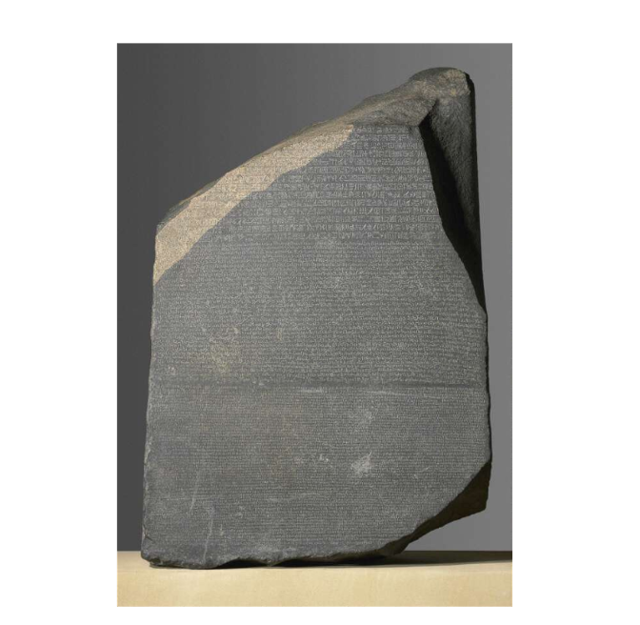
Fig. 2. The Rosetta Stone, British Museum No. EA24.

Slide 20
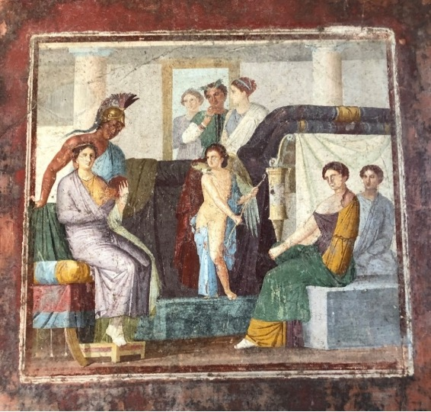
Fig. 3. Wall painting, Mars and Venus, in situ in the House of M. Lucretius Fronto, Pompeii V 4 a.

Slide 21
List of Illustrations
The List of Illustrations is used to cite any images or coins that feature within your essay. This should appear at the end of your essay, either before or after your bibliography.
Your list of illustrations should repeat the information given in your caption, but also additional information on where the image has come from, whether this be your own photograph (‘own photograph’), from a book you’ve read, or from a website.

Slide 22
Example List of Illustrations
Fig. 1. Denarius of the Roman Republic, Brutus as moneyer, mint of Rome, 54 BC, RRC 443/1.
Obv.: LIBERTAS (at left); head of Libertas right; border of dots..
Rev.: BRVTVS (in exergue); L. Junius Brutus walking left, between two lictors carrying fasces and preceded by an accensus; border of dots..
AR, 3.53 g, 5 h; American Numismatic Soceity, 1976.999.25
http://numismatics.org/crro/id/rrc-433.1 (accessed 06 June 2022).
Fig. 2. Denarius of Marcus Aurelius, Rome, AD 166-267, RIC III p. 260, no. 574.
Obv.: L [VE]RVS AVG ARM PARTH [MA]X; Head of Lucius Verus, laureate, right: border of dots.
Rev.: T[R] P VII IMP III COS III: Victory, winged, draped, advancing left, holding wreath in extended right hand and palm, sloped over left shoulder, in left hand.
AR, 3.24 g, 12 h; Valencia Museum of Prehistory, Inv. 39441; from the Lliria Hoard
https://www.mupreva.org/nomisma/id/es/39441 (accessed 28 Aug. 2023).

Slide 23
Examples Cont.
Fig. 3. The Rosetta Stone, British Museum No. EA24 (from British Museum: https://www.britishmuseum.org/collection/object/Y_EA24 accessed 06 June 2022).
Fig. 4. Wall painting. Mars and Venus, in situ in the House of M. Lucretius Fronto, V 4 a., Pompeii (author’s own photograph)

Slide 24
Complete the Dept Cover sheet and include it at the start of your essay. Please state your essay’s word count.
Remember that footnotes must be included in your word count.
The following should not be included in your word count:
Bibliography
Captions
List of Figures

Slide 25
If you have any further questions about the style guide, please reach out to your module convenor.
This style guide only focuses on the presentation of your essay, for any queries on the marking criteria or any general essay writing advice, please consult the Departmental Handbook and the following webpage:
https://warwick.ac.uk/fac/arts/classics/intranets/students/essaywritingresources

