Slide 1
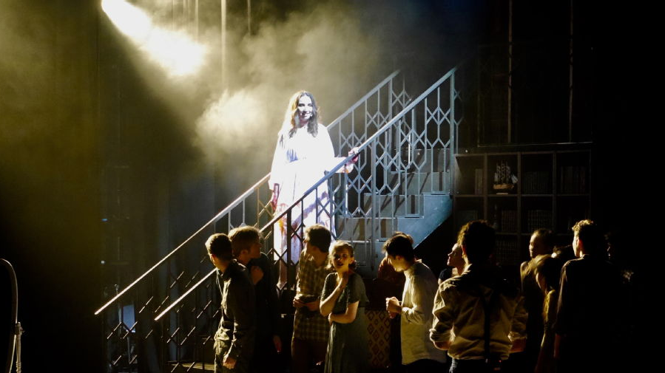
Welcome back!

Slide 2
Introductions
New staff:
Jack Nurpetlian
Alex Antoniou
Robert Rohland
Elena Claudi
Cynthia Liu
Staff on leave
Caroline Petit (Wellcome grant, all year)
Victoria Rimell (Term 2)

Slide 3
Time for a little ceremony…..

Slide 4
Staff roles (also in the handbook ☺)
https://warwick.ac.uk/fac/arts/classics/staff/
Contact during drop-in hours, online or on campus (check with staff member where/When) or email for appointment. NB working hours and research days.
Head of Dept: David Fearn
Deputy Head of Department: Victoria Rimell (Zahra in Term 2)
Director of Education / SSLC: Clare Rowan
Senior Tutor: Emmanuela Bakola
Director of Undergraduate studies: James Davidson
Study Abroad: Victoria Rimell (Keri in Term 2)
Widening Participation Coordinator: Paul Grigsby
Diversity and Inclusion: Emily Clifford
Library: Andy Calvert
Programmes Manager: Donna Davies
Administrator: Keri Husband
Careers: Clare Halldron

Slide 5
Careers
Clare Halldron: Classics Careers Consultant
C.M.Halldron@warwick.ac.uk
Careers sessions for Honours students will be advertised throughout the year – check your emails!

Slide 6
Timetable and Modules
Make sure you sign up for seminar slots ☺
Any problems or changes needed contact the office staff at classics@warwick.ac.uk
Latest date for changes is end of Week 2.
Resources on moodle, audio lecture capture, as last year
Attendance is now done through card scanners

Slide 7
Assessment and exams
Do check your various assignments and their due dates, and then make a plan accordingly. ☺
Exams in the summer term run 17th May – 24th June 2027 (includes Saturdays). We have no control over the timetable ☹
Do look at the assessment criteria for your assignments with essay criteria set out in the handbook. Ask your module tutors what they want to see! ☺ (NB: second-year criteria)
NB: there is a new (hopefully clearer) assignment cover sheet. Please make sure you use this rather than reusing an old file on your computer ☺

Slide 8
New faculty level policies/wording
Now in the handbook
Wrong file submission (if you need to swap the file after the deadline you will incur normal late penalties): Your submission will be treated as late. Late penalties will apply from the original deadline until the correct file is submitted, unless these are waived through approved mitigating circumstances.
Work that has been submitted will normally be marked as submitted.
Staff are not expected to identify incorrect file submissions.
If you do not report an issue, your submitted file will be marked as it stands.

Slide 9
Word length
Assessments are set with a defined word count range (for example, 1,250–1,500 words).
Students must submit work within the stated lower and upper limits.
There is no additional tolerance beyond this range.
Technical problems
Technical problems (including upload failures, incorrect file submissions, or IT issues) are not accepted as valid reasons for late submission.
Students are responsible for allowing sufficient time to submit their work and for checking that submission has been successful.

Slide 10
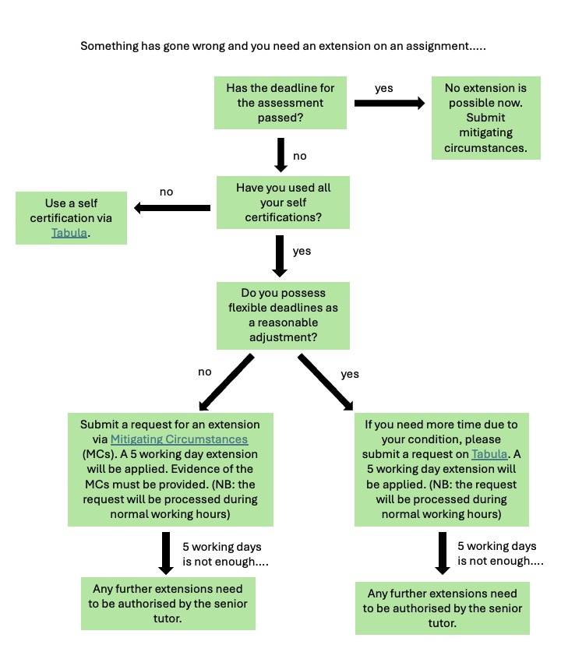
New method for requesting extensions (thanks to the SSLC and Unitu!)
NB: if you want to participate in student voice via Unitu, please respond to the emails as they get sent around later this term. :-)

Slide 11
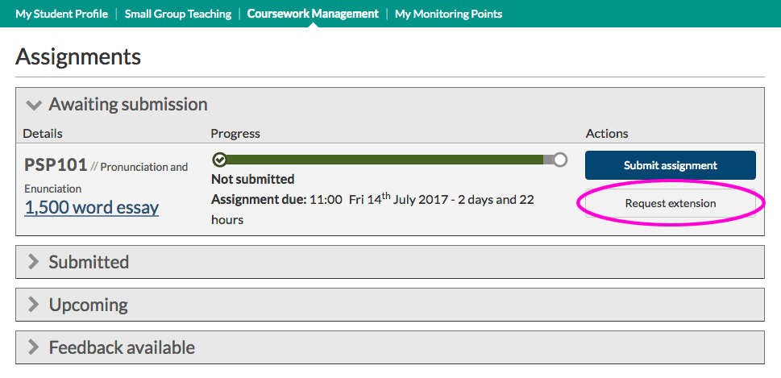

Slide 12
Rewritten AI policy
In response to SSLC request and Unitu
Updated Tabula notification when submitting assignments declaring that you have read the policy and that your submission conforms to the guidelines
The new policy (hopefully clearer) can be found in the handbook. Make sure you read it before submitting your first assignment this term.

Slide 13
Dissertation
Convenor: Trevor van Damme
Sessions in T1 Weeks 2-4
https://warwick.ac.uk/fac/arts/classics/intranets/students/modules/dissertation

Slide 14

CX303 Dissertations
Week 2: Monday, October 12 at 12:00 noon: submission of outline plan of your dissertation (no more than 250 words, submitted through Tabula). Please note that this is a formal MONITORING POINT.
Supervisors will be allocated this week.
Induction Session 1, Tuesday, October 13, OC 0.01, 1:00–2:00 pm: General guidance on research and conceptualisation of topic – scope; angle; structure; materials. At the end TVD will collect anonymised list of concerns from students, so please bring pen and paper with you!
Induction Session 2, Tuesday, October 20, OC 0.01, 1:00–2:00 pm: Open discussion of anonymous concerns submitted last week, and other matters arising. Please note that this is a formal MONITORING POINT.
Students to arrange a meeting with dissertation supervisor (recorded on dissertation log). Please note that this is a formal MONITORING POINT.
Induction Session 3, Tuesday, October 27, OC 0.01, 1:00–2:00 pm: Session with Andy Calvert, Subject Librarian, ‘Visualising your research journey’. This is an interactive session in which students explore the stages of research. Please bring a laptop with you!
AND WATCH THIS SPACE FOR AN EXTRA SESSION AT THE END OF TERM 1!

Slide 15
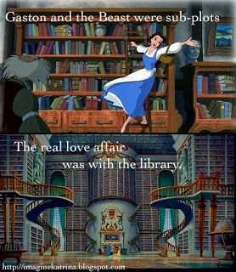
Don’t neglect the library!
Get it for me (☺ ☺ ☺ ☺)
Recall books if needed (this can frequently change the due date)
Email Andy if you have any queries or suggestions (Andrew.Calvert@warwick.ac.uk)

Slide 16
Teaching and Learning
Independent study:
You are expected to do a total of 1200 hours of study per year (300 for a 30 CAT module). Allowing for some work in vacations, this means around 25-30 hours of independent study per week in term-time, in addition to contact hours.
You will also be asked to do reading outside of lectures, and lecturers will proceed on the understanding that you will have done this.

Slide 17
Additional study sessions and support
Study Café in the common room (with quiet room) with Chris, Thursdays 11.30am-12.30pm
Academic Skills sessions starting later this term, Fridays 12-1 with Chris, H1.49a. Watch out for the emails!
Greek and Latin peer mentoring, including additional sessions for GLT and LLT (in response to SSLC) – further details announced soon!

Slide 18
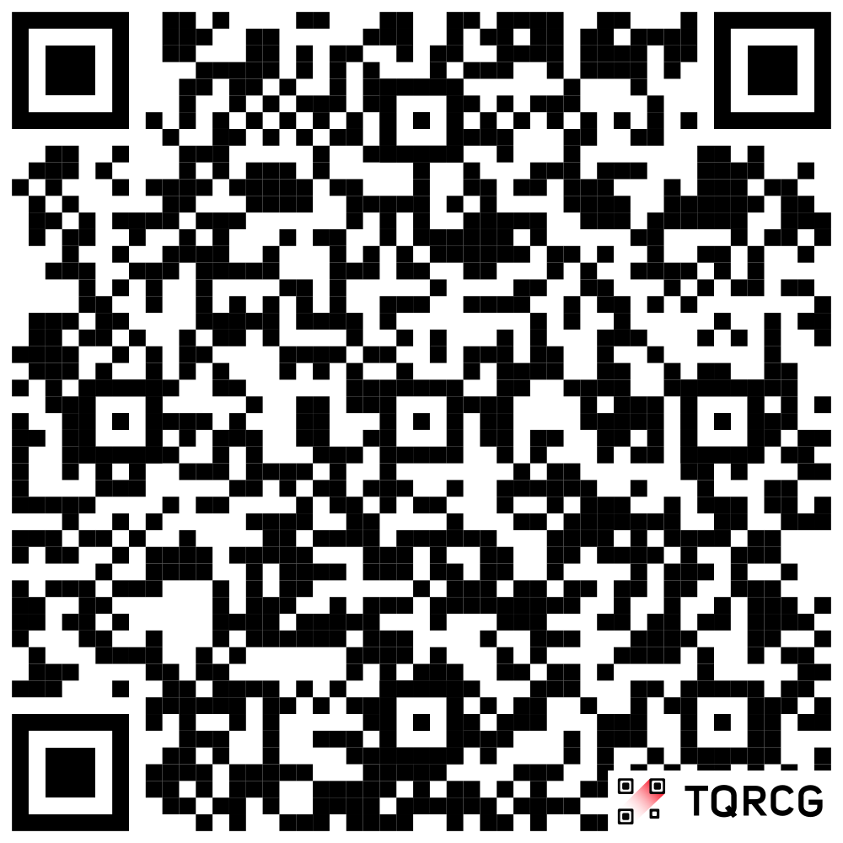
Making the most of your university experience
Thursdays in Term 1, 12-1pm, JX2.02
Different topics each week! Careers, archaeological excavation opportunities, Warwick Classics Network, Warwick Award and more!
Watch out for emails advertising each week’s event. NB: Masters info session in Week 5.
Full calendar at https://warwick.ac.uk/fac/arts/classics/news/events/?tag=mmue&view=agenda

Slide 19
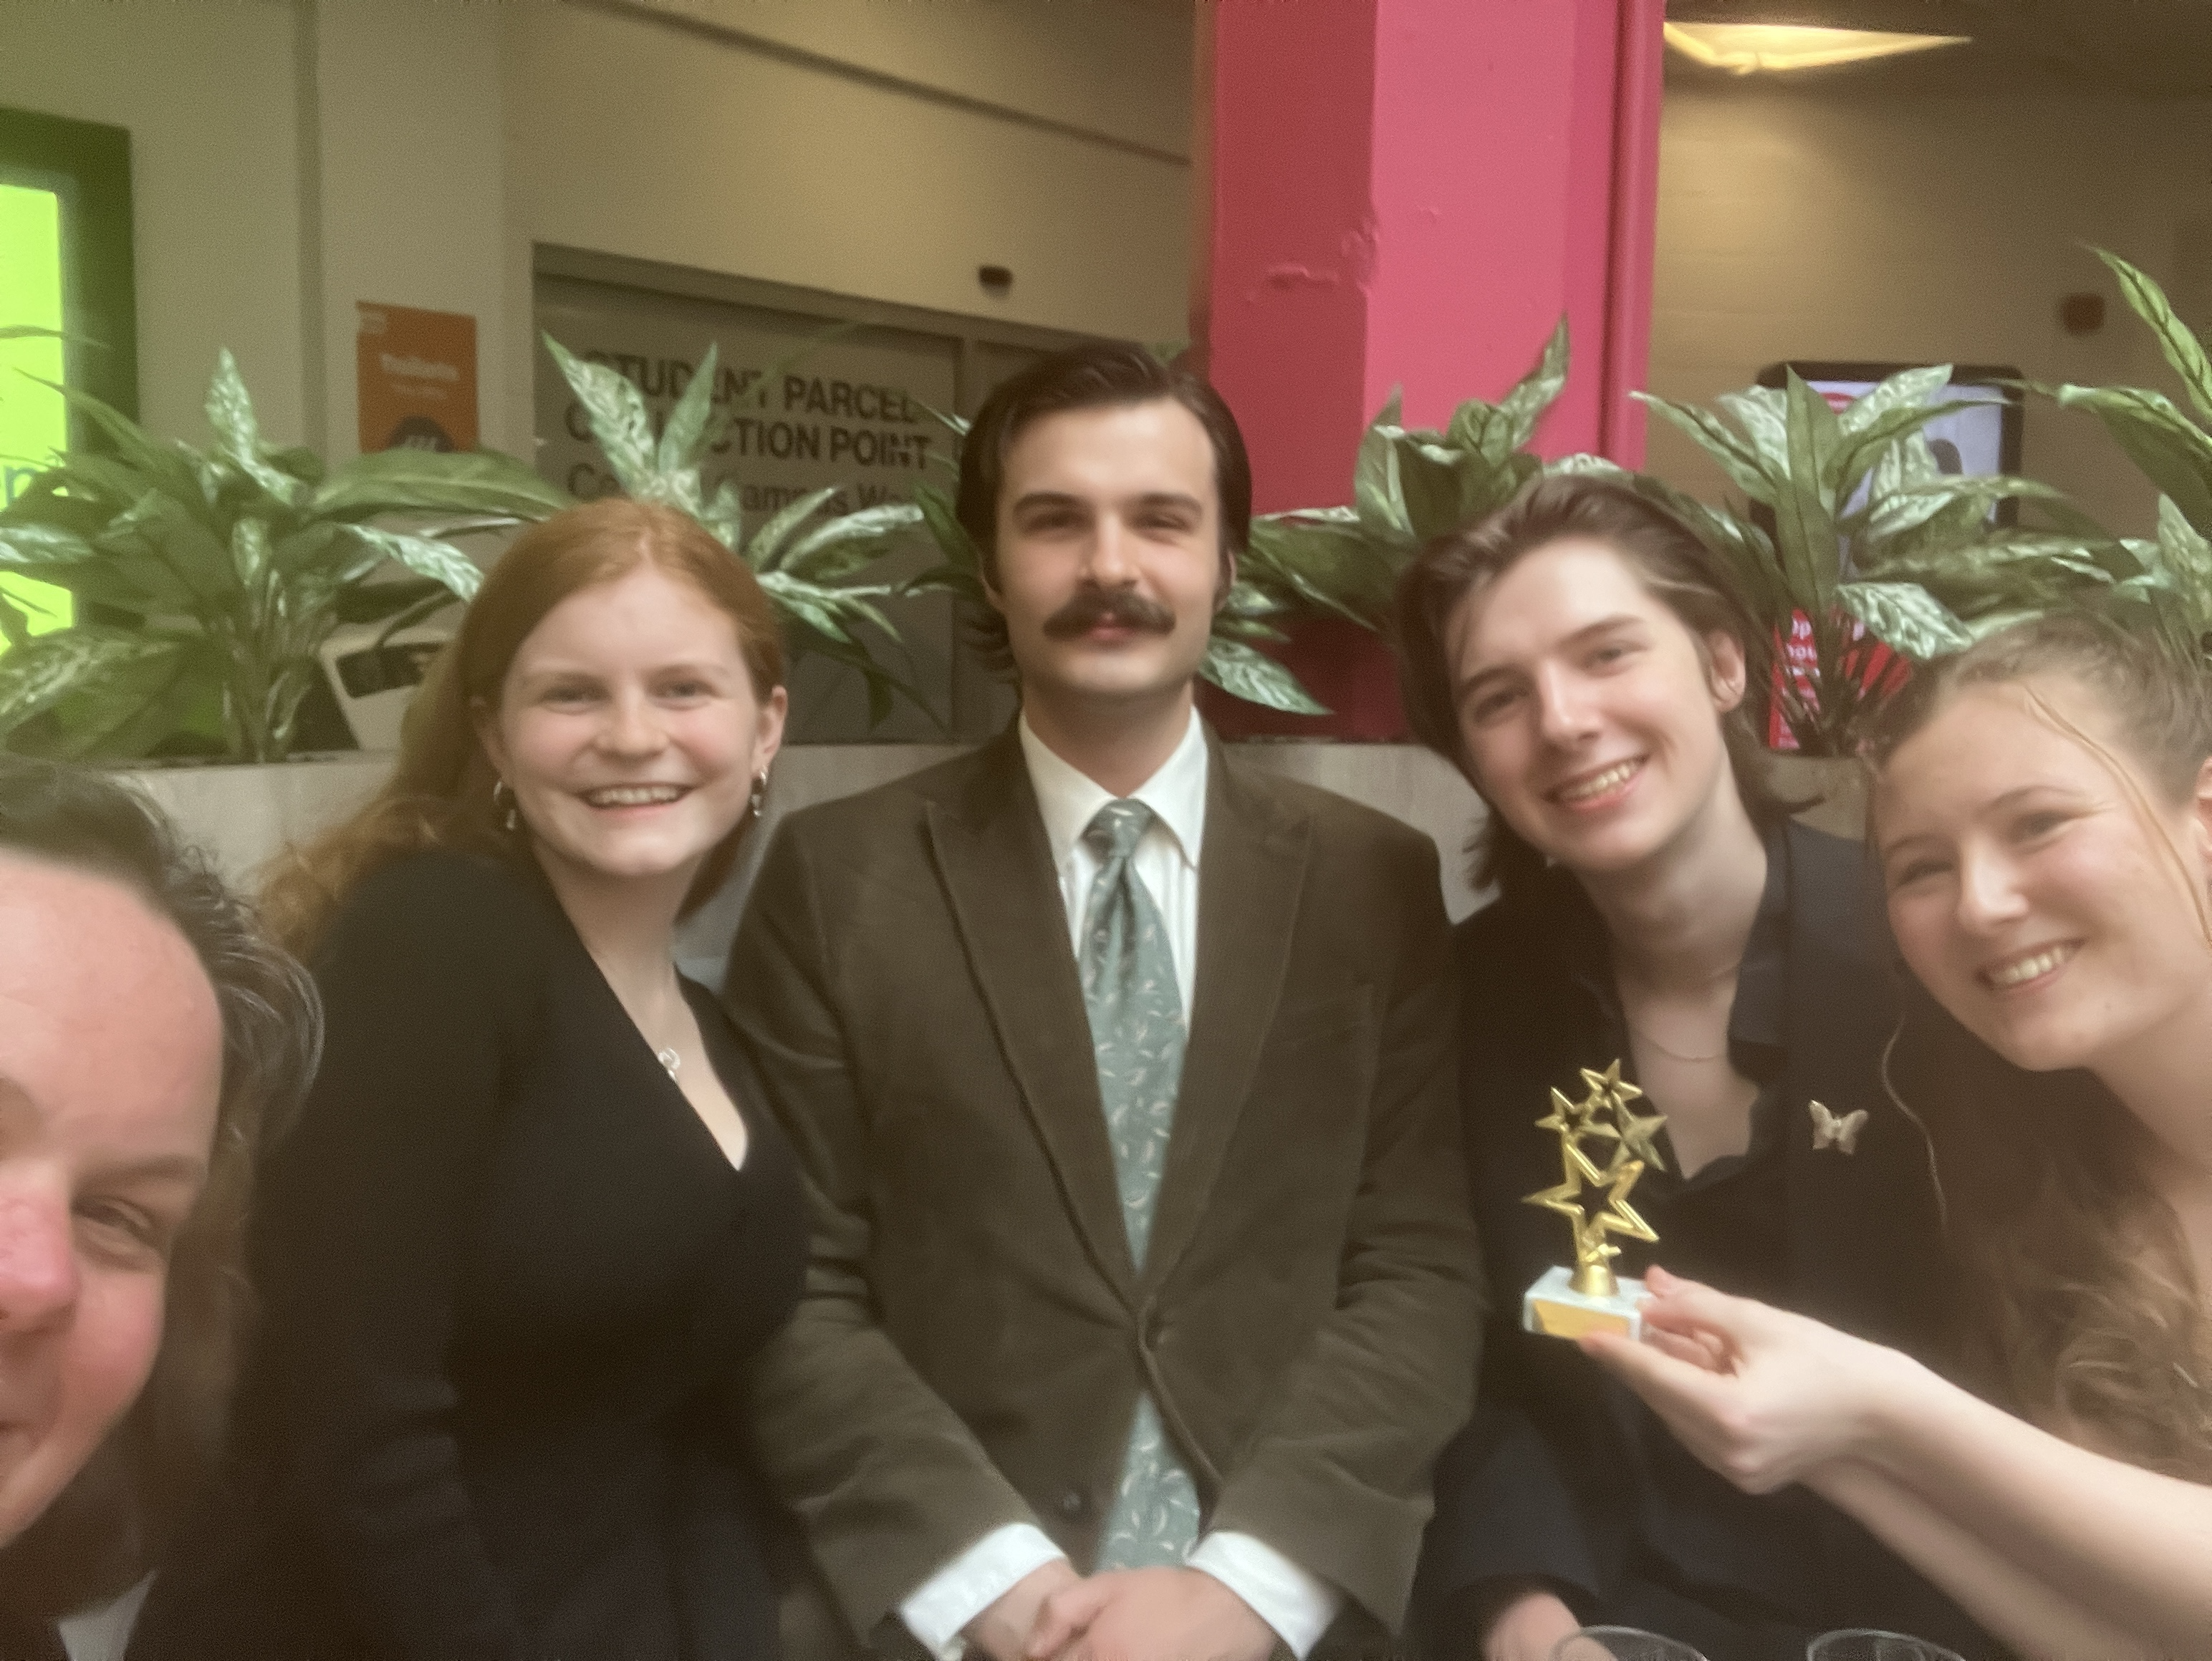
SSLC (Staff-student liaison committee)
In 2025/26 achieved (among other things):
SSLC OF THE YEAR!
Change to extension requests
Adoption of Unitu
Introduction of further support for advanced language classes
Change in wording of departmental AI policy
Change to module feedback form timing
Fed into new modules and degree changes
https://warwick.ac.uk/fac/arts/classics/intranets/students/sslc/
We traditionally have a representative from each degree and year group on our SSLC. If you would like to be a rep, or just learn more about what it involves, please to email Clare
C.Rowan@warwick.ac.uk
If you would like to be a rep please let me know by 12th October

Slide 20
Drop in hours: what are they for?
Ask module convenor questions about module content or assessments
Asking about further study opportunities (e.g. Masters)
Asking about support/advice on extra curricular activities (e.g. non-Warwick excavations, etc)
Asking about the ancient world more broadly!
Asking for support with study or essay writing skills (though don’t forget Chris)
Ideas for the department
And more….. We want to see you! ☺

Slide 21
Personal tutoring
Senior Tutor: Emmanuela Bakola, E.Bakola@warwick.ac.uk
Find your personal tutor on Tabula
Your personal tutor is there to support your academic progression, and to signpost you to University services as required
3 formal meetings a year (start term 1, start Term 2, start Term 3). These are monitoring points
You can also email for other appointments, or during drop in/ office hours.
A reminder for those with flexible deadlines to organise this with your PT in Term 1.
The personal tutor contract / PDP form
https://warwick.ac.uk/fac/arts/classics/students/guidance/personaltutors/

Slide 22
University Support Services
https://warwick.ac.uk/services/wss/
In an Emergency:
Call Campus Community Safety Team: 024 7652 2222
or internal extension 22222.
Non-emergency number: 02476 522083
Nightline 22199 or 024 7641 7668 or nightline@warwick.ac.uk
Chaplaincy
Students Union

Slide 23
Support available for students
Wellbeing Support
  Practical and emotional support and advice in relation to any wellbeing issue including accommodation concerns , homesickness, experience of sexual violence, disciplinary processes, academic concerns, stress…
Counselling & Psychology Interventions
  A broad range of therapeutic interventions with qualified specialists (BACP/BABCP accredited) for students wanting to explore and understand difficulties.
Disability Services
  We encourage existing students & applicants to declare any disability or learning difference and make contact in advance to discuss their support requirements to enable us to make reasonable adjustments for the duration of their studies.

Slide 24
Financial Support
https://warwick.ac.uk/services/wss/funding/bursariesandscholarships
Hardship/Emergency funding
https://warwick.ac.uk/services/wss/funding/hardshipfunding/
Student Funding Support: (studentfunding@warwick.ac.uk) or telephone (+44 (0)24 7615 0096 )
Monday – Thursday: 8:30 am – 5 pm or Friday: 8:30 am – 4 pm.
In person drop-in hours Monday – Friday: 10 am – 3 pm at Senate House
*REMEMBER* Welfare room with microwaves/kettles, ground floor of FAB

Slide 25
Tips for success
Attendance
Time planning
Reading for Modules outside class on a weekly basis, for academic immersion in preparation for assessments
Discuss your progress and gaps with personal tutor via the PDP process.
Seek out additional skills training if needed.
Library Course on avoiding plagiarism: https://moodle.warwick.ac.uk/course/view.php?id=51959

Slide 26
Get involved
Students Union
SSLC: Clare
Classics Society
Student Opportunity:
https://warwick.ac.uk/services/studentopportunity/
Classics Play
Warwick Classics Network

Slide 27
Postgraduate Offerings
Ancient Literature and Thought
This MA will foster your ability to read a wide range of Greek and/or Latin texts in the original language and to develop nuanced understanding of the methodologies and critical approaches to the study of these texts within their historical, cultural and political contexts.
Ancient Visual and Material Culture
This MA will train you for further research in the fields of art, numismatics or epigraphy. Acquire necessary research techniques and skills at Warwick's Classics and Ancient History department.
MA by Research
•Route A features a 40,000-word dissertation.
•Route B is a more flexible course, with a shorter dissertation of up to 25,000 words, two 5,000-word essays, and language training, designed to help you prepare for doctoral work.

Slide 28
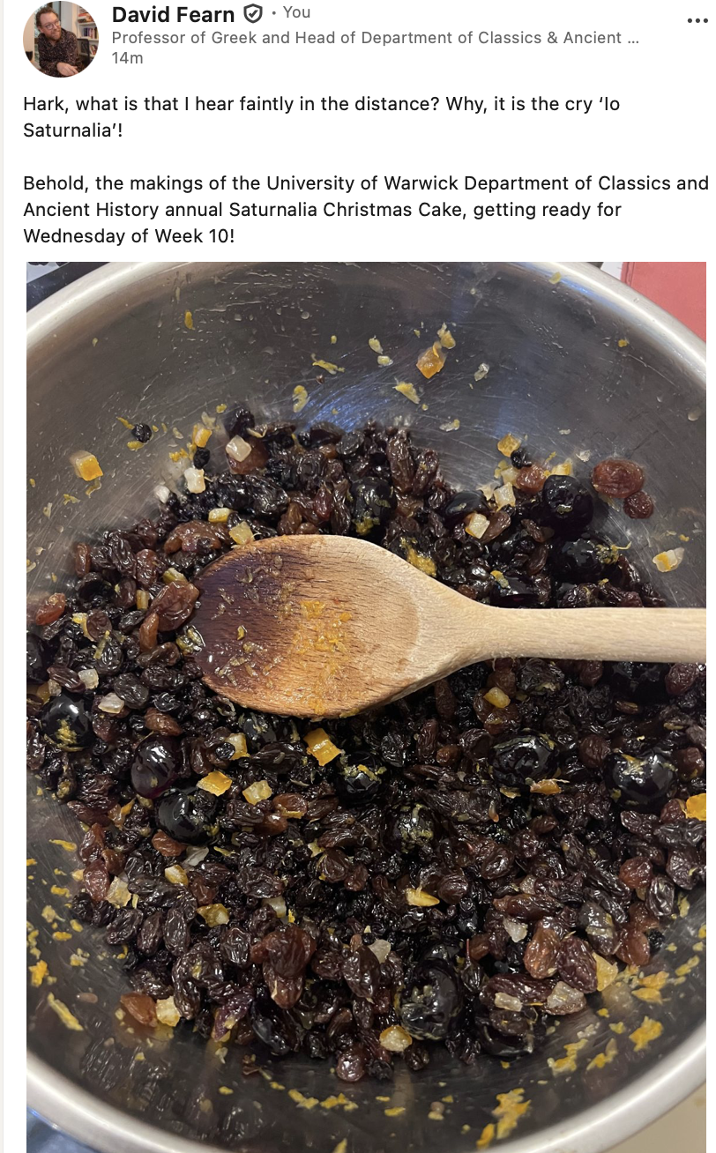
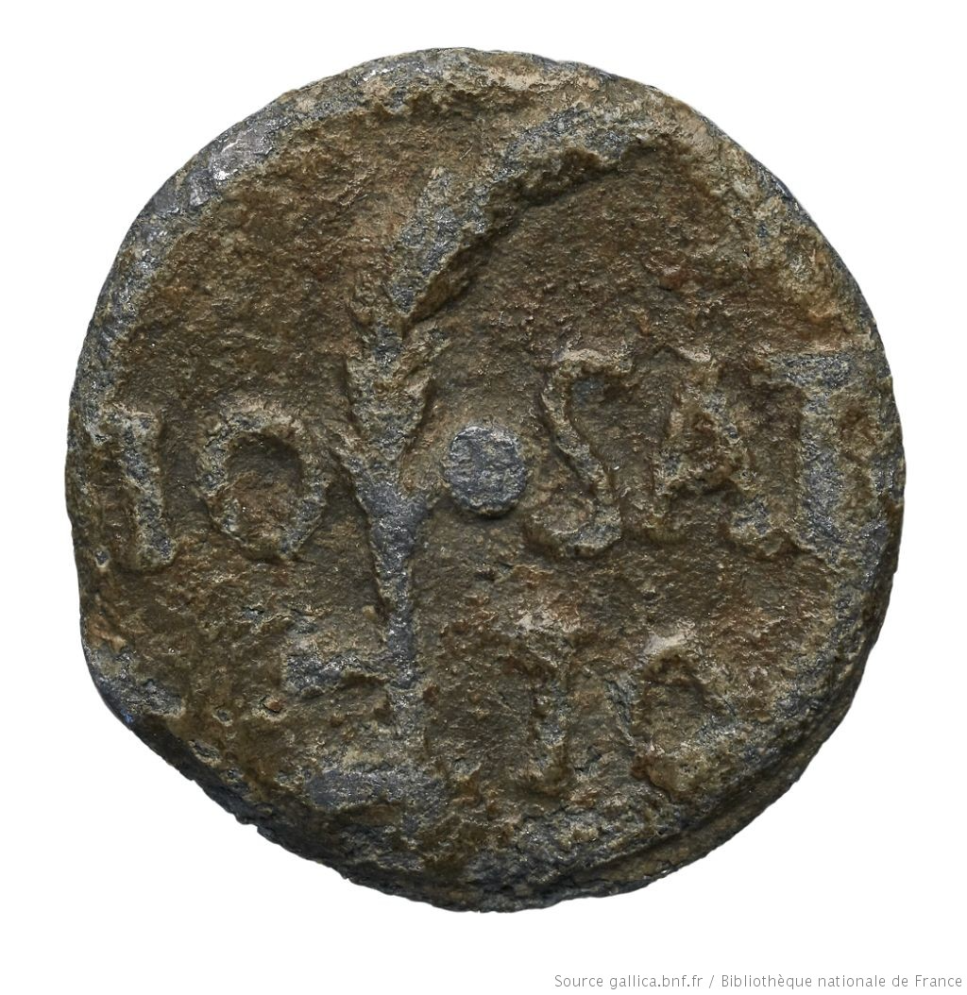
Io Saturnalia Io!
Come and join in the departmental Saturnalia!
Wednesday 9th December, 3-5pm, in the department
Food, festivities and Saturnalian activities!

Slide 29

Finally: the responsibility to build a community to make a difference
Understand that university is a challenge, but that the rewards, to be shared between yourselves and ourselves together, can be massive.
Internationally renowned primatologist, conservationist, environmentalist.

Slide 30
Questions?

