Slide 1
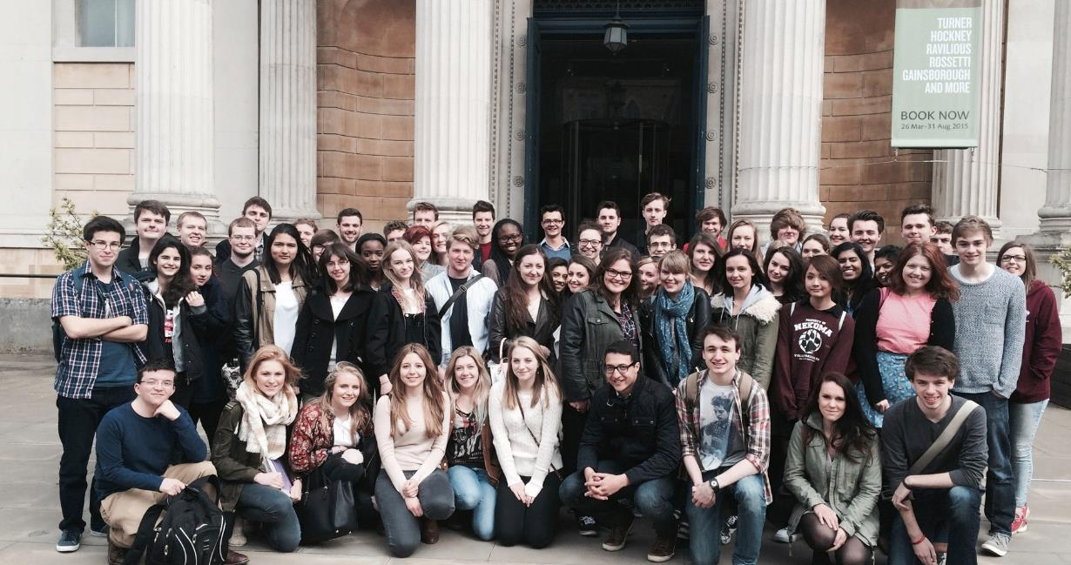
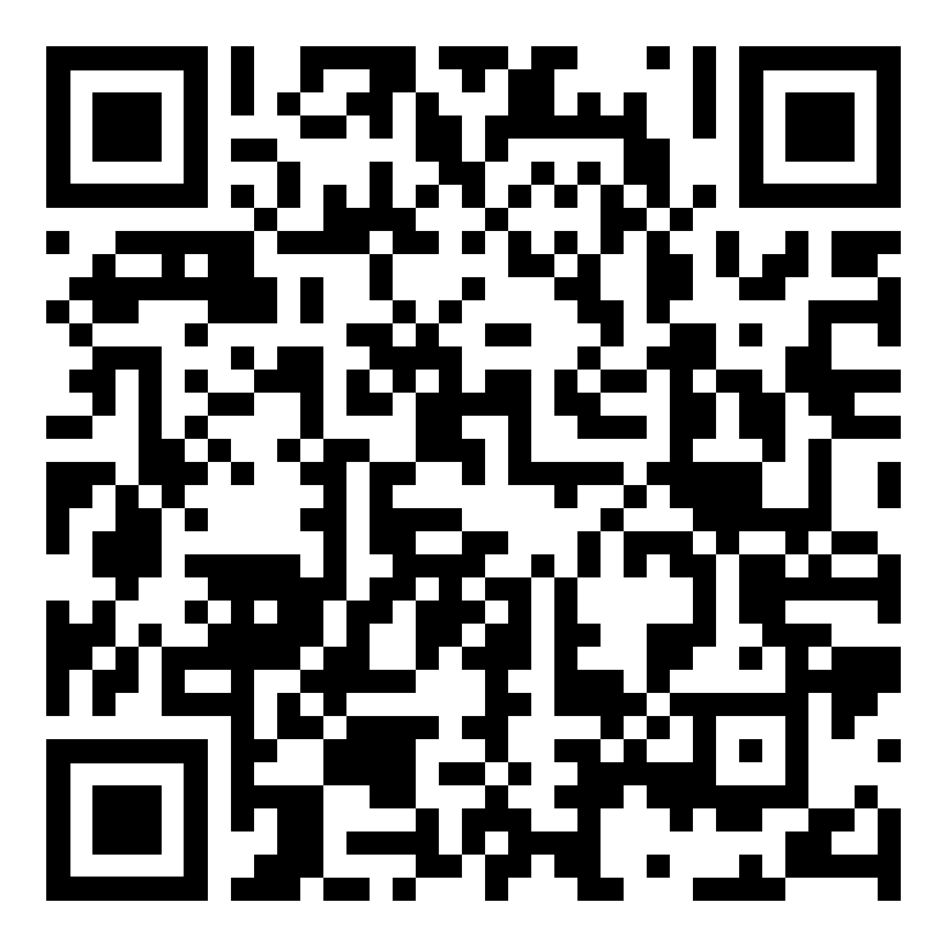
Welcome to the department!
Notes:
https://warwick.ac.uk/fac/arts/classics/intranets/students/induction2026/

Slide 2
Lets meet (almost) everyone... ☺
https://warwick.ac.uk/fac/arts/classics/staff/
Contact during our ‘drop-in hours’, via email, or during lectures
Key contacts:
Head of Department: David Fearn
Deputy Head of Department: Victoria Rimell
Director of Undergraduate Studies: James Davidson
Senior Tutor: Emmanuela Bakola
The office! (Administrative support): Keri Husband and Mel Price, classics@warwick.ac.uk

Slide 3
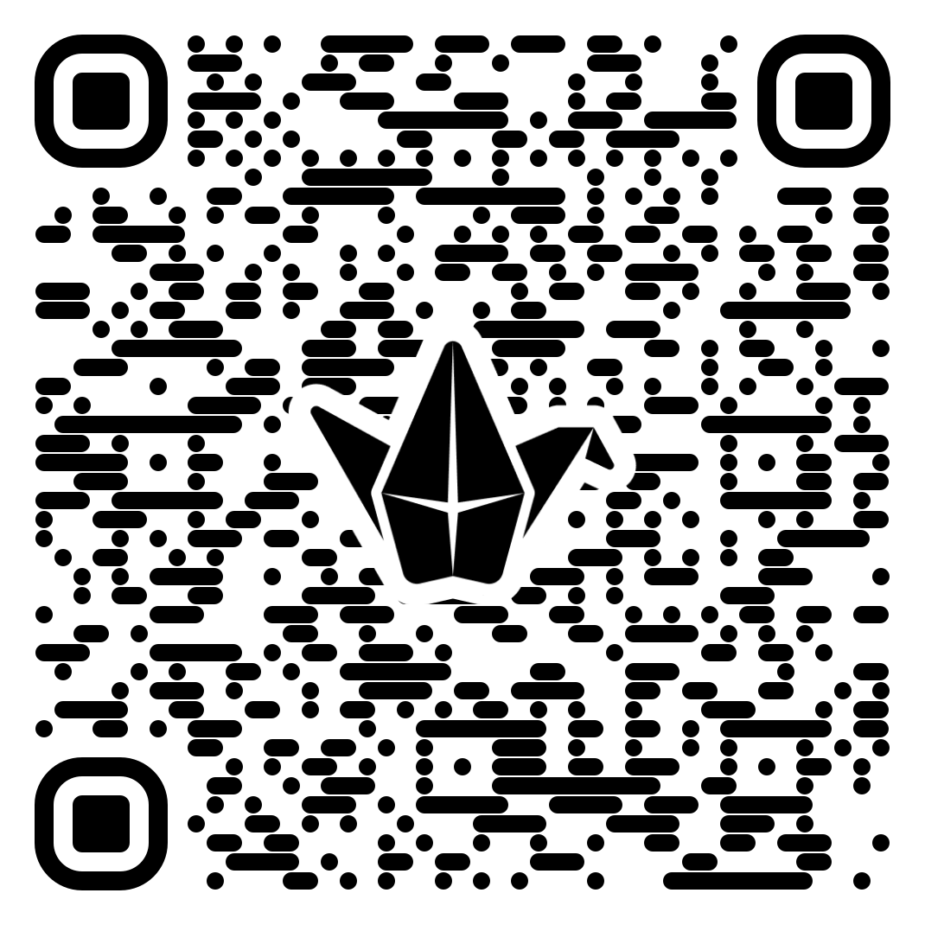
Meet and greet!
With the people around you:
Introduce yourself
Name one good thing you’ve discovered since arriving on campus
Name one thing you are worried or anxious about (and feel free to share that anonymously here: https://padlet.com/universityofwarwick/worries-or-concerns-share-them-here-s023uedr3r0tdeu4jwbw)

Slide 4
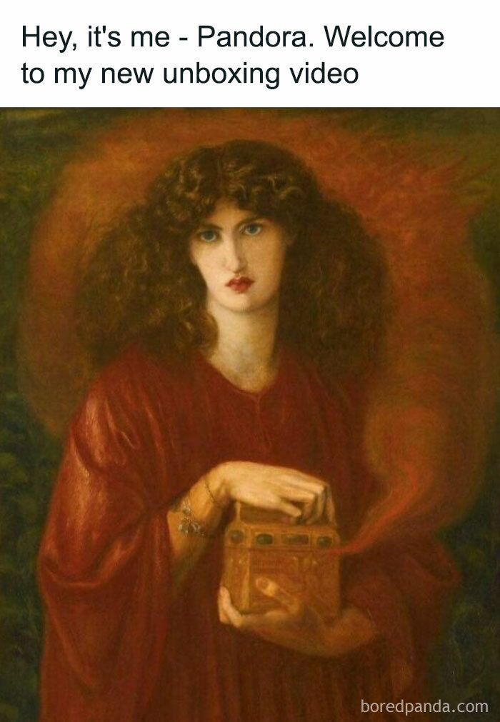
Welcome Week
Today 12.30-1pm – meeting with personal tutors
Tues 9.30am: Wellbeing induction (MS.03)
Tues 11.30am-12,30: Introduction to Latin and Greek, FAB 2.34/FAB 2.43
Tues 12.30-2pm: Lunch in the department (a chance to ask us about modules!)
Wed 10am-12pm: library tours (make sure sign up for a slot!)
Wed 2-3pm: Joint degree induction (S0.09)
Monday 5th October 11am-12pm: Q800 induction, FAB 3.30

Slide 5
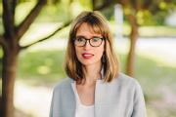
Erasmus and Study in Europe Students
Our study abroad co-ordinator is Victoria
Incoming exchange students: please meet with Victoria to discuss modules (V.Rimell@warwick.ac.uk)
All study in Europe students – please meet Victoria in FAB2.01 (just outside the department) at 1pm (after your Personal Tutoring meetings)

Slide 6
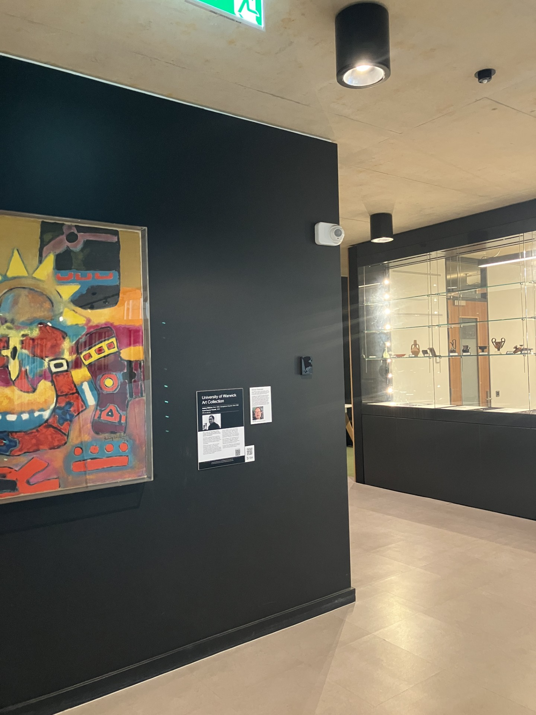
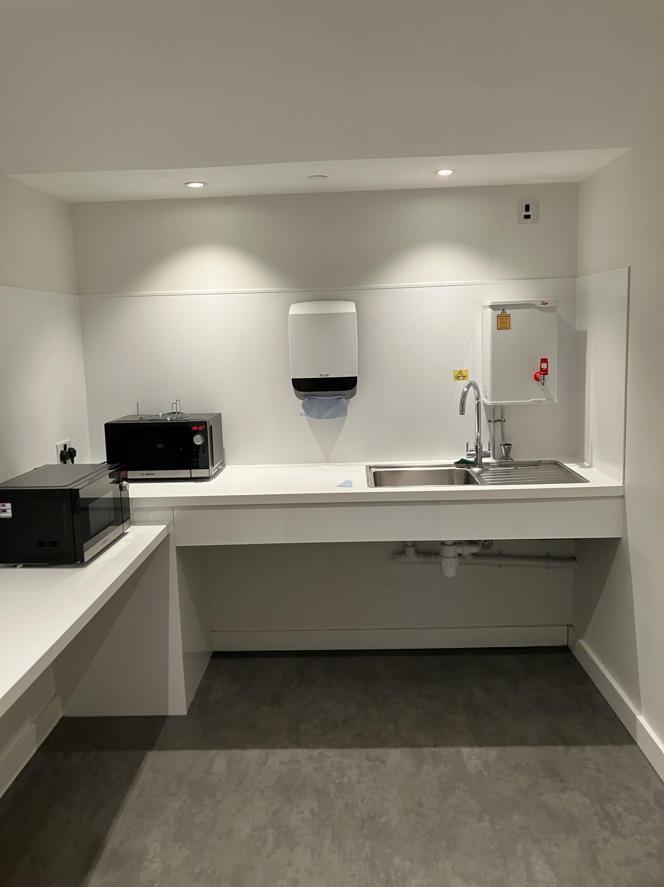
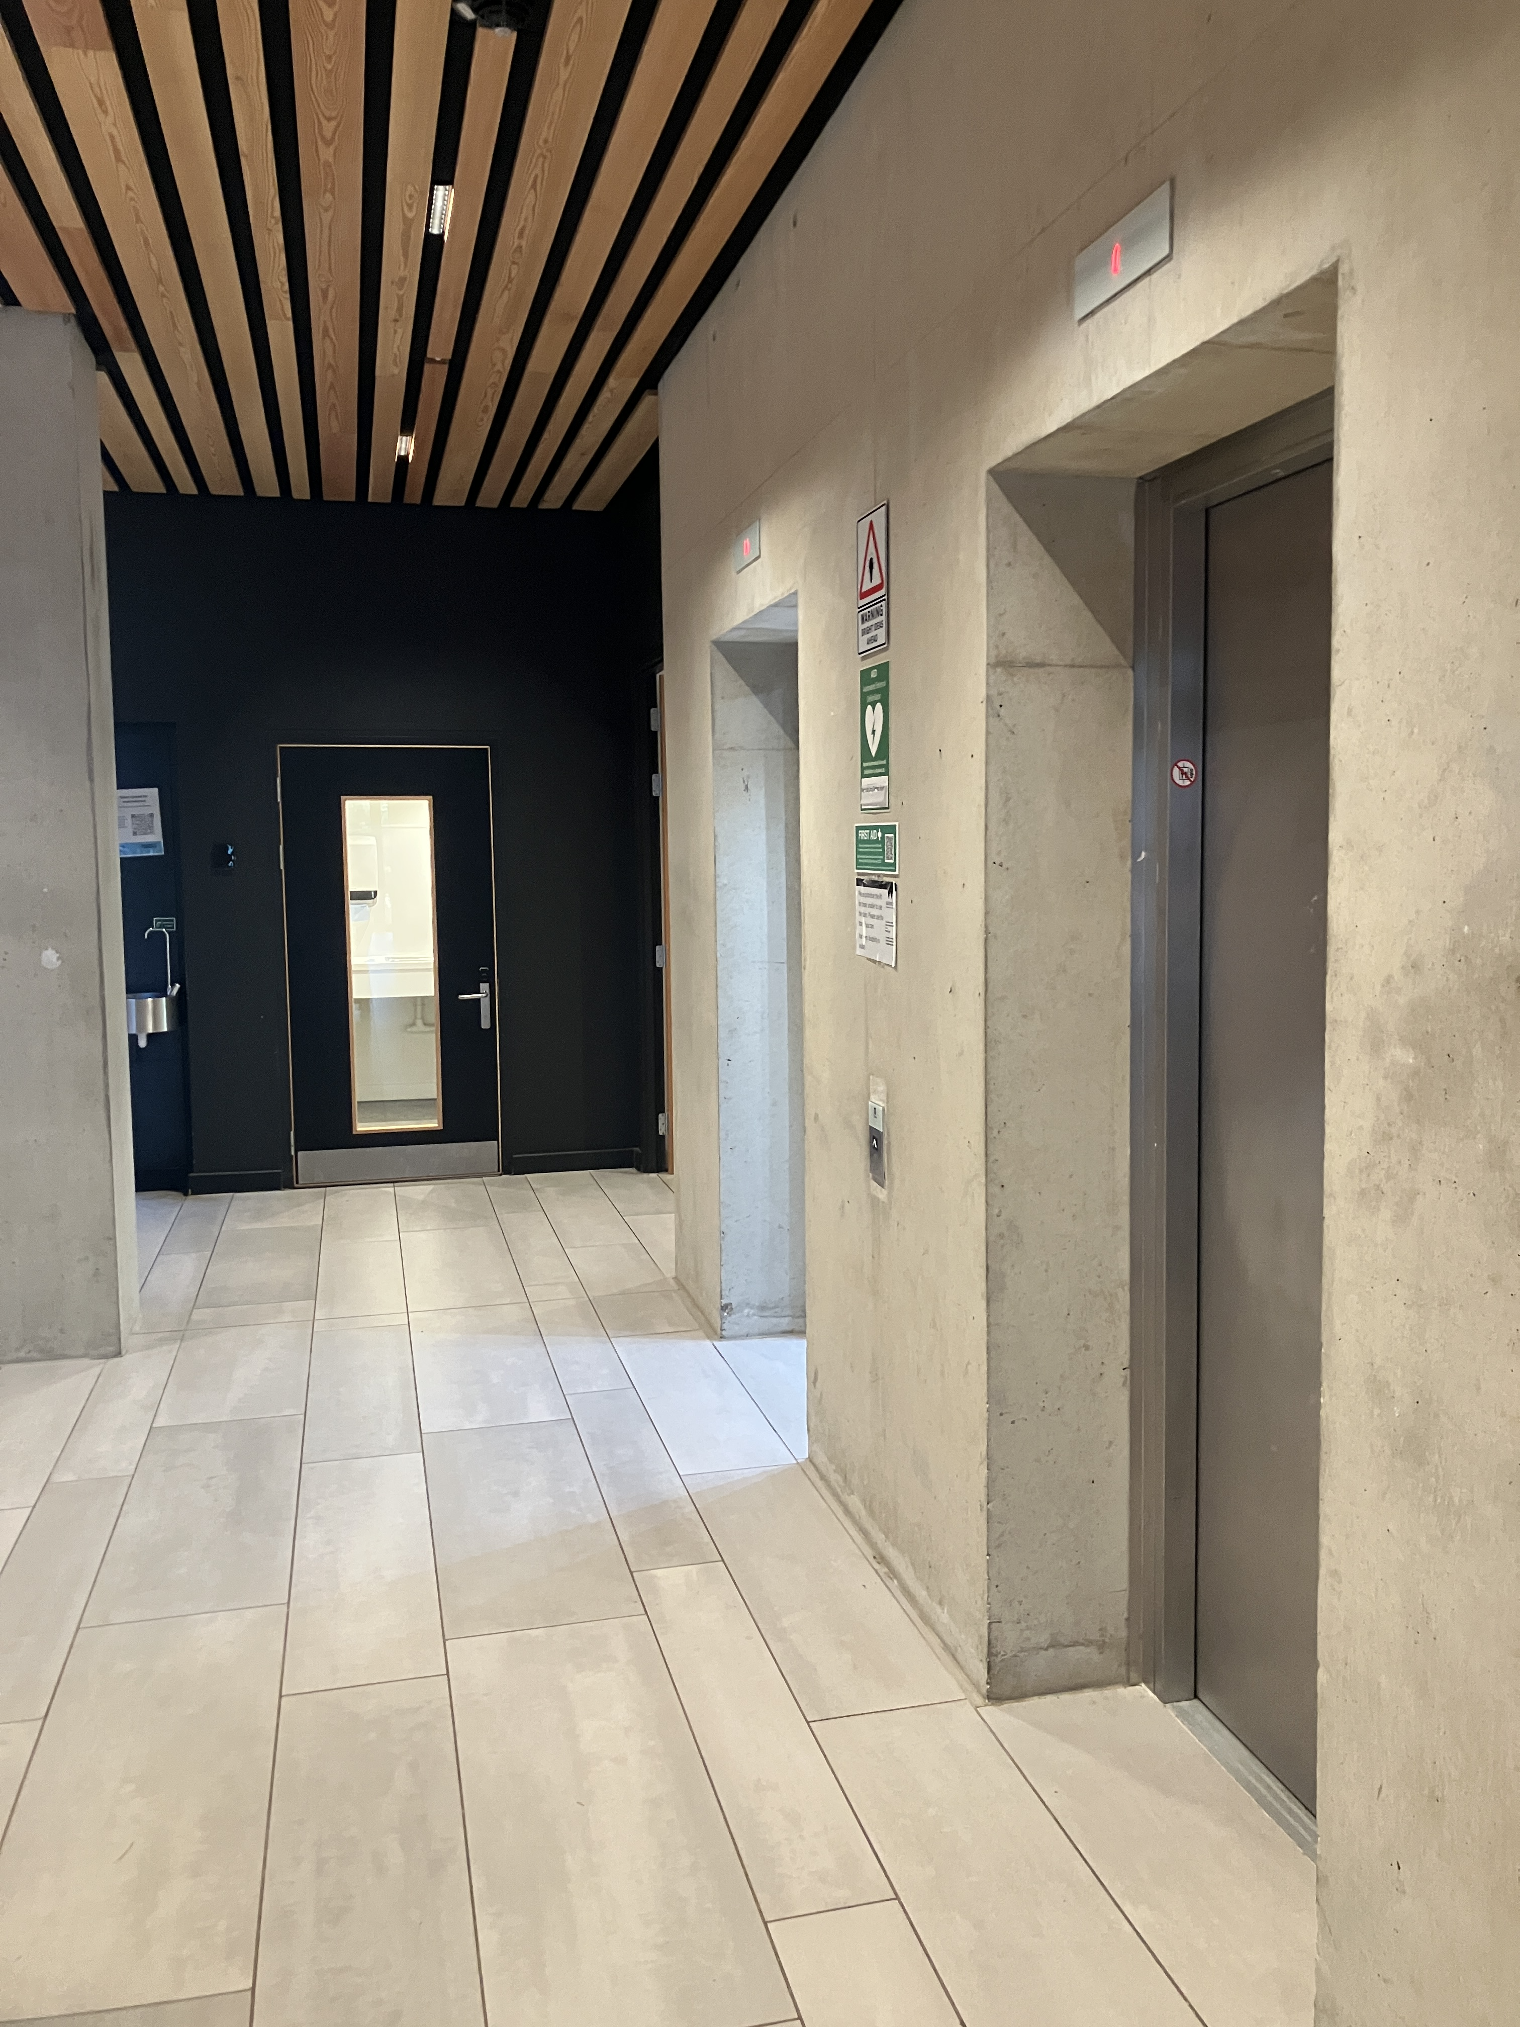
Finding your way
https://warwick.ac.uk/about/campus-journey/interactive-map/
Let’s have a quick look around!
Department Offices:
Faculty of Arts Building floor 2
Main office FAB2.02, open Mon-Fri 10-2.30 termtime (hours may change)
Timetable: Sessions start at 5 past the hour and finish at 5 to.
Teaching on campus, in person, but Teams also used for meetings etc.

Slide 7
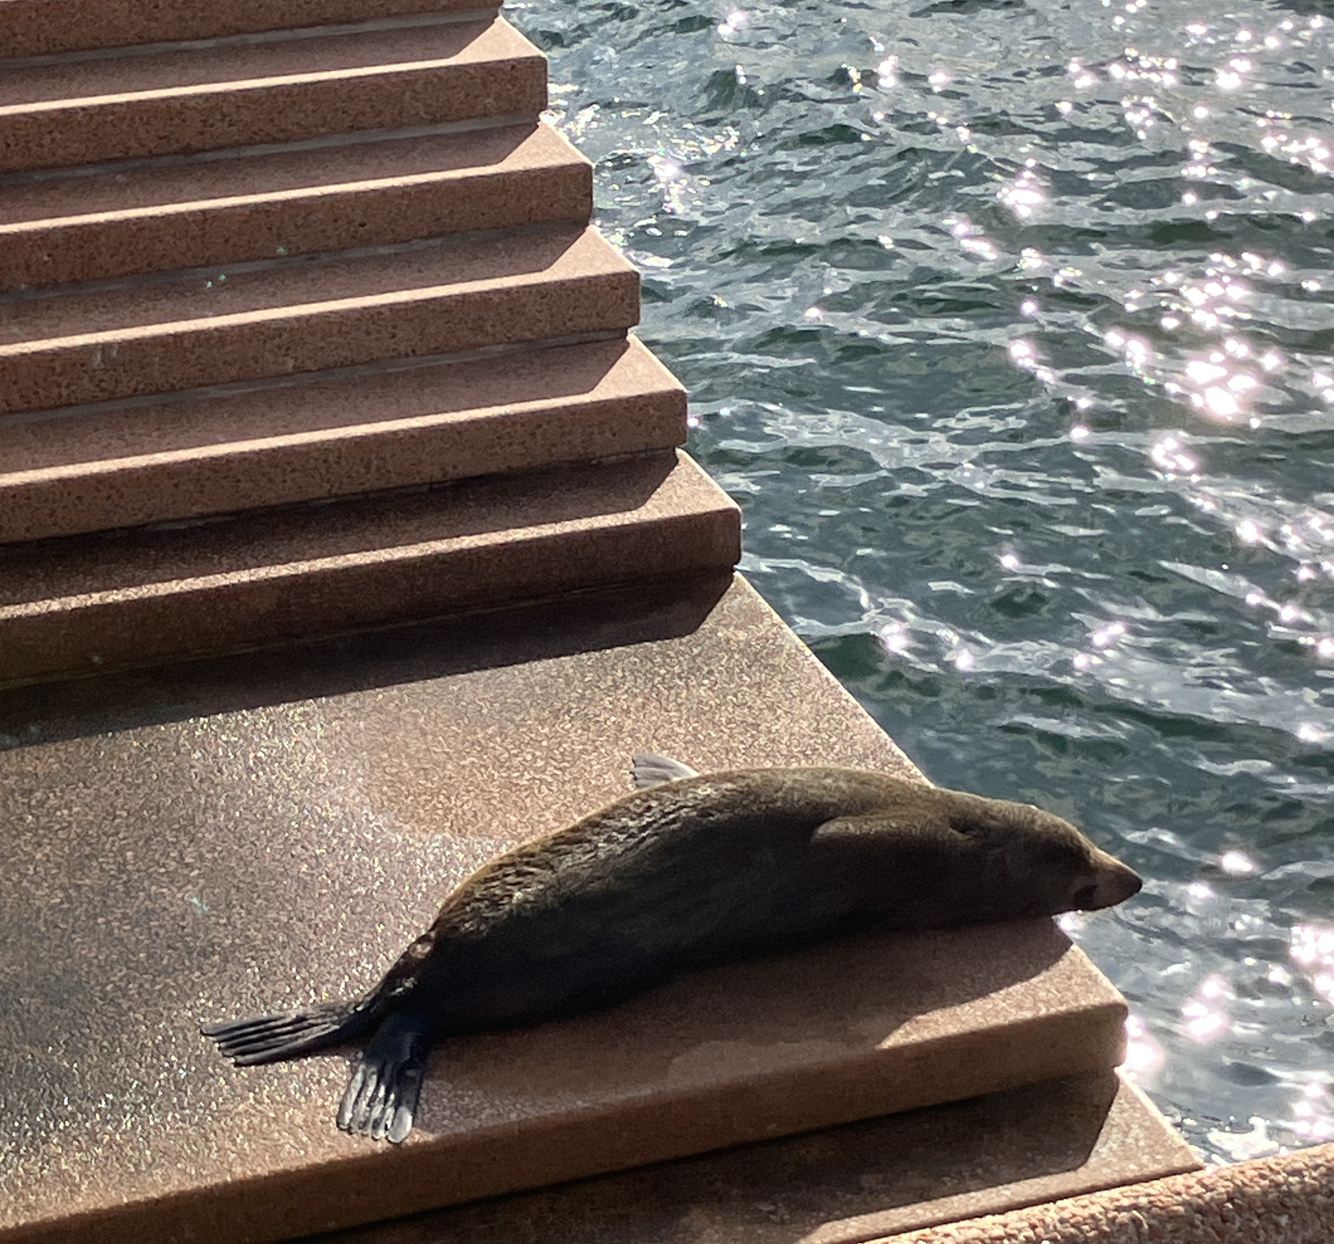
‘Snapshot’ from Clare
Don’t be afraid to ask a question if you don’t understand something
In lieu of any pets of my own I present ‘Benny the seal’ who lives (aka sleeps) at the Sydney Opera House (yes, I am Australian).

Slide 8

Key IT platforms
Email - check your Warwick email every day as it’s our main form of communication with you
MS Teams – for some personal tutor meetings/essay returns (can also be in person).
Moodle – for teaching materials for individual modules. https://moodle.warwick.ac.uk
Dept webpages – source of key information for students: https://warwick.ac.uk/fac/arts/classics/intranets/students/
Tabula – timetables, personal tutee meetings, mitigating circumstances. https://tabula.warwick.ac.uk
Many of these can be found via My Warwick: https://warwick.ac.uk/students

Slide 9
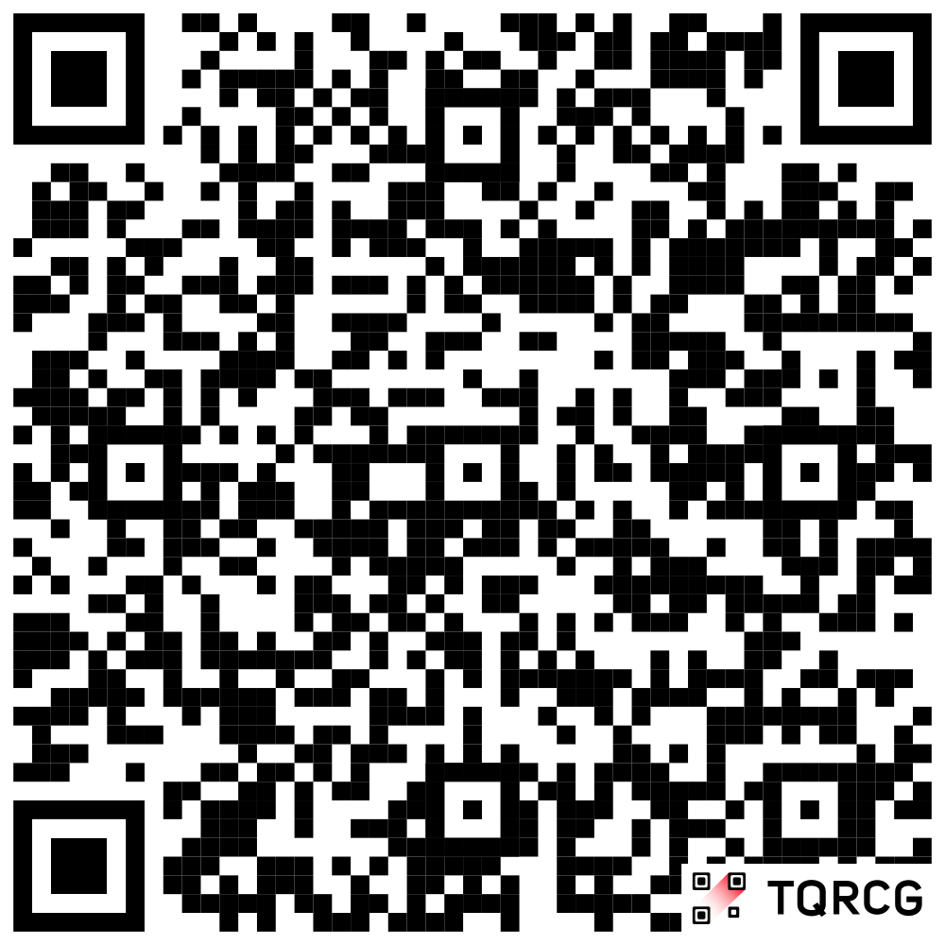
The ‘oracle’ aka department handbook
Downloadable from:
https://warwick.ac.uk/fac/arts/classics/intranets/students/ug_handbook_2026-27.docx
If you can, please do this now!
Some key points:
- How to solve problems, marking criteria, attendance, extensions, academic misconduct

Slide 10

What must I submit on the front page of my essay?
A full bibliography
A picture of my cat
A list of illustrations
An essay cover sheet

Slide 11
I can’t attend my lecture/seminar/class today, who should I tell?
My friends
The module convenor
My personal tutor
My parents

Slide 12
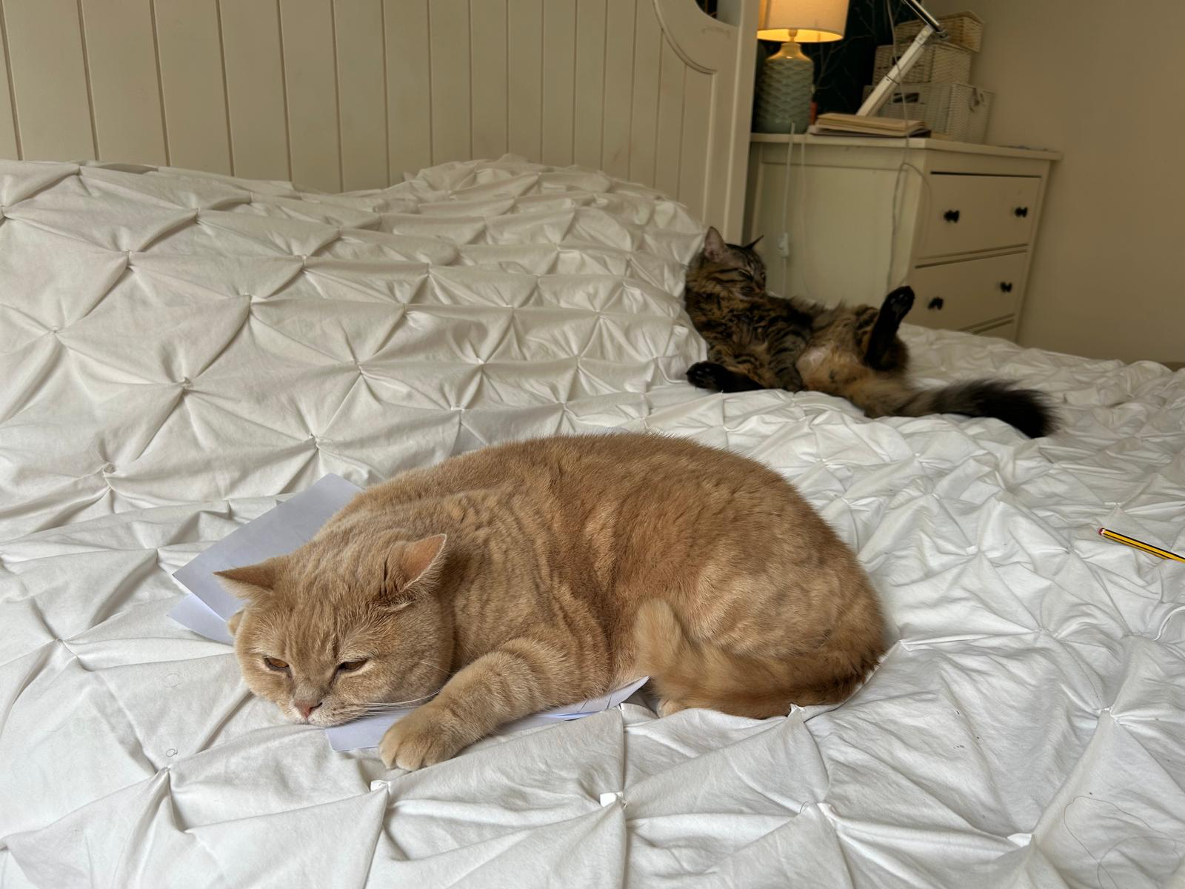
‘Snapshot’ from Emmanuela:
Follow Tofu’s example and be all over your assignments from the start.
Know your deadlines, and make sure you have a plan in place.
Don’t be like Chia, lounging on your bed, ignoring your deadlines and assuming that you have plenty of time.
There is always a lot to do. Be organised.
Chia, lounging and thinking he has plenty of time.
Tofu on top of her assignments and deadlines.

Slide 13
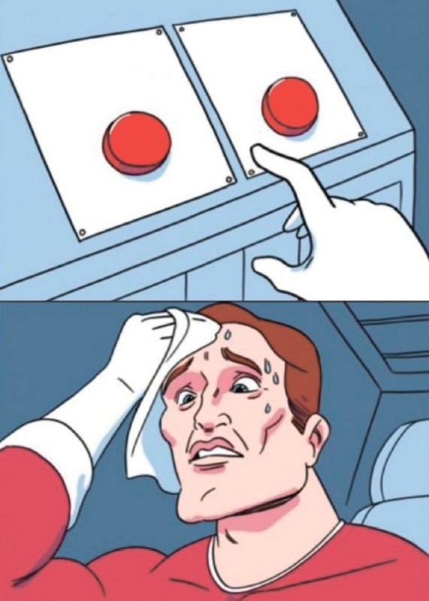
Choosing your modules
- Information about our first year modules is online at https://warwick.ac.uk/fac/arts/classics/intranets/students/modules/first_year_modules/
If you still have questions please do chat to personal tutors or ask us at lunch tomorrow!
Once you fill out the form, your choices will be processed and then your timetable will appear ☺

Slide 14

Teaching and Learning
Classes start at 9am on Monday
On campus teaching hours
2 hour lectures: include discussion and group work
+ seminars in some weeks
Language modules: 2 hours + 1 hour + additional hour
consolidation
Independent study:
You are expected to do a total of 1200 hours of study per year (300 for a 30 CAT module). Allowing for some work in vacations, this means around 25-30 hours of independent study per week in term-time, in addition to contact hours.
You will also be asked to do reading outside of lectures, and lecturers will proceed on the understanding that you will have done this.

Slide 15
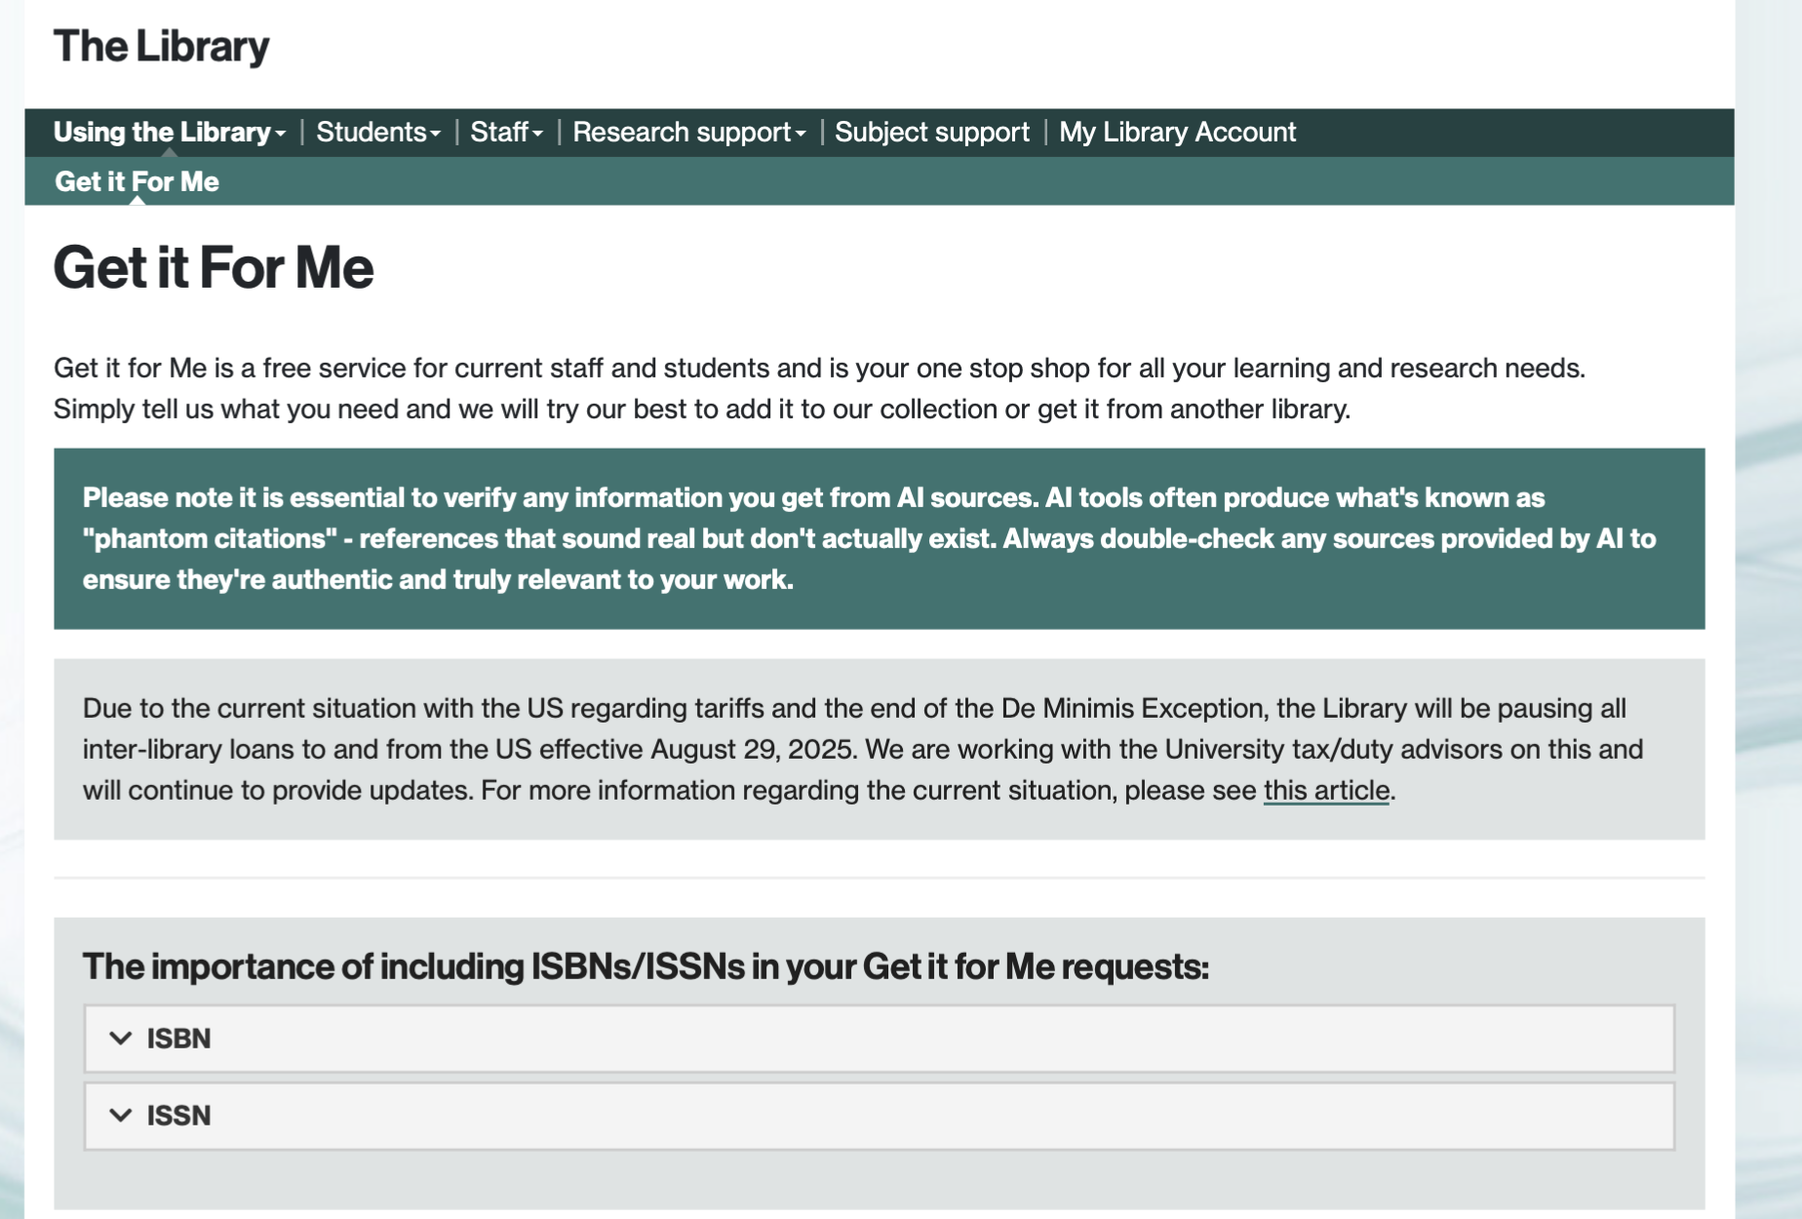

Slide 16
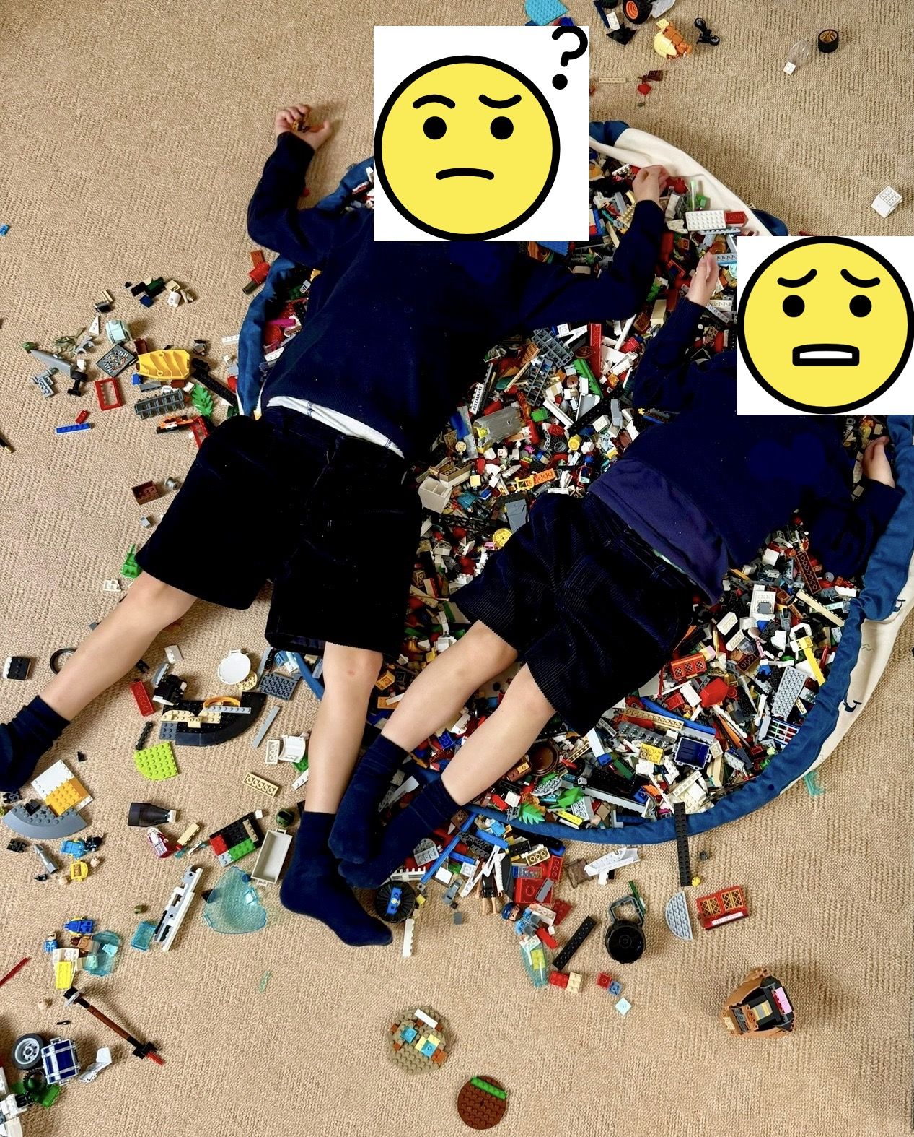
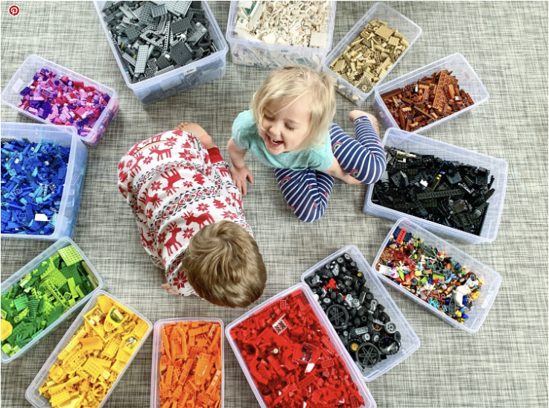

Emily’s tip (learned the hard way!):
Take control of your notes from week 1:
*folders (computer and hard copy)
*hole puncher
*note-taking system (date/lecture -> FILE IT ☺)
My kids
Instagram

Slide 17
Lectures and seminars
Lectures:
To introduce you to the breadth of topics, and allow you to find your interests, to expand upon and perhaps pursue further at honours level
You do not have to know all of this material in equal depth
Lectures are a spring-board for further independent research and consolidation – follow up the reading set / suggested
Note-taking skills – use the ppts / handouts uploaded on Moodle to annotate.
Lecture capture to catch up if ill
Log your attendance with your card on the card reader
Seminars:
To delve into particular aspects in further depth.
You will be given preparatory work to do and will need to participate.
Your chance to develop your ideas and new ways of thinking

Slide 18
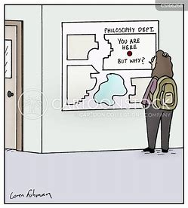

Tips from Victoria:
Don’t take my word for it!
I encourage you to disagree, query and interrupt in classes and lectures if you don’t understand. I will learn things from your questions, and other students will too
Latinists please note:
Roma uno die non est condita! Rogo ut auxilium a me petas! (Fear not, I won’t make you ask in Latin ☺)

Slide 19
Assessment
Attendance
Essays or other written assignments (gobbets)
Exams (for modules that have them): on campus, closed book
Marking criteria (See Handbook)
The 20-point Marking Scheme
1st class: 100, 94, 88, 82, 78, 74
2:1 class: 68, 65, 62
2:2 class: 58, 55, 52
3rd class: 48, 45, 42
Fail: 38, 32, 25, 12, 0
Penalties for late work (5 marks per day). NB deadline for all assessed work is 12 noon on the deadline. Leave plenty of time for IT issues!
Ensure you save your work regularly in >1 place, and that you upload the CORRECT, final, assignment.

Slide 20
Academic integrity
Learn how to properly reference other people’s views
Do not copy and paste quotes from others into your assessed work without using quotation marks. This is very important, as doing so could constitute plagiarism – passing off others’ work as your own.
Best, in any case, is to try as far as possible to summarise and critique, rather than simply present back to us scholars’ (including our own!) views, for which you are unlikely to get much credit
Take the Library ‘Avoiding Plagiarism’ course https://moodle.warwick.ac.uk/enrol/index.php?id=68911
You must have completed this by the end of Term 1 (one of your monitoring points)
Refer to UG handbook for additional information about use of AI (ChatGPT etc.).

Slide 21
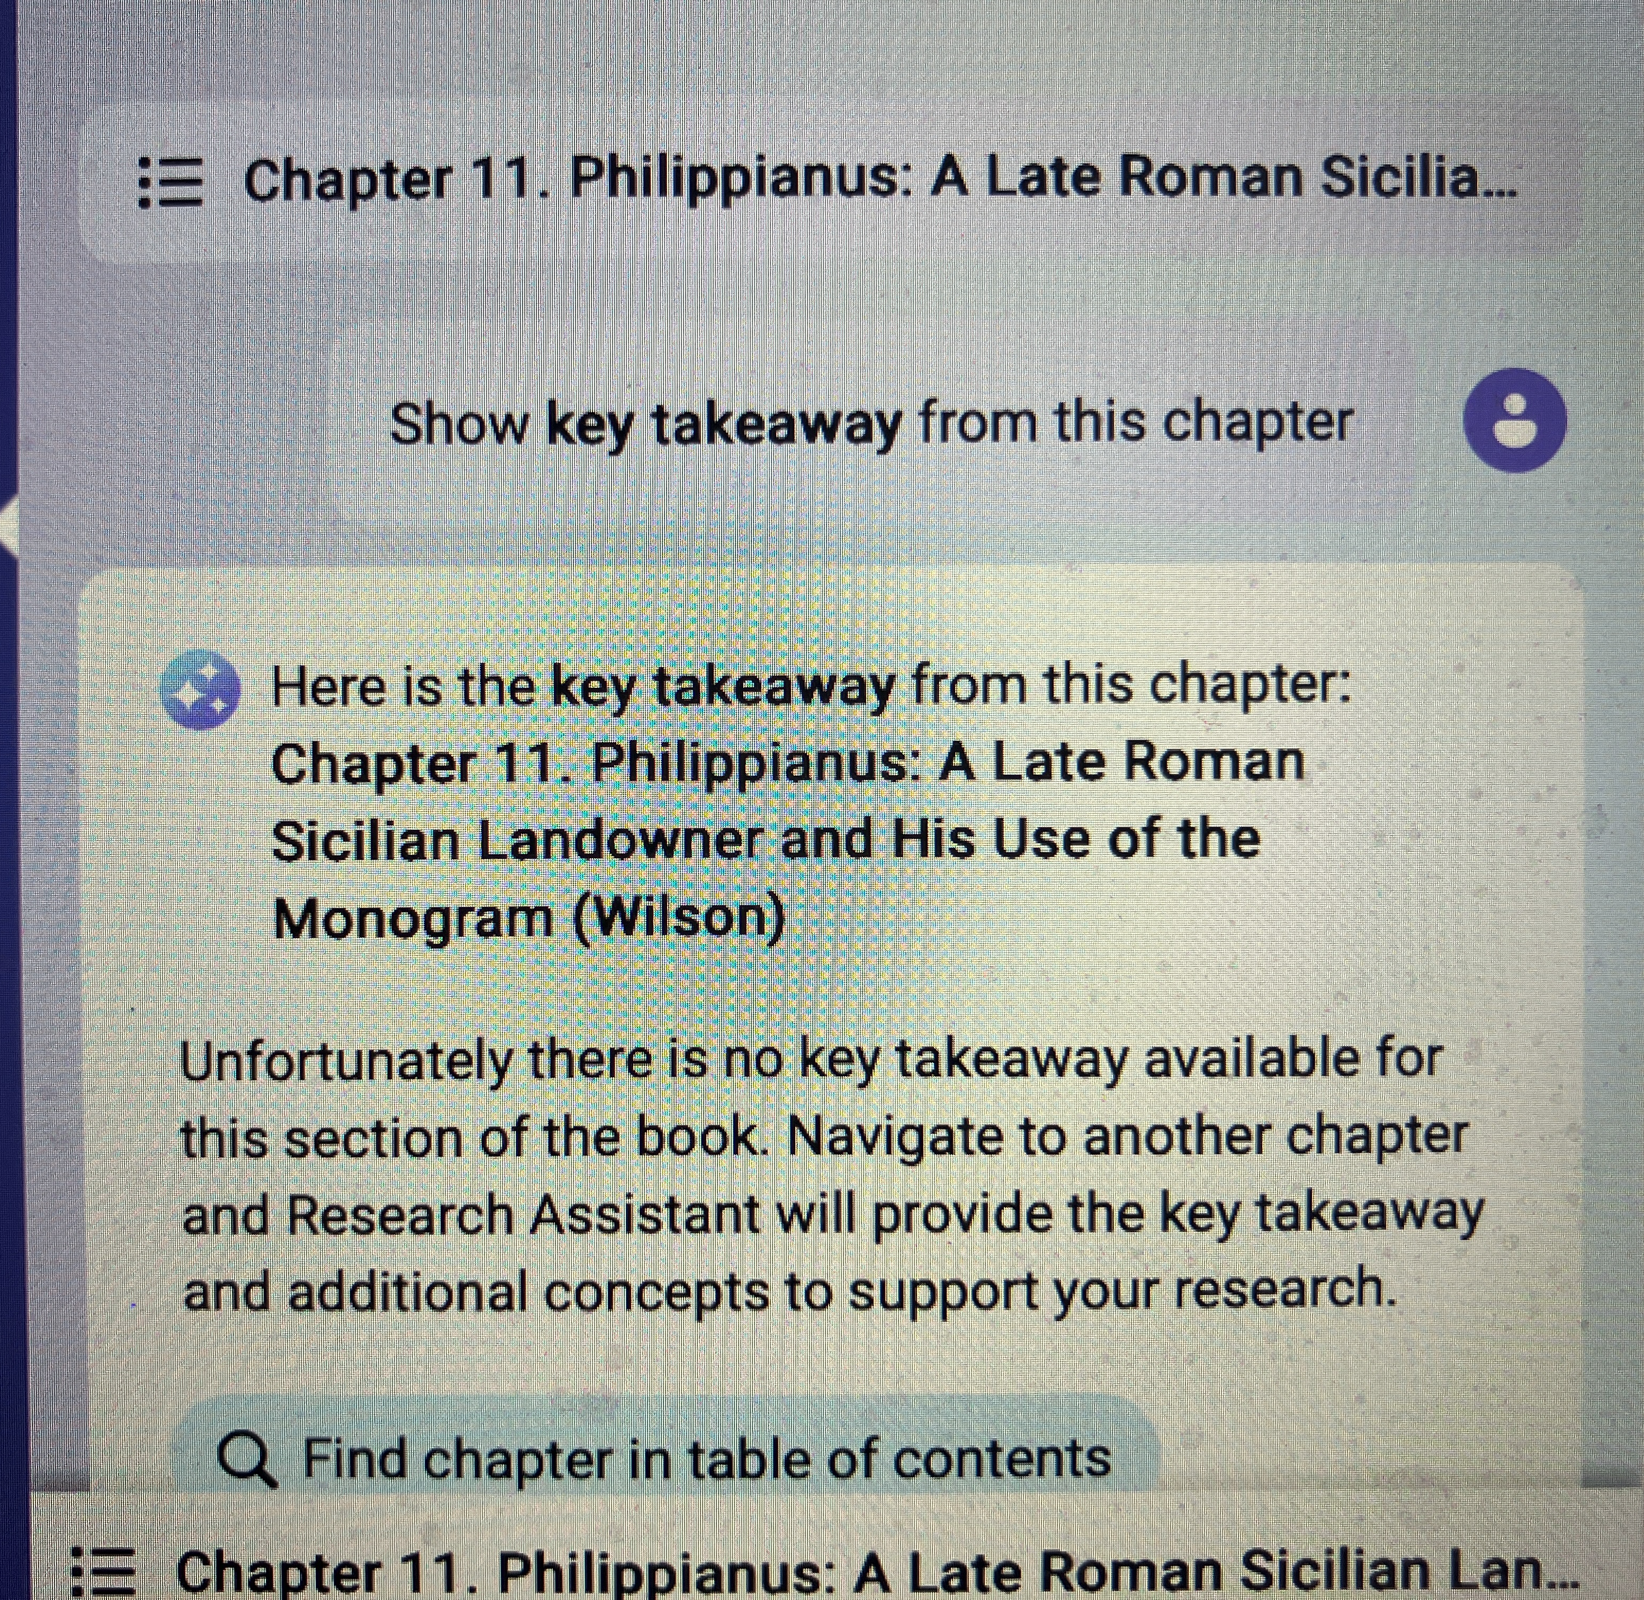


Slide 22
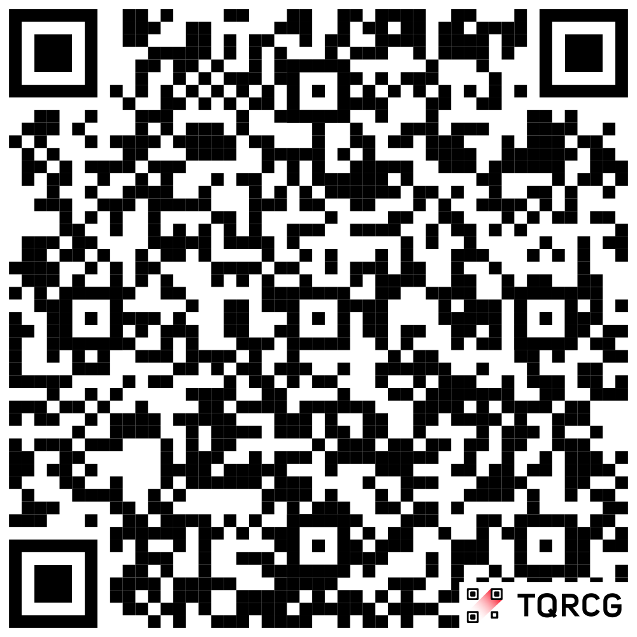
Making the most of your university experience
Thursdays in Term 1, 12-1pm, JX2.02
Different topics each week! Careers, archaeological excavation opportunities, Warwick Classics Network, Warwick Award and more!
Watch out for emails advertising each week’s event.
Full calendar at https://warwick.ac.uk/fac/arts/classics/news/events/?tag=mmue&view=agenda

Slide 23
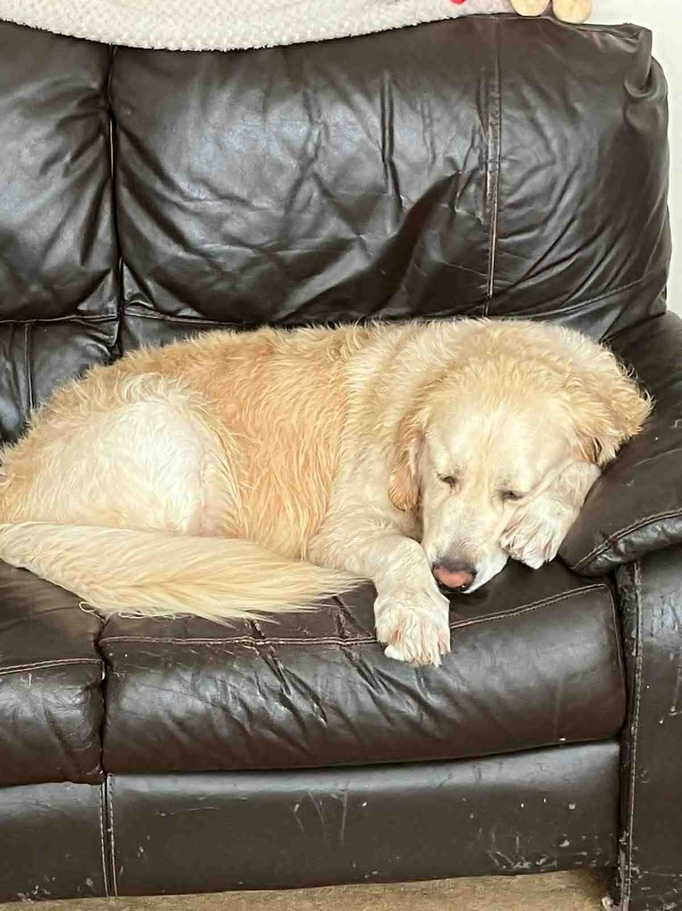
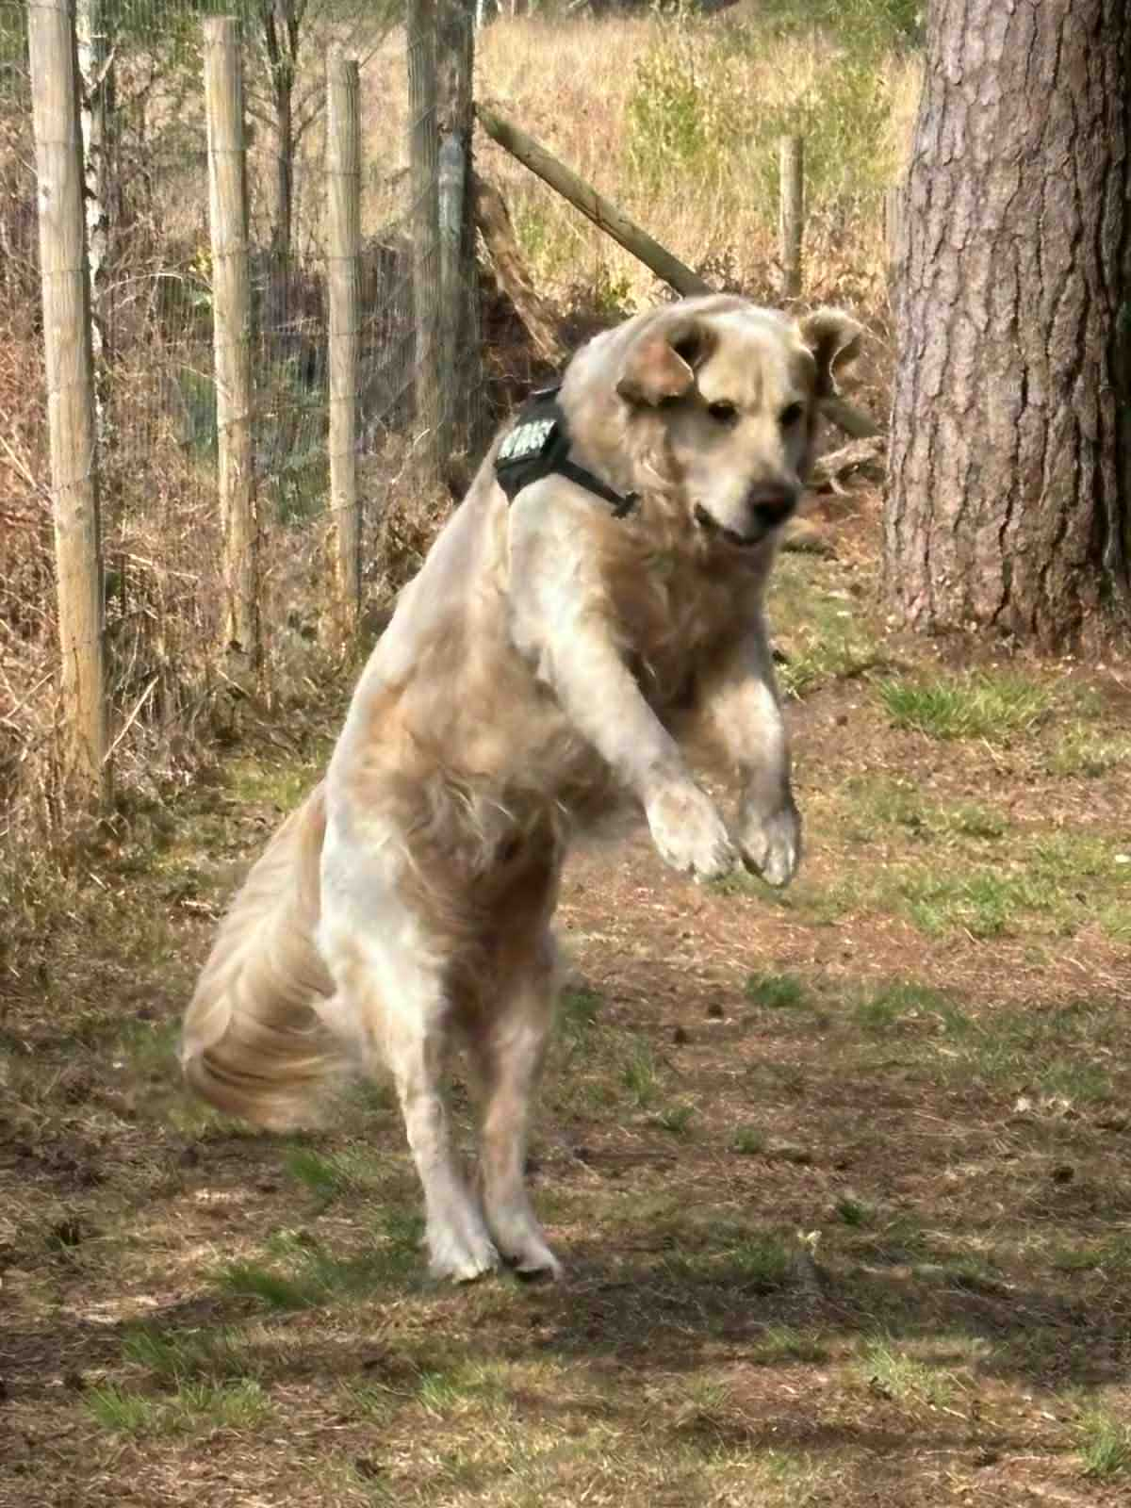
Jump on opportunities in the department (WCN, SSLC etc.)
Be like Archie
(sadly, not
mine)
Rest and look after yourself—you can’t succeed if you’re always exhausted!
From Joe

Slide 24
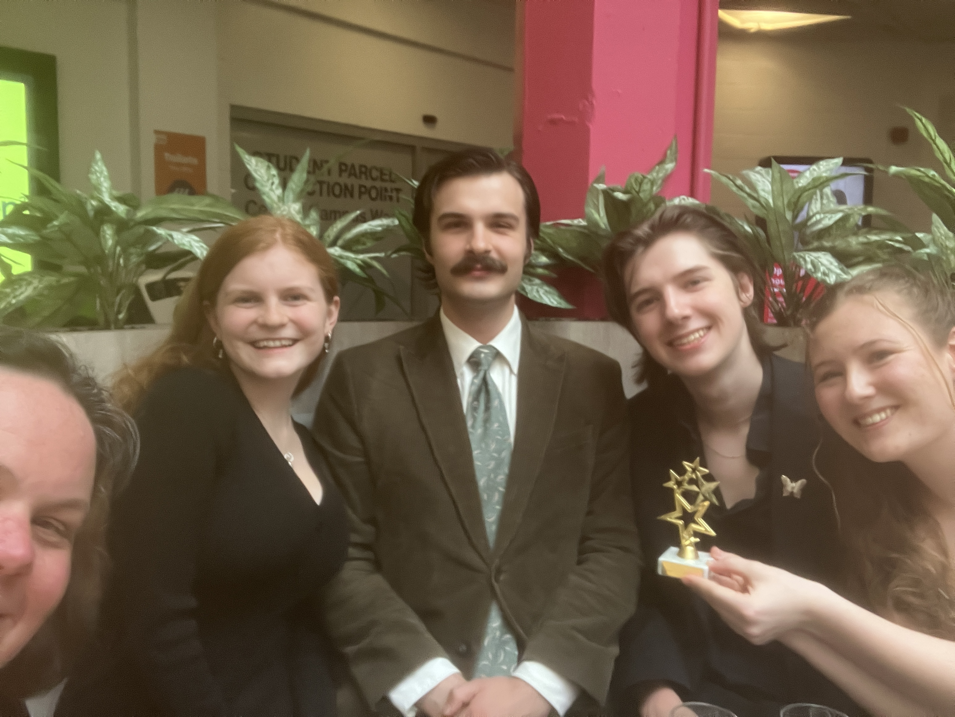
SSLC (Staff-student liaison committee)
In 2025/26 achieved (among other things):
SSLC OF THE YEAR!
Change to extension requests
Adoption of Unitu
Introduction of further support for advanced language classes
Change in wording of departmental AI policy
Change to module feedback form timing
Fed into new modules and degree changes
https://warwick.ac.uk/fac/arts/classics/intranets/students/sslc/
We traditionally have a representative from each degree and year group on our SSLC. If you would like to be a rep, or just learn more about what it involves, please to email Clare
C.Rowan@warwick.ac.uk
If you would like to be a rep please let me know by 12th October

Slide 25
Additional study sessions and support
Study Café in the common room (with quiet room) with Chris, Thursdays 11.30am-12.30pm
Academic Skills sessions starting later this term, Fridays 12-1 with Chris, H1.49a. Watch out for the emails!
Greek and Latin peer mentoring – further details announced soon!

Slide 26
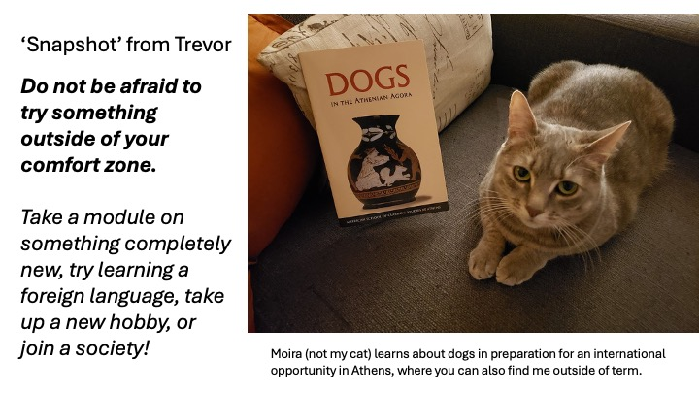

Slide 27
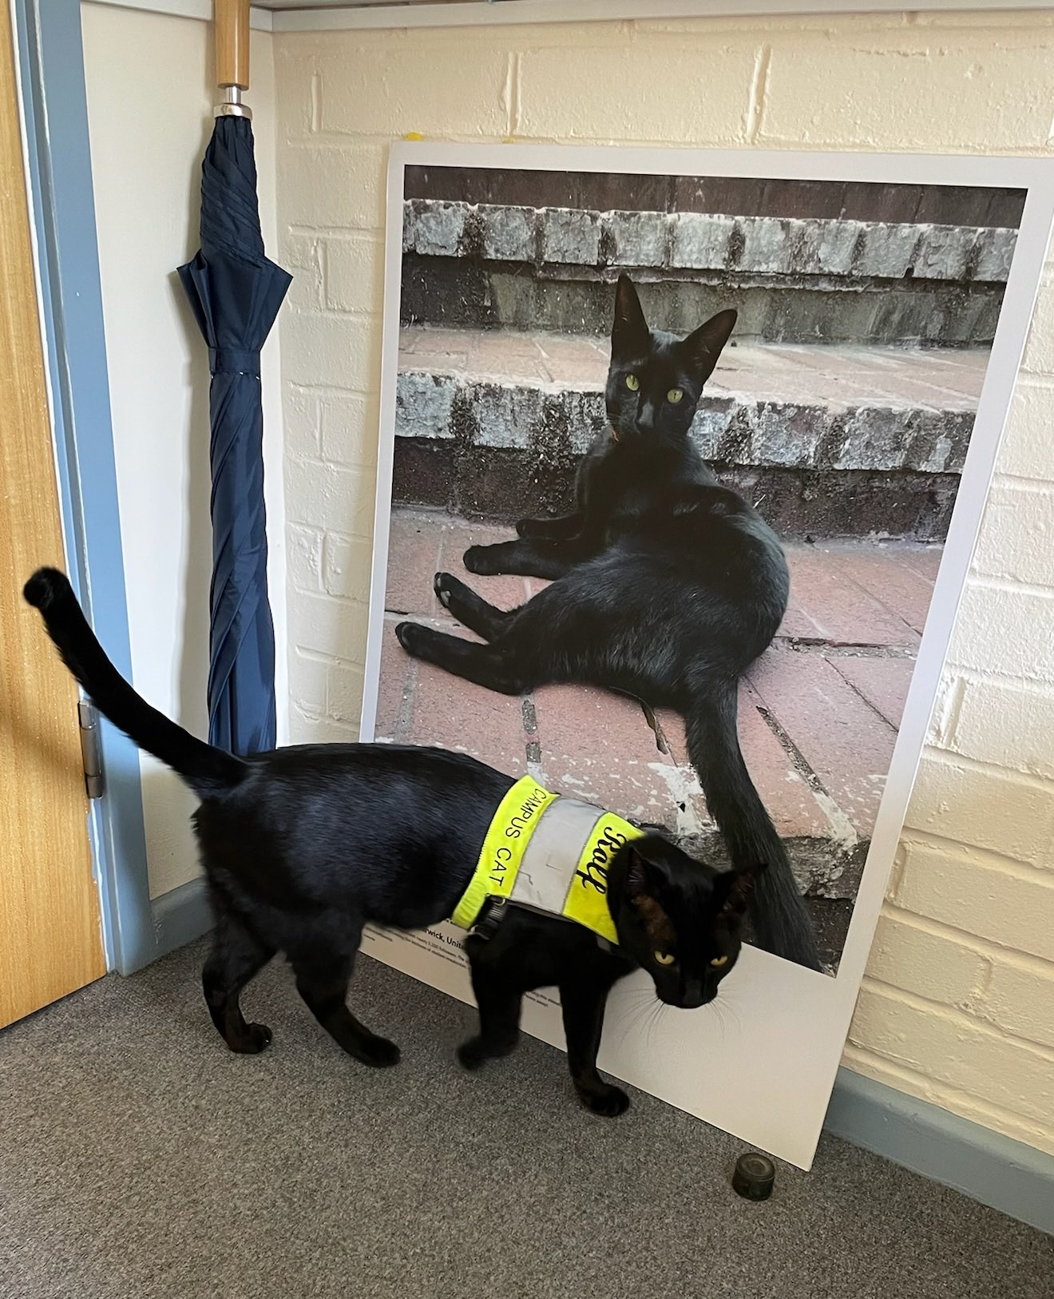
Final tips for success
If you have to miss any classes, ensure you catch up promptly
email classics@warwick.ac.uk and relevant lecturer if ill
Please ask for help – we are all here to offer it!
Make a work plan to organise research for seminars, essays around other commitments, inc. language-learning
Set up good note taking practices
Learn from your mistakes; and seek out feedback, both when officially offered re. coursework, and in general
Be kind to yourself: its normal to feel nervous, stressed or anxious when starting university – you won’t be the only one feeling like this.
Outstanding questions…..
Rolf, the campus cat (find him on Instagram)

Slide 28
Your Warwick journey essentials:
Be kind to yourself – It’s normal to feel nervous, stressed or anxious when starting University – you won’t be the only one feeling like this. Try not to put too much pressure on yourself and let go of expectations.
Get a healthy work-life balance- We really hope your time at Warwick is productive and enjoyable, so we promote wellbeing and a healthy balance of work, rest and play.
Respect yourself and others -Warwick is a vibrant community – we respect ourselves & others; we look out for ourselves & others
Be proactive - Wellbeing Support Services have courses and masterclasses that you can go to at any time, to get some advice on how to look after yourself throughout your time at University.
Talk to someone - Wellbeing Support Services are here for you. Whether you’re undergraduate or postgraduate; home or international; part-time or full-time, Wellbeing Support Services are here to help during difficult times.

Slide 29
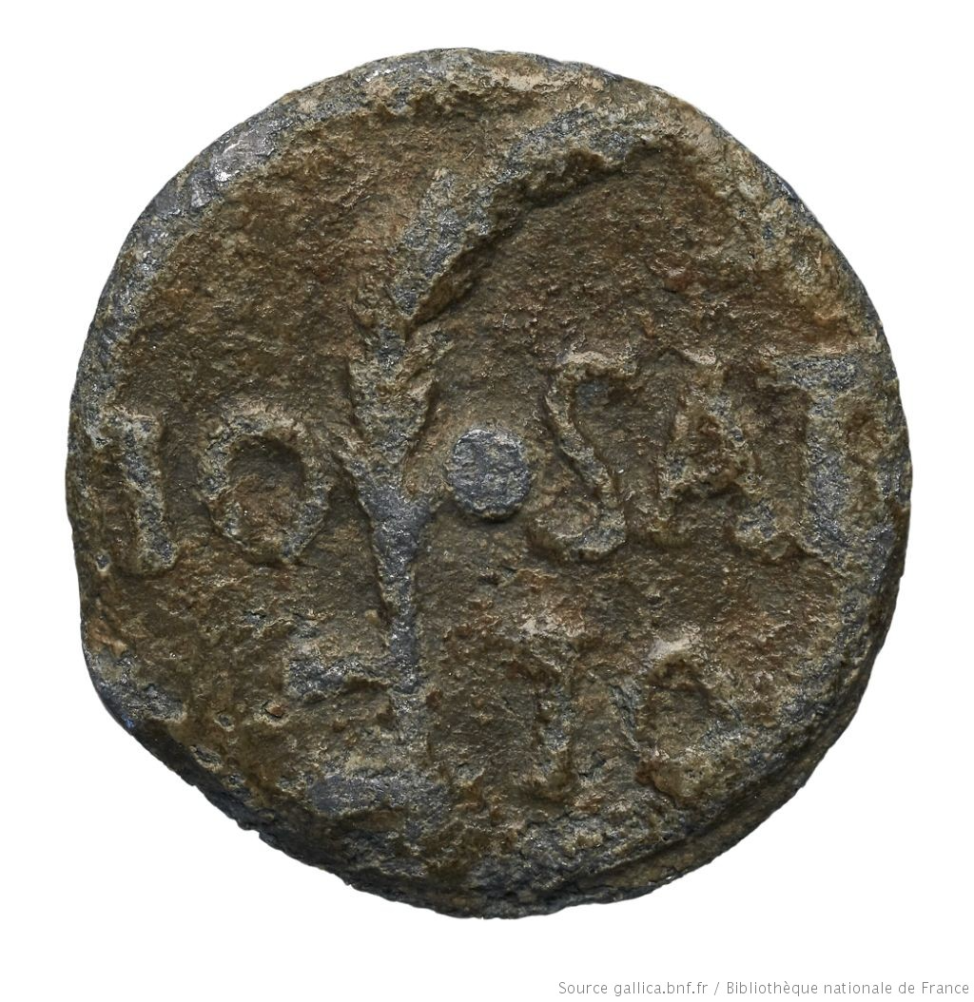
Io Saturnalia Io!
Come and join in the departmental Saturnalia!
Wednesday 9th December, 3-5pm, in the department
Food, festivities and Saturnalian activities!

Slide 30
Postgraduate offerings (never too early to start thinking ahead!!)
Current offering, likely to be updated:
Ancient Literature and Thought
This MA will foster your ability to read a wide range of Greek and/or Latin texts in the original language and to develop nuanced understanding of the methodologies and critical approaches to the study of these texts within their historical, cultural and political contexts.
Ancient Visual and Material Culture
This MA will train you for further research in the fields of art, numismatics or epigraphy. Acquire necessary research techniques and skills at Warwick's Classics and Ancient History department.
MA by Research
•Route A features a 40,000-word dissertation.
•Route B is a more flexible course, with a shorter dissertation of up to 25,000 words, two 5,000-word essays, and language training, designed to help you prepare for doctoral work.

Slide 31
Personal Tutor: Victoria Rimell, FAB 2.48
BOWERS, Zara
BULL-DIAMOND, Molly
COLOMBI, Letizia
FOO, Kitty
FURNEAUX, Kitty
GLONEK, Emily
GLACOMO, Inglese
MCAULAY, Ruben
RAWSON, James
SMITH, Lois
TURNER, Lexi

Slide 32
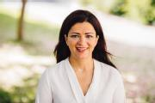
Personal Tutor: Emmanuela Bakola, FAB 2.11 (Emmanuela’s office)
COLLIER, Abigail
And anyone who has been
missed!

Slide 33
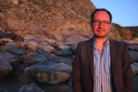
Personal Tutor: Paul Grigsby, FAB 1.07
GRICE, Cole
GUPTA, Diya
HILL, Lucy

Slide 34
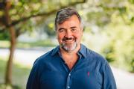
Personal Tutor: James Davidson, FAB 1.08
BOND, Harry
BROWN, Jude
CARTER, Paige
CHESTERTON, Chloe

Slide 35
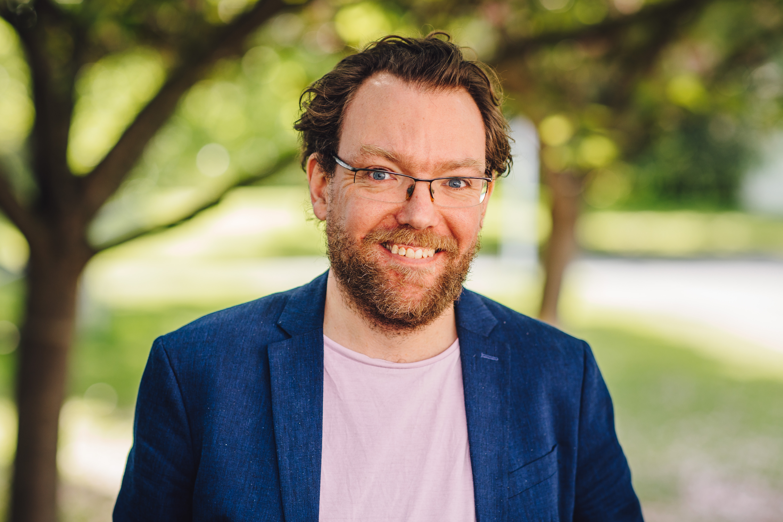
Personal Tutor: David Fearn, FAB 6.05
ALBORGHETTI-SAVAGE, Scarlett
AMOS, Amelie
BAKO-JOHNSON, Ezinne
BARKER, Dice
BENYOSEF, Yael
BHIDE, Shreya

Slide 36
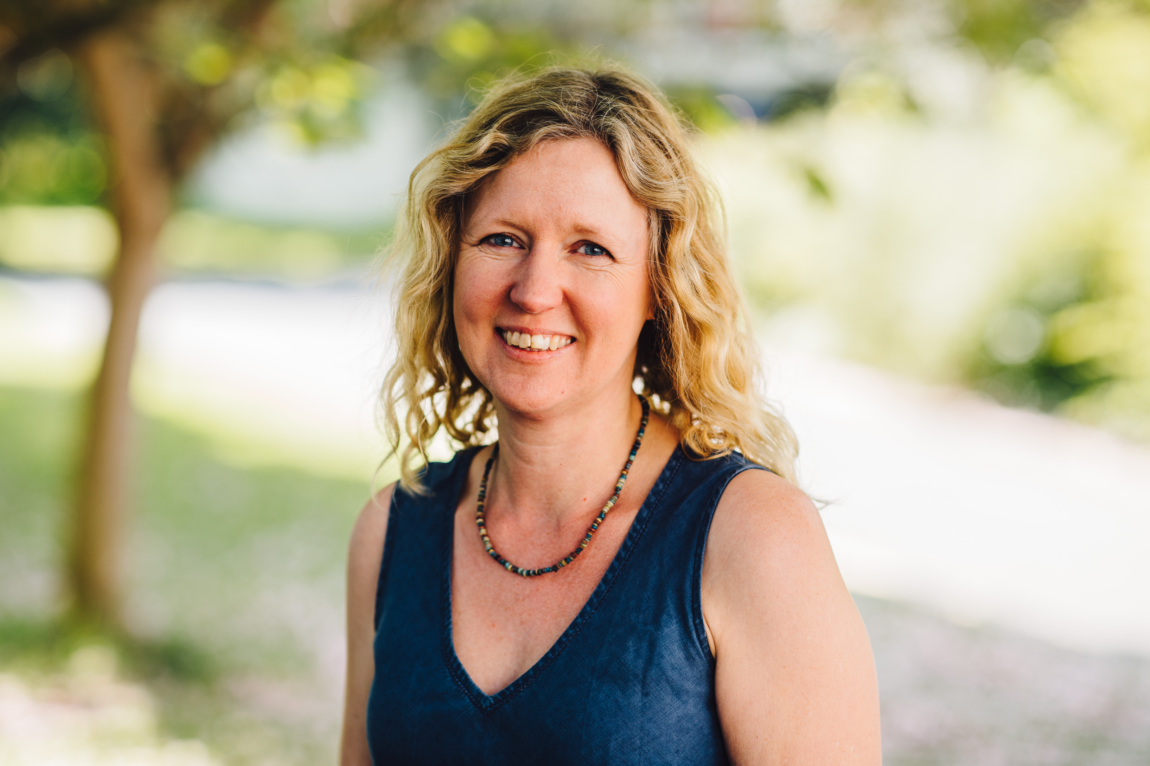
Personal Tutor: Zahra Newby, FAB 5.30
AITON-MOYES, Isabella
MILES, Zach
MILLS, Cordelia
MORRIS, Poppy
MORRISSEY, Jakob
MOUNTFORD, Maddie

Slide 37
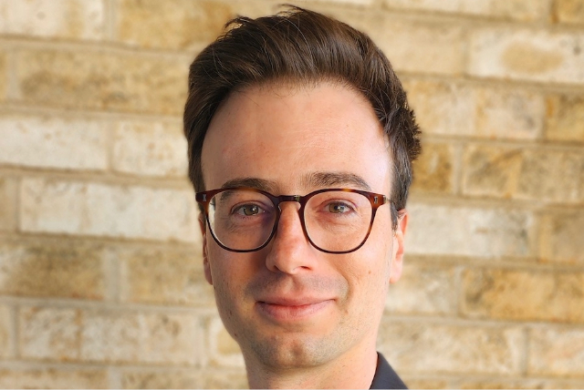
Personal Tutor: Robert Rohland, FAB 2.33
DANYAL, Muhammad
DUGGLEBY, Grace
ESSON, Zaki
EVE, Lila
FENTON, Joseph
GOUGH, Juliette

Slide 38
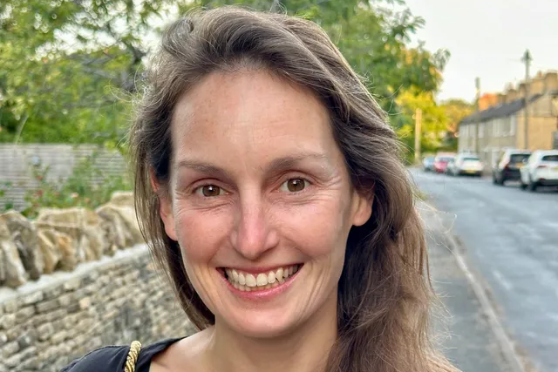
Personal Tutor: Emily Clifford, FAB 6.04
HEWITSON, Amy
ILLINGWORTH, Nathanael
JACKSON, Ava
JASSY, Avaani
JOHNSON, Daniel
Kamara, Madeline
KAY, Rosa
KEMP, Rosalin

Slide 39
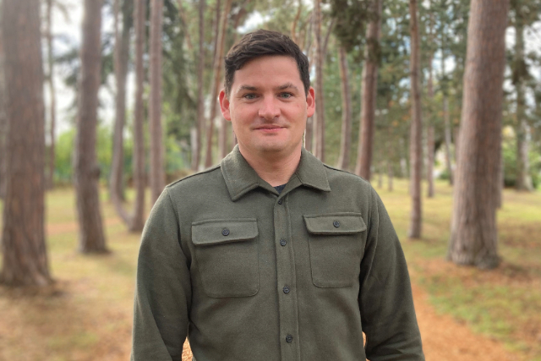
Personal Tutor: Trevor van Damme, FAB 5.07
KEMPSTER, Mae
KENNY, Adele
KIRBY, Macy
KUWIDIR, Mary
LAREDO, Libby
LUNN, Evie
MAIDMENT, Cameron
MARSHALL, Luke
MARTEN, Erin
MCCAULEY, Zoe
MEE, Isabelle

Slide 40
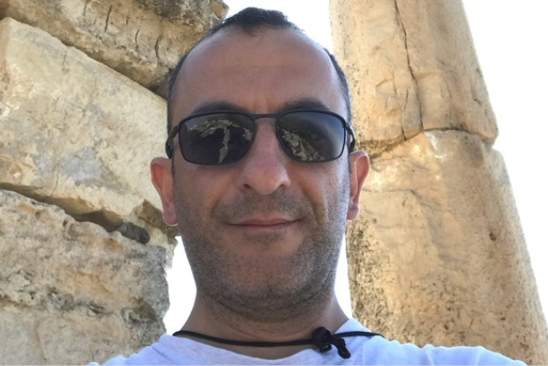
Personal Tutor: Jack Nurpetlian, FAB 2.47
MURPHY, Dylan
PALMER, Kez
PONTONE, Archie
RITCHIE, Nicole
SANT, Izzi
SKRZYDLAK, Maja

Slide 41
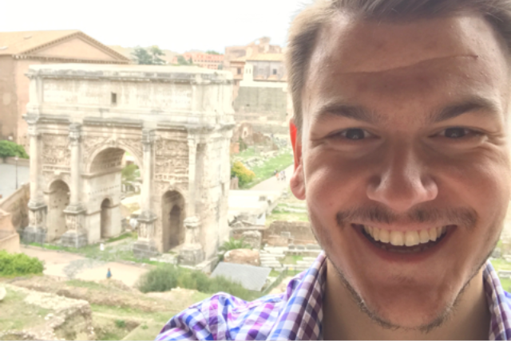
Personal Tutor: Alex Antoniou, FAB 6.03
PEARSON, Harry
POTTLE, Sebastian
SAMUEL, Robin
SANDS, Tom
SOTANDE-PETERS, Sebs
SRIVASTAVA, Demeter
STEVENSON, Isabella
UPPAL, Mina
WELLS, Lilac
WHITE, Megan
WILLIAMS, Hal
WOODCOCK, Molly
ZARATE-ASADIPOUR, Livia
ZIETSMAN, Karla

Slide 42

Classics Society

Slide 43
Classics Society

Slide 44
Classics mentor groups
2026/2027

Slide 45
Lia (President) & Neve (Stage Manager)
  Zaki Esson
  Rosalin Kemp
  Ruben Mc Aulay
  Zoe Mc Cauley
  Dylan Murphy
  Lexi Turner
  Scarlett Alborghetti- Savage
  Yael Benyosef
  Shreya Bhide
  Harry Bond
  Paige Carter

Slide 46
Ellie (Equal Opps) & Anna (Secretary)
  Isabella Aiton- Moyes
  Dice Barker
  Joseph Fenton
  Glacomo Inglese
  Daniel Johnson
  Madeline Kamara
  Maryam Kuwidir
  Cameron Maidment
  Erin Marten

Slide 47
Amelia (Producer) & Daisy (Academic Officer)
  Zara Bowers
  Molly Bull-Diamond
  Letizia Colombi
  Kitty Foo
  Kitty Furneaux
  Emily Glonek
  James Rawson
  Chloe Chesterton
  Abigail Collier
  Muhammad Danyal
  Grace Duggleby

Slide 48
Laura (Socials) & Sam (Director)
  Amelie Amos
  Ezinne Bako- Johnson
  Jude Brown
  Evie Lunn
  Luke Marshall
  Jakob Morrissey
  Demeter Srivastava
  Lila Eve
  Juliette Gough
  Cole Grice
  Diya Gupta
  Amy Hewitson

Slide 49
Addy (Sports & Charities) & Mary (Publicity)
  Lucy Hill
  Nathanael Illingworth
  Ava Jackson
  Avaani Jassy
  Rosa Kay
  Mae Kempster
  Adele Kenny
  Marcy Kirby
  Libby Laredo
  Zach Miles
  Cordelia Mills
  Maddie Mountford

Slide 50
Sophie (Socials) & Finn (Welfare)
  Archie Pontone
  Nicole Ritchie
  Robin Samuel
  Izzi Sant
  Sebs Sotande-Peters
  Isabella Stevenson
  Mina Uppal
  Lilac Wells
  Megan White
  Molly Woodcock
  Livia Zarate-Asadipour
  Karla Zietsman

Slide 51
CAMPUS SCAVENGER HUNT
FAB (Classics Common Room)
YOUR CHALLENGE:
TAKE A SELFIE OF SOME OR ALL OF YOUR GROUP AT AS MANY OF THESE LOCATIONS AS YOU CAN BEFORE THE TIME RUNS OUT!
Library
SOCIAL SCIENCES
MyWarwick App
Piazza
Link to this map
Interchange
Notes:
Created by C Pearce 18.09.2024

