Slide 1
Wellbeing and Belonging Induction
Dept of Classics & Ancient History
Dr Emmanuela Bakola, Senior Tutor (=Senior Personal Tutor)

Slide 2
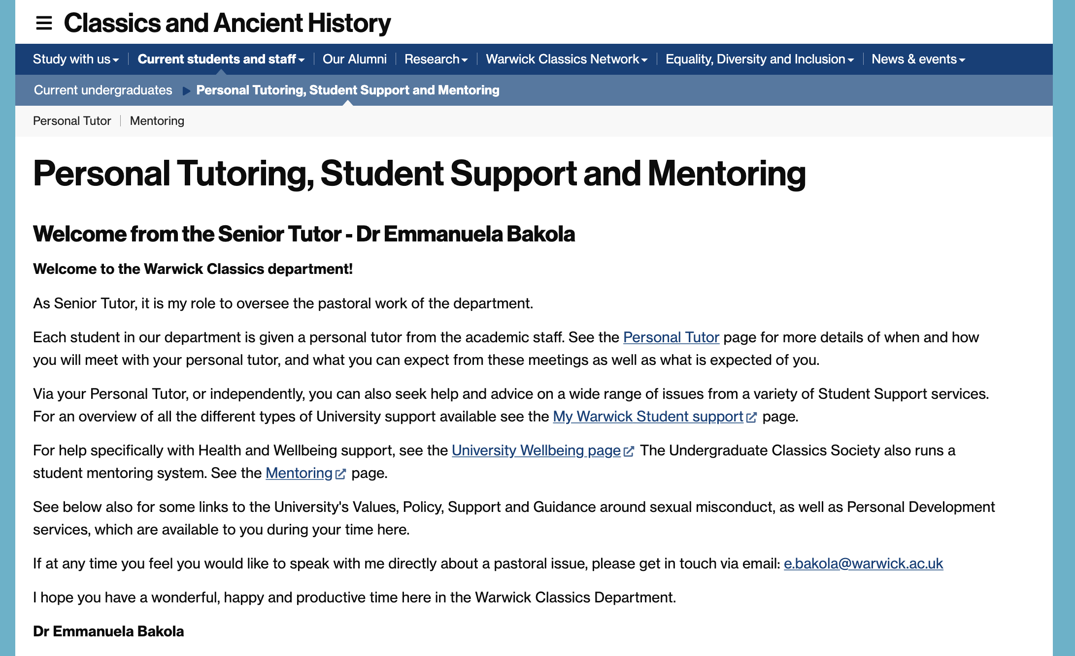
Departmental Personal Tutor & Senior Tutor

Slide 3
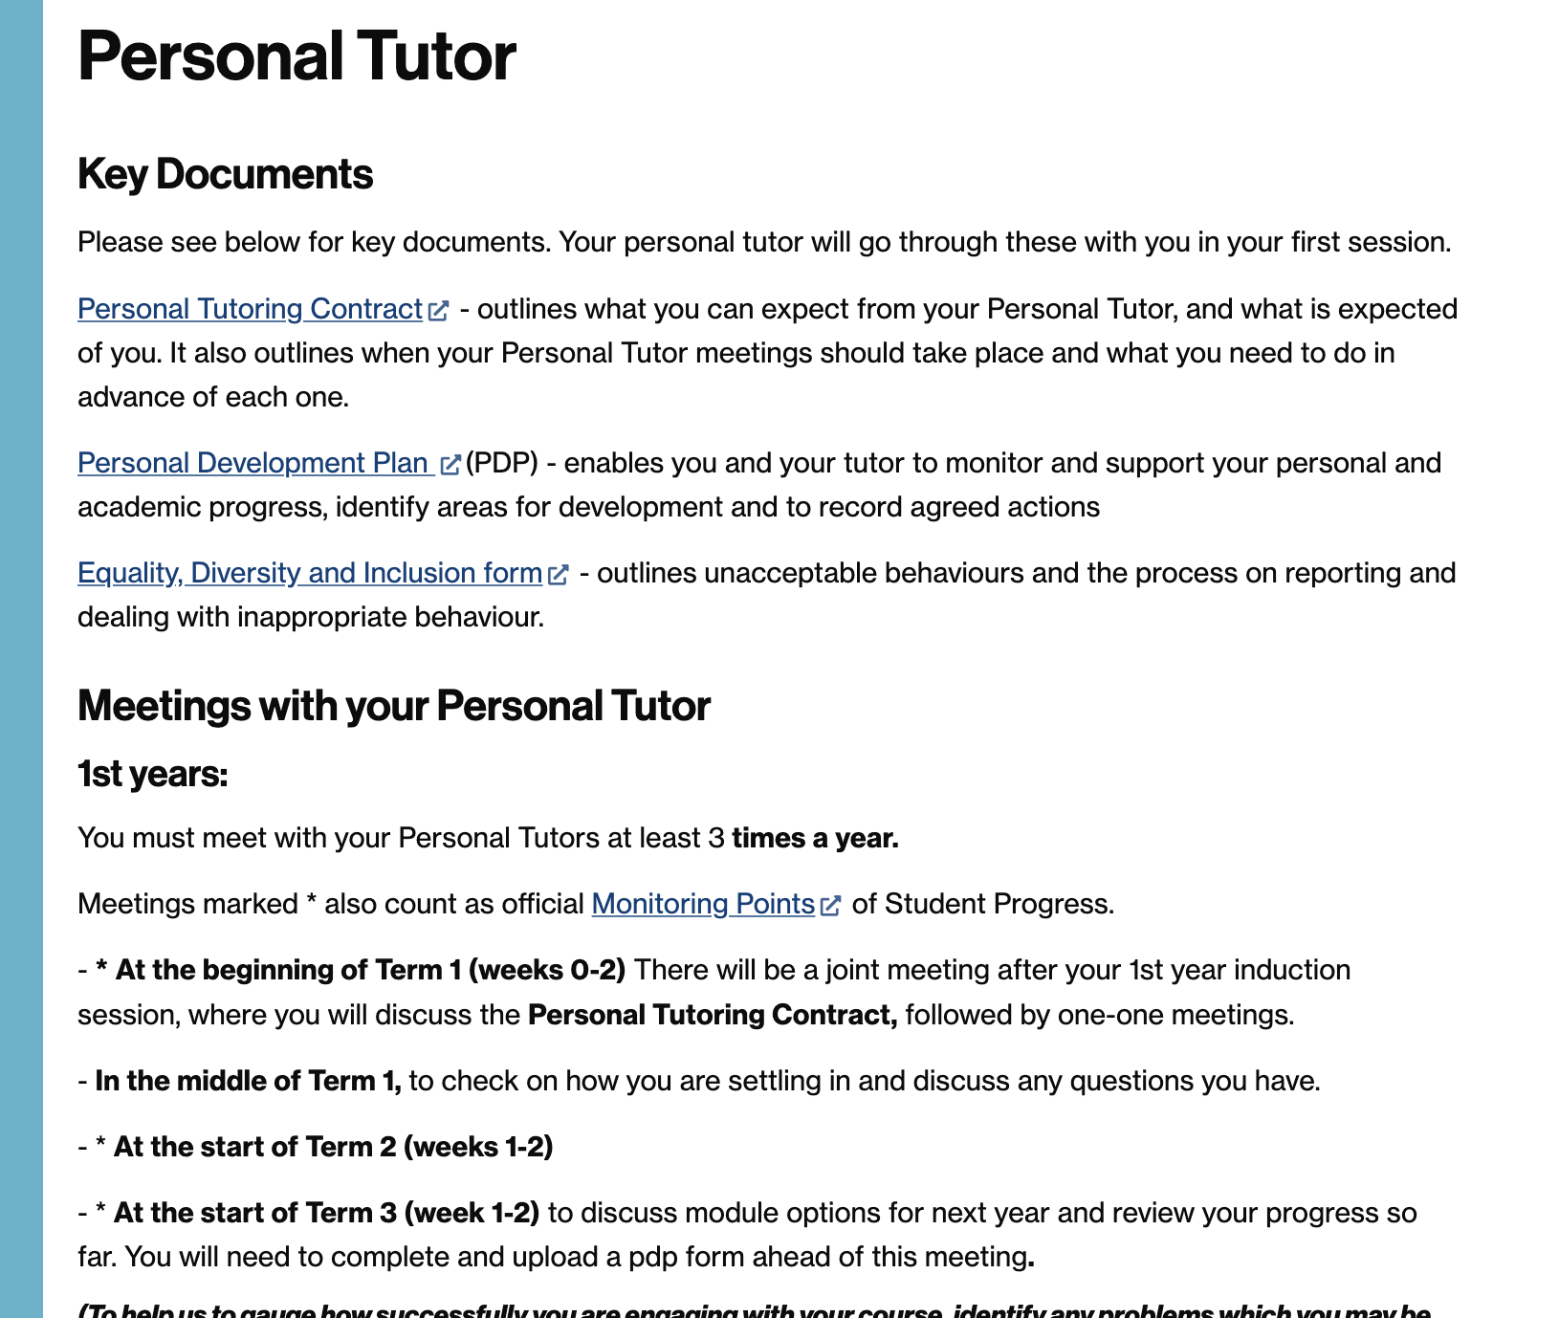
Personal Tutor
https://warwick.ac.uk/fac/arts/classics/intranets/students/guidance/personaltutors/
How often can I contact them?
When should I contact them?
What advice will Personal Tutors offer?
How can I contact my Personal tutor?
What does a PT do in relation to Reasonable Adjustments, Disabilities and Mitigating Circumstances

Slide 4
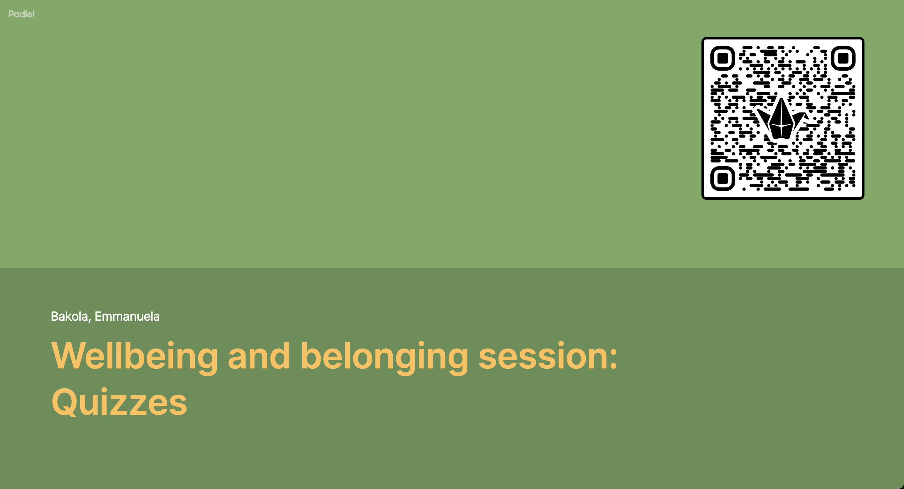

Slide 5
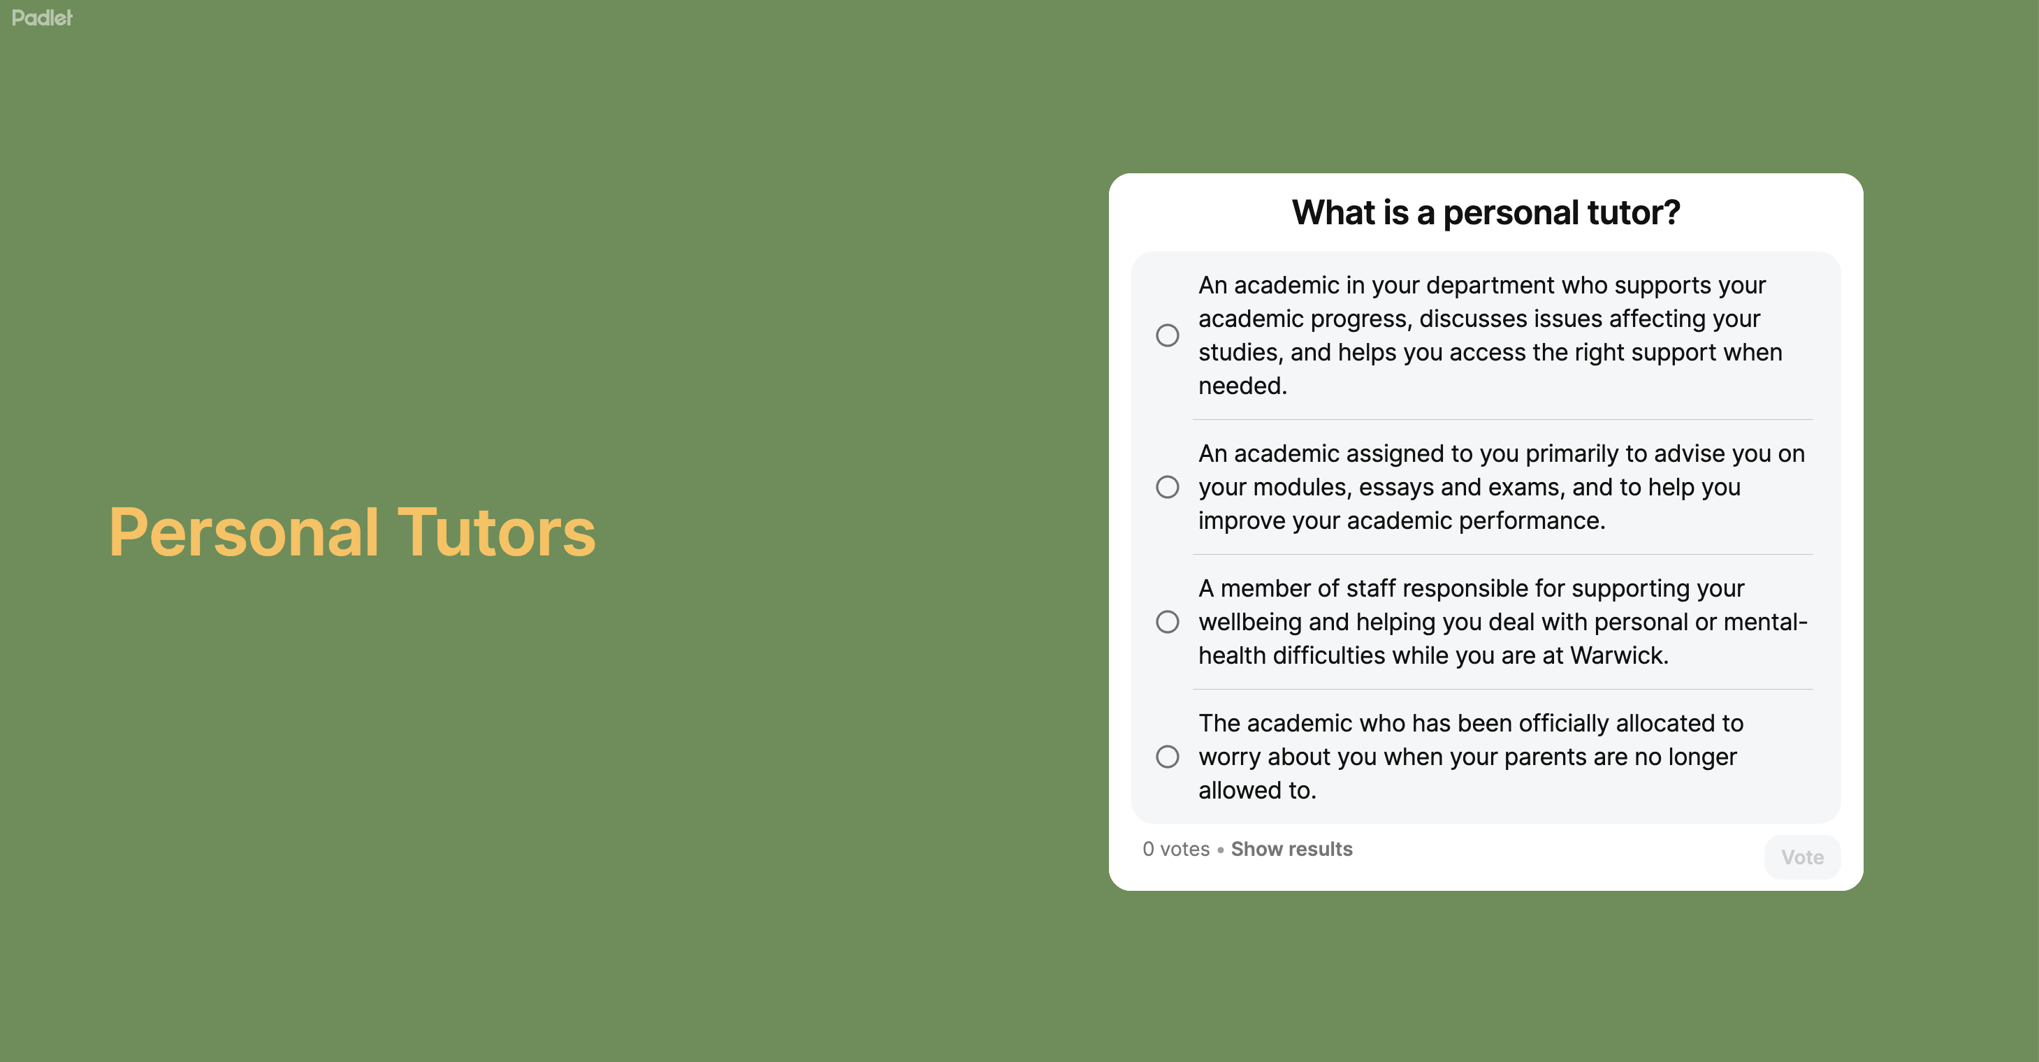

Slide 6
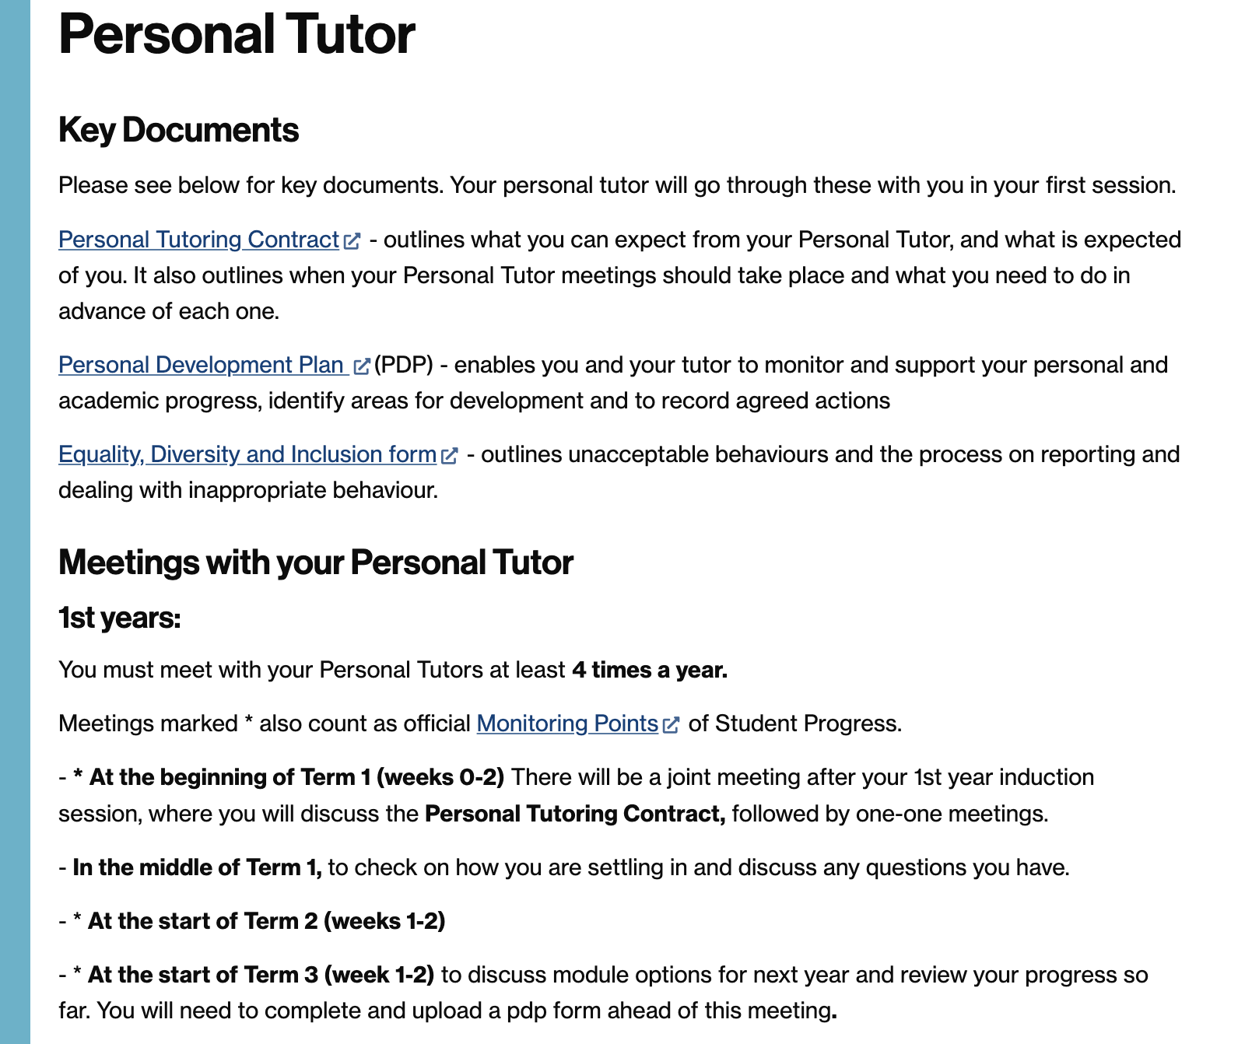
Personal Tutor
https://warwick.ac.uk/fac/arts/classics/intranets/students/guidance/personaltutors/
How often can I contact them?
When should I contact them?
What advice will Personal Tutors offer?
How can I contact my Personal Tutor?
What do they do in relation to Reasonable Adjustments, Disabilities and Mitigating Circumstances?
Group Meetings yesterday – follow up with 1-1 by end of week 2.

Slide 7
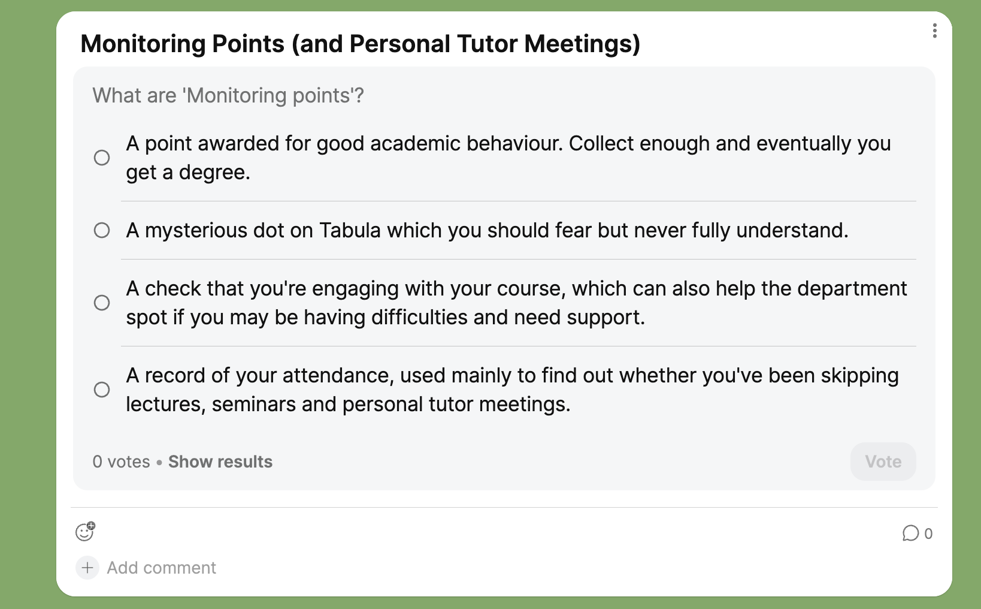

Slide 8
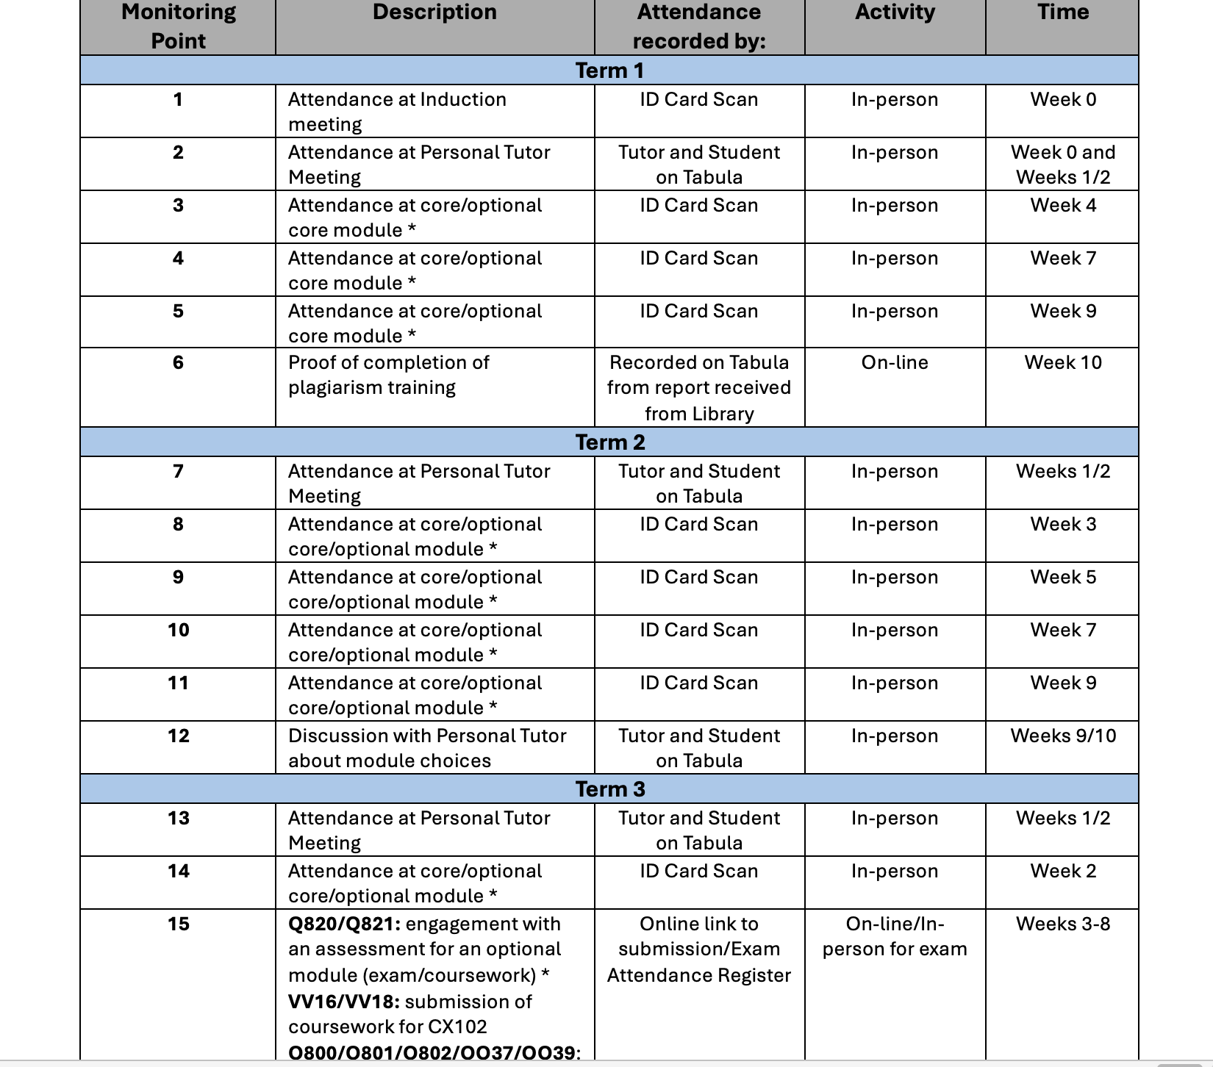

Slide 9
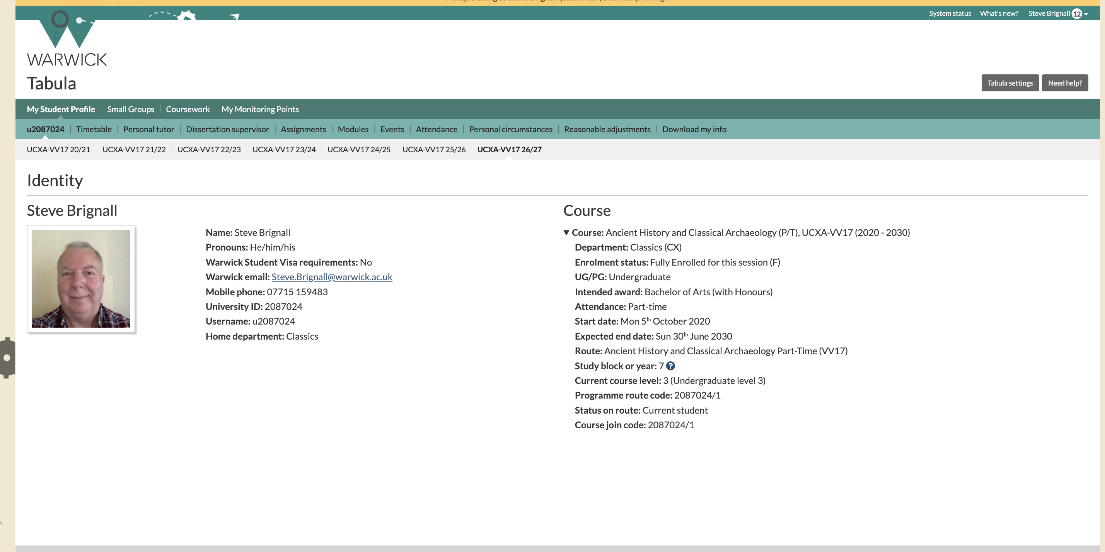
When you see your personal tutor, always make a record of the meeting on Tabula

Slide 10
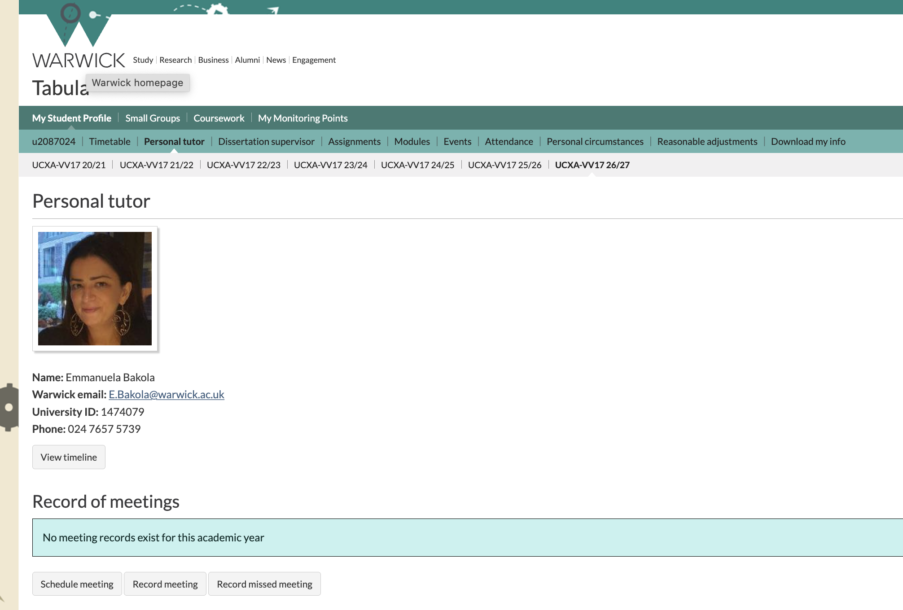

Slide 11
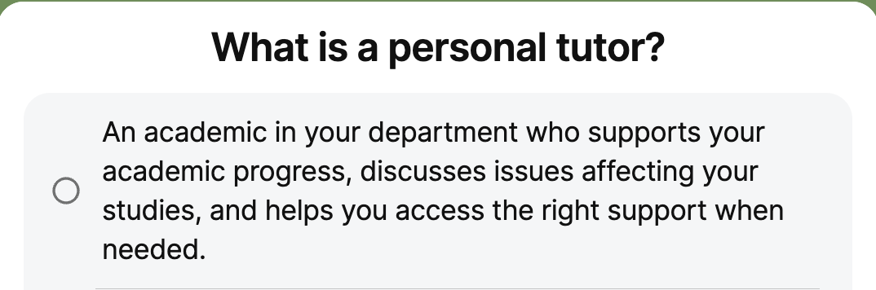
Back to

Slide 12
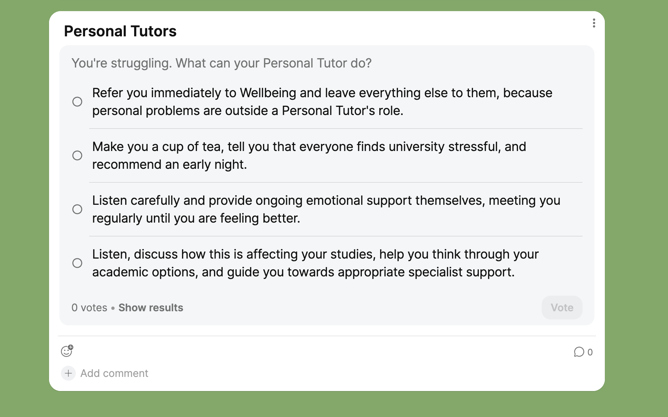
+ is your advocate, if necessary

Slide 13
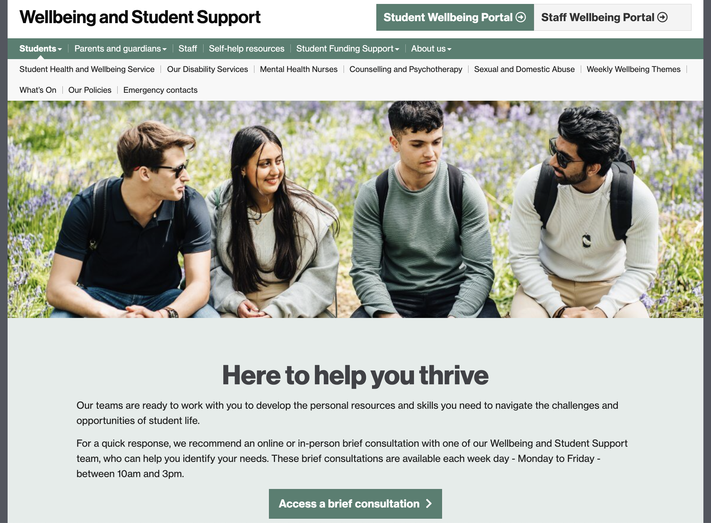
… by ‘Wellbeing and Student Support’ (or ‘Wellbeing’ for short)
Wellbeing and Student Support are available during normal working hours, with Brief Consultation sessions being offered from 10am to 3pm, Monday to Friday online (via the Wellbeing Portal) or in person at Senate House.
You can also call Wellbeing and Student Support on 024 7657 5570 or email them at wellbeing@warwick.ac.uk
Website: https://warwick.ac.uk/services/wss/
Confidentiality

Slide 14


Wellbeing and Student Support
  Practical and emotional support and advice in relation to any wellbeing issue including accommodation concerns , homesickness, experience of sexual violence, disciplinary processes, academic concerns, stress, managing anxiety and panic attacks; low mood/depression; self-harm; procrastination; motivation
=> Counselling & Psychology Interventions
  A broad range of therapeutic interventions with qualified specialists (BACP/BABCP accredited) for students wanting to explore and understand difficulties.
=> Disability Services FOR REASONABLE ADJUSTMENTS
  We encourage existing students & applicants to declare any disability or learning difference and make contact in advance to discuss their support requirements to enable us to make reasonable adjustments for the duration of their studies.

Slide 15
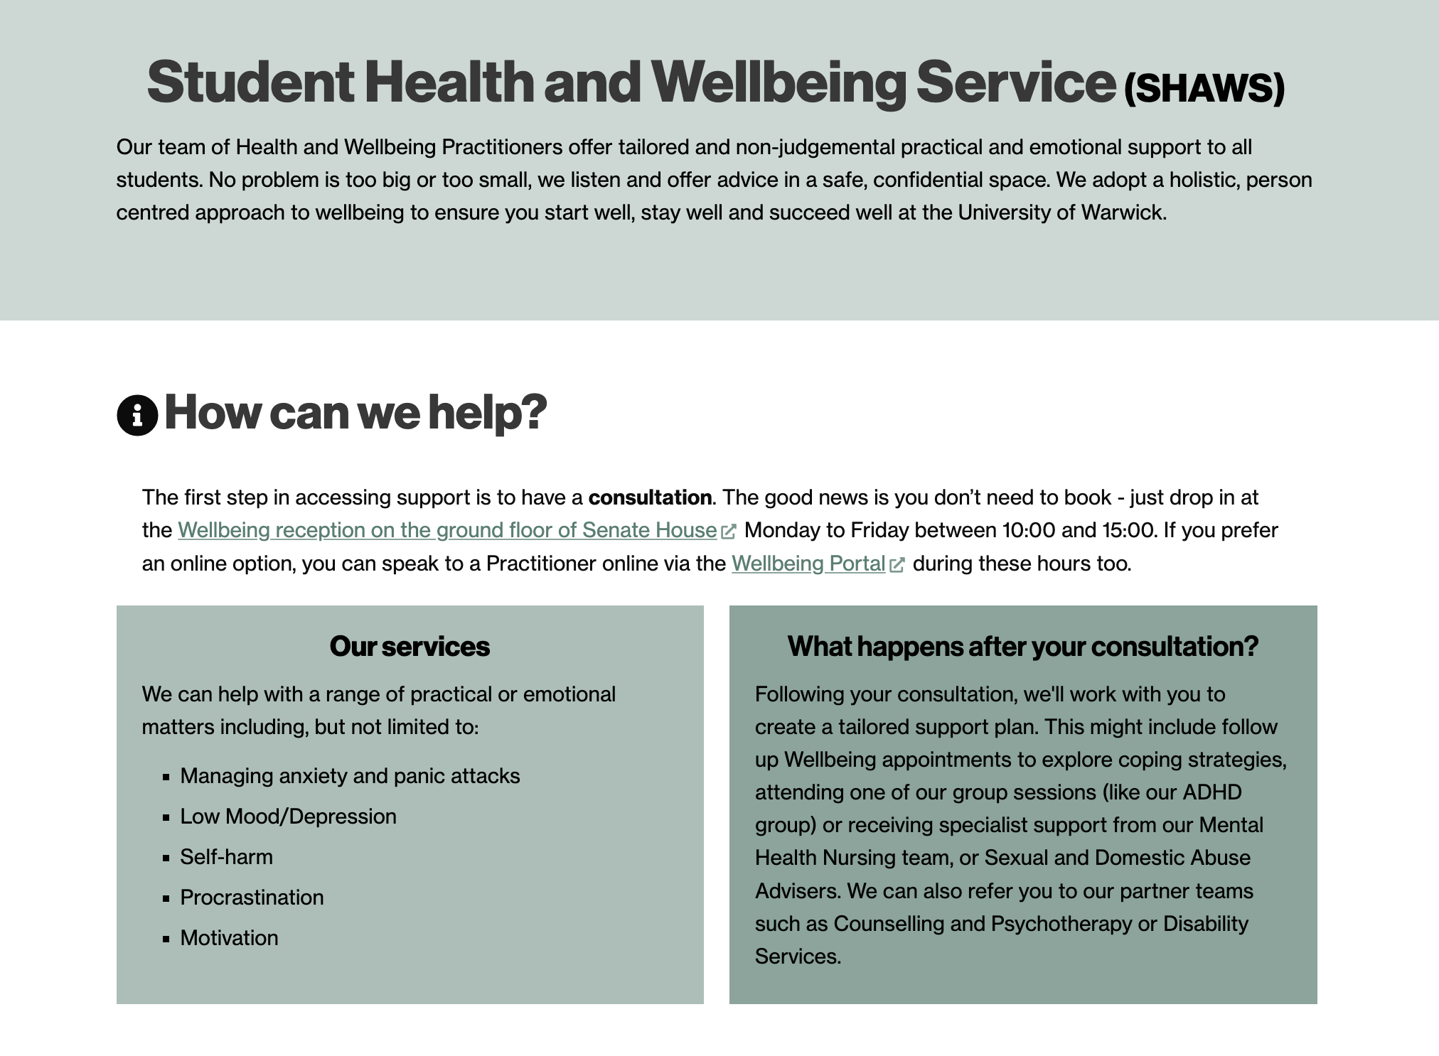

Slide 16
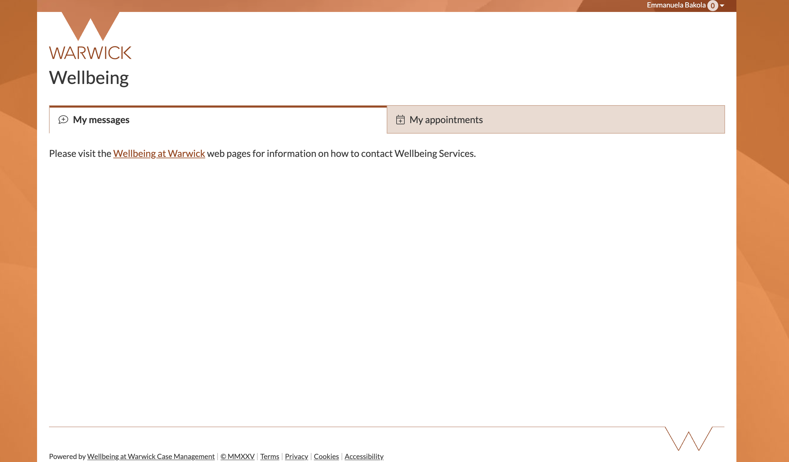
THE PORTAL

Slide 17
Wellbeing and Student Support
  Practical and emotional support and advice in relation to any wellbeing issue including accommodation concerns , homesickness, experience of sexual violence, disciplinary processes, academic concerns, stress, managing anxiety and panic attacks; low Mood/depression; self-harm; procrastination; motivation
=> Counselling & Psychology Interventions
  A broad range of therapeutic interventions with qualified specialists (BACP/BABCP accredited) for students wanting to explore and understand difficulties.
=> Disability Services FOR REASONABLE ADJUSTMENTS
  We encourage existing students & applicants to declare any disability, chronic health condition or learning difference and make contact with Wellbeing Services in advance to discuss their support requirements to enable us to make reasonable adjustments for the duration of their studies.

Slide 18
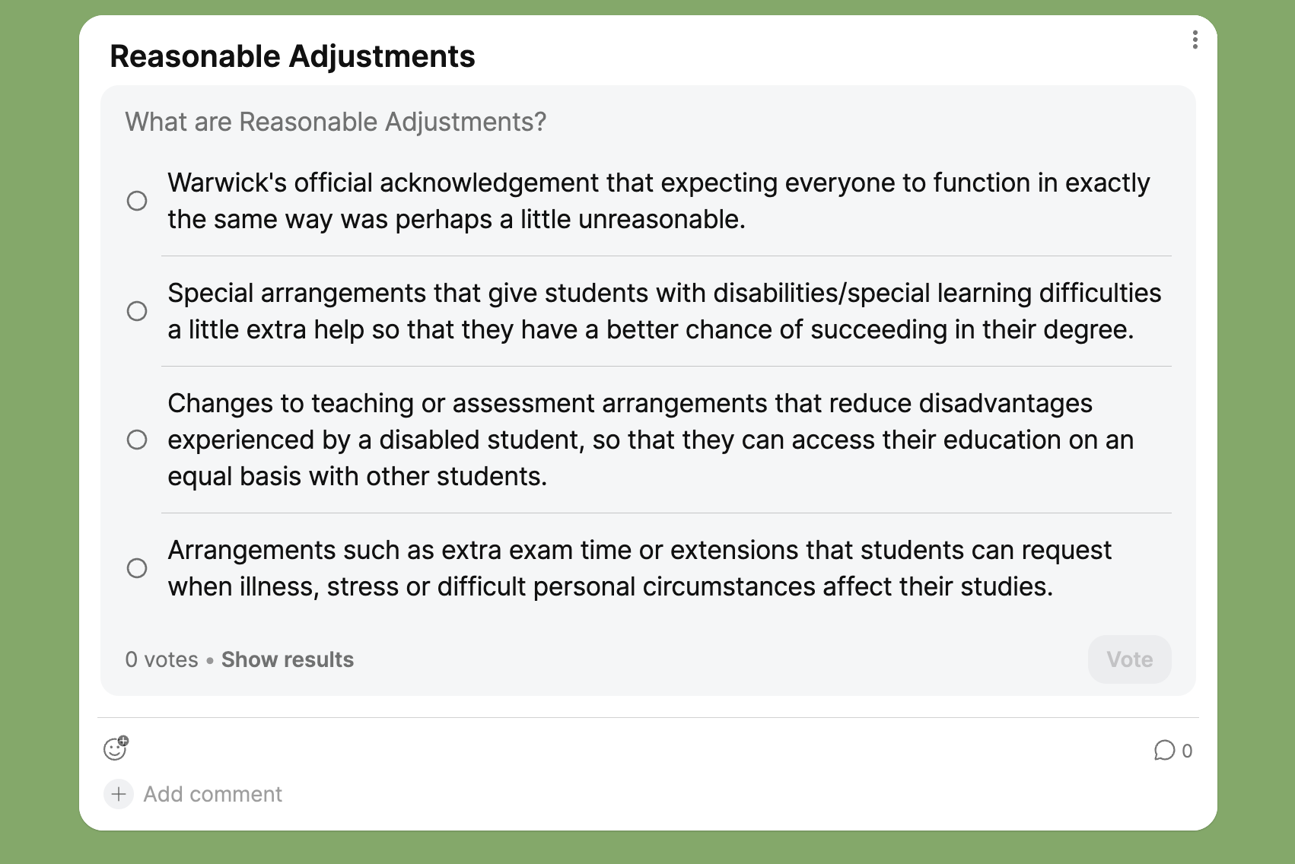

Slide 19
REASONABLE ADJUSTMENTS
In cases of disabilities, specific learning differences or chronic health conditions
Contact Wellbeing and Student Support for assessment / support
https://warwick.ac.uk/services/wss/students/disability/how-can-we-help
They will suggest specific recommendations (e.g. extra time in Exams)
If you are given a recommendation for ‘Flexible deadlines’ you will need to discuss and agree these with your personal tutor
Departmental Quiet Space: FAB2.22

Slide 20
Reasonable Adjustments – how to start the process
Wellbeing & Student Support operate using an online messaging platform, called the Wellbeing Portal which is our communication method with our students. If you have registered for an IT account (How to register for an ITS Account - University of Warwick), you should be able to access the Wellbeing Portal, using the steps below:
Log into the Wellbeing portal website https://warwick.ac.uk/services/wss using your student ID and password
Select make a new enquiry
Select the ‘disability team’ option
On the following page select yes / continue
Select general disability support
From here you can let us know about the disability support you require by adding your request to the text box. Please also upload any supporting evidence you may have using the paperclip icon. All reasonable adjustments, including exam access arrangements, are evidence based. Please refer to our website for further information about the types of supporting evidence the University will accept
https://warwick.ac.uk/services/wss/students/disability/howwecanhelp/examinations/
Please listen to your personal tutor and refer yourself for Reasonable Adjustments from the start of the year.
Don’t leave it until your academic progress is severely impacted…

Slide 21
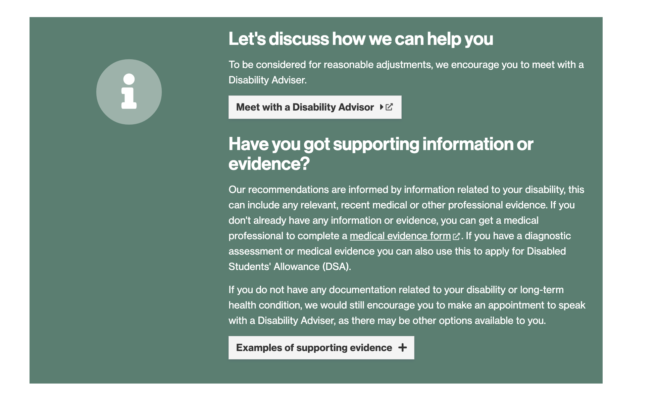
FROM WELLBEING WEBSITE
Possibility of temporary arrangements until a diagnosis is made

Slide 22
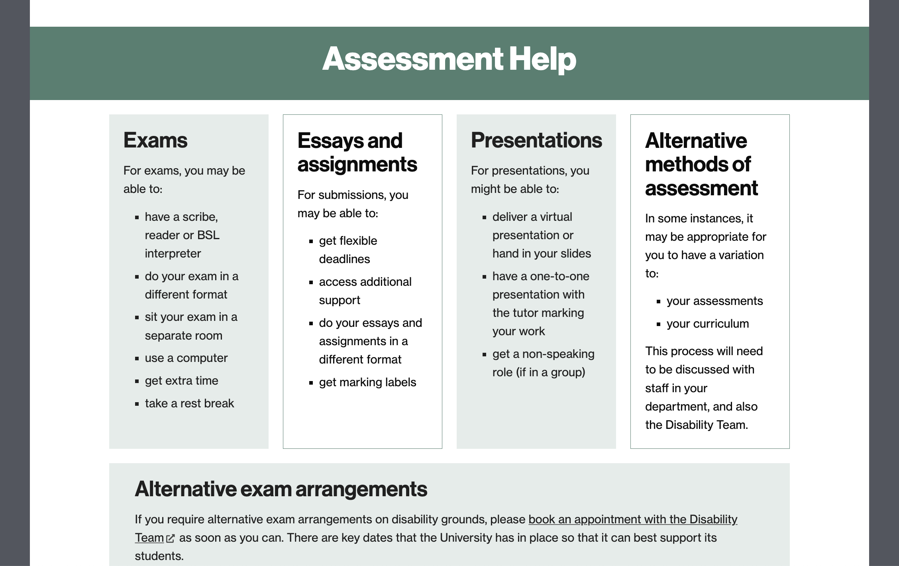
Examples of support regarding assessment

Slide 23
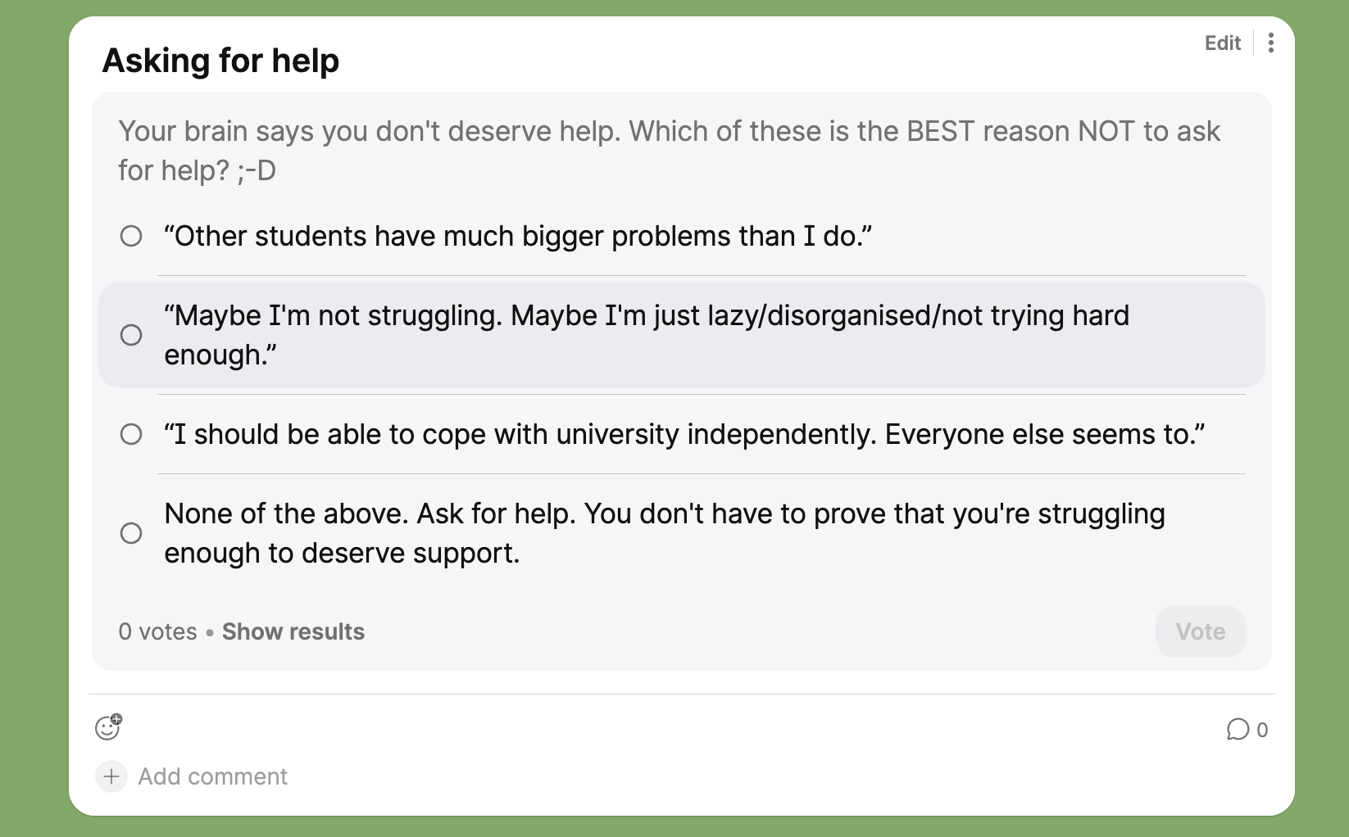

Slide 24
When life throws unexpected difficulties at you which affect your studies, it’s time to think about
MITIGATING CIRCUMSTANCES

Slide 25
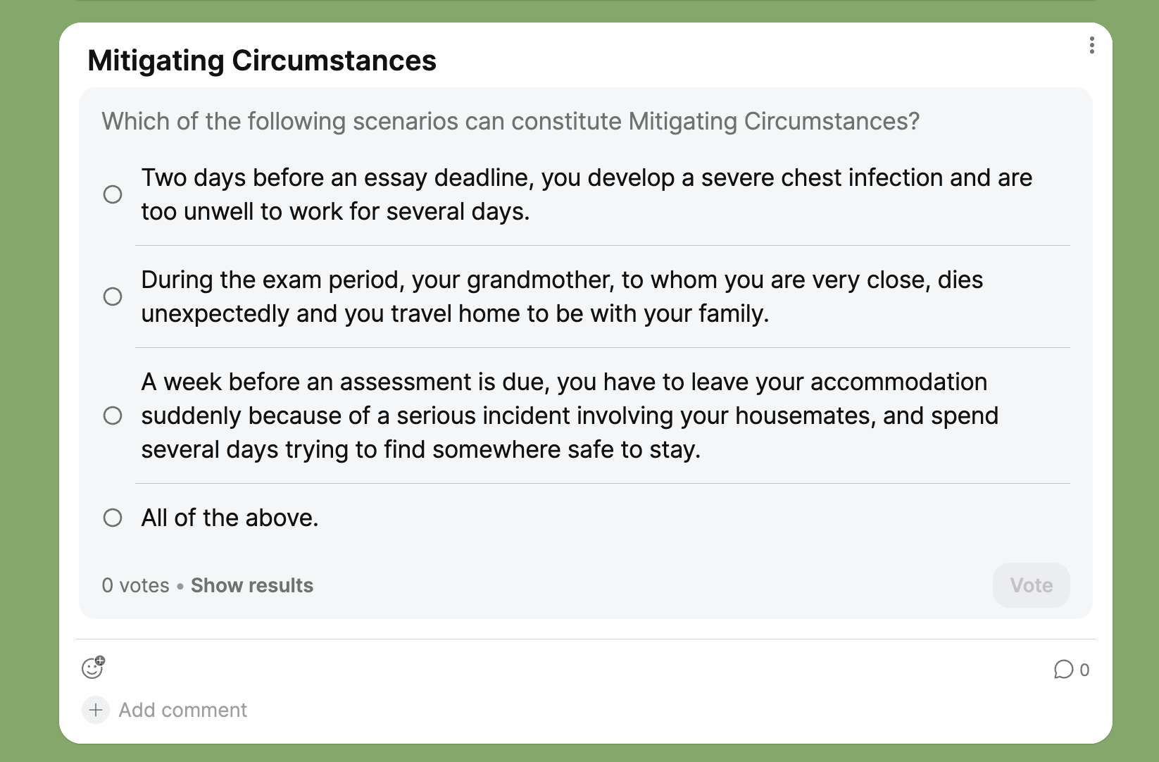
Please don't decide for yourself that your circumstances aren't ‘serious enough’. Talk to your Personal Tutor or the Senior Personal Tutor and let us help you work out what support or process is appropriate

Slide 26
Mitigating Circumstances
FACT: You are expected to hand in your work on time. Late work is subject to penalties.
In severe extenuating circumstances, you can apply for a short self-certified extension, via your Tabula profile (click on ‘personal circumstances’). These are limited to 2 this year and should be used only when absolutely necessary.
In case of other serious circumstances (e.g. serious illness, need for medical treatment), you should log full details and supporting evidence on Tabula (under ‘personal circumstances’) to be considered by the June exam mitigating circumstances committee.
Further details: https://warwick.ac.uk/fac/arts/classics/intranets/students/mitigatingcircumstances
You may discuss any such circumstances with your personal tutor who can advise further.
If you have any problems (e.g. go to A&E; are a victim of crime) please make sure to ask for documentation or take evidence at the time as it’s often harder to secure later.

Slide 28
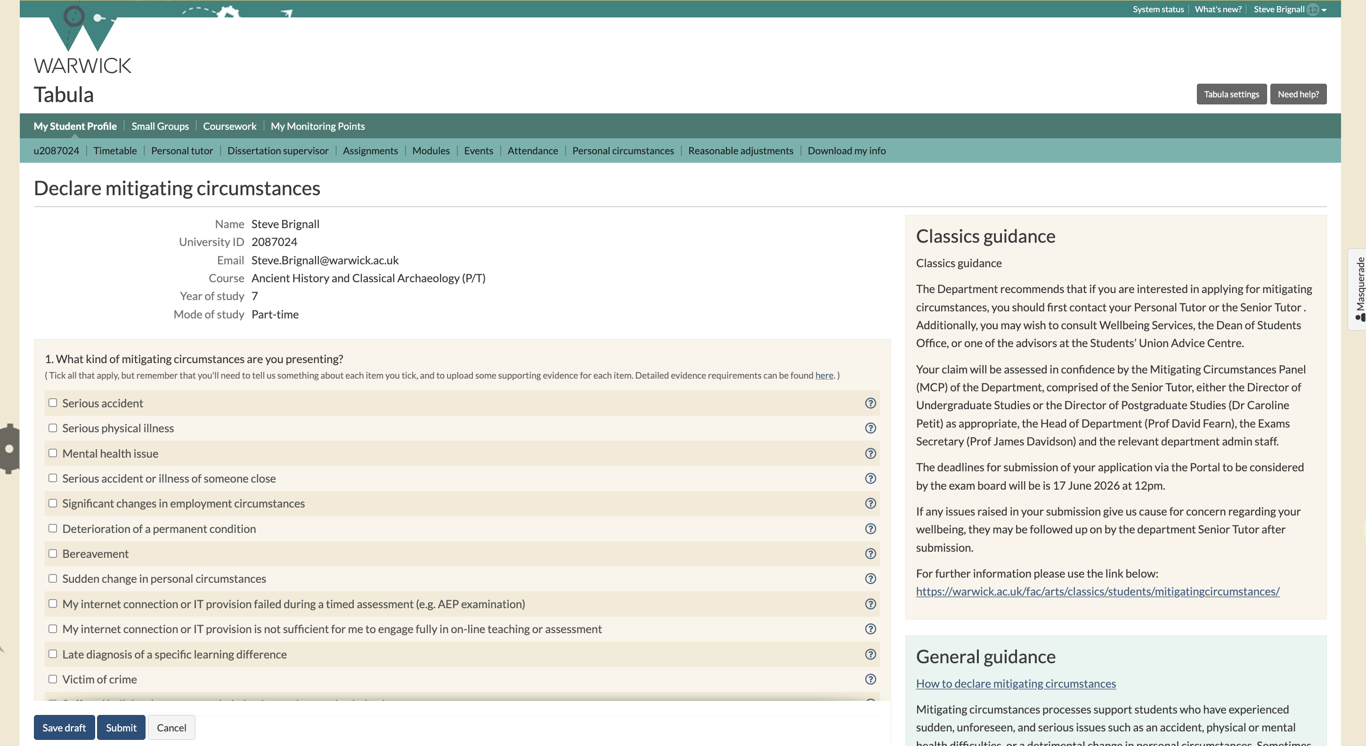

Slide 29
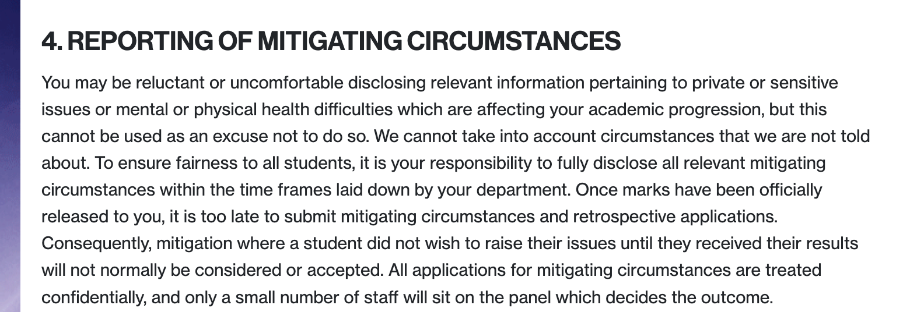
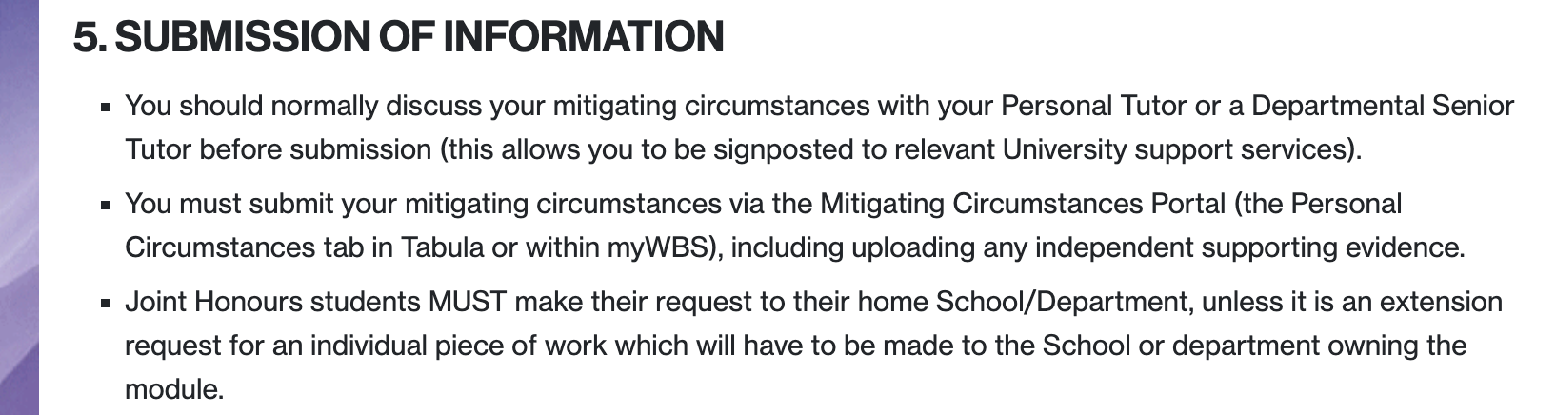

Slide 30
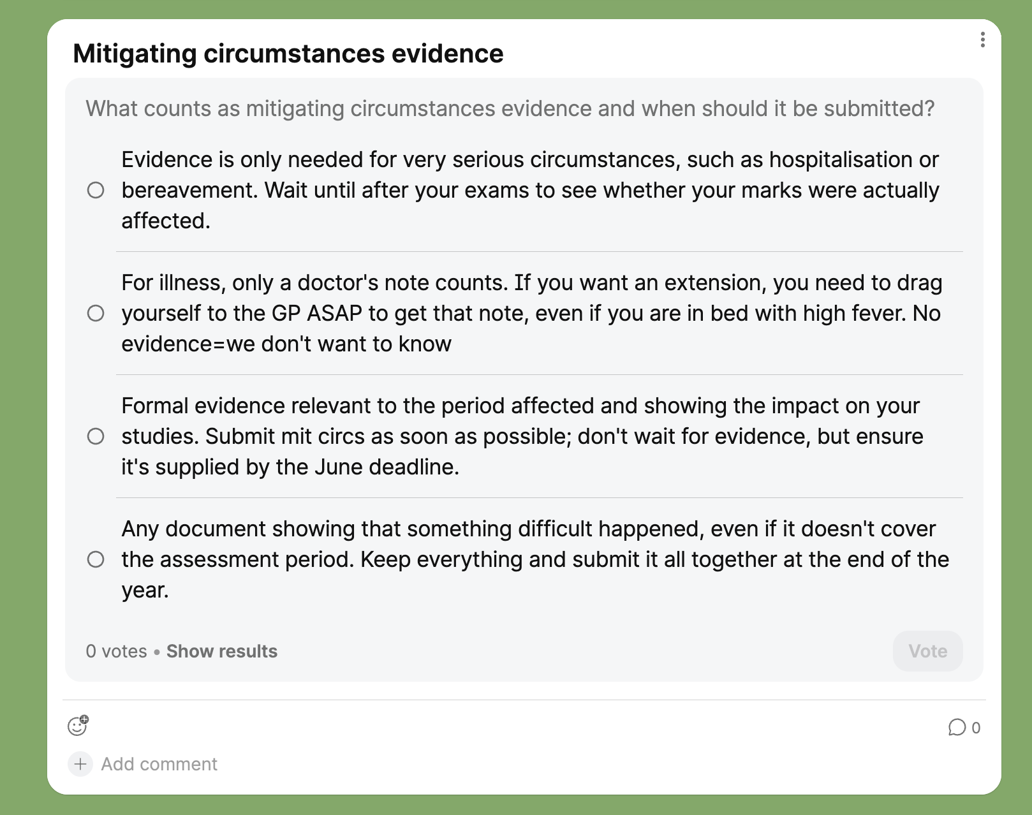

Slide 31
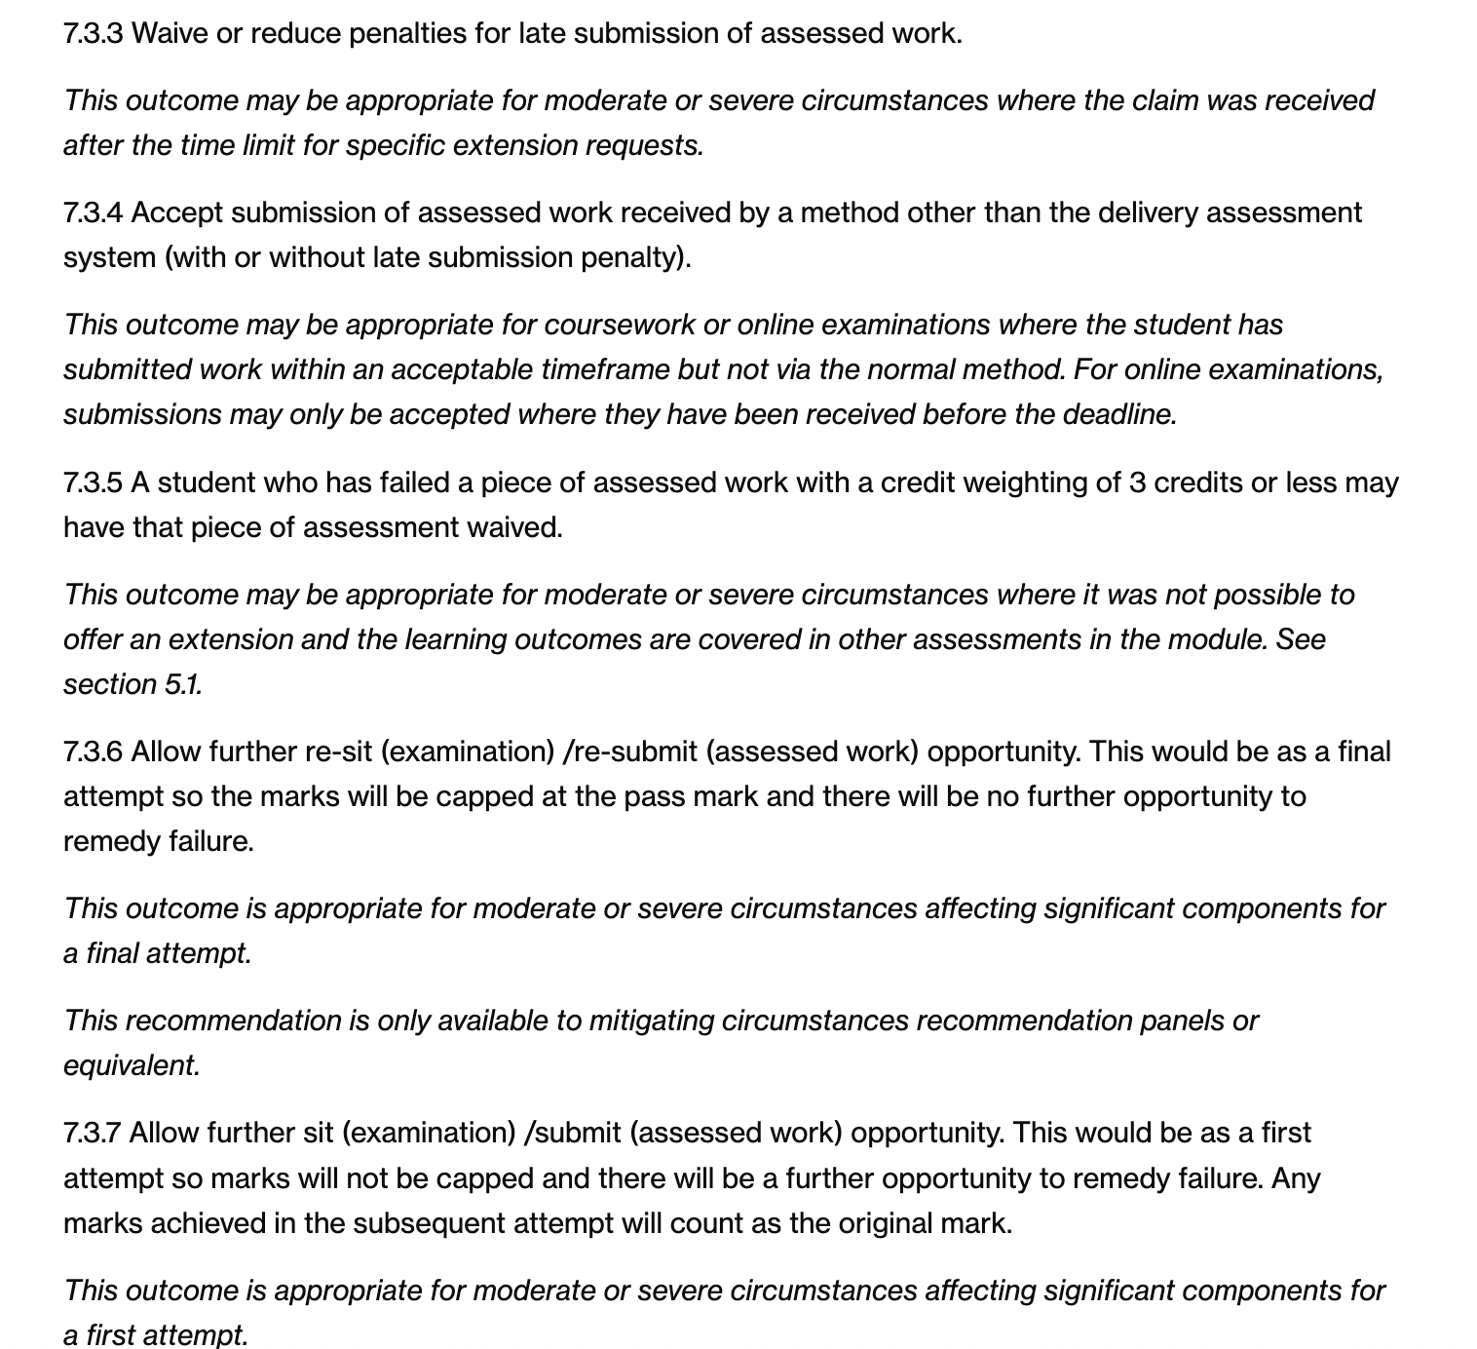
  Outcomes
Immediate outcome: extension for assessment
Mitigating circumstances committee discusses all submissions in June and proposes outcomes,
e.g. Further First Attempt in case of fail, waiving of lateness penalties, waiving of assessments

Slide 32
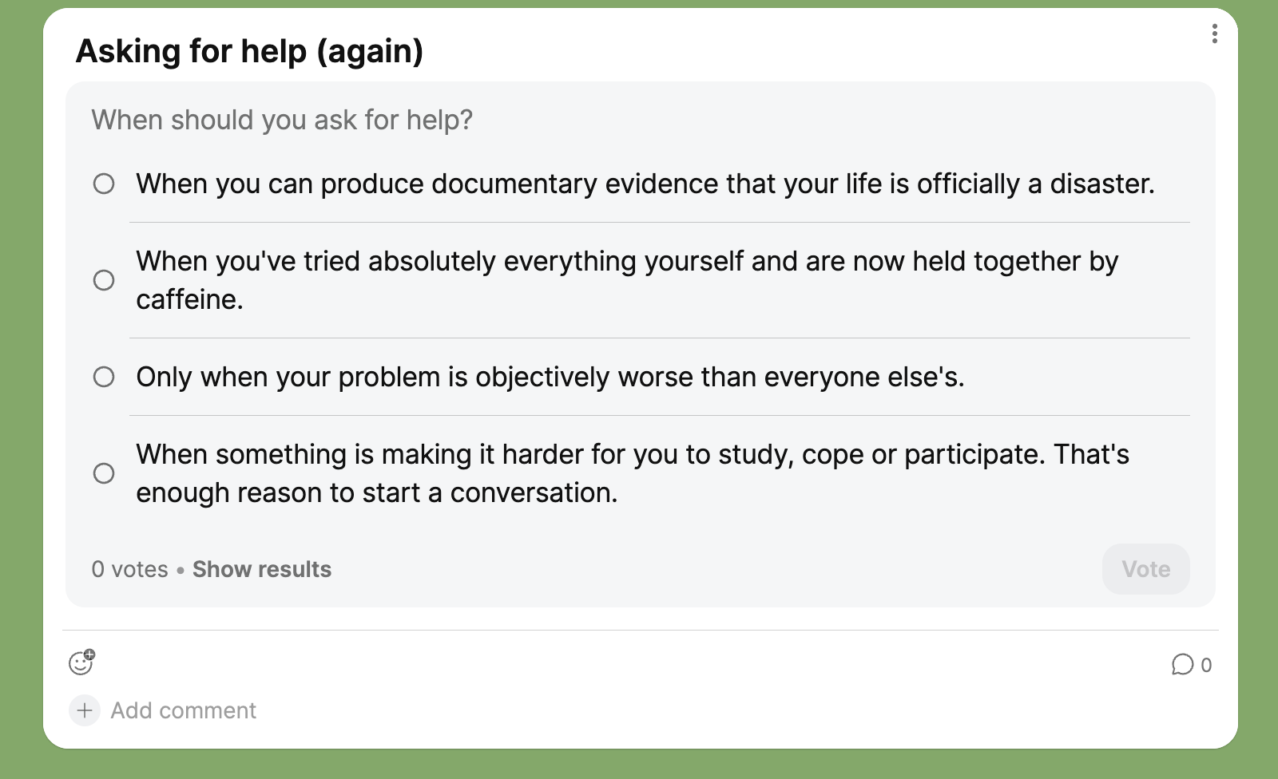

Slide 33
Support for Wellbeing, out of hours and online
Other on campus support
If there is an immediate emergency and you require the police, ambulance or fire services call the Community Safety Team first on 024 7652 2222. They will contact the appropriate emergency services and escort emergency vehicles to where you are. This is the quickest way to ensure that you get the support you need.
24 Hour Community safety Team (non-emergency):
Internal extension: x22083
External line: 024 7652 2083
https://warwick.ac.uk/services/wss/students/emergency_contacts/
https://warwick.ac.uk/services/wss/topics/

Slide 34
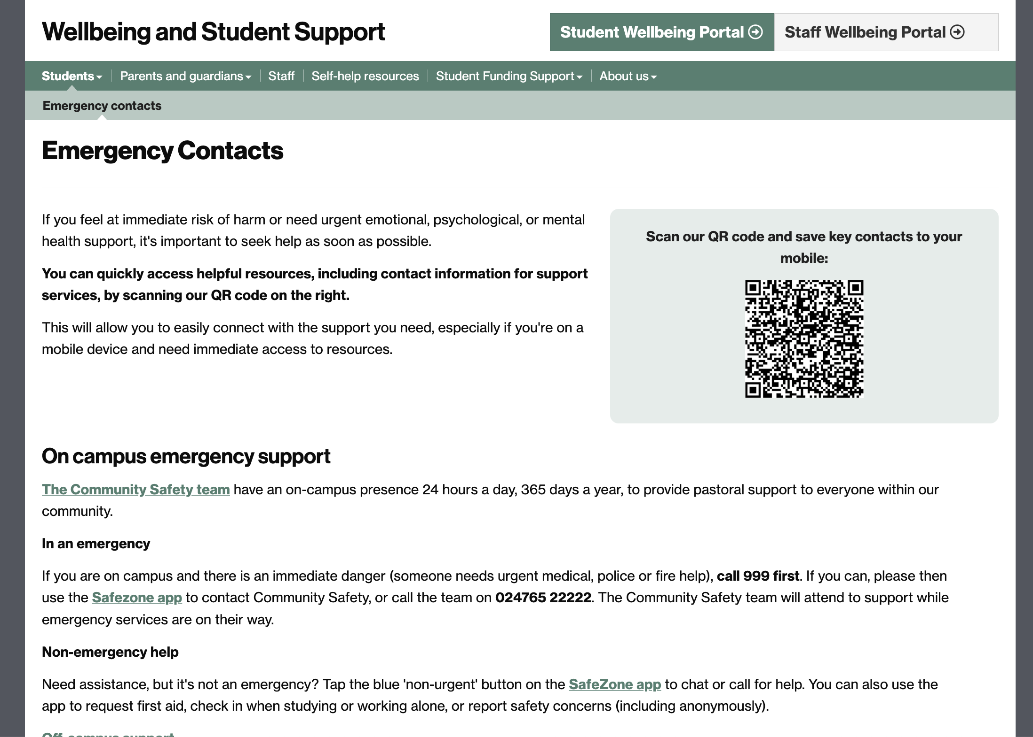

Slide 35
Other sources of support
Community Safety Warwick.ac.uk/services/community-safety/ 024 7652 2083 Gatehouse. Emergency number on back of student cards.
Report & Support team. Confidential online platform. reportandsupport.warwick.ac.uk
Warwick Student Union Advice Centre – independent advice: academic, housing, finance. Free. 2nd floor Student Union. https://www.warwicksu.com/help-support/contact/
Residential Community Team – https://warwick.ac.uk/services/rescommunity (they wear pale pink)
QR codes in bedrooms with further info
Nightline 22199 or 024 7641 7668 or nightline@warwick.ac.uk

Slide 36
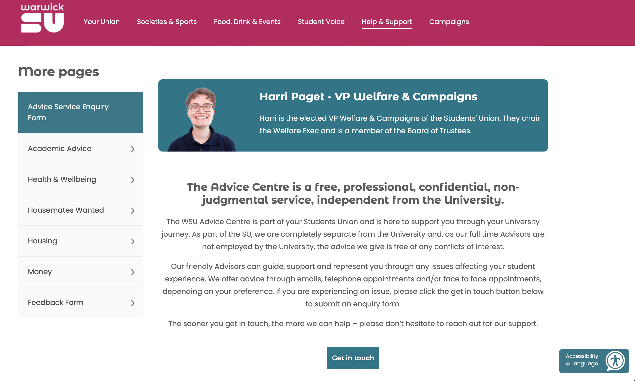

Slide 37
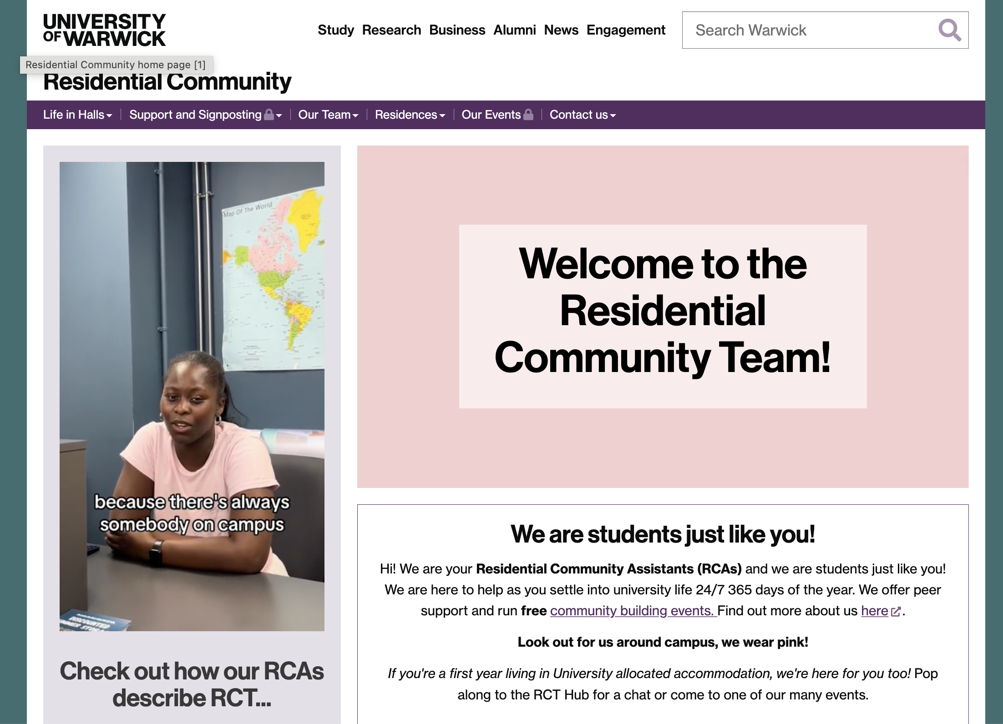

Slide 38
Specific support groups
Autism at Warwick (https://www.warwicksu.com/societies-sports/societies/autismatwarwick/), a society set up by and for students with autism
Warwick Enable: Warwick Enable (warwicksu.com) - the disability liberation and campaigning society on campus.
ADHD Society: they support and advocate for neurodivergent people in the university (including with body-doubling and study sessions), aim to improve perception of ADHD as a whole.
Departmental Disability Champion: Dr Emmanuela Bakola
Widening Participation Student Network (https://warwick.ac.uk/study/outreach/currentstudents/wpstudentnetwork/ )
Departmental Quiet Space (2.22)
https://warwick.ac.uk/fac/arts/classics/intranets/students/quiet-space/

Slide 39
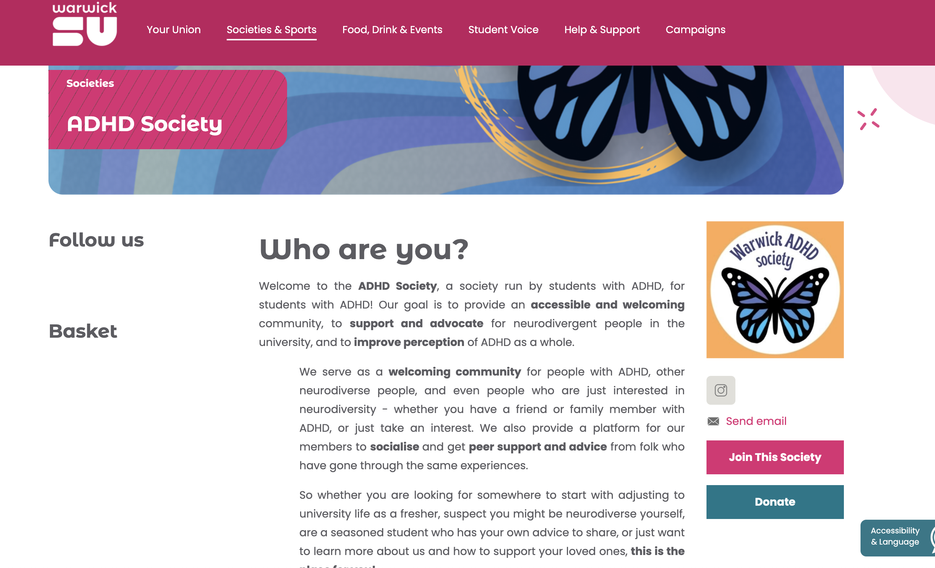

Slide 40
Support for WP students
Widening Participation Student Network (warwick.ac.uk)
You are eligible to join if you are from the UK/have Home fee status and identify with at least one of the following criteria:
You are in receipt of a Warwick Bursary or other means tested financial support
You were eligible for or in receipt of Free School Meals while at secondary school
You come from a background where your household income is below £42,875
Have a household postcode in an area with a high level of disadvantage (you can check using this website – you’d be eligible if your postcode falls into deciles 1-4)
You come from an area with low progression rates to higher education
You are a student with disabilities - including seen and unseen disabilities, specific learning differences, mental health difficulties, autistic spectrum disorder or any other disabling condition
You are a mature student who entered higher education over the age of 21
You have experience in local authority care (eg. foster home, residential children's home or kinship care)
You are are estranged from, and not supported by, both of their parents (this might be their birth, step or adoptive parents, and sometimes wider family members)
You have caring responsibilities - this could include, physical, practical or emotional care
Neither of your parents attended university and gained a degree (e.g. BA/BSc or equivalent) - excluding if they were/are a mature student
We also welcome students who have been granted refugee status, are under humanitarian protection or are currently seeking asylum in the UK.

Slide 41
Financial Support
Warwick Bursary:
https://warwick.ac.uk/services/wss/funding/bursariesandscholarships/2025-entry/
You must be a full-time Home undergraduate student for fee purposes and domiciled in England, Scotland or Northern Ireland.
You must have a family income of £42,875 or below.
Student Funding Support receives a list of potentially eligible students
Hardship/Emergency funding
https://warwick.ac.uk/services/wss/funding/hardshipfunding/
Student Funding Support, Senate House: (studentfunding@warwick.ac.uk) or telephone (+44 (0)24 7615 0096 )
Monday – Thursday: 8:30 am – 5 pm or Friday: 8:30 am – 4 pm.
In person drop-in hours Monday – Friday: 10 am – 3 pm at Senate House

Slide 42
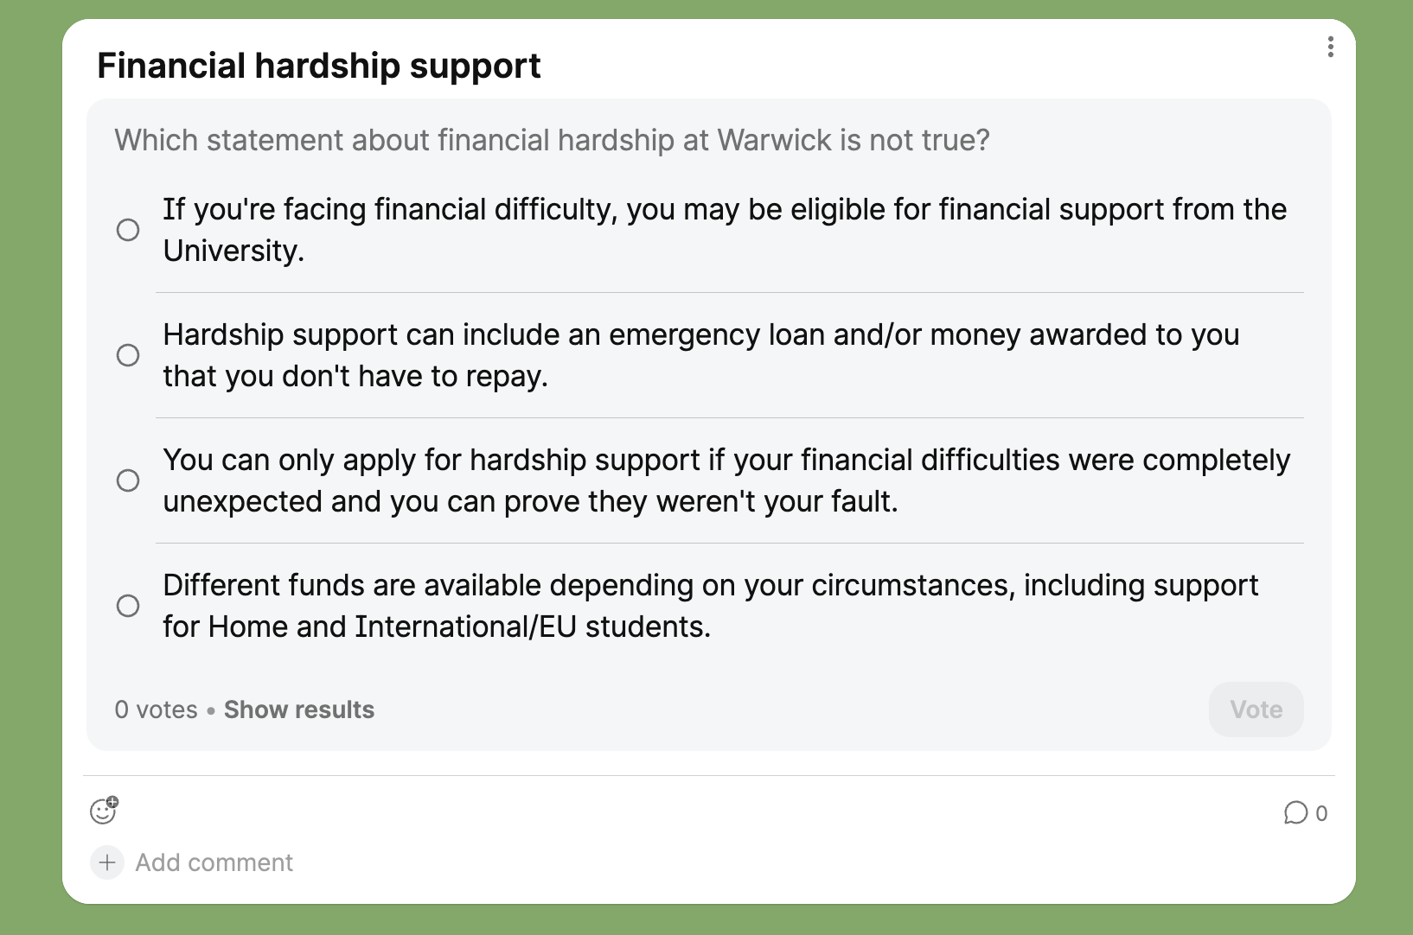
Don't decide for yourself that you won't qualify. If you're struggling financially, talk to Student Funding Support and find out what help may be available.
This is another reason to tell your Personal Tutor when something is going wrong: we may know about support you didn't know existed.

Slide 43
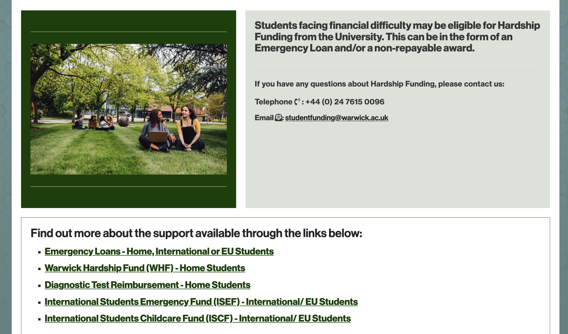

Slide 44
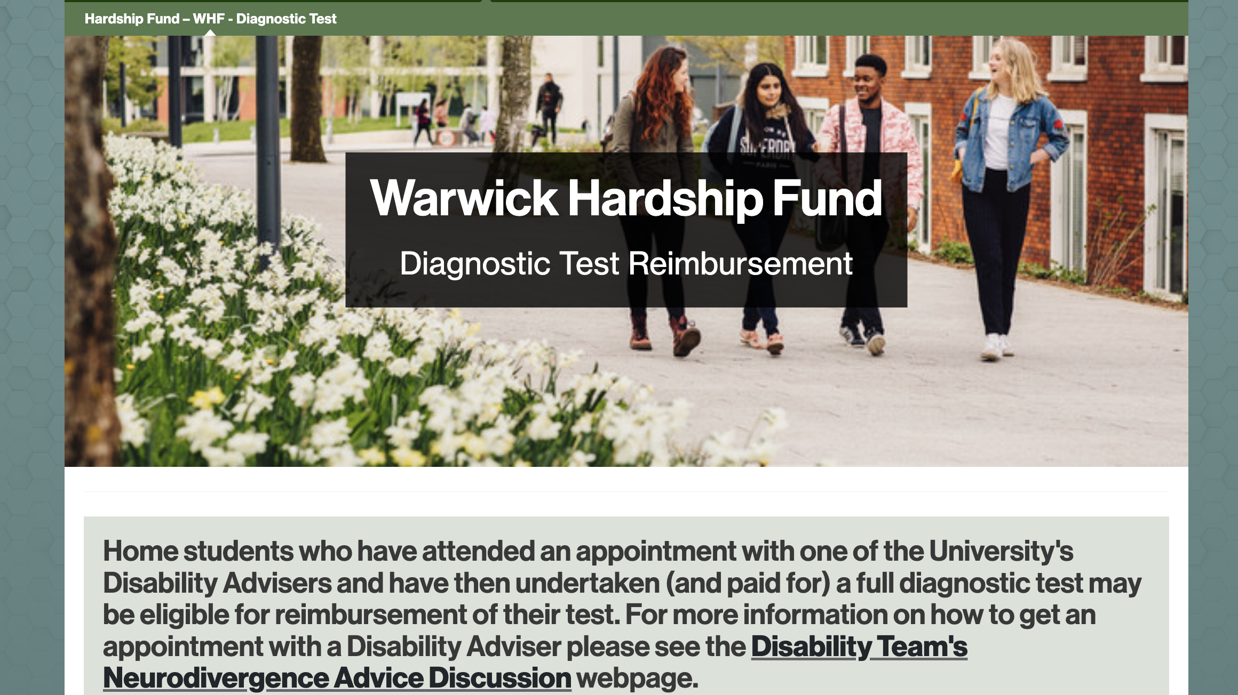

Slide 45
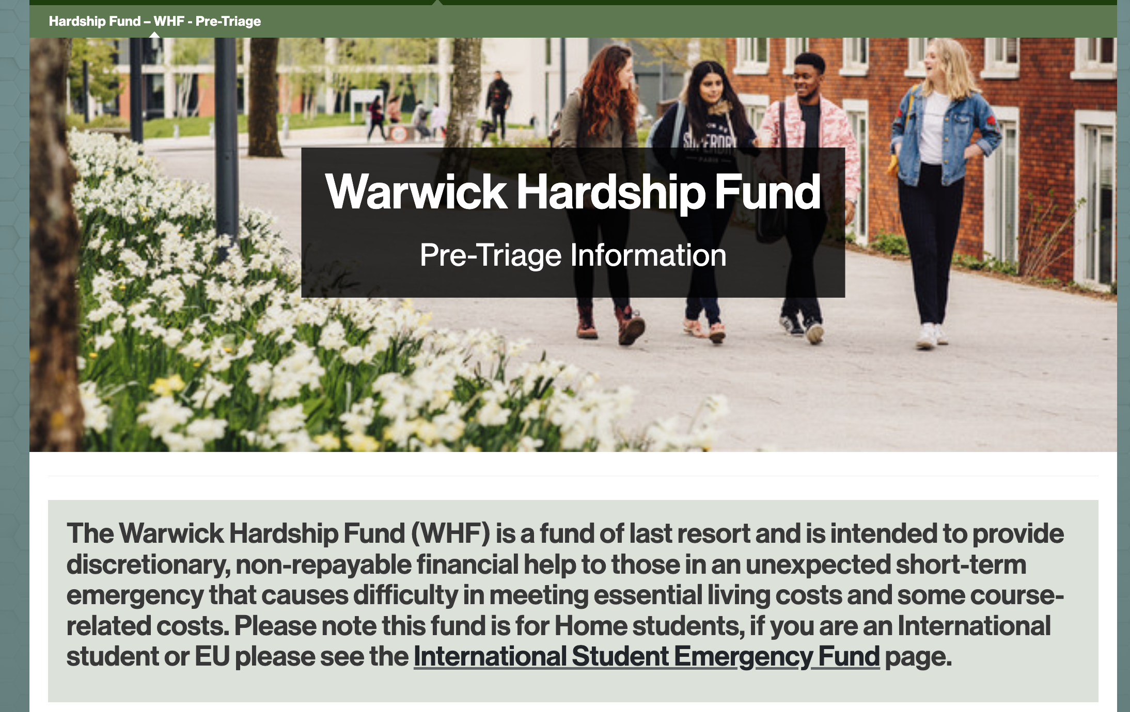

Slide 46
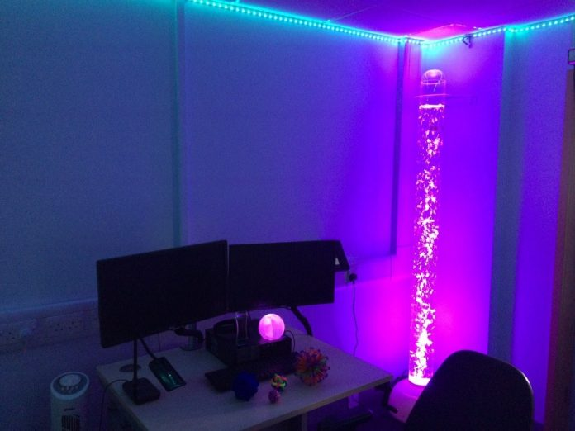
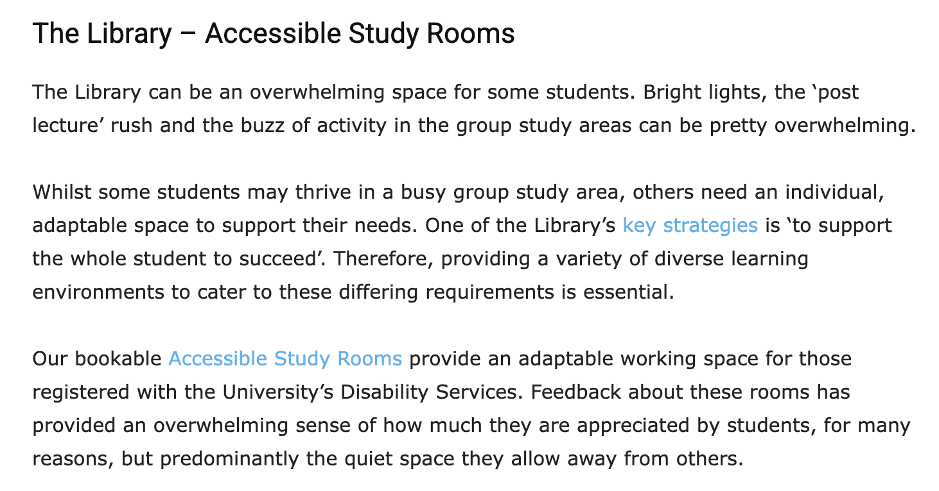

Slide 47
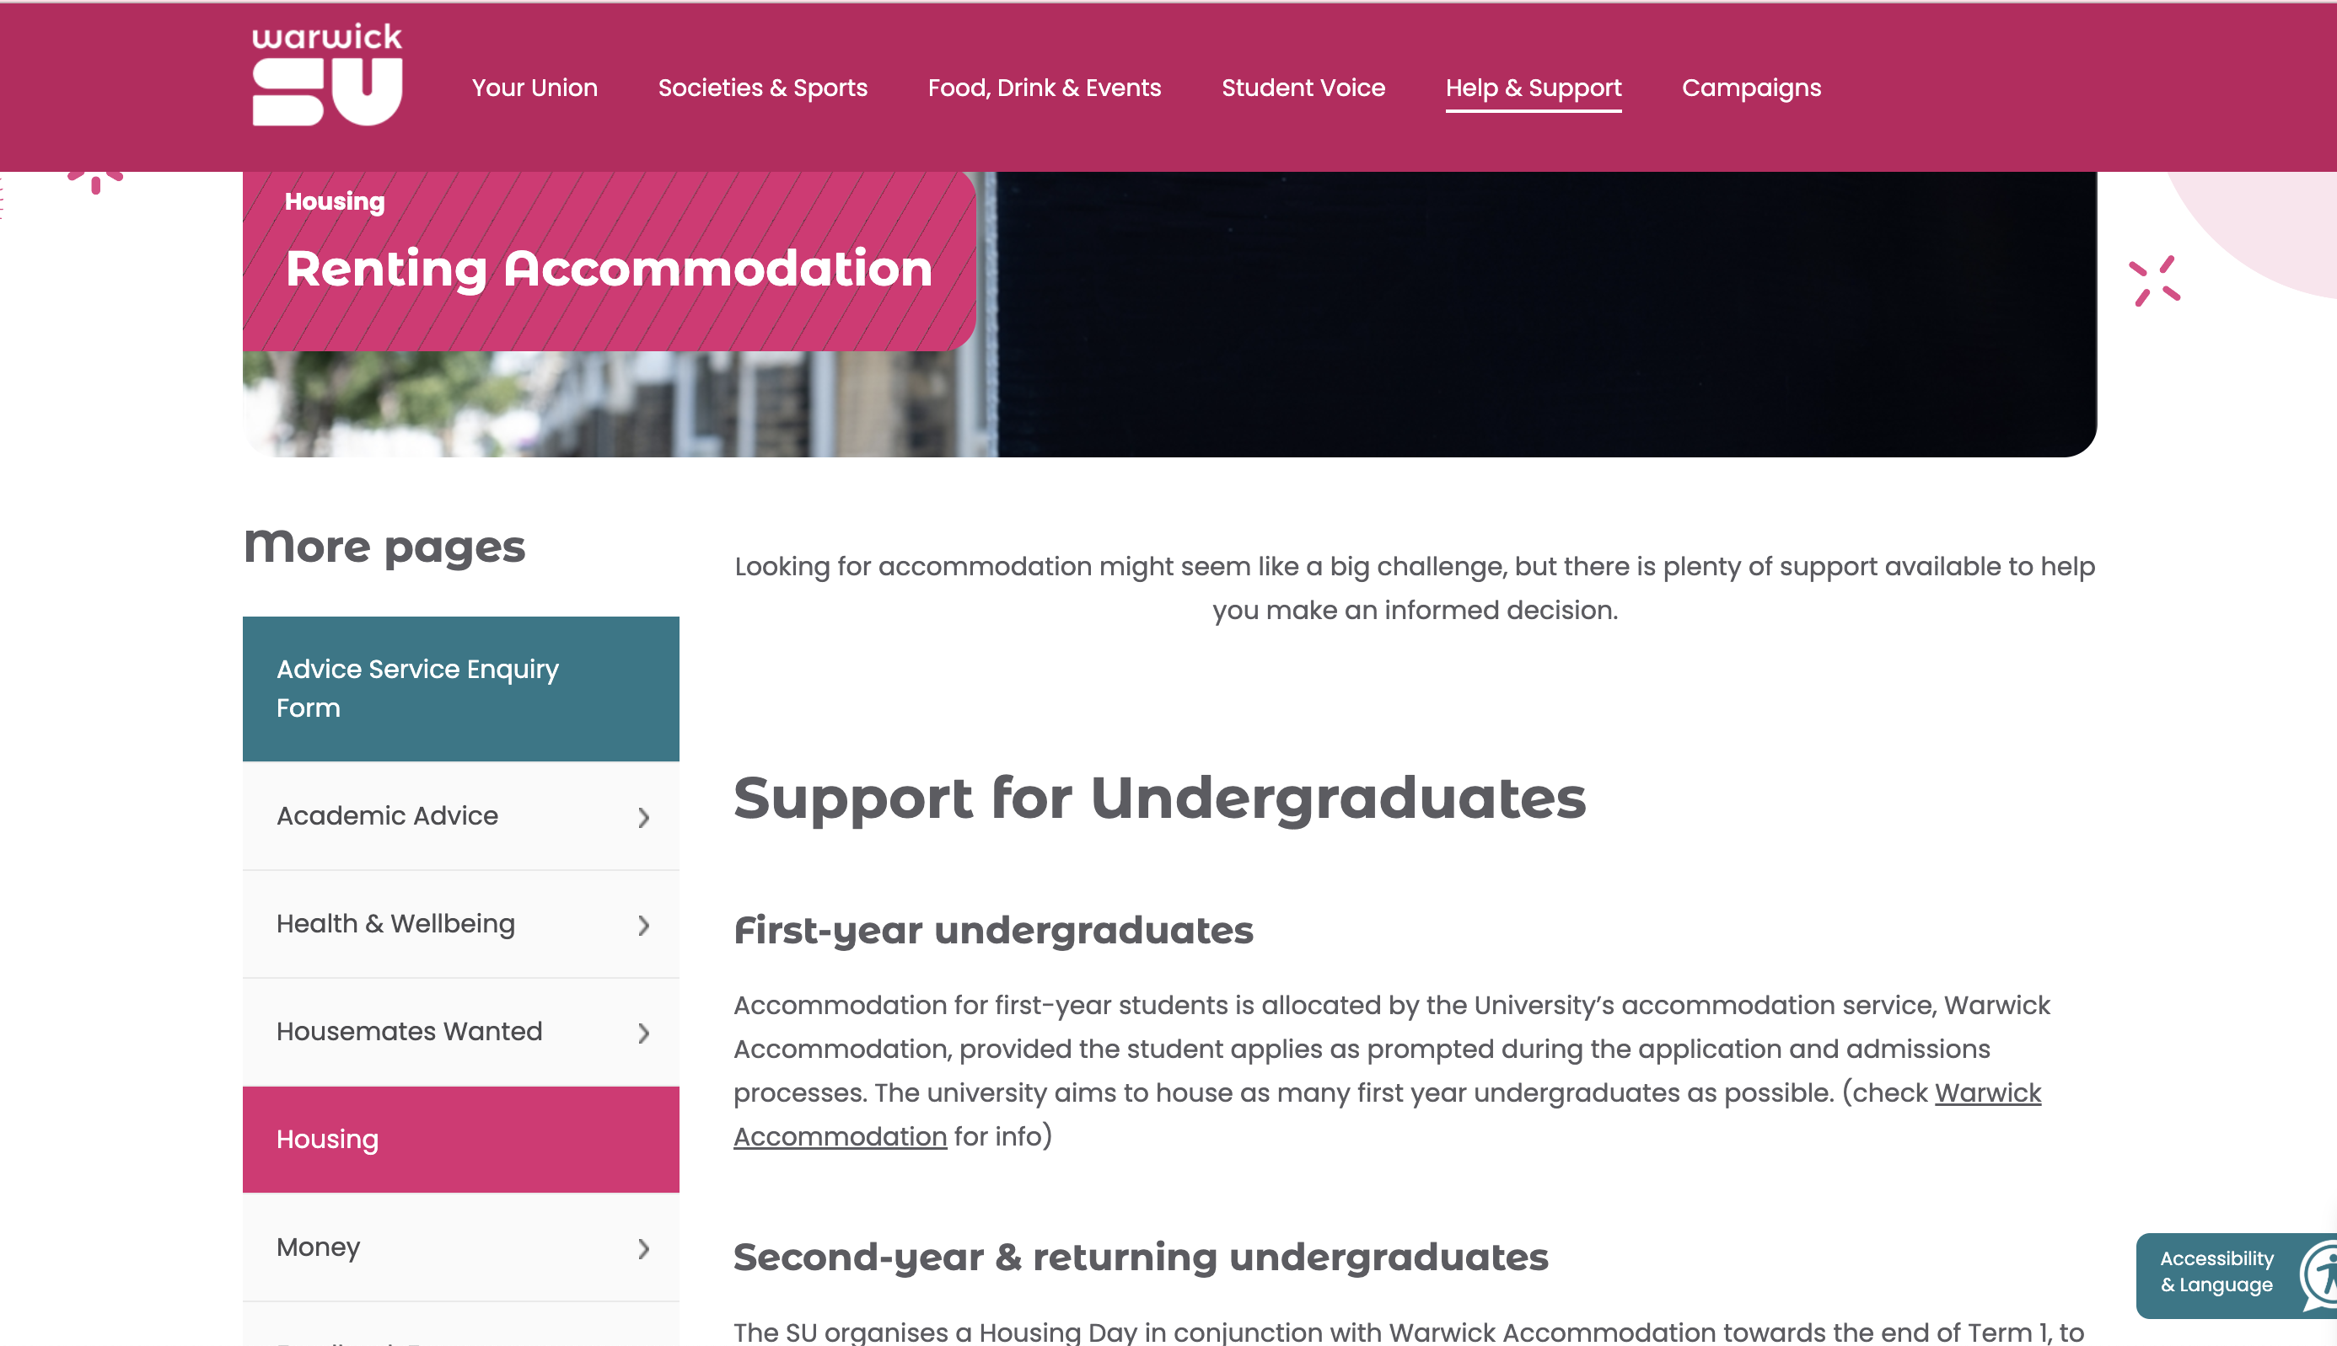
Student Union Help with Accommodation:

Slide 48
Community and Belonging: Warwick Values
https://warwick.ac.uk/about/values
We treat everyone with respect
We do not tolerate discrimination
We do not tolerate sexual misconduct, violence or abuse
We keep our campus and community safe
“We” means all of us, students and staff alike
Please complete the moodle within the first two weeks of term: https://moodle.warwick.ac.uk/course/view.php?id=38595
Attend Bystander training (in your Tabula timetable).

Slide 49

Classics Society Mentors
Introductions

Slide 50
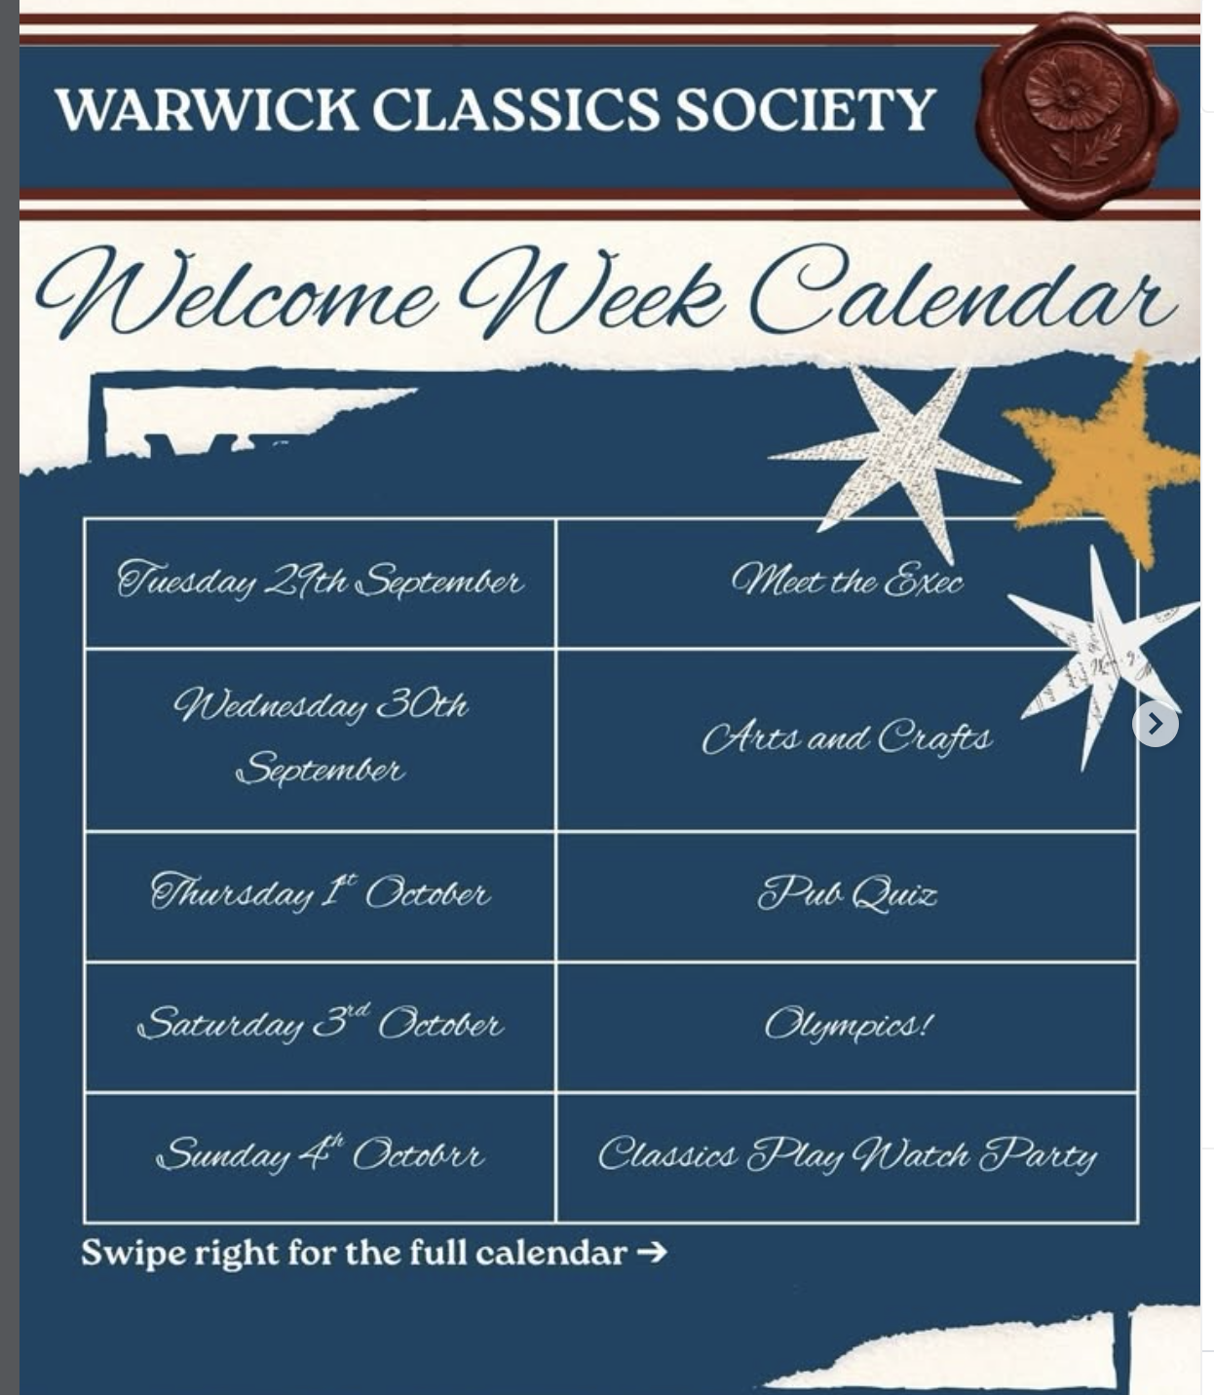

Slide 51
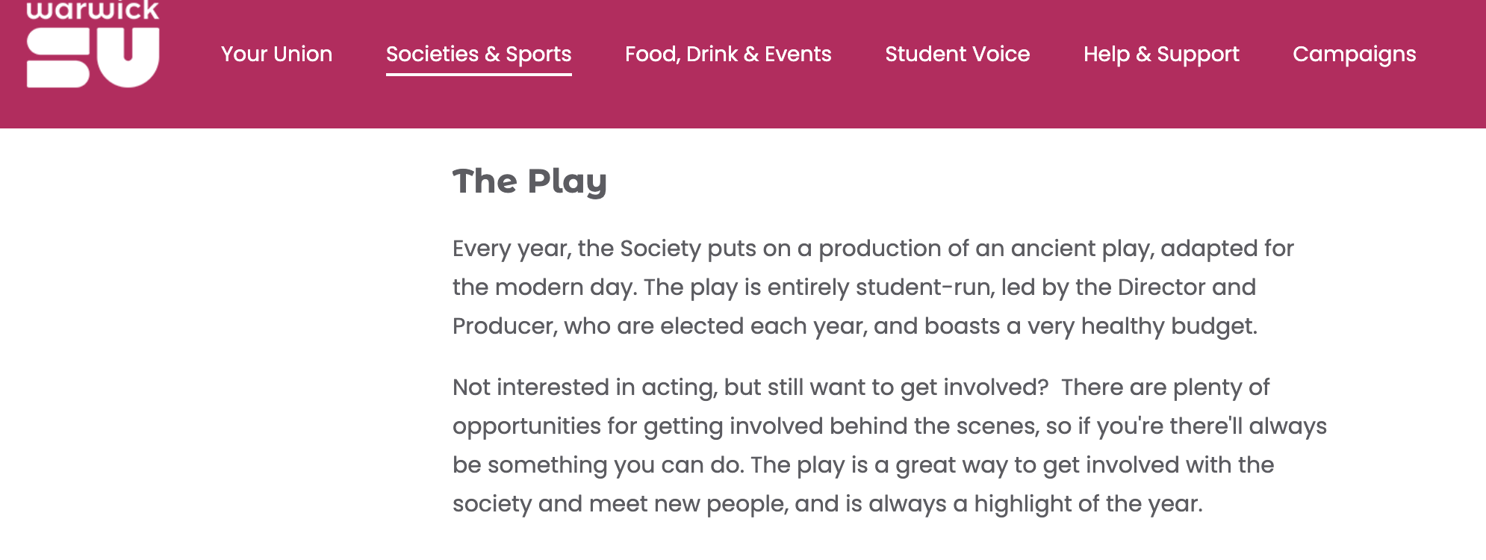


Slide 52
