Slide 1
Ancient Global History
Term 1: Lecture 2:
The Mediterranean

Slide 2
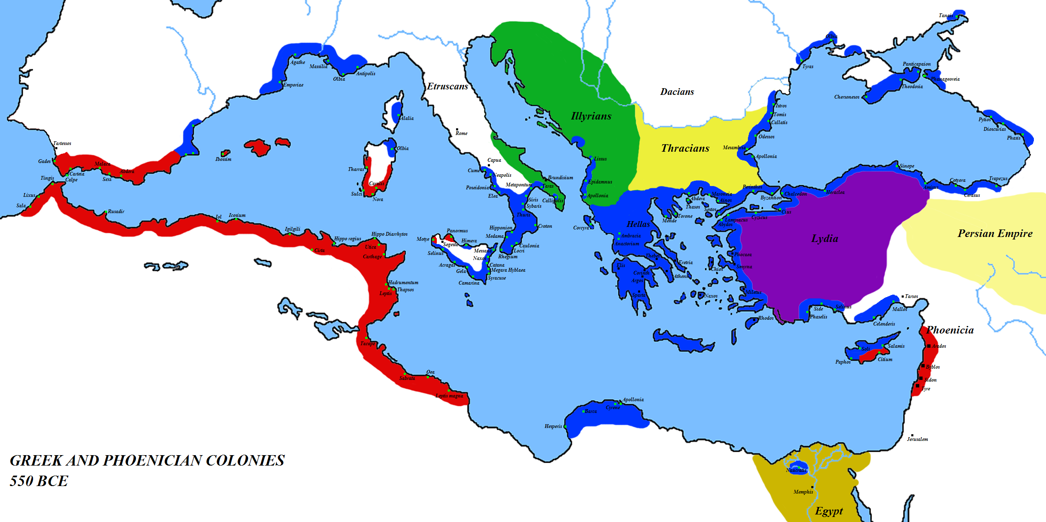

Slide 3
Framework of Events
6th century BC:
  Development of Democracy (Athens) 510-508 BC
  Expulsion of Kings and development of Roman Republic (510-08 BC)
  Widespread trade across Mediterranean world
  Development of spheres of influence/ empires
  Agreement of spheres of influence between Carthage and Rome
5th century BC:
  Persian Wars – clash of ‘East and West’
  Development of Athenian Empire
  Clash of Greeks in Peloponnesian war
  Clash of Etruscans and Romans following expulsion of Kings
  Investigation by Rome of Athenian constitution following ongoing political unrest and review of entire constitution (454 BC)
  Clash between Greek rulers in Sicily and Carthage

Slide 4
4th century BC:
  Alexander the Great’s conquest creating an empire from Greece to shore of river Indus in India (taking over Persian Empire)
  Explorations by Pytheas from Massalia sailing out of Mediterranean to discover Britain and Artic circle
  Great philosophical developments within Greek world (e.g. Aristotle)
  Collapse of Alexander the Great Empire and creation of Hellenistic monarchies: Ptolemies, Seleucids + Macedon, alongside independent city states and confederacies.
  Sending of Ambassadors by Seleucids further afield: the case of Megasthenes.
  Gauls sack Rome 390 BC
  First and Second Samnite Wars: Rome increased its hold over Italy
  Roman development of more political stability: 367 BC one consul had to be a pleb
  Treaties between Rome and Carthage (conflict growing over sea trade in Western Med)

Slide 5
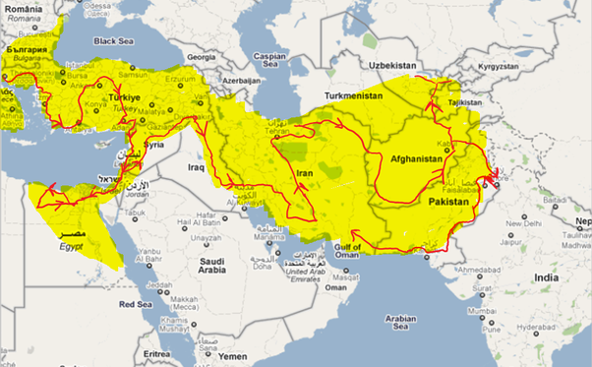

Slide 6
MEGASTHENES AND INDIA
Megasthenes – official ambassador of Seleucid court to court of King Chandragupta Maurya (known in Greek as King Sandrocottos) in Indian capital of Pataliputra (modern Patna) at end 4th century BCE.
Diplomatic relations came about as a result of failed attempt by Seleucid monarch to go further than Alexander head, but instead conducted a marriage alliance with Indian king, received elephants for his war against other Hellenistic monarchies, and set up diplomatic relations.
Wrote an Indika – account of what he saw in Indian court and out and about, as well as offered comparisons on nature of two societies, points of similarity (particularly in myth) as well as difference
His Indika survives for us in pieces quoted by later writers (e.g. Arrian, Strabo).
First Greek to write such works, but not first books. First books on India had been written in 6th century BCE for Persian kings (who named Indians as thus living near Indus river). Greeks themselves had been talking about India since 5th century BC (e.g. Herodotus – who thought the Indians occupied the edge of the inhabited world). In 4th century Greek physicians were even using Indian cures for treatment of eye and tooth disease.
Megasthenes not the only explorer: Patrocles sent to sail round the Caspian sea, Demodamas was exploring central Asia (and Megasthenes’ successor was a man called Deimachus. Ptolemy Philadelphus also sent his own ambassador at this point: Dionysius (according to Strabo 2.1.10)

Slide 7
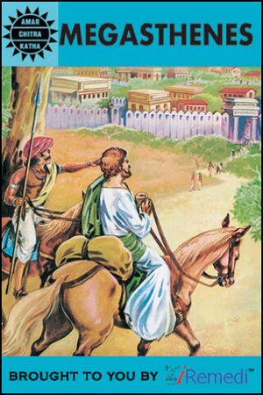
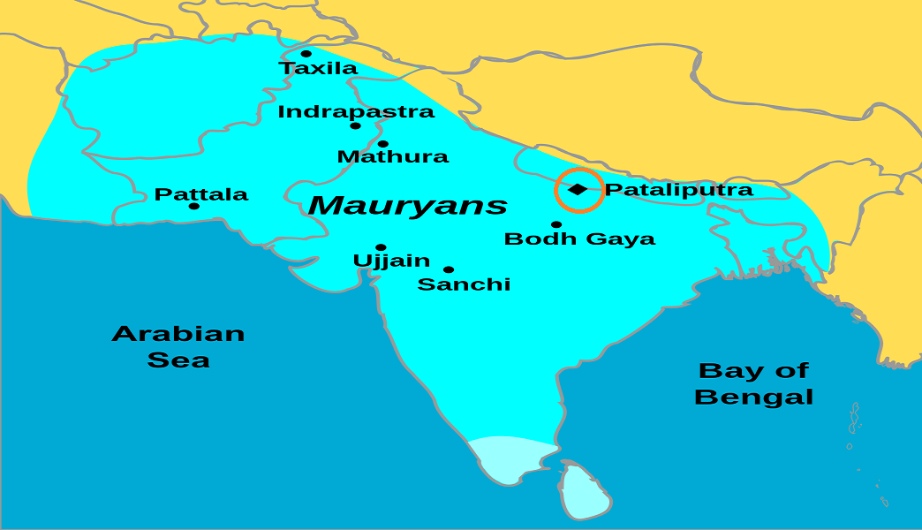
Megasthenes’ Indika

Slide 8
3rd century BC:
  First More Samnite wars leading to greater Roman control over Italy 290-80s
  Appeal from southern Italy for aid from Greece: Pyrrhus invasion (and his elephants) 280s-70s
  First Punic War 241 between Rome and Carthage over Sicily (Rome an underwhelming sea power at least to begin with)
  Illyrian War 220s – Rome extends power over Balkans
  Second Punic War 218 + invasion of Hannibal (through to 202 BC)
  First Macedonian War – Rome versus Macedon (and to some extent Greece)
  Mediterranean turns from multipolarity to unipolarity (with Rome as supreme power)
  Polybius: his account of Punic wars, and his emphasis on ‘symploke’ – the connectedness of events and major players
  Ptolemaic Egypt expands his territories to cover some Aegean islands as well as parts of Eastern Mediterranean coast, also across Africa (Cyrene) and south to Kingdom of Kush (part of ancient Nubia). In 2nd half of century, massive expansion of Ptolemaic control into Babylonia and across Aegean as far north as Thrace

Slide 9
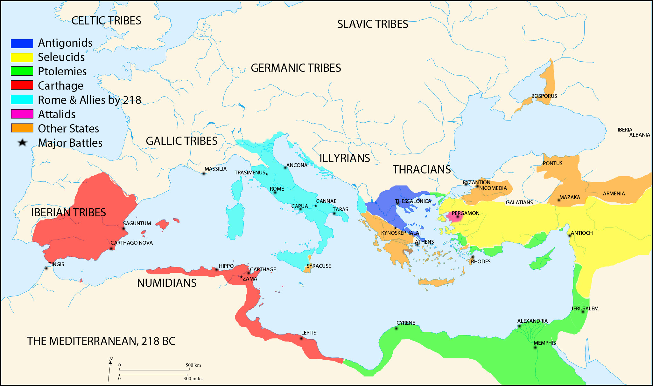

Slide 10
2nd century BC
  Romano-Seleucid war 190s – defeat of Seleucid ruler and creation of Taurus mountains as boundary of Roman and Seleucid affairs
  Second, Third and Fourth Macedonian wars – Roman defeat of Macedon and incorporation into Roman world + destruction of Carthage by Romans
  Third Punic War (146 BC) leading to destruction of Carthage and Carthaginian empire enveloped into Roman world
  Jugurthine wars (110-110s) – Rome defends its ally in Numidia (modern day Algeria) against attack from other North African tribes
  Roman wars against Germanic tribes (100s)
  Ptolemaic Egypt lose many of their gains of the previous century after Macedonian and Seleucid rulers gang up on Egypt to attack simultaneously.

Slide 11
1st century BC:
  Social War – rebellions against Rome by internal Italian tribes (90s-80s BC)
  First, Second, Third Mithridatic War – Rome in action against Kingdom of Pontus (around Black sea) – 80s-60s BC
  Sullan Civil War in Rome – 80s BC
  Sertorian War – rebellion against Rome in Iberian Peninsula (80s-70s BC)
  Rome Siege of Jerusalem (by Pompey) 63 BC
  Gallic Wars (Rome pushing back tribes of Gaul) 50s BC
  Romano-Parthian wars: Parthian empire inflicts defeat on Rome at battle of Carrhae (53 BC)
  Caesar’s Civil War (crossing of the Rubicon) 40s BC
  Anthony’s Parthian War (33 BC)
  Battle of Actium: Octavian v. Antony and Cleopatra – absorption of Egypt into Roman Empire
  Cantabrian Wars: dealing with revolts in Iberia (10s BC)
  Germanic Wars: pushing back Germanic tribes (10s BC)
  Ptolemaic Egypt needing Roman support to ensure ongoing control – defacto dependence on Rome from 50 s BC

Slide 12
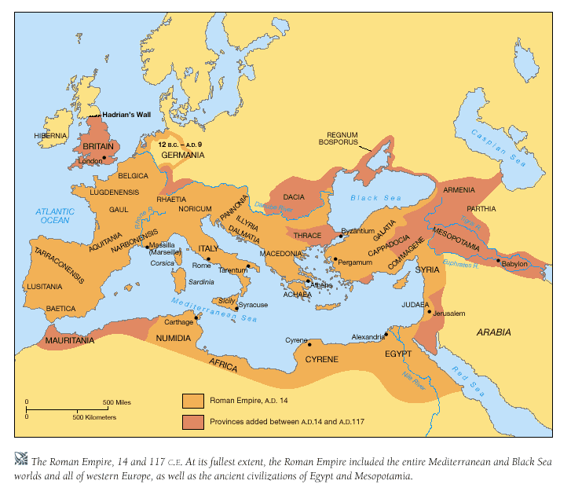

Slide 13
STRABO AND HIS WORLD VIEW
Strabo a citizen of Pontus – took advantage of Augustan era of peace to travel widely. Based in Rome 44-31 BC. “I have travelled westward from Armenia to Sardinia, southward from Black Sea to Ethiopia” 2.5.11 Important focus on having seen with his own eyes (’autopsia’)
His Geographica composed probably 7-24 CE.
It is an encyclopaedical chronicle and consists of political, economic, social, cultural, geographic description of almost whole Europe, as well as Northern Black Sea region, Anatolia, Middle East, Central Asia and North Africa.
Describing the ‘oikoumene’ – the inhabited world (begins with chapters on methodology and history of geography, before a series of chapters on geographical areas moving in a circular order starting with Iberia and concluding with Egypt, Ethiopia and North Africa
The Geographica is the only extant work providing information about both Greek and Roman peoples and countries during the reign of Augustus. It is full of distinctions between civilisation and barbarism (those not leading a Roman cultured way of life)

Slide 14
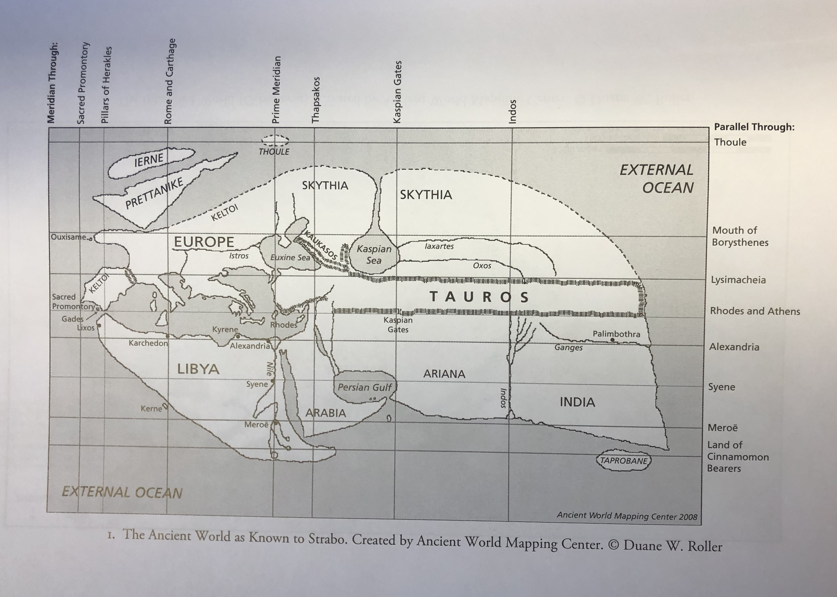

Slide 15
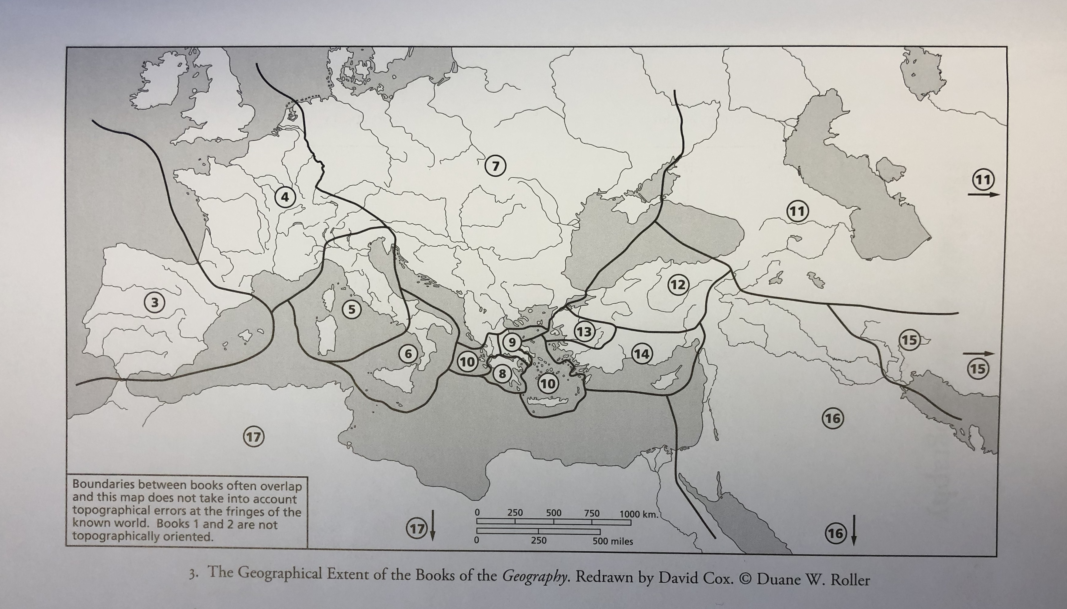

Slide 16
1st century CE:
  Province of Judea organized into Roman empire (having been a client kingdom)
  Wars in Illyria against rebelling tribes
  Wars in Germania against rebelling tribes (defeat of Rome at Teutoburg Forest)
  Creation of Kingdom of Cappadocia (in place of previous allied kingdom)
  On-going imperial politics/ murder/suspicion
  Invasion of Britain (43 CE)
  Romano-Parthian war 58-63 CE – breaking out over preferred candidates for King of Armenia
  Boudicca revolt in Britain 60s CE
  Romano-Jewish war 66 CE – province of Judea revolts from Rome
  Siege of Jerusalem and destruction of 2nd temple – 70 AD
  Dacian Wars – 80s AD – ending with Moesia as client kingdom of Rome

Slide 18
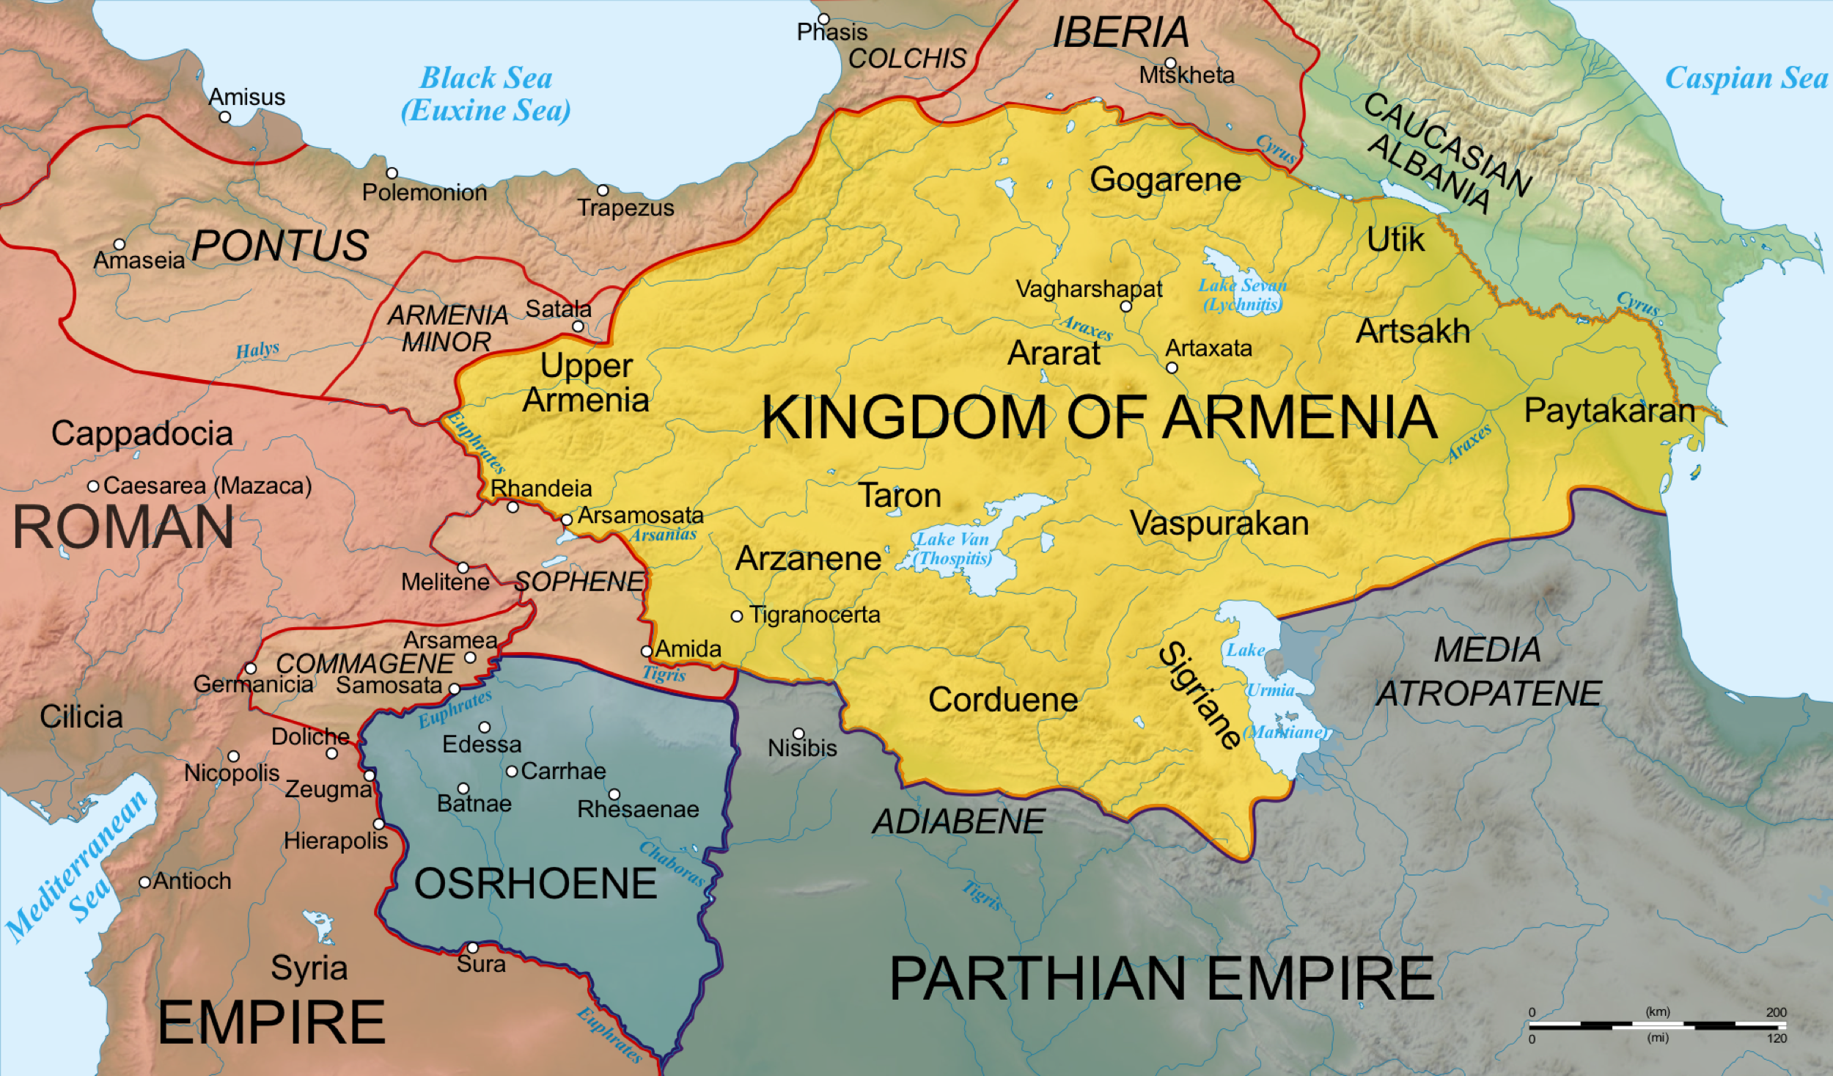
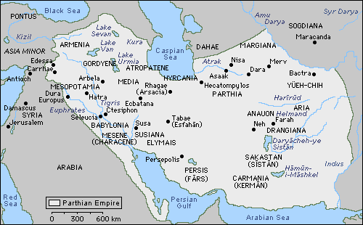

Slide 19
Discovery of Monsoon winds and international Trade
Before arrival of Romans, Egyptians had exploited trade with India and Arabia through construction of ports along Red Sea Coast.
But before the discovery of how to sail with the Monsoon winds, trade was limited and indirect (using intermediary Arab ports such as Aden)
Discovery led to direct crossings to India, the sidelining of Arabia’s role as trading hub/ importance of Petra as land trade base (bar for Arabia’s own goods – frankincense and myrrh)
Timed with Roman annexation of Egypt – led to vast increase in annual trade. Soon enough, 120 ships a year making the journey to India (leaving in July with about 20 days voyage and returning in December/January).
Description: Periplus of the Erythraean Sea (text of what can be found at each port).

Slide 20
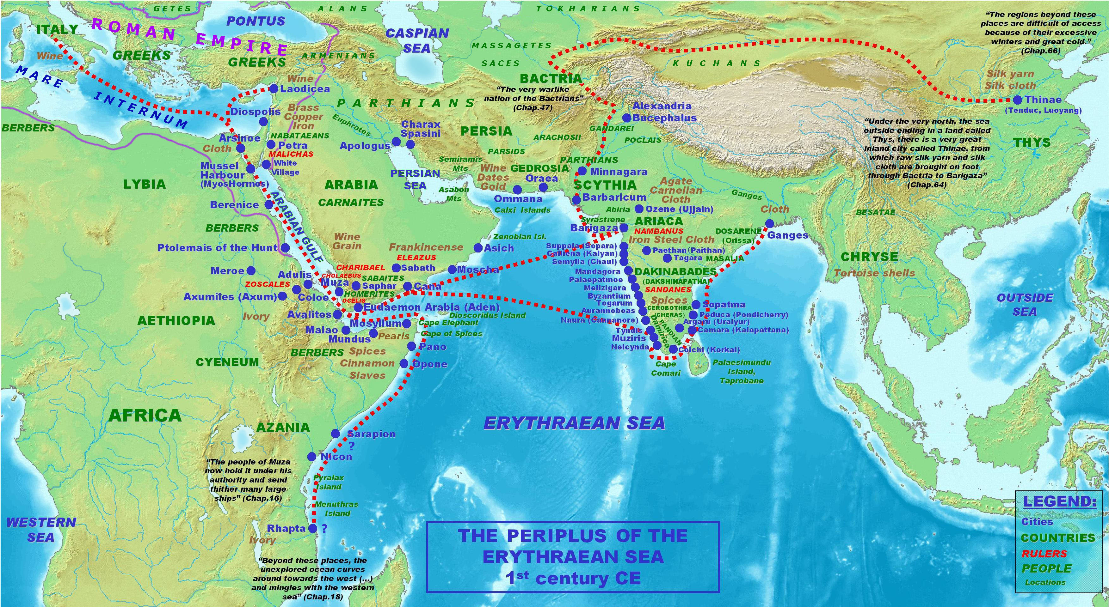

Slide 21
2nd century CE:
  First and Second Dacian Wars under Trajan (100-110s CE)
  Nabatea annexed to Rome empire (106 CE)
  Romano-Parthian war from 113 CE – leading to major annexation of Parthian territory, creation of new Roman provinces of Mesopotamia and Assyria.
  Roman organization of province of Armenia following military intervention (110s)
  Roman military intervention in Cyrene to put down Jewish Rebellion (Kitos Wars – 110s)
  118 – Hadrian as new emperor withdraws from new territories of Mesopotamia, Assyria and Armenia, re-instituting their client kingdoms
  120s CE – Hadrian’ tour of the Empire (including building of Hadrian’s wall)
  130s – Bar Kochba revolt against Rome in Judea
  Romano-Parthian war 161-66 after Parthian kill Roman client king and install their own. Leads to Roman sacking of Ctesiphon
  Antonine Plague 160s – brought back to Rome by soldiers in East
  Marcomannic Wars 170s CE – Germanic tribes in rebellion against Rome
  197 Romano-Parthian Wars: Roman’s sack Ctesiphon (Parthian capital)

Slide 23
Romano-Parthian Wars
Battle against the Parthians at Carrhae 53 BCE – Roman defeat
Roman attack against Parthia led by Mark Anthony – 40 BCE.
Emperor Augustus negotiated a peace in 20 BCE
During the 1st century CE, the two powers frequently came into conflict over their respective influence in Armenia.
In the early 2nd century CE, the Roman emperor Trajan not only conquered Armenia, but even took the Parthian capital of Ctesiphon
Emperor Hadrian reversed Trajan’s policy and sought to re-establish the Euphrates river as the boundary between the two empires.
In the 160s CE, conflict once again broke out between the two empires over Armenia, leading to a brief Roman invasion again as far as Ctesiphon and subsequent withdrawal.
Further Roman invasions in 190s CE and in 210s CE
Parthian Empire taken over by the Sassanids in 220s CE.

Slide 24
Trade between Rome and Parthia (and Palmyra)
Palmyra urbs nobilis situ, divitiis soli et aquis amoenis, vasto undique ambitu harenis includit agros, ac velut terris exempta a rerum natura, privata sorte inter duo imperia summa Romanorum Parthorumque, et prima in discordia semper utrimque cura.
“Palmyra is a city famous for its situation, for the richness of its soil and for its agreeable springs; its fields are surrounded on every side by a vast circuit of sand, it is as it were isolated by nature from the world, having a destiny of its own between the two mighty empires of Rome and Parthia, and at the first moment of a quarrel between them always attracting the attention of both sides”
Pliny NH 5.88

Slide 25
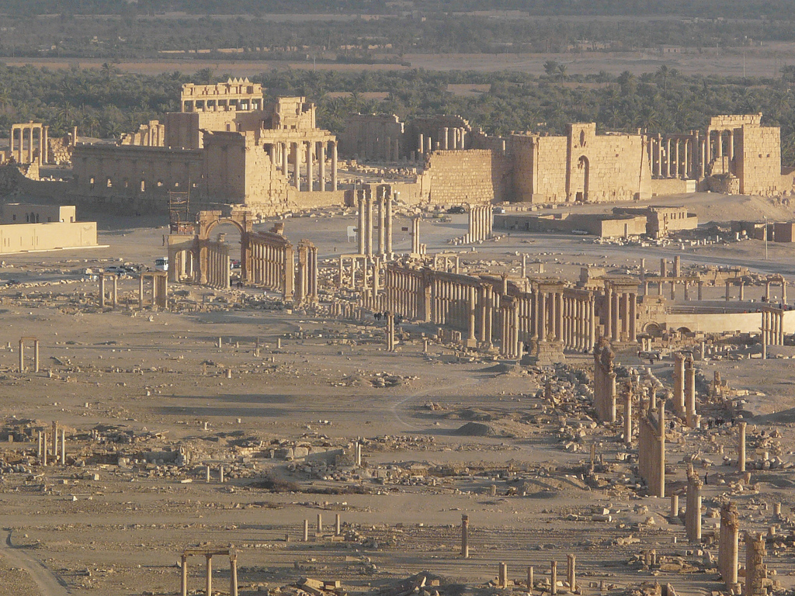
Palmyra
Independent of Rome until after 41 BCE (tributary status)
Paying taxes to Rome by 19 CE (and fully incorporated into Roman empire)
19-131 CE: occasional trading ventures
A free city from 129 CE
131 CE -272 CE: Highly successful trading post
Becomes colonia under Septimius Severus / Caracalla.
265 CE: attacked by Sassanid Empire
269 CE: Queen Zenobia of Palmyra led an attack on Rome’s Eastern Empire
272 CE: Rome reconquers the town and destroys much of it

Slide 26
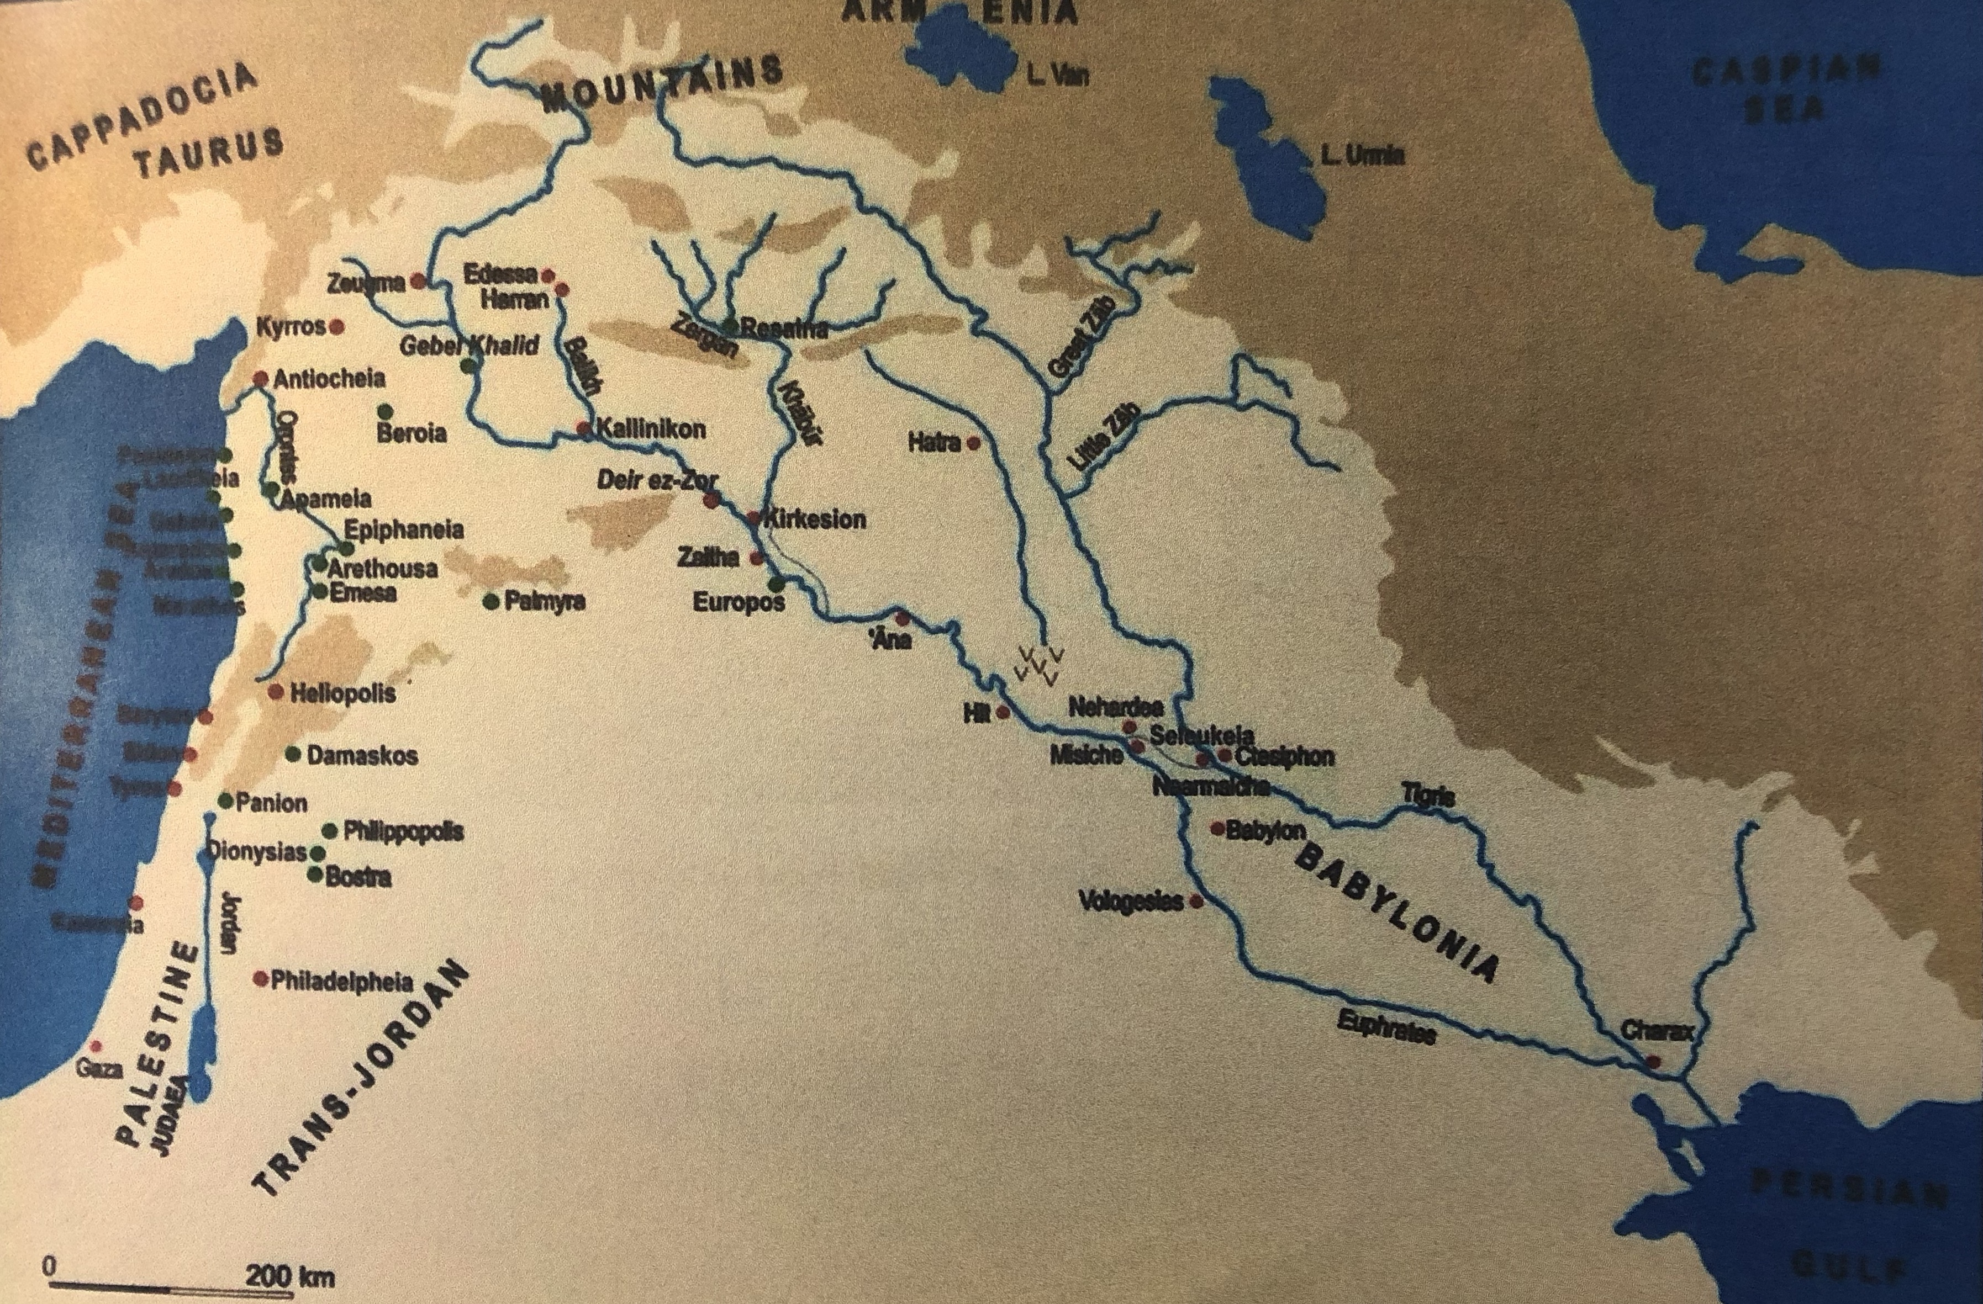

Slide 27
ἀποπλευσάσης δὲ τῆς Κλεοπάτρας ἐς τὰ οἰκεῖα, ὁ Ἀντώνιος ἔπεμπε τοὺς ἱππέας Πάλμυρα πόλιν, οὐ μακρὰν οὖσαν ἀπὸ Εὐφράτου, διαρπάσαι, μικρὰ μὲν ἐπικαλῶν αὐτοῖς, ὅτι Ῥωμαίων καὶ Παρθυαίων ὄντες ἐφόριοι ἐς ἑκατέρους ἐπιδεξίως εἶχον (ἔμποροι γὰρ ὄντες κομίζουσι μὲν ἐκ Περσῶν τὰ Ἰνδικὰ ἢ Ἀράβια, διατίθενται δ᾿ ἐν τῇ Ῥωμαίων), ἔργῳ δ᾿ ἐπινοῶν τοὺς ἱππέας περιουσιάσαι
“When Cleopatra returned home Antony sent a cavalry force to Palmyra, situated not far from the Euphrates, to plunder it, bringing the trifling accusation against its inhabitants, that being on the frontier between the Romans and the Parthians, they had avoided taking sides between them; for, being merchants, they bring the products of India and Arabia from Persia and dispose of them in the Roman territory; but in fact, Antony’s intention was to enrich his horsemen”
Appian Civil Wars 5.9

Slide 29
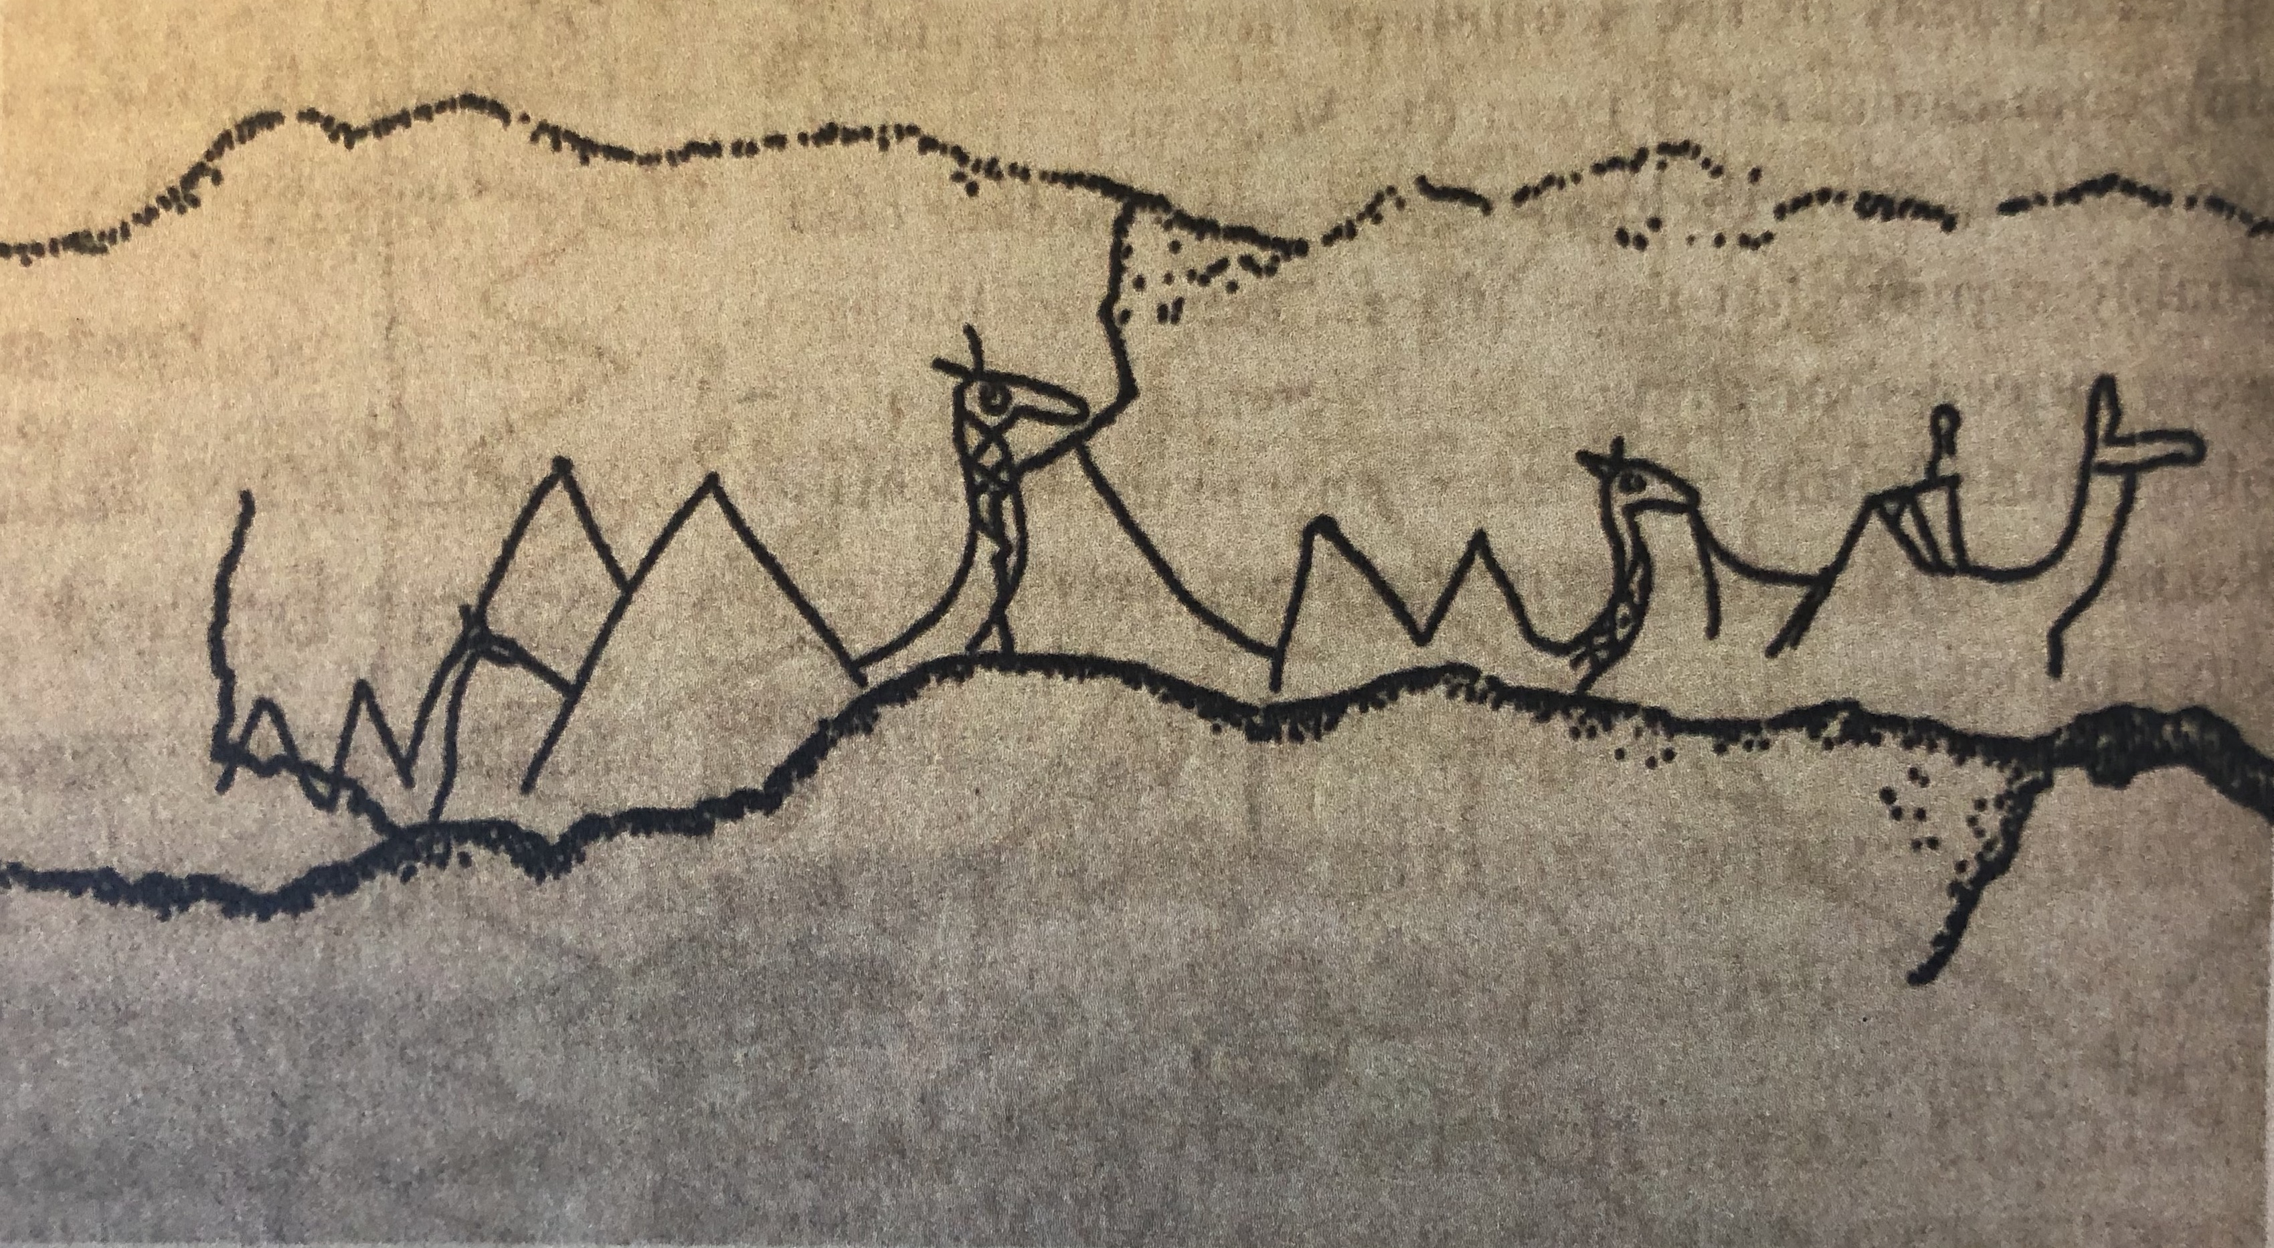

Slide 30
“By the decree of the council and the people, the four tribes (have erected these images) of Ogelos (the son) of Makkaios, (the son) of Ogelos, (the son) of Agegos, (the son) of Sewiras, who had assisted them with all his valour and courage, particularly because of his frequent military expeditions against the nomads. He has always secured the safety of the merchants and the caravans in all his superintendence of these caravans. For this he has spent large sums of money out of his own resources and has conducted his whole political career with brilliance and glory. In his honour. In the year [5]10 (= CE 199).”
PAT 1378

Slide 31
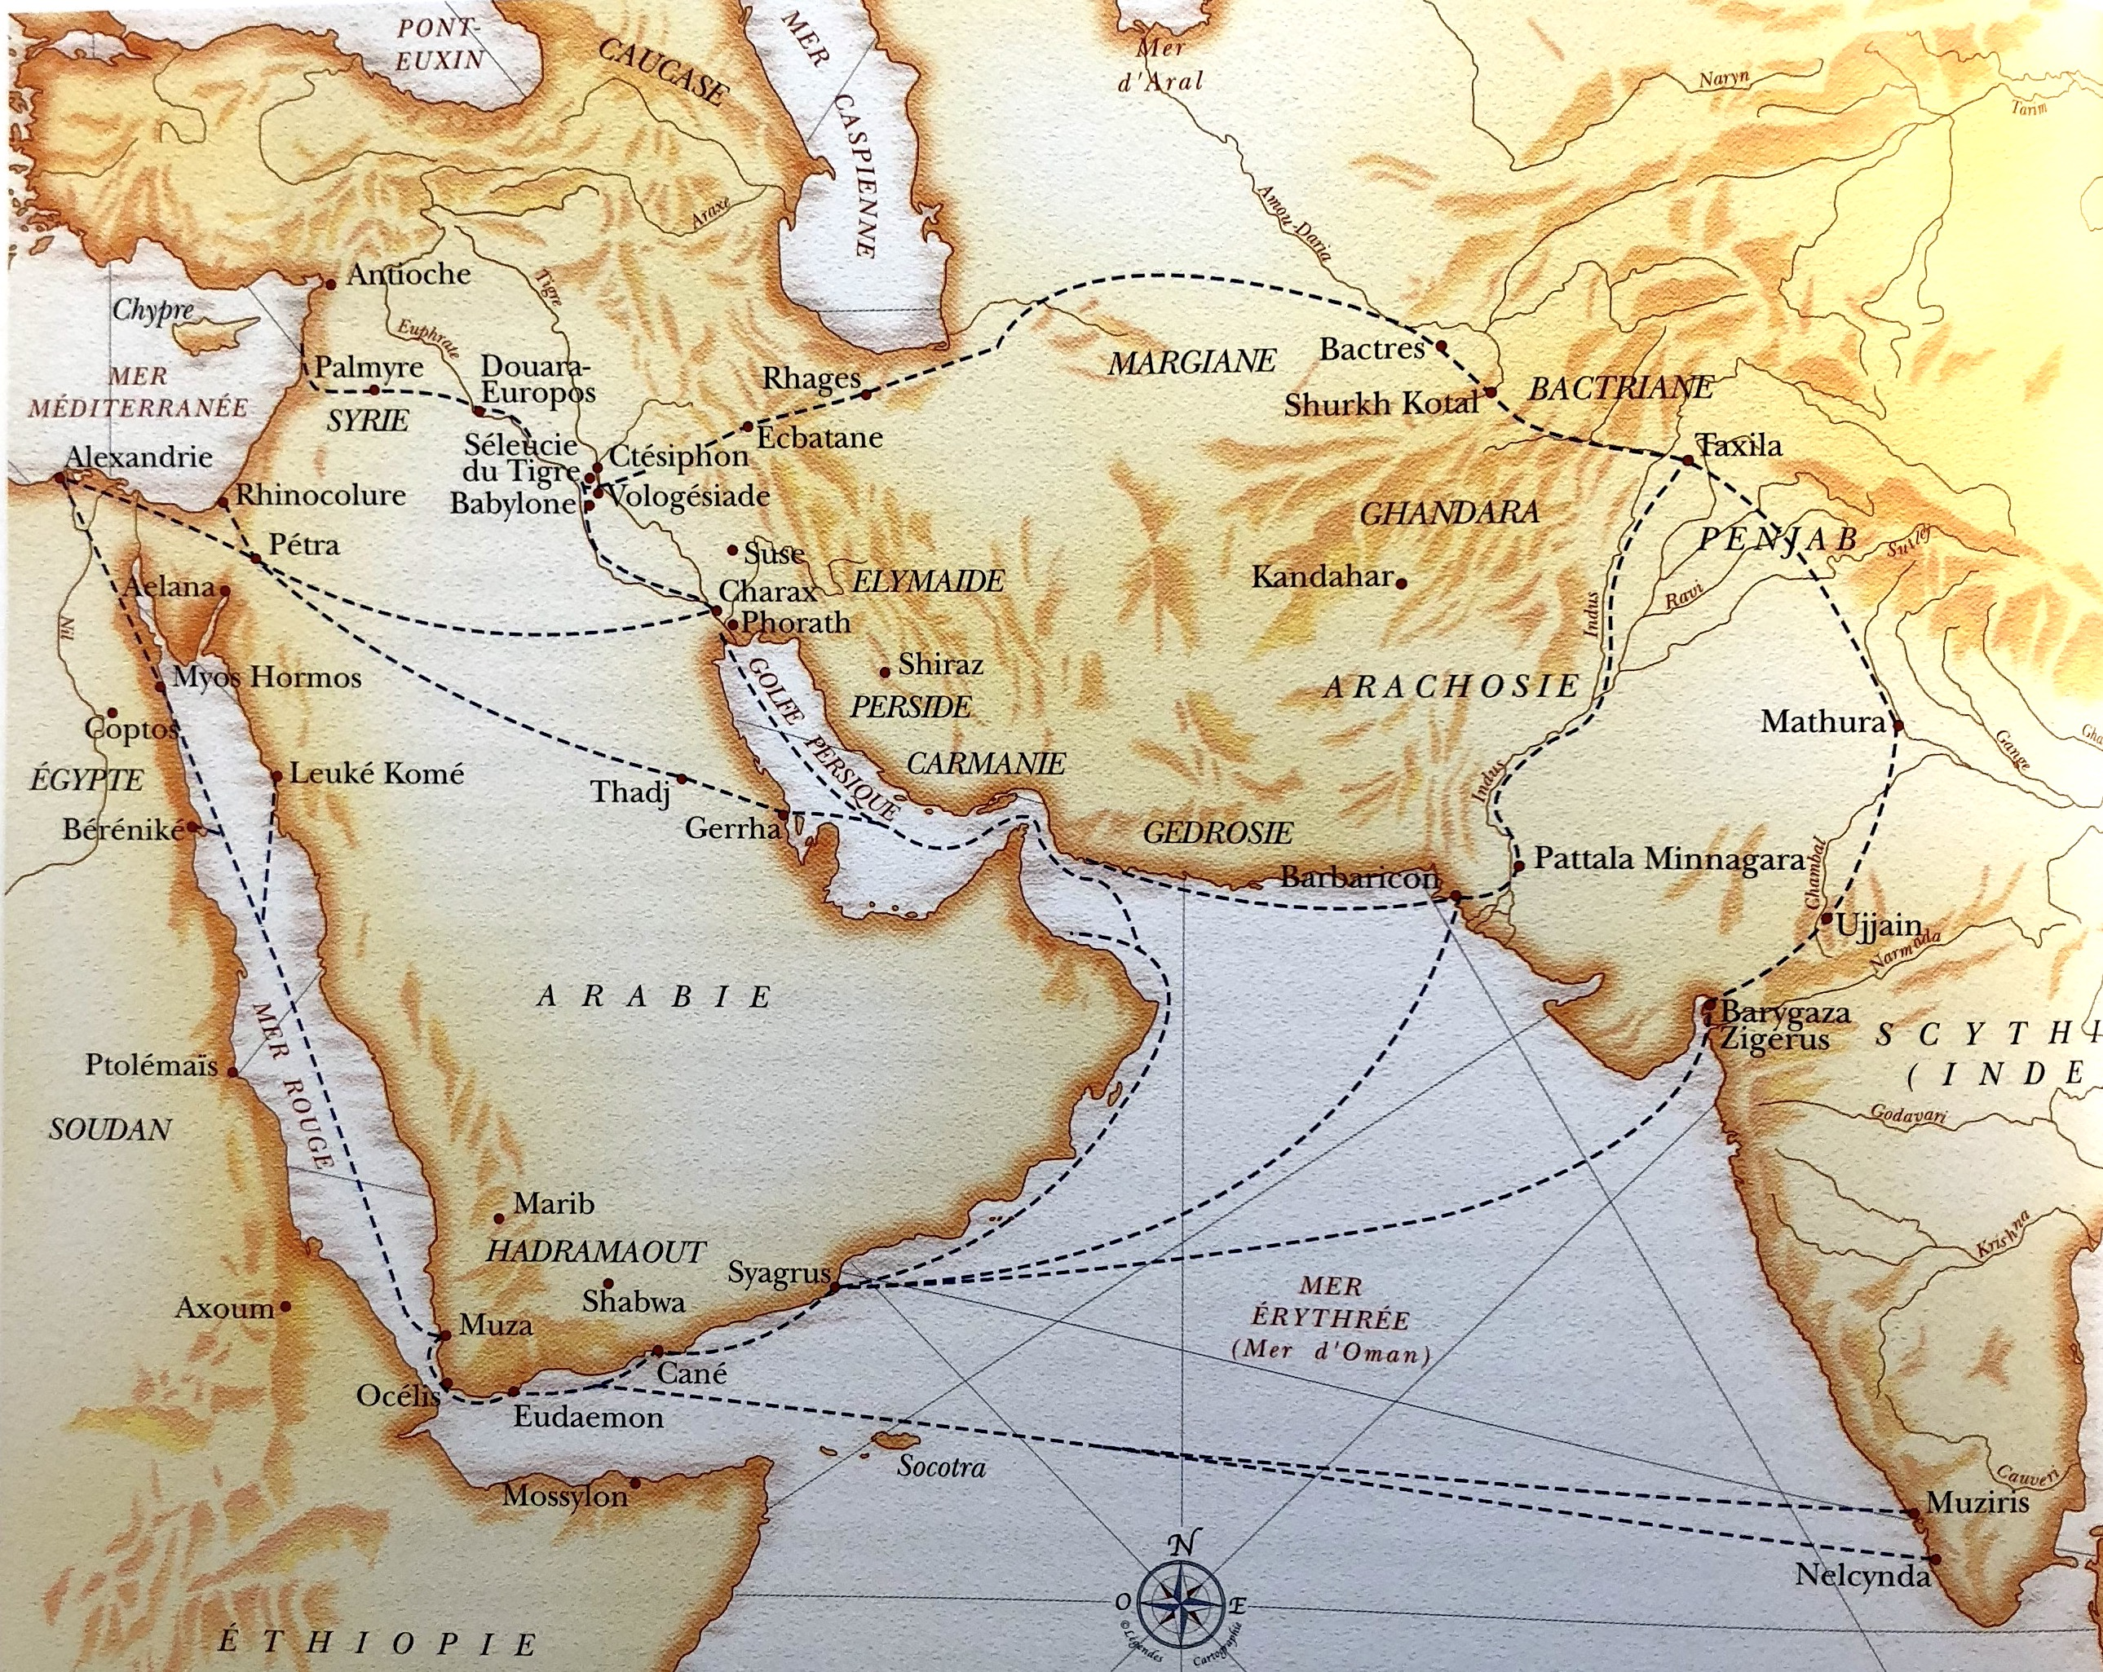

Slide 32
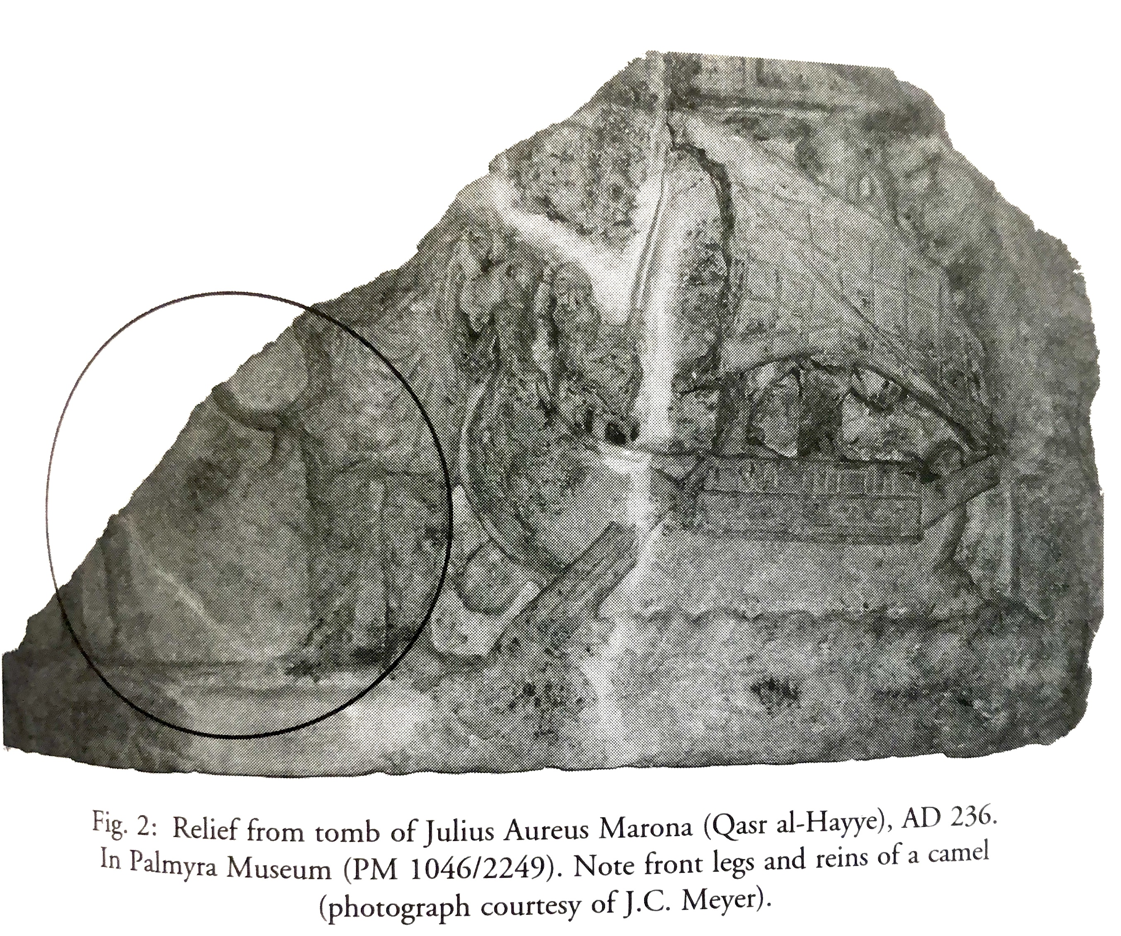

Slide 33
This is the statue of Julius Maximus, centurion of the legion, which was made for him by Marcus Ulpius Abgar son of Haryan and the members of the caravan which came up with him from Kerak of Mayshan (Characene) to honour him, in the month of Kislev of the year 447 (= 135 CE)
PAT 1397

Slide 34
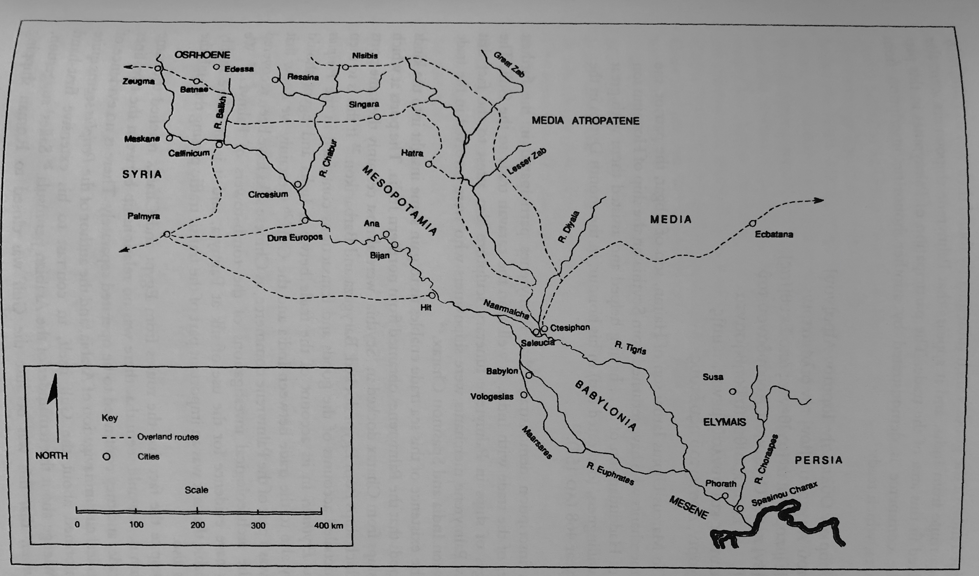
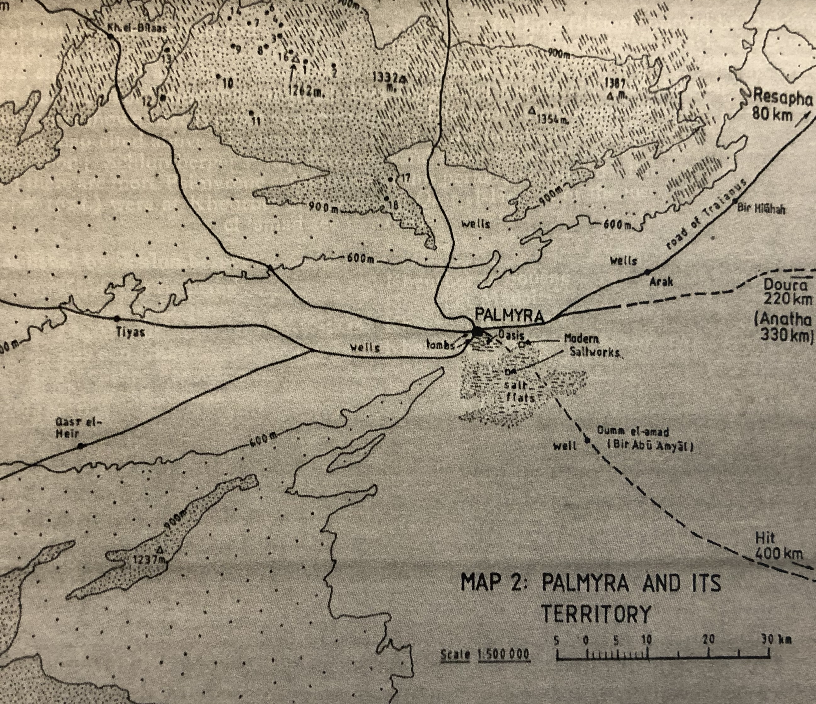
Honorific Inscriptions and Statues for Soados son of Boliades, from Vologesias, set up a total of 17 times in
period 132-147 CE

Slide 36
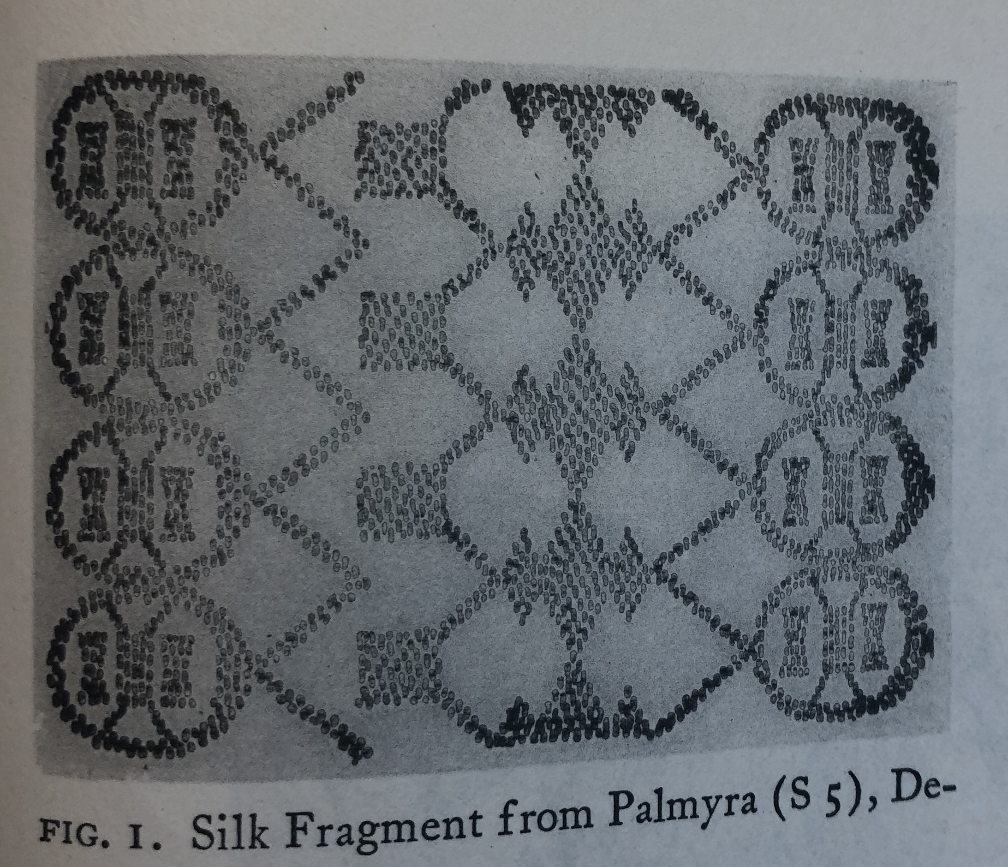
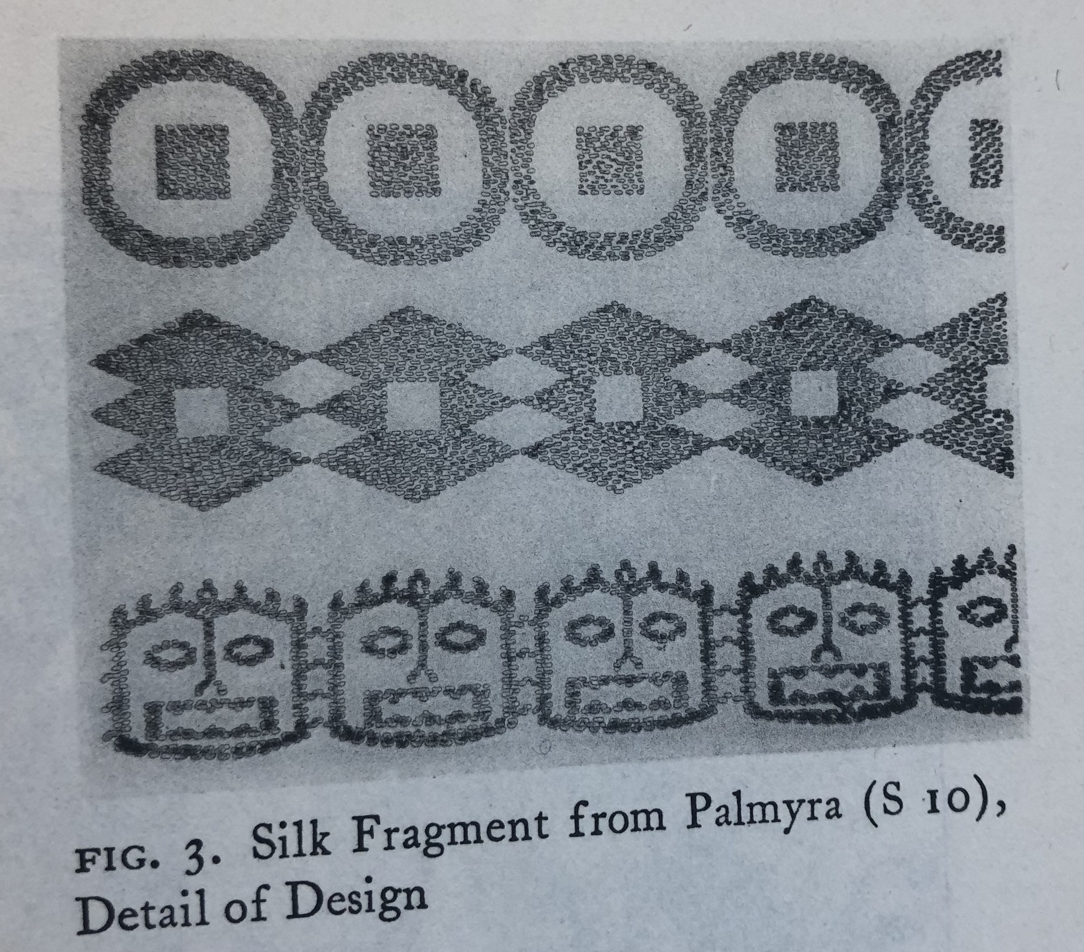
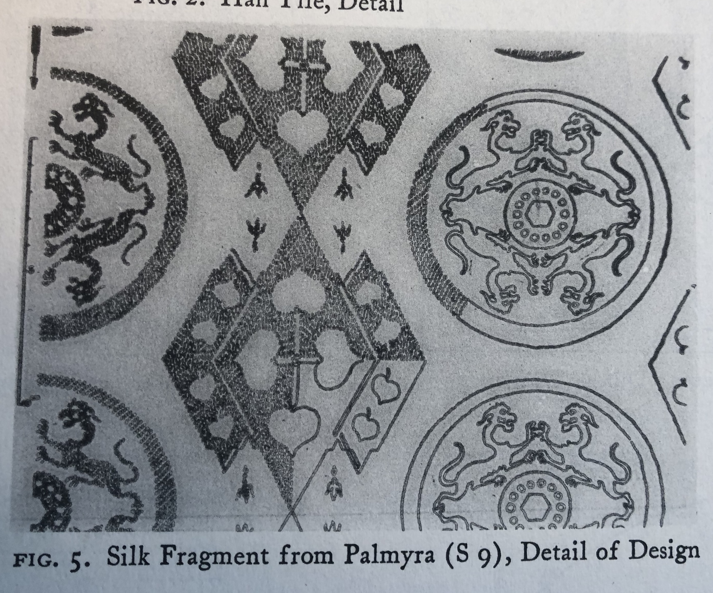

Slide 37


Slide 38
3rd century CE:
  Roman-Persian Wars 230-2 – Sassanid invasion of Roman territory
  240s ongoing –Roman-Sassanid conflict including the ceding of territory to Sassanid ruler
  256 Sassanid conquer Antioch (later recovered by Rome)
  258 Goths invade Asia Minor
  260 Emperor Valerian taken prisoner by Sassanids
  Breakaway Gallic Empire fighting against Roman empire 260s-270s CE
  269 Rome finally manages to stall Gothic invasion of Balkans at Battle of Naissus
  260s-270s – Zenobia, Queen of Palmyra, leads revolt against Rome, including conquering of Egypt, before finally being defeated and Palmyra destroyed.
  293 Establishment of Tetrarchy by Diocletian.

Slide 39
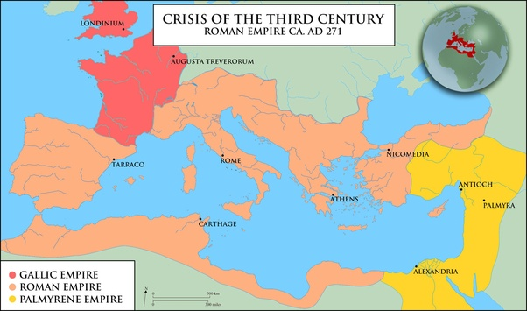

Slide 40
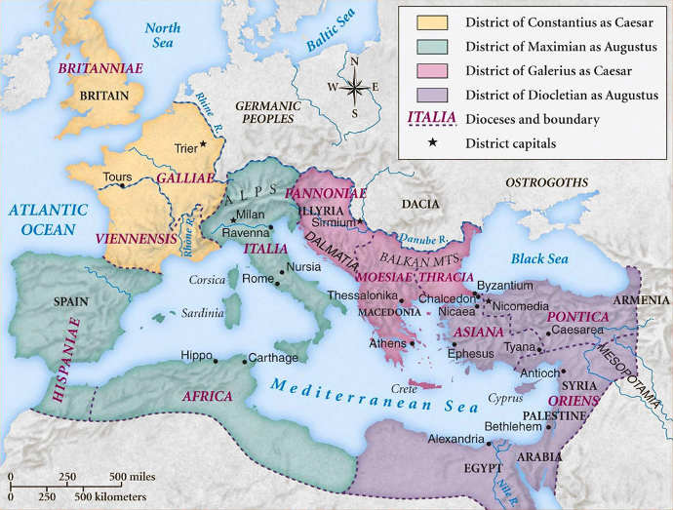

Slide 41
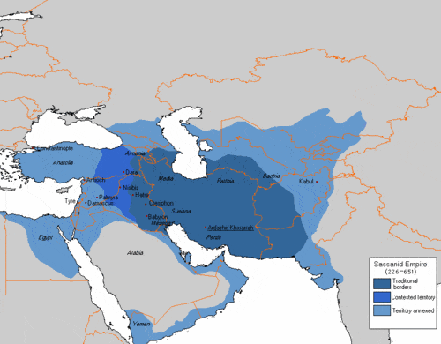

Slide 42
4th century CE:
  Civil Wars of the Tetrarchy leading to battle of Milvian bridge and assent of Constantine
  330 Constantine moved the capital of Roman Empire from Rome to Constantinople – his new city foundation
  330s Constantine at war against the Goths and Sarmatians
  337 Roman back at war against the Sassanids after Sassanids invaded Armenia and Mesopotamia
  360s Julian leads new campaign against the Sassanids, but ends with ceding of 5 provinces east of Tigris river to Sassanids
  370s Gothic wars: Goths, pressed on by migrating Huns, cross Danube in Roman territory. Eventually in 380s given official land in Thrace.

Slide 44
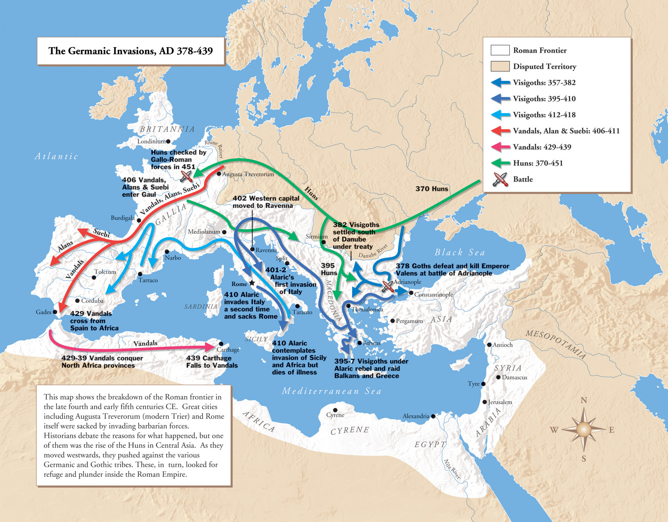

Slide 45
Bibliography
A. Bosworth ‘The Historical Setting of Megasthenes’ Indika’ Classical Philosophy 1996 (91) 113-27
D. Dueck 2000 Strabo of Amasia. A Greek Man of Letters in Augustan Rome.
J. Romm 1992 The Edges of the Earth in Ancient Thought
N. Rosenstein 2012 Rome and the Mediterranean 29-146 BCE
G. Shipley 2000 The Greek World after Alexander the Great 323-30 BC
A. Eckstein Rome Enters the Greek East: from anarchy to hierarchy in the Hellenistic Mediterranean 230-170 BCE
S. Payaslian 2007 The History of the Armenians from the Origins to the Present
G. Young 2011 Rome’s Eastern Trade: International Commerce and Imperial Policy 31BC-AD 305
P. Edwell 2008 Between Rome and Persia
R. Tomber 2008 Indo-Roman Trade: From Pots to Pepper
M. Dodgeon, S. Lieu. 1994 The Roman Eastern frontier and the Persian Wars (AD 226-363). Part 1.
J. Howard-Johnston 2006 East Rome, Sasanian Persia and the End of Antiquity: Historiographical and Historical Studies

