Slide 1
Ancient Global History
Term 2: Week 1

Slide 2
Your feedback… and feedback to you

Slide 3
Essay Feedback Thoughts:
Broad questions – specific case studies explored in depth
Answering the exact question asked + clarity of argument
Importance of original selection of secondary scholarship
Term 2 Essays + Option B
Broad questions again (get started early!)
Option B:
Your own research question developed from use of Oiko.world portal
Marking scheme:
Clarity of Research Question: marks will be awarded for the clarity and phrasing of the research question formulated, which the essay seeks to answer. • Pertinence of the Research Question and Essay: marks will be awarded for the degree to which the research question formulated, and responding essay, is related to the original data entries in Oiko.world the student cites as inspiration.

Slide 4
Seminars
Week 2: Chronicle of the Western Regions + Weilue
9-10am OC1.01
11-12am B2.04/5
Week 4: Documents of Trade
9-10am OC1.01
11-12 B2.04/5
Weeks 4 + 5: Class Presentations – NEW!

Slide 5
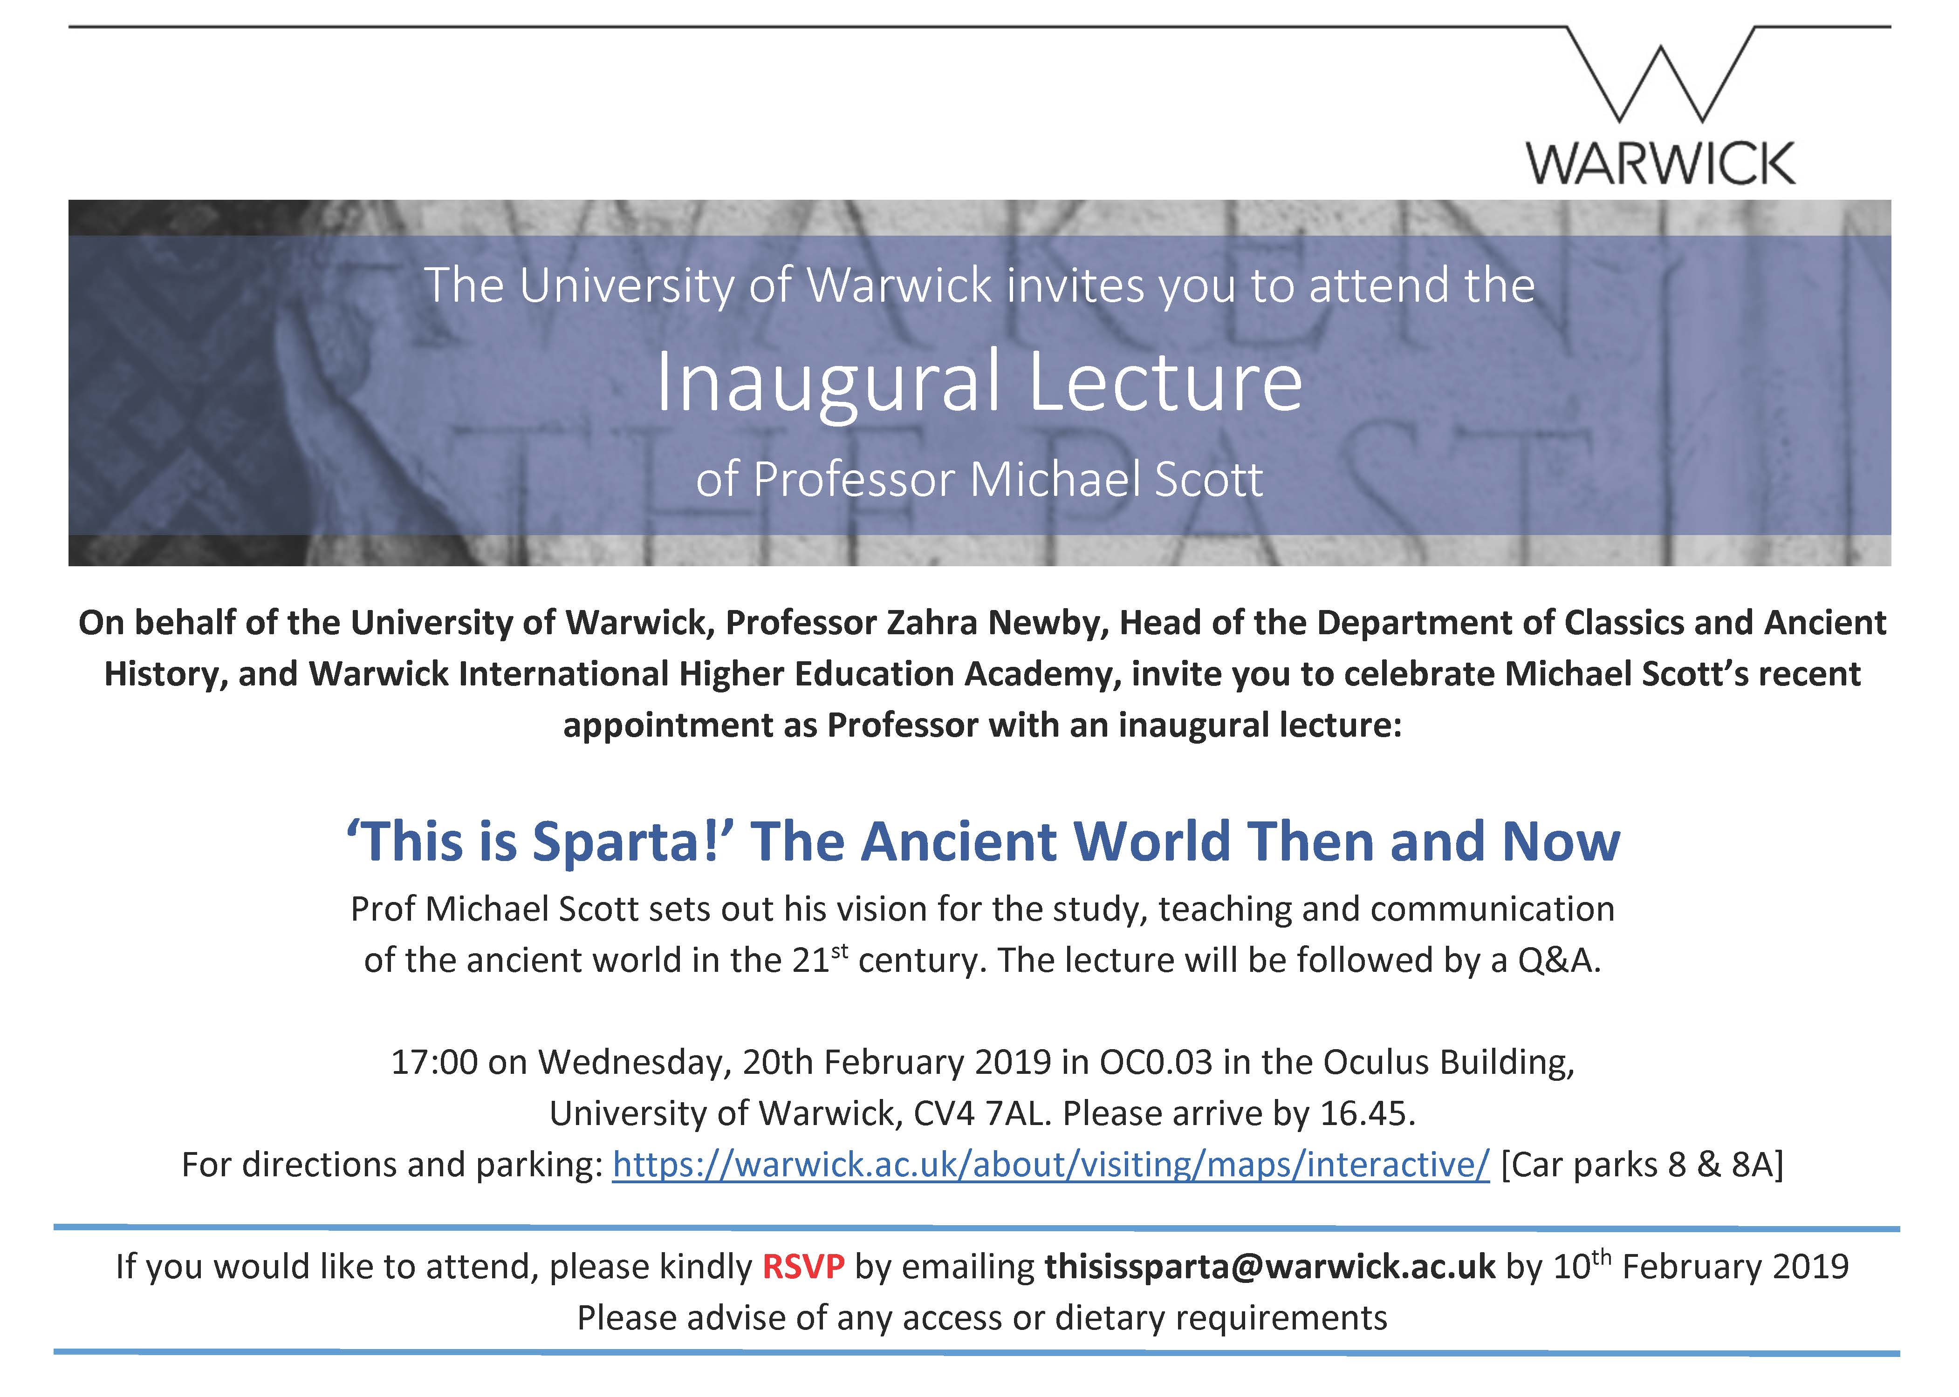

Slide 6
Comparative Ancient Global History
“Only comparisons with other civilisations make it possible to distinguish common features from culturally specific or unique characteristics and developments” W. Scheidel Rome and China: Comparative Perspectives on Ancient World Empires 2009.5.
“Comparison combats hyperspecialisation, the great bane of modern professional scholarship”
“Comparison allows us to identify problems and questions that are not readily apparent from the historical record of a given time and place”
“The reward of comparative analysis is coherent and compelling explanations of cultural difference”
Cf work of Sir Geoffrey Lloyd – science, medicine and ways of understanding the worlds of Greece and China.
Cf K. Raaflaub War and Peace in the Ancient World 2007; K. Raaflaub and N. Rosenstein War and Society in the Ancient and Medieval Worlds 1999
Cf. I. Morris and W. Scheidel The Dynamics of Ancient Empires: State Power from Assyria to Byzantium 2009 and W. Scheidel State Power in Ancient China and Rome 2015.
Cf. L. Raphals Knowing words: Wisdom and Cunning in the Classical Traditions of Greece and China; S. Shankmann and S. Durrant The Siren and the Sage: Knowledge and Wisdom in Ancient Greece and China 2000; S. Shankmann and S. Durrant Early China – Ancient Greece: Thinking Through Comparisons 2002.

Slide 7
Work on comparisons Greece-China:
J. Tanner ‘Ancient Greece, Early China: Sino-Hellenic Studies and Comparative Approaches to the Classical World’ Journal of Hellenic Studies 2009 (129): 89-109.
Work has been done (but largely unnoticed by Classicists) on law, music, self-divination, language, logic, medicine, philosophy, science. Could be the most exciting sub discipline of Classics. But inherent problem of comparing the ‘Classics’ to other things (without surrendering the sense of incomparability of the ‘Classical’).
A. Beecroft ‘Comparisons of Greece and China’ in Oxford Handbooks Online 2016. (see full article online via module website)
Comparative work fulfilling its own pre-existing bias?
What gets compared and what not? Persia and India? Parthians and Chinese? India and Greece? Note the idea of the ‘Great Divergence’ c. 1800 (K. Pomeranz 2000 The Great Divergence).

Slide 8
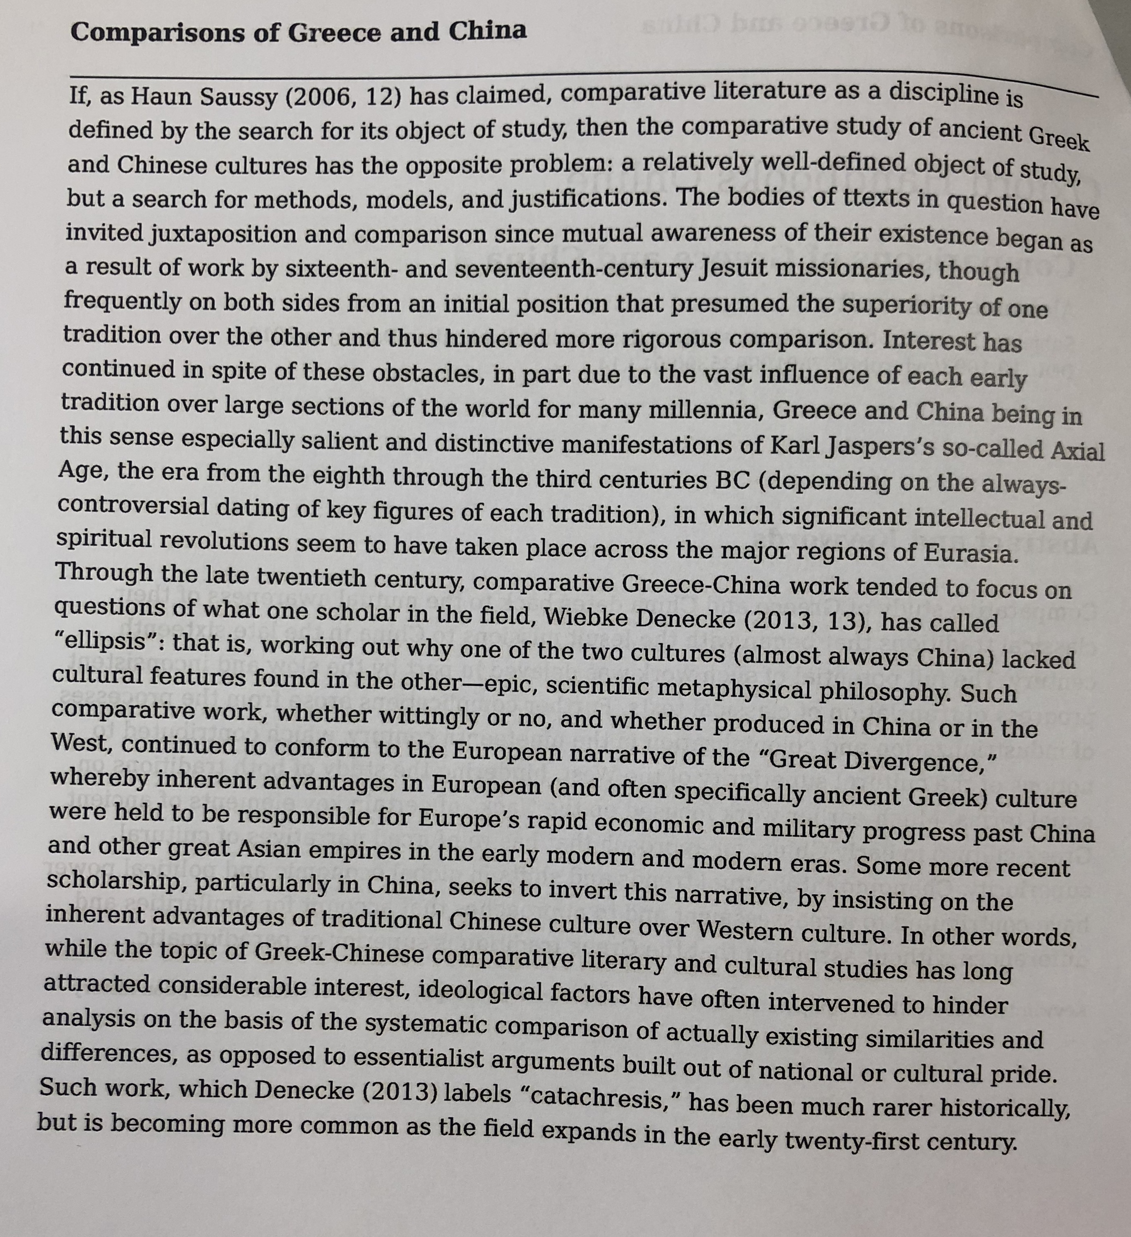

Slide 9
Modern push for more comparisons
- University of Athens and China signing co-operation agreements.
See recent joint conference re closer cooperation in September 2018 (66 people from 30 Chinese institutions in Athens), Professor Huang Huilin, Dean of Academy for International Communication of Chinese Culture from the Beijing Normal University: “Both countries’ civilizations exerted great influence on the development of the world civilization,” she said, adding that the meeting of the two civilizations in the 21st century can help mankind.”
Acropolis Museum and Shanghai Museum just recently finished exhibitions comprising objects they sent to one another representing their respective cultures (Ancient Greece in Shanghai was a sell-out success).
2017 was the Greece China Year of Cultural Exchanges and Cooperation of Creative Industries
Antikythera Shipwreck exhibition that was National Archaeological Museum in Greece is now in Palace Museum inside Forbidden City in Beijing until December
Publication of public facing volumes ‘Museum and Ancient Greek Civilisation’ in China – a Getty Standard publication full of beautiful colour images, new commissioned articles by Chinese and foreign scholars – published by Beijing University Press.
August 2018: signing of a Memorandum of Understanding between Greece and China on the Belt and Road Initiative: As an important meeting point of the land Silk Road and the maritime Silk Road, Greece is China's natural partner in the construction of the Belt and Road, Foreign Ministry Spokesperson said, adding that the Port of Piraeus is the model of China-Greece cooperation

Slide 10
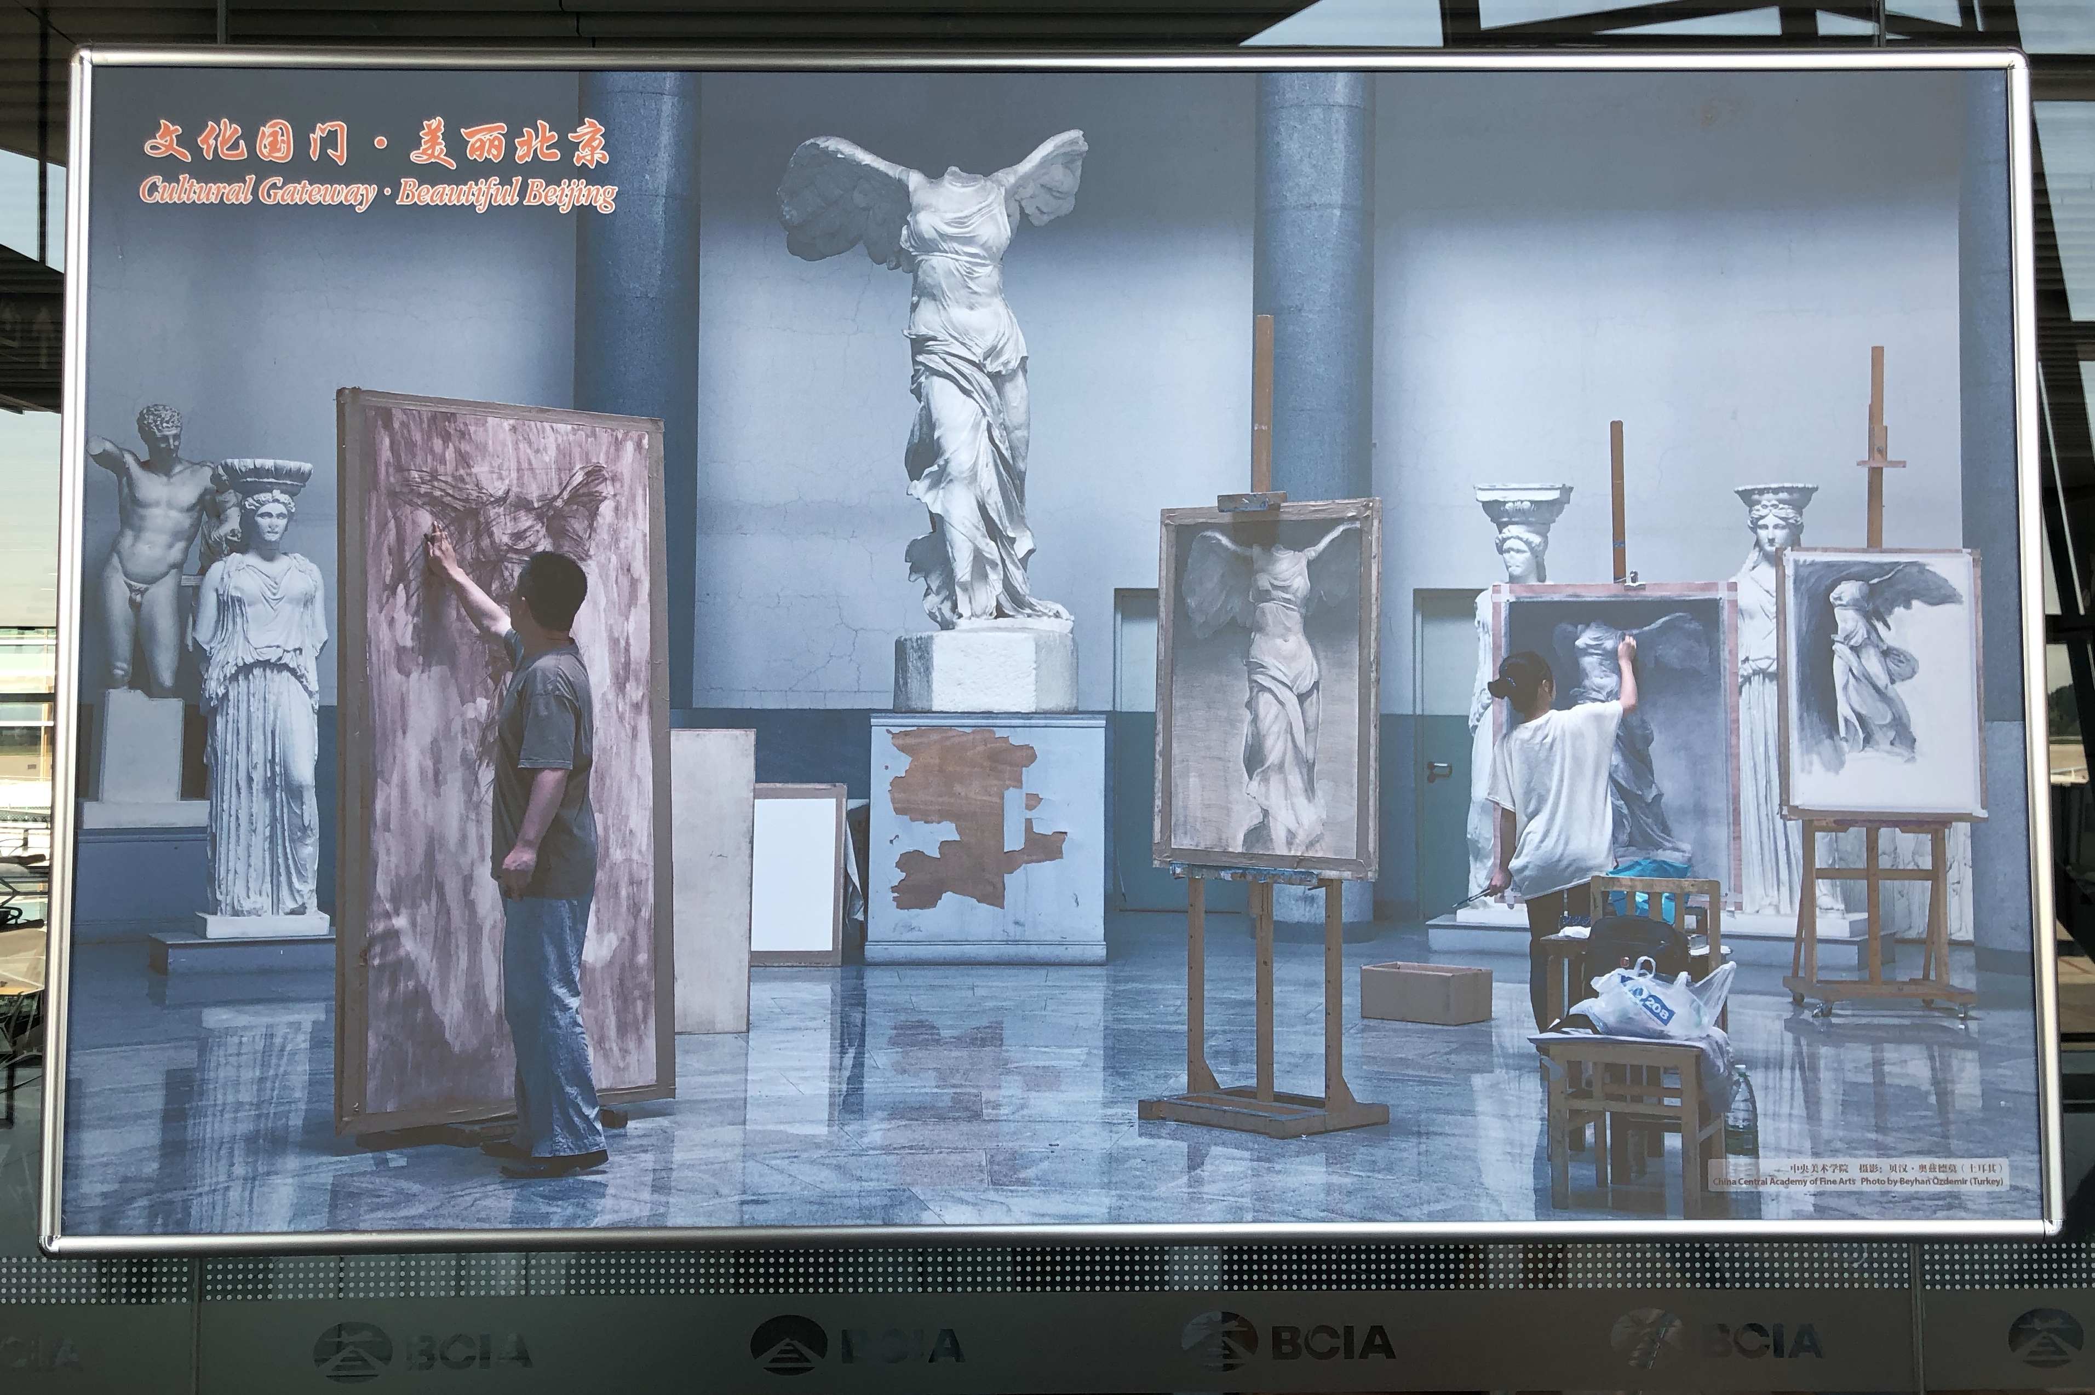

Slide 11
What does Comparative history need to look like?
What’s its objective? Explaining difference or explaining the properties of each case?
How do you frame the comparison? Or ‘Why don’t they have that…’
How do you frame the outcome? ‘Better of worse… or just different?’
What kind of conclusions do you draw? ‘so what…’

Slide 12
The work of Prof Sir Geoffrey Lloyd
“The chief prize is a way out of parochialism”
E.g. G. Lloyd 1996 Adversaries and Authorities: Investigations into ancient Greek and Chinese science
See attached text (conclusions)
Central Argument: difference in context of learning between Greece and China: Greece as competitive where leaders debate, students follow more than 1 teacher v. China where usual practice is following of one master and learning from him.

Slide 13
Comparing Kinship and Friendship
Y. Zhou Festivals, Feasts and Gender Relations in Ancient Greece and China 2010
Researches the social solidarity that was pursued within different institutions – festivals, symposia and gymnasia in Greece; ancestral sacrifice, family banquets and communal drinking parties in China (see p. 2-5)
Argues for a contrast between peer group and kinship centred relations.
The Greek tradition emphasizes extrafamilial homosocial bonds, the Chinese tradition revolves around patrilineal family and kinship.
In Results: also focuses on gender relations and equality, comparing mother-son bonds and female homosocial ties. pages 322-3
Analysis: pages 325-327

Slide 14
H. Kim Ethnicity and Foreigners in Ancient Greece and China 2009
“to determine the historical, political and cultural factors that determined the Greek and also Chinese perception of foreigners” (p.2)
Key insights (see attached text)
Central argument: Greece, lacking material differences from its near ‘barbarian’ rivals, sought to distinguish between themselves as different peoples. China, confronted with such obvious different in style of civilization, did not need such a difference, and defined difference in terms of ritual and customs – which could be changed and with it the ‘foreign’ status of the group.

