Slide 1
Connections between india and the Greek world
Megan Cradock, Lucy Kitcher & Maya Russell-Smith

Slide 2
HERAKLES IN INDia
Although Herakles was inherently a classical Greek divinity, an Indian version was established there and identified by the Greek envoy Megasthenes.
“They further assert that Herakles also was born among them. They assign to him, like the Greeks, the clubs and the lion's skin. He far surpassed other men in personal strength and prowess, and cleared sea and land of evil beasts. Marrying many wives he begot many sons, but one daughter only.”- Megasthenes, Indika
Many scholars have suggested that the deity identified was actually the Hindu god Krishna, a major deity and god of compassion and love.
According to the Roman historian Quintus Curtius, the Sibae might have derived their name from the god Siva, or Shiva, which has caused other scholars to suggest that this deity was in fact Siva, the destroyer god.

Slide 3
“They said also that the Sibae were descended from those who accompanied Herakles on his expedition, and that they preserved badges of their descent, for they wore skins like Herakles and carried clubs, and branded the mark of a cudgel on their oxen and mules.” – Megasthenes’ Indika.

Slide 4
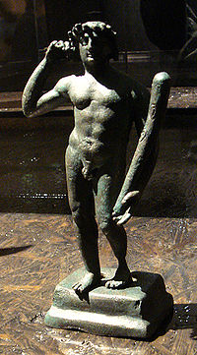
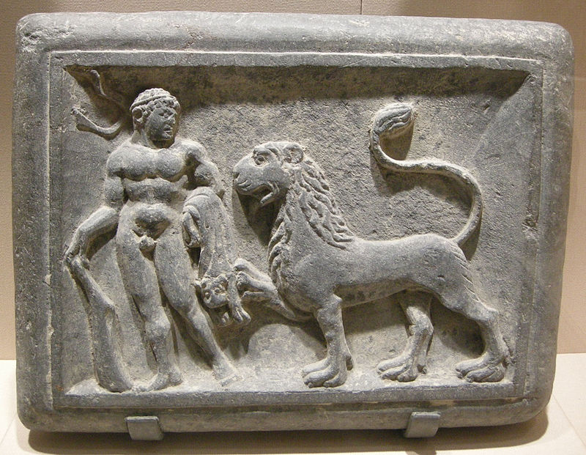
Hercules and the Nemean Lion, 1st century CE, Gandhara.
Image of a Bronze Herakles statuette from Ai Khanoum, Bactria, 2ND c BC.

Slide 5
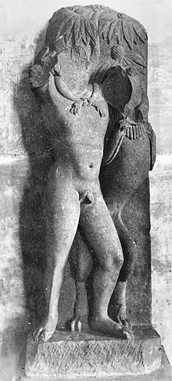
Mathuran herakles
The man fighting the lion in the scene is very generally considered as being Herakles, but some authors have suggested that an Indian sculptor, influenced by western art, could have meant to represent Krishna for example.
2nd century CE. Mathura, India.

Slide 6
Gandhara & ITS ART
Ancient state in modern day Pakistan with its capitals in Pushkalavati (during Achaemenid and Hellenistic region) and Peshawar (by the time of the Kushans)
Over time, Gandhara was ruled by the Achaemenids, Alexander the Great, the Mauryans and was part of the Indo-Greek Kingdom.
Greco-Buddhism and Indo-Greek culture had a major centre here.
Between the first to fifth centuries CE, under the Kushan Empire, it flourished by being situated on the crossroads throughout India meaning it was able to access trade routes and a lot of cultural diversity.
The start of the Indo-Greek tradition could be seen as far back as Alexander the Great’s conquests, but the fusion of cultures doesn’t happen until later, during the Kushan era.
Alexander settled many craftsmen and soldiers in this area and Ashoka promoted Buddhism in this area laying the groundwork for this fusion

Slide 7
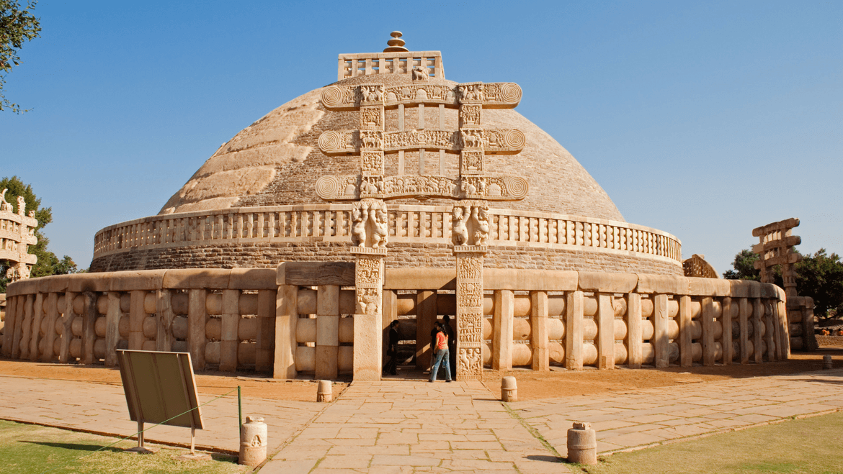
Buddhist stupas- mounts containing relics
King Kanishka was the one who deified Buddha and arguably introduced the canonical image of him.
He strongly instituted Buddhism in Gandhara and this helped in spread further East where it touched upon Han China- there is evidence of Chinese pilgrimages to view Buddhist monuments
Artwork was solely on propagating religious ideals and the religious iconography found its way into everyday life
Many stupas date to the time of Ashoka and during the time of Kanishka were pre-existing ones were enlarged and new ones were built

Slide 8
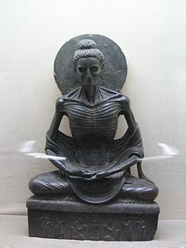
The art tends to depict stages in the life of the Buddha (Jatakas)
In Gandhara Mahayana Buddhism flourished and Buddha was represented in human form which became the prolific image of the Buddha
Previously Indian artists had depicted the Buddha though symbols – footprints or an empty chair
The princely pre enlightenment Buddha (bodhisattva /Siddhartha) and monastic Buddha are both represented
As can be seen in the Buddha to the right, not every image of a Buddha is one entirely similar to Classical art, this can be due to the Buddhist ideology not exactly aligning with Classical/Hellenistic iconography.
While the tradition of depicting religious figures in human form has Classical/Hellenistic influences the artists of India and Gandhara clearly have their own interpretations and influences separate to the west.
Siddartha Gautama depicted in Greco-Buddhist style during his extreme fasting, 2/3rd century.

Slide 9
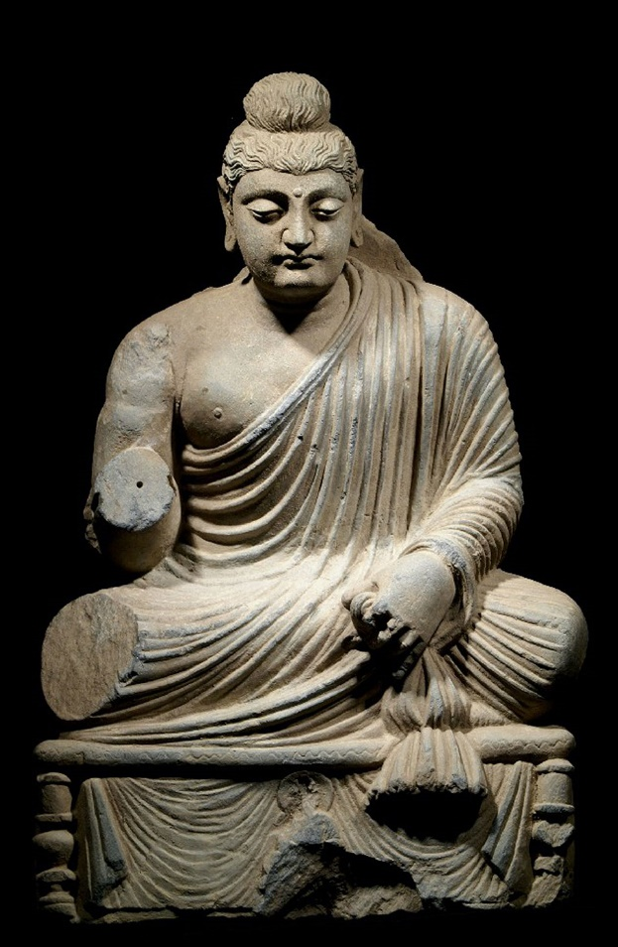
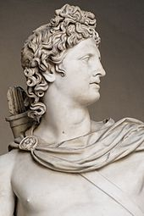
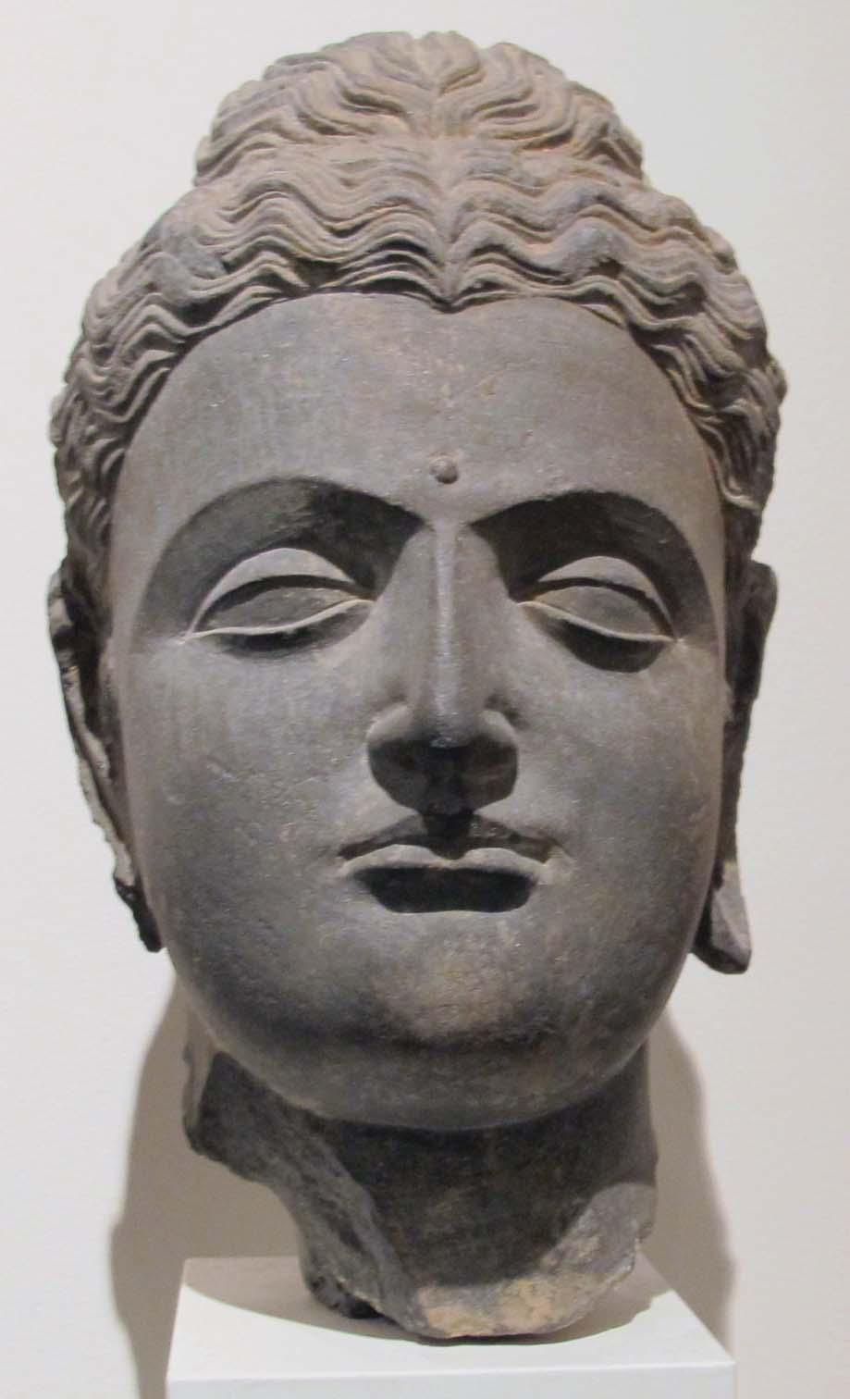
The familiar image of the human Buddha came from mixing artistic elements of the Hellenistic World with the symbolism of Buddhism.
The Buddha is depicted as youthful with wavy hair like an Apollo, and the depiction of the robes might imitate a Greco-Roman style, despite being monastic robes.
Artists in Mathura under the Kushans depicted the Budda slightly differently – body expanding with sacred breath and monastic robe draped over the left side, leaving the right shoulder bare.

Slide 10
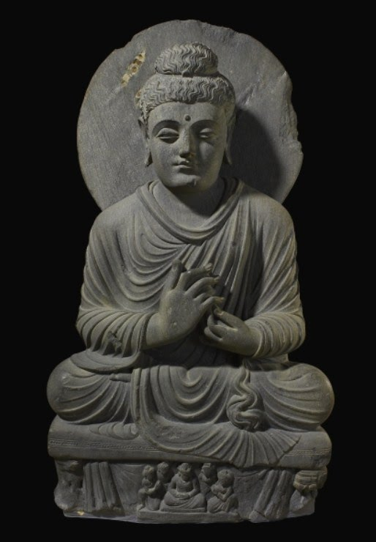
From the Hellenistic period to the Islamic conquests in 7th centruy CE, we see the syncretism Greek art and Buddhist culture, with the first depiction of the Buddha in human form (something the westerners liked to do), combined with Hellenistic realism.
Art style influenced the Indian art of Mathura and Hindu art of the Gupta Empire, with influence spreading into Central Asia, affecting the Tarim Basin, China, Korea and Japan.
Seated Buddha from Gandhara

Slide 11
Mythology and religion- making connections
Brahma: Brahma was a spiritual deity connected deeply with the origin of the universe and so was a key part of Hindu Cosmogony. He was central to legends about the origin and control of universe.
-In one creation myth he lifted the world from primeval waters as a boar.
-In another he was created by the “supreme soul”.
His importance was recorded in the Mahabharata, but worship became less widespread by 6 AD.
Krishna: god linked with childhood, youth and being an adult. “Universal appeal… wide popularity.” He had human abilities of drinking and fighting and love affairs; but epically skilled at playing the flute. –comparable to Orpheus.
Agni: God of fire, gives out weapons. Arjuna (Prince of Pandu), received a bow from him. –comparable to Vulcan/Hephaestus.

Slide 12
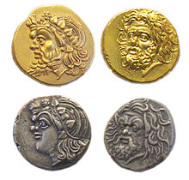
A further Connection to Greek deities
Rudra- Rudra is a Rigvedic deity, but one translation of his name is The Roarer, or the personification of terror.
Can connect him to the Greek God Pan, god of the wild. Pan was closely associated with nature, and Rudra has also been connected with the wild.
Thesis from 2015 by Kresimir Vukovic, Stephen Hayworth, and Gavin Flood entitled:
The Roman festival of the Lupercalia: history, myth, ritual and its Indo-European heritage
Considers the parallels between the god of the
Lupercalia festival (Faunus) and Rudra.
Challenges ideas of the Lupercalia having
Indo-European origins.

Slide 13
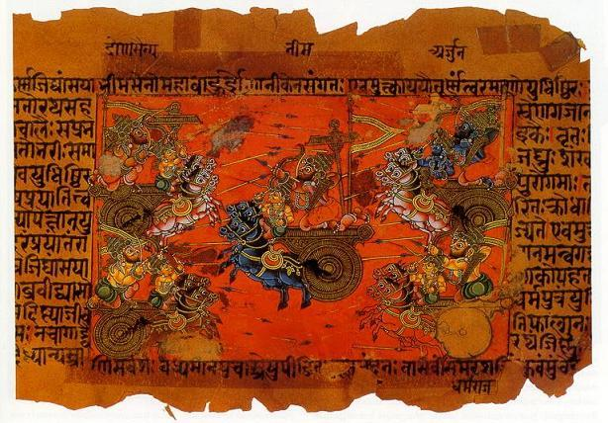
The Mahabharata
Ancient Indian Epic
10 times the length of The Iliad and The Odyssey combined ☹
Based on legends and philosophy.
A summary: The Mahabharata is about two families, the Kauravas and the Pandavas, both of whom want the throne. The Kaurava (the older family) tries to claim the throne but the Pandavas assert their claim on the throne as their eldest member is older. This develops into a full scale battle: the Battle of Kuruksheta (which was supposedly based off a real battle). The Pandavas eventually defeat the Kauravas, and thus the struggle for the throne is resolved.

Slide 14
Obviously it is much more complicated than this as the epic is so long, but even a summary such as this can show how similar themes are presented in Indian epics to those of the Greeks and Romans.

Slide 15


