Slide 1
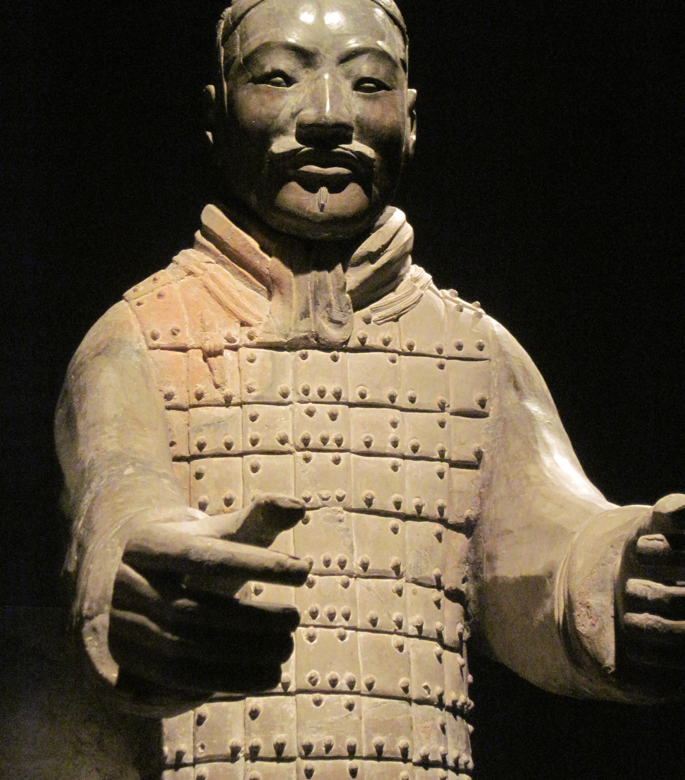
The demise of the Qin dynasty and the rise of the Han dynasty.

Slide 2
Brief overview of the Qin dynasty
First imperial dynasty in China lasting only 15 years: from 221BCE to 206BCE.
Expand significantly within these 15 years: conquering all 7 Warring states, first of all the Zhou dynasty. Extend the frontier.
Although brief the Qin dynasty created an imperial system that lasted interrupted and with adaption until 1912CE.
Only 2 emperors during the short dynasty: Qin Shi Huang and his younger son, Huhai, known as Qin Er Shi.

Slide 3
The two Emperors
The first emperor ruled ruthlessly for 11 years, tying together the warring states into his domain through war.
He set up a vast bureaucracy and organized the new population into groups for mutual surveillance, ensuring that everyone kept each other in check.
He physically had drawn the population together as well with a new system of roads covering 4,350 miles and introduced a policy of empire-wide standardization in everything.
-Including weights to currency and language.
Sima Qian, the grand historian “the first emperor created a new beginning he has put order the laws, standards and principals…he has rectified and given order to the different customs”.

Slide 4
The death of Emperor Qin and the downfall of the Qin dynasty
Three assassination attempts were made on Qin Shi Huang’s life which resulted in him becoming paranoid and obsessed with the ‘elixir of life’. This resulted in him taking a drink (mercury) while visiting the far eastern reaches of his empire which killed him.
On 10TH September 210BCE Emperor Qin, died, creating a power struggle within the court for who should rule, due to his numerous sons and questionable heir…
Zhao Gao and Li Si, hid the news until he could alter the will and place the weakest of his sons as the new ruler. Huhai who took the name of Qin Er Shi. Hoping to manipulate him…

Slide 5
Sliding into War
This new Emperor of the Qin was nothing like his formidable father..
The young emperor was inept and pliable, executing many ministers and imperial princes which favored Zhao Gao and his attempts to remain at the top.
He enlarged the army, continued expansive building projects, increased taxes and arrested any messenger that brought bad news.
The result was that men from all over China revolted, raising armies and declaring themselves ‘kings’ of the territory they had seized.
Civil war broke out across the country as generals attempted to seize the capital and power for themselves.

Slide 6
The Chu-Han Contention (206-202 BC)
A period of discontinuity in government between the Qin dynasty and the Han dynasty in Chinese history.
Following the collapse of the Qin dynasty in 206 BC, Xiang Yu split the former Qin Empire into the Eighteen Kingdoms.
Two major contending powers emerged, Western Chu and Han, which engaged in a struggle for supremacy over China.
Western Chu was led by Xiang Yu, while the Han leader was Liu Bang.
Several minor kings also warred, but these were largely independent of the main conflict between western Chu and Han.
The War ended in 202 BC with total victory for Han, with Liu Bang soon proclaiming himself first emperor of the Han dynasty.

Slide 8
Initial Stages - Han Rebellion
During the division of the Eighteen Kingdoms, Xiang Yu appointed some former rebel generals as vassal kings even though they were subordinates of other lords.
In 206 BC Liu Bang was deprived of his title in Guanzhong and instead sent to the remote Bashu region along with 30,000 troops and thousands more civilians and given the title “King of Han”.
After reaching his destination, Liu Bang ordered the gallery roads leading into Bashu to be destroyed as a precautionary move against any possible attack from the rear and to trick Xiang Yu into thinking that he had no intention of leaving Bashu.
In 206 BC the last Qin emperor Ziying surrendered to Liu Bang and brought an end to the Qin dynasty.

Slide 9
Initial Stages – Han conquest of the Three Qins
While Xiang Yu was away suppressing rebellions in Qi and Zhao, Liu Bang used the opportunity to attack the Three Qins in Guanzhong.
Liu Bang’s general Han Xin ordered his men to pretend to repair the gallery roads in order to put Zhang Han (King of Yong) off guard, while secretly making advances through Chencang.
Zhang Han was taken by surprise and defeated by the Han forces in two consecutive battles.
Taking advantage of the victory, Liu Bang proceeded to conquer Longxi, Beidi and Shangjun.
He also sent his men to fetch his family in Pei.
Upon receiving news of Liu Bang’s attacks, Xiang Yu sent an army to intercept the Han army, and appointed Zheng Chang as the “King of Hán” to help him cover his flank.

Slide 10
Initial Stages – Battle of Pengcheng
In 205, after establishing his base in Guanzhong, Liu Bang advanced to the east to prepare for an attack on the Henan region.
The Kings of Sai, Di and Henan surrendered to Liu Bang, but Zheng Chang (King of Hán) refused to submit to Liu Bang and was defeated by Han Xin in battle.
Liu Bang replaced Zheng Chang with Han Xin as the new King of Hán.
With support from the kings who surrendered to him Liu Bang took Chu’s capital, Pengcheng.
When Xiang Yu received news that Liu Bang had occupied Pengcheng, he led 30,000 troops to retake it, catching Liu Bang off guard and inflicting heavy casualties.

Slide 11
Initial Stages – Battle of Jingsuo
After their defeat at Pengcheng, the strength of the Han forces decreased drastically, as many of the kings who had surrendered to Liu Bang defected to Xiang Yu’s side.
Moreover, the Qi and Zhao kingdoms, which were previously at war with Chu had requested to make peace with Chu.
On top of this, Liu Bang’s family members were captured by Chu forces and kept as hostages.
Liu Bang retreated and persuaded Ying Bu (King of Jiujiang) to support him and rebel against Western Chu.
Liu Bang named his son, Liu Ying as his crown prince and ordered him to defend Yueyang.
Liu Bang reorganised his army, which now included reinforcements from Guanzhong and attacked Chu at Jing County and Suoting, emerging victorious and driving Xiang Yu’s forces back.

Slide 12
The Main Battles
Multiple battles took place between the Han and Chu forces in the following two years, the main battles of note being:
The Battle of Anyi (205 BC)
The Battle of Jingxing (205 BC)
The Battle of Wei River (204 BC)
The Battle of Chenggao (204 BC)

Slide 13
Battle of Chenggao and the Treaty of Hong Canal
In late 204 BC, while Xiang Yu was away suppressing the rebellion in the Qi kingdom, Han forces made the most of the opportunity, conquering Chenggao and defeated the Chu army near the Si River.
Following Han Xin’s victories in recent battles, the Chu army’s morale fell and it ran short of supplies months later.
Xiang Yu had no choice but to request to make peace with Liu Bang and release Liu’s family members, who were held hostage by him.
Chu and Han agreed to a ceasefire at the Treaty of Hong Canal, which divided China into east and west under their respective domains.

Slide 14
The Breaking of the Treaty
In 203 BC, while Xiang Yu was retreating eastward, Liu Bang renounced the Treaty of Hong Canal and ordered an attack on Western Chu.
He also requested assistance from Han Xin and Peng Yue to attack Xiang Yu simultaneously from three directions, however they never mobilised their troops.
Liu Bang was defeated by Xiang Yu at Guling, causing him to retreat and reinforce his defences.
He then sent messengers to meet Han Xin and Peng Yue again, promising to give them land and titles if they joined him in attacking Xiang Yu.

Slide 15
Battle of Gaixia
202 BC, Han forces led by Liu Bang, Han Xin and Peng Yue attacked Western Chu from three directions.
The Chu army was running low on supplies and Xiang Yu was trapped in Gaixia.
Han Xin ordered his troops to sing Chu folk songs to create a false impression that Chu had fallen to Han forces
The Chu army’s morale plummeted and many soldiers deserted.
Xiang Yu attempted to break out the siege and was left with only 28 men when he reached the northern bank of the Wu River.
He made a last stand and managed to kill several Han soldiers before eventually committing suicide.

Slide 16
Aftermath
After Xiang Yu’s death, the rest of Western Chu surrendered to Han, and China was unified under Han rule
Liu Bang granted Peng Yue, Ying Bu and Han Xin the titles “King of Liang”, “King of Huainan” and “King of Chu” respectively.
Months later Liu Bang declared himself Emperor and established the Han dynasty.

Slide 17
The Han kingdoms
Emperor Gaozu had to stabilize the empire after the war – kept control in the West (Qin Dynasty) and divided up the East to surviving senior allies
The Han Kingdoms continued but Emperor Gaozu had a less productive and populous portion of the Empire
The other kingdoms had richer resources
Gaozu tried to exert control but the kings resisted this.
Gaozu resulted in a steady pressure instead - reduced to lords and to live in Han capital – some switched their allegiance to the Xiongnu

Slide 18
The Han Kingdoms continued
195 BCE – all but one of the kings were not part of the Liu clan
Ying Bu – leader of Huianan revolted, costing Emperor Gaozu his life in 195 BCE.

Slide 19
Rise of the Han
Qin Dynasty prelude to the Han Dynasty
Emperor Gaozu adopted Qin model of government
But
Re-established kingdoms – proved to be a mistake in the future as it created tensions and significant resources to centralize power
Han territory moved South, North East and North West – came to clash with the Xiongnu
Early Han – emergence of intellectual and literary thought e.g. Records of the Grand Historian by Sima Qian

