Slide 1
Ancient Global History
Term 1: Week 5

Slide 2
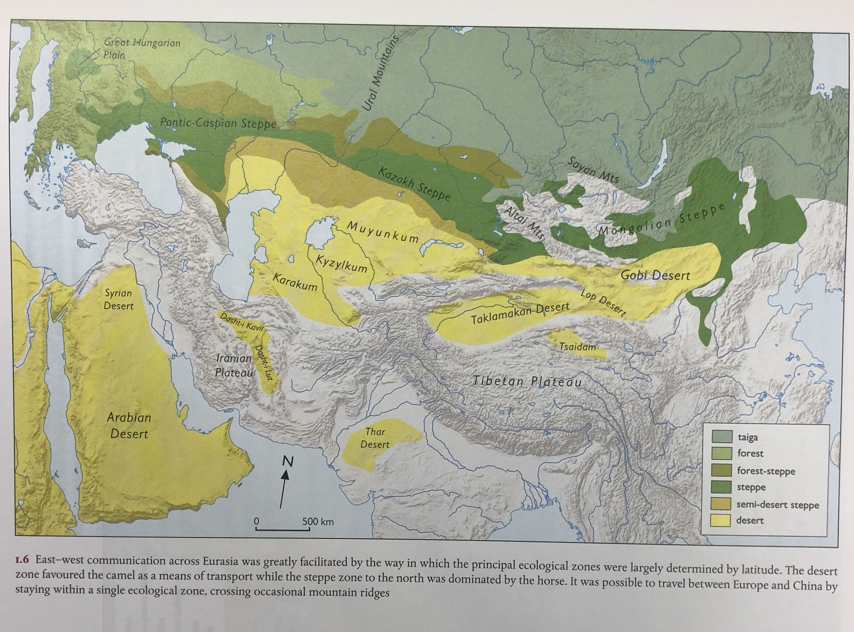

Slide 3
The Steppe
Unlike the mountain ranges and deserts to the south, the Steppe provides a remarkable uninterrupted route running almost the entire length of Eurasia from Great Hungarian Plain to Manchuria (9000 km).
This was the land of the horse rider, of nomadic communities with their flocks, and (later) of nomadic warrior tribes
Open grassland with drought resistant and frost tolerant grass and plants
Broadly falls into Western Steppe (5000 km) and Eastern Steppe separated (‘Mongolian Steppe’) by Altai mountains (fragments the grassland corridor).
Characterised by early intricate networks of connectivity linking the different cultures who moved continuously along it

Slide 4
Nomadic communities
Predatory nomadism sweeps across Steppe in 10-9th centuries (starting probably in Altai-Sayan region: nomadic communities evolve into warrior nomadic communities focused around warrior leaders, with raiding as an essential feature of their social system - raiding both other nomadic tribes + further south into sedentary communities)
Raiding and subsequent pressure on nomadic communities causes them to migrate further and en masse.
The Scythians (move into Black Sea area, taking over from Cimmerians):
Herodotus thought they moved into the Pontic Steppe c. 8th century ‘from Asia’
Arzhan Burials (Altai-Sayan region): ‘formative / pre-Scythian’) – 9th/8th century BCE
Kuban region Burials (Kostromskaya) - 4th century BCE
Nomadic communities invade south: ‘Aryan invasion’ splitting into different groups such as Hittites and taking over from Indus Civilisation in India
Scythians help Medes and Babylonians to destroy Assyrian empire in 612 BCE (but then driven back north)
Greek colonies and Scythian nomads co-exist more successfully around the Black Sea
Scythians will be pushed out and overtaken by the Sauromatae (Sarmatians) c. 300 BCE.
In Central Asian steppe were the Sakas (who will push down into central Asia in 2nd century BCE following pressure of nomadic migration from East, followed by Yuezhi (who become the Kushans)

Slide 5
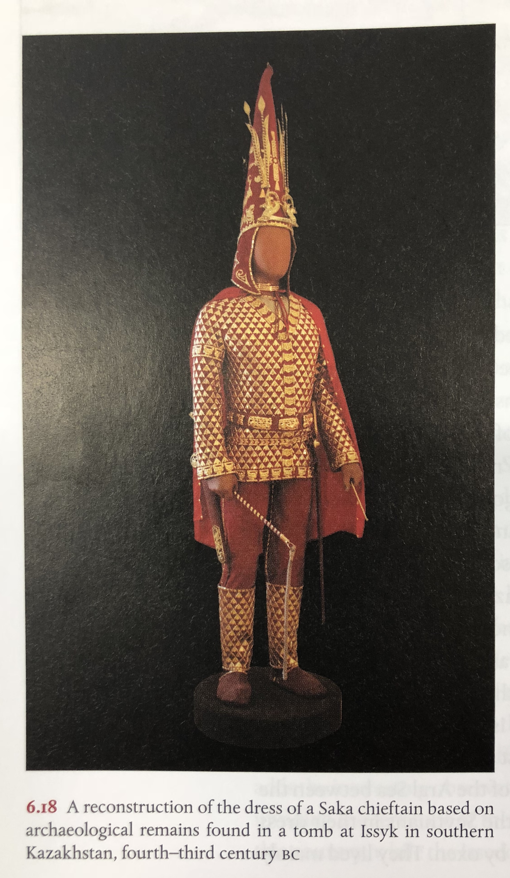
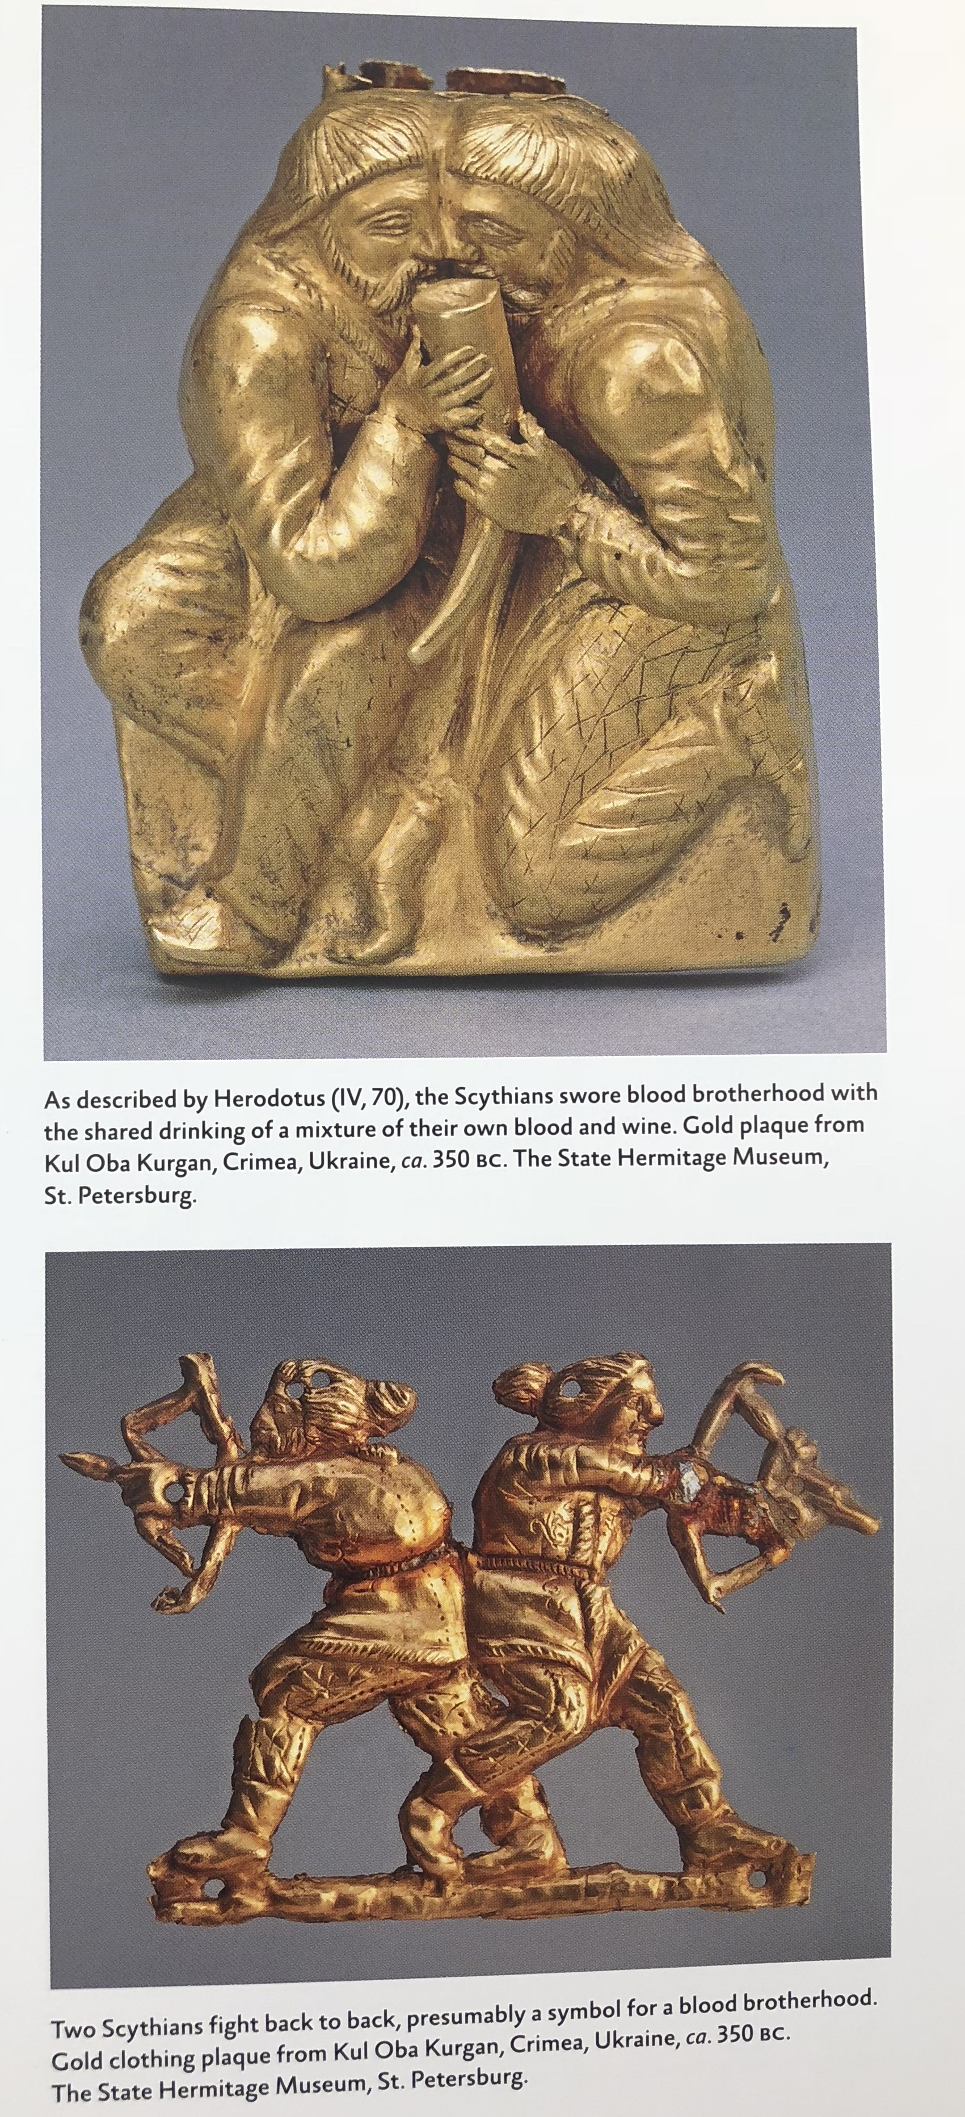

Slide 6
Nomadic/Sedentary connections in the East
C. 1200 BCE – ongoing ‘gift-exchange’ connection between Nomads and early Chinese dynasties particularly re introduction of the horse-drawn chariot (along with people to build them and train horses).
Introduction of Nomadic items into Chinese culture: curved knives with loop terminals, circular bronze mirrors with loop handles
Cast-bronze helmets from China make their way to nomadic communities (as far as the Pontic Steppe - cf Scythian burial at Kelermes).
Between 10-9th centuries BCE, similar picture of conversion of nomadic communities into ‘predatory nomadism’ with consequent invasions down into early Chinese communities: ongoing attacks from late 9th century BCE.

Slide 7
Chinese dynasties
Xia dynasty 2070-1060 BCE
Shang dynasty 1600-1046 BCE – hierarchical and dominated by ruling house (Zi), with eventual capital at the city of Anyang. Composed of central directly ruled core, surrounded by a series of smaller semi-autonomous polities (hou), owing allegiance to Shang.
Shang army composed of huge numbers of archers, driven in war chariots, alongside foot soldiers
Zhou dynasty 1046-256 BCE – led by King Wu, in 1046 BCE, to attack Shang (to end ‘corruption of Shang rulers’). Zhou perhaps originally living as nomads up on steppe before migrating to live in Wei valley. Their capital was Luoyang. Ruled through a central capital alongside strong regional centres.
Later represented as a golden age of tolerance and culture when honourable and just kings held real power
From 1046-771BC period of ’Western Zhou’ - ended with attacks from nomadic tribes, with forced migration of Zhou to new capital at Zhengzhou and period of ‘Eastern Zhou’ or ‘Spring and Autumn period’

Slide 8
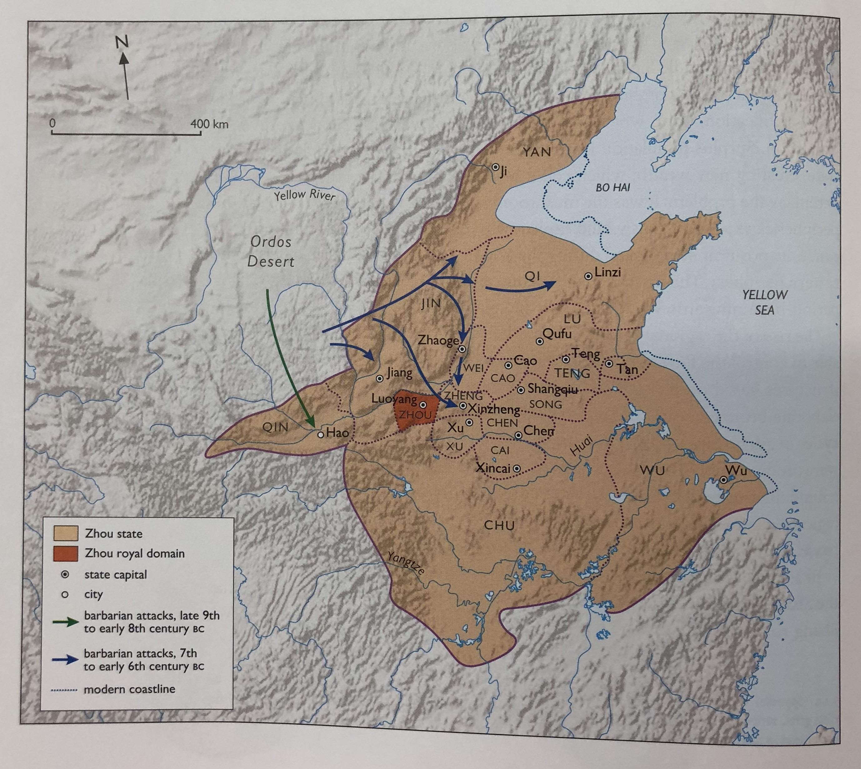
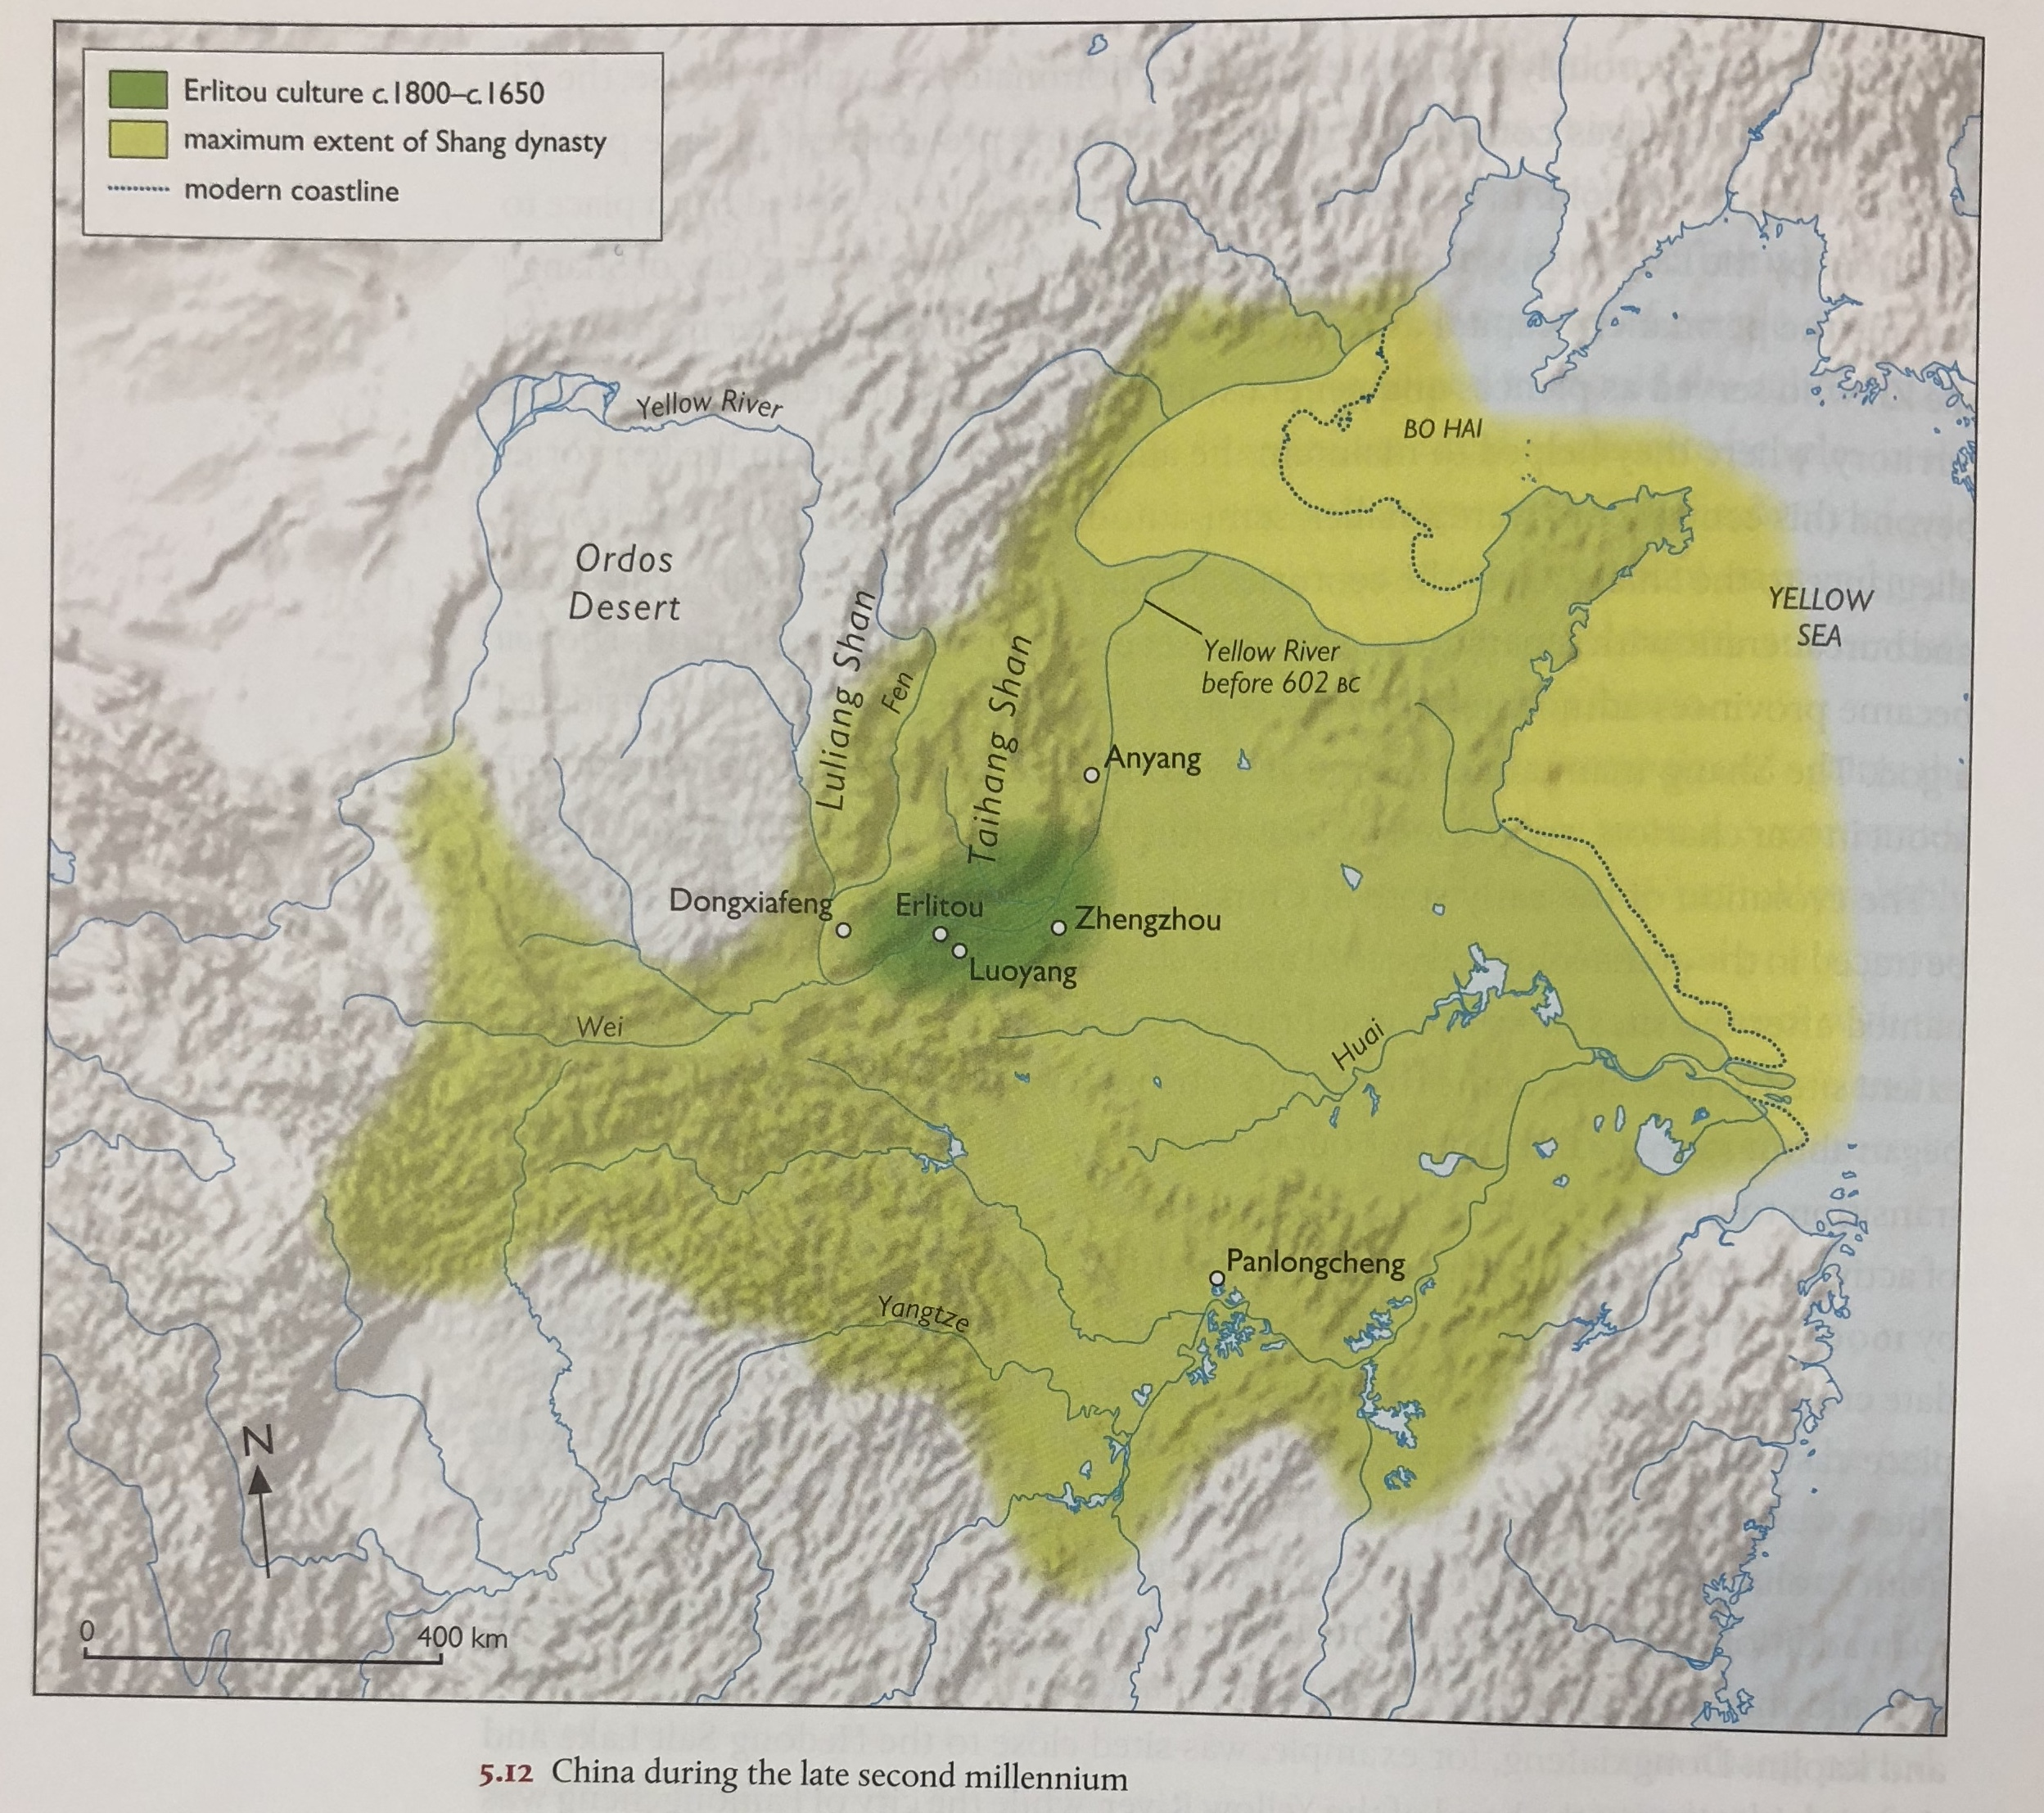

Slide 9
Spring and Autumn Period: 771-480 BCE
Crumbling power of Zhou centre and increasing independence of independent ‘states’
A period of rapidly changing alliances as each polity struggled to keep power and avoid domination by others.
But one of on-going trade with nomadic world. Nomadic tribes needed to trade to provide themselves with commodities that their nomadic lifestyle could not. Regular trading relationship between fully nomads, through ‘semi-nomad’ communities living on edge of Eastern Zhou (like Rong and Di). Nomads sent horses, furs, cattle and sheep in return for gold, silk and women as brides. Chinese coinage of this period also found in nomadic communities.
Confucius: b. 550s BC – died c. 479 BCE: at the very end of the SA Period/cross over into Warring states. Saw the worst excesses of bad leaders: tried to teach the Duke of Lu (and others) how to be a good leader. Cf to ‘Analects of Confucius’ – compiled between Warring States and Han Period. Confucius’ ideas much interpreted and evolved by subsequent disciples: Mencius and Xunzi.
Historical text: Spring and Autumn Annals (State of Lu) – court chronicle + commentaries.

Slide 10
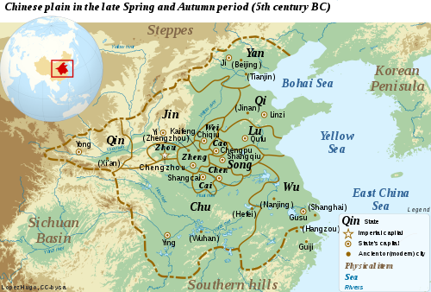
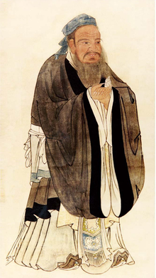

Slide 11
Warring States Period (480-221 BCE)
While different Chinese states fighting with one another, also started defining a harder border with nomadic communities to north, including the building of walls to prevent lightening nomadic raids, as well as make permanent land grabs of good pastoral land.
480 BCE: 140 different states competing – total population of about 50 million people (compare to empires of West)
By 300 BCE, 11 states were engaged in continuous warfare
By 256 BCE (when technically last Zhou king deposed), 7 main warring states
221 BCE: Qin state emerged as victorious to create a new unified ‘Chinese’ Qin Empire.
Leader was Ying Zheng, who took the title Qin Shihuangdi (The First August and Divine Emperor of Qin)

Slide 12
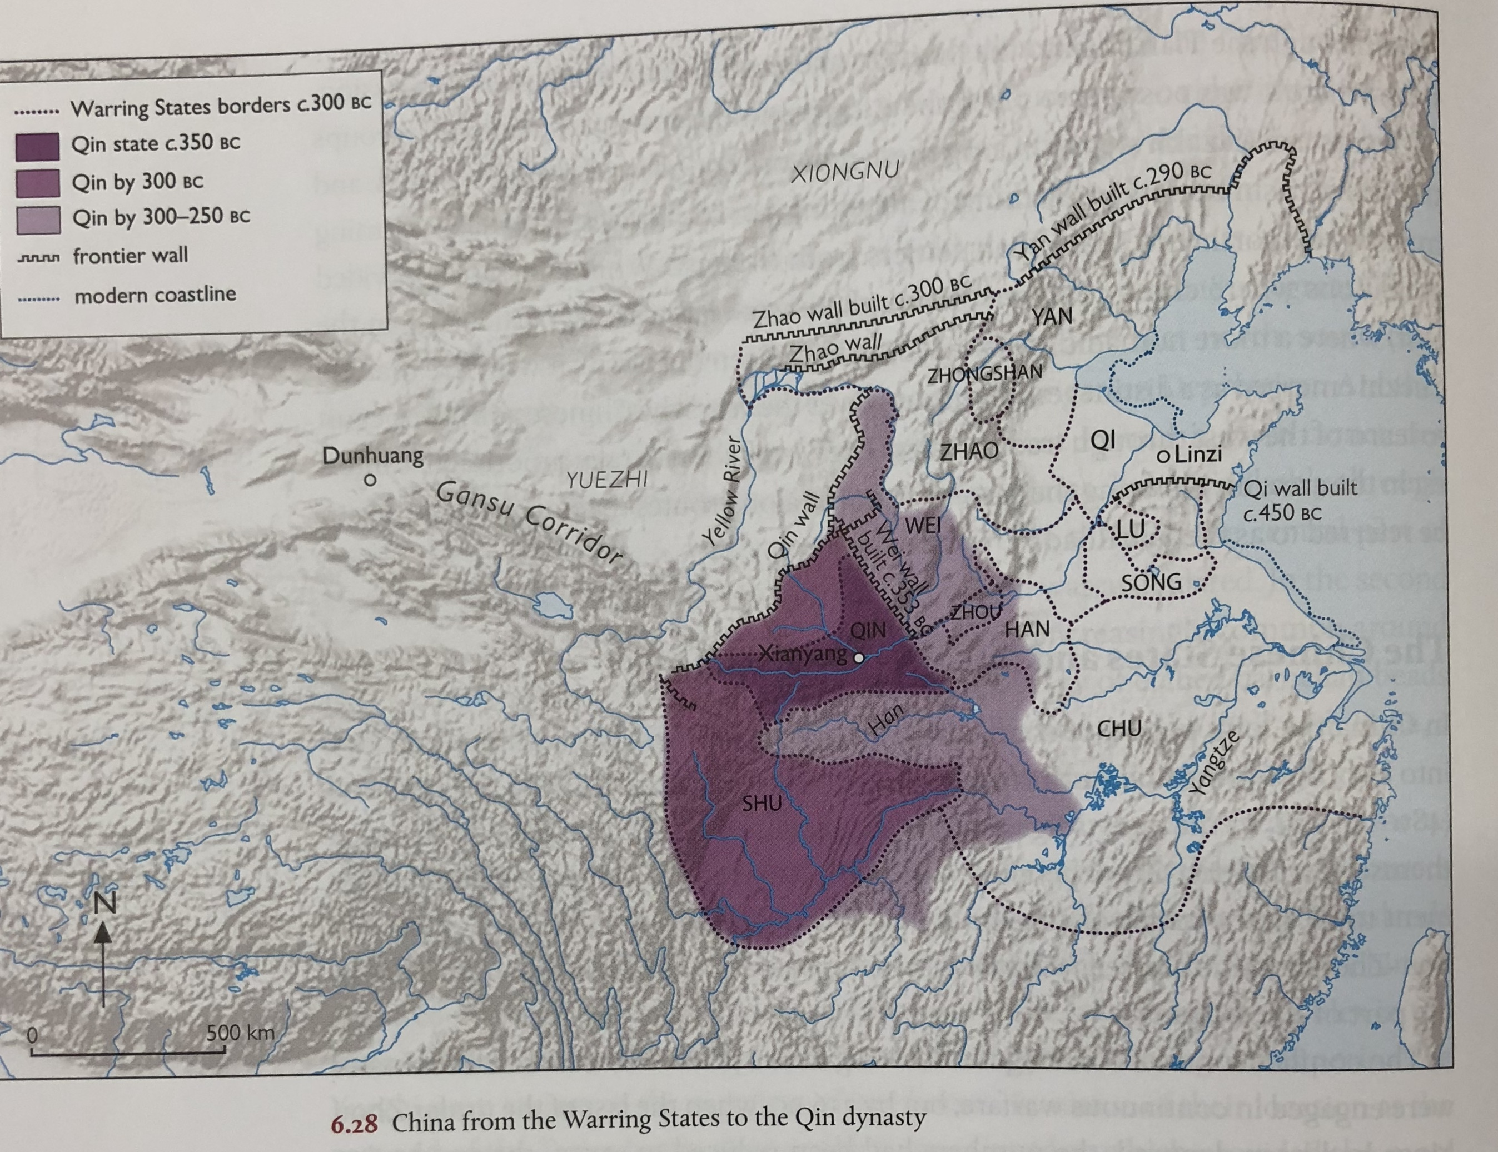

Slide 13
Outcomes of this period of conflict:
Cities grow in size as commercialization grows
Agriculture intensified to feed growing populations + accompanying technological evolution (irrigation, ox-ploughs, tools)
Military change:
Development of large cavalry (learning from nomads)
Speedy increase in technology and manufacturing:
Casting of iron perfected
Invention of military weapons: cross bow that fire up to 800m
Development of bronze coinage
Political and social change:
New bureaucratic systems developed as old elites good not cope on own
Development as a result of new social classes (intellectuals)
Development of different schools of thought of philosophy and politics ‘100 Schools of Thought Period’ cf Confucius and Confucianism, Laozi and development of Taoism, Mozi (all about profit), as well as Shang Yang and Legalism, also Structuralists, Logicians.

Slide 14
On-going exchange with nomadic communities
The Pazyryk Burials:
3rd century BCE burials from Altai mountains. 25 Kurgans grouped together
Due to height (1600m), burials have remained frozen throughout the year, which means fabrics, even human flesh have survived.
Bodies had their organs removed and packed with vegetable material. Man killed by axe blows to head and been scalped. Body extensively tattoed early in life.
Bodies surrounded by rich array of objects: wooden tables, drum, instruments, squirrel-fur coat, leopard skin boots, bronze cauldron, ceremonial carts, Persian carpet, felt, Chinese silk with embroidered birds
Intricate wood carvings of mythical and real animals
Indian Tin Mirror and cotton, Chinese lacquer work bowls and silk embroidery
All coming from down the line trade, diplomatic gift exchange, dowries, war booty?

Slide 15
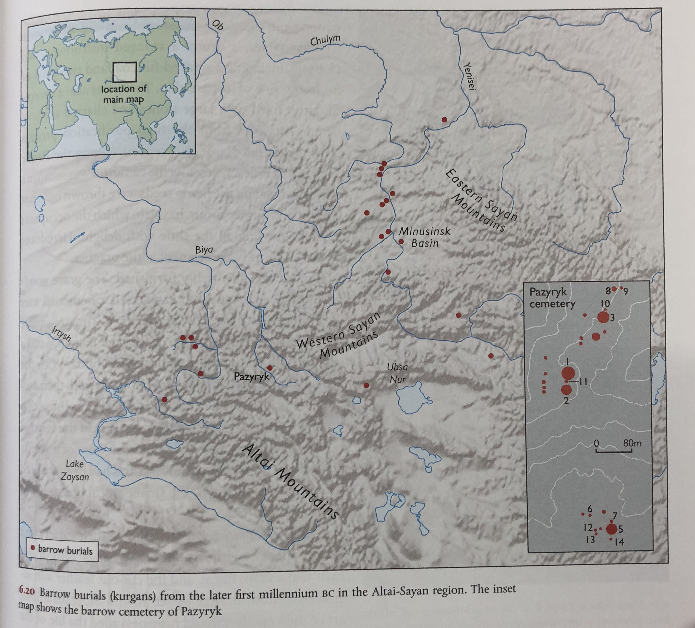
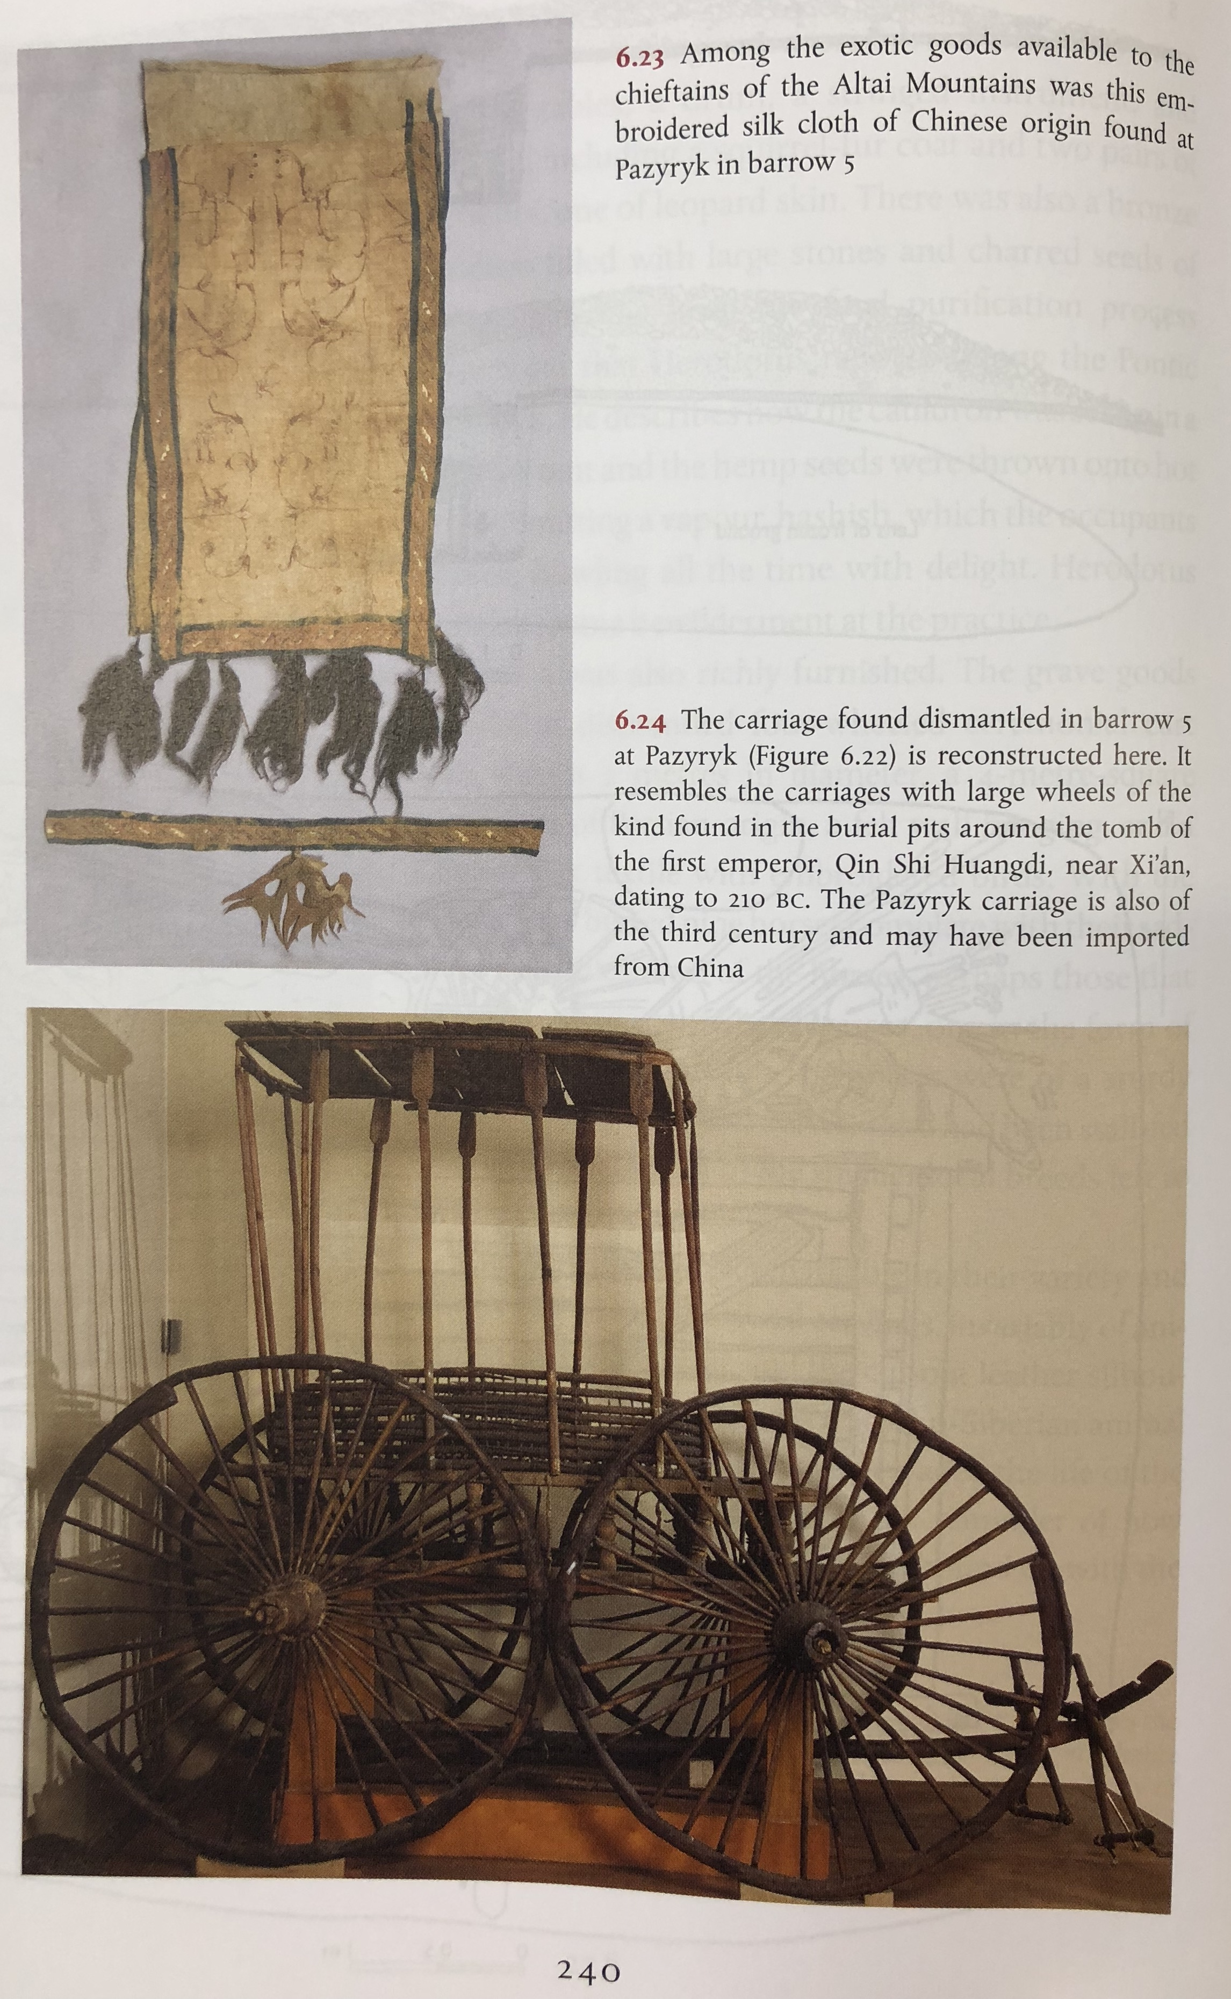

Slide 16
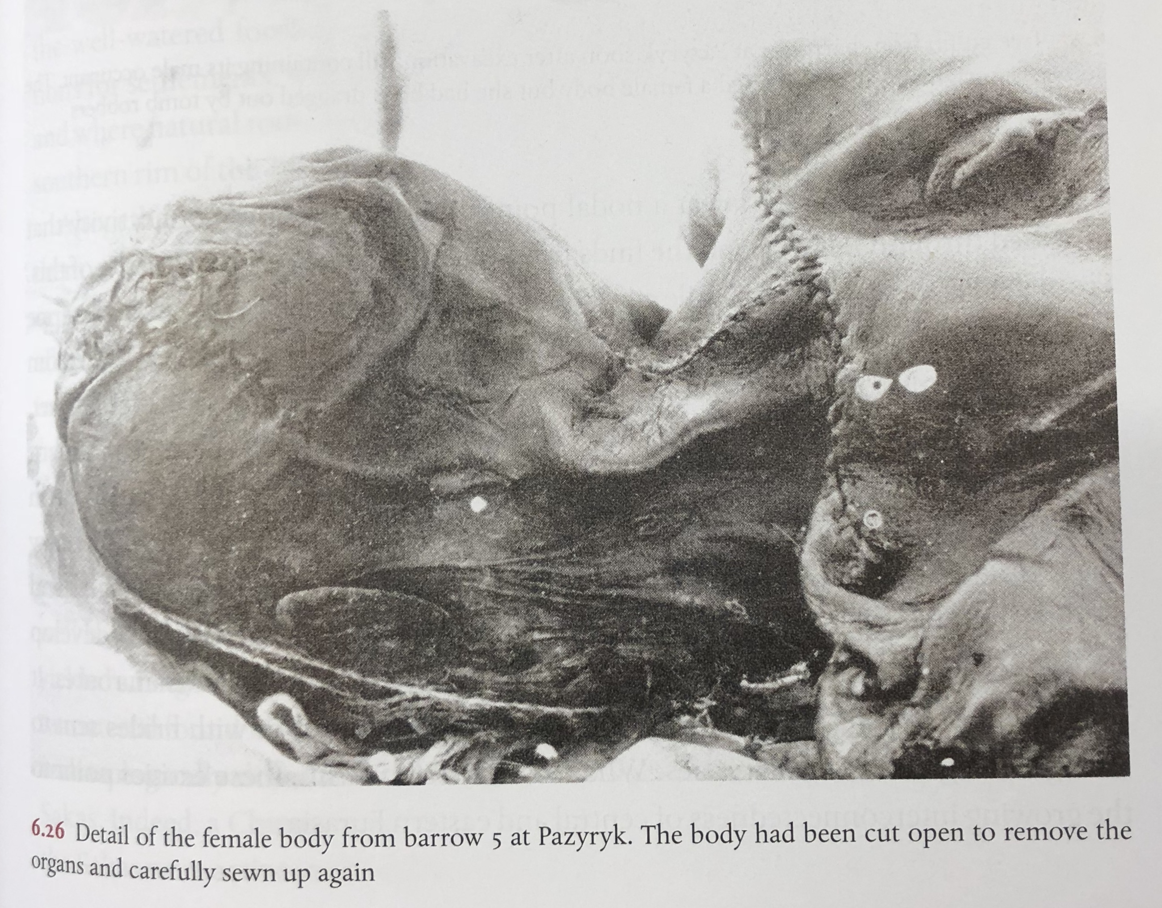
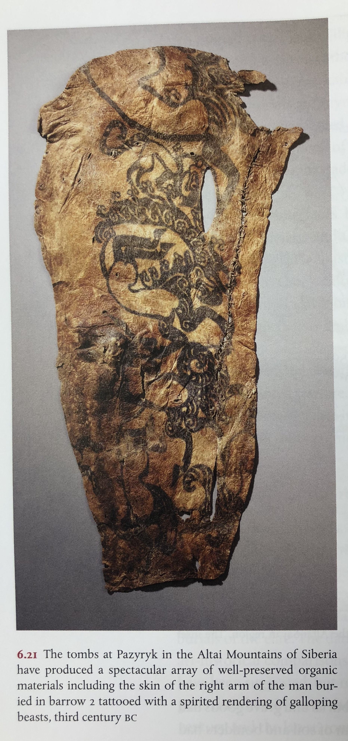

Slide 17
The Qin and the Xiongnu
Qin ruler governed 221-210 BCE:
Extended the system of walls along the nomadic frontier
Set about creating a sense of unified Chinese state (and trying to rule over such a vast area of conquest) e.g. system of roads
Set up of vast bureaucracy
Discarded Confucianism in favour of Legalism “Wise men make laws, stupid men are constrained by them’
Qin ruler creates a vast burial complex for himself: now made famous as the Terracotta Warriors:
Use of full size modelling of humans and horses; techniques of hollow bronze casting using in manufacture of water birds had no antecedents in China, but well known in Bactria, Gandhara and beyond. Western ideas and western craftsmen introduced into elite culture in China?
Given a very negative reputation by later Han scholars: burning of Philosophy books (and execution of philosophers)
By end of 4th century, we start to hear of a new entity among the Nomads (Hu), the Xiongnu. They grew in power, dominating over neighbouring nomadic tribes by end 3rd century, growing in their own organization and complexity in response to development of Qin Empire
The emergence of a charismatic leader – Modu led to further formalization of a hierarchy based around a leader, who in turn, needed to maintain that loyalty, principally through the provision of distribution of goods. Some through trade, but increasingly Xiongnu turn to both dominating vast areas of the Steppe and increase raiding into China.
Qin Empire initially attempt to restrict trade in iron weapons to Xiongnu, but that only intensified Xiongnu desire to raid Chinese territory.

Slide 18
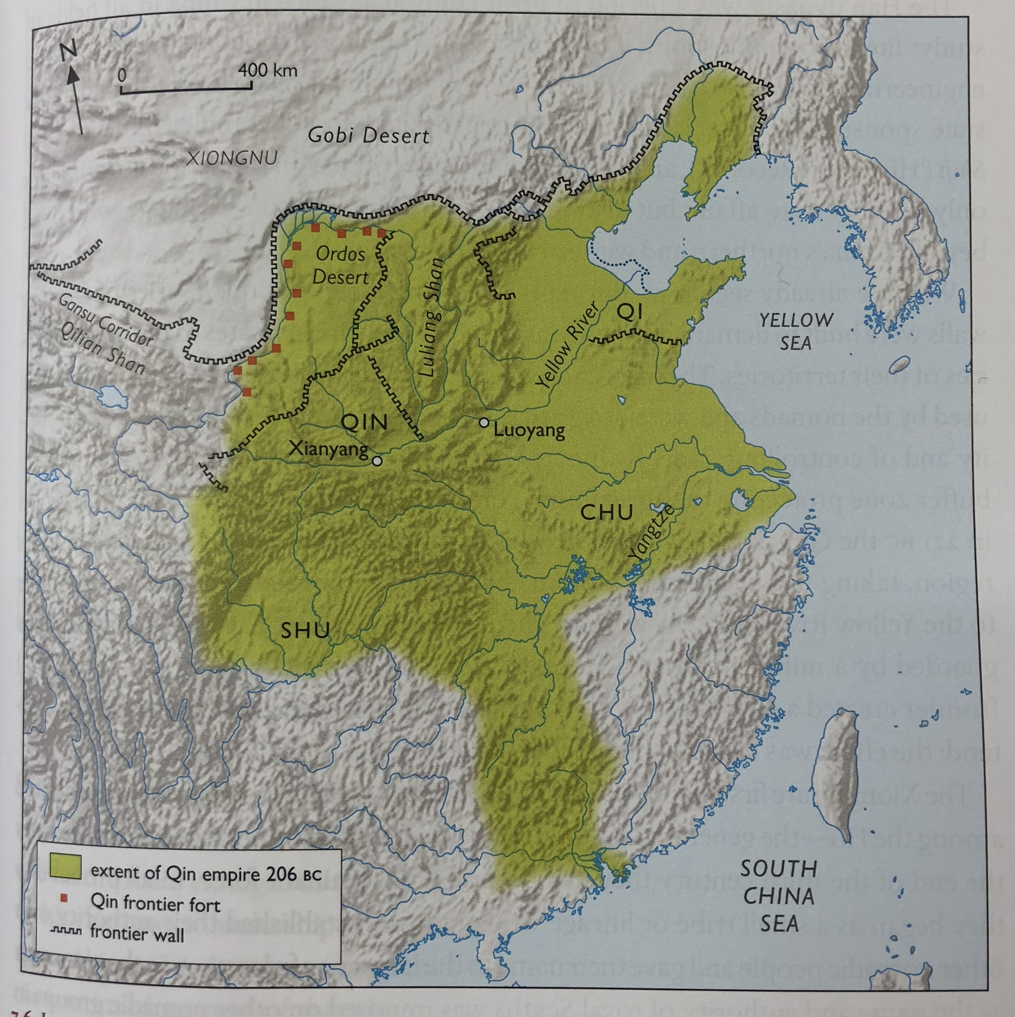
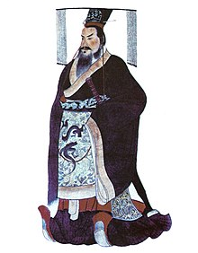

Slide 19
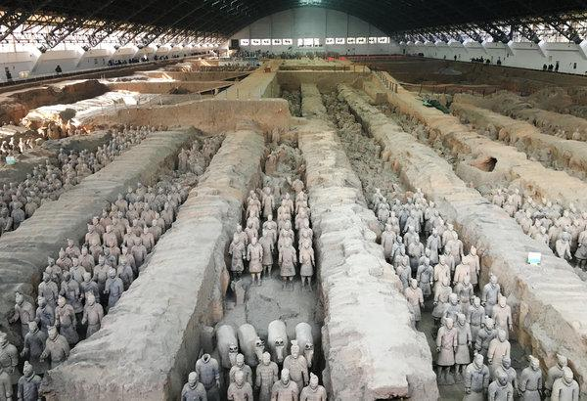
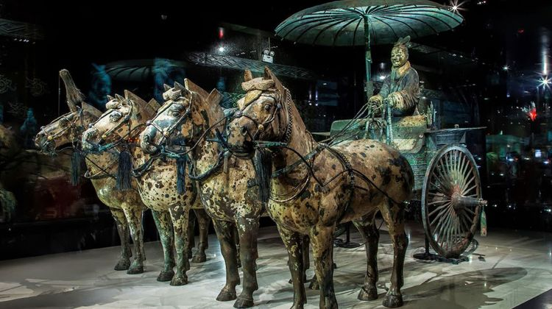

Slide 20
The Han Dynasty
Death of Qin emperor throws new found empire into civil war.
Emergence in 206 BCE of one rebel leader, Liu Bang of Han, leading to formulation of Han Dynasty, which would last till 220 CE.
Liu Bang ruled until 195 BCE, when his wife, Empress Dowager Lu continued to rule until 180 BCE (formidable figure)
Western (Former) Han: 206 BCE-9 CE – with capital at Chang’an (modern Xian)
Eastern (Later) Han: 25 CE- 220 CE – with capital at Luoyang.
Divided the Han Empire into two zones: the eastern 2/3 was subdivided into 10 semi-autonomous kingdoms, while the western 1/3 was organized into 13 commanderies under direct control of central government.
Massive bureaucracy created under principles of Confucianism (and Confucius starts received worship)

Slide 21
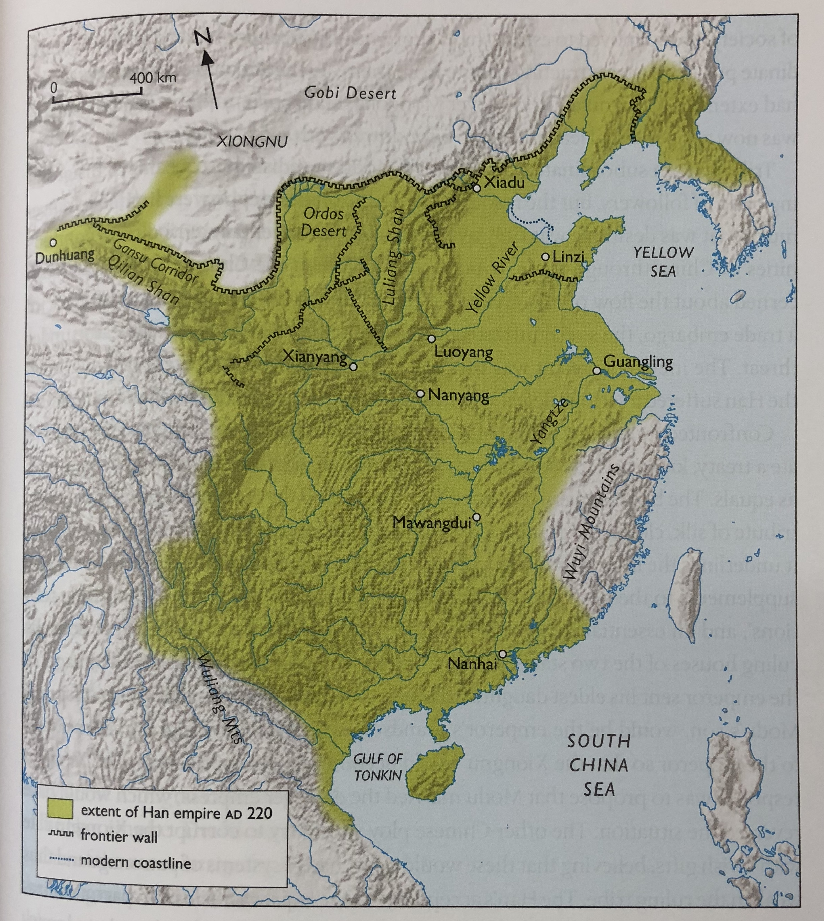
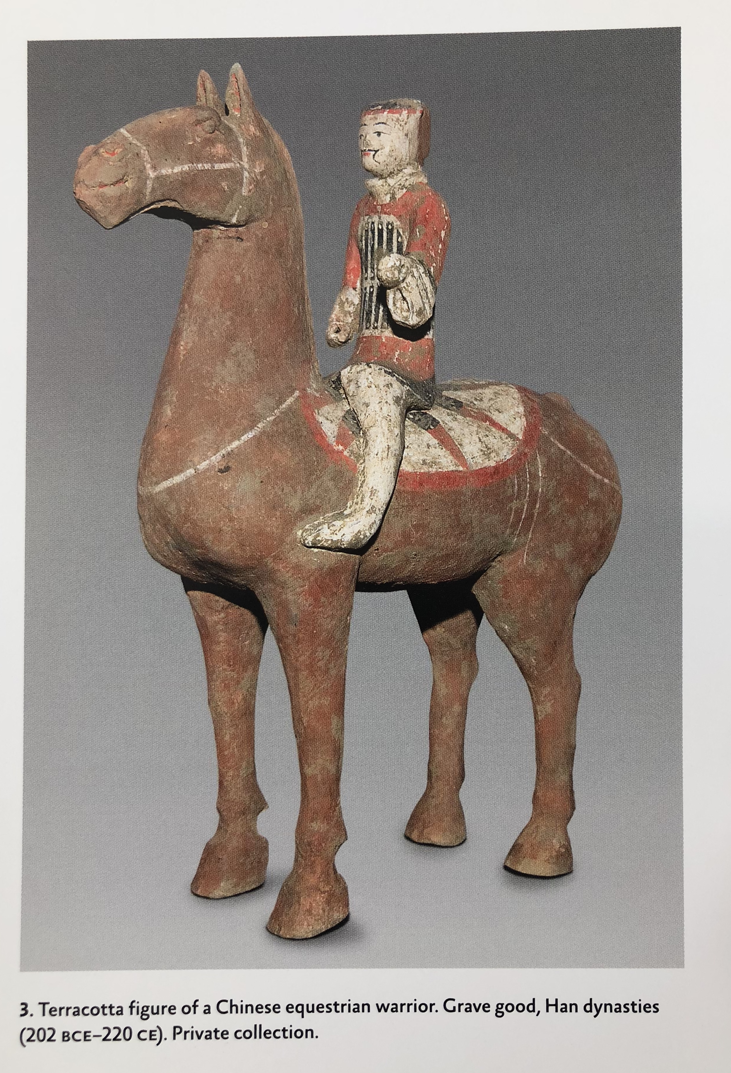

Slide 22
The nature of the Han Empire
Huge period of cultural creativity: literature, philosophy, mathematics, astronomy, navigation, medicine, engineering
Development of official history under state sponsorship: Sima Qian (145-80 BCE) Shiji ‘Historical Records’ (including ‘Biography of Assassins’)
In 200 BCE, Han suffered military defeat at hands of Xiongnu
Led in 198 BCE to heqin – ‘peace through kinship relations’ agreement between Han Emperor and Xiongnu ruler: a marriage alliance between the ruling houses with accompanying gifts.
But only gift from Xiongnu was not to raid Han territory. Gifts from Han on the other hand were vast and expensive.
Attempts to turn the Xiongnu to Han way of life (get them used to luxuries – the 5 baits)
But left incredible power in hands of Xiongnu – and huge unease amongst Chinese elites.
Actually allowed Xiongnu society to strengthen around its leaders: more goods for Xiongnu ruler to distribute among his followers.
Result was Xiongnu aggression also against nomadic tribes of Wu-sun and Yuezhi: with massive migrations westwards across steps and down into central Asia.

Slide 23
The situation of the empire may be described just like a person hanging upside down. The Son of Heaven, the head of the world, at the top; the vassal, the foot, at the bottom. Now the Xiongnu are arrogant and insolent on the one hand, and invade and plunder us on the other hand, which must be considered an act of extreme disrespect towards us. And the harm they have been doing to the empire is extremely boundless. Yet each year Han provides them with money, silk floss and fabrics. To command the Barbarian is the power vested in the Emperor on the top, and to present tribute to the Son of Heaven is a ritual to be performed by vassals at the bottom. Now the feet are put on the top and the head at the bottom. Hanging upside down like this is something beyond comprehension
Ban Gu HanShu (History of the Han) 48:6a-6

Slide 24
The nature of the heqin
At its height, Han subsidy to Xiongnu was huge (Hanshu 94A):
5000 hu of grain (140 men for a year)
10000 shih of wine (daily ration to court of 55 litres)
10000 pi of silk cloth (92,400m of silk)
Even after accepting sovereignty, amounts increased substantially between 51 BCE and 1 BCE (cf Hanshu 94B):
51 BCE: 6000 chin of silk floss and 8000 pieces of silk fabric (and gold, gold coin, and clothes)
1 BCE: 30,000 chin of silk floss and 30,000 pieces of silk fabric.
Indeed this was the way Han China dealt with most of the Western Regions:
In 54 CE, another nomadic tribe, Hsien-Pi submitted to Han and received 270,000,000 cash (Hou Hanshu 120:3b)
In 91 CE: Southern Xiongnu received 100,900,000 cash (Hou Hanshu 75:2b); the Western Regions received 74,800,000.
Tributary payroll was about 1/3 of annual government payroll and 7% of total revenue of empire

Slide 25
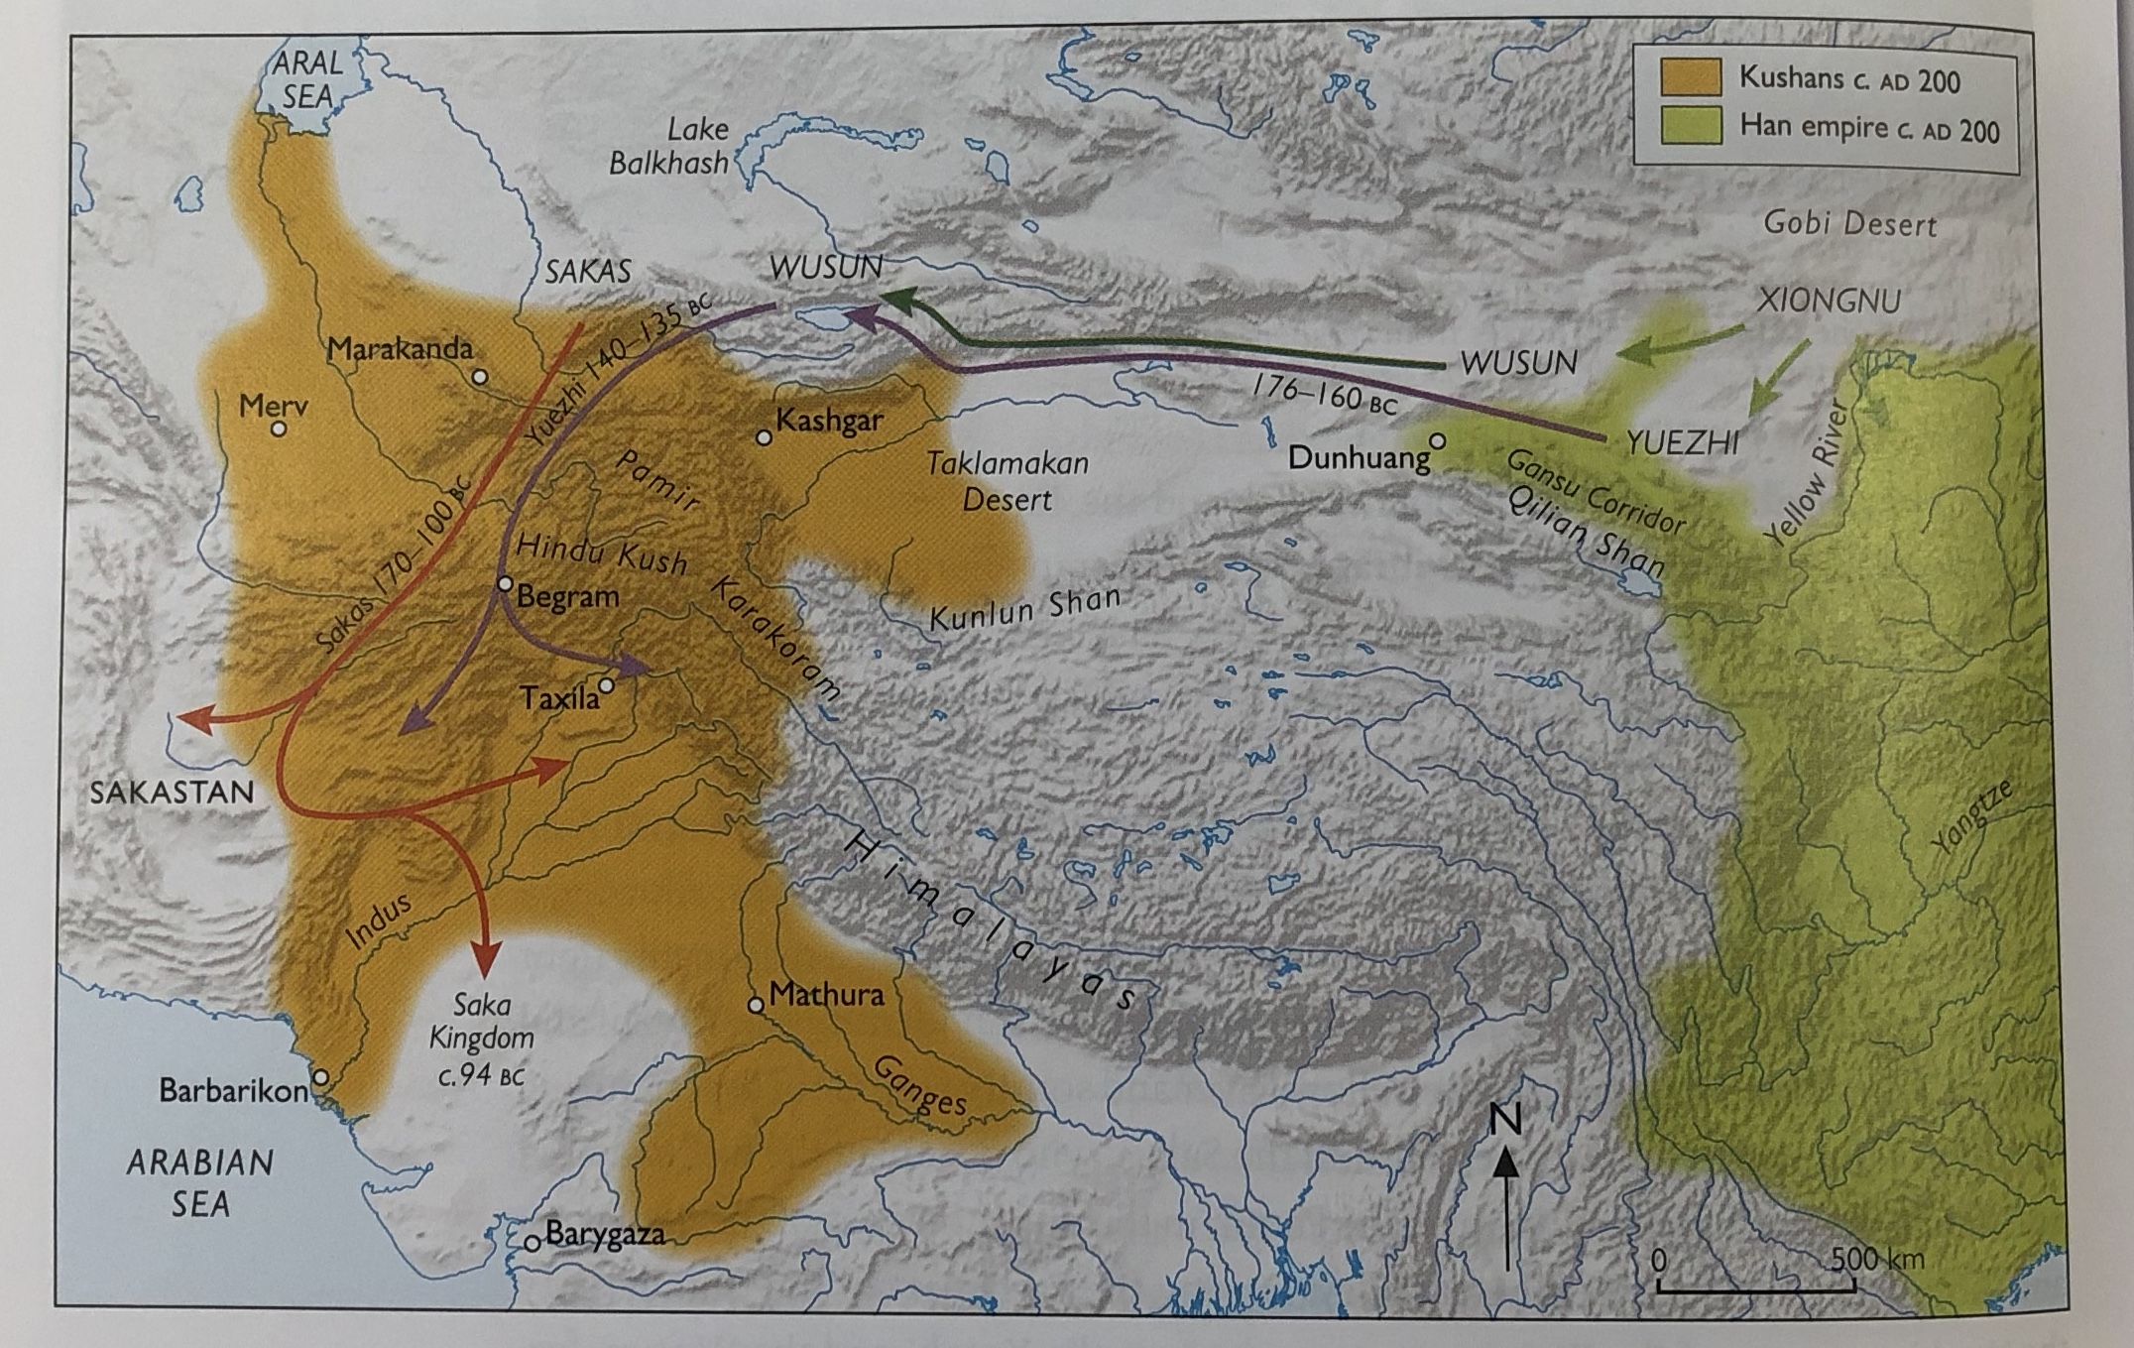

Slide 26
Major Chinese Historical Texts
Autumn and Spring Annals Chunqiu – official chronicle of State of Lu (state in which Confucius lived and worked) covers 722-481 BCE + 5 Commentaries on the Annals: created during the Warring States period to find deeper meaning in Annals (e.g. Commentary of Zuo).
Sima Qian Shiji (written 1st c BCE about China’s relationship with the Xiongnu as well as the Qin and Han dynasties
Hanshu (History of the Western Han) covering period 202 BCE-9 CE. Begun in 36 CE by historian Ban Biao, continued by his son Ban Gu, finished by his sister, Ban Zhao c. 110 CE.
HouHanshu (History of the Eastern/Later Han) 25-220 CE, compiled by the historian Fan Yen (398-446 CE)
Zizhi Tongjian ‘ Comprehensive Mirror to Aid in Government’ written by Sima Guang (1019-1086) – a chronological account in 354 volumes of 1362 years of Chinese history

Slide 27
Han Expansion
In 140 BCE Emperor Wu came to throne:
Sent Zhang Qian to visit Yuezhi in central Asia to gain them as allies to attack Xiongnu
In 120s BCE, Han Emperor Wu began an era of Han expansion:
In 129 BCE – Han expand into Xiongnu territory as far as Longcheng
By 121 the Han occupy the Gansu corridor connecting Han territory to Tarim Basin
By 119 BCE, Han expansion had been backed up with re-settlements of large numbers of Han in former Xiongnu territories, tribute was no longer paid
By 110 BCE, the Xiongnu had been forced out of Yellow River region and retreated to northern Steppes. Han established 14 new border commanderies and starting conquest of Tarim Basin area.
By 51 BCE the Xiongnu had collapsed and accepted sovereignty of Han state
Han ambassadors brought back knowledge of communities to west (like Parthians), as well as Han conquest to Pamir mountains facilitated greater ability and desire for trade. See the Xuanquan documents: 35000 documents (111 BC-107 CE) regulating movement of people and goods, posting of new imperial edicts etc. Complex relationships with each of pre-existing oasis communities around the Tarim basin (often communities with strong links to nomadic groups)
101 BCE – the Han expand over Pamirs and into Ferghana Valley. Continue to defend and expand their interests there, with full Chinese control established in 94 CE over the territory of the ‘Western Regions’

Slide 28
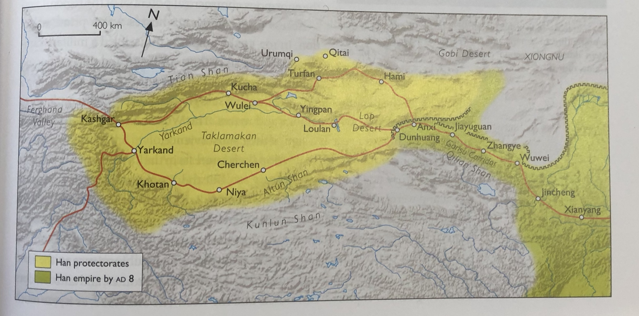
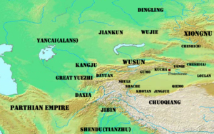

Slide 29
The Xiongnu Burials at Noin-Ula
Noin Ula burials (modern Mongolia) belong to Xiongnu elites rulers, with one burial (kurgan 6) identified with a historical Xiongnu ruler Uchjulü-Jodi-Chanuy, who died in 13 CE.
Clothes trimmed with fur and silk, felt boots, woolen trousers, carpets of wool and silk, bronze Chinese mirrors, Chinese lacquered cups, ornamental plaques.
Silk used to cover bodies, sides of coffins, roofs, floors, every conceivable surface.
More Chinese silk has been found in Xiongnu burial sites than from every other period of nomad history.
See everything that was found (mostly in Hermitage in St Petersburg): https://depts.washington.edu/silkroad/museums/shm/shmnoinula.html

Slide 30
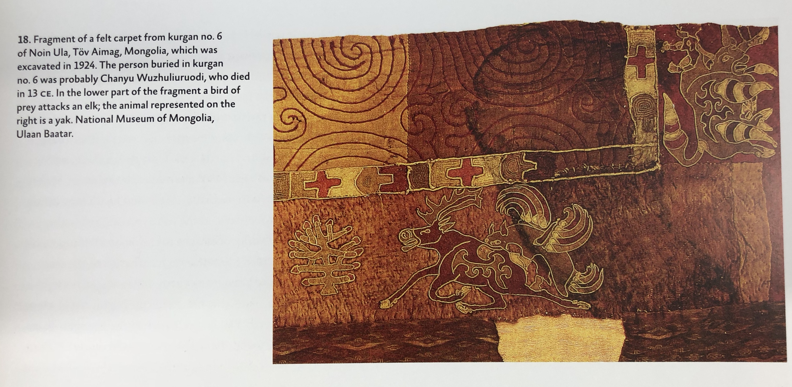
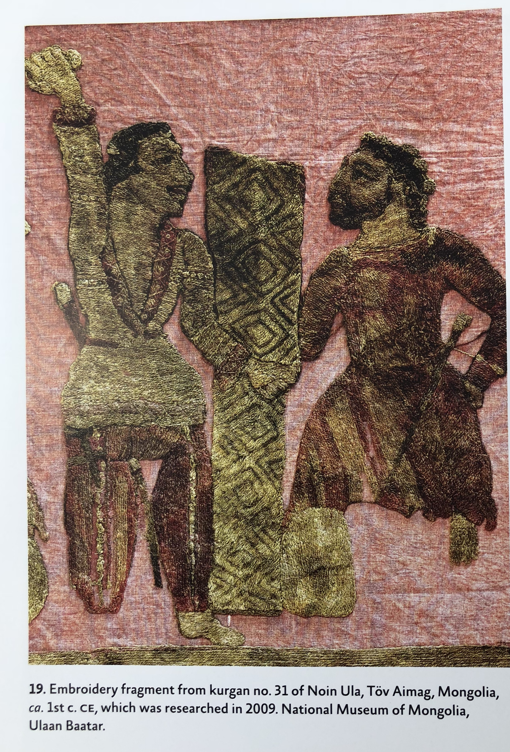
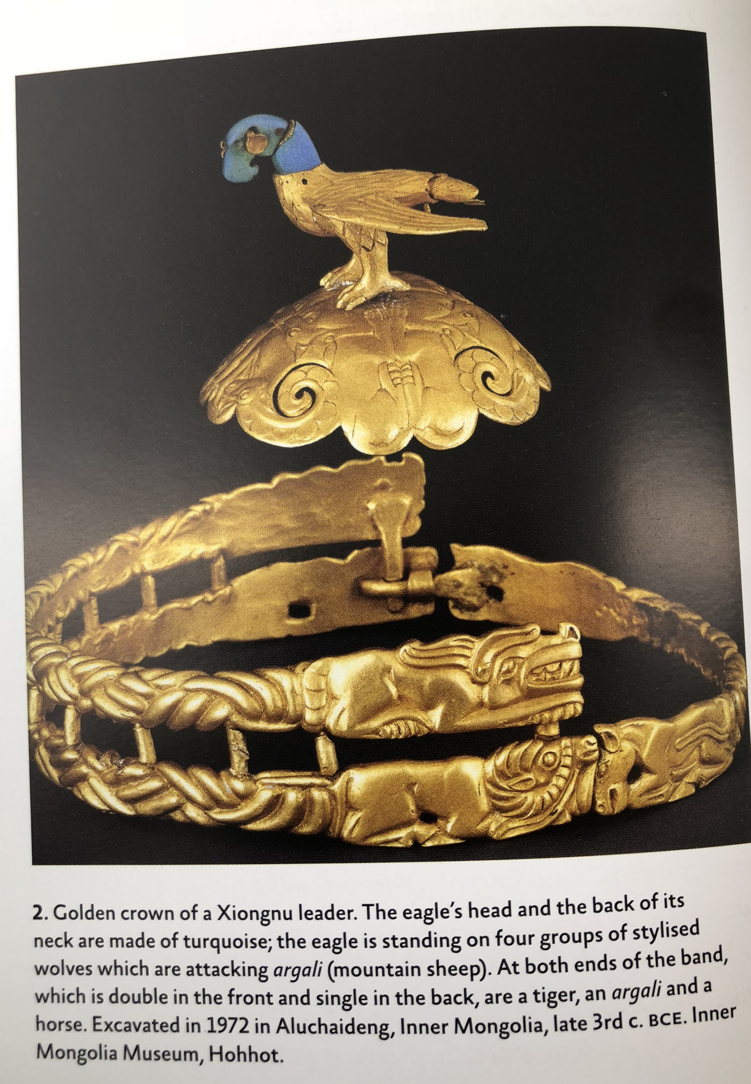

Slide 31
Age of Disunity: 220CE onwards
Eastern (Later) Han dynasty collapsed in 220 CE, led to period of disunity in China known as ‘the six dynasties’ – continued until 581 CE under the Sui dynasty and then Tang dynasty from 618 CE.
After the abdication of last Han Emperor, China split into 3 kingdoms: Wei in the north, Wu in the south and Shu in the West.
In 280 CE, Wei became the dominant power. Beginning of the Western Jin era (see Jinshu – Book of the History of Jin)
But continued problems with nomadic invasions: in 311 CE, the Xiongnu sacked the city of Luoyang and in 316 CE the city of Chang’an fell (with the emperors themselves in both cases being caputured). Led to so called ‘Sixteen Kingdoms’ period

Slide 32
As a result, there was a mass migration within China itself south towards territory of Wu and to city of Nanjing in Yangtze valley. Beginning of the Eastern Jin period.
From 317 CE, ‘Northern China’ was a mixed-ethnicity, mixed nomad/sedentary community and ‘Southern China’/ Eastern Jin was the mix of sedentary communities – mirrored boundary between millet producing areas and areas of irrigated rice production (rice fields proved effective deterrent to cavalry).
In north, mix of kingdoms and groups continued with occasional emergence of overlords (a ‘sino-barbarian synthesis). At one point c. 500 CE the overlords (the Toba) prohibited the use of nomadic language, dress and customs: the northern kingdoms became, essentially, Chinese.
The Eastern Jin in the south continued through to early 5th century. It was to Nanjing that Faxian the Buddhist monk returned after trip to India (see text)

Slide 33
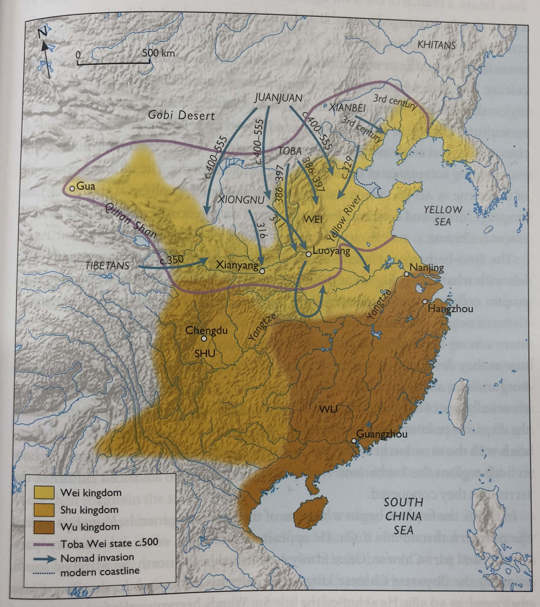

Slide 34
Apart from politics:
On-going trading links with India and Central Asia:
Despite the retrenchment of direct Chinese control from Western Regions and Tarim Basin, different smaller kingdoms and communities had grown up (e.g. Kingdom of Khotan, Kroraina Kingdom) often with influxes of migrant populations (e.g. Kushans after 200 CE). Also increasingly crucial to trading mix in 3-4th centuries were the Sogdians.
Sogdians from Sogdiana (Central Asia) cf Sogdian Letters (found in Dunhuang relating to fall of Luoyang and Chang’an in 311/316); homeland was trading oases of Bukhara and Samarkand. Became ‘merchant middlemen’ - apolitical, and often spread out and resident across the trading network: e.g. Loulan, Tarim Basin, 330 CE has Sogdian merchants trading with Chinese authorities: 319 animals for 4326 bolts of coloured silk.
On-going reception of ideas into China moving along trading routes, especially ideas of religion: Buddhism:
Buddhism entering into China by 1st c CE.
Buddhism appeals for different reasons (and morphs in different ways to fit in with) communities in both northern and southern China.
By 4th century CE it is accepted as official imperial religion by one of south China rulers
Late 4th century CE monk Faxian heads off on tour to India to collect Buddhist texts

Slide 35
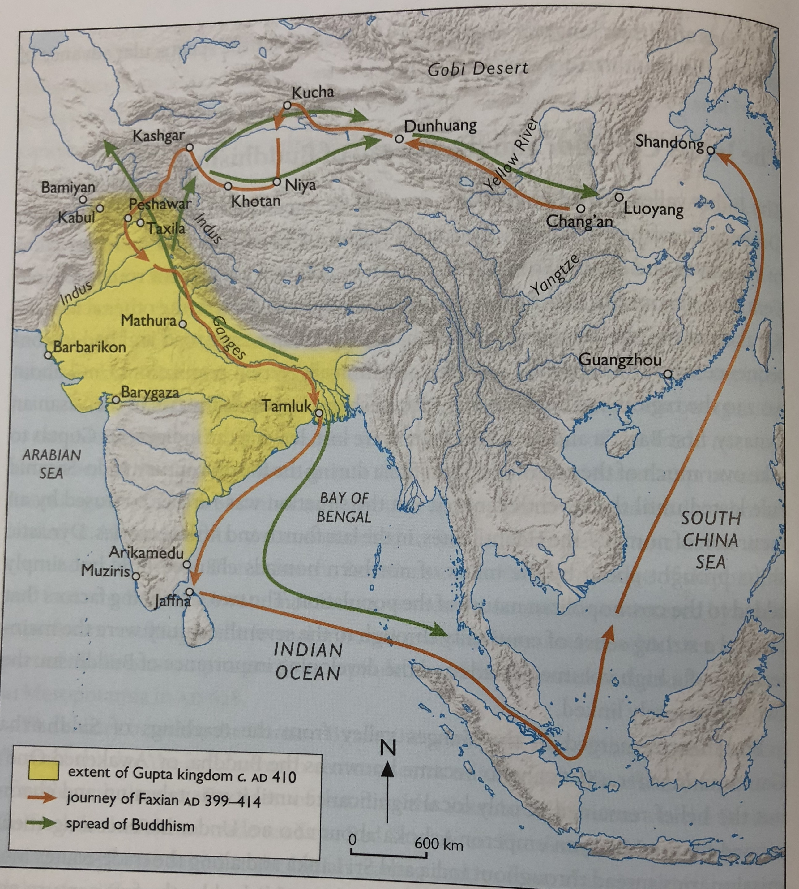

Slide 36
Bibliography
B. Cunliffe 2015 By Steppe, Ocean and Desert
C. Baumer The History of Central Asia (vols 1 and 2)
B. Watson 1961-3 Records of the Grand historian (Sima Qian)
R. Dawson 2007 Sima Qian: The First Emperor (selections)
H. Tanner 2009 China: A history
P. Nancarrow 1978 Early China and the Wall
J. Man 2008 The Terracotta Army
M. Edward Lewis 2007 The Chinese Empires Qin and Han
L. Rainey 2010 Confucius
J. Roberts 1999 A History of China
Li Jun 1996 Chinese Civilisation in the Making 1766-221 BCE
W. Scheidel (ed) 2009 Rome and China: Comparative Perspectives on Ancient World Empires
A. Khazanov and A. Wink 2001 Nomads in the Sedentary World
T. Barfield The Perilous Frontier: Nomadic empires and China 221 BCE-1575CE
Y. Yu 1967 Trade and Expansion in Han China

