Slide 1
Ancient Global History
Term 1, Week 8 (Lecture 7)

Slide 2
From last time…
Axial Age – Karl Jaspers 8th c—2nd c BCE – a moment in which humanity pushed boundaries of knowledge / understanding – creating new religions, setting the framework for our world today.
Not a moment in which cultures were connected, but a moment in which they were all doing something similar / facing similar issues?
Can we see other, different kinds of moments, that help us give shape to our period at a global level?

Slide 3
The forming of worlds: end 3rd BCE
221 BCE: Qin Shu Huangdi leads state of Qin in defeat of other Warring States to create Qin Empire – a unified China.
218 BCE: Hannibal leads army across Alps to attack Rome as part of 2nd Punic War.
206 BCE: State of Greco-Bactria recognized in Central Asia by Antiochus III of the Seleucid Empire and set up as stalwart against Nomadic invasion from the East (and begins expansion of its empire into territory of dissolving Mauryan empire)
202 BCE: End of 2nd Punic War with victory of Rome
202 BCE: Foundation of Han Dynasty in China under Gaodi
192-0 BCE: Rome defeats both Philip V of Macedon and Antiochus III extending its power across the Mediterranean.

Slide 4
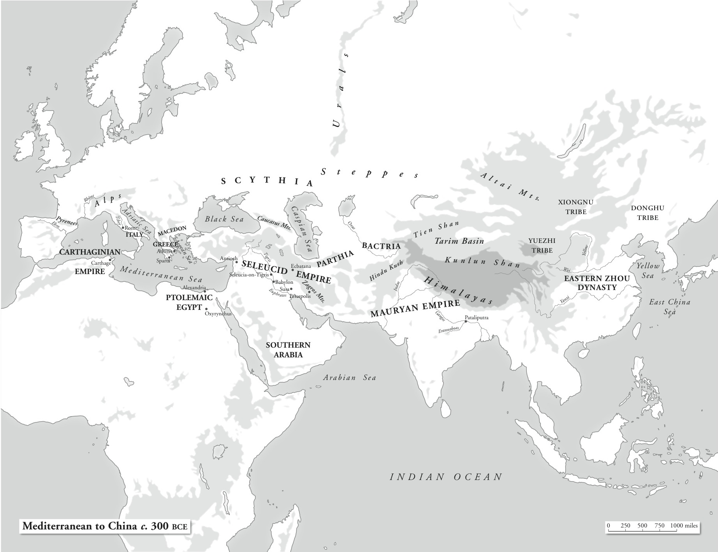
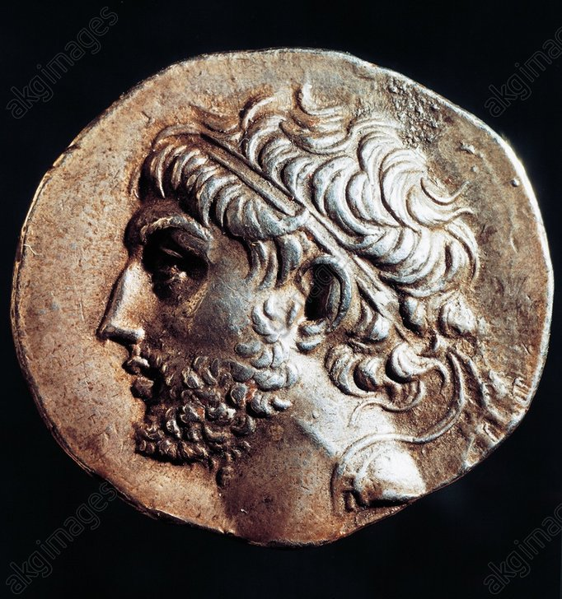
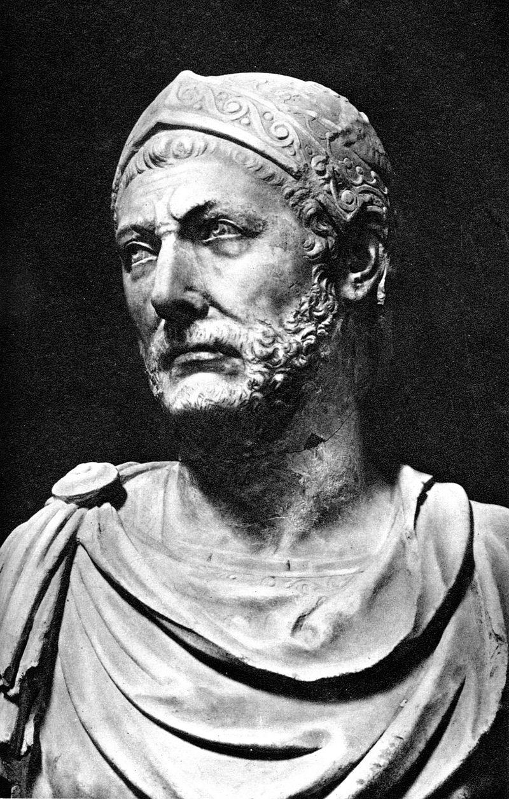
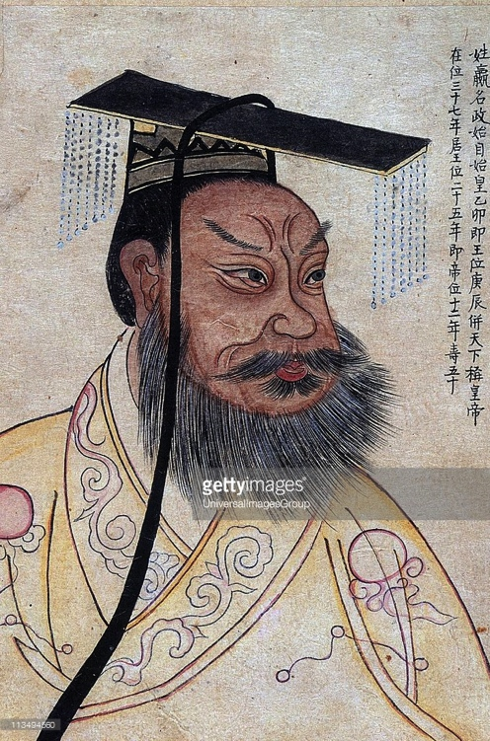
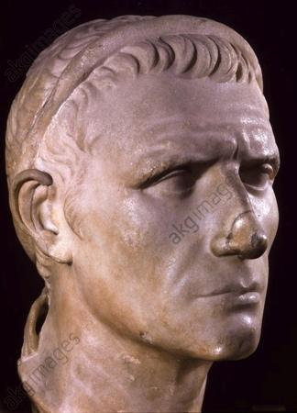
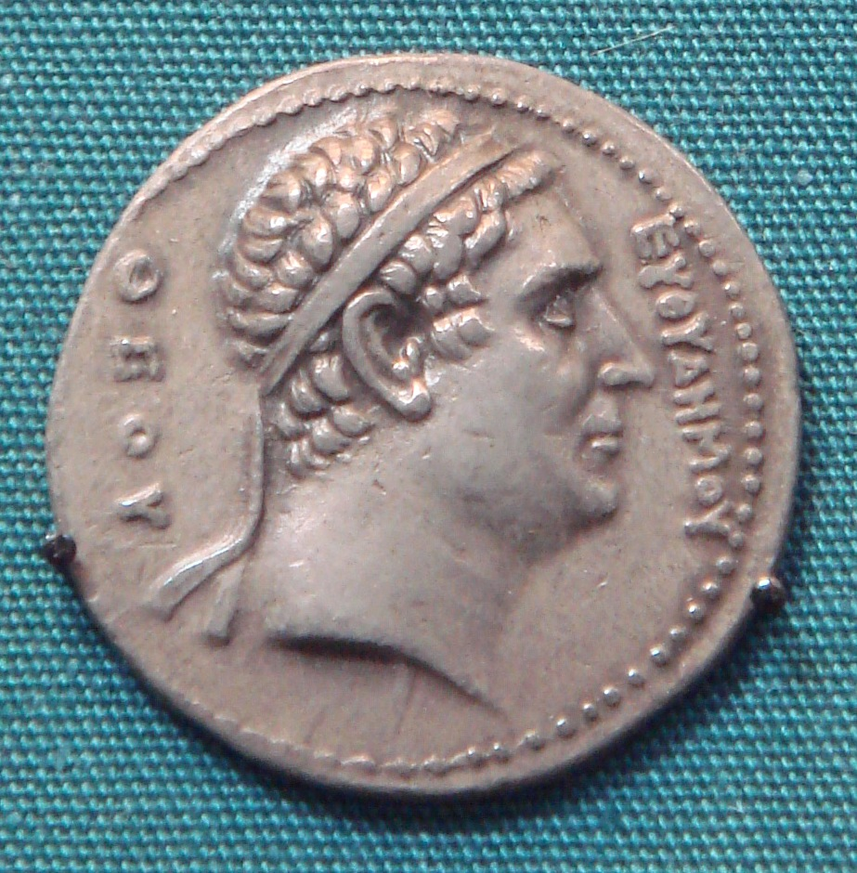

Slide 5
The meeting of worlds: 2nd century BCE
176 BCE: Xiongnu ruler Maodun now claims Xiongnu rule “all the people who live by drawing the bow”
170s BCE: Yuezhi nomad tribes start to migrate West following defeat by Xiongnu.
146 BCE: Destruction by Rome of Carthage and Corinth.
145 BCE: Ai Khanoum, jewel in Greco-Bactria crown, attacked by Saca nomads forced southwards from the Steppe
145-0BCE: Arrival of Yuezhi nomadic tribes into Greco-Bactria (will eventually become the Kushans)
141 BCE: Emperor Wu comes to rule Han dynasty, stops policy of heqin, and plans for aggressive expansion campaign against Xiongnu.
139 BCE Emperor Wu sends ambassador Zhang Qian to meet with and recruit the Yuezhi in central Asia against the Xiongnu.
126 BCE: Ambassador Zhang Qian (Chang Ch’ien) reports back to Emperor Wu about what he discovered in Greco-Bactria – including see goods for sale from China.

Slide 6
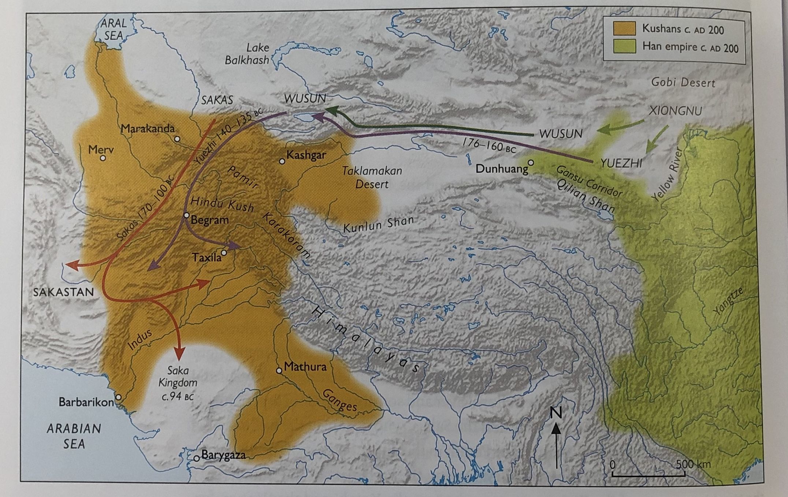

Slide 7
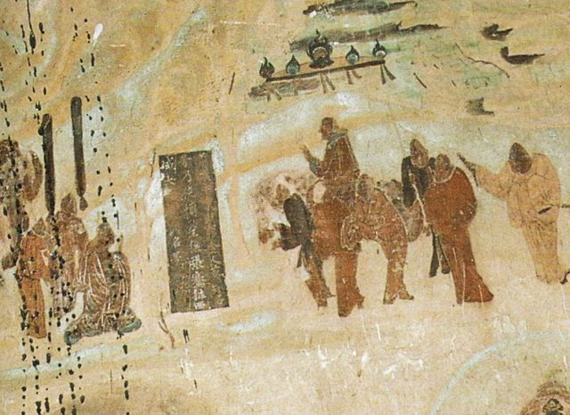
Zhang Qian
Emperor Wu told by Xiongnu deserters that the Yuezhi, who had had to flee west, hated the Xiongnu, brooded on revenge and were looking for allies against them
Zhang Qian was a palace attendant – volunteered to be ambassador and set off in 139 BCE
Captured by Xiongnu while passing through their territory to get to Yuezhi
Treated with respect by shanyu and provided with a Xiongnu wife, but would not release him.
In 129 BCE – after 10 years of captivity, Zhang Qian succeeded in escaping and continued east.
Now had to travel further as Yuezhi had moved further west and south (into Bactria)
Stayed a year with Yuezhi – gathering information about peoples even further south and west. By now Yuezhi not interested in joining Han against the Xiongnu.
Captured again by the Xiongnu on his return journey but escaped again arriving back to Chang’an in 126 BCE
His report repeated in Sima Qian Shiji 123 (read text) + Hanshu 61

Slide 8
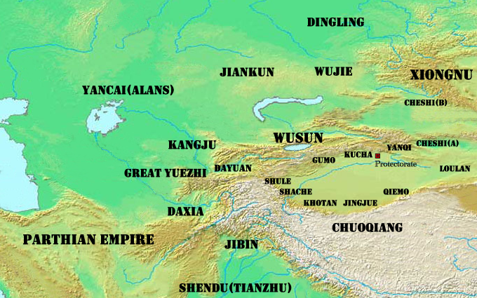

Slide 9
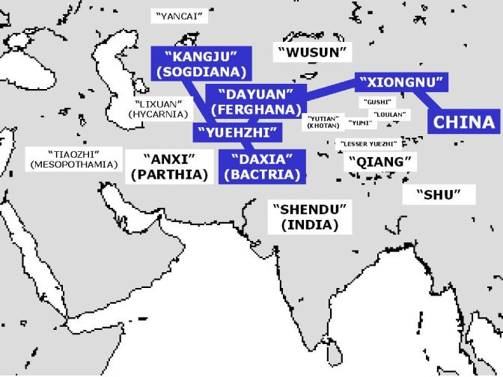

Slide 10
Zhang Qian’s further missions
Zhang Qian’s further missions: Sima Qian Shiji 123:
  120s BCE: Zhang Qian sent to find a pathway through the ‘Shu’ to the south through to India: to follow the route of the goods that he had seen in Bactria. But this failed (see text)
  119 BCE: Trade and alliance mission to the Wusun: 300 men, 10,000s of sheep and cattle and gold and silk worth 100,000,000 cash. Brought Wusun ambassadors back with him but no grand alliance (see text)
  See HanShu 61 “For the first time the states of the North West came into communication with the Han. It was Zhang Qian who had pioneered the way”

Slide 11
Emperor Wu’s expansion of Han power
Wu’s attacks against the Xiongnu while Zhang Qian was away:
  134-3 BCE: Wu attacks Xiongnu. Further attacks in 129-126 BCE - with some success, moving Han into Xiongnu heartland (Shiji 108)
  121 BCE: a new decisive campaign by Han against the Xiongnu. Led to submission of the Ganzu and Shanxi regions to the Han – with Emperor Wu moving 700,000 Han to settle the regions. Shiji 110-111.
  119 BCE: Wu crosses the Gobi desert to push even further into Xiongnu heartland. Success but at huge cost to Han China – particularly in loss of war horses. Made Wu even more desperate to secure access to strong horses elsewhere. But to get to them, he would need to create a permanent access corridor to the West
  Led to Han permanent annexation and development of secure Hexi corridor – creation of watchtowers + ‘Jade Gate’ at Dunhuang (built 96-94 BCE)
  On-going conquest further west of former Xiongnu outposts along the Tarim Basin.

Slide 12
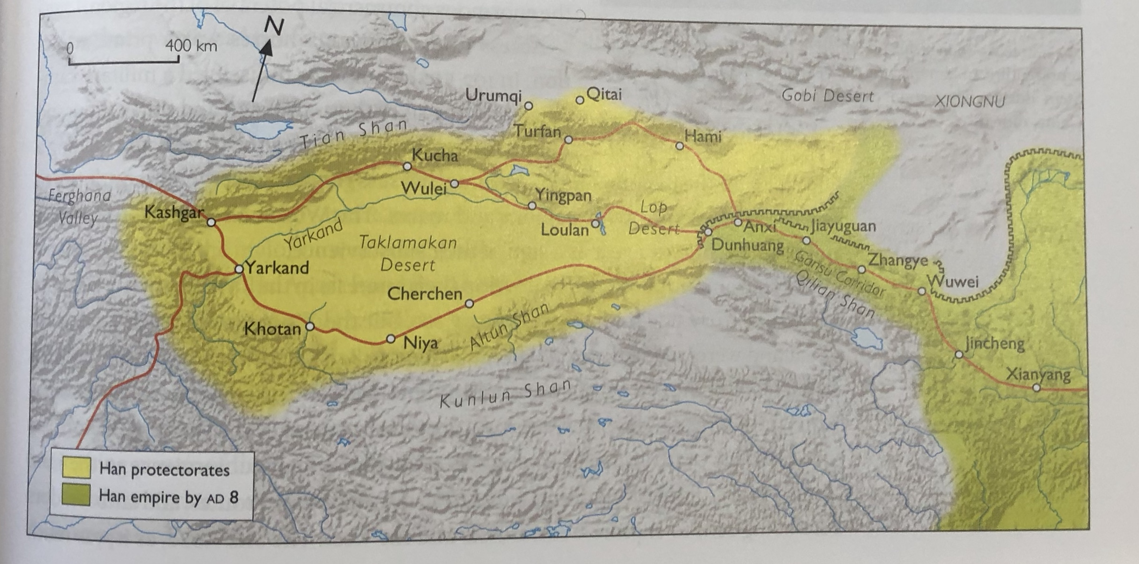

Slide 13
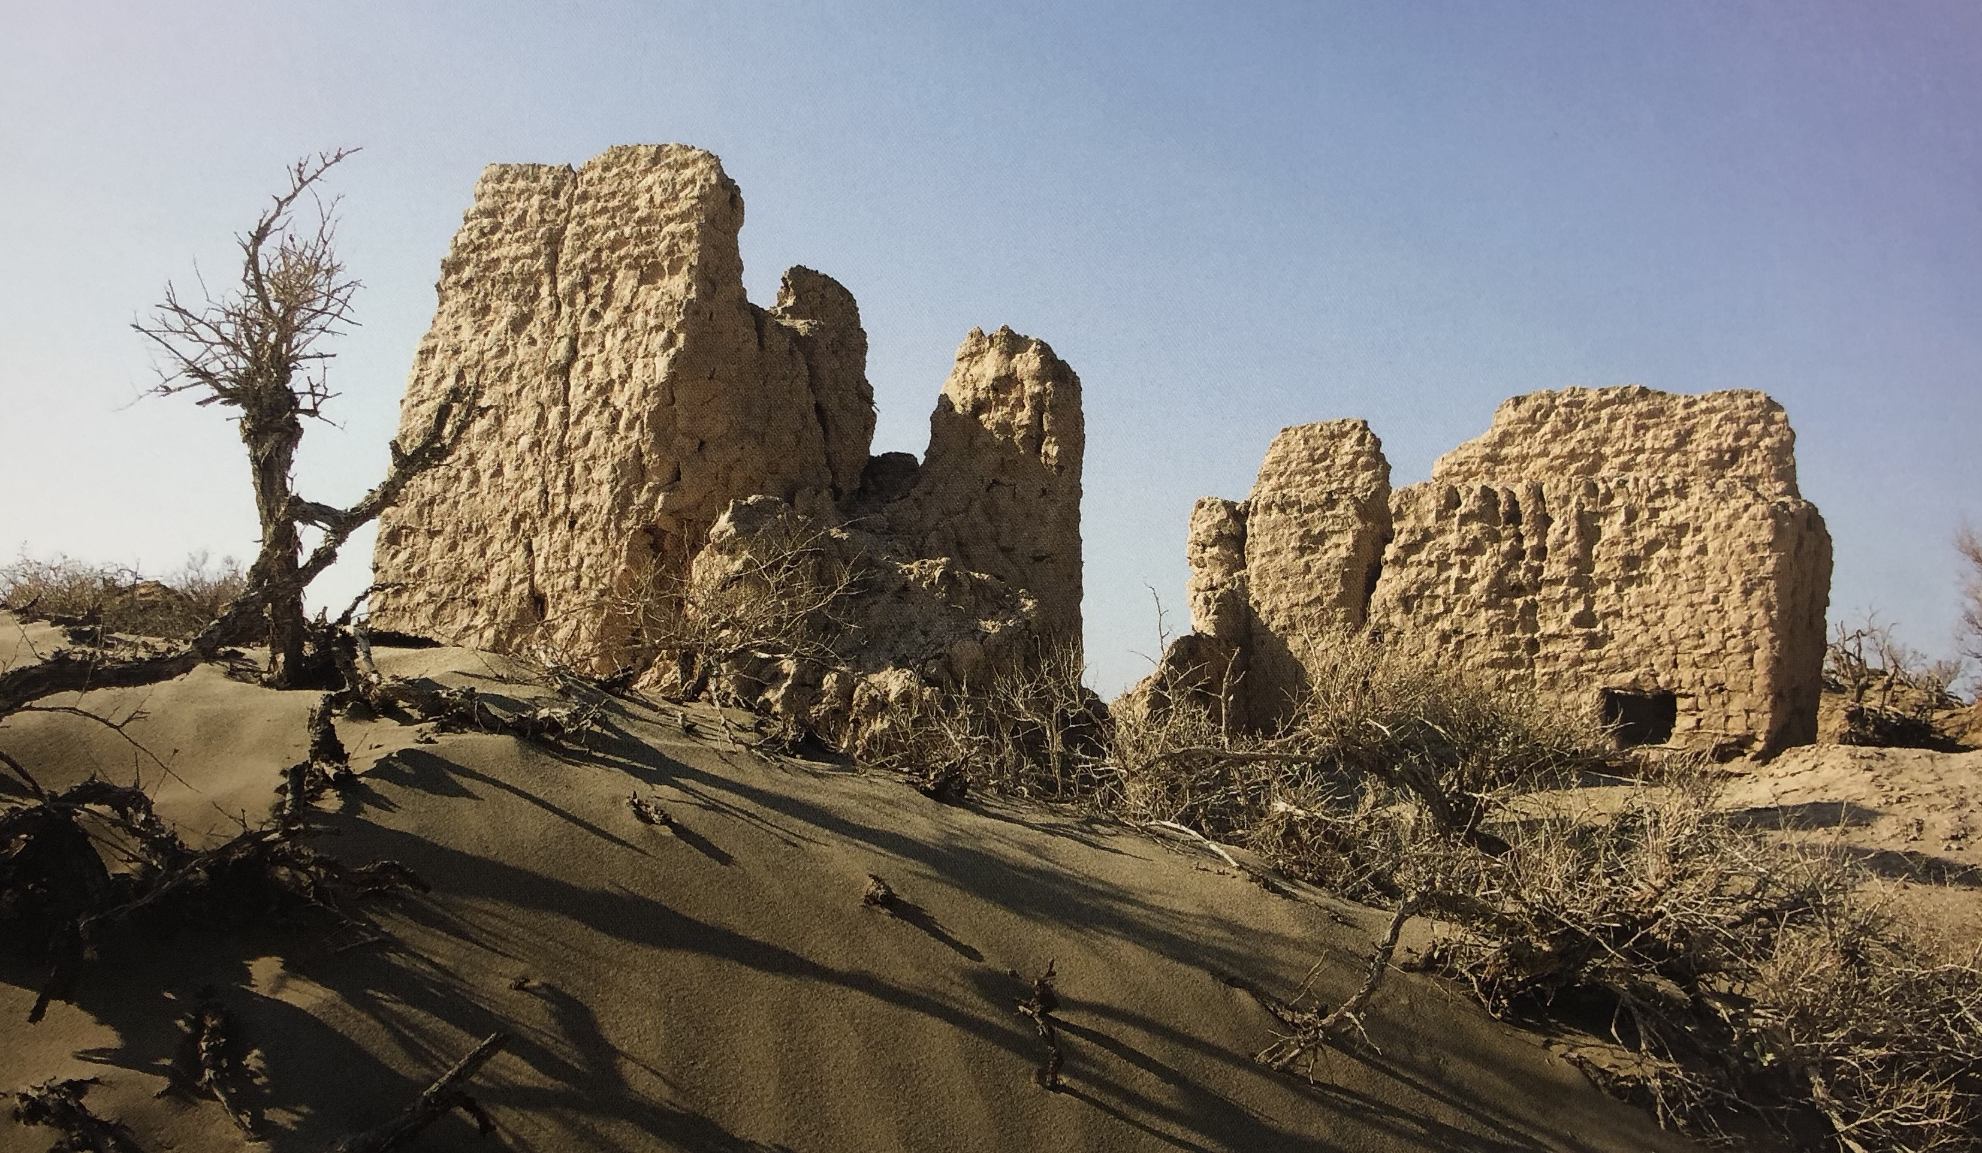
Fort 86 defending the Hexi Corridor

Slide 14
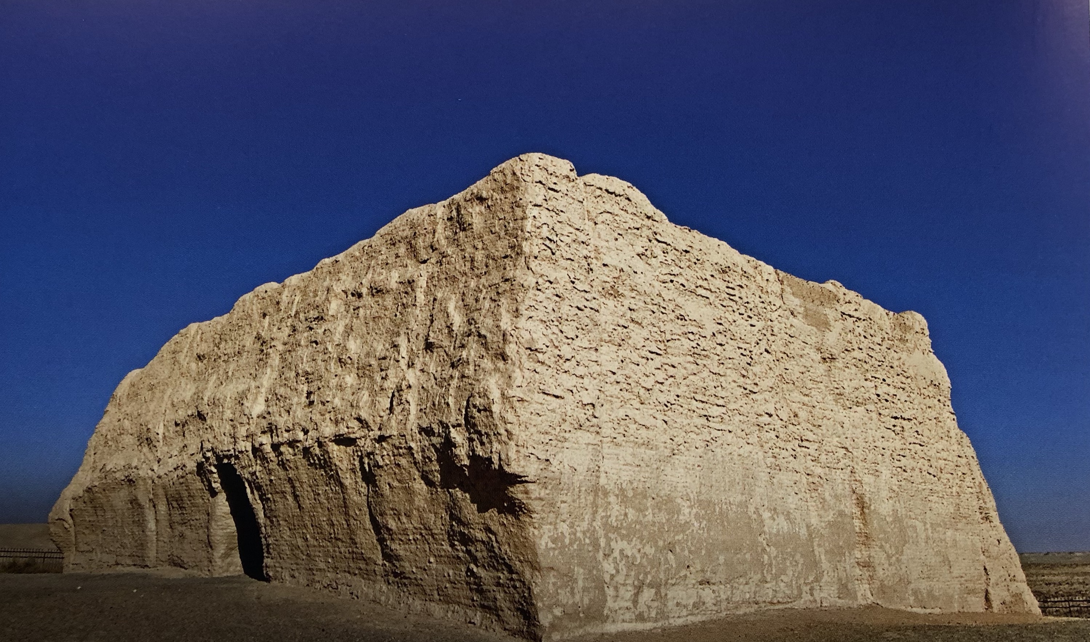
Jade Gate at Dunhuang

Slide 15
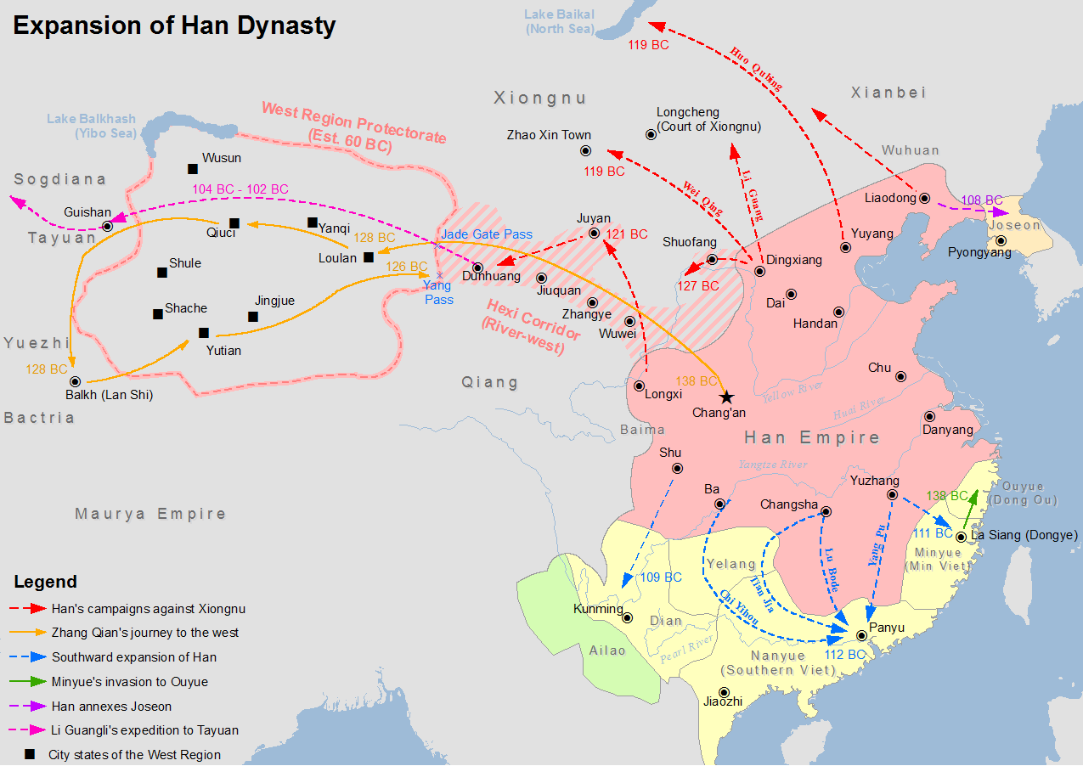

Slide 16
Major advances by Han West
108 BCE: Han campaigns against communities around the Tarim Basin (under General Zhao Ponu)
108-105 BCE: Han receive war horses from the Wusun tribes as part of a marriage alliance Hanshu 96A.
104-102BC: Major campaign against the people of Ferghana to secure access to horses (see Shiji 123 – note especially the way this is also required due to disrespectful ways in which communities have been reacting to previous Han envoys). Led by general Li Guangli - first attempt failed, but later reinforced by Han emperor returned a second time (with force of 180,000) to eventually succeed in their mission.
101 BCE: Li Guangli returns with stallions + 3000 horses: all taller and more muscular than breeds of northern China. Simultaneous adoption of alfalfa (for horses) and grape vine. Key moment in demonstrating ‘reach’ of Han China.
Extension of Chinese wall for 1000 km from Dunhuang into Tarim Basin to reach Kucha.

Slide 18
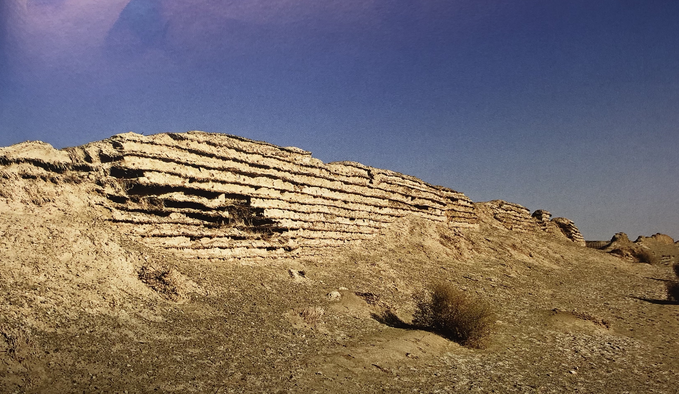
Extension of Han wall from Jade Gate out into Tarim Basin c. 100 BCE.

Slide 19
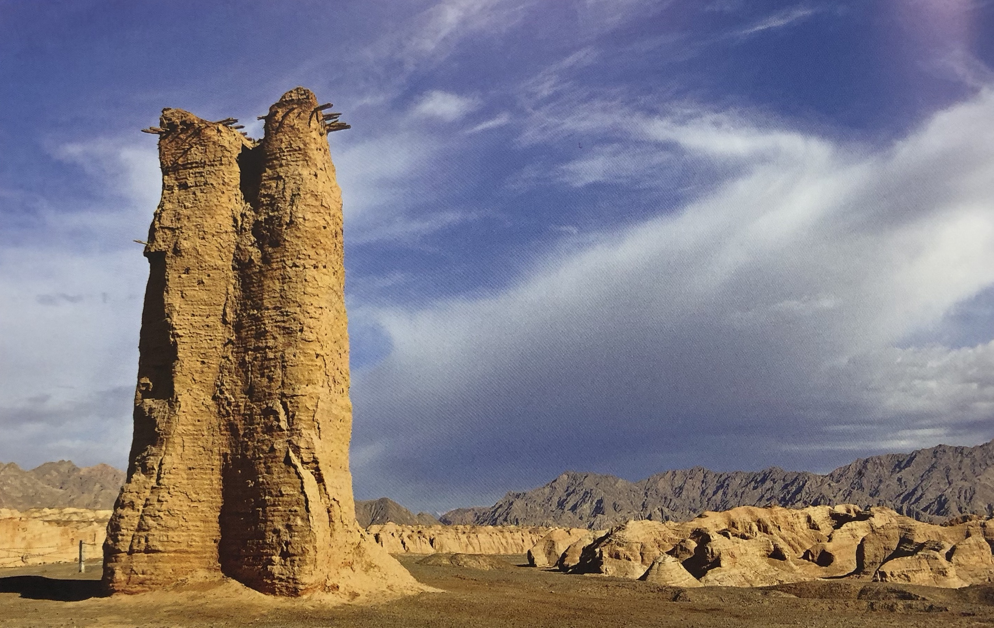
Defensive tower surviving near Kucha from this era of Han Expansion

Slide 20
Massive Chinese territorial expansion: 1.5-1.7 million sq miles of new land added to Han territory. At huge cost – Emperor Wu expressing regret at end of life? Hanshu 96B:5a-b (see also Discourses of Salt and Iron text – on need to establish government monopolies on goods to raise money).
Massive population re-settlement. This would continue into 1st century CE: population of oasis towns around Tarim basin would increase 6 times. Population (and military) invests into agriculture and irrigation projects. These larger communities able to support and enable more frequent trading missions.
Demonstrated extreme reach of Han armies into Ferghana
Motivated by a range of interests and individuals
Leads to on-going Chinese interest in, trading with, ‘the Western Regions’ which they will periodically extend political/military control over.
  See Xuanquan garrison (40 miles east of Dunhuang): 35000 documents discovered (23K wooden slips, 12K bamboo slips). Many of them from period 111 BCE onwards: correspondence among officials stationed there, notice of edicts of emperor, announcements of runaway prisoners, private letters). Note payment to soldiers often in silk.
Parthian embassy comes to see Han Emperor c. 100 BCE: brought gifts for emperor including 5 skilled conjurers from ‘Lijian’ (Egypt?).

Slide 21
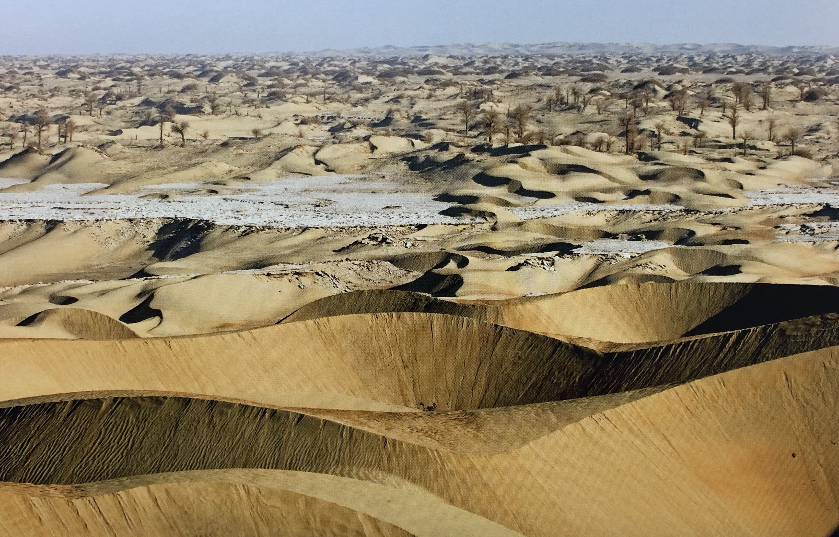
Conditions in the Tarim Basin

