Slide 1
Ancient Global History
Term 1, Week 9

Slide 2
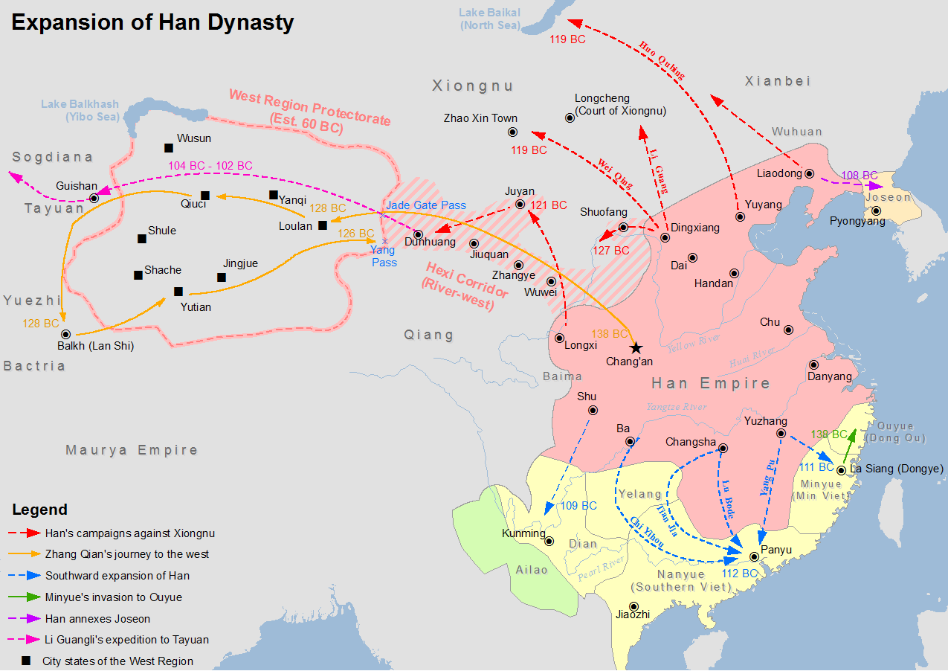

Slide 3
Major advances by Han West
108 BCE: Han campaigns against communities around the Tarim Basin (under General Zhao Ponu)
108-105 BCE: Han receive war horses from the Wusun tribes as part of a marriage alliance Hanshu 96A.
104-102BC: Major campaign against the people of Ferghana to secure access to horses (see Shiji 123 – note especially the way this is also required due to disrespectful ways in which communities have been reacting to previous Han envoys). Led by general Li Guangli - first attempt failed, but later reinforced by Han emperor returned a second time (with force of 180,000) to eventually succeed in their mission.
Parthian embassy comes to see Han Emperor c. 100 BCE: brought gifts for emperor including 5 skilled conjurers from ‘Lijian’ (Egypt?).
101 BCE: Li Guangli returns with stallions + 3000 horses: all taller and more muscular than breeds of northern China. Simultaneous adoption of alfalfa (for horses) and grape vine. Key moment in demonstrating ‘reach’ of Han China.
Extension of Chinese wall for 1000 km from Dunhuang into Tarim Basin to reach Kucha.

Slide 4
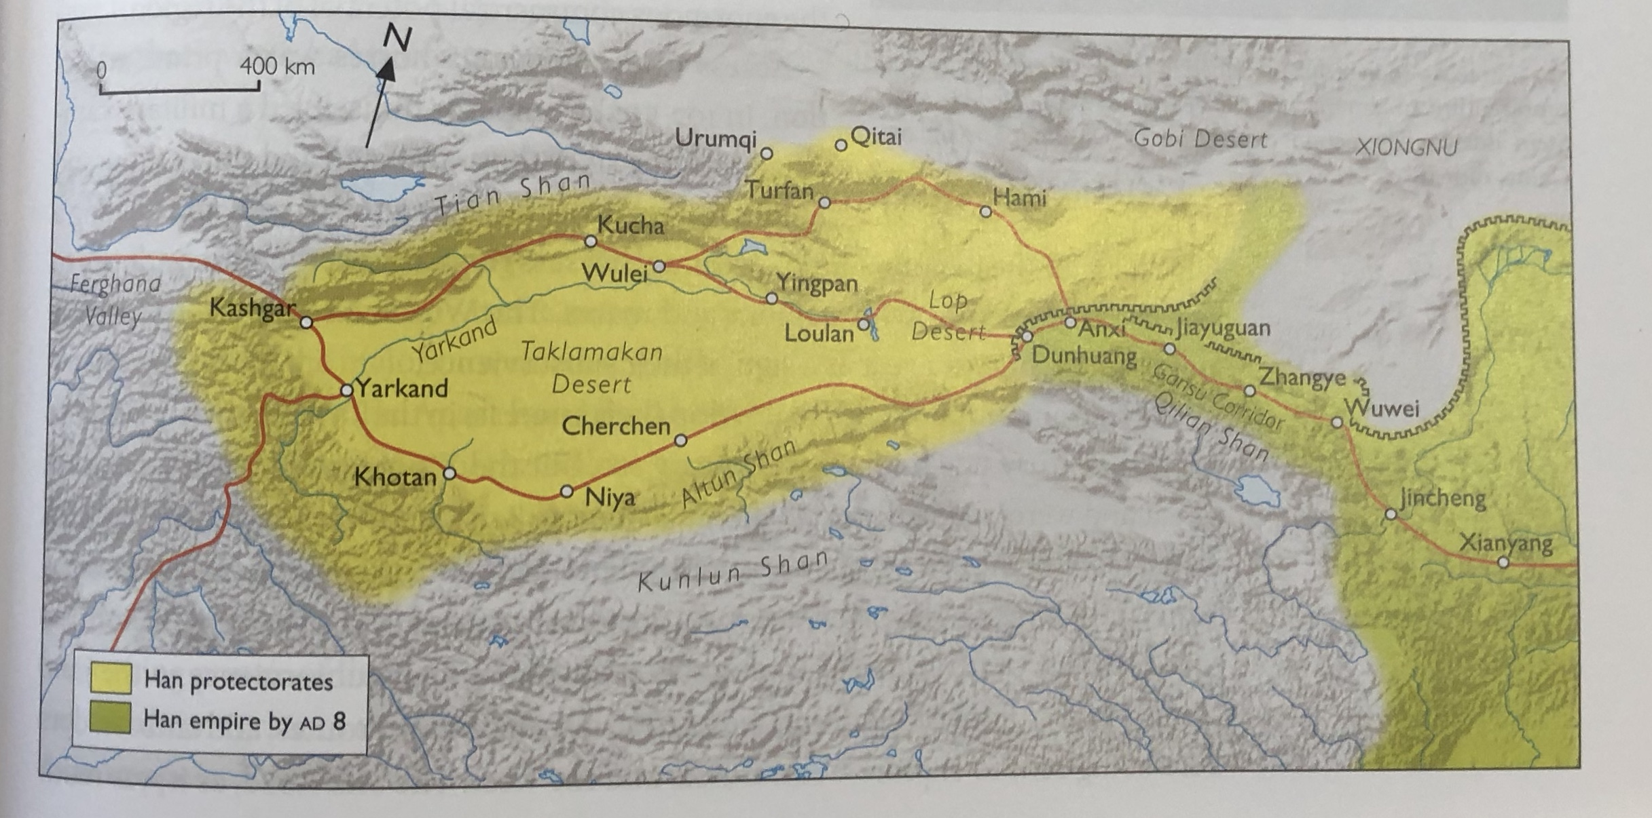

Slide 5
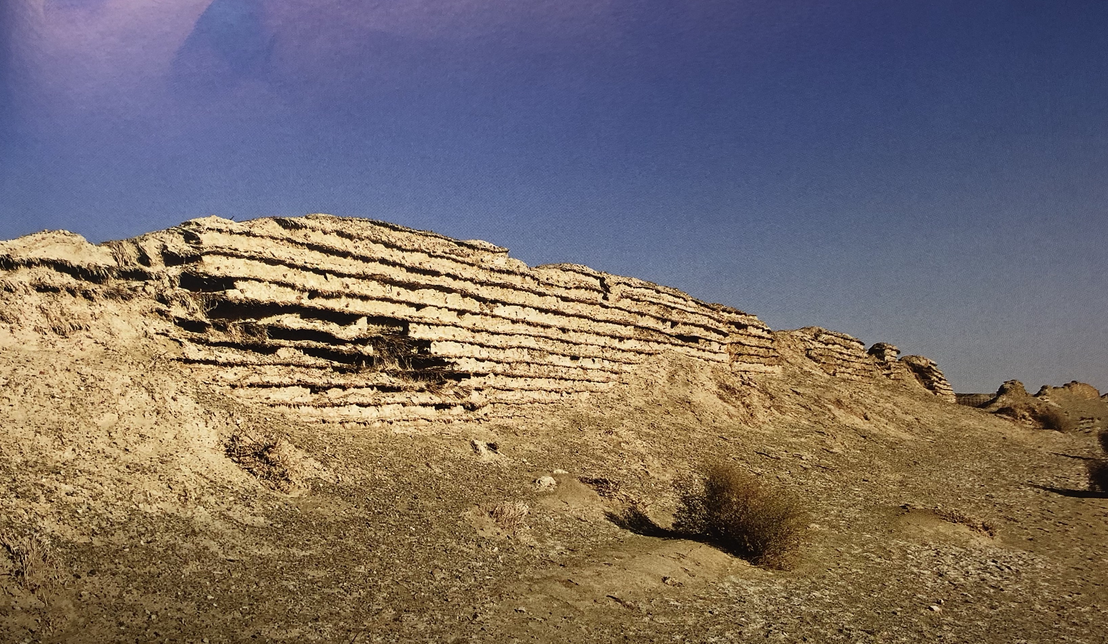
Extension of Han wall from Jade Gate out into Tarim Basin c. 100 BCE.

Slide 6
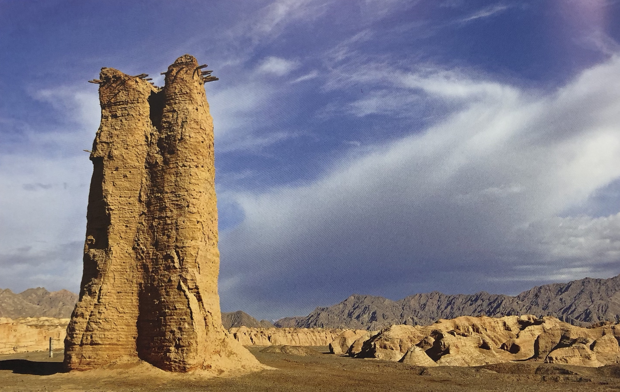
Defensive tower surviving near Kucha from this era of Han Expansion

Slide 7
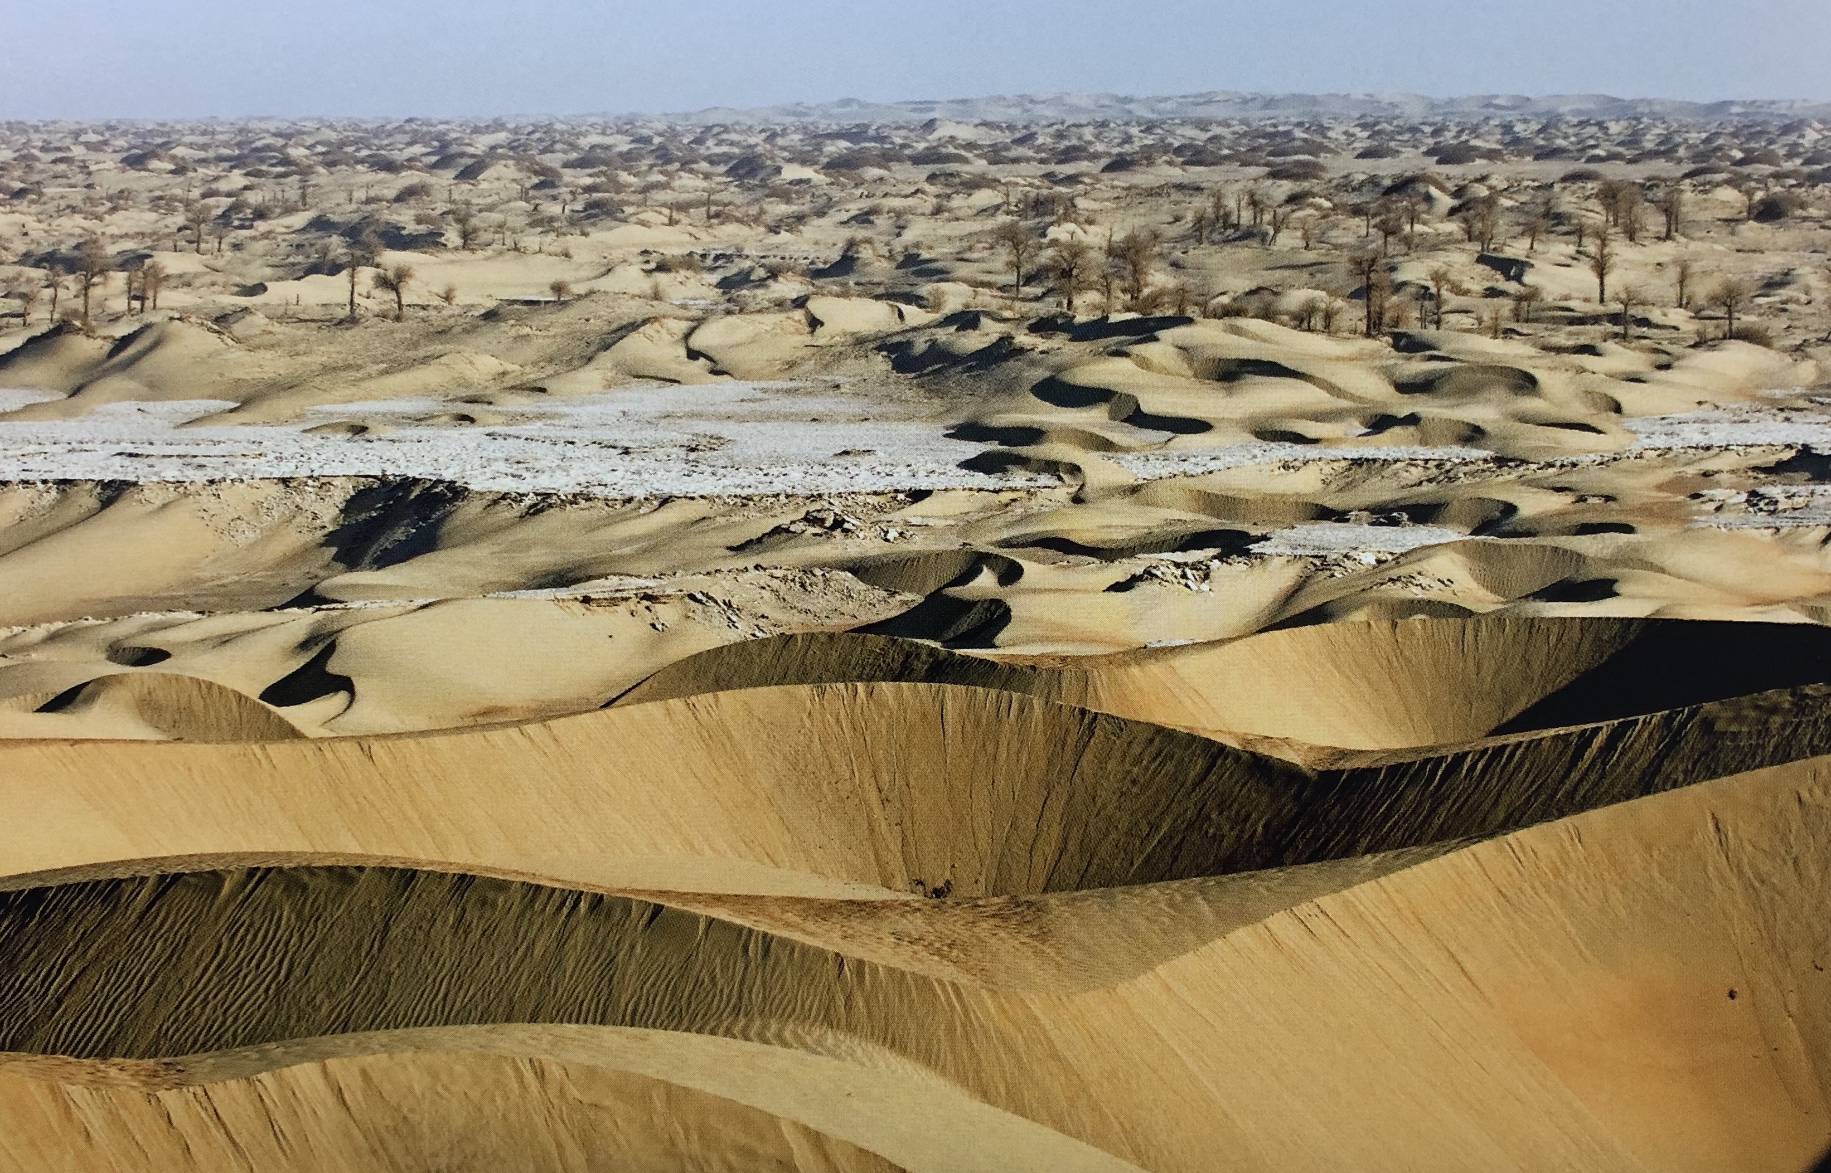
Conditions in the Tarim Basin

Slide 8
Diplomacy (with trade on the side)
Negative first reactions to Han embassies (Sima Qian Shiji)
“That which the official Chinese texts call plunder or want of respect was in reality a form of commercial organization….The first attested commerce in central Asia, owed its structure to the means available to Chinese diplomacy.” G. de la Vaissiere Sogdian Traders. A History 2005.32.
Goods, in particular silk, sent as diplomatic tribute, now found their way into the hands of commercial groups in Central Asia who were intent to use it to gain a profit (remember by 53 BCE the Parthians are unfurling silk banners to scare the Romans at the Battle of Carrhae in modern Iraq – cf Florus Epitome 3.11)

Slide 9
The creation of the ‘Office of the Protector General of the Western Regions
From 110 BCE: Xuanquan garrison (40 miles east of Dunhuang): 35000 documents discovered (23K wooden slips, 12K bamboo slips). Many of them from period 111 BCE onwards: correspondence among officials stationed there, notice of edicts of emperor, announcements of runaway prisoners, private letters). Note payment to soldiers often in silk.
90-87 BCE – Tarim basin community of Turfan made formal vassal submission to Emperor Wu (who dies in 87 BCE). Massive Chinese territorial expansion during his reign: 1.5-1.7 million sq miles of new land added to Han territory. At huge cost – Emperor Wu expressing regret at end of life? Hanshu 96B:5a-b (see also Discourses of Salt and Iron text – on need to establish government monopolies on goods to raise money).
81 BCE, Emperor Zhao establishes a garrisoned agricultural community at Wuwei (HanShu 61/96)
77 BCE – Han try to kill the king of Loulan and replace him with their own choice
60-59 BCE– Emperor Xuan and his court make decision to establish a permanent presence through the Tarim basin.
Office of the Protector General of the Western Regions established, with General Cheng Chi as first ‘Protector General’. Had control over all garrison commanders and watched the neighbouring kingdoms and other Western states.
Meant Han control over both northern and southern routes around the Tarim basin

Slide 11
Reactions to Office of the Protector General
In 59 BCE a Xiongnu prince renounced allegiance to Shanyu and placed himself in the hands of the Protector General
Massive population re-settlement undertaken by Han in Tarim basin. During 1st century CE population of oasis towns around Tarim basin would increase 6 times. Oasis of Khotan goes from 3,300 households to 32,000 households. Population (and military) invests into agriculture and irrigation projects. These larger communities able to support and enable more frequent trading missions.
Presence of Chinese ‘advisers’ in areas where no military presence. E.g. surviving documents from Niya oasis show the court has adopted the Chinese tradition of attaching little wooden slips to gifts with namer of giver and recipient.
Split in Xiongnu between Southern and Northern Xiongnu – Southern Xiongnu offer submission to Han court and receive gifts in return (shanyu came to Han court in person in 51 BCE). The ‘tributary system’ – still incredibly expensive for the Han (increasing amount of gifts given each year)

Slide 12
1st century CE: a loss of influence
3BCE: Han court consider turning down an offer of homage as expense of giving the gifts in return would be too much (although eventually decide to go ahead due to political necessity: Hanshu 94B:6b-8a.
Peak of tributary payments came in 1 BCE: Southern Xiongnu leader sought to bring 500 followers with him to pay homage at Han court.
At collapse of Former Han (9 CE) and during interregnum till establishment of later Han, Han lost control of the Tarim basin. Xiongnu not only reunited but stepped back in during this period to control much of the Western Regions.
In 45 CE Later Han emperor refused to enlarge tributary system again – declined offer of 18 states of Western Regions to send hostages to China. “We are not able at the moment to send out envoys and Imperial troops so… each Kingdom [should seek help] as they please, wherever they can, to the east, west, south or north’ (Hou Hanshu 48:8b)
In 47 CE, the Xiongnu once again broke into Southern and Northern, with Southern once again by 50 CE pledging submission to Later Han and re-entering tributary system.
Start of a process in which a number of nomadic groups submitted to Han in return for payments and gifts as part of the Tributary system (e.g. Hsien-Pi and Wu-huan). Although some tribes like Hsien-Pi leave tributary system again between 91-110 CE.
We hear about Western Regions in this period from Chronicle of the Western Regions (part of the Hou Hanshu) – the report of Ban Yong to the Chinese Emperor c. 125 CE.

Slide 13
From 75 CE, Later Han (Emperor Ming) re-establish military control under general Ban Chao –who maintained peace for 3 decades.
94 CE Ban Chao led military expedition against Tarim basin kingdom of Karashahr (joined by several hundred thousand Chinese merchants) Hou Hanshu 77.4
Ban Chao asked by his brother (Ban Gu) to acquire rare Western Goods while on campaign because of the prices they would fetch in China.
97 CE Ban Chao – sent a chief ambassador Gan Ying to reach the Roman Empire. Made it to Persian Gulf/ Tiaozhi area (Hou Hanshu 88.10) But encouraged to turn around by traders in area of Mesene “There is something in this sea which makes a person long for home and many men have lost their lives on it, for a man may surely die from homesickness. Appreciating all this, Gan Ying did not go any further” Ban Chao as a result concluded that Rome too far away to be of any assistance in China’s battles in Central Asia and no further embassies were dispatched.
Son of Ban Chao, Ban Yong, succeeded him as commander and maintained control through 120s CE – winning acknowledgement of the China’s supremacy from 36 states of the West (a symbolic concept in Chinese world vision).
But after this Han control weakened: in 175 CE Han withdrew its administrators and soldiers and in 185 CE it even gave up official command of the Gansu corridor.
Oases states matured into stable independent caravan cities. Trade now part of their nature and reason/method for existence.

Slide 14
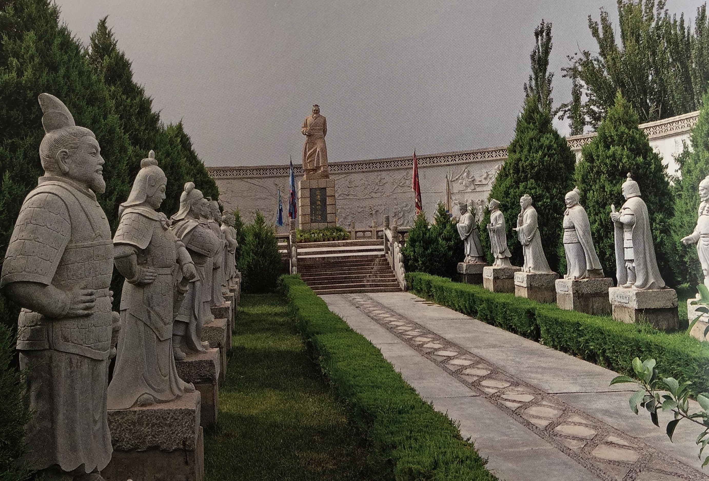
Monument to Ban Chao in Kashgar, Xinjiang, China

Slide 15
Compare to 1st century CE – development of monsoon wind knowledge (Periplus) – Romans getting to India.
Also King of Shan (modern Burma) sending tribute to Han court in 94, 97 and 120 CE – development of India-Burma-Yunnan trade route (finally).
Yuezhi develop as Kushan kingdom covering Bactria and India.
In-depth knowledge and interest in goods from West in Chinese sources:
  Chronicle of the Western Regions (part of the Hou Hanshu) – the report of Ban Yong to the Chinese Emperor c. 125 CE. But also covers what they know about peoples to the West (and their goods / interests)
  Weilue ‘Peoples of the West’ – composed 239-265 CE
  Both the focus of our first seminar next term.

Slide 16
