Slide 1
Ancient Global History
Term 1, Week 4

Slide 2
India
Indus Valley Civilisation (3300-1300 BCE)
Major excavations at Harappa and Mohenjo-daro.
Harappa:
2300-1750 BCE
3.5 miles in circumference
City walls of brick (40 feet thick at base)
Supporting system of granaries outside the citadel (feed a population of c. 35K)
Workers quarters also found
No names preserved of rulers but likely to have been a priest-king
Mohenjo-daro:
10 cities built on top of one another (west bank of Indus)
Walled citadel with imposing buildings (built by same planners as Harappa due to same standardized brick used)
Larger settlement extending outside the citadel – standardized streets and blocks (central authority led building?)
Indus civilization now represented at over 70 sites (0.5 million sq miles of Punjab and Sind). Trading with Sumerians (2300-2000 BCE) – especially trade in Indian cloth.

Slide 3
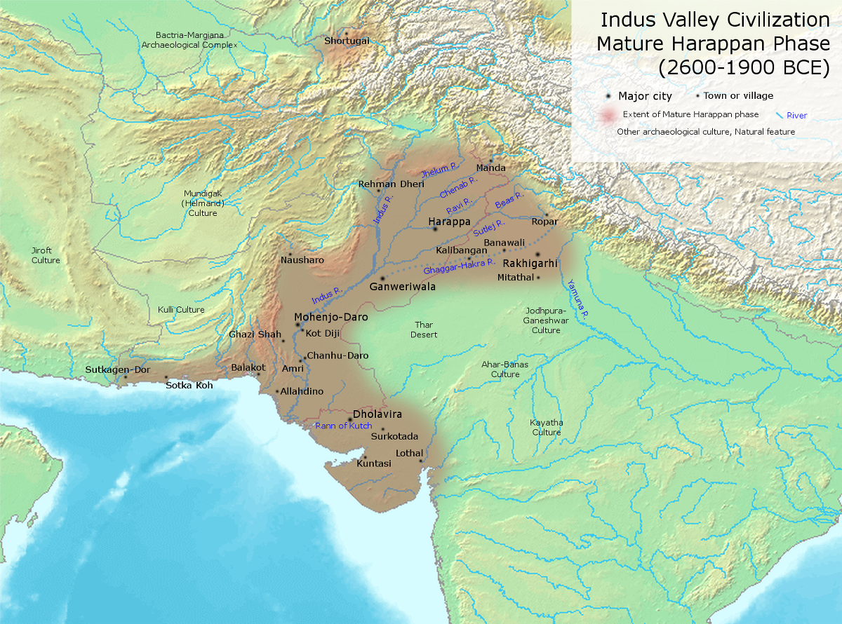

Slide 4
Major advances of nomads from the region between Black Sea and Caucuses south from around 2000 BCE. Split into different groups and settled in different regions (e.g. Hittites in Western Asia). By 1500 BCE a group of these settlers had pushed over Hindu Kush and into India (so called ‘Aryan age’)
No real archaeological evidence from this period 1500-1000 BCE.
But some sense of its from earliest religious ‘books of knowledge’ of Vedas. Earliest: Rig Veda (‘Verses of knowledge’) – 1017 Sanskrit poems addressed to various Aryan gods. Written down completely c. 600 BCE, but earliest surviving text c. 1200 BCE (world’s earliest surviving Indo-European Literature).
Aryans lived in tribal villages with migrant herds (as opposed to walled cities of Indus civilization) – waging war against surviving fortified communities.
Land they occupied known as ‘Land of the Seven Rivers’: the area of the Punjab.

Slide 5
The Vedas and Indian Society
Rig Veda (1400-1200 BCE)
Mahabharata (c. 1000 BCE)
Ramayana (500 BCE)
Growing importance of Kingship (and male dominance at every level of society)
Societal Divisions

Slide 6
Rigveda
HYMN I. Agni.
1 I Laud Agni, the chosen Priest, God, minister of sacrifice, The hotar, lavishest of wealth. 2 Worthy is Agni to be praised by living as by ancient seers. He shall bring hitherward the Gods. 3 Through Agni man obtaineth wealth, yea, plenty waxing day by day, Most rich in heroes, glorious. 4 Agni, the perfect sacrifice which thou encompassest about Verily goeth to the Gods. 5 May Agni, sapient-minded Priest, truthful, most gloriously great, The God, come hither with the Gods. 6 Whatever blessing, Agni, thou wilt grant unto thy worshipper, That, Aṅgiras, is indeed thy truth. 7 To thee, dispeller of the night, O Agni, day by day with prayer Bringing thee reverence, we come 8 Ruler of sacrifices, guard of Law eternal, radiant One, Increasing in thine own abode. 9 Be to us easy of approach, even as a father to his son: Agni, be with us for our weal.

Slide 7
Vedic (early Hindu) religion and social organisation
Society in this period slowly evolved to develop a system of ‘varnas’
Brahmins: priests, scholars and teachers
Kshatriyas: rulers, warriors and administrators
Vaishya: agriculturalists and merchants
Shudras: laborers and service providers
Said to emerge from Hymn 10.90 of the Rigveda: Purusa the ‘Cosmic Being’
Huge power for connection with divine held by Brahmin group – only through them (and their ritual) can divine be accessed

Slide 8
Rigveda 10.90
1. A THOUSAND heads hath Puruṣa, a thousand eyes, a thousand feet. On every side pervading earth he fills a space ten fingers wide. 2 This Puruṣa is all that yet hath been and all that is to be; The Lord of Immortality which waxes greater still by food. 3 So mighty is his greatness; yea, greater than this is Puruṣa. All creatures are one-fourth of him, three-fourths eternal life in heaven. 4 With three-fourths Puruṣa went up: one-fourth of him again was here. Thence he strode out to every side over what cats not and what cats. 5 From him Virāj was born; again Puruṣa from Virāj was born. As soon as he was born he spread eastward and westward o’er the earth. 6 When Gods prepared the sacrifice with Puruṣa as their offering, Its oil was spring, the holy gift was autumn; summer was the wood. 7 They balmed as victim on the grass Puruṣa born in earliest time. With him the Deities and all Sādhyas and Ṛṣis sacrificed. 8 From that great general sacrifice the dripping fat was gathered up. He formed the creatures of-the air, and animals both wild and tame. 9 From that great general sacrifice Ṛcas and Sāma-hymns were born: Therefrom were spells and charms produced; the Yajus had its birth from it. 10 From it were horses born, from it all cattle with two rows of teeth: From it were generated kine, from it the goats and sheep were born. 11 When they divided Puruṣa how many portions did they make? What do they call his mouth, his arms? What do they call his thighs and feet? 12 The Brahman was his mouth, of both his arms was the Rājanya made. His thighs became the Vaiśya, from his feet the Śūdra was produced. 13 The Moon was gendered from his mind, and from his eye the Sun had birth; Indra and Agni from his mouth were born, and Vāyu from his breath. 14 Forth from his navel came mid-air the sky was fashioned from his head Earth from his feet, and from his car the regions. Thus they formed the worlds. 15 Seven fencing-sticks had he, thrice seven layers of fuel were prepared, When the Gods, offering sacrifice, bound, as their victim, Puruṣa. 16 Gods, sacrificing, sacrificed the victim these were the earliest holy ordinances. The Mighty Ones attained the height of heaven, there where the Sādhyas, Gods of old, are dwelling.

Slide 9
The age of the Buddha
C. 563 BCE Sidhartha Gautama, the Buddha ‘enlightened one’ raised in Kapilavastu.
By this time later Buddhist sources talk of 16 major kingdoms and tribal oligarchies in North India
Buddha rejected the brahmans’ pretentions to inherited piety and innate religious connection to the divine. Instead he argued everyone could achieve that connection via enlightenment (first sermon c. 527BCE).
Development also in this period of Jainism – central doctrine that all nature is alive and everything has a soul. Crucial importance of nonviolence.
This religious challenge to central authority, combined with the emergence of cities and towns again, wider and stronger communication and trade, led to a more fraught atmosphere of warring kingdoms and tribes.
Note also in this period engagement with Achaemenid empire: Gandharan region of India’s northwest (capital Taxila) under Persian control from 518 BCE. India had to pay annual tribute in gold dust to Persia. Influence of Achaemenid religions (e.g. Zoroastrianism also infiltrating into Indian society at this time)

Slide 10
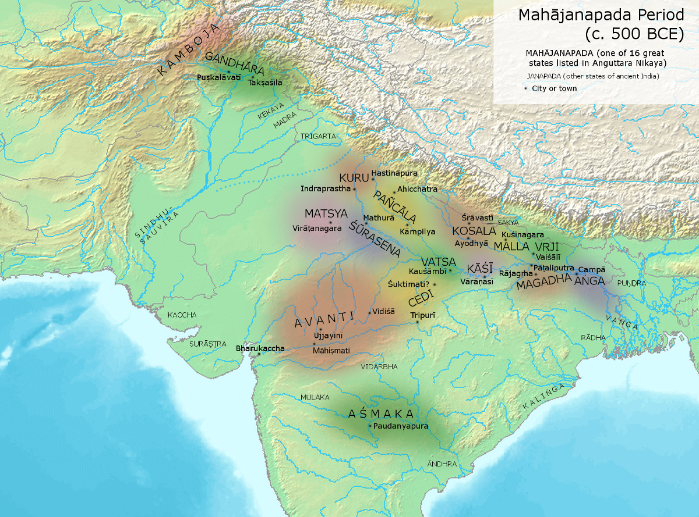

Slide 11
Buddha
A prince who left his palace + home to live as a life of meditation
Seeking a ‘Middle Way’ between extreme aestheticism and indulgence.
At age of 35, having meditated underneath a Bodhi tree for 49 days, he found Enlightenment.
According to some Buddhist texts, as a result, he found release from the eternal cycle of rebirth – reaching Nirvana, a state without desire, hatred or ignorance.
He spent the next 45 years teaching the path to Enlightenment, and also created the first sangha – Buddhist monastery.

Slide 12
Mauryan Empire (326-184 BCE)
Magadha as one of the strongest of the competing kingdoms of the Gangetic plain (thanks in no small part to wide scale trade from 5th century BCE)
King Chandragupta Maurya (324-301 BCE) – in response to invasions of Alexander the Great to Indus/Beas rivers in 326 BCE – took opportunity for conquest and unification of north India under his rule: the Mauryan Empire.
Chandragupta’s rise aided by brahman aide Kautilya who wrote the Arthashastra (‘Science of Material Gain’) – Indian version of Machiavelli’s Prince: what does a king need to be, importance of spying (see TEXT)
Mauryan king claimed ¼ of value of all crops raised through his domain.
Chandragupta conquered the Nanda Monarchs and took over their capital as his own: Pataliputra (cf to Megasthenes -TEXT).
305 BCE Chandragupta agreed deal with Seleucos over border of Mauryan/Seleucid empires at Hindu Kush mountains (with elephants/ marriage/ ambassadors)

Slide 13
Mauryan Empire
Divided into districts, each administered by general/member of royal family.
Army: 600,000 infantry, 30000 cavalry, 8000 chariots, 9000 elephants.
Foreign policy: ‘mandala’ ‘circle: 12 concentric rings with Mauryan empire at middle. First circle outwards was ‘of the enemy’, and next circle ‘ of the friend’ alternating outwards to the final one ‘the neutral king’. Key idea was to ensure that the intermediate monarch did not ally with his enemies (and thus lead to destabilization).
Chandragupta abdicated his throne in 301 BCE to become a Jain monk. Son Bindusara took the throne. He requested of Antiochus I Greek wine, figs and a Sophist. Antiochus sent first 2, but not Sophist. Also expanded Mauryan kingdom south of the Vindhyas.

Slide 14
Ashoka (269-232 BCE)
Clearest insight into him as rulers thanks to the ‘Ashoka Edicts’ – carved into stone and erected (Persian style) throughout the limits of the empire.
5000 words carved on 18 rocks and 30 pillars (10 of which are still standing). Earliest Indian writing to be deciphered (Brahmi script) – with some in NW of empire also written in Karoshthi script.
Initial Invasion and conquest of tribal kingdom of Kalinga to south.
Followed by royal policy of peace and nonviolence
Ashoka converts to Buddhism (although continued to warn outsiders that Ashoka would do what is necessary to ensure ‘safety and happiness of all’
Empire claimed revenue from Kashmir to Mysore, from Bangladesh to heart of Afghanistan. Only 3 kingdoms to south (Kerala, Chola, Pandya) remained independent to the south, as well as Sri Lanka.
Ashoka hailed as chakravartin (‘he for whom the wheel of the law turns’) – universal emperor of India.
250-240 BCE Ashoka hosted the 3 Great Council of Buddhism at Pataliputra (Asia’s foremost centre of art and culture). Erected 84000 stupas (Buddhist reliquary mounds)
Following his death, Mauryan Empire starts to fall apart - economic and spiritual decline with multiple rulers contesting the throne.

Slide 15
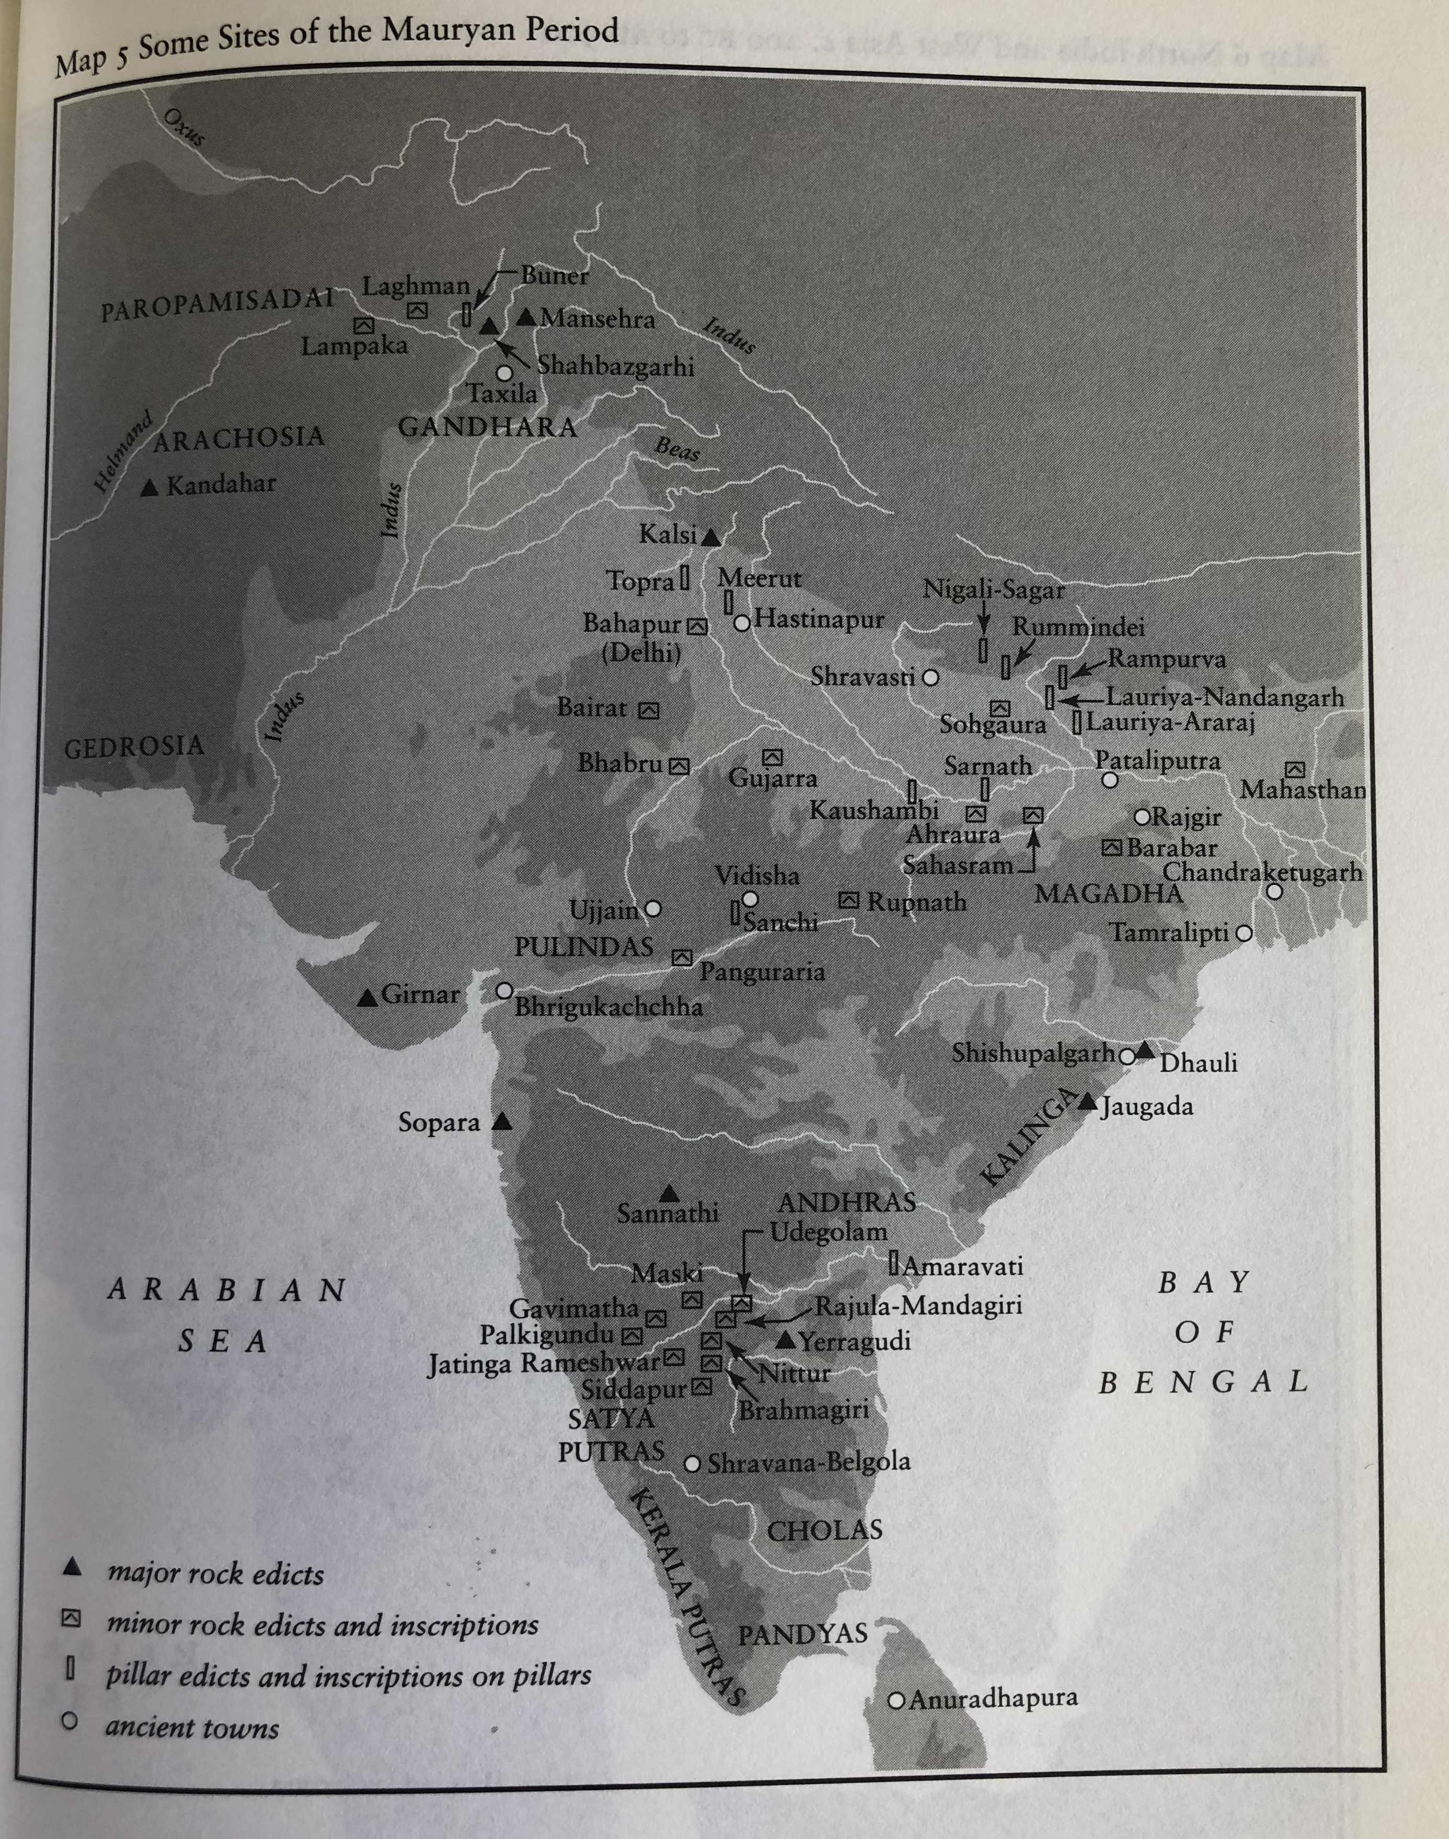
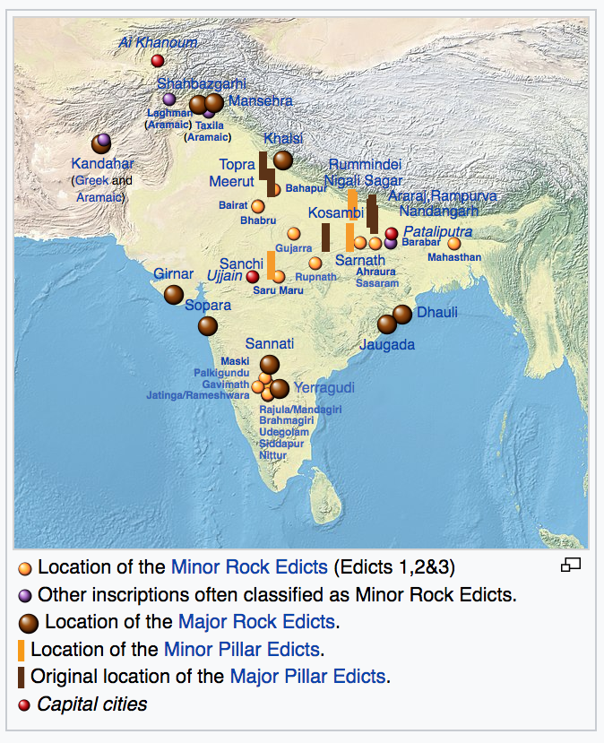

Slide 16
The Edicts are divided into four categories, according to their size (Minor or Major) and according to their medium (Rock or Pillar). Chronologically, the minor inscriptions tend to precede the larger ones, while rock inscriptions generally seem to have been started earlier than the pillar inscriptions:
Minor Rock Edicts (inscribed at beginning of reign (Prakrit, Greek, Aramaic)
Minor Pillar Edicts (in Prakrit)
Major Rock Edicts (14 in Prakrit and Greek)
Major Pillar Edicts (7 in Prakrit – inscribed at end of reign)

Slide 17
Kandahar Bilingual Rock Inscription - first Edict of Ashoka 260 BCE. Written in Greek and Aramaic
Ten years (of reign) having been completed, King
Piodasses (Ashoka) made known (the doctrine of)
Piety (Eusebeia / Dharma) to men; and from this moment he has made
men more pious, and everything thrives throughout
the whole world. And the king abstains from (killing)
living beings, and other men and those who (are)
huntsmen and fishermen of the king have desisted
from hunting. And if some (were) intemperate, they
have ceased from their intemperance as was in their
power; and obedient to their father and mother and to
the elders, in opposition to the past also in the future,
by so acting on every occasion, they will live better
and more happily.”
Ten years having passed (?). It so happened (?) that our lord, king Priyadasin, became the institutor of Truth,
Since then, evil diminished among all men and all misfortunes (?) lie caused to disappear; and [there is] peace as well as joy in the whole earth.
And, moreover, [there is] this in regard to food: for our lord, the king, [only] a few [animals] are killed; having seen this, all men have given up [the slaughter of animals]; even (?) those men who catch fish (i.e. the fishermen) are subject to prohibition.
Similarly, those who were without restraint have ceased to be without restraint.
And obedience to mother and to father and to old men [reigns] in conformity with the obligations imposed by fate on each [person].
And there is no Judgement for all the pious men,
This [i.e. the practice of Law] has been profitable to all men and will be more profitable [in future]

Slide 18
Political Fragmentation 184 BCE-320 CE
For the next 5 centuries, India was fragmented politically.
Greco-Bactrian invasions:
From 190 BCE G-B invaded Peshawar + took entire Punjab under their control from 180s BCE.
Eucratides moved his capital from Kabul Valley to Taxila – dominating region of Gandhara.
One of these monarchs, ruling Punjab from capital at Sagala around 150 BCE converted to Buddhism. See Milindapanho ‘Questions of Milinda’ (Menander). Key Buddhist Text that we find in China…
Continuation of erection of columns to confirm victories: e.g. Garuda Pillar at Besnagar.
The Kings based south of the Hindu Kush often referred to in their own right as ‘Indo-Greek Kingdoms’ – warring polities at their height in the last two centuries BCE.

Slide 19
Questions of Menander
Background History
Questions on Distinguishing Characteristics : (Characteristics of Attention and Wisdom, Characteristic of Wisdom, Characteristic of Contact, Characteristic of Feeling, Characteristic of Perception, Characteristic of Volition, Characteristic of Consciousness, Characteristic of Applied Thought, Characteristic of Sustained Thought, etc.)
Questions for the Cutting Off of Perplexity : (Transmigration and Rebirth, The Soul, Non-Release From Evil Deeds, Simultaneous Arising in Different Places, Doing Evil Knowingly and Unknowingly, etc.)
Questions on Dilemmas : Speaks of several puzzles and these puzzles were distributed in eighty-two dilemmas.
A Question Solved By Inference
Discusses the Special Qualities of Asceticism
Questions on Talk of Similes

Slide 20
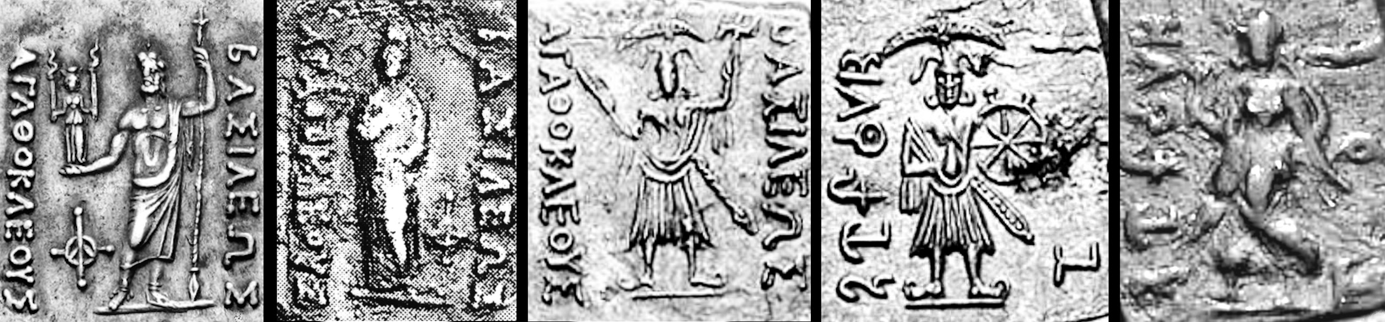
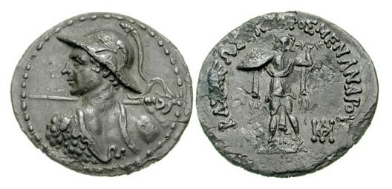
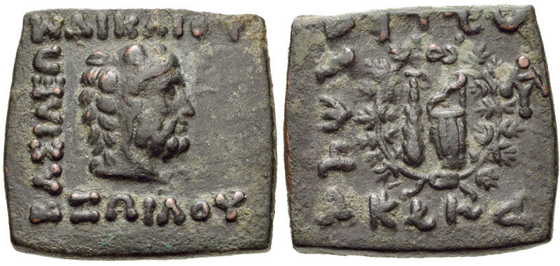
Indo-Greek Kings
First Bilingual Indian-Greek coins struck by Agathocles (found at Taxila (185-170 BCE)
Coins on Menander I found as far east as Punjab (165-55 BCE)
Coin of Zoilos I (130–120 BC) showing on the reverse the Heraklean club club with the Scythian bow, inside a victory wreath

Slide 21
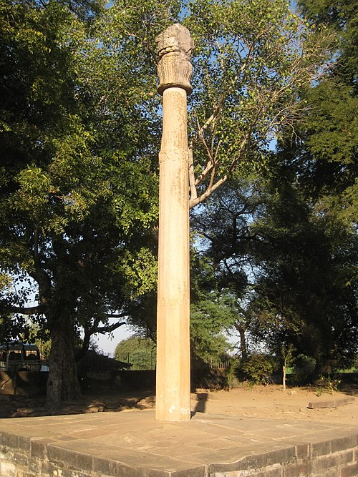
Interactions with Indian Communities
It is around this time, in 115 BC, that the embassy of Heliodorus, from King Antialkidas of Taxila to the court of the Sunga king Bhagabhadra in Vidisha. Heliodorus established a pillar in dedication to Vasudeva
“This Garuda-standard of Vasudeva, the God of Gods was erected here by the devotee Heliodoros, the son of Dion, a man of Taxila, sent by the Great Yona King Antialkidas, as ambassador to King Kasiputra Bhagabhadra, the Savior son of the princess from Varanasi, in the fourteenth year of his reign."[“

Slide 22
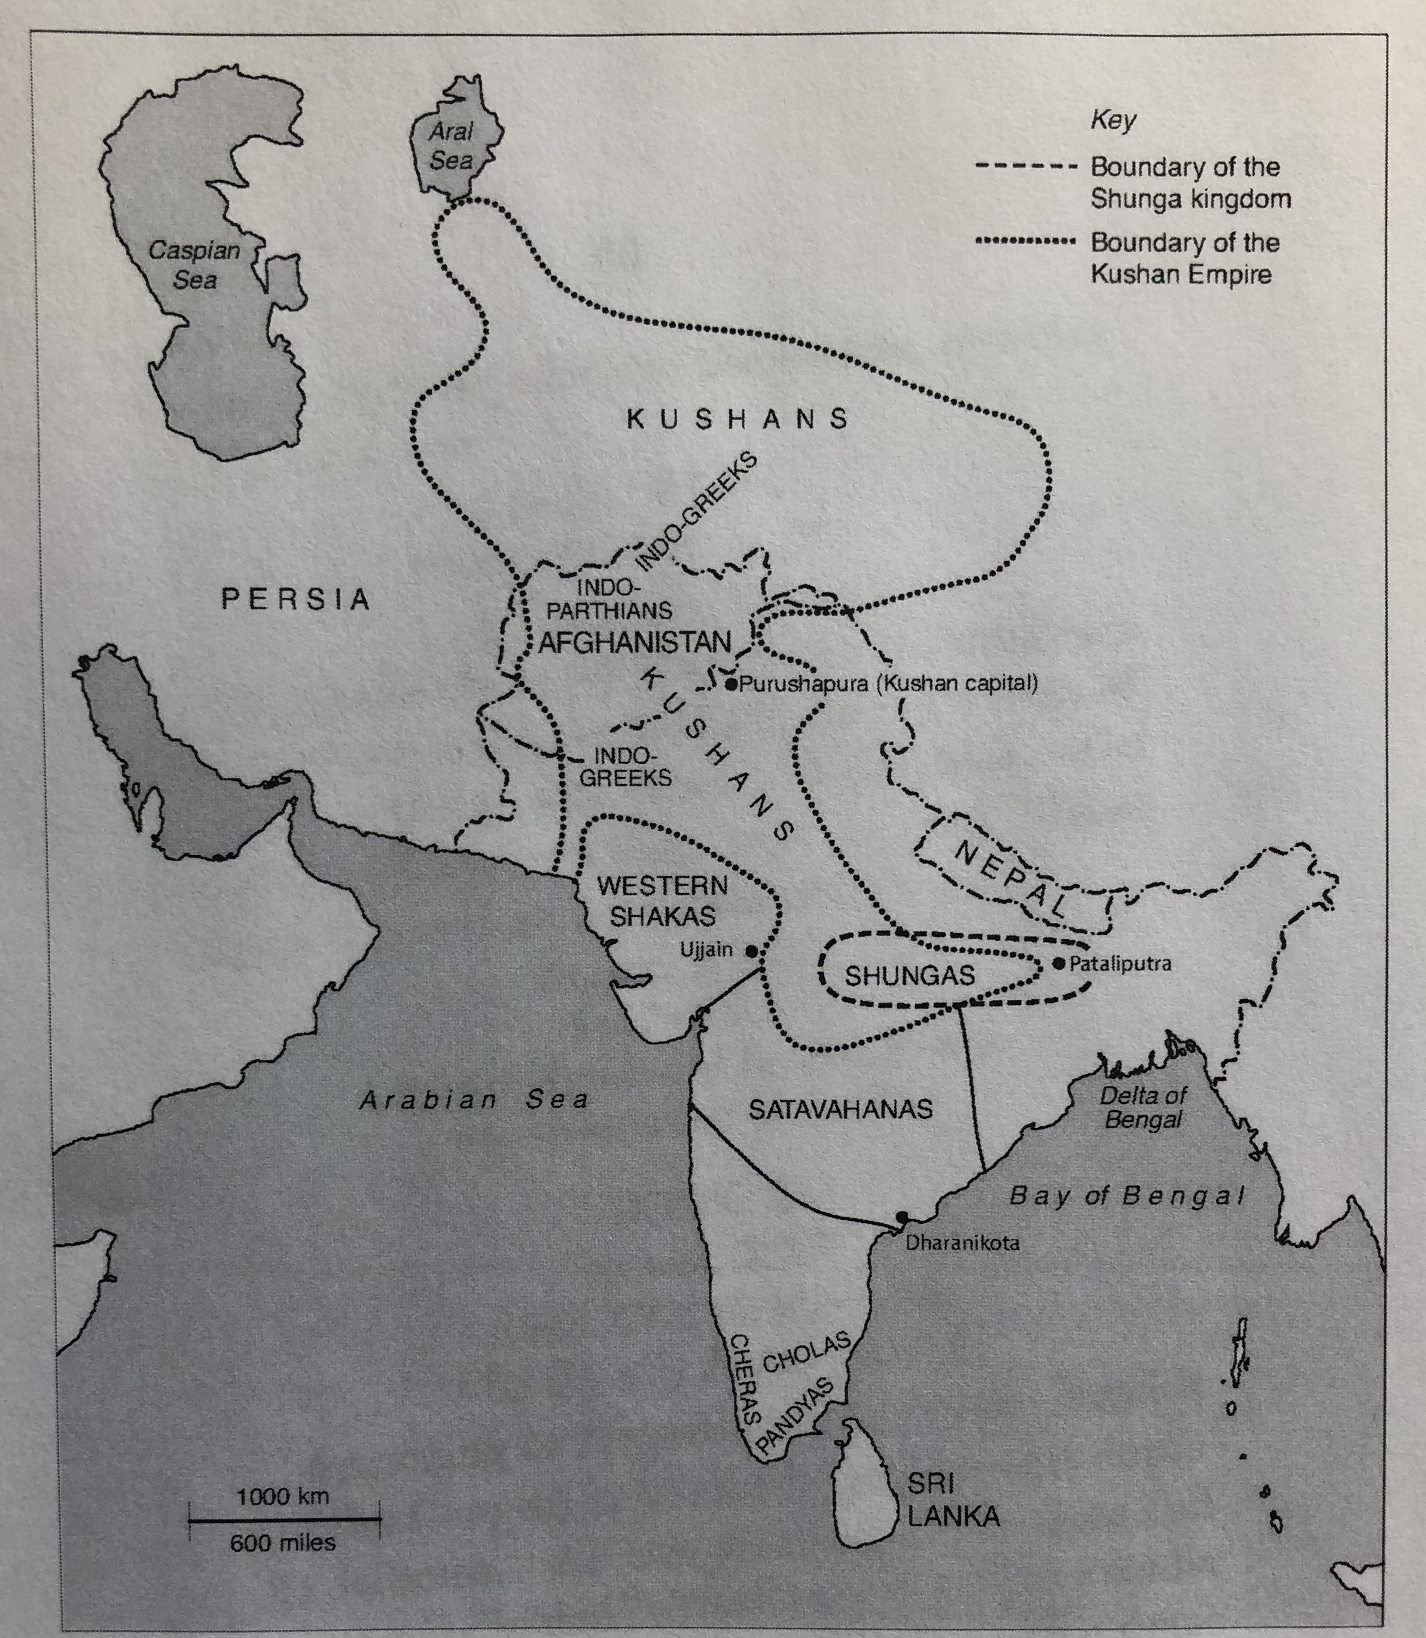
MAP

Slide 23
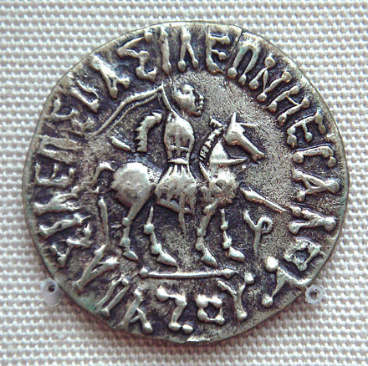
Invasions
Scythian (Saka) invasions:
Sakas forced to migrate south under pressure from Yuezhi migrating from the East. Sakas not only spell end for Greco-Bactria and Indo-Greeks, but permanently set up new power bases in northern India from 50 BCE.
Maues seems to have been first Scythian conqueror of Punjab
Coins minted by Indo-Scythians in honour of dead Indo-Greek rulers: Kushan invasions
Coins of new Indo-Scythian rulers: King Azes I (35-12 BCE)

Slide 24
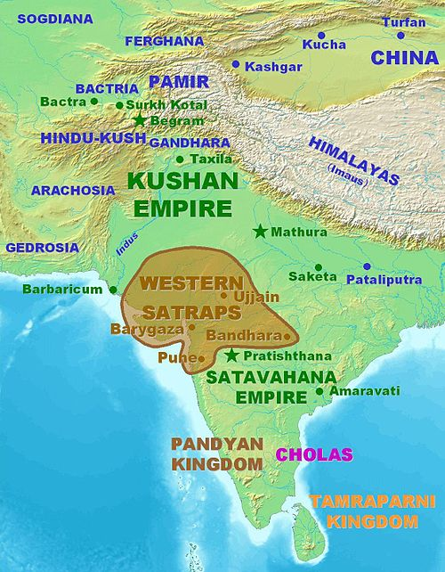
More Invasions: the Kushans http://www.kushan.org/
Kushan invasions:
From mid 1st century CE, Kushan (former Yuezhi) also invade into northern India, setting up their own areas of control.
Cf Silver scroll at Taxila from 78 CE mentions a Kushan monarch with official titles as ‘great king’, ‘king of kings’ and ‘son of heaven’ – a mix of Persian and Chinese ideology. This may have been Kanishka – ruiling from Bactria to Banaras (Kashmir, Punjab, Sind, Delhi, Mathura, Sanchi). Kanishka converted to Buddhism.
Kushan empire here attracts artists, musicians, Chinese ambassadors
Sakas are forced further south – creating new territories in central India’s ‘middle province’ – like the Western Satraps (connecting into ports like Barygaza)

Slide 25
The art of Gandhara and Mathura
Region of Gandhara ( with capital at Taxila) home to a multitude of cultures – and its art (even under Kushan rule) reflects mixing of G/R/Parthian/Saka/Kushan/Indian ideals.
See new research project: http://www.carc.ox.ac.uk/GandharaConnections/default.htm
Buddhism, was embraced by the Gandharan people, whose wealth (thanks to trade) gave them the means to invest large sums of money in the construction of Buddhist monasteries and sacred areas. More sculpture and architecture made in the service of Buddhism has been found in Greater Gandhara than in any other part of ancient South Asia.
Mathura on the other hand is home to a different artistic style: that of the Satavhanas (with a mix of early Hindu and Buddhist iconography)

Slide 26
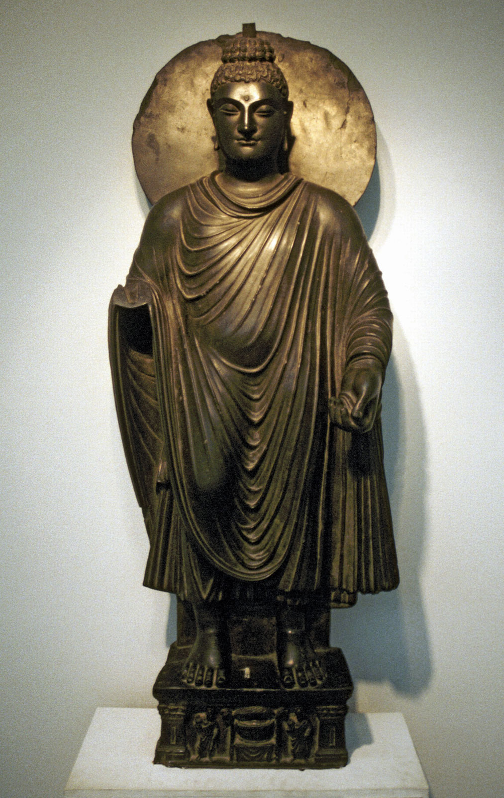
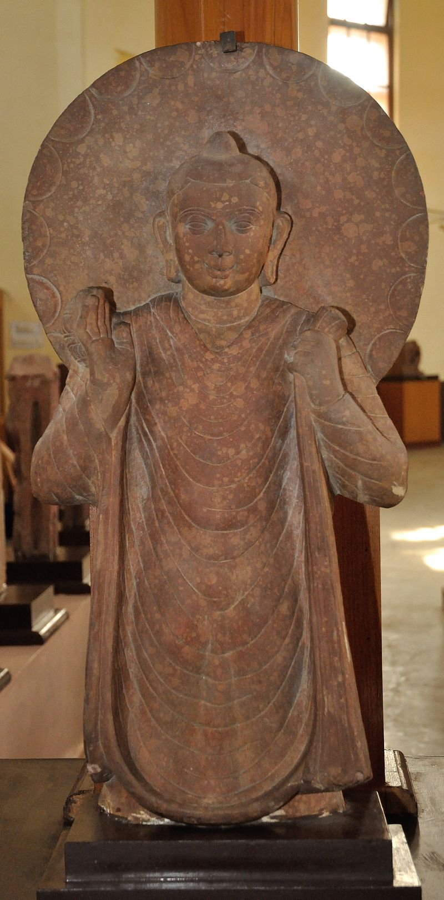

Slide 27
Other kingdoms across India
Satavahanas (or Andhra dynasty): spread across much of south and central India from 2nd c BCE to 2nd c CE.
Pliny refers to the ‘Andarae’ as ‘a powerful race’ with at least 30 walled towns, 100,000 infantry, 2000 cavalry, 1000 elephants.
Huge role in trade between southeast Asia, Sri Lanka and Rome.
Had to cede territory to the Sakas when they were pushed south by Kushans (particularly in regions of Malwa and Gujurat).
Tamil Kingdoms:
South of Satavahanas were 3 Tamil Kingdoms: Cheras (Keralas) in west, Pandyas ( in centre) and Cholas (on east coast).
Madura (Pandya capital) as centre of Tamil literary culture with Tamil sangams ‘academies’ – 2000 sangam poems have survived, as well as a Tamil grammar.
Tamils were divided into castes based on geographic domain (hill people, plain people, forest, coastal, desert), with then further occupational subdivisions e.g. pearl diver, fishermen, boatmaker).
Renown as home to pearls and precious jewels, it was a region of fine feasts and fortune. Hoards of Roman coins found in southern India
Their foreign policy alternated between forming confederacies to fight off invasions from north (e.g. in c. 165 BCE) and, especially from mid 1st c BCE, of fighting one another for self-preservation.

Slide 28
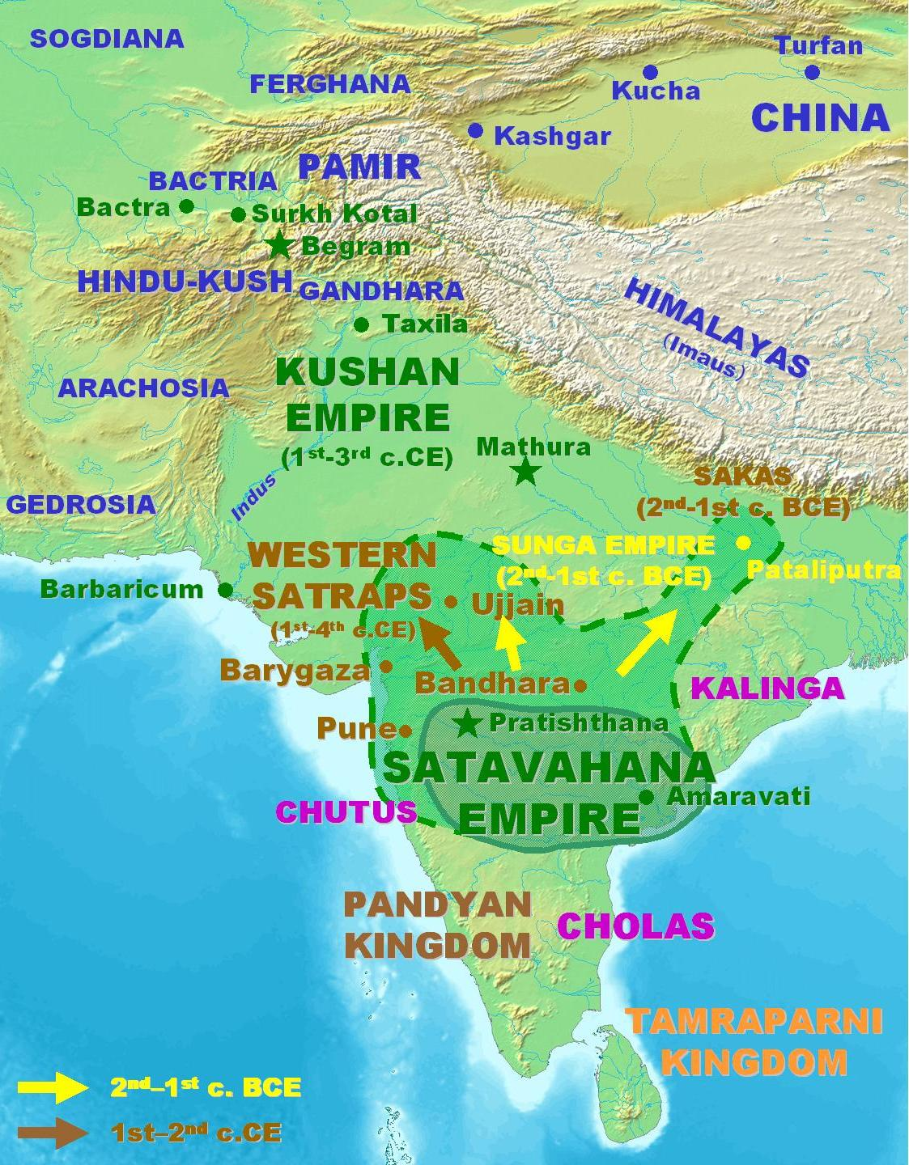

Slide 29
Social impact of trade in India
Shreni or merchant class increased incredibly in wealth thanks to position of India in ancient trade routes.
Shreni members donated to religious orders (especially Buddhist and Jain)
Merchant guilds contributed to construction of religious sites: Karla (near Poona) caves as well as later Ajanta and Ellora Caves. At Karla, images of merchant patron and his wife are carved – cave has internal stupa, chaitya hall, viharas living quarters for monks.
New cities emerged around ports and caravan stops, with shreni assuming responsibility for maintenance of municipal order, evolved their own legal regulations for guild members.
Emergence of Indian bankers and financiers (thanks to circulation of coinage)
Impact of development of religious thought (emergence of Hindu worship from Vedic-Brahmanic faith), further development of forms of Buddhism (Theravada and Mahayana). Major developments of religious literature (the Puranas ‘Ancient tales and myths about various Hindu gods’)

Slide 30
Guptas (320-550 CE)
Earliest Gupta ruler, took for himself the name Chandragupta (echoing Mauryans) and seems to have bolstered power through marriage alliance to nearby ruling Licchavi family (area of modern Bihar).
His son, Samudragupta, featured this alliance on his coinage and also added his own inscription to one of Ashoka’s pillars (that at Prayaga/ modern Allahabad). Also performed the ashvamedha horse sacrifice.
His son, Chandragupta II (375-415 CE) defeated the Sakas in Western India and married into the Vakataka kings of central India.
Followed by Kumaragupta and then Skandagupta – whose realm is threatened by nomadic invasions from north (cf to invasion of Huns)
Gupta money came from (as Mauryan) from a share of all harvests to royal treasury + tax for water supply + % of their animals and any other produce.
A triumphal display of Indian nationalism and identity – linking directly with Mauryan era.
Guptas lavished money on Hindu, Buddhist and Jain faiths. Hindu temple emerges during this era (e.g. Dashavatara Temple). Their art favours the Mathura style (rather than that of Gandhara)
Accounts of Chinese monk Fa-hsien (Faxian) who was in India between 399 and 414 CE to obtain Buddhist texts – speaks of lavish court at Pataliputra.

Slide 31
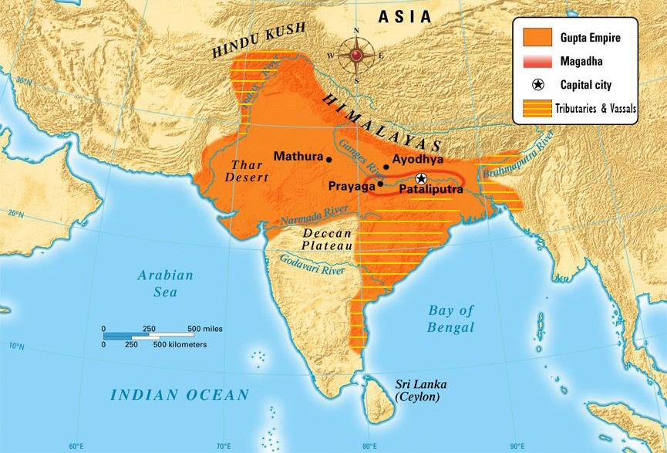

Slide 32
Guptas on themselves:
Samudragupta on Ashoka’s pillar at Allahabad (Corpus Inscriptionum Indicarum vol III no. 1):
“(Lines 28–30) This lofty column, (is) the raised arm of the earth, proclaiming as it were, that the fame having pervaded the entire surface of the world with (its) rise caused by the conquest of the whole earth, has acquired an easy and graceful movement in that it has repaired from here (i.e. from this world) to the abode of (Indra) the lord of the gods—(the fame) of that prosperous Samudragupta the Mahārājādhirāja, son of the prosperous Chandragupta, the Mahārājādhirāja, born of the Mahādēvī Kumāradēvī, (and) daughter's son of the Lichhavi, son's son of the prosperous Ghatotkacha, the Mahārāja and the son of the son's son of the prosperous Gupta, the Mahārāja. “
Eran Stone Pillar CII III no. 2 (335-375 CE): Samudragupta (ruler praised for erecting a temple)
Mathura Pillar inscription CII III no. 4 (380 CE): Chandragupta II (development and protection of new offshoot of religious worship)
Sanchi Stone inscription CII III no. 5 (412-413 CE): Chandragupta II (records grant of a village to community of Buddhist monks)

Slide 33
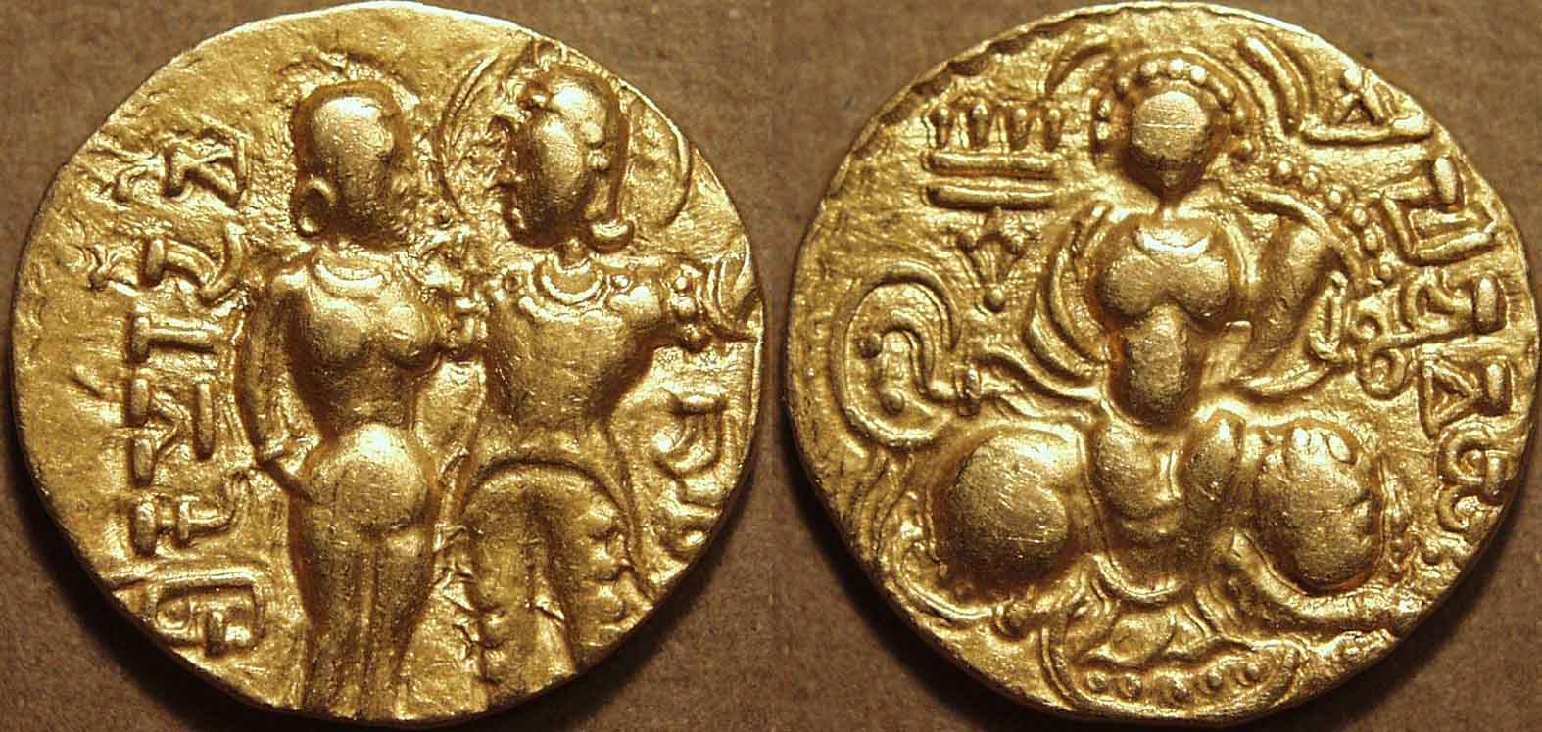
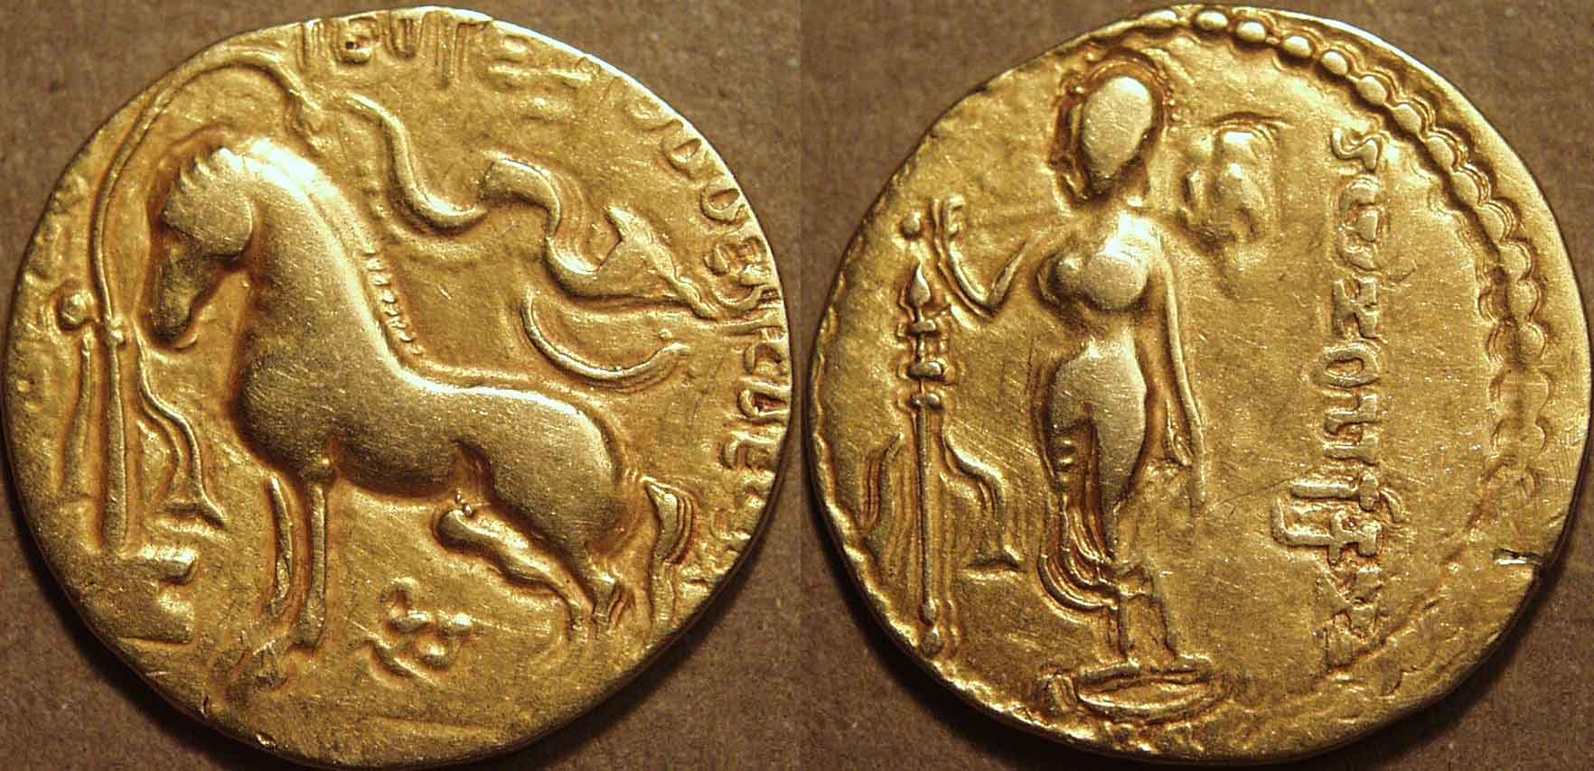
Gupta Coinage:

Slide 34
Sense of Guptas as one of India’s ‘golden ages’
Period of intense artistic creativity (e.g. Kalidasa ‘India’s Shakespeare’ – see his Meghaduta (‘Cloud Messenger’) lyric poem; Vatsyayana Kamasutra ‘The science of love’ 300-400 CE.
Creation of Nalanda University (under Kumaragupta) – 7 halls, 300 hundred rooms – by 7th c CE there were 5000 students.
Continuing importance of guild and merchant class – see the Gupta Silk Weaving Guild inscription for their support of a temple and its worship.

Slide 35
Gupta Silk Weaving Guild – Paid for a Temple 436 CE ‘Mandasor Inscription’
Verse 15: So all together through constant association, their friendship expanding from day to day, honoured by the kings like their own sons, they [the weavers] dwelt happily rejoicing in their city
Verse 21: And these men, who have adorned their whole earth in / Robes of silk Pleasant to the touch, lovely to the eye, with varied stripes of different colours,
Verse 22: Remembered that the world, was very fickle, unstable / Blown by the wind like the flower in the ear of a fairy, / As was all that is human, and all wealth, however large, / And so they made an auspicious and firm resolve.
Verses 23 –28 praise of Gupta ruler KumaraGupta
Verse 29: When Bandhuvarman, the noble, the bull among kings / The strong shouldered, was well protecting this flourishing Dasapura / The silk-weavers, who had formed a guild, skilled in their craft / With hoarded wealth had this incomparably noble temple / Made for the god with burning rays

Slide 36
Bibliography
V. Singh 1999 Early History of India
U. Singh 2008 A History of ancient and medieval India
B. Stein 1998 A History of India
J. Auboyer 1968 Daily Life in Ancient India
P. Robb 2002 A History of India
S. Wolpert 2000 A New History of India
R. Thapar 2002 Early India from the Origins to AD 1300.
P. Stewart (ed) Problems of Chronology in Gandhāran Art: Proceedings of the First International Workshop of the Gandhāra Connections Project
W. Tarn 1966 The Greeks in Bactria and India
A. K. Narin 1957 The Indo-Greeks
I. Habib and V. Jha 2004 Mauryan India
I. Habib 2012 Post Mauryan India 200 BC- AD 300
B. Smith (Ed) 1983 Essays on Gupta Culture
S. Goyal 2005 The Imperial Guptas: a multidisciplinary study

