Slide 1
Ancient Global History
Term 2: Week 8

Slide 2
Buddhism within India
Buddhism (unlike Vedic / Hindu religions) a missionary religion: part of its worship is to spread its message. 3 ‘jewels’ of Buddhism: the Buddha, Dharma and the Sangha (the physician, the remedy, the nurse who administers the remedy)
However, Buddhism unpopular with political and religious hierarchy in India as it circumvented traditional route to the divine (via Brahmans)
Ashoka, King of Mauryans in 3rd c BCE is first ruler to convert to Buddhism:
  250-240 BCE Ashoka hosted the 3 Great Councils of Buddhism at Pataliputra
  Actively sending out missionaries East and West in 3rd century BCE + building stupas (cf to Kandahar Bilingual Rock Edict)
  Result is fall of Mauryans but…
By mid 2nd c BCE – Buddhist monk in conversation with Indo-Greek King Menander – leads to key Buddhist text Milindpanho (the Questions of Milinder) – note this text survives in Burmese and Chinese Buddhist literature (how it got there we will come back to)
Development of trading links 3rd century BCE onwards leads to rise of ‘shreni’ or merchant class in India
  Shreni members donated to religious orders (especially Buddhist and Jain) – precisely because they offered direct connection to spiritual world without recourse to traditional hierarchy
  Merchant guilds contributed to construction of religious sites: Karla (near Poona) caves as well as later Ajanta and Ellora Caves. At Karla, images of merchant patron and his wife are carved – cave has internal stupa, chaitya hall, viharas living quarters for monks.
  As merchants moved and traded, their embracing of Buddhism, alongside Buddhism’s missionary zeal, set idea conditions for Buddhism (unlike Vedic, Hindu beliefs) to spread along emerging trading routes.

Slide 3
Questions of Menander
Background History
Questions on Distinguishing Characteristics : (Characteristics of Attention and Wisdom, Characteristic of Wisdom, Characteristic of Contact, Characteristic of Feeling, Characteristic of Perception, Characteristic of Volition, Characteristic of Consciousness, Characteristic of Applied Thought, Characteristic of Sustained Thought, etc.)
Questions for the Cutting Off of Perplexity : (Transmigration and Rebirth, The Soul, Non-Release From Evil Deeds, Simultaneous Arising in Different Places, Doing Evil Knowingly and Unknowingly, etc.) SEE ATTACHED TEXT
Questions on Dilemmas : Speaks of several puzzles and these puzzles were distributed in eighty-two dilemmas.
A Question Solved By Inference
Discusses the Special Qualities of Asceticism
Questions on Talk of Similes

Slide 4
Expansion of Buddhism outside of India
By 43 BCE – Buddhist texts were being written down on Palm leaves in Sri Lanka (Ashoka had sent his son there to act as missionary)
c. 20 BCE an Indian embassy comes to Augustus – as part of embassy/ at same time a Buddhist monk (Zarmanochegas) sets himself on fire in front of Augustus in Athens Strabo 15.1; Dio Cassius 54.9
By 1st c CE – Buddhism was officially supported by a number of Kushan rulers in central Asia:
  Kushan King Kanishka the Great a supporter of Buddhism c. 127-50 CE
  His coins show him represented with a range of Indian, Greek, Iranian deities but also with the Buddha
  Administered the 4th Buddhist council in Kashmir (and around this time that images of the Buddha come into being for first time). Worked closely with Buddhist scholars like Ashvaghosga
  Patron of Gandharan Art (largest collection of Buddhist art in South Asia)
  Built a stupa at Peshawar (Pakistan) + donor of Kanishka casket
  Note how later sources also tell the story of his conversion akin to Ashoka (nasty ruler ‘saved’ by Buddhism)
  Central place of Kushan realm in trade routes – particularly connecting to Tarim basin, sets scene for Buddhism to spread further

Slide 5
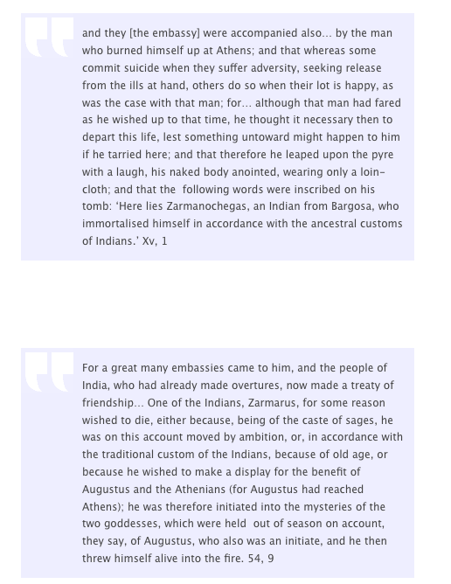

Slide 6
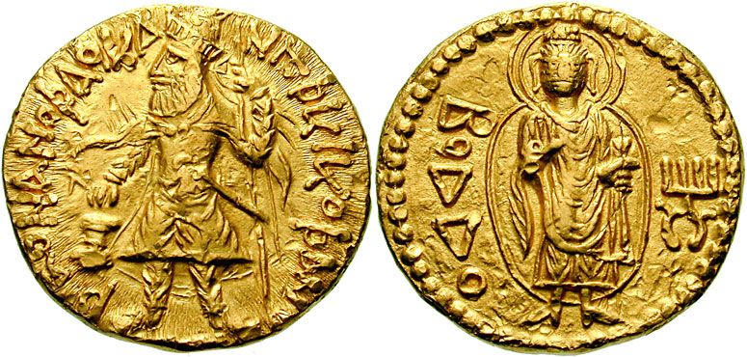
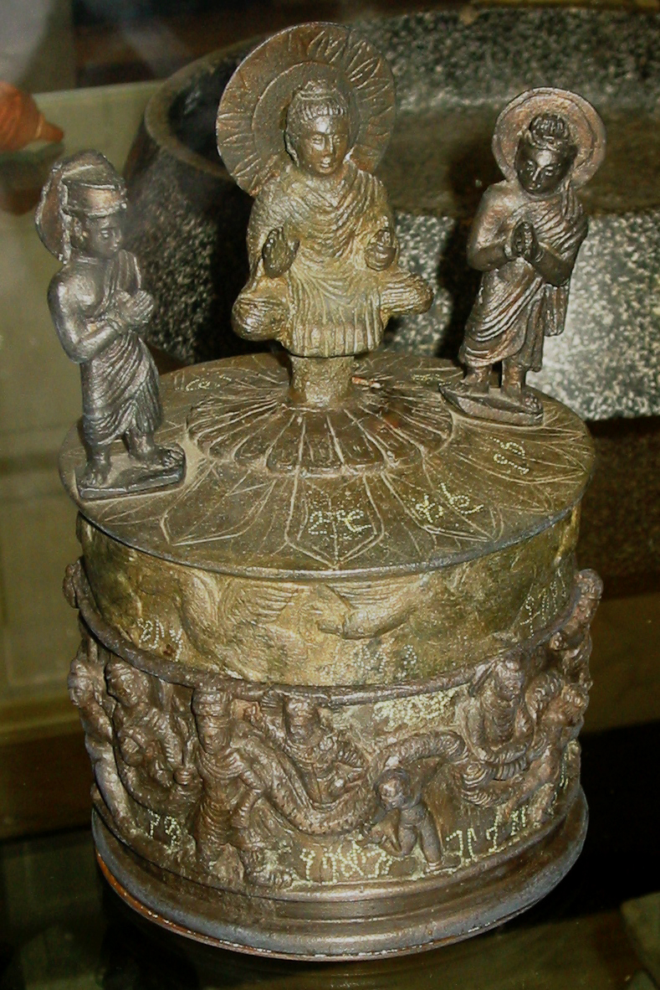
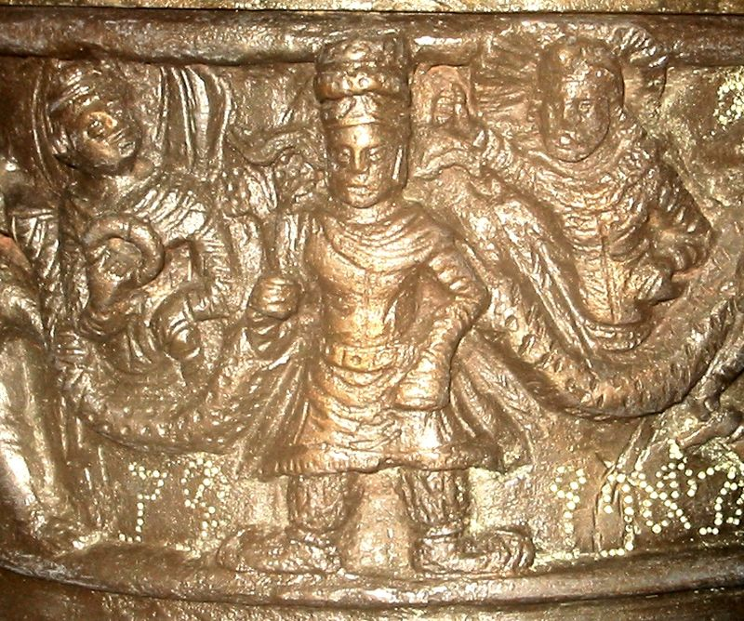
Kanishka and ‘Boddo’ on coins; Buddha, Brahma and Indra on top of casket; Kanishka with Sun God and Moon God

Slide 7
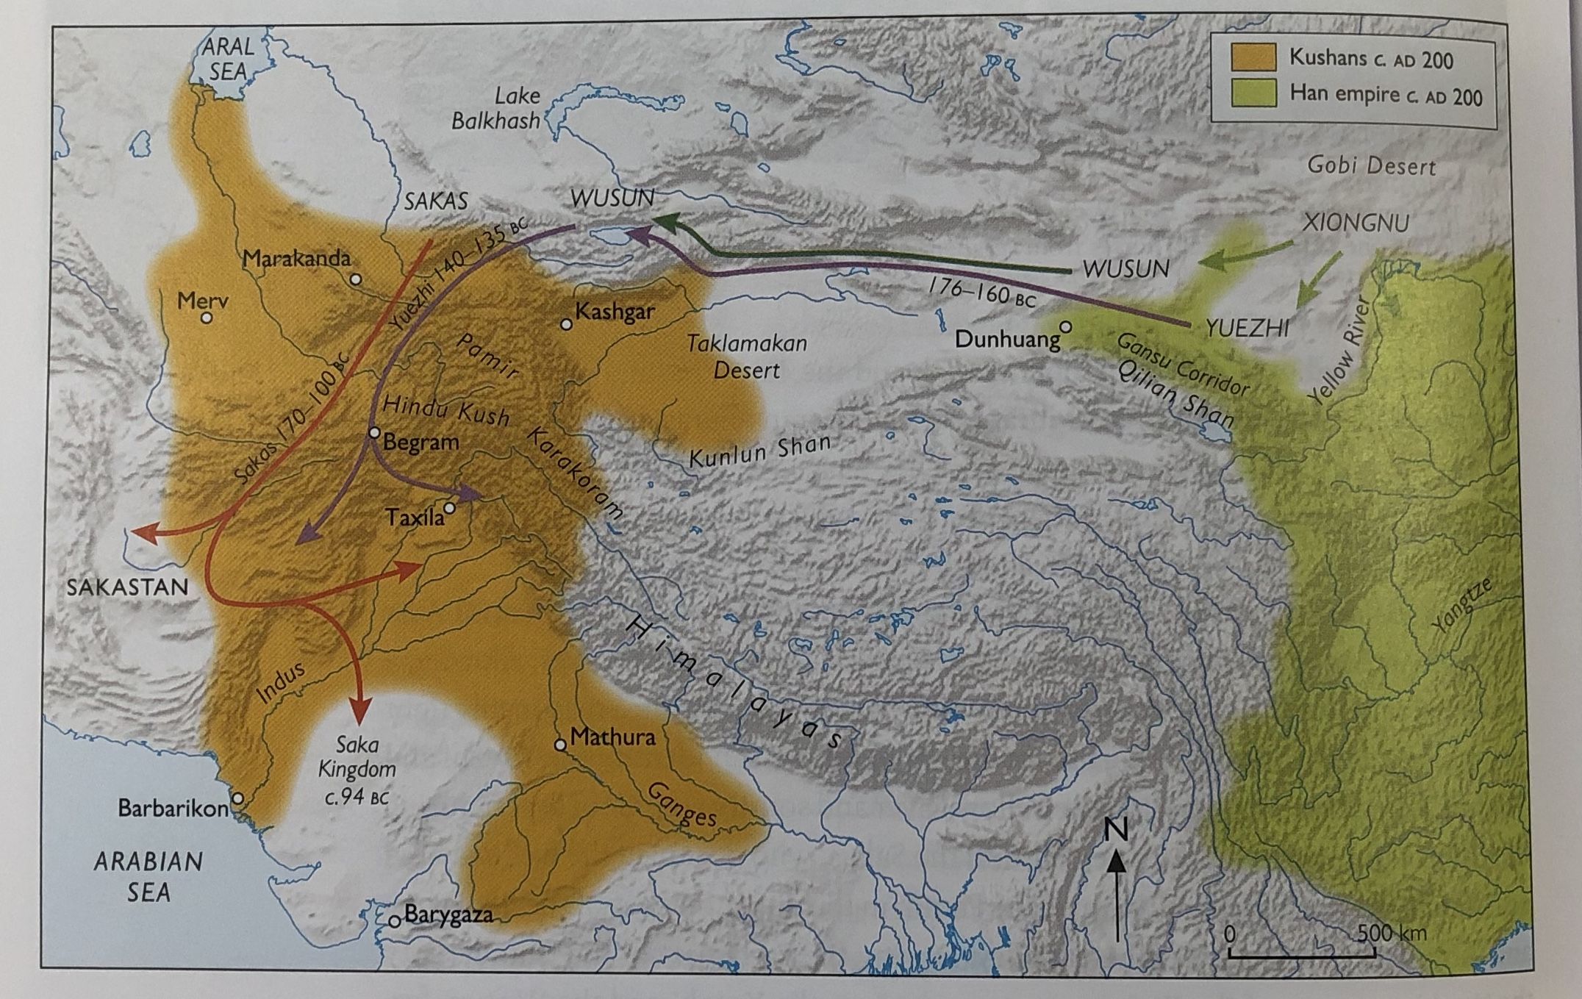

Slide 8
The sacred landscape in China
Traditional Chinese beliefs focused around lunar and solar festivals, ancestor worship and folk traditions based on a belief in multiple deities (inc. idea of Mandate of Heaven)
Daoism: advocating the setting of individual action in harmony with the greater rhythm of the universe. Began life as part of the ‘100 Schools of Thought era’ – Laozi Daodejing, added to with 2 key commentaries which by 2nd c CE form three formal key texts of Daoism.
Confucianism:
  Originally a philosophy of rule and government
  From 57 CE sacrifices were ordered to be made in honour of Confucius
  In 195 CE official worship at his tomb in Qufu began

Slide 9
Buddhism entering China (according to Chinese sources)
Buddhist missionaries come to China:
  Buddhist delegation arrived at court of Qin Shi Huangdi in late 3rd century BCE – were promptly thrown in jail (Buddhism v. Legalism). Story goes that they were broken out of jail by an enormous golden man who forced the emperor into allowing them to continue their worship (only circulates from 6th c. CE: see Zurcher 1959.20 for discussion)
  Under Han, Han experts stumped by presence of dark sludge deep in the ground when building an artificial lake. It was identified by Buddhist authorities as the ashes left over from the conflagration of all that remained at the end of a kalpa – the Indian concept of cosmic time period (4,320,000 years) 3rd c CE source? For discussion Zurcher 1959.20
  Chronicle of the Western Regions (Hou Hanshu 88) Section 15: discussing Northwest India: “they practice the Buddhist way, not to kill or wage war”

Slide 10
Buddhism entering China (cont)
C. 50 CE: Emperor Ming is said to have dreamt of a golden deity and been told by one of his advisors that it was the Buddha form India. Ming dispatched a delegation to search for Indian disciples of Buddhism and bring them to his court. They return 65 CE, accompanied by 2 Buddhist monks, who arrived on a white horse, bringing relics and some sacred texts ( see Text Hou Hanshu 88)
Emperor Ming builds a Buddhist monastery for them on outskirts of Han capital of Luoyang (named the White Horse Monastery)
Ming’s half brother starts to worship the Buddha, with official sanction of Emperor: “He respectfully performs the gentle sacrifices to the Buddha.. What dislike or suspicion could there be?” Hou Hanshu 12.5a.
By 100 CE the devotion of Buddhist monks in China is well known: “with their lovely open eyes they cast bewitching glances upon the company. One look at them would make one surrender a city. Even the virtuous sramanas (Buddhist monks) could be captivated by them” Zhang Heng Xijing Fu (Poetical Description of the Western Capital)

Slide 11
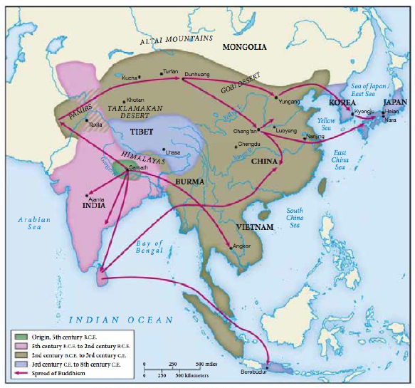
Key points:
Buddhism does not enter China from one source:
  Missionaries from southern India and Sri Lanka coming via sea routes up via Vietnam to China
  Missionaries from northern India going over land via Burma
  Missionaries from Central Asia coming across Pamirs and Tarim Basin
  During 2nd and 3rd centuries CE we know by name 18 foreign missionaries preaching Buddhism in China: 4 Indian, 4 Indo-Scythian, 3 Parthian, 4 Sogdian and 3 Khotanese.

Slide 12
Key Points (2)
Buddhism does not enter China as a single agreed doctrine:
  Buddhism from the 4th/3rd century BCE had been divided into 2 key strands by councils held in India after Buddha’s death to codify practices: Mahayana and Theravada
  Each of these strands continues to evolve as it spreads into different cultures and meets and interact with those societies and other religions (especially under Kushans)
  There was no official codified set of texts: Buddhist texts covered the sermons and stories of the Buddha (including his 550 earlier lives); how the Buddhist monastery should run; stories of the Buddha’s disciples; songs of devotion; commentaries on teaching of Buddhism; records of particular conversations by Buddhist missionaries; additional texts revealed by the Buddha to certain disciples at certain points.
  NB – the text that the Buddhist monks on a white horse could with them in 65 CE to China – a Sutra of 42 sections – unknown in India: it seems to have been a compilation of different Buddhist texts hastily put together by the monks. But it becomes the first Buddhist text translated into Chinese and a key text of Chinese Buddhism.
  Mid 2nd century CE a Parthian An Shigao is in Luoyang translating 179 different Theravada texts into Chinese. At the same time, also in Luoyang, a Kushan called Lokaksema – is translating a similar number of Mahayana texts.

Slide 13
The problem of translation
Mid 2nd century CE: a Parthian An Shigao is in Luoyang translating 179 different Theravada texts into Chinese. At the same time, also in Luoyang, a Kushan called Lokaksema – is translating a similar number of Mahayana texts.
How did translation take place:
  Theravada texts mostly in Pali; Mahayan texts in Sanskrit
  Very few Chinese read these languages, and few Buddhist monks spoke good Chinese.
  Translations happen via a team of translators who between them find common languages to translate through, with the Chinese versions then polished by Chinese scholars who have no concept of the ideas they are translating, creating versions that could not be checked by the Buddhist monk
  Often concerning ideas which often had no obvious translation from one culture to another e.g. Nirvana (quenching of the cycle of rebirth in the attainment of a place of perfect enlightenment)
Late 2nd century CE: Buddhist teacher Mozi asked why he tried to explain Buddhist ideas only via reference to Chinese texts: “It is because you know the contents of the Classics that I quote them. If I should speak about the words of the Buddhist sutras and explain the essential meaning of Nirvana it would be like speaking about the five colours to the blind, or playing the five tones to the deaf” Mozi Lihuolun (Treatise of Settling Doubts) 26.
Buddhist monks sought increasingly to align Chinese beliefs with Buddhist ideas: dao (the ‘Way’, ‘Path’ ‘Principle) as translation for dharma. Increasing move to overlap Daoism and Buddhism: In 2nd century CE Emperor Huan performs joint sacrifice to Laozi and Buddha (and stories appear that Laozi was the Buddha). By 3rd c CE Daoist and buddhist ideas freely matched in Chinese art, and even reports that Confucius had also become the Buddha.
On 16th October 286 CE the Buddhist monk Dharmaraksa, performed the first simultaneous translation of Buddhist texts into Chinese: the Saddharmapundarika (Scripture of the Lotus of the True Doctrine). He had lived in Dunhuang since the age of 8.

Slide 14
The Political Landscape in China
On 11 December 220 CE the last Han Emperor formally abdicated and ceded power to Cao Pi.
He styled himself as the First Emperor of Wei with power over parts of northern China, with other parts China under the power of the kingdoms of Shu and Wu.
By 265 these kingdoms had given way to Sima Yan who created the Western Jin dynasty.
By 304 CE Liu Yuan ‘supreme commander of the 5 Xiongnu hoards’ attacked northern China. Led to the sacking of Luoyang and Chang’an in 311 and 316 (cf to Sogdian Letters) by his son Liu Cong + mass emigration of remaining Jin to southern half of China.
For the remainder of the 4th century CE, China’s north would be ruled by nomads (the 16 Kingdoms periods) and its southern half by a displaced Eastern Jin dynasty ruling from Jianking

Slide 15
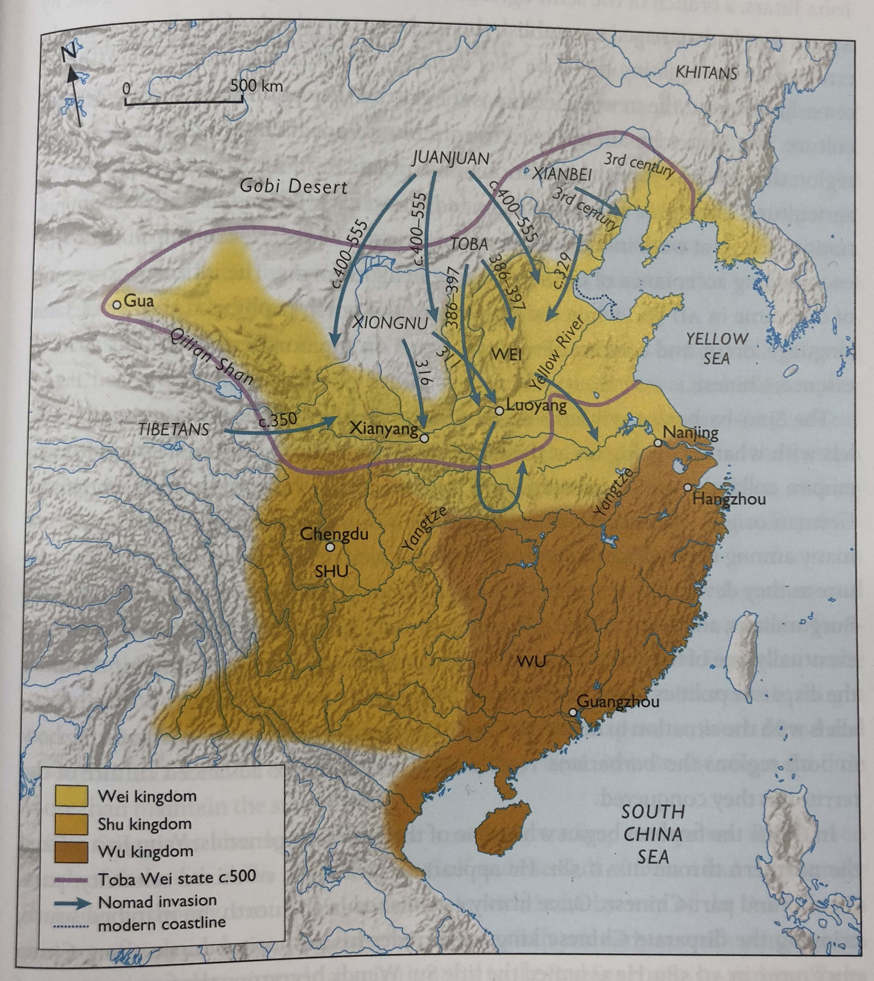

Slide 16
How and Why did Buddhism appeal?
Buddhism offering a message of worldly futility in response to current disasters, but also long term hope and personal salvation via good deeds and intentions in a time of tumultuous upset and difficulty accessible to people of all levels in society
Buddhism finding its feet within a sacred landscape in which there was no official religious doctrine tied to the ruling hierarchy (cf to the West or to India with the rise of the Guptas and their rebranding of Vedic Hinduism)
Buddhism’s main competitors suffering a fall from grace: Confucianism as main stay of Han had ‘failed’; Daoism failed to comfort/ help during Nomad invasions. Neither religion had much to say about death + the hereafter – two issues about which Buddhism had much to say.
Buddhism as a ‘foreign’ religion favorable to the massive number of new foreigners who had recently invaded and taken over in northern China
But also crucially Buddhism – as put forward by its missionaries – was already extremely varied, and able to adapt itself to setting, needs, and rulers.

Slide 17
Buddhism making itself at home
By 300 CE, there were approximately 4000 Buddhist monks in China. How did this religions expand?
Impressing the ruler:
  Buddhist monk Fotudeng magically produces Blue Lotus flowers from a bowl of water; as well as water from dried up wells, to impress Nomadic ruler Shi Le in northern China (Buddhism overlapping with traditional nomadic lover of conjuring of divine signs) – Shi Le converts to Buddhism, build Buddhist temple, financially supports their work of translation.
  Buddhism in the North develops at a fast pace and is incredible varied and multiplicitous: free from restraint of having to fit in with previous ‘native’ religious landscape (compare in India and West); can respond to multitude of new arrivals + new communities being formed.
But in the south, newly constituted Eastern Jin dynasty:
  Elites sought refuge in deep philosophical conversations about how to change Confucianism and Daoism (“dark learning”) to make them more responsive to the age. All took place within ‘Qingtan’ ’pure conversation sessions’ – elite bookclubs, that Buddhism would have to break into
  In addition, Eastern Jin Elites very sensitive to further usurpations of traditional hierarchies. Sangha (Buddhist monastery) set up as external to the ruler’s remit and power; individual recourse to salvation (and worldly futility of power) seemed anti-establishment.
  Buddhism responds with new version of Buddhism linked to dark learning “Prajna Buddhism”
  New generation of Chinese born Buddhist monks able to enter the Qingtan and discuss on equal terms with others e.g. Gaozuo – hugely respected for the ‘understanding’ he brought to Qingtan.

Slide 18
Buddhism becoming an official religion
Series of Buddhist ’apologist’ texts which take key philosophical, hierarchical and cultural arguments made against Buddhism and refute/ rebut them (cf to apologist work of early Christianity in Rome in same period).
The Sangha:
  “Nowadays the monks are very numerous: among them are scoundrels and evaders of labour service, and many of them are unfit to perform religious duties” Gaoseng zhuan (Biograhpy of Buddhist Monks) 9.385.3.2
  “There are many monks in Luoyang, but I have never heard them be able to proloing the life of the ruler. They are unable to harmonise ying and yang, to prevent natural disasters or make the people rich” Hongming ji (Collection of Apologetic Work) 2.8.2.22
  Response: sangha monks should be seen as ‘ambassadors’ of ruling Emperor for the afterlife, and just as the Emperor supplies ambassadors with everything they need to represent the Emperor well, so should the sangha be furnished with everything it needs.
  Creation of understanding of Buddhism as a ‘native’ religion – thanks to Ashoka who had built 84,000 stupas in area subsequently part of Han China after 140s BCE and expansion of Emperor Wu. Jinshu Book of Jin 64.8a
Increasingly close relationship of Buddhist monk and Emperor: key monks called to preach to rulers through 360-80s. Emperor Jianwen officially employed a Buddhist monk on behalf of the court. His successor, Xiaowu, married a follower of Buddhism, and formally accepted Buddhist doctrine as his religion. At the capital in Jianking a sangha was established within the palace.
Chinese who had converted to Buddhism now learnt original Buddhist text languages (e.g. Sanskrit) so they could actively seek out and translate their own texts (e.g. Zhu Fonian)

Slide 19
Buddhism becoming official religion (cont)
In 395 CE, Buddhist ruler of Sri Lanka sends gifts to Xiaowu including more Buddhist monks and statues.
In 399 CE Faxian sent on official mission to court of Gupta rulers with objective to collect Buddhist scriptures from India to bring back to China (an earlier mission had been sent in 260 CE but only gone as far as Khotan in Tarim Basin (where they found 25000 new texts). See Text of Faxian’s journey
In 401 CE the Buddhist monk Kumarajiva arrived in Chang’an in Northern China to become part of 3,000 strong Buddhist community paid for by ruler. Kumarajiva leads a team of 1000+ Buddhist scholars in improving older translations, translating new texts. He was honoured with title guo shi ‘National Teacher’ (and given hareem to help him produce heir to continue his work).
In 402 CE: Buddhism summed up as: “Formerly there were among the people of Jin hardly any Buddhists. The monks were mostly Barbarians, and moreover the Chinese rulers did not have any contact with them. It was only therefore that the government could tolerate their local customs, and did not restrain them. But nowadays the rulers and the highest dignitaries venerate the Buddha and personally take part in religious affairs: the situation has become different from former times” Hongming ji (Collection of Apologetic Work) 12.81.2.7.

Slide 20
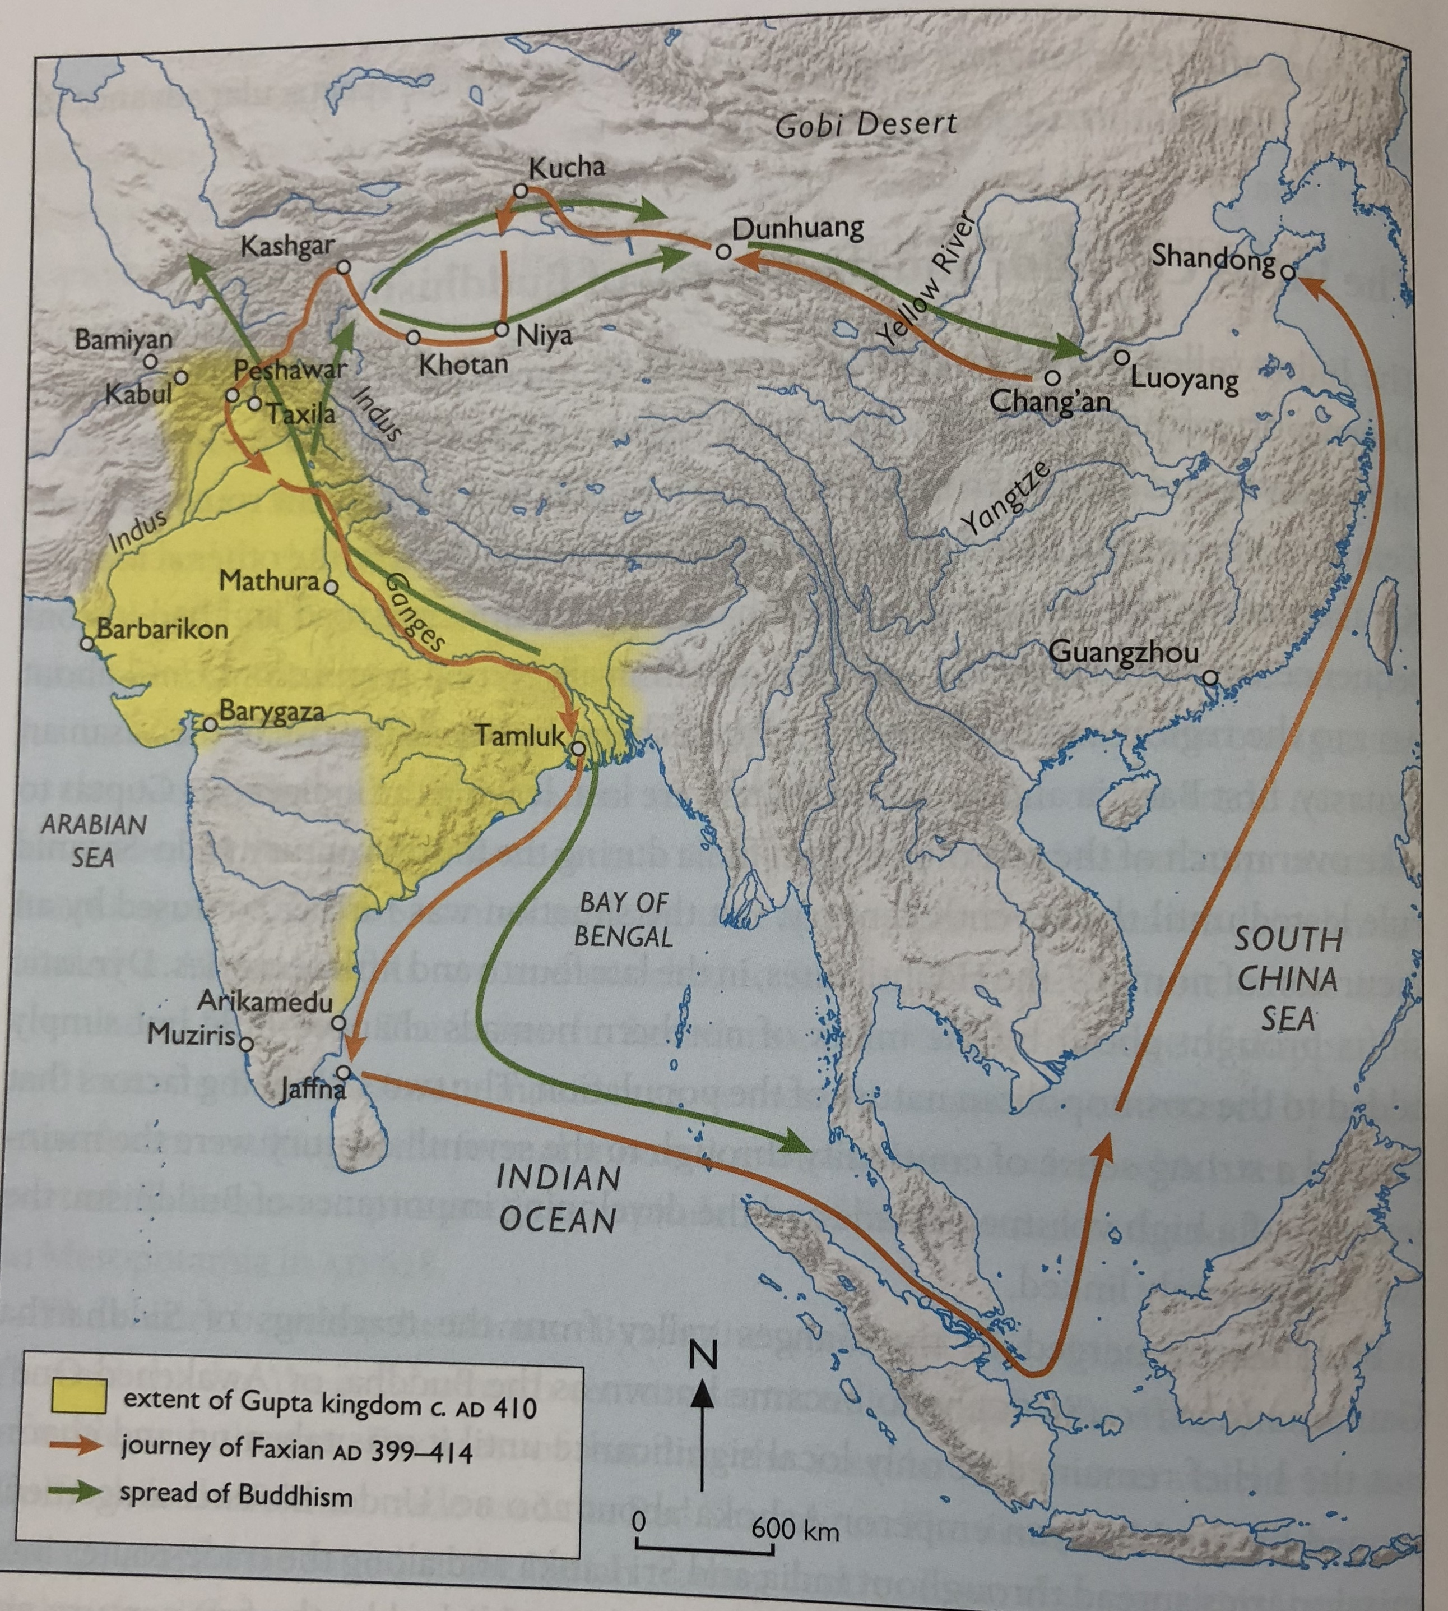

Slide 21
Biography and Additional Sources
Gaozeng Zhuan (Biography of Eminent Monks who went to the Western World in search of the Law during the Great Tang Dynasty); Biqiuni zhuan (Biographies of Buddhist nuns)
I Tsing A Record of the Buddhist Religion: As Practised in India and the Malay archipelago.
Faxian Record of the Buddhist Kingdoms
E. Zurcher 1959 The Buddhist Conquest of China
B. Wang and T. Sen (eds) 2011 India and China: interactions through Buddhism and Diplomacy
Y. Kumar 2005 A History of Sino-Indian relations 1st c AD to 7th c AD
Z. Tsukamoto 1985 A History of Early Chinese Buddhism
M. Scott 2016 Ancient Worlds

