Slide 1
Ancient Global History
Term 2: Week 3

Slide 2
1st century CE: a loss of influence
3BCE: Han court consider turning down an offer of homage as expense of giving the gifts in return would be too much (although eventually decide to go ahead due to political necessity: Hanshu 94B:6b-8a.
Peak of tributary payments came in 1 BCE: Southern Xiongnu leader sought to bring 500 followers with him to pay homage at Han court.
At collapse of Former Han (9 CE) and during interregnum till establishment of later Han, Han lost control of the Tarim basin. Xiongnu not only reunited but stepped back in during this period to control much of the Western Regions.
In 45 CE Later Han emperor refused to enlarge tributary system again – declined offer of 18 states of Western Regions to send hostages to China. “We are not able at the moment to send out envoys and Imperial troops so… each Kingdom [should seek help] as they please, wherever they can, to the east, west, south or north’ (Hou Hanshu 48:8b)
In 47 CE, the Xiongnu once again broke into Southern and Northern, with Southern once again by 50 CE pledging submission to Later Han and re-entering tributary system.
Start of a process in which a number of nomadic groups submitted to Han in return for payments and gifts as part of the Tributary system (e.g. Hsien-Pi and Wu-huan). Although some tribes like Hsien-Pi leave tributary system again between 91-110 CE.

Slide 3
From 75 CE, Later Han (Emperor Ming) re-establish military control under general Ban Chao –who maintained peace for 3 decades.
94 CE Ban Chao led military expedition against Tarim basin kingdom of Karashahr (joined by several hundred thousand Chinese merchants) Hou Hanshu 77.4
Ban Chao asked by his brother (Ban Gu) to acquire rare Western Goods while on campaign because of the prices they would fetch in China.
97 CE Ban Chao – sent a chief ambassador Gan Ying to reach the Roman Empire. Made it to Persian Gulf/ Tiaozhi area (Hou Hanshu 88.10) But encouraged to turn around by traders in area of Messene “There is something in this sea which makes a person long for home and many men have lost their lives on it, for a man may surely die from homesickness. Appreciating all this, Gan Ying did not go any further” Ban Chao as a result concluded that Rome too far away to be of any assistance in China’s battles in Central Asia and no further embassies were dispatched.
Chronicle of the Western Regions (section 1): “From the period 22-55CE to 122-25CE period, communications with the Western Regions were cut three times, and then restored”
.

Slide 4
Review of historic situation in 123 CE: Chronicle of the Western Regions (section 1 - the ‘review’ by Chen Zhong)
Leads to appointment of son of Ban Chao, Ban Yong, as commander and maintained control through 120s CE – winning acknowledgement of the China’s supremacy from 36 states of the West (a symbolic concept in Chinese world vision).
But after this Han control weakened: “Following the period 132-6 CE, the reputation of the imperial court gradually declined. The kingdoms of the Western Regions became arrogant and negligent. They oppressed and attacked one another” Chronicle of the Western Regions Section 1
In 175 CE Han withdrew its administrators and soldiers and in 185 CE it even gave up official command of the Gansu corridor.
Oases states matured into stable independent caravan cities. Trade now part of their nature and reason/method for existence

Slide 5
Comparative Timeline:
Compare to 1st century CE – development of monsoon wind knowledge (Periplus) – Romans getting to India (massive boast to Roman trading with India and thus with the East). Note parallel massive increase in shipwrecks in Mediterranean dating to 1st c CE (trading boom)
Also King of Shan (modern Burma) sending tribute to Han court in 94, 97 and 120 CE – development of India-Burma-Yunnan trade route (finally). Burmese embassy party included ‘skilled courtiers’ who identified themselves as Roman subjects (Hou Hanshu 5)
Under Roman Emperor Claudius, Sri Lankan king sends ambassadors to establish connections between Sinhalese kingdom and Roman world.
Development of Kushan Kingdom covering Bactria and India – the Begram Hoard (1st/2nd centuries CE) reflecting the cosmopolitan tastes and interests of this community. Most famous Kushan king, Kanishka rules 127-150 CE – cf to his gold coins. A once nomadic/ now sedentary community in central Asia governing over central trading routes going East/West
A golden age for trade

Slide 6
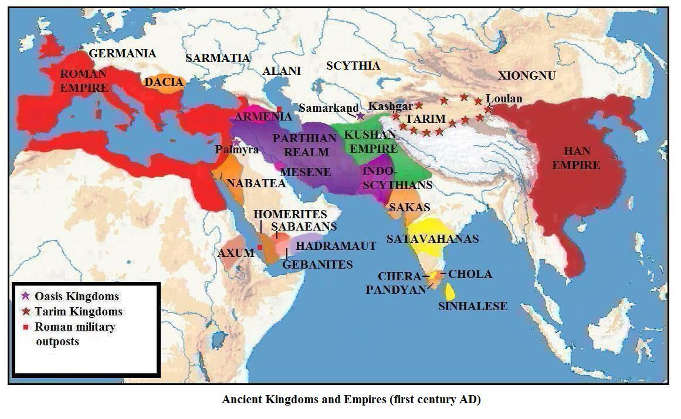

Slide 7
Attempts to connect across cultures in 1st and 2nd centuries CE:
Isidore’s Parthian Stations 20s BCE (see text) – overland trade routes describing conditions in Parthian territories ( for military or trade intentions?)
The case of Maes, qui et Titianus: c.100-120 CE
A man of Macedonian descent (?) starting an expedition from Syria - interested in cutting out the middleman and shake loose Parthian hold on trade – seems to have made it to the Pamirs cf. Ptolemy 1.11.7 “All this became known through an opportunity provided by commerce. Marinus tells us that a certain Macedonian named Maen, who was also called Titian, son of a merchant father, and a merchant himself, noted the length of this journey [to the Stone Tower], although he did not come to Sera in person but sent other there”
Hou Hanshu 88.1: “In winter 2 states from the Western regions of king Meng-Chi Tou-le sent envoys to submit tribute to China. They brought silks and the gold seal of their king”
The Roman ‘ambassadors’ coming to Chinese Emperor ‘from Roman Emperor Andun’ via Vietnam in 166: Chronicle of the Western Regions (section 12)
“The Romans have always wanted to communicate with China but Anxi (Parthia), jealous of their profits, would not allow them to pass (through to China)”: Peoples of the West Text (Seminar 3): section 11
Late 2nd c CE Caracalla writes to Parthian king suggesting that their two territories should unite to achieve ‘ a single empire without rival.. ‘when there is one world under one supreme authority, both peoples could enjoy these goods and share them in common” Herodian 4.10.
Kushan ambassadors come to Rome during reign on Antoninus Pius: Aurelius Victor Roman History 15.4.

Slide 8
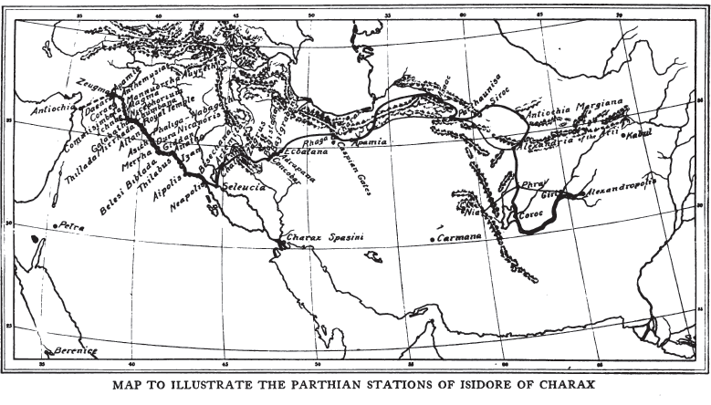

Slide 9
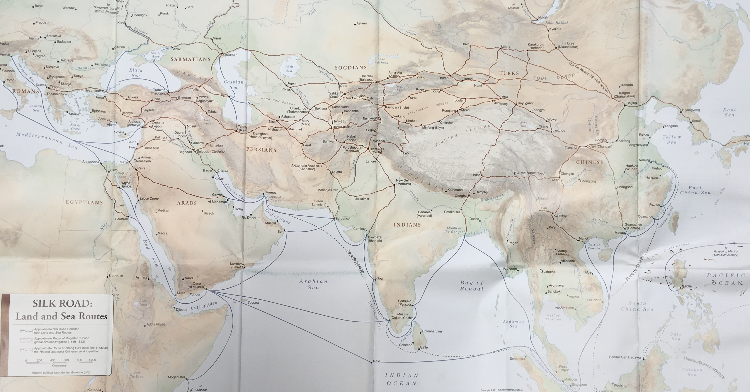

Slide 10
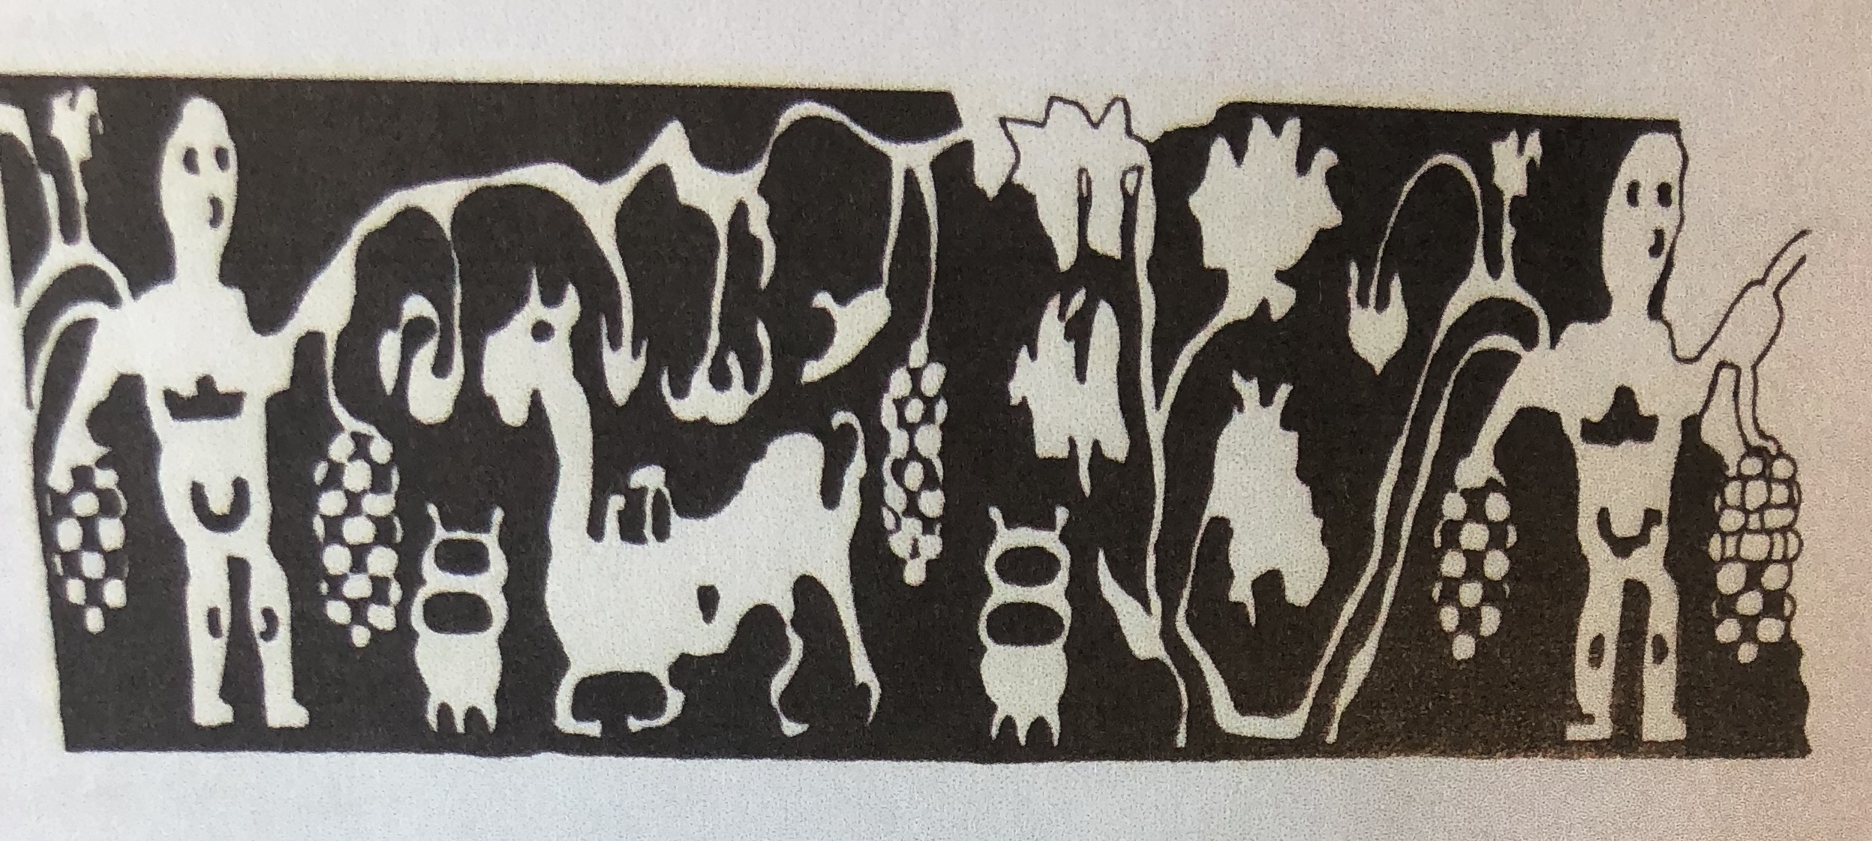
Trade in the 2nd century CE:
The honorific inscriptions of Palmyra (cf to text for Seminar in week 4): The case of G16 (145-6 CE): honours to Soados
Chinese silk is found in Palmyran graves 1st-3rd centuries CE (like this one from Tomb no. 65)

Slide 11
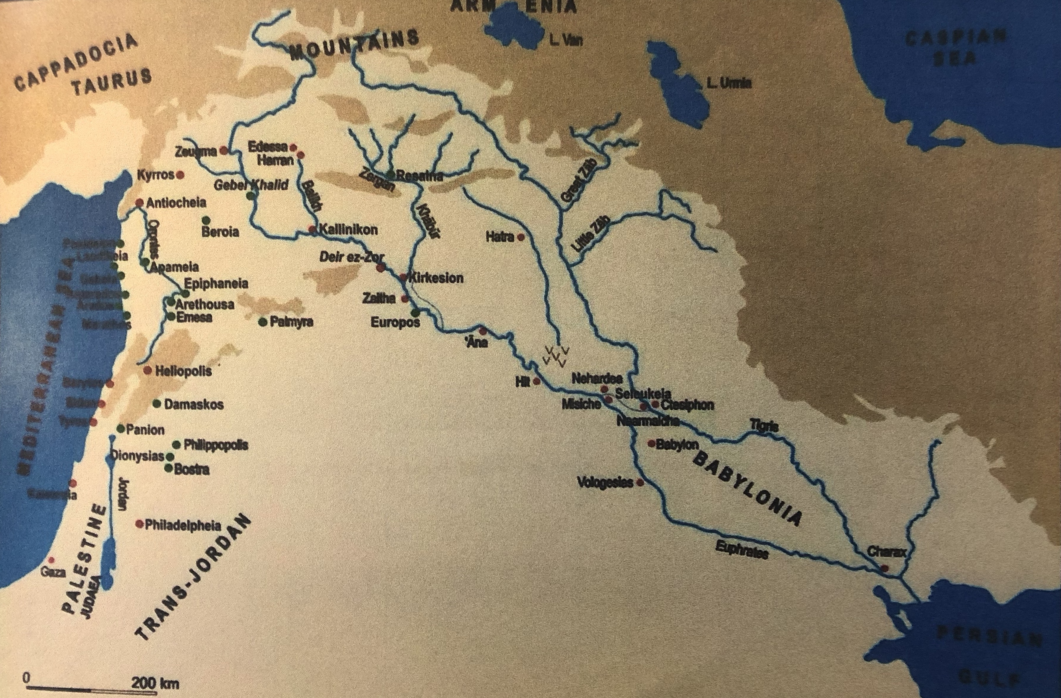

Slide 12
The story of connectivity end 2nd-4th centuries CE
Problems of connection:
We have seen slackening of political/military Han control over Western Regions from 136 CE + withdrawal from 175 CE.
Beginning of massive internal political upheaval for Han China. In 168 CE palace eunuchs stage a coup against 12 year old Emperor – leads to 20 year period of civil war (Han v ‘Yellow Turbans’).
But Sakas sent embassy to China 159-161 CE? HouHanshu 88.15
Collapse of Han dynasty from 220 CE.
In West, equally problems of connection (brought about by connection?)
Plague of 160s CE (Antonine Plague in Rome): brought to Rome by soldiers in the East.
(Plague equally devastating in Han China 171-85 CE)
Plague of the 160s CE in the West seems to have major impact on goods moving from Palmyra across Roman/Parthian border eastwards (cf back to lecture T1:week2)
Number of shipwrecks in the Mediterranean declines from 200 CE onwards – decline in Trade combined with overarching long term changes in climate: weather cools 2 degrees, rainfall slackens off: cities shrink, trade declines (cf to 3rd century Roman ‘crisis’)
Palmyran honorific trading inscription (see Seminar 4 text): stop in 160s and restart again in 190s CE (see example of G29 – 199 CE)

Slide 13
In Asia and India:
Parthians give way to Sassanids 224 CE – Sassanids take a much harder line to Roman/ Sassanid cross-border trade. Era of Palmyra trading across desert comes slowly to a halt (and destruction of Palmyra eventually be Romans when it rebels against them).
Rare survival of trading inscriptions 211 CE (G30); 247 CE (G31); 257 CE (G32), 267 CE (G34) – see text
Sassanids expand in East against Kushans during 3rd century CE and Kushans scatter from 260s CE. Many move to settle on southern rim of Tarim Basin / Taklamakan desert.
See The Kharosthi Language documents from site of Niya (southern side of Tarim Basin) covering trade and interaction in 3rd + 4th centuries CE. (seminar 4 text – no. 3 and 35.)
A new group in northern central Asia – the Sogdians – start to take over many of the trading opportunities formerly exploited by Parthians and Kushans. Sogdians settle in oases communities along northern rim of Tarim Basin.

Slide 14
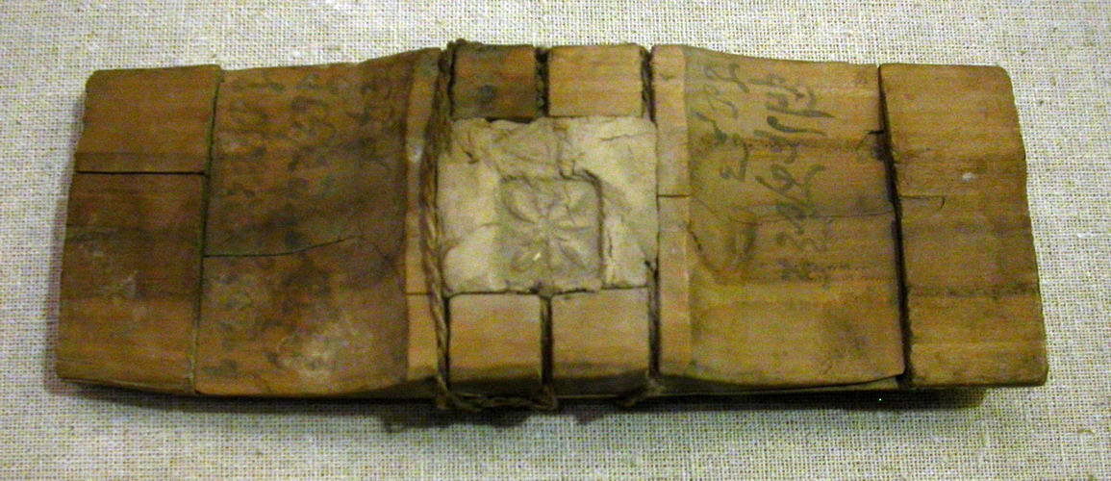
Wooden Tablet with Kharosthi writing, Niya, Tarim Basin

Slide 15
Sogdians
Long established community – Roxana, wife of Alexander the Great, was a Sogdian. Often linked to Bactria (and was part of Greco-Bactrian kingdom). Capital traditionally at Samarkand. Their defeat and submission at hands of Alexander potentially sent at least some of them fleeing East (beginning of their trading network?)
A group of people first identified by Zhang Qian’s embassy (area of Kangju) and visits in 2nd-1st centuries BCE. Sima Qian Shiji 123 “They are skillful at commerce and will haggle over a fraction of a cent”
In 29 and 11 BCE ambassadors from Kangju presented themselves in Han emperor’s court asking for commercial exchange (Hanshu 96A)
Sogdian traders seem to travel and settle along the commercial networks through 1st and 2nd centuries CE (learning from Kushans). Trade based on exchange rather than value of a Sogdian currency.
By 3rd century, representatives of Kushans and Sogdian merchants were placed on same level of importance in political negotiations at Chinese court (Sanguo zhi Ch. 4)
See Seminar 4 text (Sogdian letters – 313-4 CE – found in abandoned silk mail bag at Dunhuang following destruction of Luoyang in 311. One bag had written on it ‘bound for Samarkand’). Sogdians traders buried in major Chinese cities
Never a Sogdian empire but huge network of trade – the first ‘long distance traders’?

Slide 16
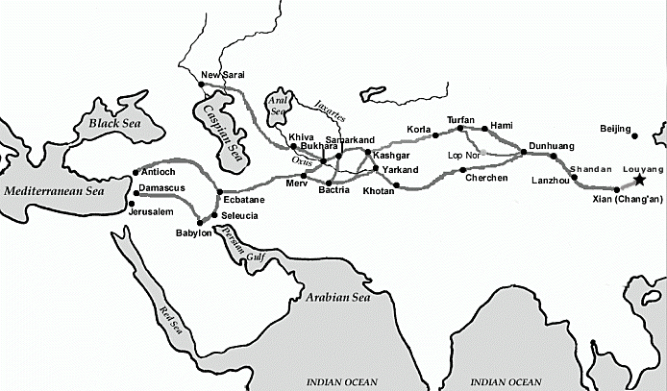
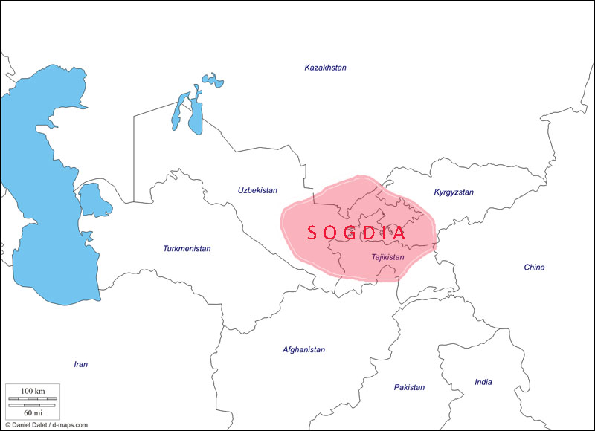

Slide 17
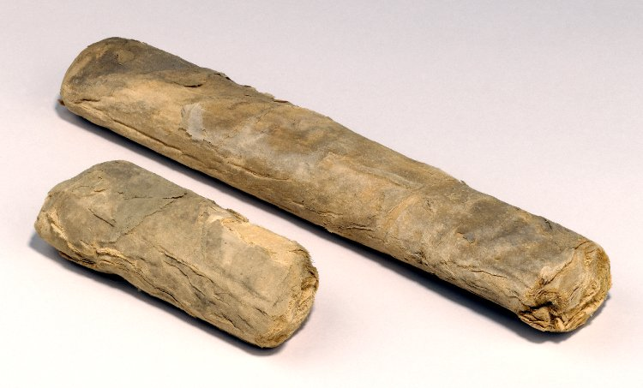
Tarim Basin communities 3rd +4th centuries: system of passports (e.g. at Niya) surviving allowing people to move between oases towns and across the basin.
A Chinese military presence (a garrison) back at Loulan in late 3rd + early 4th centuries CE: Loulan military garrison received funds in both coin + silk + expected to grow their own food/ barter with locals
Use of goods (esp silk) as material for barter exchange rather than currency – easier and better in uncertain political and military conditions?
In 3rd + 4th centuries CE, rather than being directed by major political communities, importance of autonomous trading networks, merchant organisations and local communities sustaining trade and exchange.
Importance also of religious institutions and exchanges helping sustain trade in this period (to be followed up in later lecture).

Slide 18
Romans make it to China in this period:
In 226 CE a Roman merchant called Da Qin Lun comes to the court of the Emperor Wu at Nanking cf. MacLaughlin Rome and China 2010.136
260s CE “Merchants of Rome often visited Fu-nan (Cambodia), Jih-nan and Chiao-chih (Vietnam), but few people of these regions have been to Rome” Liang-shu 54.
282-4 CE a Roman business delegation arrived via ship to China with a Mediterranean cargo: “asbestos cloth” I-wen Lei-chu 76. Delegation returned to Egypt and informed them about their discoveries. In 284 another Roman arrival: bringing with them 30,000 rolls of scented agarwood. Chinese emperor impressed and order the Chinese classics to be written on the wood (MacLaughlin Rome and China 2010. 138)

