Slide 1
Ancient Global History
Term 2: Week 9

Slide 2
Silk in Palmyra
Silk in the Tombs of Palmyra
  1931 G F Hudson “there is no evidence that there was ever in the Roman world a taste for Chinese patterned silk” Europe and China 1931.91.
  1933: Palmyrene tombs discovered.
  How can this be identified definitively as ‘Chinese’ silk?
    Weave? But lots of different weave style existed in China
    Design?
      See Fragment S9 (Pfister Fig. 10/Pl. XI) Design has been argued to be Parthian and to be Chinese (concentric circles with dots, crested tigers with thin necks, zigzag lozenges)
      Resemblance to fragments found elsewhere (e.g. Loulan from 1st c CE cat no. LC VII 09): Pfister 1941.77.
      See Kat 521: a mix of scenes / origins / influences?
    Chinese characters: see von Falkenhausen article. 25-220 CE: 30 pieces of silk with Chinese character surviving at Palmyra
    Scientific analysis of silk fibres: can prove it comes from cocoon secretion of mulberry leaf moth (which in the period 1-3rd c CE means China)
For Bibliography:
  Schmidt-Colinet, Stauffer and Al-Asad (eds) Die Textilien aus Palmyra: Neue und alte funde 2000
  Pfister ‘Les soieries Han de Palmyra’ Revue des arts asiatiques 13.2 (1941) p.67-77
  Maenchen-Helfen ‘From China to Palmyra’ Art Bulletin 25 (1943) p.58-62

Slide 3
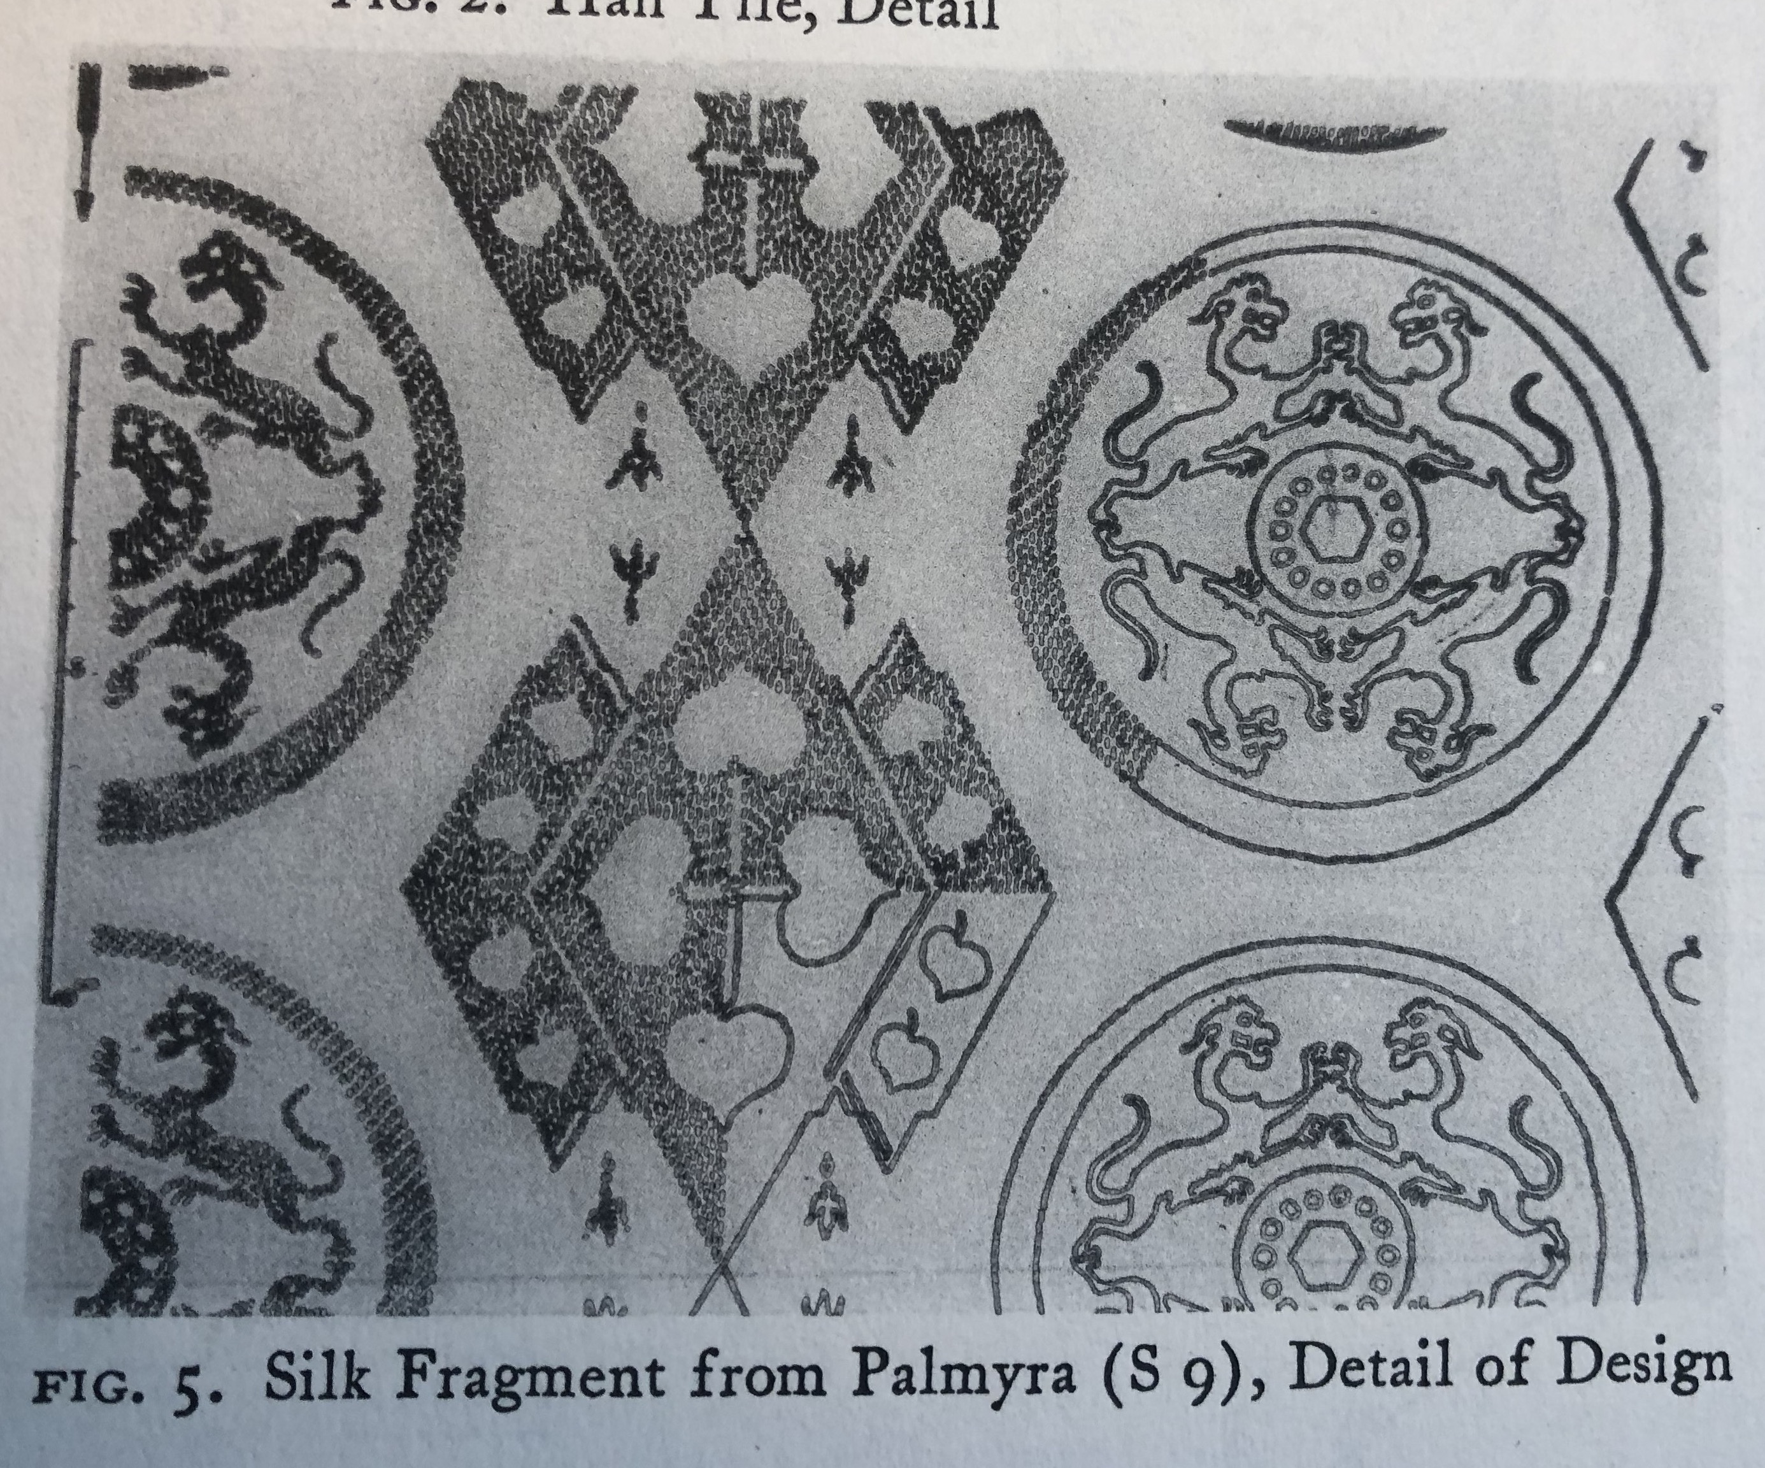
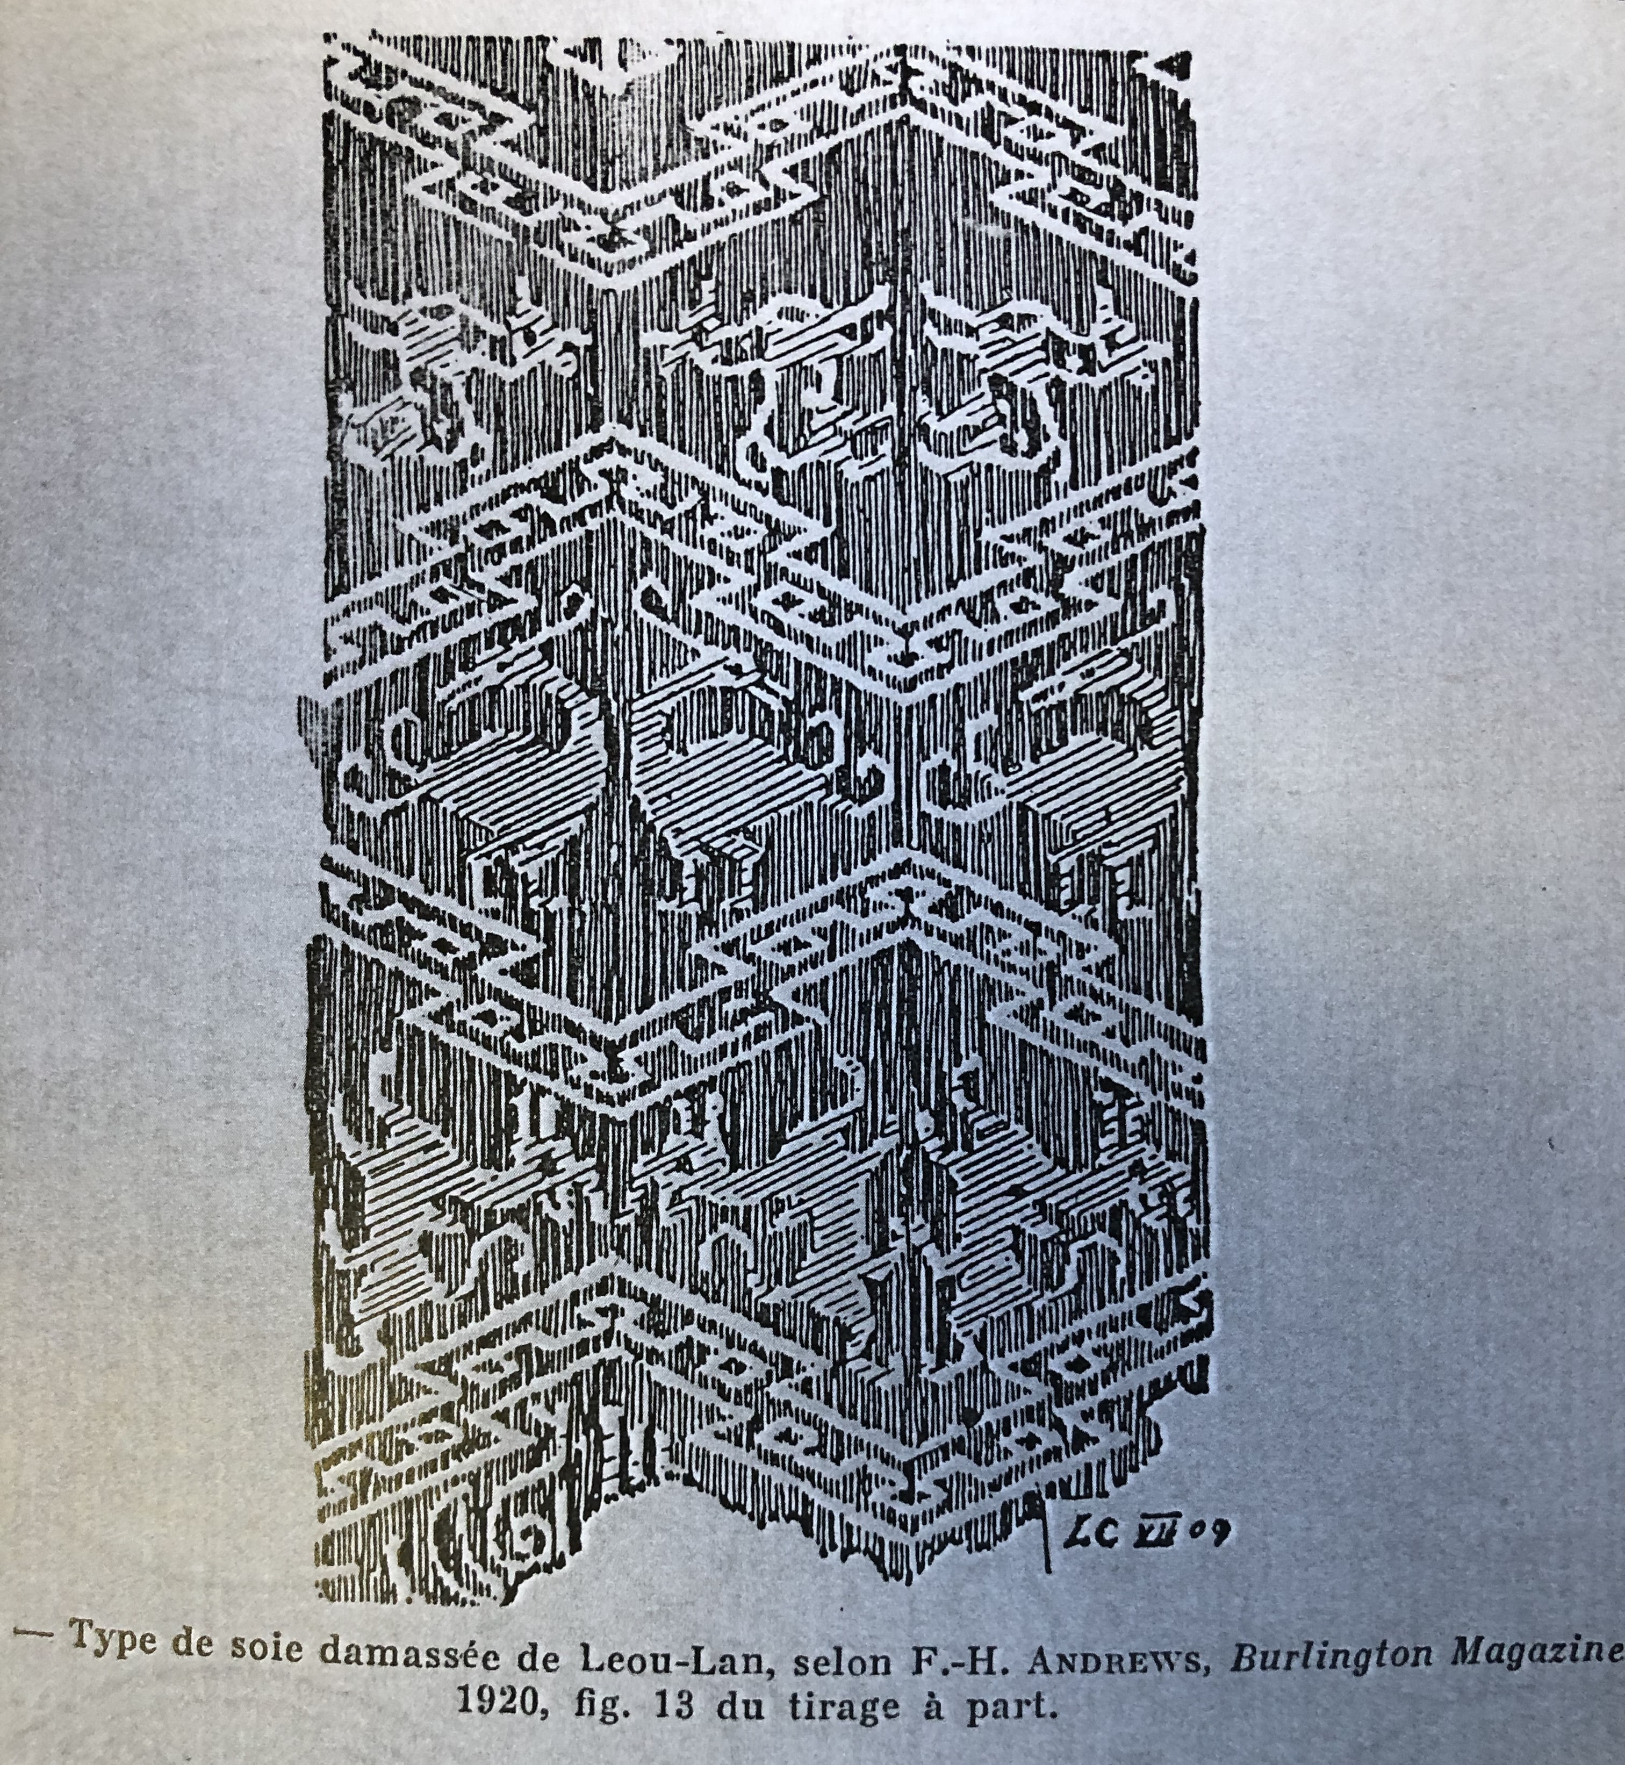

Slide 4
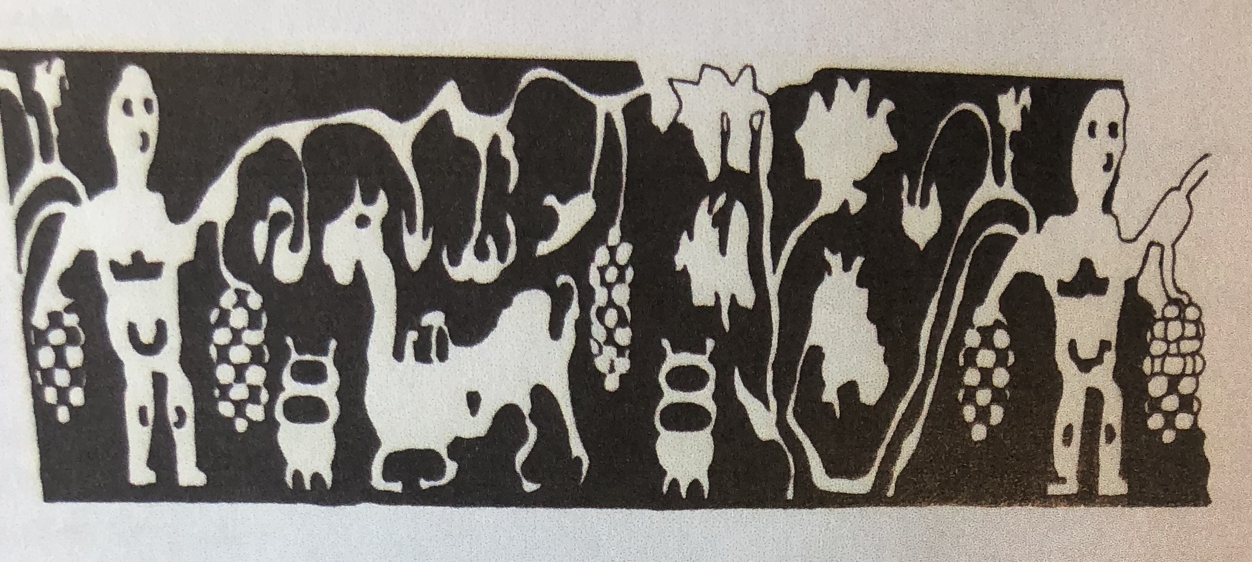
Schmidt-Colinet and Stauffer 2000
Kat 290 (Taf 96-7), found in Tomb 65:
Woven using Chinese techniques
Depicts central Asian scene (men harvesting grapes with camels (?) in background

Slide 5
Tillya Tepe Burials (Afghanistan)
7 graves (6 excavated, 1 robbed) found at Tillya Tepe (‘Golden Hill) near modern city of Shibergan in NW Afghanistan (1969)
Local aristocracy/ royal family – hastily reburied (?) in abandoned fire temple sanctuary
Most of items are of personal ornament (not funerary offerings), with 2 crowns set on heads of 2 deceased.
Coins found in graves date burials at 1st c CE
See Sarianidi article (excavator) – ‘The Treasure of Golden Hill’ AJA 84 (1980) p.125-131.
Compare Boardman The Greeks in Asia 2015.109-115
Specifically compare reactions to ‘Dionysus and Ariadne’

Slide 6
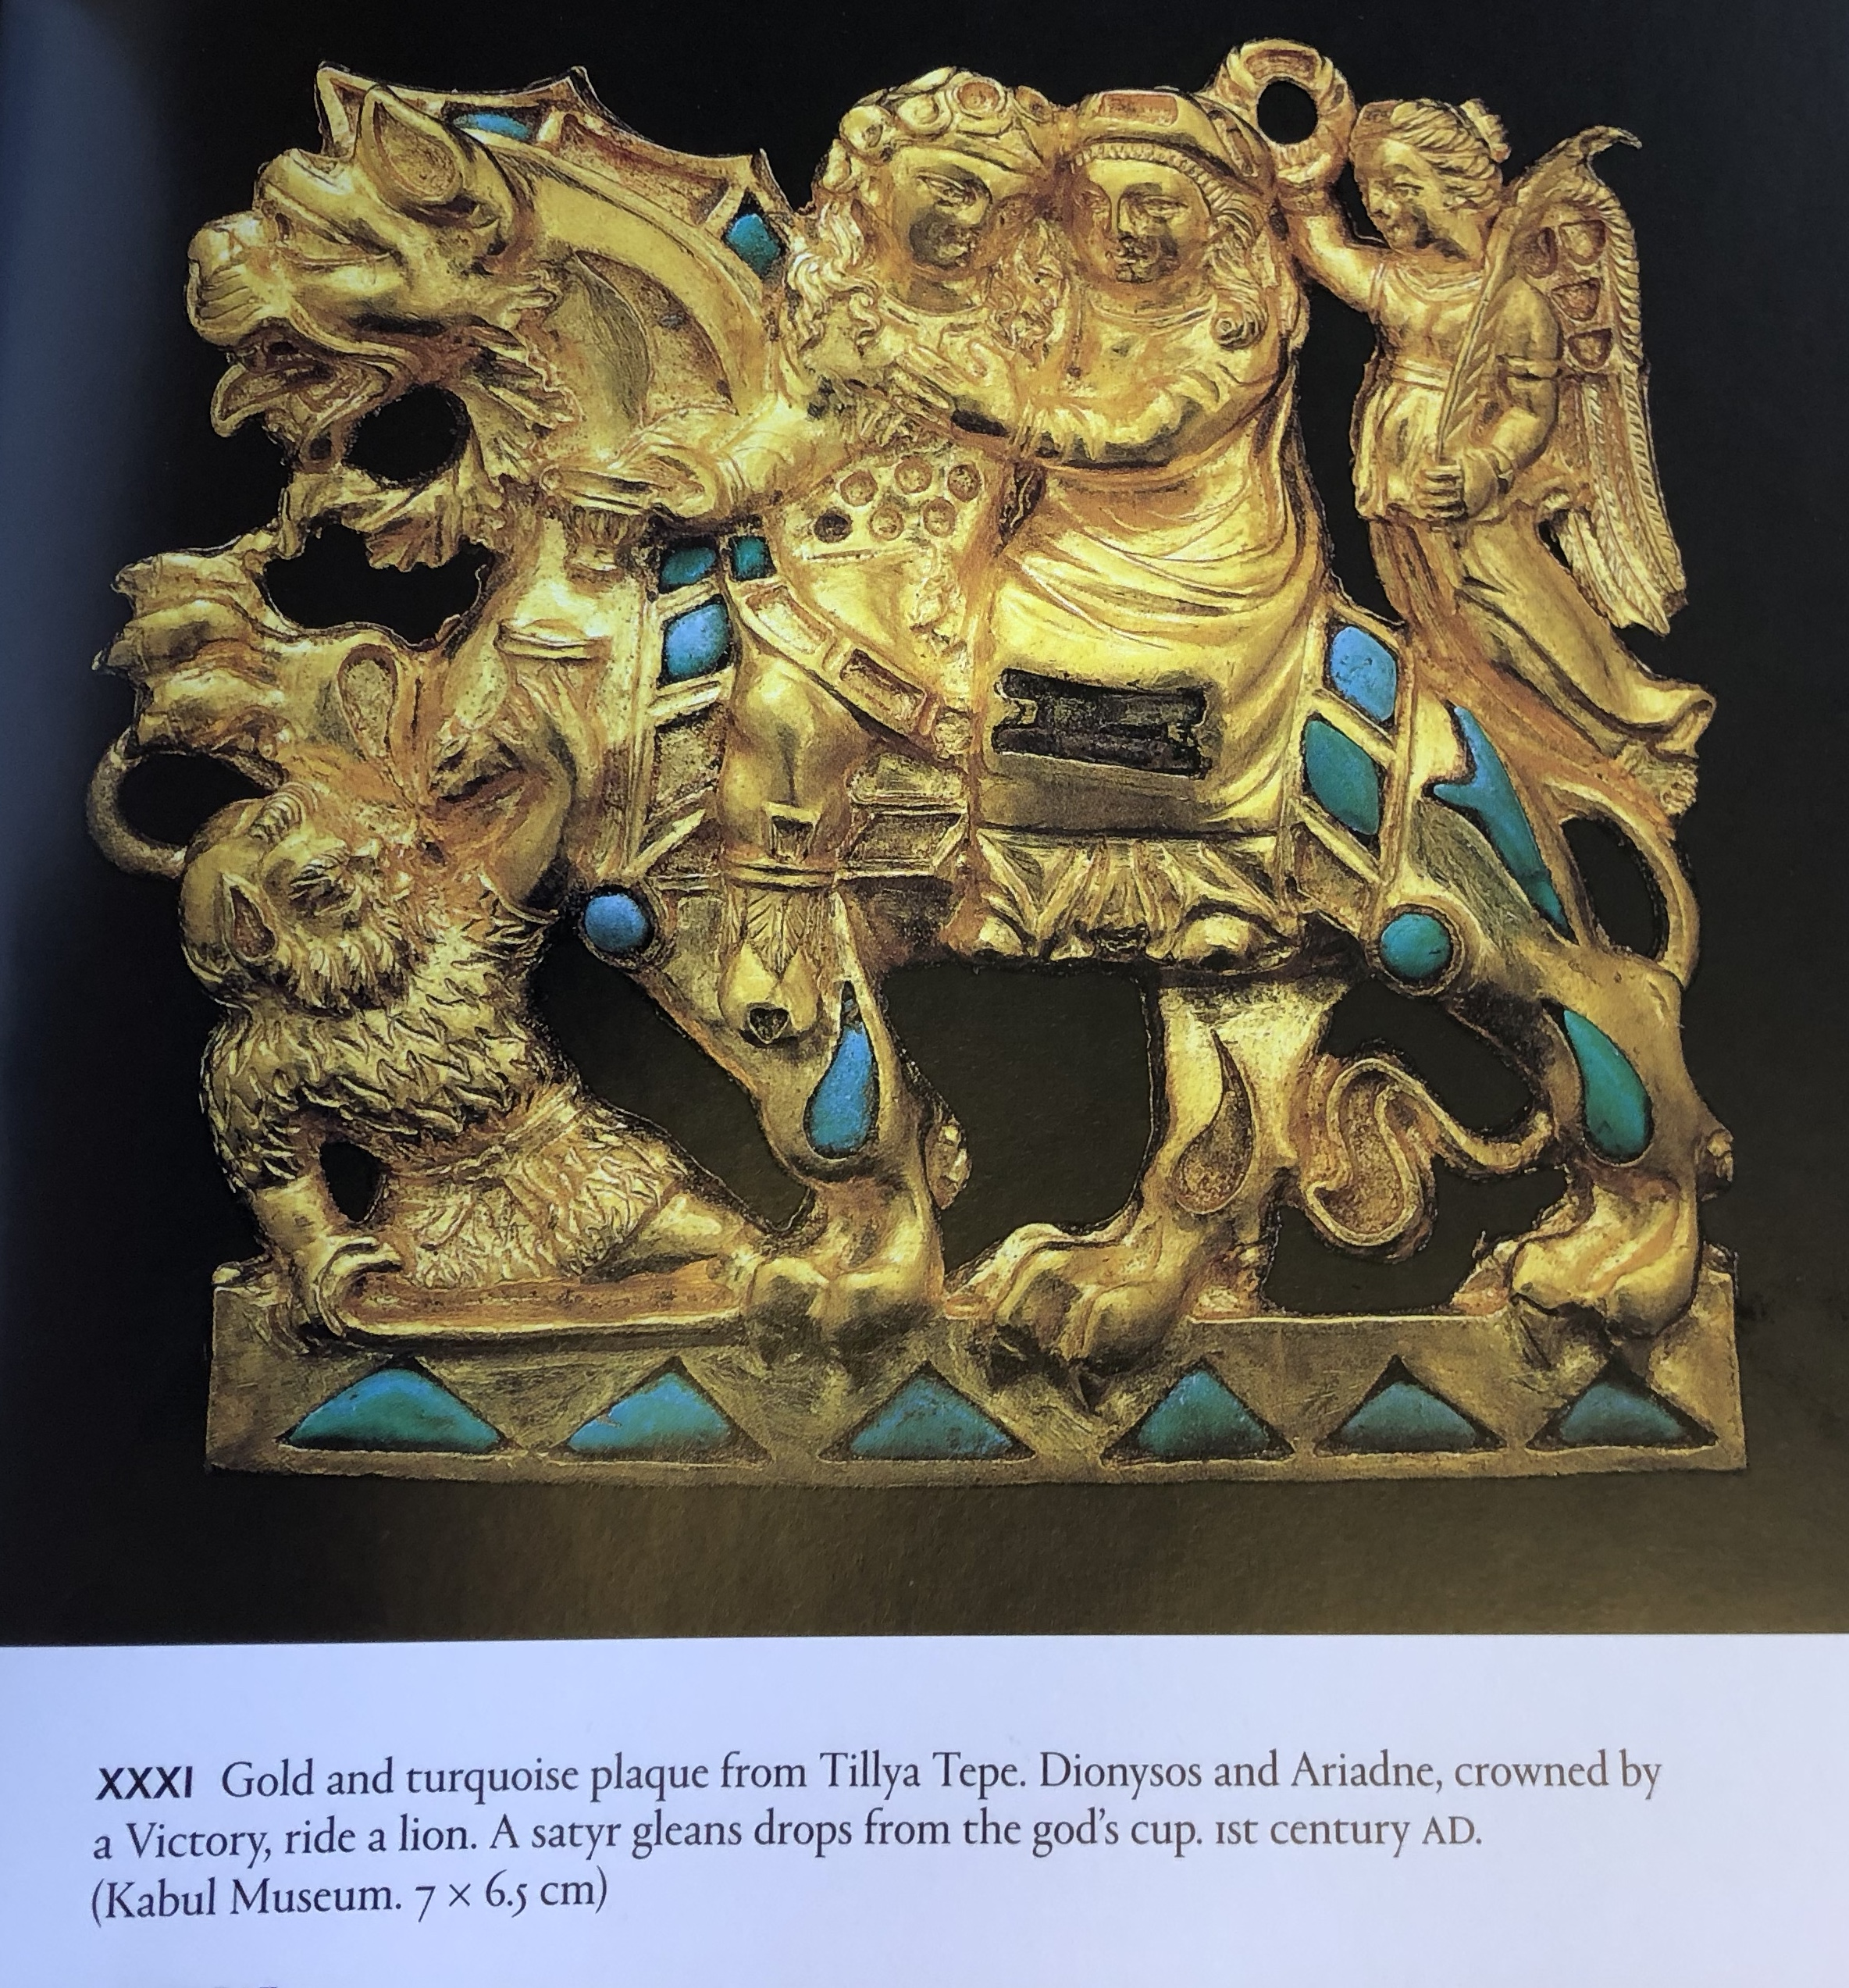

Slide 7
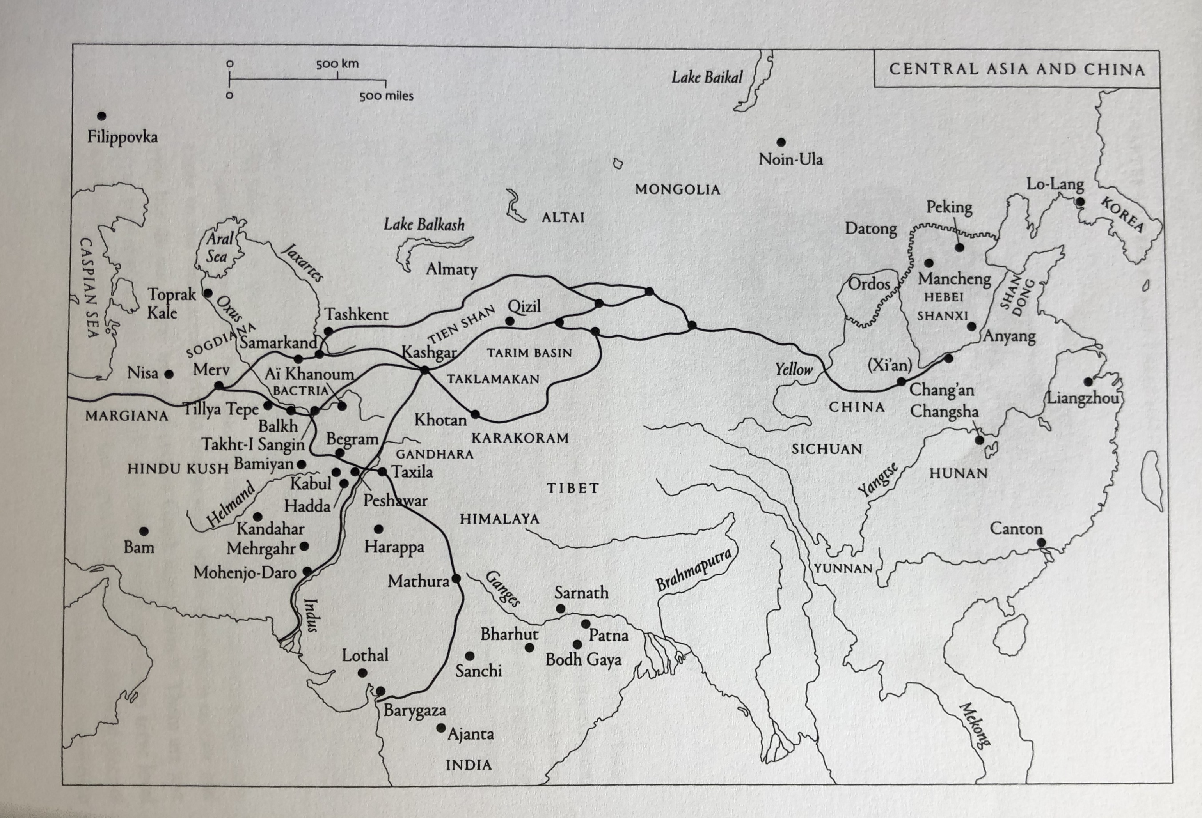

Slide 8
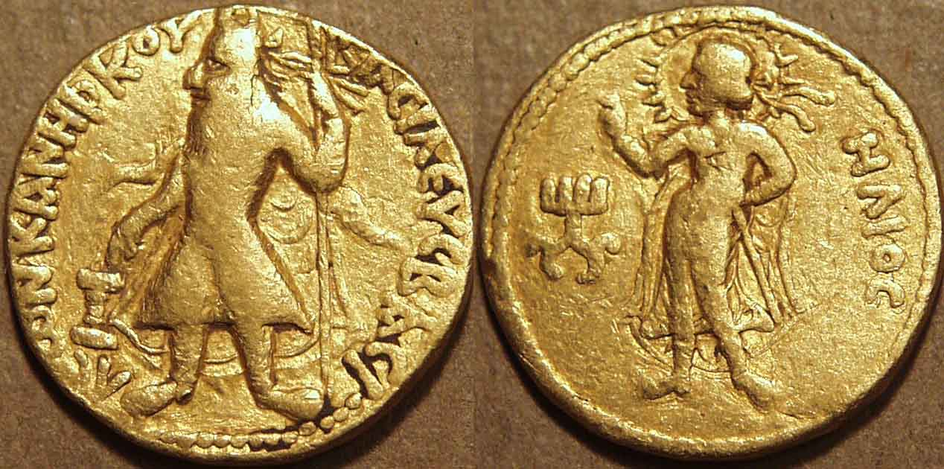
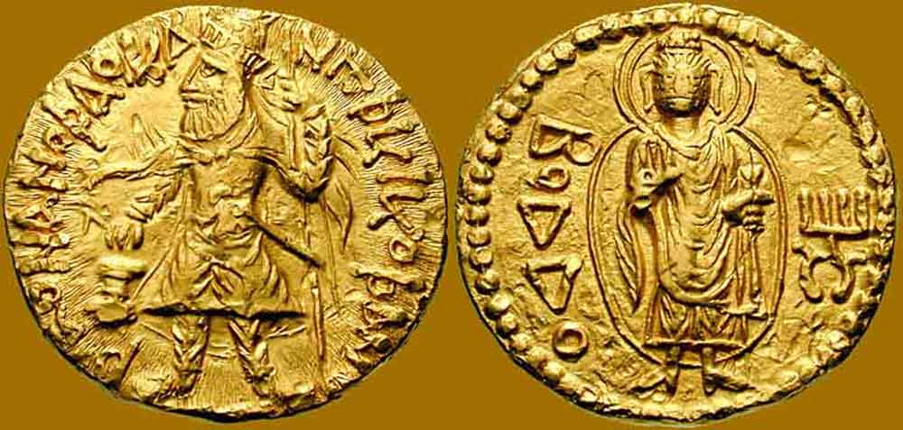
Coins in central Asia: changing allegiances (cf Rabatak Inscription – in Greek and in Bactrian)
127 CE: early issue King Kanishka
Crowned, diademed king, holding spear and sacrificing at altar
Greek script: King of Kings Kanishka Kushan
Obverse: Helios, one hand on hip, one raised in blessing + Kanishka’s emblem.
Greek writing ‘Helios’
128-150 CE
Crowned Diademed King, holding spear and sacrificing
Bactrian script: King of Kings Kanishka Kushan
Obverse: Buddha with emblem of Kanishka
Bactrian legend: Budda

Slide 9
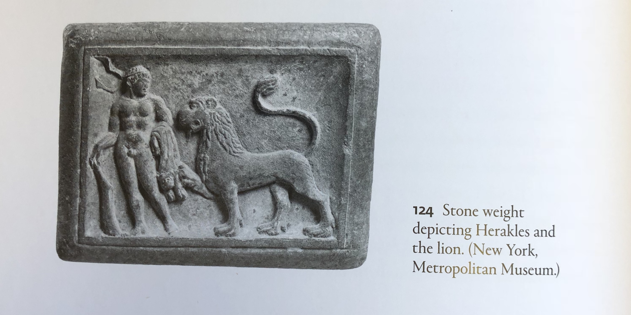
Gandharan Art
Heracles and the Lion (stone weight 1st century CE)
Compare Boardman The Greeks in Asia p. 189 with
Art of Gandhara in the Met Museum of Art p.13-4

Slide 10
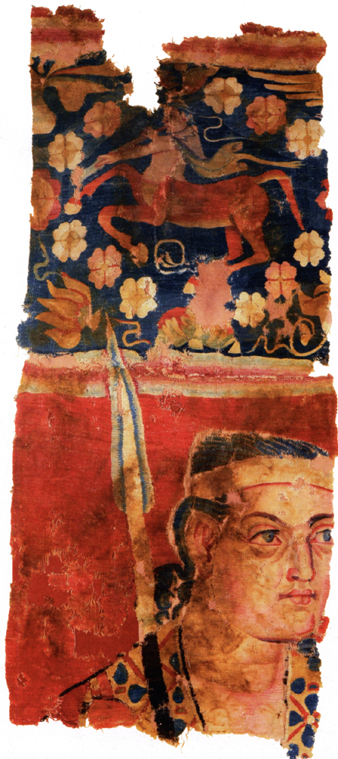
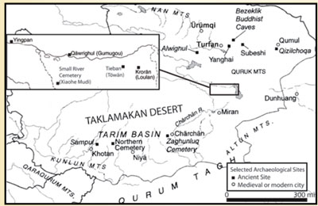
The Sampul Tapestry
Found in Tarim Basin, at Sampul (modern Xinjiang province) in1983
Left decorative border of a larger wall hanging
Later this piece fashioned into pair of trousers
Made of wool, 24 threads of various colours
A man (warrior with spear). Wears tunic with rosette design. Head band (diadem?)
Above him centaur, playing a horn, wearing a cape. Surrounded by floral ornaments
Has been argued to have been made in Rome, in Greece, to depict Alexander the Great, to be from central Asia…
See description in “China: Dawn of a Golden Age 200-750 AD” Met Museum of Art (text by Zhao Feng) General editor: J. Watt 2004

Slide 11
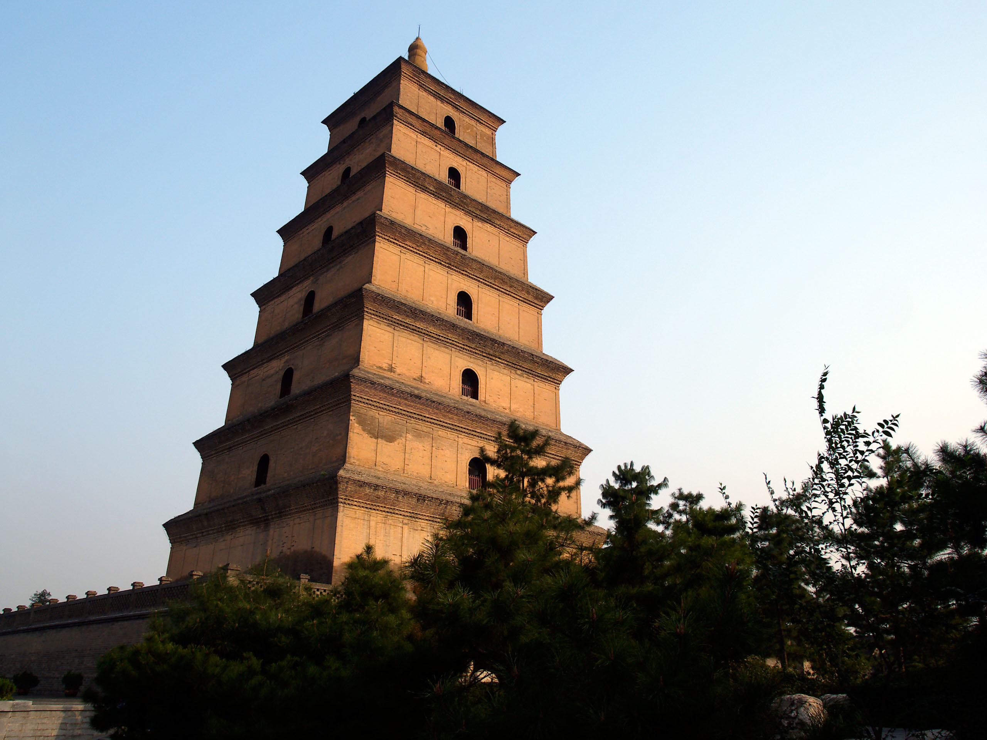
Buddhist Art / Architecture
For discussion:
  The development of the Chinese pagoda from the design of the Buddhist stupa: Great Wild Goose Pagoda built in 7th century to commemorate return of a Chinese buddhist monk from India (and house relics and manuscripts brought back by him). Many argue that Pagoda is fusion of Buddhist stupa (round) with Han-era watchtower

Slide 12
Dunhuang Caves (Mogao caves/Thousand Buddha Grottoes)
Architecture:
  First cave built second half 4th c CE. Early caves are argued to have been more influenced in design by Buddhist architecture in India. E.g. Meditation Caves – square main chamber, with meditation cell opening on both sides (e.g. cave 285). Comparable to vihara style in India (e.g. Ajanta caves). Caves at Dunhuang (e.g cave 428) also copy the chaitya (prayer hall) style of Indian Buddhist architecture (e.g. Ajanta caves). But later caves (from 7th c CE) tend to follow Assembly Hall style (e.g. cave 429), a style not known in India.
Statues:
  Carved in sandstone – fine sculpting not so easy - so often overlaid in clay stucco to allow for more details effects. Influenced by both Gandharan and Mathuran schools, as well as by later Gupta art (4th century CE).
  Cf. S. Whitfield (ed.) The Caves of Dunhuang 2010

Slide 13
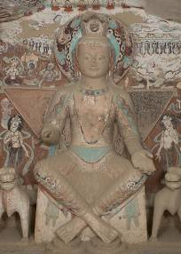
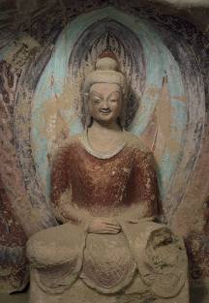
Cave 275: Early Buddha with central Asian influence
Cave 259: Northern Wei Statue (5th-6th c CE)

Slide 14
The Terracotta Army: an example of earlier influence?
See article by L. Nickel ‘The First Emperor and Sculpture in China’ Bulletin of the School of Oriental and African Studies 76.3 (2013) p.412-47.

