Slide 1

ALEXANDER AND ASHOKA
Katharine, Euan and Amy

Slide 2
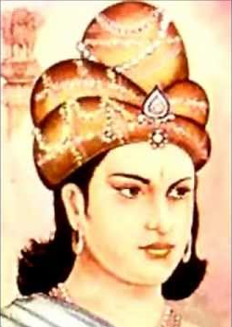
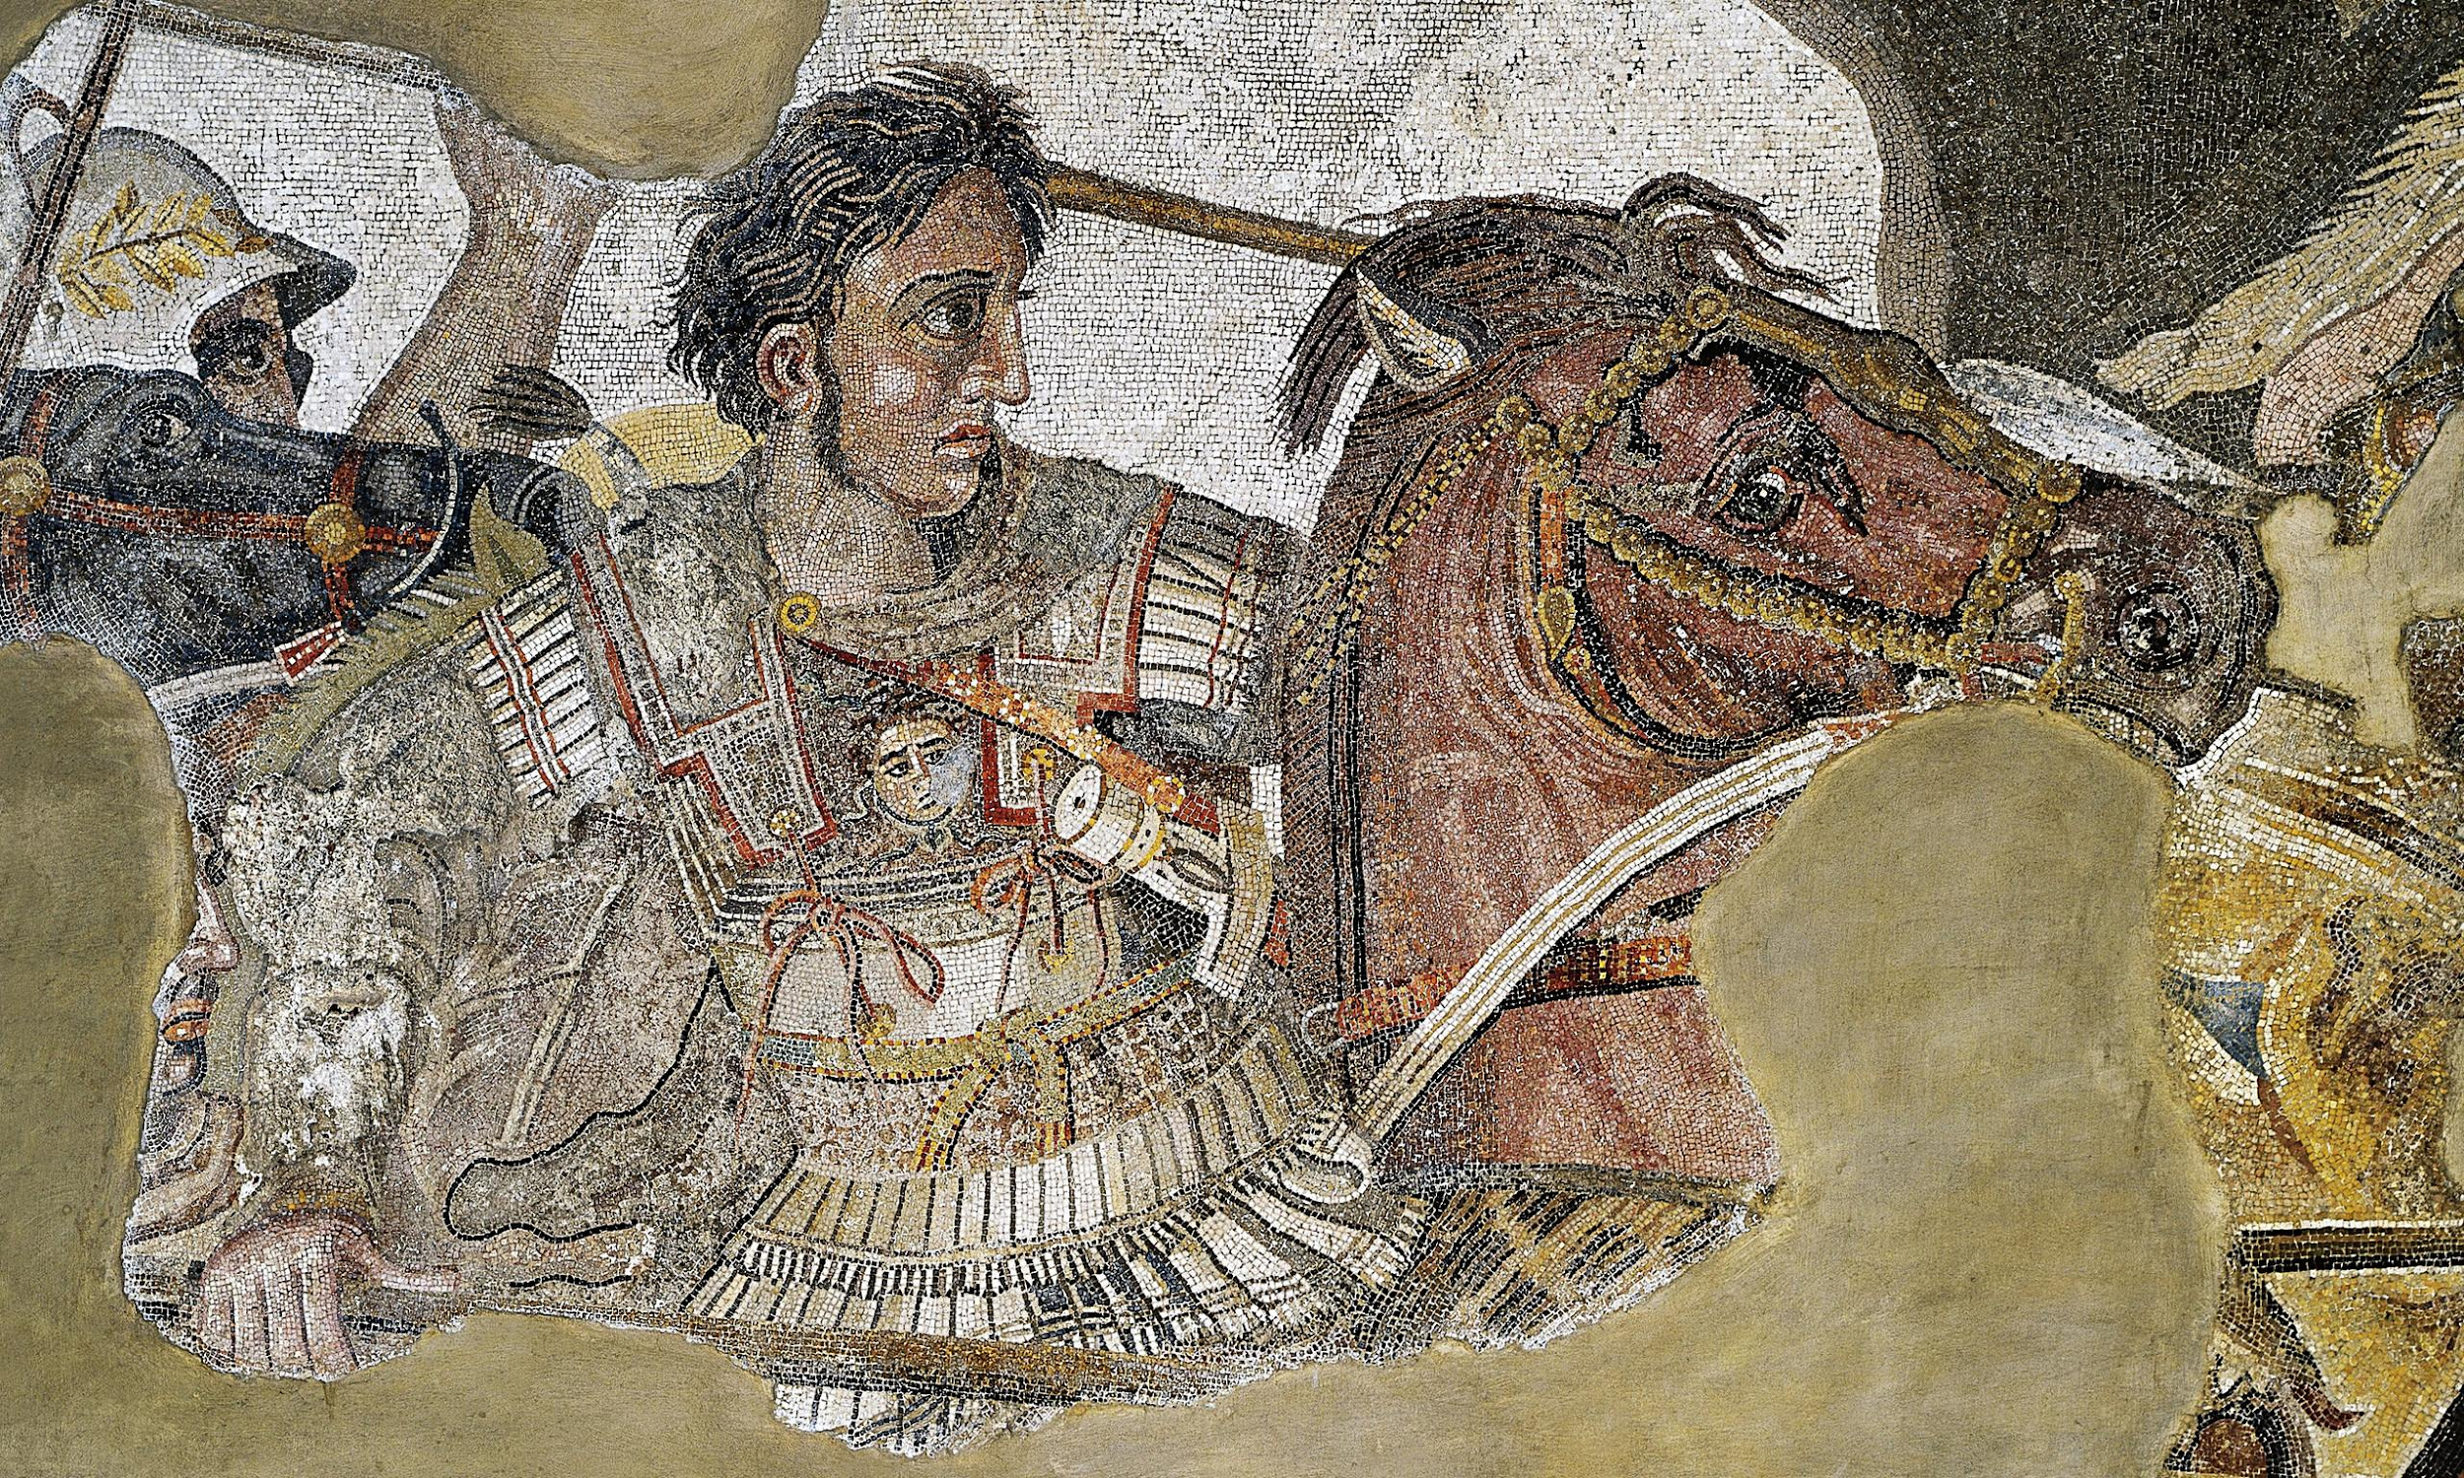
RISE TO POWER
Alexander
Ashoka
Became King in 336 BC
Not first in line for throne
Taught by Aristotle
Phillip assassinated
Killed rivals for the throne
Reigned 269-233 BC
Bloody struggle for the throne.
Murder of 99 brothers
Born in past life - Jaya.

Slide 3
ROLE OF VIOLENCE
Alexander
Ashoka
Consolidation of his rule
Torture just like the Persians
Attitudes to Zoroastrians.
Definition of name, and nickname given to him.
Ashoka’s Hell
Ashokavadana - disguise of torture chamber.
Kalinga War - enormous loss of life
Result - revolutionary change in ideology: Buddhism.
“
The accursed Evil Spirit, the Wicked One, in order to make men doubtful of this religion, instigated the accursed Alexander, the westerner who was dwelling in Egypt, so that he came to the country of Iran with severe cruelty and war and devastation; he also slew the ruler of Iran,note and destroyed the metropolis and empire, and made them desolate.
”

Slide 4
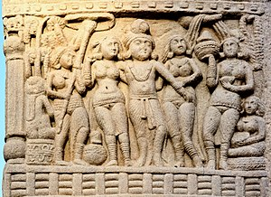
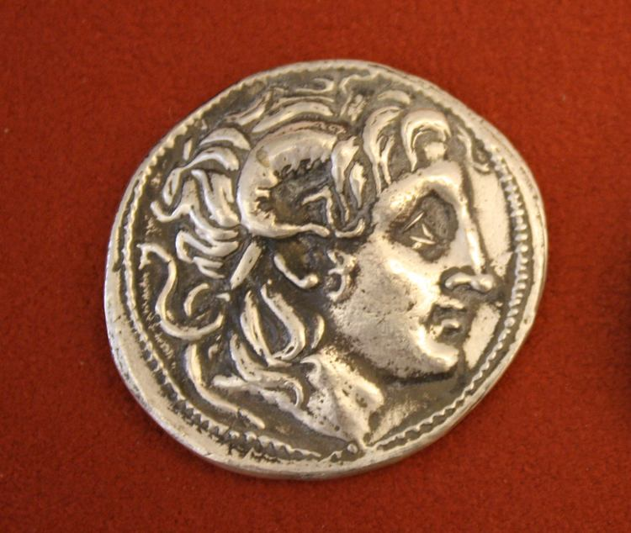
RELATIONSHIP TO RELIGION
Alexander
Ashoka
Stylized himself as Ammon Zeus and Hercules and made himself Egyptian god
Created a god myth while he was still alive
Buddhism conversion in 263 BC
As shown in his Edicts

Slide 5
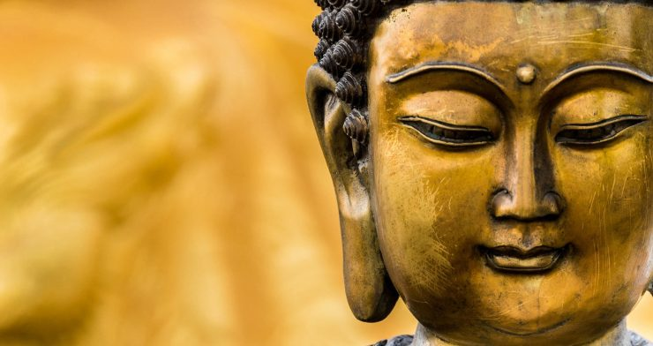
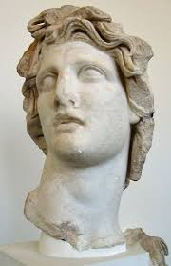
LEGACY
Alexander
Ashoka
Lots written about alexander- source Arrian, Polybius, Diodorus
Paintings and art
Empire in turmoil and spilt, no clear succession
Not a lot written about him- myths and inscriptions, edicts
Considered on of the best rulers
50 year succession of weaker kings
Territory shrunk after his death
Spread of Buddhism, seen as a role model to leaders within the Buddhist community

Slide 6
HOW IS THIS COMPARISON HELPFUL?
The difference between what makes a leader great in the East and in the West . They both were called ‘Great’
How a ruler’ s stylized and presented himself to his people and to history? Manipulated history?
The difference between having a state religion of Alexander compared to a open religion?

