Slide 1
Pre-Inca Andean Cultures
Leo Crozier, Simone La Falce, Theo Guinness

Slide 2
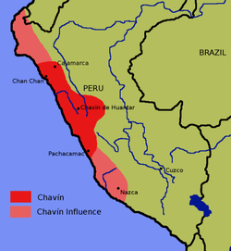
Chavín Culture
An extinct, prehistoric civilization, named for Chavín de Huantar, the principle archaeological site at which artefacts have been found
Developed in the northern Andean highlands of Peru from 900 BCE to 200 BCE
It extended its influence to other civilizations along the coast
The Chavín is the main culture of the Early Horizon period in highland Peru, characterized by the intensification of the religious cult, the appearance of ceramics closely related to the ceremonial centers, the improvement of agricultural techniques and the development of metallurgy and textiles

Slide 3
Achievements of the Chavín:
Architecture: The Chavín de Huantar temple’s design shows complex innovation to adapt to the highland environments of Peru.
To avoid the temple flooding and being destroyed, the Chavín created a successful drainage system consisting of several canals built under the temple which acted as drainage
Evidence of acoustic understanding – during the rainy season water would rush through the canals and created a roaring sound like a jaguar (a sacred animal for the Chavín)
The temple is built from white granite and black limestone – these materials are not found in the vicinity of the Chavín site and so it is possible that leaders organized many workers to bring these special materials from far away, rather than using local rock deposits
Domesticated Camelids: such as llamas, used as pack animals, for fibre and meat. Production of ch’arki (dried llama meat/jerky) – commonly traded by camelid herders and was the main economic resource for the Chavín
Agriculture: cultivated several crops, including potatoes, quinoa, and maize

Slide 4
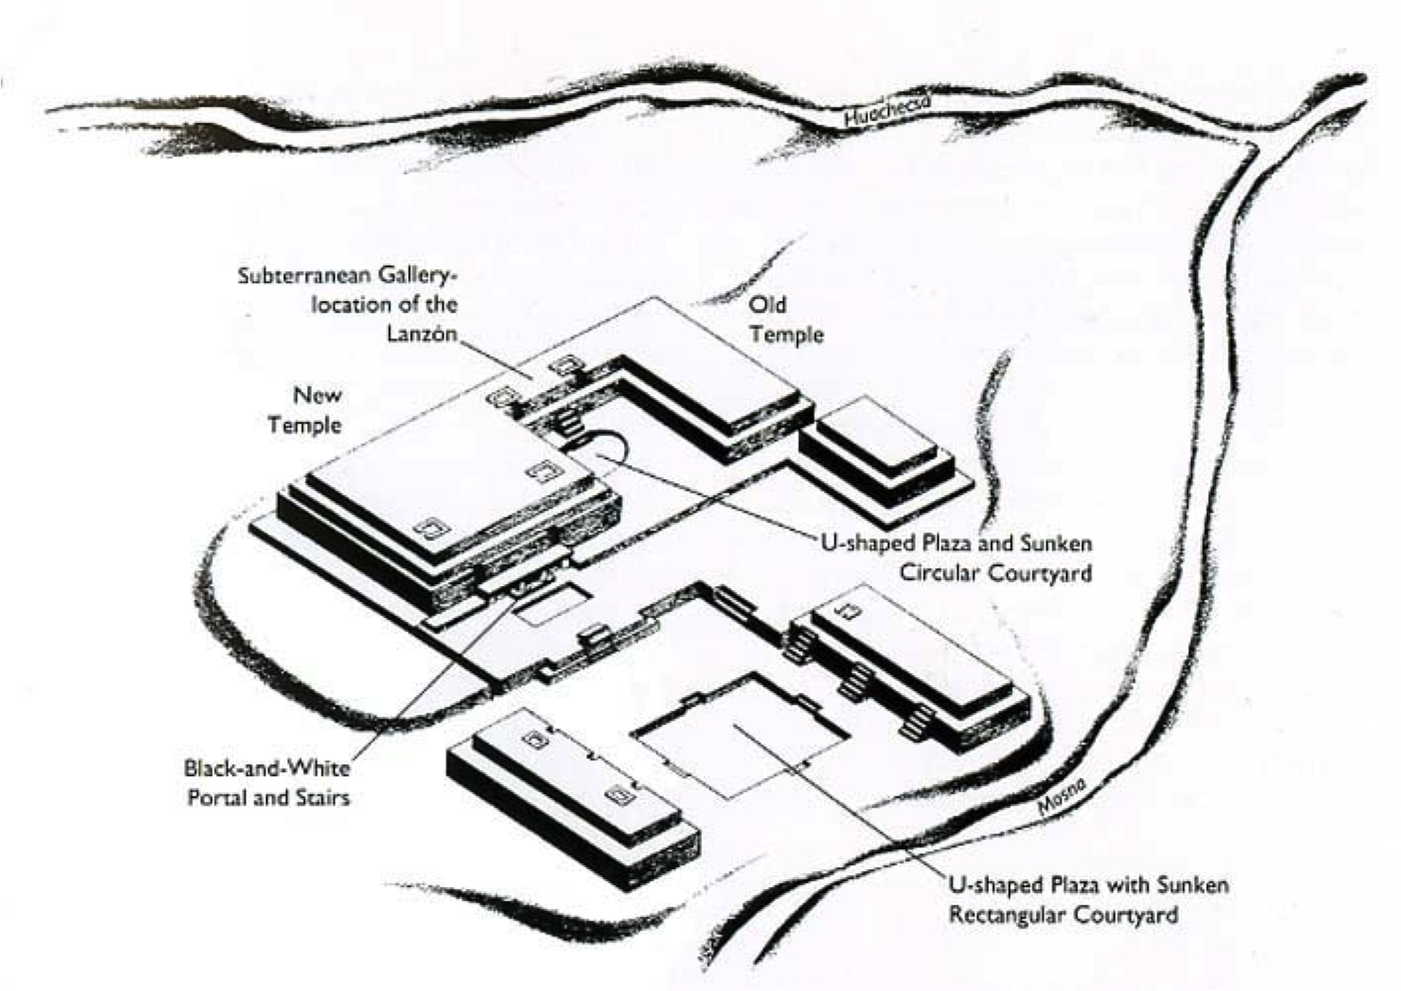
Chavín Art and Architecture:
Architecture: The site uses both internal and external architecture.
Construction of the ”Old Temple” took place from around 900 to 500 BCE
Construction of the “New Temple” took place from around 500 to 200 BCE
Lack of residential structures, occupational deposits, generalized weaponry and evidence of storage

Slide 5
Chavín Art and Architecture:
Art:
The Chavín culture represents the first widespread, recognizable artistic style in the Andes
Constant evidence within all types of Chavín art of human-animal interactions, which was reflective of societal interconnections and how the Chavín viewed themselves connected with ”the other world”
General evidence of the use of psycho-active plants in ritual – the San Pedro cactus is often seen on various art forms, sometimes being held by humans, which is used as evidence to support the use of the plant
Coastal Chavín pottery reveals two types of vessels (a polyhedral carved type and a globular painted type) The art is intentionally difficult to interpret and understand, since it was intended only to be read by high priests of the Chavín cult, who could understand the intricately complex and sacred designs (Raimondi Stele)
Chavín art decorates the walls of the temple and includes carvings, sculptures and pottery
Depictions of exotic creatures found in other regions, such as jaguars and eagles, rather than local plants and animals

Slide 6
Tello Obelisk:
A prismatic white granite monolith carved in low relief to represent a caiman and covered with Chavín symbolic carvings, such as bands of teeth and animal heads.
Considered to be an object of worship.
Features one of the most complex stone carvings known in the Americas for its time.

Slide 7
Tenon Heads:
Stone heads which originally protruded from the exterior wall of the temple at the site of Chavín de Huantar.
Over 100 such heads have been found, each is unique and represents the transformation of a shaman into a supernatural fanged creature. Depicted sacred animals of pre-Colombian Peru: the heads of felines, serpents and birds.
The bird symbolized the celestial world of the skies; the feline represented earthly power; while reptiles and snakes were associated with the underworld. Human heads were also depicted, probably to invoke the ancestors of a community’s shared bloodline

Slide 8
The Lanzón:
Considered the most important statue of the central deity of the Chavín. It is housed in the central cruciform chamber of a labyrinthian series of underground passages in the Old Temple.
Devotees would be led into the maze of pitch-black tunnels, eventually coming face to face with the sculpture. The worshipers’ disorientation, in addition to the hallucinogenic effects of the San Pedro cactus they were given before entering, may have heightened the visual and psychological effects

Slide 9
Chavín Sphere of Influence:
Wide sphere of influence throughout surrounding civilizations, due to their location at a trade crossing point between the deserts and the Amazon jungle
Pacopampa: located north (about a 3-week-trek) of Chavín, has renovations on the main temple that are characteristic of Chavín culture
Caballo Muerto: a coastal site in the Moche valley region, has an adobe structure created during renovation of the main temple, the adobe is related to Chavín influence
Garagay: a site in the modern-day Lima region, has variations of the characteristic Chavín iconography, including a head with mucus coming from the nostrils
At the site of Cerro Blanco: in the Nepena valley, excavations revealed Chavín cermaics
Warfare doesn’t appear to be a significant element:
Lack of basic defensive structures in Chavín centres
Warriors not depicted in art
Effective social control may have been exercised by religious pressure, and the ability to exclude dissidents from managed water resources
Climate and terrain of the neighbouring areas outside the managed land were a daunting option for farmers wishing to flee the country

Slide 10
Chavín Presence of Elite:
Power legitimized through the belief in the small elite having a divine connection; shamans derived power and authority from their claim to a divine connection
The community believed in and had a desire to connect with the divine
Strategic Manipulation: a vehicle of change which shamans could use to produce authority – archaeological evidence shows several examples of reinterpretation, use of psychotropic drugs, and landscape altering

Slide 11
Chavín Religion and Ritual:
Architecture has religious influence and significance. The sacred spaces and structures within this society were evident to have ritualistic and potentially religious purposes
The site of Chavín was considered to be sensory, the architectural structure and design elicited a feeling through the senses, through sight and touch
Sacred spaces, such as plazas, were designed to mainly disrupt visual impact, meaning that the sacred architecture was designed to be experienced more so than actually viewed
Configuration of the site also emphasizes that there was a presence of high-ranked officials – the architecture within Chavín was dictated by these individuals to keep the ritual elements of their culture prominent
The details and formatting of each building, in essence, created the effect that those participating in ritual were experiencing their religious phenomena

Slide 12
Chavín Religious Art and deities:
Art:
Reflective of the landscape around the Chavín and everyday experiences they lived through
Artistic impressions included images of jaguars and hybrid humans with felines, avians, and crocodilian features – believed to have been made by shamans under the influence of psychedelic drugs
Deities:
Most important was the Lanzón – believed to be a founding ancestor who ahd oracle powers
Other deities reflected the landscape around Chavín, including animals in nature and the cosmos, and included figures such as crested eagles, hawks, serpents, crocodiles (caymans), and jaguars. They were intermingled with human aspects, becoming more of a hybrid
The Chavín were also interested in binaries and manipulating them, such as showing men and women, the sun and the moon, and the sky and water in the same image

Slide 13
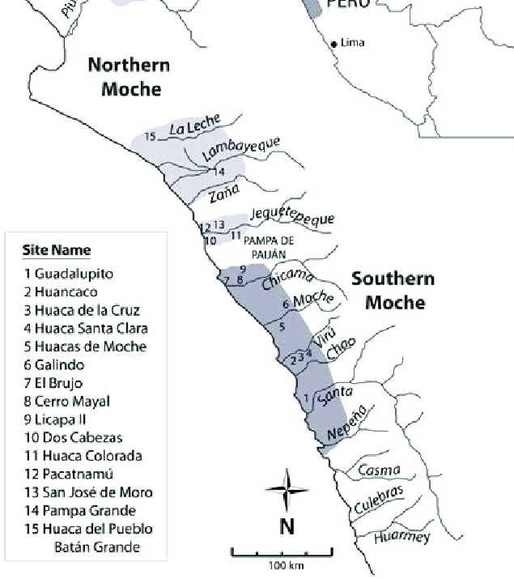
Moche Culture
The Moche civilization flourished in Northern Peru with its capital near present-day Moche, Trujillo, Peru from about 100 to 700 AD during the regional development epoch
Many scholars contend that the Moche were not politically organized as a monolithic empire or state
Agriculturally based, with a significant level of investment in the construction of a network of irrigation canals for the diversion of river water supply to supply their crops
Their culture was sophisticated; and their artefacts express their lives, with detailed scenes of hunting, fishing, fighting, sacrifice, sexual encounters and elaborate ceremonies
The Moche are particularly noted for their elaborately painted ceramics, gold work, monumental constructions (huacas) and irrigation systems

Slide 14
Moche Cultural Sphere
The Moche cultural sphere is centered on several valleys on the north coast of Peru
Southern Moche region: believed to have been the heartland of the culture, originally comprised the Chicama and Moche valleys. The Huaca del Sol/ Huaca de la Luna site was probably the capital of this region
Northern Moche region: included three valley systems
Appears there was a lot of independent development among these various Moche centers. They all likely had ruling dynasties of their own, related to each other
Centralized control of the whole Moche area may have taken place from time to time, but appears infrequent

Slide 15
Moche Material Culture:
Moche pottery some of the most varied in the world
At least 500 Moche ceramics have sexual themes – the most frequently depicted act is anal sex, with scenes of vaginal penetration being very rare
Most pairs are heterosexual, with carefully carved genitalia to show that the anus, rather than the vagina, is being penetrated
Images of breastfeeding infants while the couple have sex are often shown
Fellatio is sometimes represented, but cunnilingus is absent
Some depict male skeletons masturbating, or being masturbated by living women
Irrigation was the source of wealth and foundation of the empire, so the Moche culture emphasized the importance of circulation and flow – Moche artwork frequently depicted the passage of fluids through vulnerable human orifices
The colouration of Moche pottery is often simple, with yellowish cream and rich red used almost exclusively on elite pieces. White and black are rarely used

Slide 17
Moche Religion:
Both iconography and the finds of human skeletons in ritual contexts seem to indicate that human sacrifice played a significant part in the Moche religious practices
These rites appear to have involved the elite as key actors in a spectacle of costumed participants, monumental settings, and possibly the ritual consumption of blood
Practiced Sacrifice and potential cannibalism

Slide 18
Moche Links with other cultures:
Chronologically, the Moche was an Early Intermediate Period culture, which was preceded by the Chavín horizon, as well as the Cupinisque, and succeeded by the Huari and Chimu
The Moche co-existed with the Ica-Nazca culture in the south.
The coastal Moche culture also co-existed (or overlapped in time) with the slightly earlier Recuay culture in the highlands.
The Moche also interacted with the neighbouring Viru culture. Eventually, by 700 CE, they established control over the Viru

