Slide 1
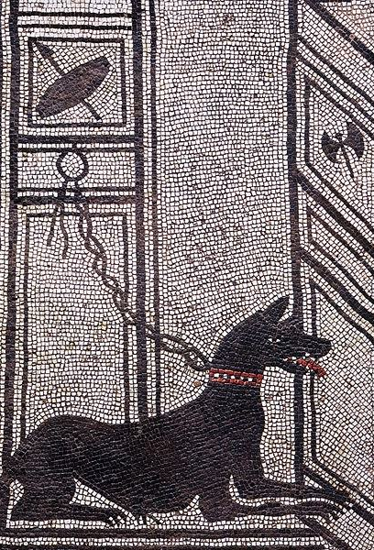
Dogs in the ancient world
A study of comparison.

Slide 2
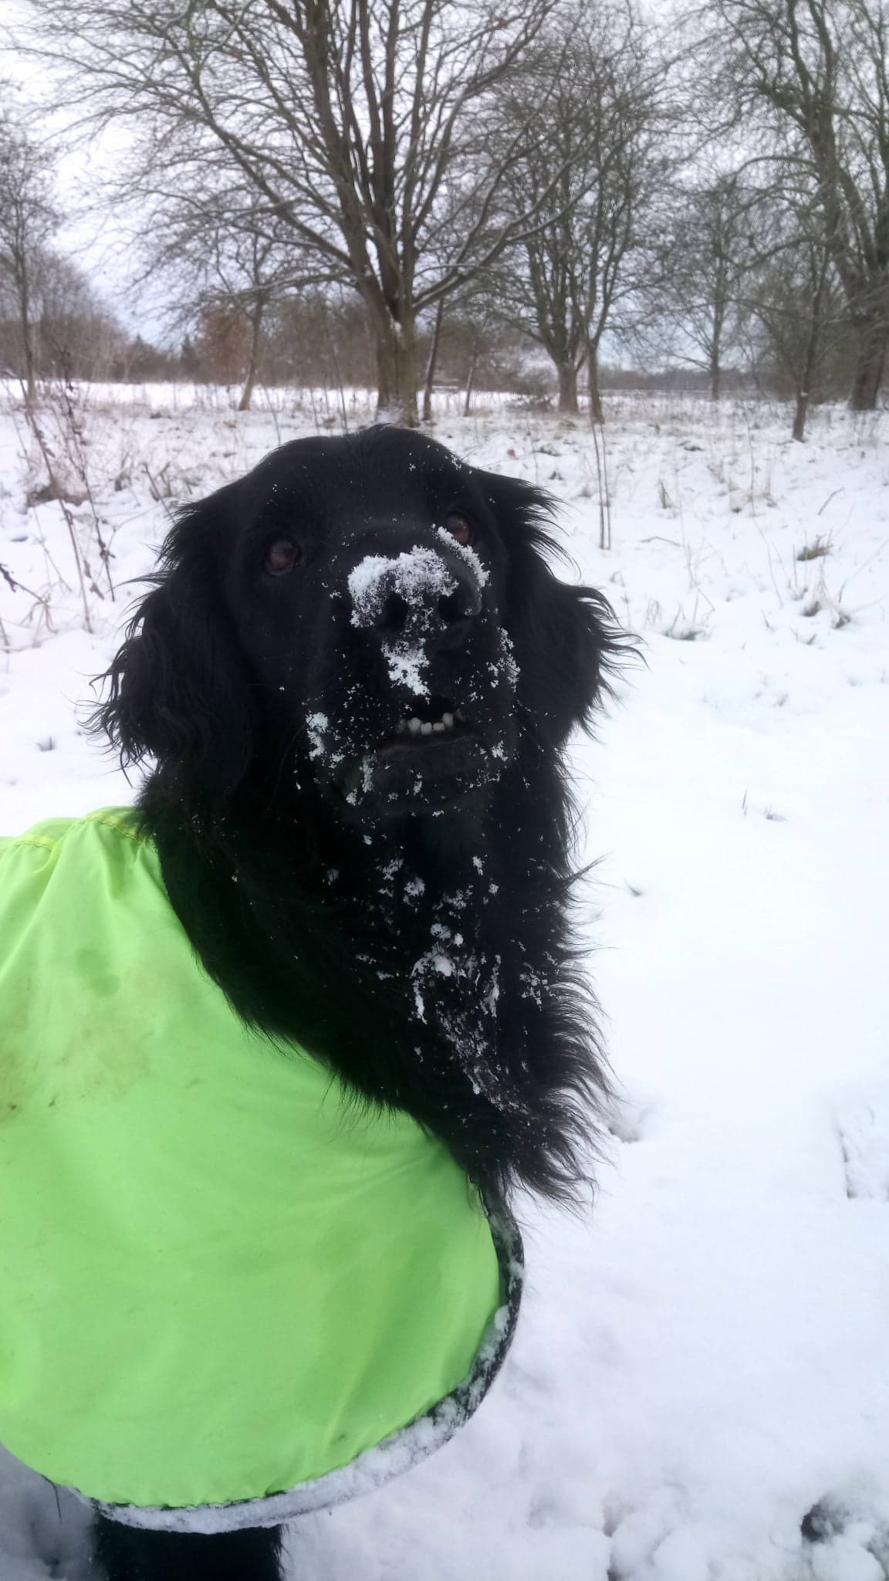
Really Really Ancient Dogs
Dogs have been a part of human history since before the written word.
The world’s oldest temple may have been built to worship the dog-star;
Temple of Gobekli Tepe
This temple in Turkey contains findings that date back for more than 12,000 years. There was clear evidence in these findings that domesticated dogs already existed.
The tomb of Natufian.
Also from 12,000 years ago, this tomb was discovered in Israel. Inside, archaeologists found the remains of an old man buried with a puppy.

Slide 3
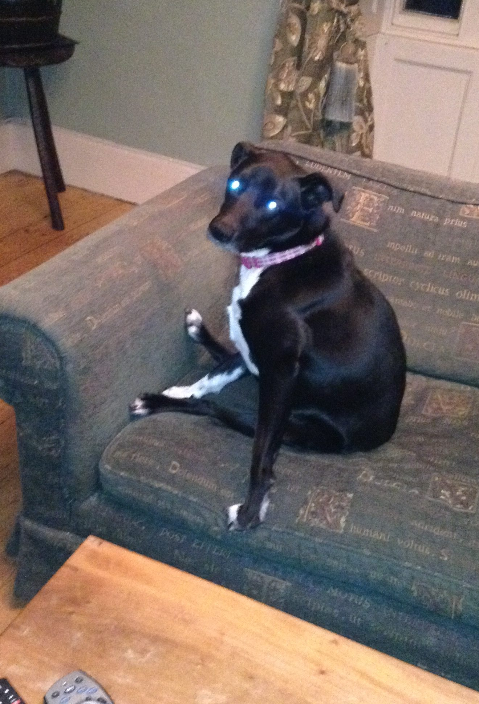
Why dogs?
Domesticated, they served the role of hunters, messengers, guarders, food, sacrifices
Regardless of how dogs came to be domesticated, they became friends to humans quite early in history and have remained so
Stalwart part of society.
In many cultures throughout the ancient world, dogs figured prominently and, largely, were regarded in much the same way that they are today.
Dogs were seen as faithful companions, hunters, guardians, spirit-guides, and as a treasured part of the family.

Slide 4

Role of Dogs: Supply in demand?
Ashkelon dog cemetery -
In Israel and was used as a burial site for dogs in fifth to third centuries BC
The majority of the dogs buried there were puppies.
It could have been a breeding facility for dogs that were to be traded across Asia.
Could have been part of a religious cult site where dogs were used for their saliva which was thought to have healing powers.
It shows that dogs were used on a mass scale
Idea of dogs being a product

Slide 5
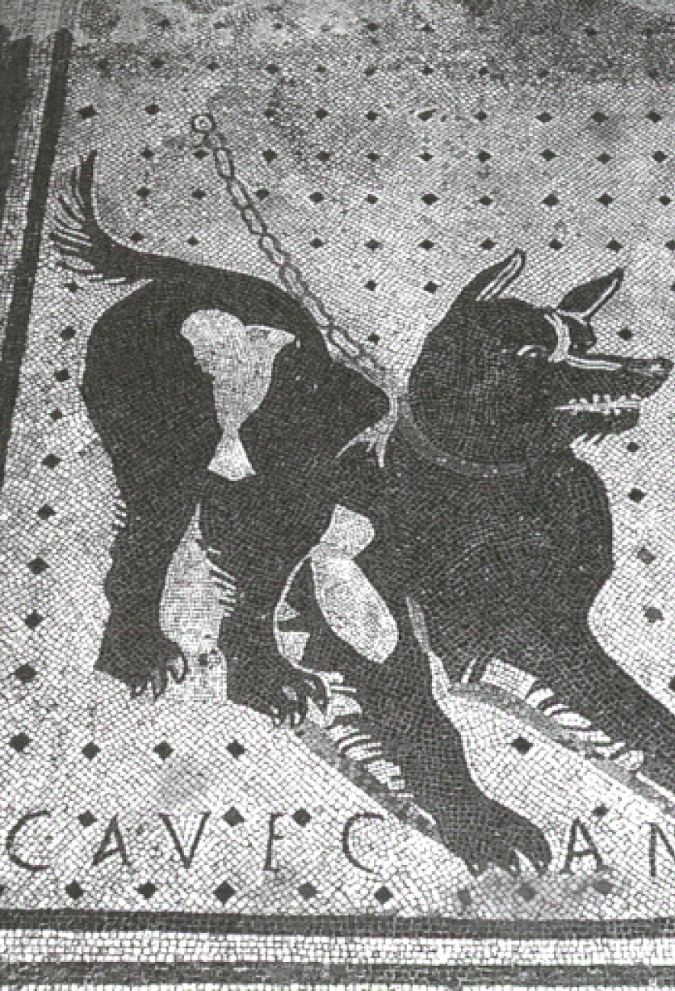
Role of Dogs: Guardians of Rome
The well-known mosaic, Cave Canem (Beware of Dog) shows how dogs were appreciated in Rome as guardians of the home.
Virgil wrote;
“Never, with dogs on guard, need you fear for your stalls a midnight thief”(Georgics III, 404ff)
Varro, in his work on living in the country, says that every family should have two types of dog, a hunting dog and a watchdog (De Re Rustica I.21)
Dogs protected people not only from wild animals and thieves but also from supernatural threats.
The goddess Trivia (the Roman version of the Greek Hecate) was the Queen of Ghosts, haunted crossroads and graveyards, and was associated with witchcraft.
She would silently attack people but dogs were always aware of her presence; a dog who seemed to be barking at nothing was thought to be warning one against the approach of Trivia or some other disembodied spirit.

Slide 6

Role of dogs: the pet distinction?
My eyes were wet with tears, our little dog, when I bore you [to the grave]. So, Patricus, never again shall you give me a thousand kisses. Never can you be contentedly in my lap. In sadness, I buried you, as you deserve. In a resting place of marble, I have put you for all time by the side of my shade. In your qualities, you were sagacious, like a human being. Ah, what a loved companion we have lost!”
“To Helena, foster child, soul without comparison and deserving of praise.”
“Myia never barked without reason, but now, he is silent.”

Slide 7
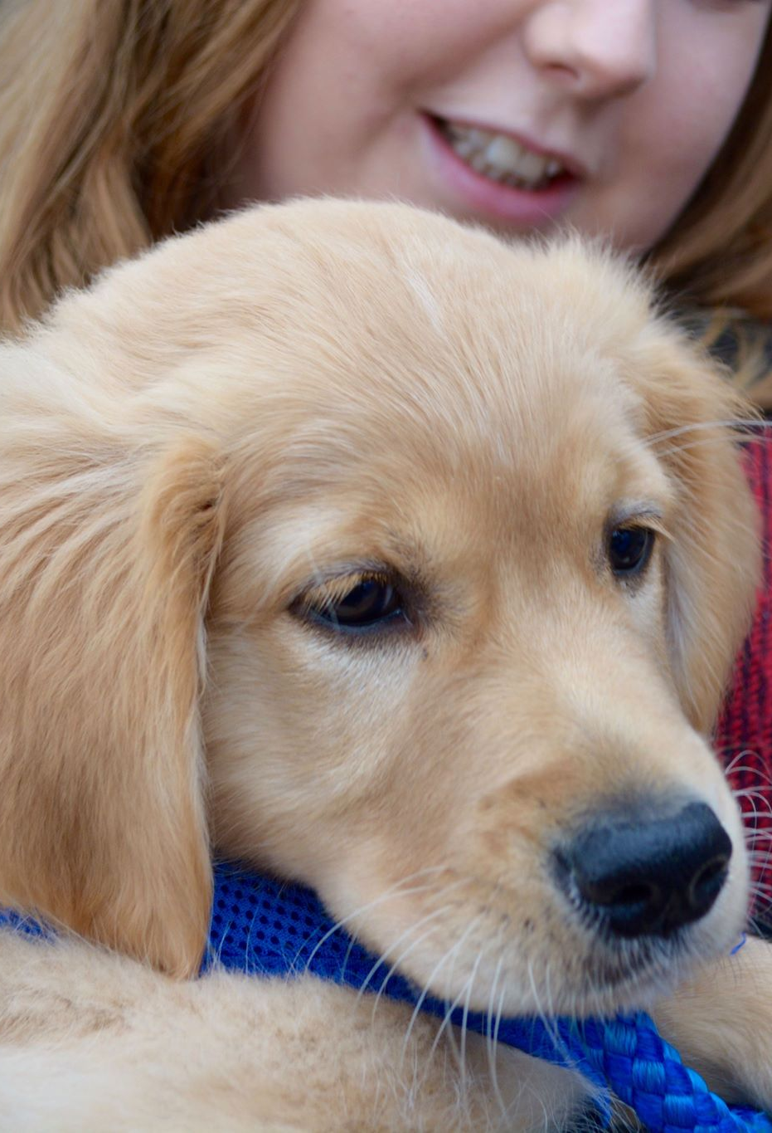
Dogs in ancient Texts
In the Hindu epic Mahabharata, Yudhishthira is a prince.
He goes on long travels with a dog as a companion
At the end of his journey he was offered a place in heaven but refused because the dog couldn’t go with him
Dogs are loyal and we shouldn’t abandon them
It turned out that the dog was his godfather in disguise.
Dogs were valued as more than just a tool in Indian culture, they were part of the family.

Slide 8
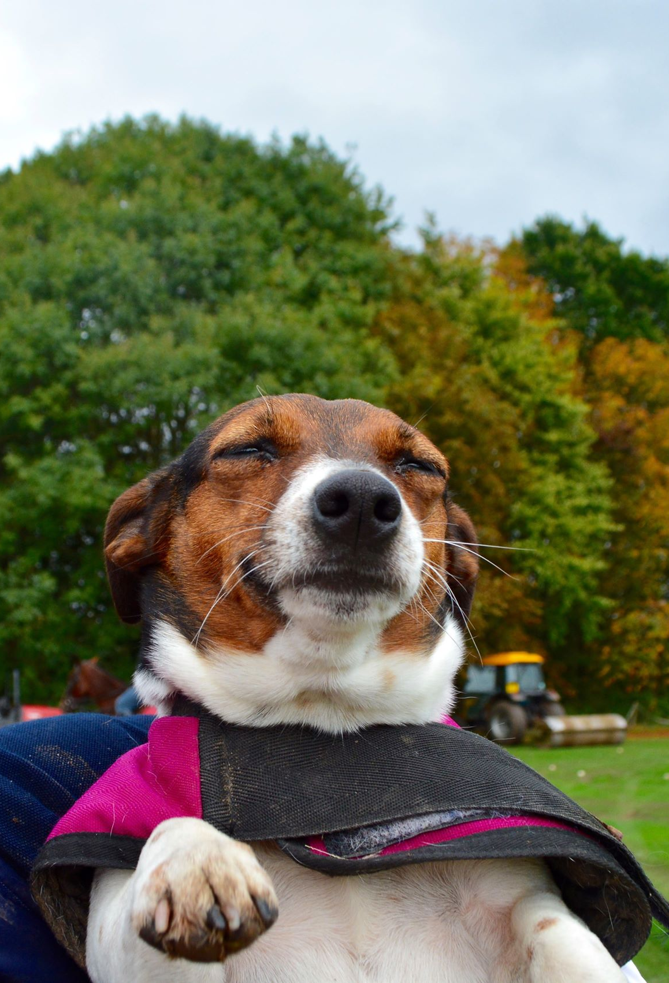
What do we learn about society?
do dogs affect our ability to think critically about history?
Consider western opinions of China eating dogs.
We villainise them- it forms part of our modern perspective
By looking into cultures that interacted with dogs positively- do we naturally look positively on these people?
Do we villainise those who eat/ sacrificed dogs.
Are we aware modern perspectives can be influenced like this?
Do we feel more connected to Romans and places where we can see evidence of dogs being loved similar to our modern society?
‘Unfortunately, during ancient times, when dogs were used as messengers, they usually died. Their job was to swallow and carry a copper tube with a message inside. The only way to recover the message was to open the dog to get it out’- how does that make us feel.
This philosophy can apply to any topic or field of study. If something is in direct contrast to what we feel is morally right, how does that then affect how we seeing the opposing culture as a whole.

Slide 9
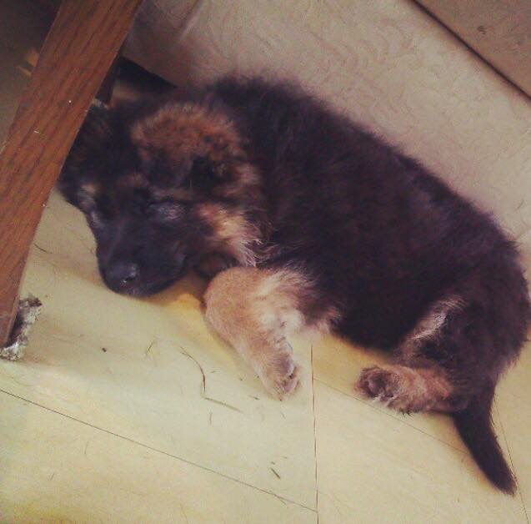
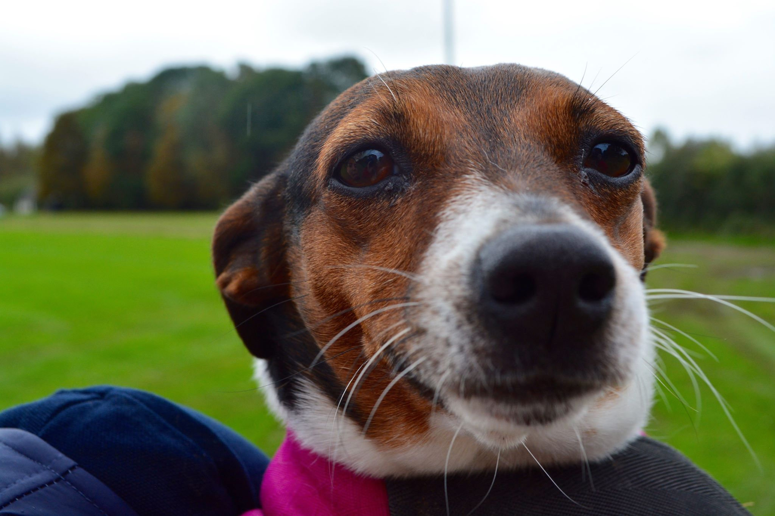

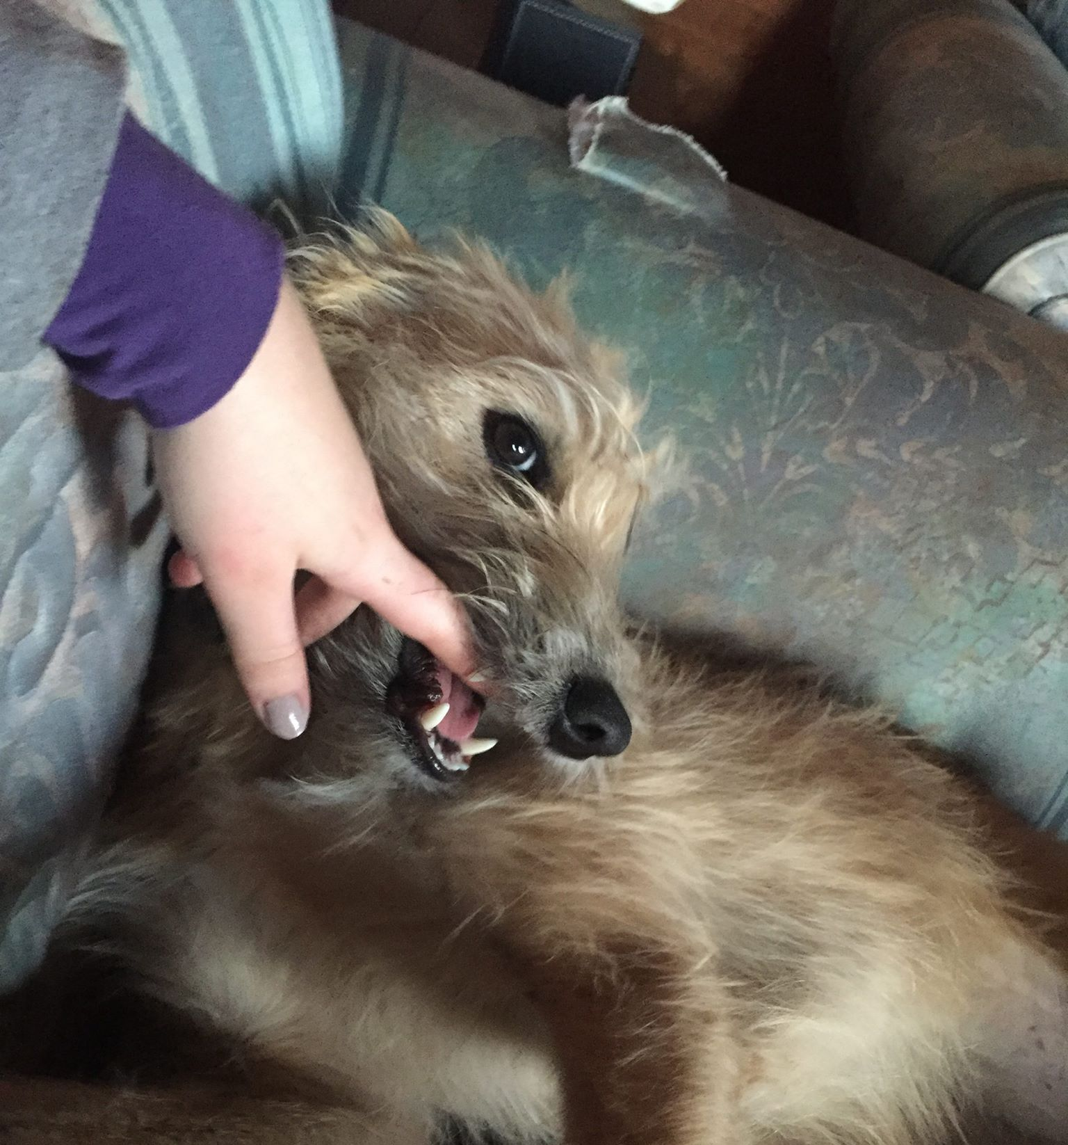

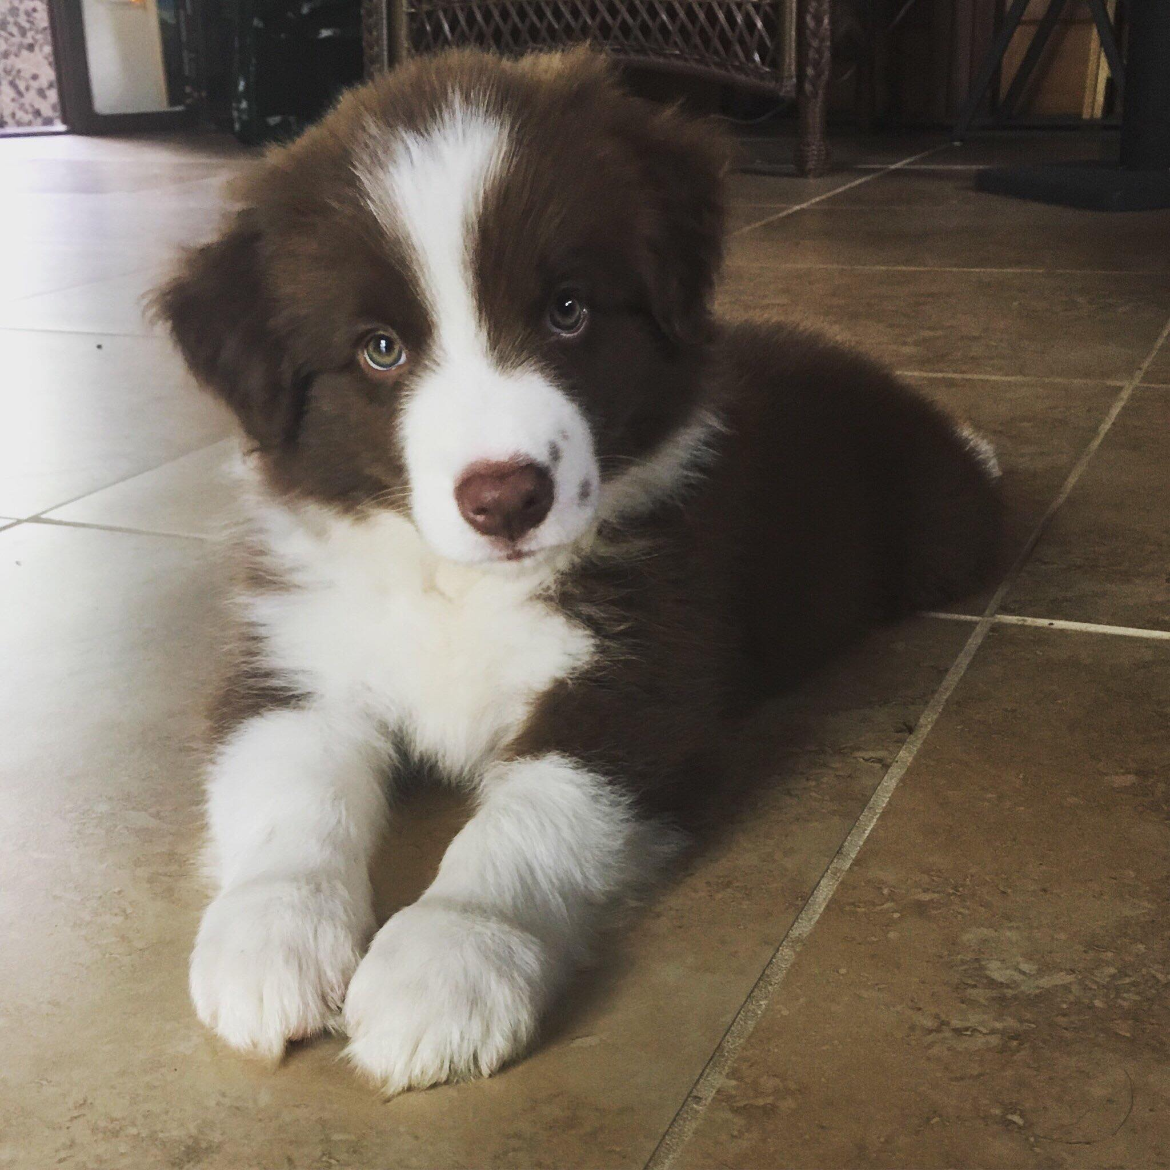
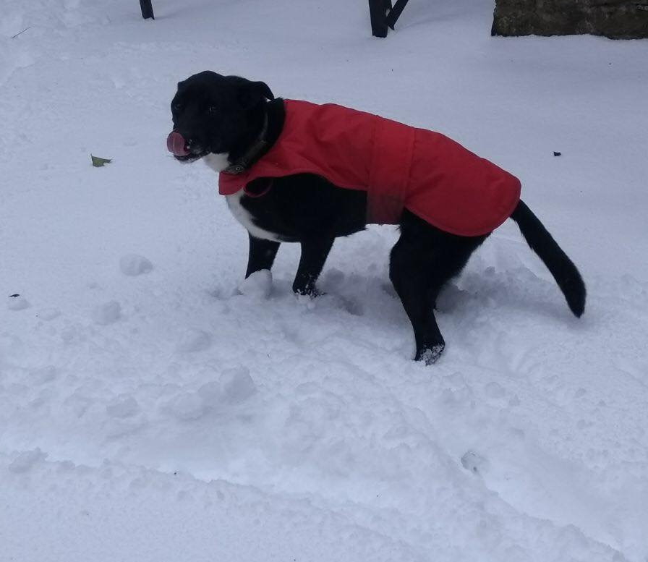
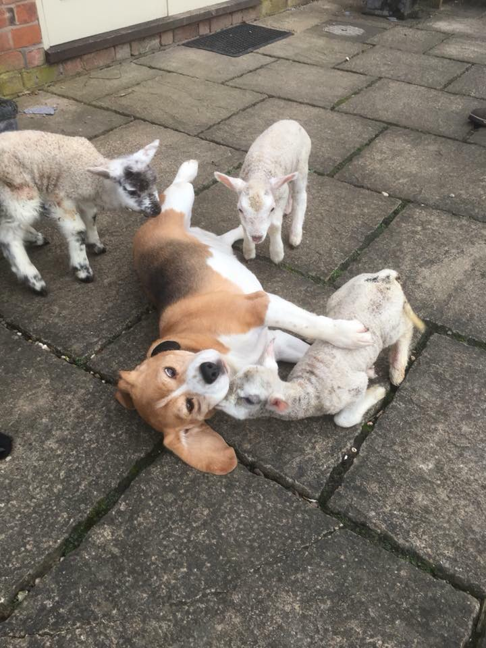

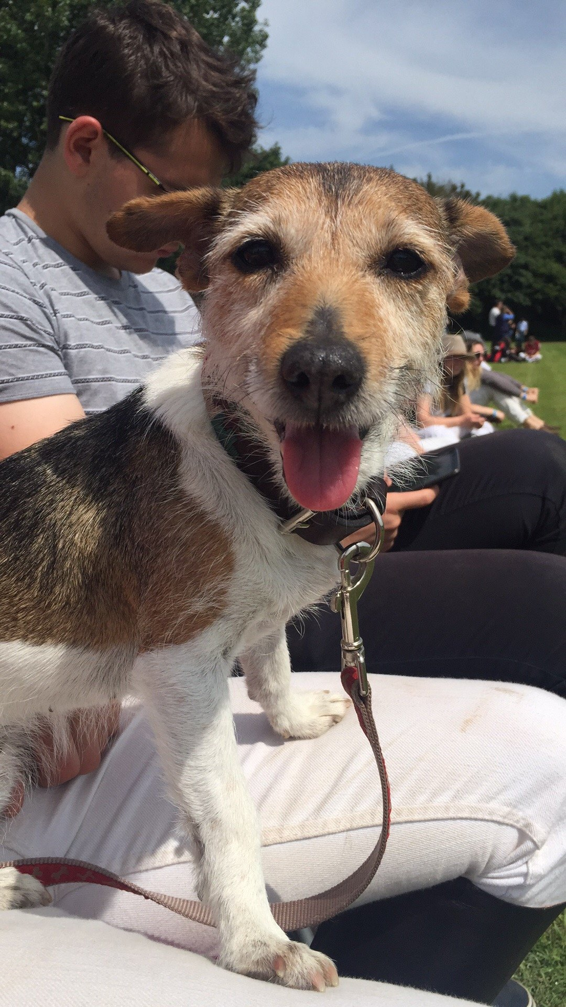

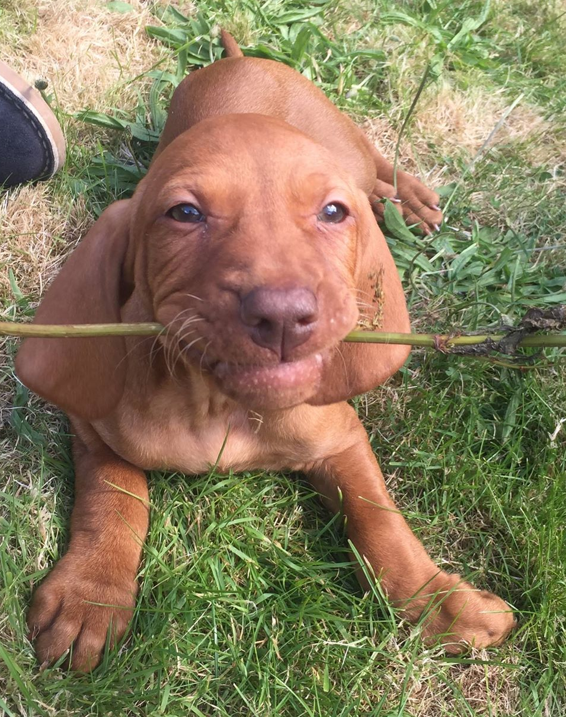
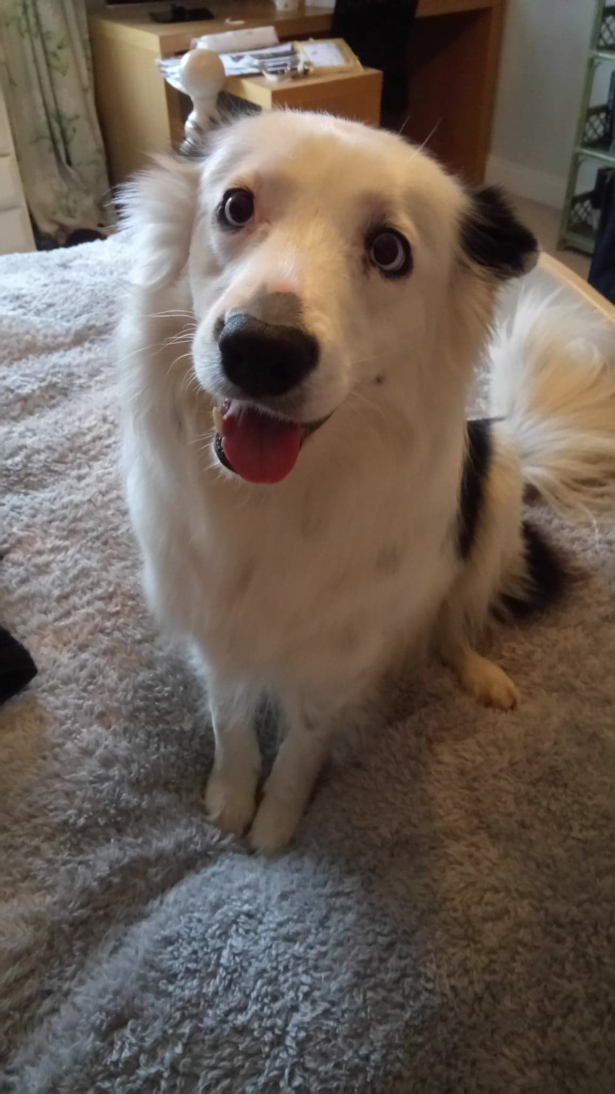
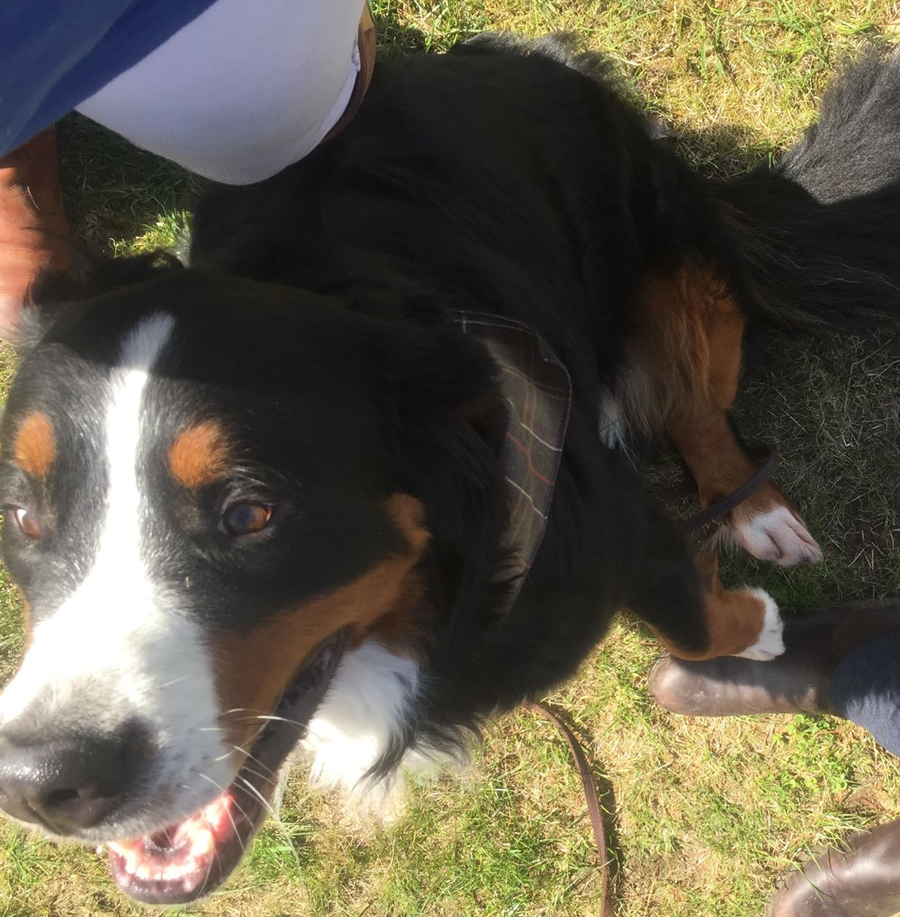

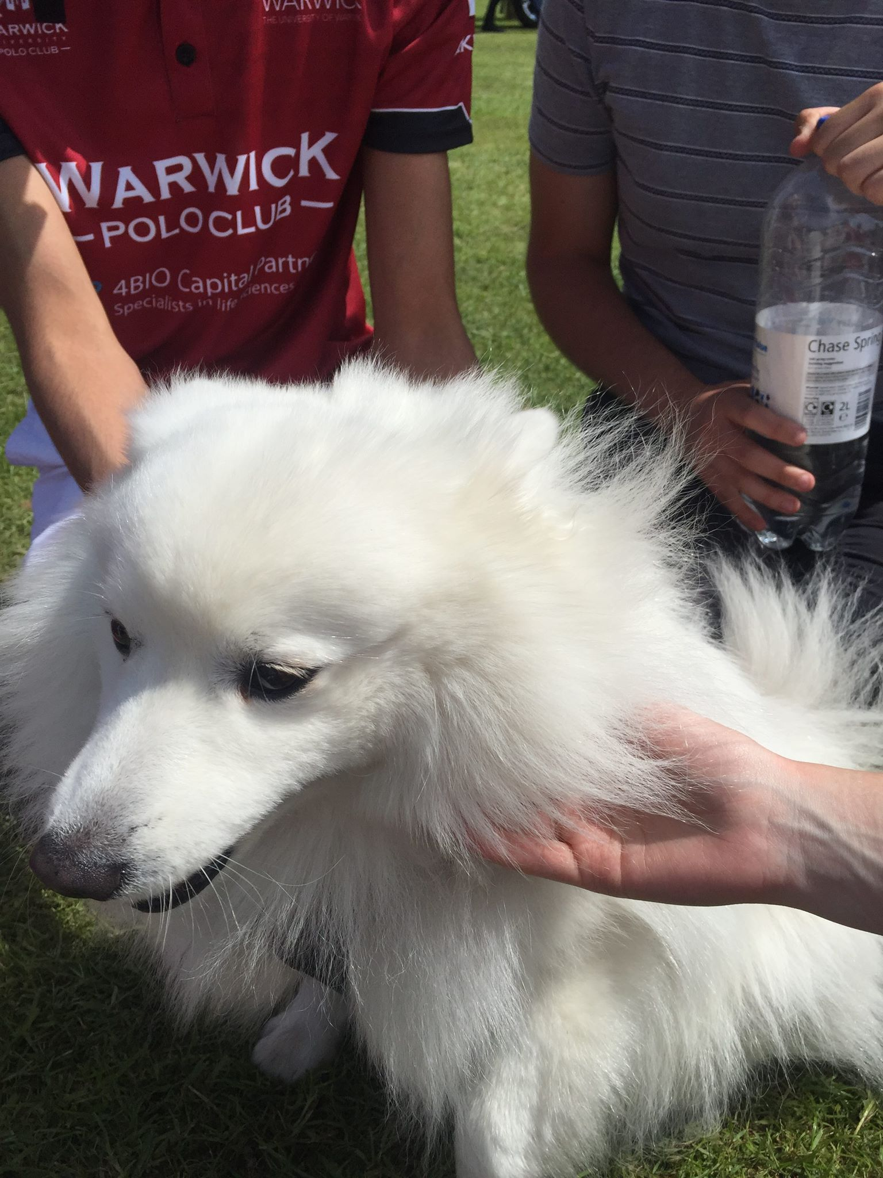
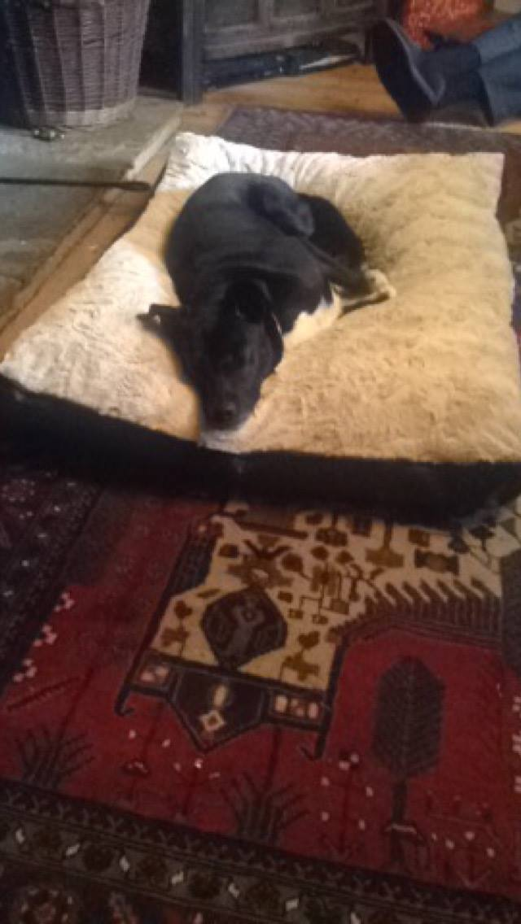
Any Questions?

Slide 10
Sources
https://www.newscientist.com/article/mg21929303-400-worlds-oldest-temple-built-to-worship-the-dog-star/
https://www.ancient.eu/article/184/dogs-in-the-ancient-world/
https://brewminate.com/domestication-and-contribution-of-dogs-in-the-ancient-world/
https://www.thedodo.com/9-touching-epitaphs-ancient-gr-589550486.html?fbclid=IwAR13hFR3jd6fRewR03-LqYXxvmPykPZn4AuyzhQ26SzURie1U1oXYe8Qalk
https://ia801400.us.archive.org/11/items/societypoliticsi00abbouoft/societypoliticsi00abbouoft.pdf
https://brewminate.com/domestication-and-contribution-of-dogs-in-the-ancient-world/?fbclid=IwAR2eUZ5K14EVgJP65MpVztZCpgGLRIkSz3L6XRNr5uPEcW-N3chNKrsYnCU
http://penelope.uchicago.edu/~grout/encyclopaedia_romana/miscellanea/canes/canes.html
https://adfamiliares.classicsforall.org.uk/the-roman-family-pet/

