Slide 1
Western Influences in Gandharan Art
Alice, Holly & Megan

Slide 2
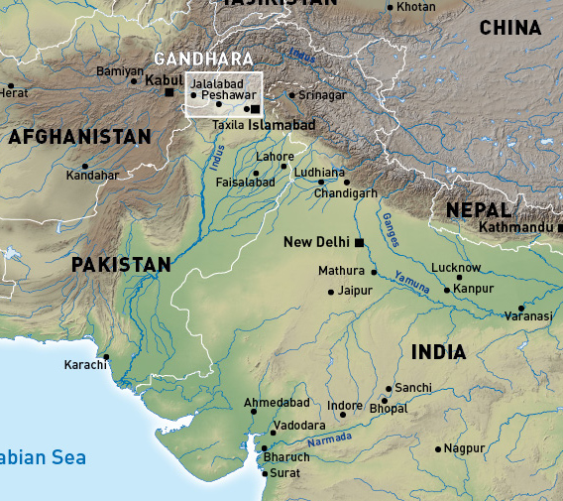
Gandharan Art
1st century BCE – 7th Century CE
Many influences, most interestingly Greco-Roman
Flourished during Kushan Dynasty (formed by migrating Yuezhi, c. 1st Century BCE)
Contemporary (though dissimilar) to the Kushan style of art coming from Mathura

Slide 3
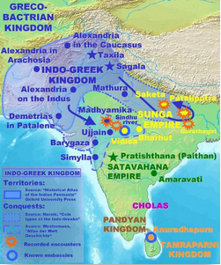
Greeks/Greco-Bactrians in India (map c. 130 BCE)
Migration of Yuezhi from Central Asia into Bactria forces the Greco-Bactrians to settle in Northern India.
Greeks settled in this area since c. 190 BCE in Indo-Greek ‘possessions’, hybrid states politically separate from Bactria.
Northern India conquered by Alexander the Great 330 BCE

Slide 4
Chronological and Dating Issues
Few confirmed fixed dates in Gandharan history
Few artefacts survive with dates inscribed
Dating artefacts can be extremely difficult
Fit works within developed artistic style in order to date

Slide 5
Examples of Western Influences on Gandharan Art Works

Slide 6
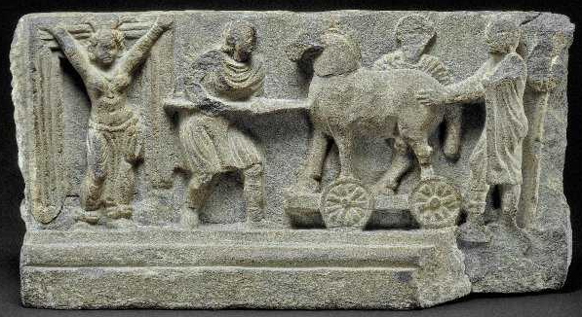
Trojan Horse 2nd/3rd Century CE
Possible Buddhist context
up stairs of a stupa or monastery? (or well: arguments for both)
Jakarta Tale: stories of Buddha’s past life
counter factual version of the myth
intervention works?
Laocoon actually Bodhisattva?
the narrative converted for Buddhist purposes?
Likely origin
Hund: significant place in antiquity
entry point for Alexander the Great into India
Hellenistic
Homeric Myth
Cassandra (barring gate)
Laocoon? (w/ spear)
Priam (bearded)
Sinon (pushing horse)
Clothing (tunics, Drapery)
Stylistically (physicality of figures and realistic proportions)
poses
Indian
Cassandra (drapery around waist, Anklets and necklace between breasts)
Cassandra’s Hairstyle

Slide 7
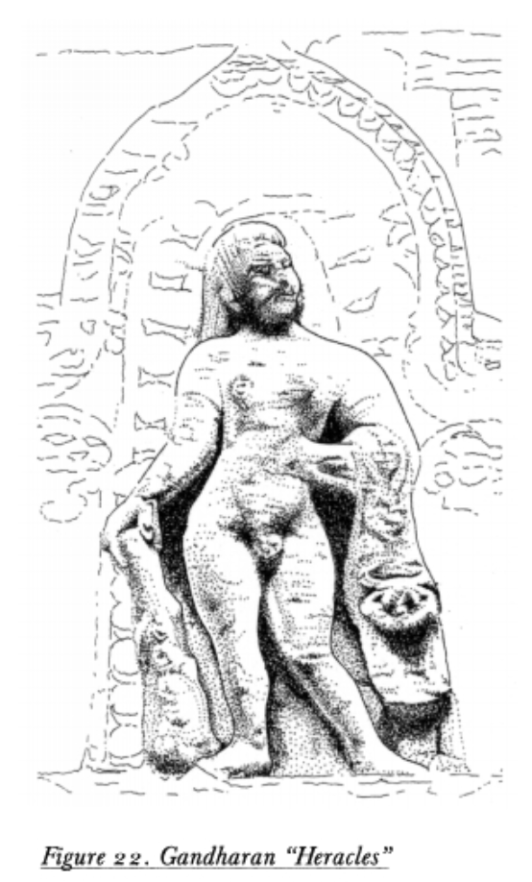
Herakles
‘Modified Heracles’ of Gandharan art
Herakles used in Gandhara to represent Vajrapani, protector and guide of Buddha
The first/ earliest example of Heracles, found in a private collection in Japan
Greek pose, club and lion skin part of Greek cannon
However, lacks the muscular physique, expression deviates from Classical Greek style
Presented in small niche, with this location being typical of Gandharan depictions of Heracles

Slide 8
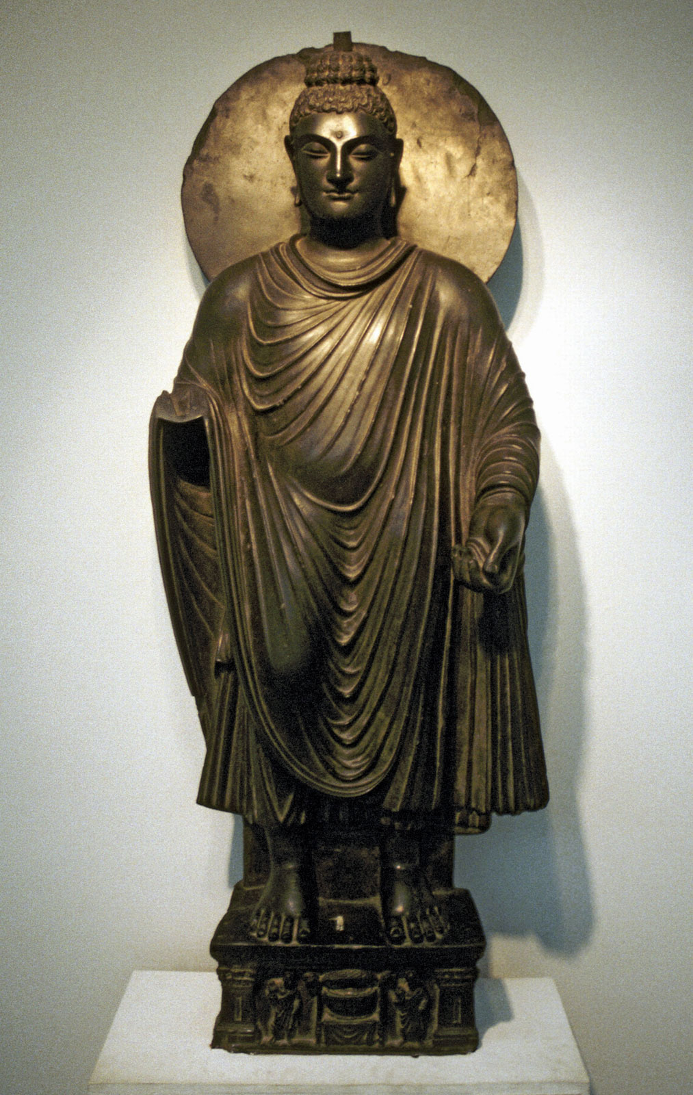
Buddha
C. 2nd Century CE
Drew inspiration from classical Roman religious iconography
Shows connections to western world other than Greek settlers (trade)
From c. 2nd/3rd Century CE Buddhist missionaries travelling from Gandhara
Youthful face in style of Apollo
Standing iconography more popular in Gandhara, sitting in Mathura

