Slide 1
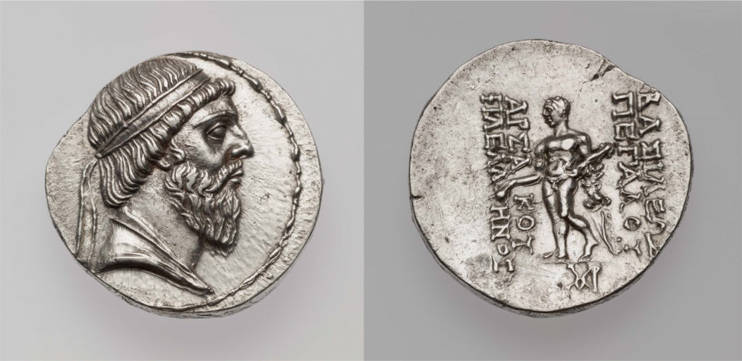
Coin of the Arsacid king Mithradates I, c. 141–138 BCE. On the obverse is a diademed bust of Mithradates; the reverse features Hercules, and describes the king as a “Lover of Greeks.

Slide 2
A bilingual inscription in Greek and Parthian carved onto the right and left thighs, respectively, of a bronze Heracles statue. The text records the victory of the Arsacid king Vologaeses IV over the kingdom of Characene (in Parthian, Meshan) and dates to 151 CE.
Translation of the Greek text
1 In the year 2 according to the Greeks 3 462 [=151 CE], the King 4 of Kings Arsaces 5 Vologaeses, 6 son of Mithradates 7 the king, campaigned 8 in Mesene 9 against Mithradates the king, 10 son of Pacorus, the 11 previous king. And 12 having driven Mithradates 13 the king from Mesene, 14 he became master of 15 all Mesene; and this 16 bronze statue of Heracles 17 the god, which was brought 18 by him from Mesene, 19 he dedicated in the shrine 20 of the god Apollo who 21 sits near the bronze 22 gate.
Translation of the Parthian text
1 [In the year] 2 [398] A[rsa]ces 3 Vologaeses, King of Kings, 4 son of King Mithradates, fought 5 in Mesene against King Mithradates, 6 son of Pacorus, King of Kings. King Mithradates 7 he [sc. Vologaeses] drove out from there. All 8 Mesene he took. This statue 9 of Verethragna the god which from 10 Mesene he removed, having had it inscribed, in 11 the temple of Tir he set up as an offering.

