Slide 1
The Tamil Kingdoms
Overslept
Didn’t oversleep
By Kelsi Russell and Hamish Traill

Slide 2
Who were the Tamil kings?

Slide 3
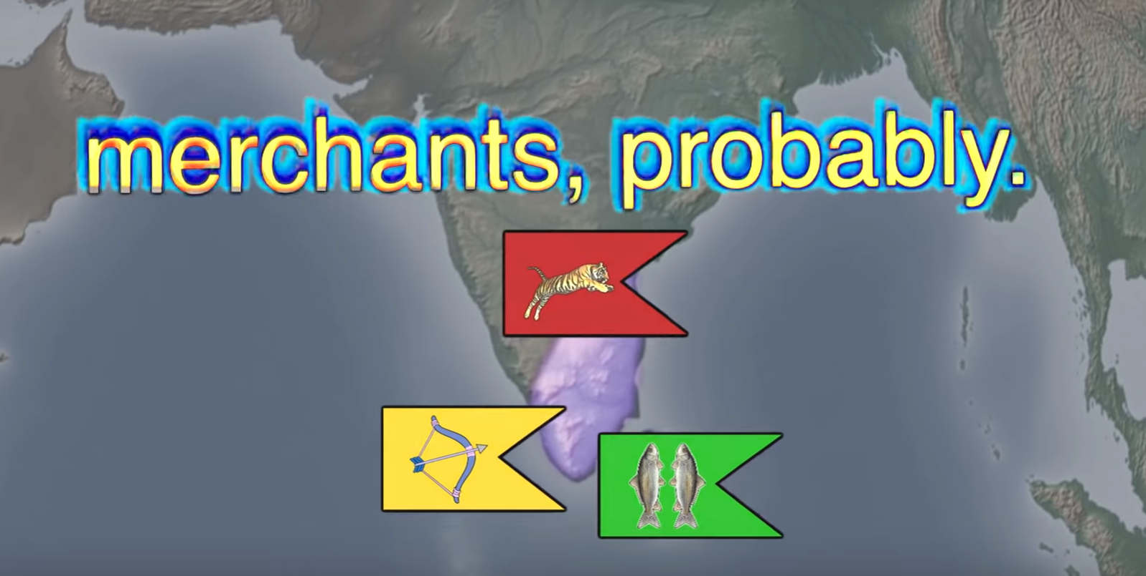

Slide 4
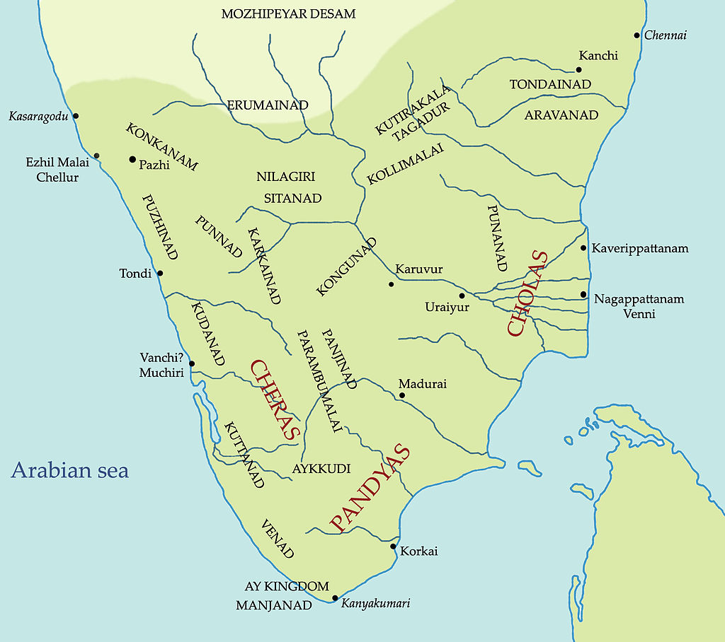
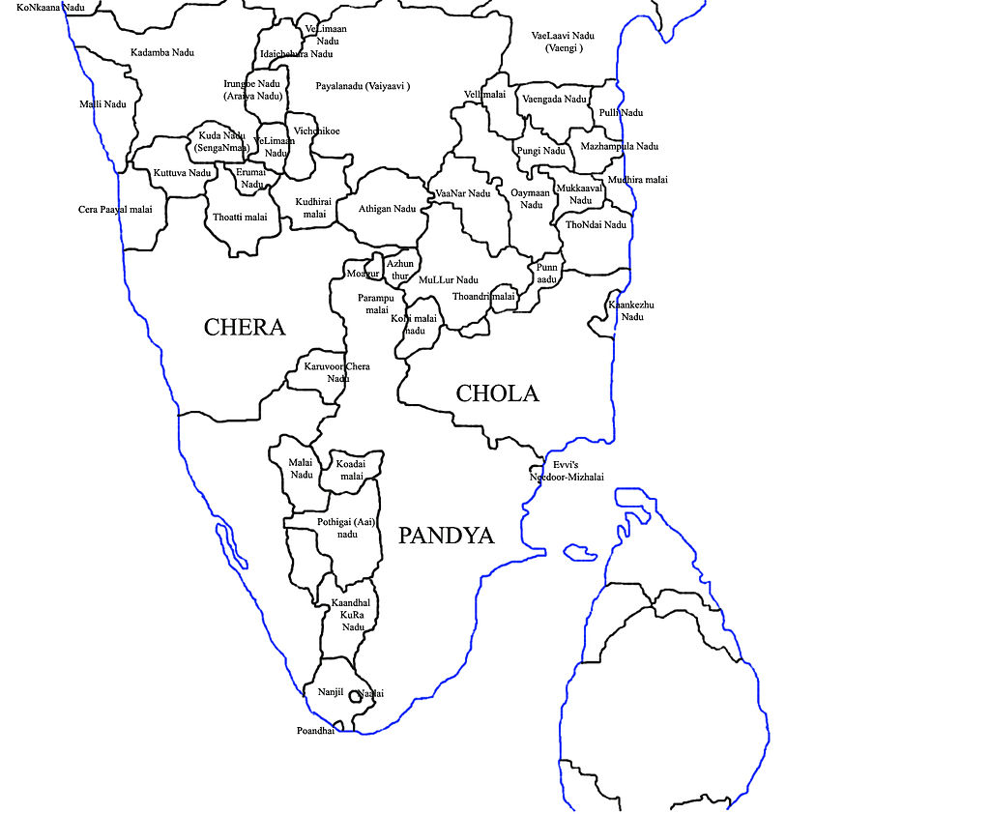
Geography
Divided into 3 kingdoms; The Cholas, Cheras and Pandyas.
600 BCE - 300 CE
Rice, Sugarcane, Millets, Pepper, coconuts etc.
Poetic attributes of the landscapes: the 5 land classifications.

Slide 5
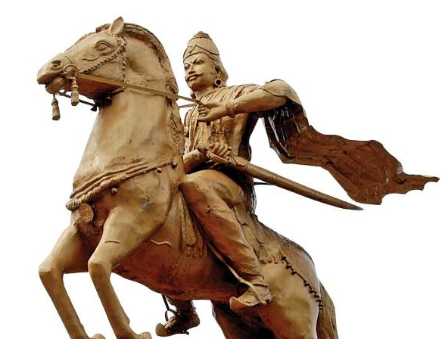
Governance
Vendhar > Velir > Kizhar
Ideal of Dharma.
Regularly in conflict with each other.
Potentially a very loose confederacy?
Courts for the allocation of resources over dispensation of authority.
Society was divided into five groups based on occupation: farmers, traders, hunters, seafarers and warriors.

Slide 6
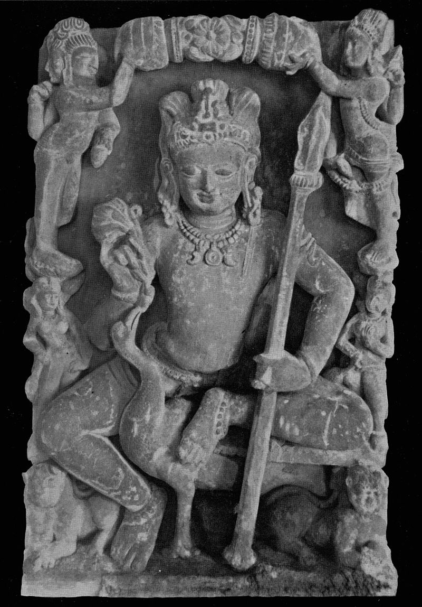
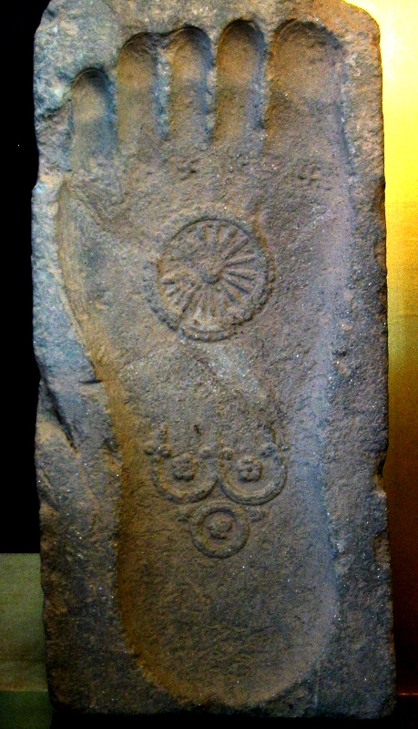
Religion
Buddhism, Hinduism, Jainism
Veriyattam
Theyyam
King worship

Slide 7
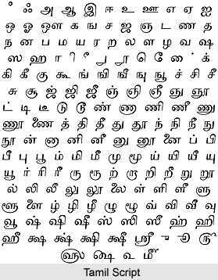
Literature
Named the Sangam period after three legendary Sangam academies, the last of which equates to our period.
In Tamil myth these academies existed as far back as 9,000 BC.
Tamil writers were men and women from various areas of society.
Division between agam and puram.
We know of 2381 texts from the period, composed by 473 authors, of which 102 are anonymous.

Slide 8
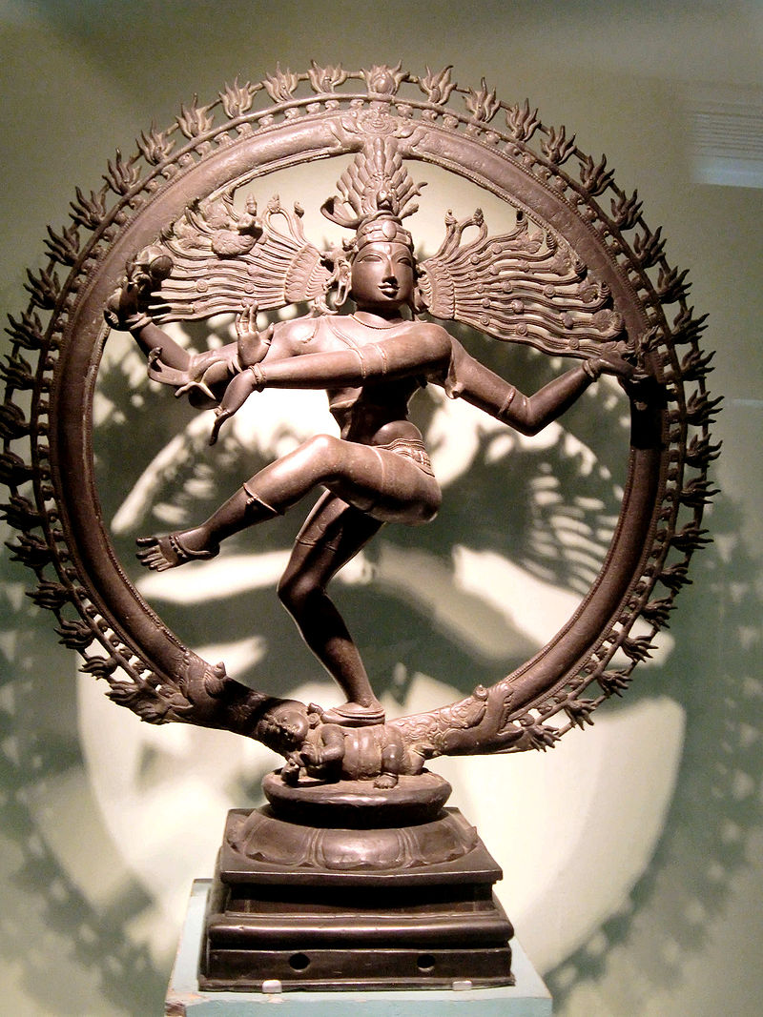
The Arts
Architecture
Martial traditions: Kuttu Varisai, Varma Kalai, Silambam, Adithada, Malyutham and Kalarippayattu.
Hinduism in the arts.
Importance of music
Bronze dancing Siva from the Chola empire

Slide 9
Interactions with the outer world
Extensive trade connections.
The kingdoms of the Cheras and Pandyas are mentioned in the Periplus of the Erythraean Sea.
Muziris receives especial mention as a port “abounds in ships sent there with cargoes from, and by the Greeks.”
Exports included: “fine pearls, ivory, silk cloth, spikenard from the Ganges, malabathrum from the places in the interior, transparent stones of all kinds, diamonds and sapphires, and tortoise-shell.” - Not just their own goods.
Pliny records that in his time 100 million sesterces was spent on foreign trade with India, Arabia and China, with south India being the most significant region for this.
55 Roman coin hoards have been found in the region, with examples from every emperor between Augustus and Septimius Severus.

Slide 10
