Slide 1
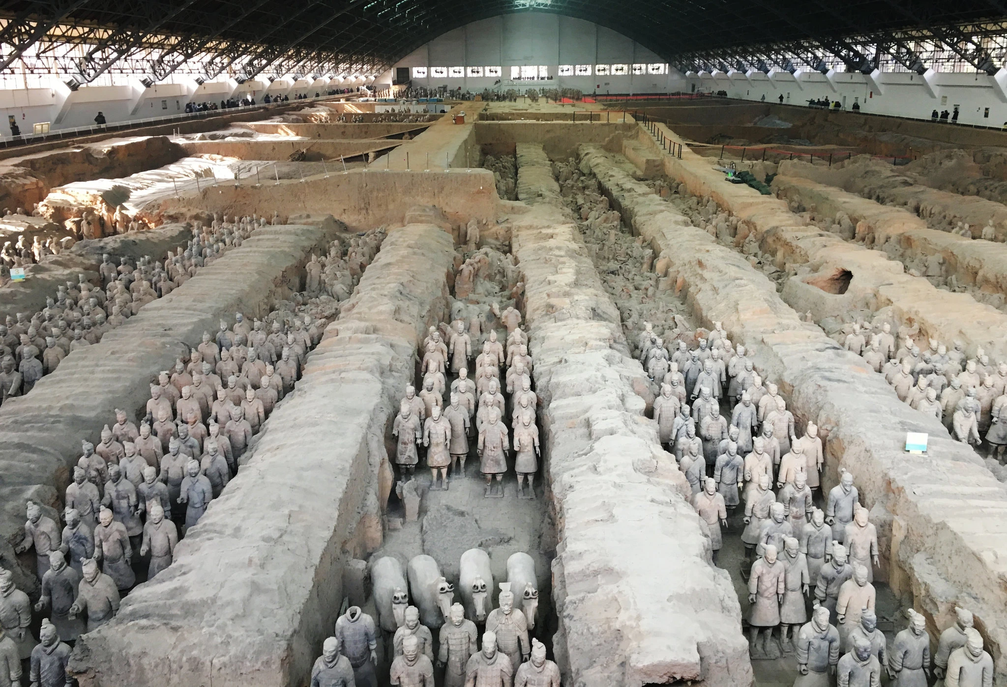
The Terracotta army

Slide 2
Discovery…

Slide 3
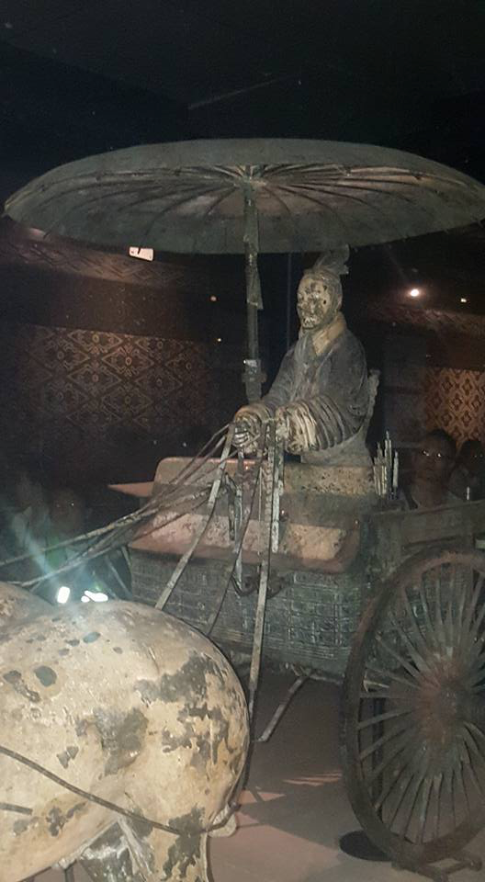
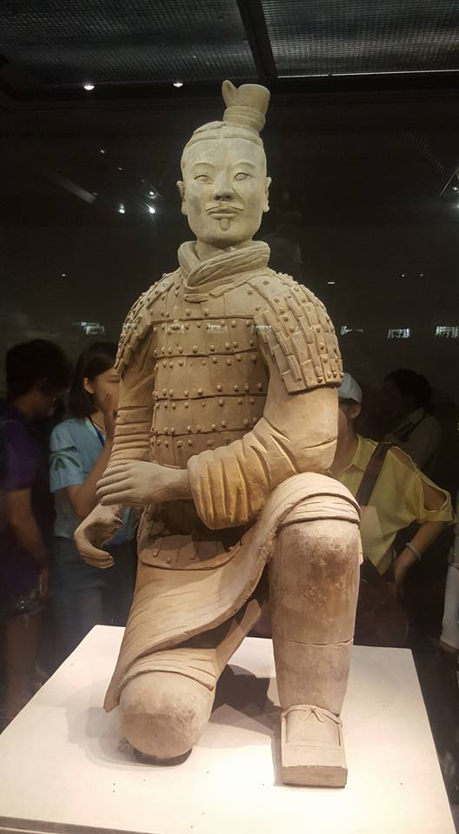
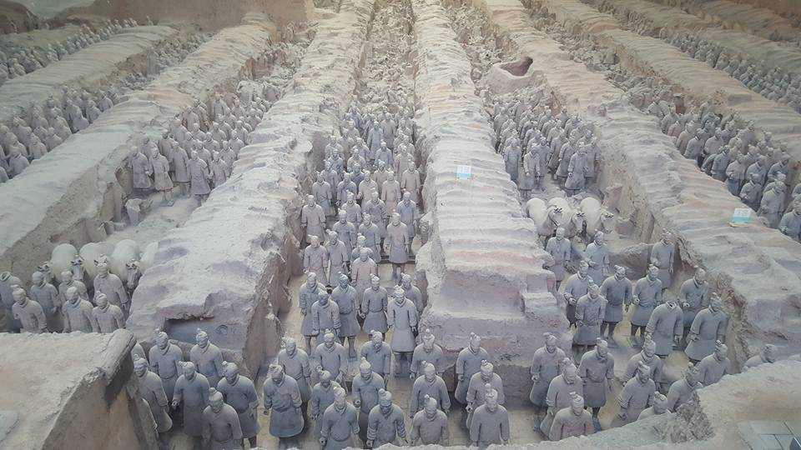
The Warriors…

Slide 4
Why?

Slide 5
Ancient Influences(?)
2016: Mitochondrial DNA test suggested “Westerners” in Xinjiang as early as c. 3rd BCE (during lifetime of the first emperor of China)
1974:
Tomb of the first emperor discovered in Shanxi by local farmers, along with thousands of terracotta figures

Slide 6
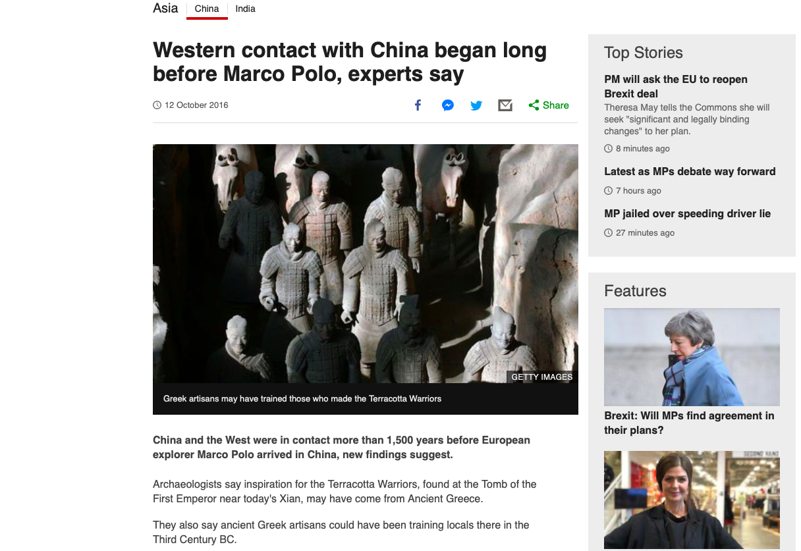
Article by archaeologist Li Xiuzhen

Slide 7
Arguments for
Li Xiuzhen, clarifying: “The terracotta warriors may be inspired by Western culture, but were uniquely made by the Chinese”.
Luckas Nickel: ”… contrary to popular belief, it is conceivable and actually likely that the Chinese and the Hellenistic cultures came into contact in the third century BC”.

Slide 8
Arguments against
Zhang Weixing: “No substantial evidence at all” for contact between ancient Greeks and those responsible for the Qin tombs.
Ladislav Kesner: “… the figures of infantrymen, with their static postures and frozen movements, do not display the degree of rigidity and symmetricity characteristic of classical examples of archaic Greek sculpture”.

Slide 9
The Terracotta army's ROLE in modern Chinese globalisation

Slide 10
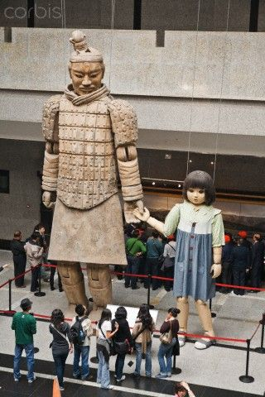
From “silent” remains to a “a state public relations tool”- D. J. Davies (2012) 22.
The Terracotta Warrior Museum, in China’s Shaanxi Province, was inaugurated on 1st October 1979
“cultural memory itself consists of objectified culture, which includes texts, rituals, images, buildings, and monuments, whose main function is to bring to mind fateful events the collective has experienced in the past.”- M. A. Matten (2012) 9
“the warriors have become an important tool of soft power for the Chinese government, which lends out a number to two or three museums each year.”- H. Pidd (2018) The Guardian

Slide 11
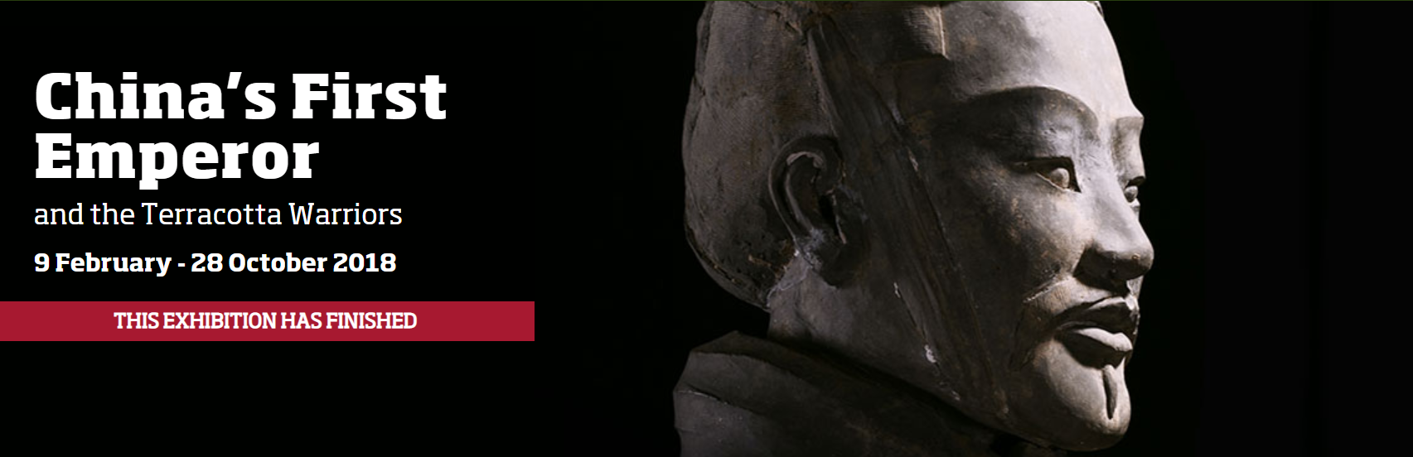
The Terracotta Army in international exhibitions
Liverpool World Museum exhibition, over 600,000 saw the exhibition.
Organised by National Museums Liverpool, United Kingdom and the Shaanxi Provincial Cultural Relics Bureau, Shaanxi Cultural Heritage Promotion Centre

Slide 12
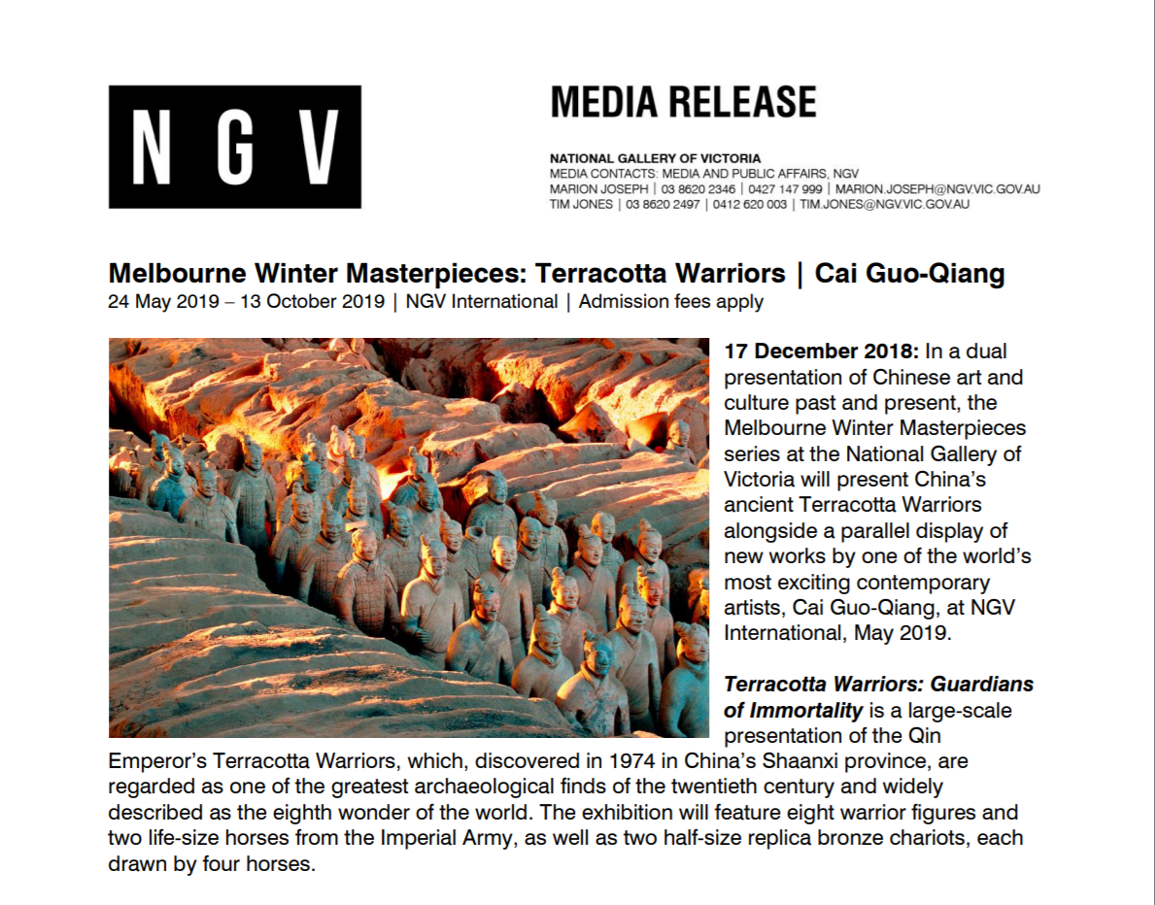
‘This exhibition will inspire Australian and international audiences to delve deeper into the many rich and diverse facets of China’s heritage.” – Jeff Xu, Golden Age Group

Slide 13
Any questions?

