Slide 1
Democracy and Imperialism
Term 2, Lecture 3
Democracy set in stone: epigraphic evidence

Slide 2


Slide 3
Democracy in political thought
Scattered arguments for democracy focus on equality, fairness, engagement of citizens, rule of law
Anti-democratic thought built around inequality as natural and just
Literature suggests general anti-democratic sentiment, but persistence of democracy proves its popularity

Slide 4
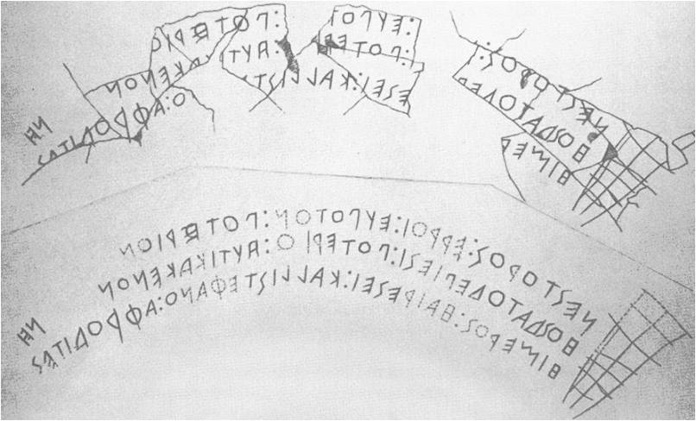
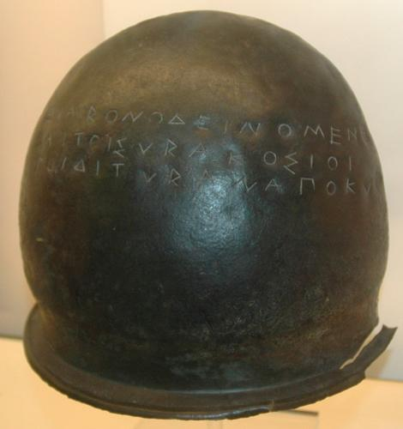
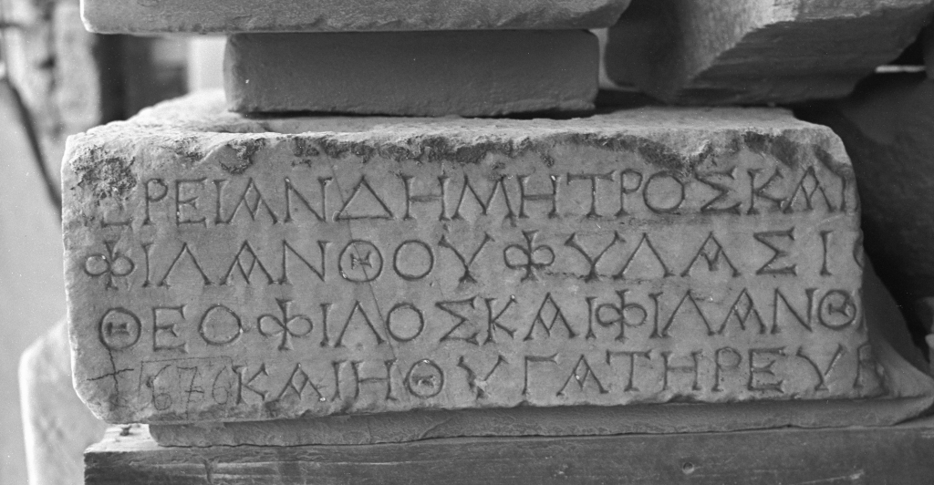
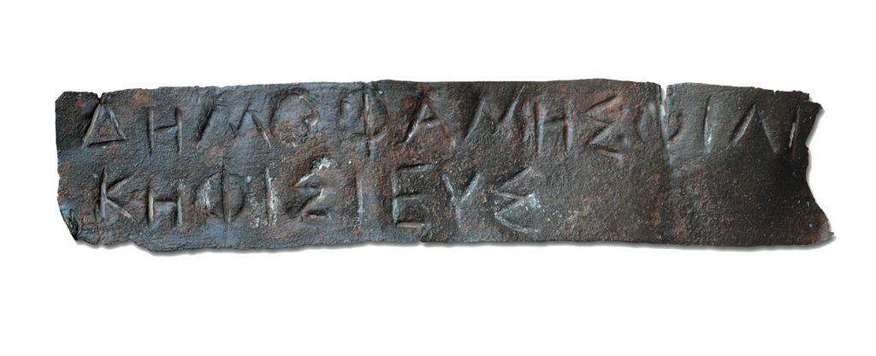
Epigraphy (scribbling on stuff)

Slide 5
Epigraphic evidence
Greeks wrote on stone, bronze, lead, tin, wood, pottery, papyrus
c. 100,000 Greek inscriptions preserved, vast majority on stone (walls, statue bases, stelai)
Majority are epitaphs & dedications
State inscriptions include laws, treaties, decrees, inventories, accounts, lists of magistrates, ephebes, debtors, those eligible for military service…

Slide 6
Key questions
How did the Athenian democracy use official inscriptions?
How are Athenian democracy and imperialism reflected in these inscriptions?
Are these inscriptions a typically ‘democratic’ phenomenon?

Slide 7
Democracy and epigraphy
About 1/5 of surviving inscriptions are Athenian
Nearly 500 decrees survive from 4th-century Athens; M.H. Hansen (1991) estimates c. 30,000 were passed
Inscriptions often contain formulae appealing to democratic ideology (i.e. ‘so that anyone who wishes can see it’)

Slide 8
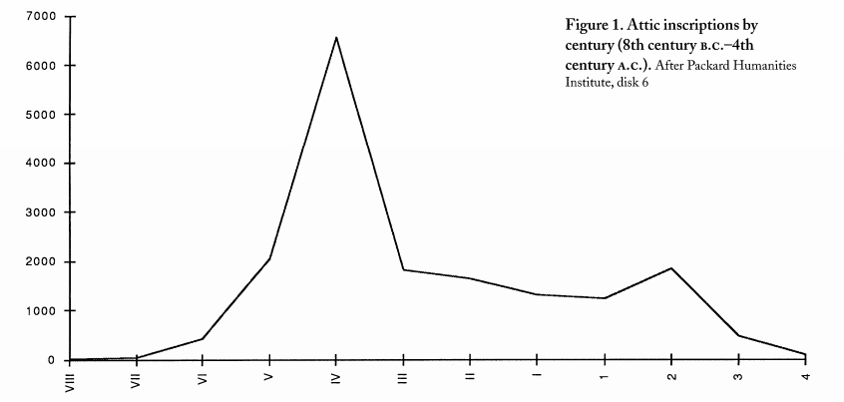
Source: C.W. Hedrick, ‘Democracy and the Athenian epigraphical habit’, Hesperia 68.3 (1999), 392

Slide 9
Inscriptions as a pillar of democracy
Transparency & accountability
Equal access to information relevant to state policy
Monumentality & permanence of decisions of the demos
Honorific decrees invoke competitive service to the polis

Slide 10
The importance of keeping records
They also appoint by lot the officer called Clerk for the Prytany, who is responsible for documents, is keeper of the decrees that are passed and supervises the transcription of all other documents, and who attends the sittings of the Council.
[Arist.] Ath. Pol. 54.3
Suppose someone had entered the Metroon and erased one law and then excused himself on the grounds that the city was not endangered by the loss of just this one. Would you not have killed him? I think you would have been justified in doing so, at least if you intended to save the other laws.
Lysias 1.66
He made an agreement with the people and proposed the decree against himself, to be kept by the mother of the gods, who is the city's guardian of all written contracts.
Dinarchus 1.87

Slide 11
Case closed?
Valued records were in the archive, not on stone; inscriptions are monuments, not archives
If inscriptions are meant to inform, why are they so lacking in critical data?
If inscriptions are meant to be seen by all, why are they placed on the Acropolis/other sacred spaces?
Connection democracy-epigraphy clear for 4th century but not 5th (or 6th)
Athenian literacy rates unknown

Slide 12
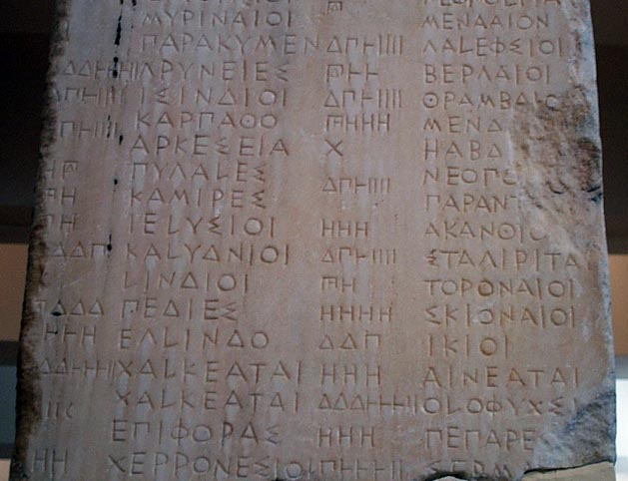
Imperialism and epigraphy
Athenian Tribute Lists: records of the 1/60th share dedicated to Athena
‘Allies’ to ‘subjects’:
open imperialism?

Slide 13
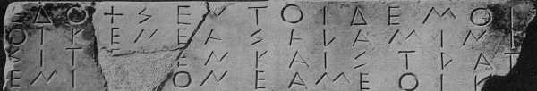
Decree on the settlers of Salamis (c. 501)
Decided by the demos.
Those in Salamis who are cleruchs shall be allowed to reside on Salamis (…) to the Athenians to pay taxes and provide military service.
But what is theirs on Salamis shall not be leased, unless a kinsman is the lessor. If someone should lease it, the lessee and the lessor shall pay a penalty, each of them (…) to the public treasury.
And the transaction shall be handled by the archon, if not, he shall be held accountable at his euthyna.
Their weapons they shall furnish themselves; the cost is thirty drachmas.
Having been armed the archon shall review their weapons. The Council, in the year (…)

Slide 14
Decrees of the democracy
1. Heading: invoking gods/audience/fortune
2. Prescript: ‘resolved by the people’, dating through magistrates in office
3. Proposal, typically verbatim
4. Amendments (if any)

Slide 15
Athenian decrees
What standard elements can you identify?
What is the decree about?
Which institutions/magistrates are involved?
How does it reflect the functioning of democracy?
How does it reflect the values of democracy?

Slide 16
Athens, democracy and epigraphy
Classical Athenian democracy coincides with an explosion in number of inscriptions
Democracy used public monuments to commemorate Assembly decisions on all matters
‘Epigraphic habit’ is certainly Athenian, but not necessarily democratic

