Slide 1
Democracy and Imperialism
Term 2, Lecture 8
Rome, Democracy and Imperialism

Slide 2
The early reception of democracy: topics
Democracy in the Hellenistic world
Rome and its political system
Rome’s effect on democracy
Roman attitudes to the Greeks
Views on Athenian democracy in the Roman period

Slide 3
Key questions
What did the rise of Rome mean for democracy?
How did the Romans view Athenian history?
Can Rome be regarded as a successor to Athens in the development of democracy?

Slide 4
Recap: the end (and return) of democracy
322: Athens defeated; democracy abolished
318/7: democracy restored
317: democracy abolished; Demetrius of Phaleron
307: Demetrius ousted; democracy restored
c.300: Lachares seizes tyranny
c.287/6: democracy restored
262: Athens defeated; democracy abolished
229: democracy restored
229-88: Athens preserves neutrality & democracy

Slide 5
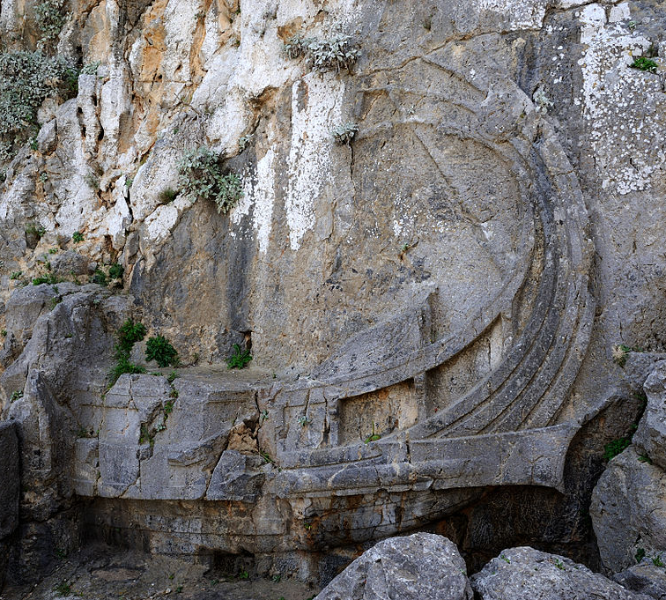
The heyday of democracy?
New Greek cities model institutions after Athens
Evidence of other forms of government disappears
When all cities are democracies, are any of them democracies?

Slide 6
Democracy or ‘democracy’?
The demos has come back and taken back its laws and the democracy.
IG II2 448 (Athens, 318/7)
Demokratia (though varied in meaning) still used to distinguish ‘people power’ from other forms of government
Democracies defined by equal citizen rights & sovereign assemblies
Epigraphy shows functioning assemblies, councils, jury courts

Slide 7
The end of democracy (for real this time)
After mid-2nd century, democratic habits & institutions fade throughout Greek world
1st century: Greek states controlled by small councils of wealthy citizens
Late Hellenistic/Roman period: politics of benefaction & honours

Slide 8
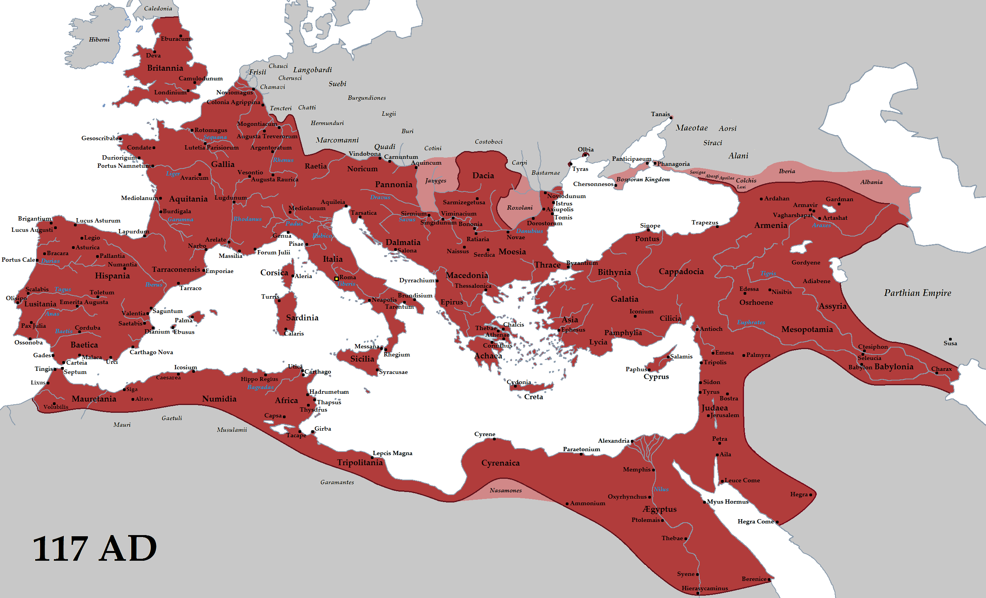

Slide 9
The Roman system: similarities to Athens
Constitution described by a Greek (Polybius 6)
Rome grows as city-state in city-state system
Notions of citizenship, voting rights, resistance to tyranny develop early
People divided into tribes & property classes
Military importance gives the poor political leverage

Slide 10
Differences
Roman assemblies traditionally rigged to favour elite
Leisure class retains dominant position as Senate and through magistracies
Romans allow outside groups to integrate into citizen body
Conflicts between rich & poor resolved through conquest & gradual elite concessions

Slide 11
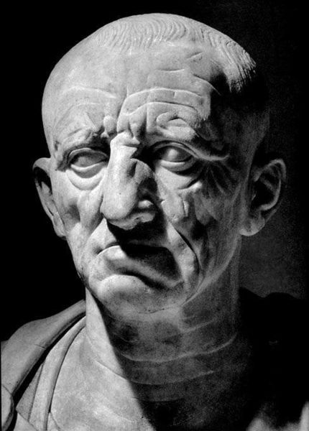
Republican Rome is what it says on the tin
Power of elites + alternative escape valves preclude/prevent/ obviate need to develop democracy
Roman system geared towards minimising power of the masses
Concessions to the plebs are really concessions to wealthy sub-elite

Slide 12
An Imperial destiny
Let others better mold the running mass
Of metals, and inform the breathing brass,
And soften into flesh a marble face;
Plead better at the bar; describe the skies,
And when the stars descend, and when they rise.
But, Rome, 't is thine alone, with awful sway,
To rule mankind, and make the world obey,
Disposing peace and war by thy own majestic way;
To tame the proud, the fetter'd slave to free:
These are imperial arts, and worthy thee.
Vergil, Aeneid 6.847-853

Slide 13
How Rome killed democracy
Roman imperialism: replacement of hostile regimes with favourable oligarchies (Achaea, Sparta)
Rome favours elite representatives in diplomatic dealings
The masses: tuned out, locked out, or nudged out?

Slide 14
The end of politics
There has been established throughout the world alike a democracy – under one man, namely the best ruler and moderator.
Aelius Aristides, To Rome 60
Nowadays, then, when the affairs of the cities no longer include leadership in wars, nor the overthrowing of tyrannies, nor acts of alliances, what opening for a conspicuous and brilliant public career could a young man find? There remain the public lawsuits and embassies to the emperor, which demand a man of ardent temperament and one who possesses both courage and intellect. But there are many excellent lines of endeavour that are neglected in our cities which a man may take up…
Plutarch, Moralia 805a-b

Slide 15
Rome and the Greeks
Interaction goes back to Archaic period
Greek cultural influence pervasive
Greeks militarily powerless in Hellenistic world
Development of contradictory stereotypes

Slide 16
Licentious, corrupt, untrustworthy Greeks
[to the audience] And don't you be surprised that men, who are slaves, drink, court, and give invitations to dinner. This is allowed us at Athens.
Plautus, Stichus 446-448
‘The better knowledge they had of Greeks, the more worthless were their respective characters.’
Cicero, De Oratore 2.265
[Greeks] to whom an oath is a joke, evidence a plaything, your opinion of them a shadow, men who place all their credit and profit and reputation, and triumph telling the most impudent lies.
Cicero, For Flaccus 12

Slide 17
Athens as centre of learning
To say nothing of Greece, which has ever claimed the leading part in eloquence, and of Athens, that discoverer of all learning, where the supreme power of oratory was both invented and perfected, in this city of our own assuredly no studies have ever had a more vigorous life than those having to do with the art of speaking.
Cicero, De Oratore 1.13
The distinction of the Attic orators in their style is well known, but their essential characteristics are unknown. Many see one side—that there was nothing in them with which to find fault—but few see the other side—that there was much to praise.
Cicero, De Optimo Genere Oratorum 7

Slide 18
Sources
What sort of text is your source?
Which aspect of Athenian democracy is discussed?
What is the judgment, and why is it negative?
Can we see a historical grounding for the passage?

Slide 19
Rome and Athenian democracy
Democracy persists until rise of Rome chokes it
Roman-era thinkers recognise past Athenian glory, but regard democracy as flawed & doomed to fail
Roman institutions developed independently; never aimed for or became democratic

