Slide 1
Democracy and Imperialism
Term 2, lecture 9
Classical Athens in Modern Thought

Slide 2
A Tale of Two Cities
Roman institutions developed independently as a republic, not a democracy
Roman expansion coincides with disappearance of democracies in the Greek world
Roman view of (Athenian) democracy, heavily influenced by Plato & Aristotle, consistently negative

Slide 3
Key questions
In what way has democracy survived in European political thought?
How did we come to think of democracy as an absolute good?
To what extent do modern Western states show the legacy of Athenian democracy?

Slide 4
What is demokratia?
Equality of all citizens
Offices filled by sortition
Magistrates accountable to the demos
Supremacy of the Assembly
Culture of personal liberty (Pericles)

Slide 5
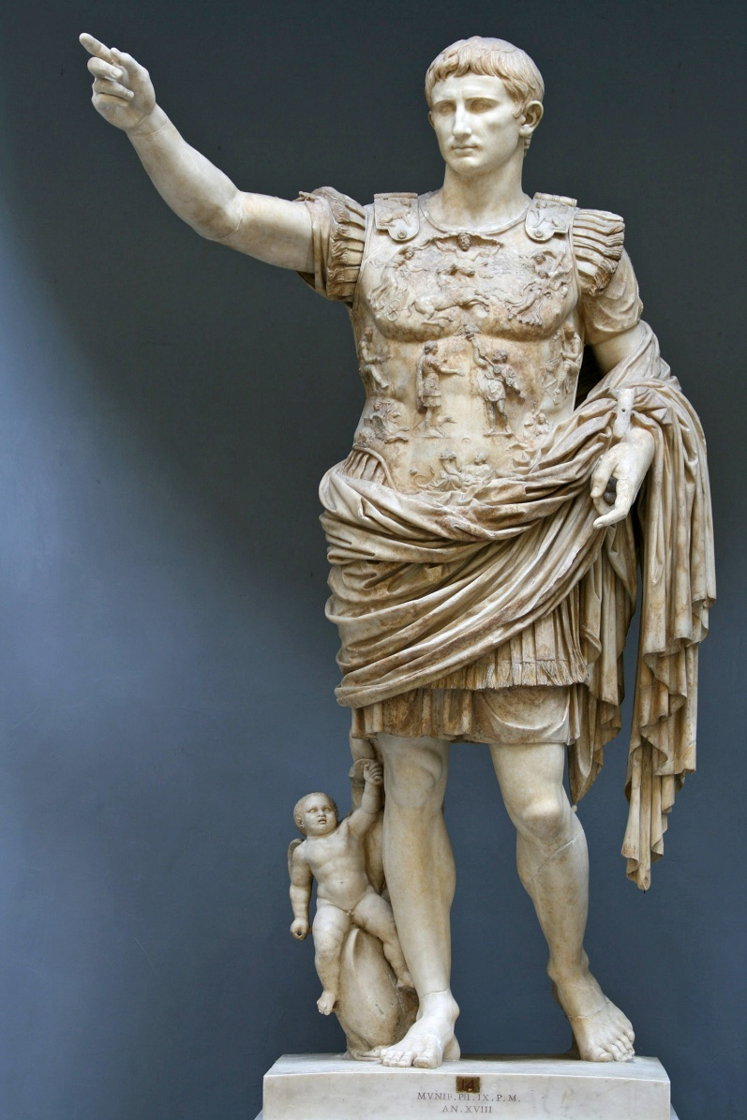
A flexible term
Democracy as synonym for system of government: Roman Empire as ‘democracy’
6th-century Constantinople: ‘democracy’ = political riot

Slide 6
Democracy in the Middle Ages

Slide 7
Reawakening or reinvention?
Rashidun caliphate (632-661): election of caliphs – but shura is only recommendation, councils very small, Umayyads make caliphate hereditary
Republic of Florence (from 1115): Council filled by sortition from all citizens – but very unstable, soon devolves into oligarchy
Swiss Landsgemeinde (13th century): Council, Assembly, vote by show of hands – but no connection to Athens

Slide 8
No Renaissance for democracy
Republic of Venice, contemporary hallmark of stable constitution, ‘mixed’ but mainly oligarchic
Despite recovery of Greek, Renaissance mostly looked to Latin and Rome
Main Greek texts read were Plato, Aristotle, Plutarch

Slide 9
The Greek tradition in a nutshell
One time, when he was delivering an opinion to the people, and he met with their approval, and saw that all alike accepted his argument, he turned to his friends and said: ‘could it be that I am saying something stupid without realising?’
Plutarch, Phocion 8.3

Slide 10
Democracy in Early Modern thought
Democracy only studied as a type of government (one of Aristotle’s 6 or 7), not as historical reality
Athenian democracy characterised as ochlocracy – fickle, unruly, ungrateful, uncontrollable
Praise only for Solon’s Athens
Examples of good constitutions: Sparta, Rome

Slide 11
Athens and Sparta in Enlightenment thought
It was in the very bosom of Greece that there was seen to arise that city as famous for her happy ignorance as for the wisdom of her laws, that republic of demigods rather than men, so superior to humanity did their virtues seem! O Sparta! Eternal shame to a vain doctrine!
Jean-Jacques Rousseau
What benefit did Sparta do to Greece? Had she ever a Demosthenes, a Sophocles, an Apelles, or a Phidias? The luxury of Athens formed great men of every description.
Voltaire

Slide 12
Classics in the Age of Revolution
Greek history largely derived from Plutarch: anecdotal, hostile to democracy, focus on great men
Greeks admired only as educators; Athens serves as warning against mob rule
Reformers admire Rome, republics and mixed constitutions

Slide 13
The Founding Fathers
Levity, gayety, inconstancy, dissipation, intemperance, debauchery, and a dissolution of manners, were the prevailing character of the whole nation [of democratic Athens].
-
The astonishment ought to be that there is one sensible man left in the world who can still entertain an esteem, or any other sentiment than abhorrence, for a government in a single assembly.
John Adams

Slide 14

New age, new politics
Locke, Paine: resistance to monarchy, importance of individual rights (especially property rights)
Montesquieu: separation of powers
Hamilton, J.S. Mill: representation as a moderating principle

Slide 15
The Great Switch (1)
Late 18th century: Founding Fathers terrified of democracy. US not called democracy
Early 19th century: democracy begins to be used to describe the US
Late 19th century: democracy regarded as ideal government throughout Western world

Slide 16
The Great Switch (2)
Late 18th century: democracy defined as mob rule
Early 19th century: de Tocqueville defines ‘Democracy in America’ as ‘the largest possible amount of liberty accorded to each citizen’
Late 19th century: democracy defined as representative government guaranteeing individual liberty, property rights, freedom of speech

Slide 17
The Great Switch: why?
American experiment, surprisingly, turns out to work
Modern representative system allows redefinition of terms
Liberal philosopher-politicians embrace widening franchise for representative government (including, in UK, pay for MPs & secret ballot)

Slide 18
Classics and the Great Switch
Rise of academic scholarship redefines Athenian democracy: Grote reads Herodotus, Thucydides, Demosthenes
Greek War of Independence focuses West on Greece
Increasing Western claim to Greece as ‘European’ heritage

Slide 19
What is democracy?
Equality of all citizens
Representative bodies filled by fair elections
Politicians accountable to voters
Culture of equality, liberty, civil rights
Democracy as unquestionably positive

Slide 20
The death of demokratia
Not a single Athenian institution seems to have left its mark on posterity.
Mogens Hansen

Slide 21
A future for democracy
Detachment from politics & apathy of voters spurs innovation
Scholarship pushes Athenian model as foil for reform
Experiments with direct democracy
Experiments with sortition, deliberative democracy

Slide 22
The survival of democracy
Tradition of democracy uniformly negative until 19th century
Switch in perception driven by change in meaning: our democracy is not demokratia
Legacy of democracy is only now starting to make itself known

