Slide 1
Democracy and Imperialism
Lecture 2: Athens in the Sixth century

Slide 2
The story so far
Early Greek government: unaccountable lords, weak assemblies
Rise of citizenship and people’s councils, but also of tyranny
Athens rejects tyranny (Cylon, 632/1)
Laws of Draco (621/0)

Slide 3
Athens in crisis
But to destroy a great city by their thoughtlessness
Is the wish of the citizens, won over by money;
And unrighteous is the mind of the people’s leaders
Who are about to suffer many pains from their great arrogance (hybris)
(…)
This is an inescapable wound which comes to every city
And swiftly brings it to wretched slavery
Arousing civil discord and slumbering war
Which has destroyed the lovely prime of many
(…)
Thus the public evil comes to each at home
And house doors can no longer keep it out;
It has leapt over high fences, found people in all ways
Even one who runs and hides in the furthest corner of a room.
Solon fr. 4, lines 5-29

Slide 4
What’s going on here?
One penalty was assigned to almost all offenders, namely death, so that even those convicted of idleness were put to death, and those who stole vegetables or fruit received the same punishment as those who committed sacrilege or murder. Therefore Demades later became famous for saying that Draco's laws were written in blood, not ink.
Plut. Solon 17
The Athenian constitution was in all respects oligarchic, and in fact the poor themselves and also their wives and children were actually enslaved by the rich; and they were called Dependents and Sixth-parters (hektemoroi) (for that was the rent they paid for the rich men's land which they farmed, and the whole of the country was in few hands), and if they ever failed to pay their rents, they themselves and their children were liable to arrest (…) Thus the most grievous and bitter thing in the state of public affairs for the masses was their slavery – though they were discontented also about everything else, for they had, so to speak, no share in anything.
[Arist.] Ath. Pol. 2.2-3

Slide 5
Athens, circa 600
All power held by leisure-class families, the so-called Eupatridae (“those of good fathers”)
Strict laws of Draco fail to prevent injustice & violence
Competitive elite culture encourages ruthless greed
Pressures of land encroachment and rent forces poor citizens into debt bondage

Slide 6
What is to be done?
Of those things for the sake of which I gathered the people,
Which did I abandon unaccomplished?
[he boasts about ‘freeing the black earth’, bringing enslaved Athenians back home, and writing ‘straight justice’ for all]
Another man, taking up the goad like I,
A foolish and greedy man,
Would not have restrained the people;
For if I had been willing to do
What then pleased their opponents,
Or again what the other side contrived for them
The city would have lost many men.
For this reason, making a defence on every side,
I turned about like a wolf among many hounds.
Solon fr. 36, lines 1-28

Slide 7
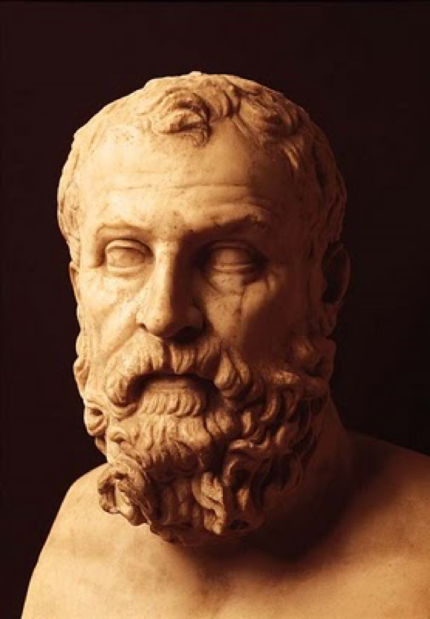
Who is this Solon guy anyway?
War hero, taker of Salamis from Megara?
Of noble blood, but ‘of the middle’ in terms of wealth?
Chosen by the Eupatridae and the people as Archon and lawgiver

Slide 8
The reforms of Solon, 594/3
Seisachtheia (“shaking off of burdens”): cancellation of debt/abolishment of debt bondage
Removal of horoi (boundary markers): land returned to the people?
Abolishment of Draco’s laws (except on homicide)
Introduction of property classes with defined political rights

Slide 9
The Solonic property classes
Pentakosiomedimnoi (five-hundred-measure-men): 500 measures of agricultural produce, wet or dry
Hippeis (horsemen): 300 measures
Zeugitai (yoke-men): 200 measures
Thetes (labourers): everyone else

Slide 10
Eunomia, not demokratia
Assembly given role of law court (Heliaia): ‘the people, having the power of the vote, becomes sovereign in the government’ (Ath. Pol. 9.1)
Possible introduction of Council of 400
Only top 2 property classes can become Archon; thetes have no access to any magistracy
The zeugitai: recognition of a new middle class, or mere stratification of the leisure class?
‘To the people I gave as much privilege as was appropriate…’ (Solon fr. 5, line 1)

Slide 11
Problem solved?
Solon goes into volunary exile to avoid being pressured to change his laws
Irregularities in appointment of Archons due to factional strife
Athens divided into Coastal (Alcmeonid), Plains (Lycurgan) and Hills (Peisistratid) factions, all striving for different reforms
The spectre of tyranny

Slide 12
Peisistratus seizes power
Peisistratus, war hero and ‘most popular/an extreme advocate of the people’ (demotikotatos)
First coup, 561; ousted by alliance of Lycurgus and Megacles
Second coup, 556; ousted by alliance of Lycurgus and Megacles
Third coup, 546; rivals defeated in battle; Alcmeonids go into exile

Slide 13
The dreadful yoke of tyranny?
And Peisistratus ruled the Athenians, disturbing in no way the order of offices nor changing the laws, but governing the city according to its established constitution and arranging all things fairly and well.
Herodotus 1.59.6
Indeed, generally their government was not grievous to the people, or in any way odious in practice; and these tyrants cultivated wisdom and virtue as much as any, and without exacting from the Athenians more than a twentieth of their income, splendidly adorned their city, and carried on their wars, and provided sacrifices for the temples.
Thucydides 6.54.5
Peisistratus's administration of the state was moderate, and more constitutional than tyrannical; he was kindly and mild in everything, and in particular he was merciful to offenders, and moreover he advanced loans of money to the poor for their industries, so that they might support themselves by farming. (…) And in all other matters, too, he gave the people no trouble during his rule, but always worked for peace and safeguarded tranquillity; so that men were often to be heard saying that the tyranny of Peisistratus was the Golden Age of Cronos.
[Arist.] Ath. Pol. 16.2 and 7

Slide 14
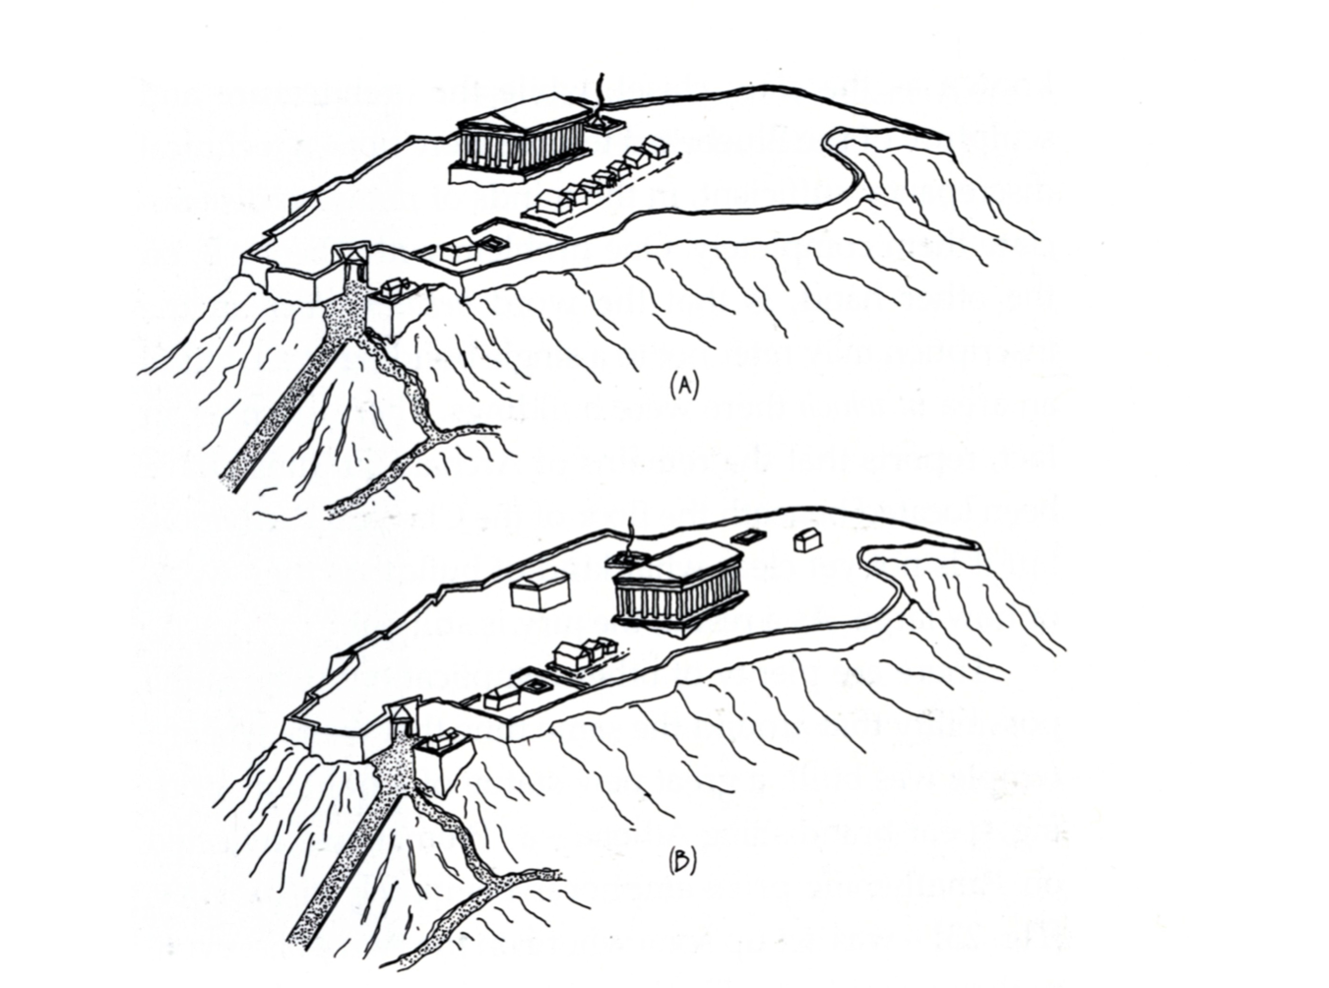
Peisistratus’ building programme

Slide 15
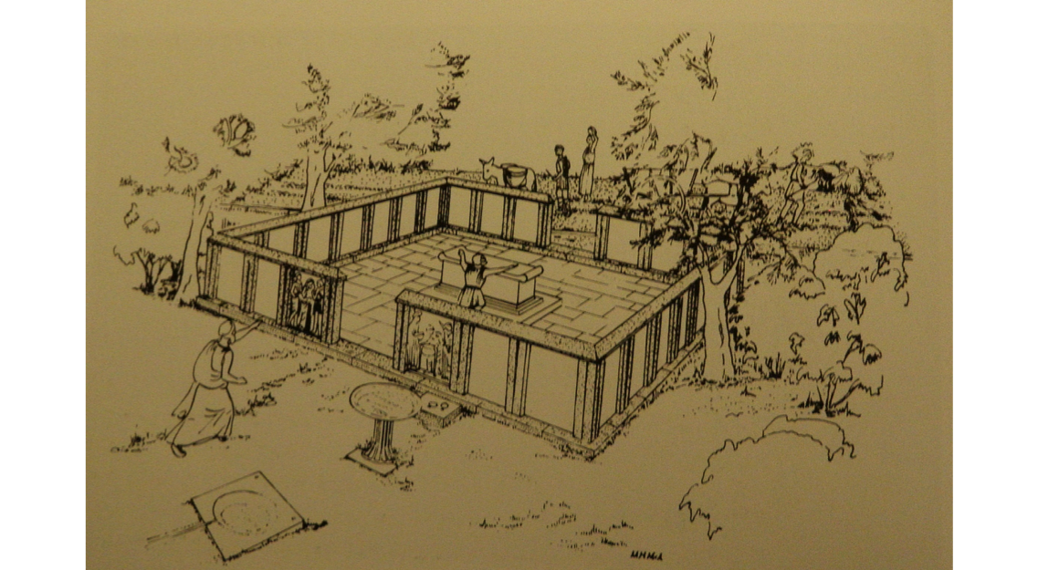
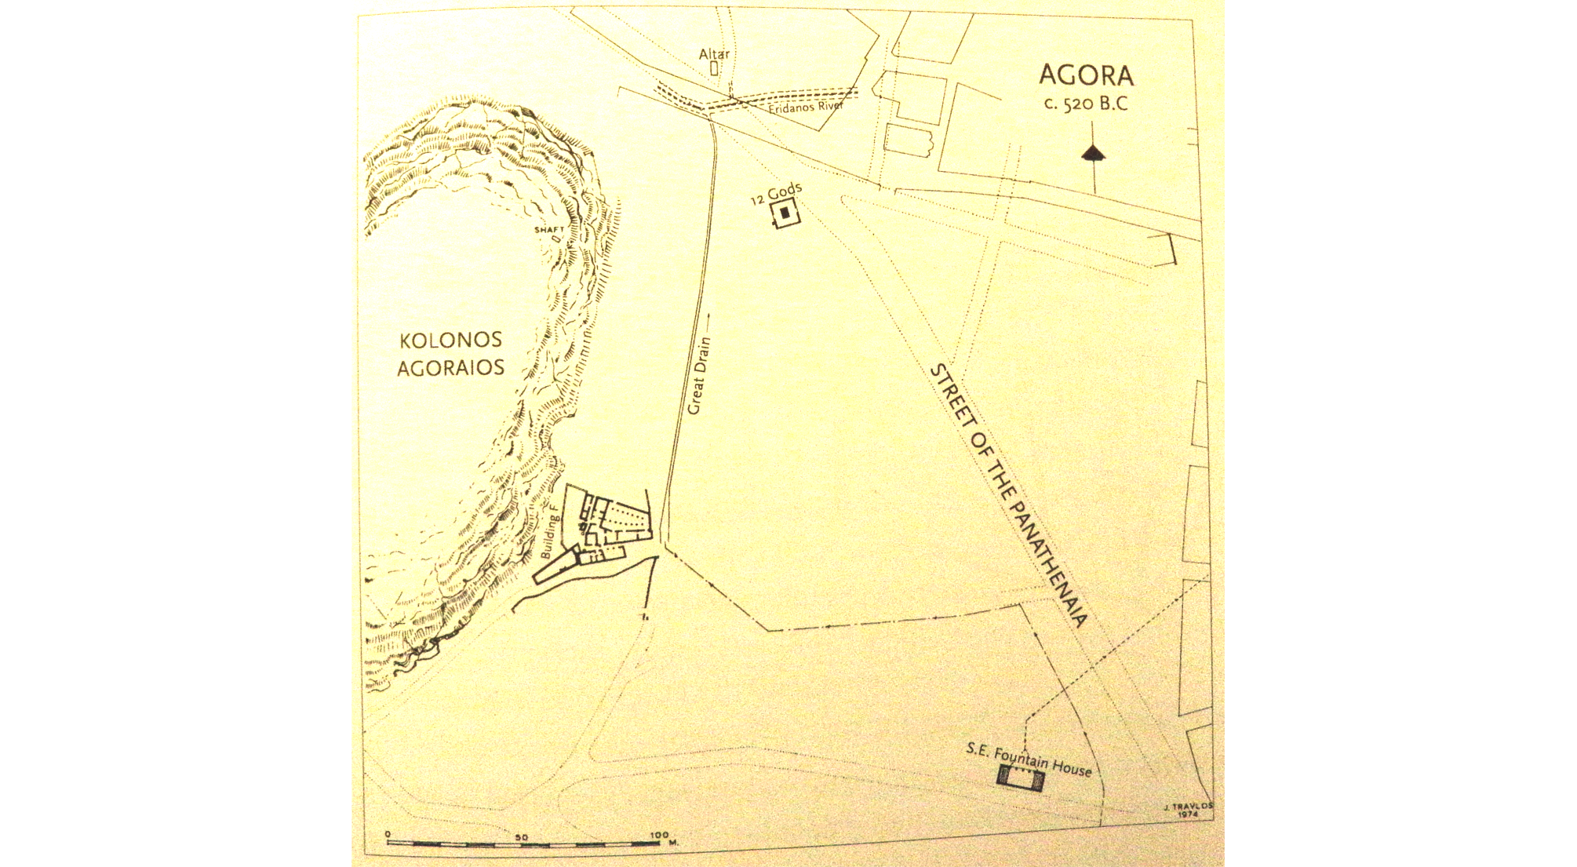
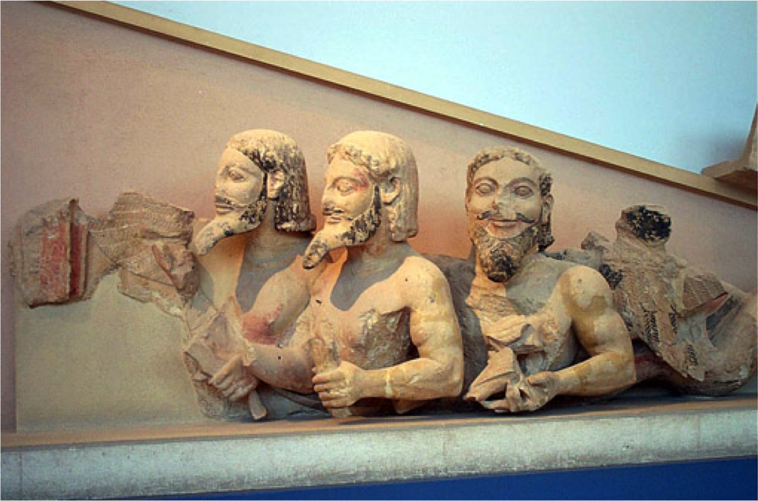
Peisistratus’ building programme

Slide 16
Peisistratus’ public benefactions
Construction of temples and buildings on Acropolis
Opening of the agora with first public buildings
Fortification of sanctuary at Eleusis
Creation of Panathenaea and Dionysia (city-wide religious festivals: procession, sacrifice, performance)
Attempt to build Olympieion – to compete with the largest temples elsewhere (temple of Hera on Samos)

Slide 17
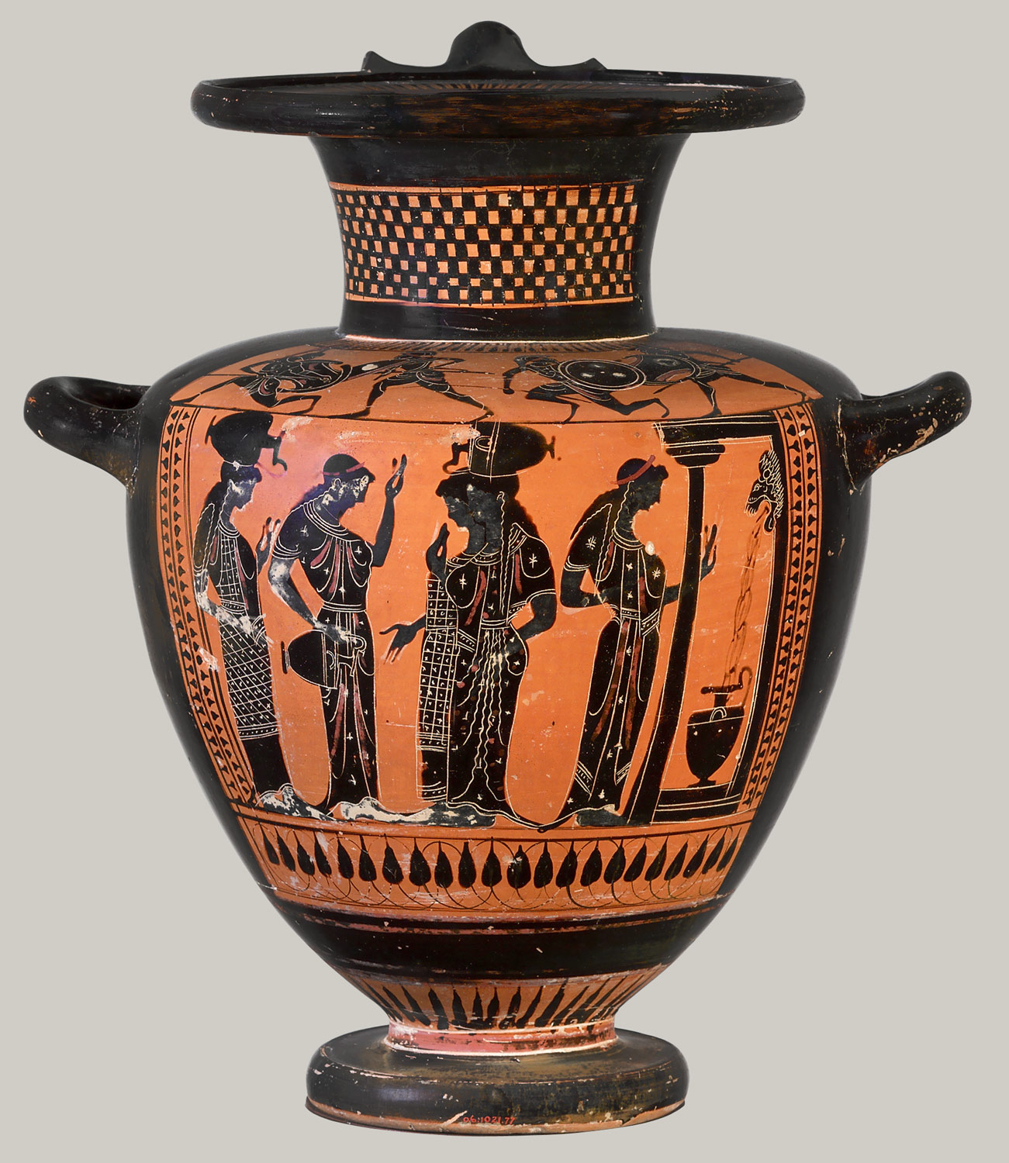
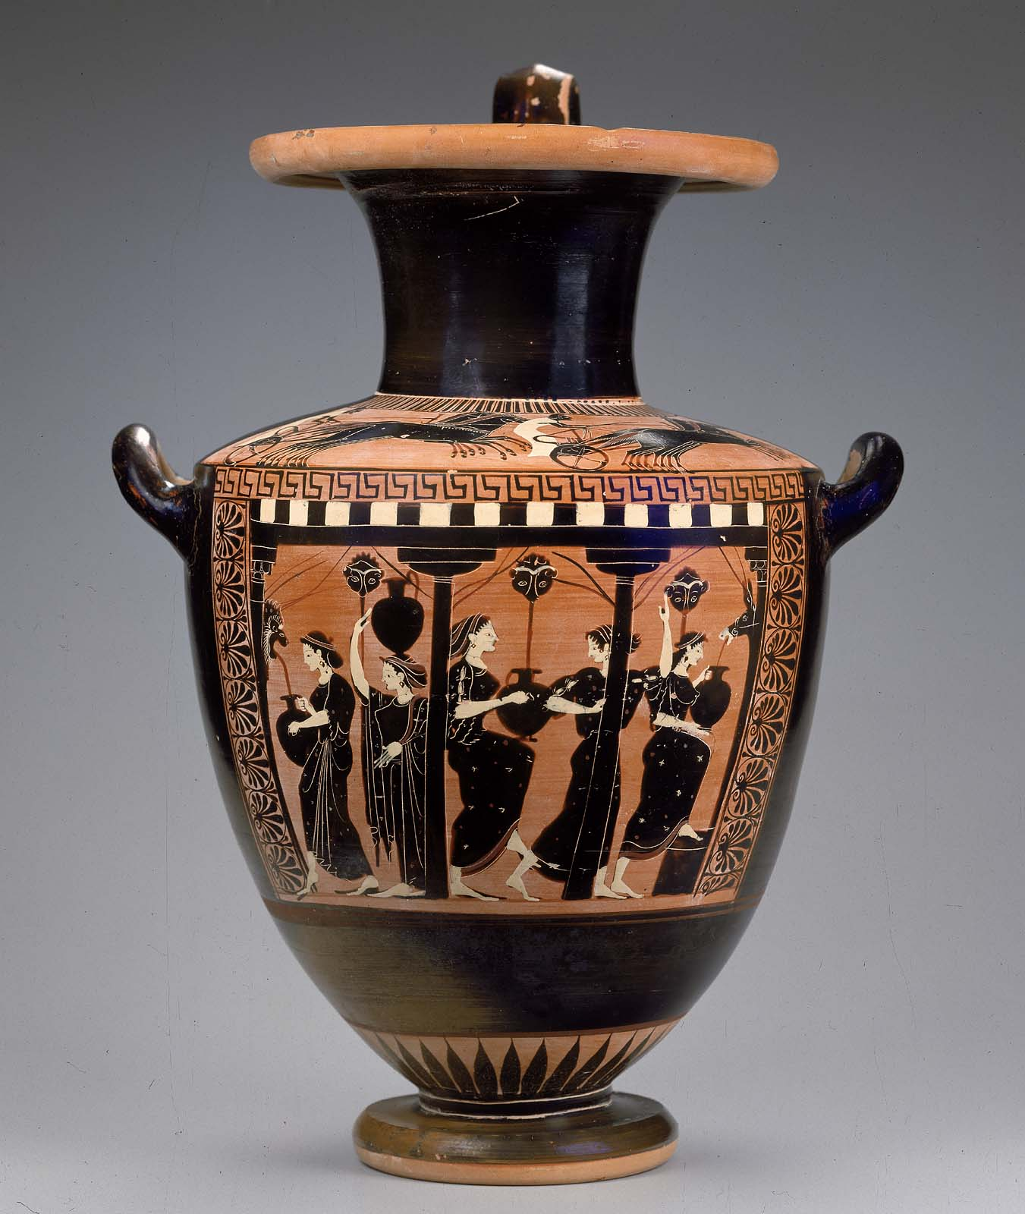
Peisistratus’ fountains

Slide 18
Politics under the Peisistratids
527: Peisistratus dies. His son Hippias becomes tyrant
IG I3 1031a: the Archon list of 527/6-522/1
527/6: Onetor(ides?)
526/5: Hippias
525/4: Cleisthenes
524/3: Miltiades
523/2: Kalliades
522/1: Peisistratus

Slide 19
Athens in the sixth century
Solon creates Athenian ‘constitution’
Peisistratus creates Athens
Flourishing of art, architecture, agriculture & trade under the Peisistratid tyranny

