Slide 1
Democracy and Imperialism
Revision session 3: athenian imperialism

Slide 2
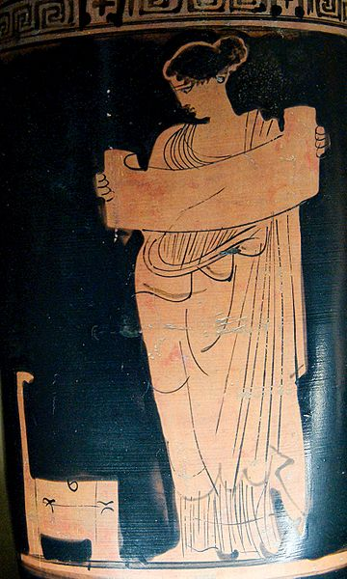
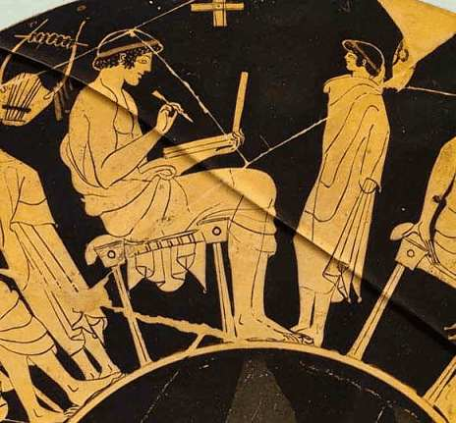
Key term quiz

Slide 3
Imperialism: context
Local imperialism: rise of Sparta & formation of Peloponnesian League (c. 550)
Regional imperialism: Greeks of Asia Minor subjected to Croesus of Lydia (late 7th century)
Continental imperialism: rise of Persia (559-546)
‘Either do or suffer’: Spartan interventionism (512-508), Persian expansion (499-479)

Slide 4
Early Athenian imperialism
Saronic Gulf: seizure of Salamis, invasions of Megarid, war with Aegina for naval supremacy
Aegean: Settlement of Thracian Chersonese (c. 520?), participation in Ionian Revolt (499)
Colonization of Euboea after defeat of Chalcis (507/6)

Slide 5
The Force Awakens
490: Athens stops Persian expansion at Marathon
483: Themistocles urges Athens to use silver to expand trireme fleet
480: Athens razed by Xerxes, but Greek fleet (2/3rds Athenian) victorious at Salamis
479: Persians defeated. Counteroffensive begins

Slide 6
The Delian League
478: Sparta yields leadership of anti-Persian alliance; Athens takes over
Formation of eternal alliance; members encouraged to pay tribute into treasury on Delos
League under Cimon rolls back Persian control from Aegean; battle of Eurymedon (460s); campaigns on Cyprus, in Egypt (450s)

Slide 7
From League to Empire
Athens monopolises military power within League
Refusal to let members leave League; uses League forces to besiege rebels (Naxos 471, Thasos 465, Miletus & Erythrae 453, Samos 440)
Use of League resources to acquire land for Athenian settlers
Athens’ enemies forced into League (Aegina 458)
456: completion of Long Walls
454/3: League treasury moved to Athens. Pericles uses tribute money to beautify Athens

Slide 8
The fruits of Empire
Wealth & secure grain trade enable explosive growth
Citizens benefit through employment, pay for office, allotment of land
Imperial opportunities (naval service, public works, trade) attract thousands to Athens
City monumentalised on unprecedented scale
City becomes centre of cultural & intellectual life

Slide 9
The sins of Empire
Tribute increased from 460 (478) to 600 (431) to 1000 (424?) to c. 1500 (412?)
Cleruchs settled throughout Aegean; governors & garrisons placed in subject cities
Athens claims jurisdiction over allies
Cruel treatment of rebels (Thasos 465, Samos 440, Mytilene 427, Scione 421)
Destruction of Melos (416)

Slide 10
Fall of the Tyrant City
Incursion into Corinthian/Spartan area of influence provokes war (461-446, 431-404)
Imperial overstretch: Delium (424), Amphipolis (422), Sicilian Expedition (415-413)
Sparta mobilises Persian money to challenge Athenian naval supremacy
Defeat & dismantling of Empire (404)

Slide 11
The call of the glory days
Lingering Athenian imperialism leads to reconstruction of empire during Corinthian War (395-386)
King’s Peace (387/6) outlaws Greek empire on pain of war with Persia
Athens builds Second Athenian League (378-338) as ‘soft empire’; pledges not to repeat its sins
Athens repeats its sins
Recovery of naval supremacy in the Aegean

Slide 12
Empire’s End
Second Athenian League crippled by Social War (357-355)
Elite circles begin to question imperialism, advocate soft power
League dissolved by Philip of Macedon (338)
Athenian fleet destroyed by Antipater (322)

Slide 13
Good luck!

