Slide 1
Democracy and Imperialism
Lecture 5: The Rise of the Athenian Empire

Slide 2
The defeat of Xerxes
Athens under new regime again proves militarily successful
Victory as the result of joint effort and sacrifice; Athenian fleet proves decisive
Greek alliance ready to take the fight to Asia

Slide 3
Athens 478-431: key questions
When did Athens become a democracy?
What role did leisure-class clans play in the politics of early democracy?
When did Athens establish its empire?
How did the empire contribute to the strengthening of democracy?

Slide 4
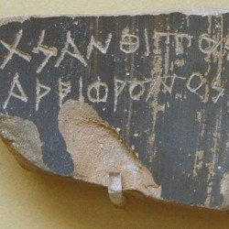
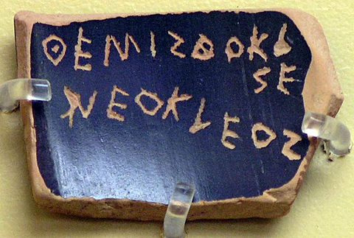
The people grow confident
Ostracism first used after Marathon – initially ‘friends of the tyrants’, later other prominent citizens (Xanthippus, father of Pericles)
487/6: Archonships selected by lot instead of election
479/8: Athens rebuilds city walls despite Spartan misgivings
472: Aeschylus’ The Persians performed for the first time – produced by a young Alcmeonid named Pericles

Slide 5
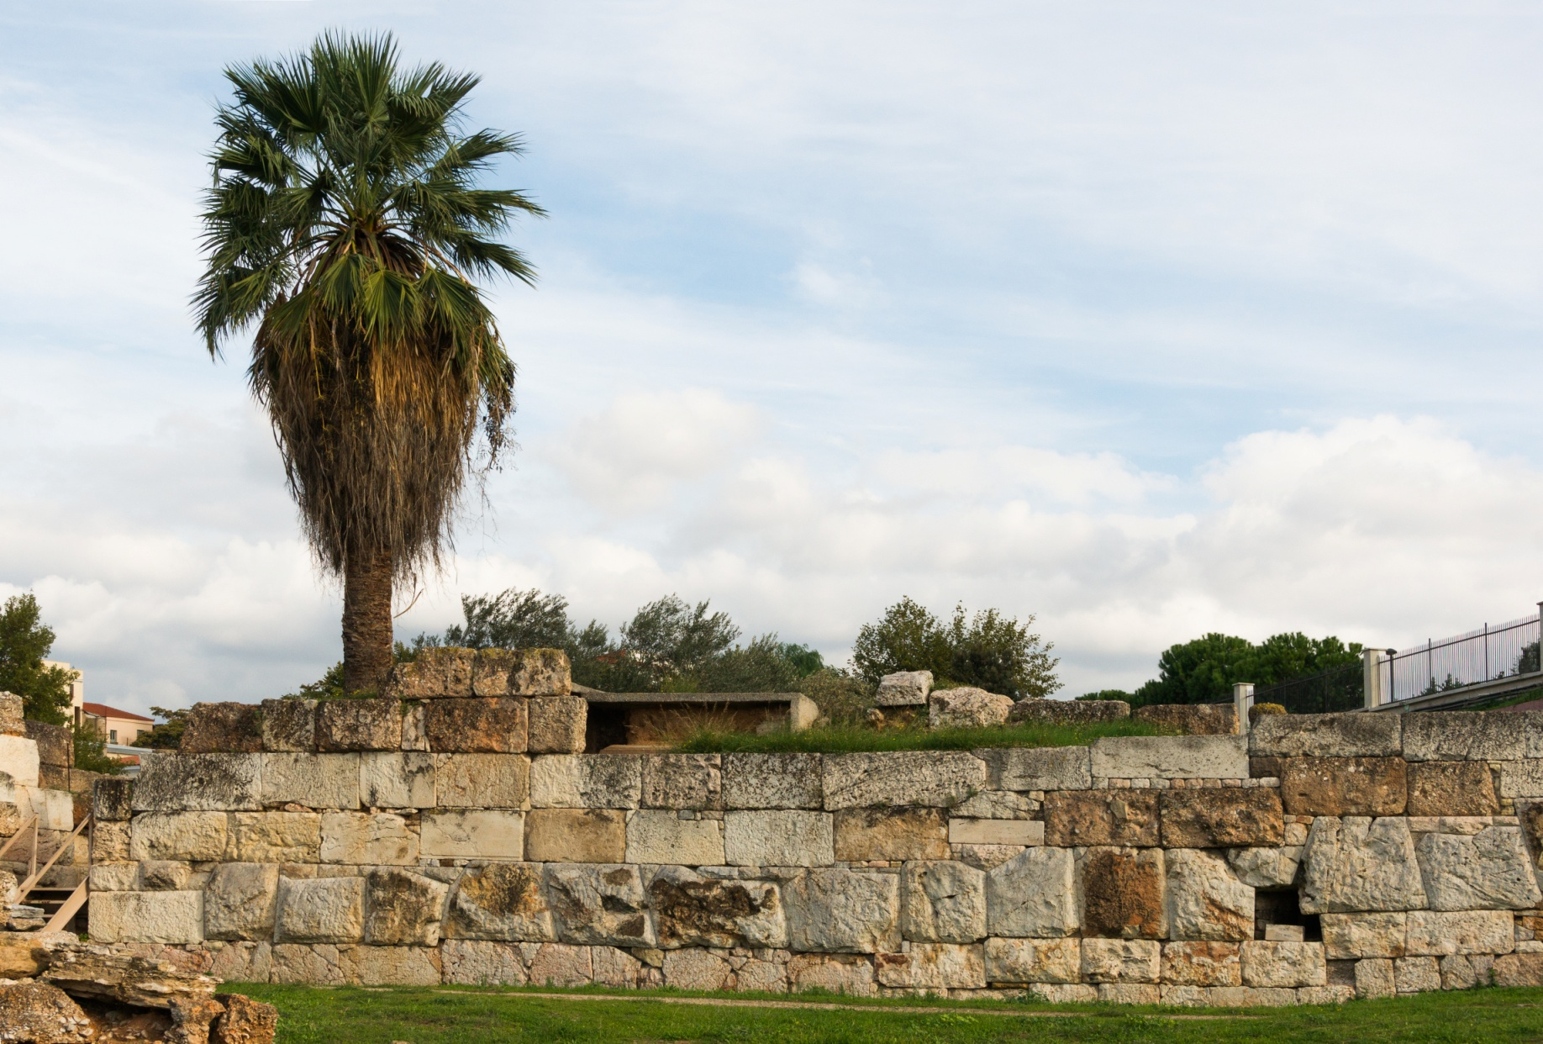
The Wall of Themistocles

Slide 6
The march of democracy?
After the Persian Wars the Council on the Areopagus became powerful again, and carried on the administration. (…) The constitution remained under the leadership of the Areopagites for about seventeen years after the Persian War, although it was being gradually modified.
[Arist.] Ath. Pol. 23.1, 25.1

Slide 7
The hero of the Areopagus Council: Cimon
Son of Miltiades, of the Philaidae clan, and Hegesipyle, a Thracian princess; married an Alcmeonid
Famously wealthy and generous to the people
Friend of Sparta and firm advocate of the Athenian-Spartan alliance
Most prominent Athenian commander after ostracism of Themistocles (473/2)

Slide 8
The aftermath of Xerxes’ invasion
479: battle of Mycale; remains of Persian fleet destroyed
Peloponnesians return home; Athenians besiege Sestus
Next goal unclear; meanwhile, Spartan regent Pausanias accused of maltreatment and collusion

Slide 9
478: Athens takes over the alliance
The Ionian states approached the Athenians, asking them, since they were their own kinsmen, to take them under their protection and, if Pausanias acted in a dictatorial manner, not to allow it. These approaches were welcomed by the Athenians, who made up their minds to put a check on Pausanias and to arrange matters generally in a way that would best suit their own interests.
Thucydides 1.95.1-2
Or, to put it another way…
The Athenians stripped the Spartans of the leadership, using Pausanias’ behaviour as an excuse.
Herodotus 8.3.2

Slide 10
Why let Athens take charge?
Given the ideology of liberty that was a direct outcome of the Persian Wars, and the Athenians’ role as champion of that freedom in the recent struggle, how is one to explain Athens’ archē, or the fact that many Greeks, to a certain extent willingly, gave the Athenians the means to oppress them?
Lisa Kallet

Slide 11
The Delian League
Voluntary alliance ‘to avenge our sufferings by destroying the lands of the King’ (Thuc. 1.96.1)
Members can contribute ships or money; tribute level set by Aristides “the Just”, total 460 talents
League treasury on sacred Delos, managed by Hellenotamiai (‘treasurers of the Greeks’)
Oath binds members for eternity

Slide 12
The early campaigns of the League
Liberation of Eion (Thracian coast), c. 475
Conquest of Skyros from Dolopian pirates, c. 473
But also:
Athenian colonisation of Skyros, conquest of Carystus
Athens encourages League members to pay tribute instead of manning their own ships
Naxos tries to leave the League (471?); Athens forces it back in

Slide 13
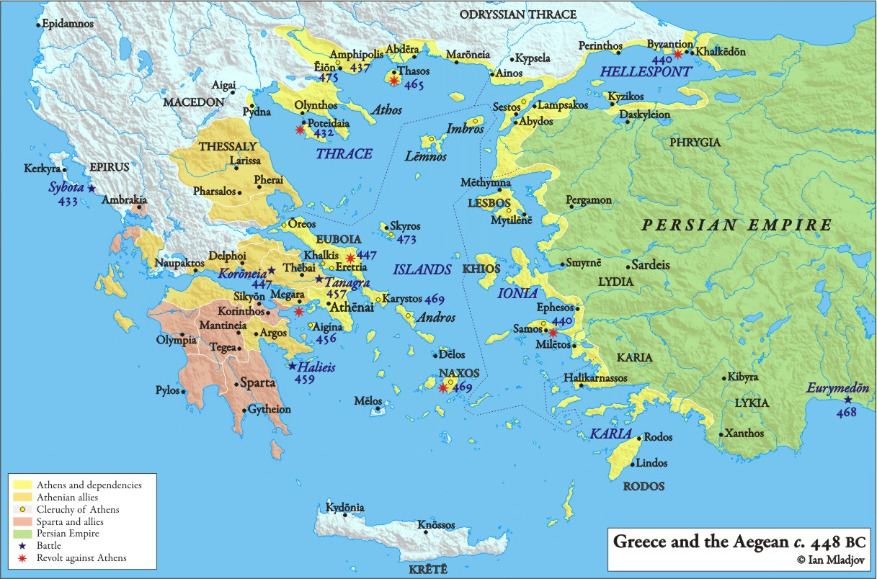
Athens’ new hegemony

Slide 14
Campaigns of the 460s
467/6? Battle of the Eurymedon. Cimon destroys Persian army and fleet
468: Thasos revolts from the League, but submits after 3-year siege; forced to give up its walls and fleet
464: Athens renounces alliance with Sparta despite Cimon’s protestations

Slide 15
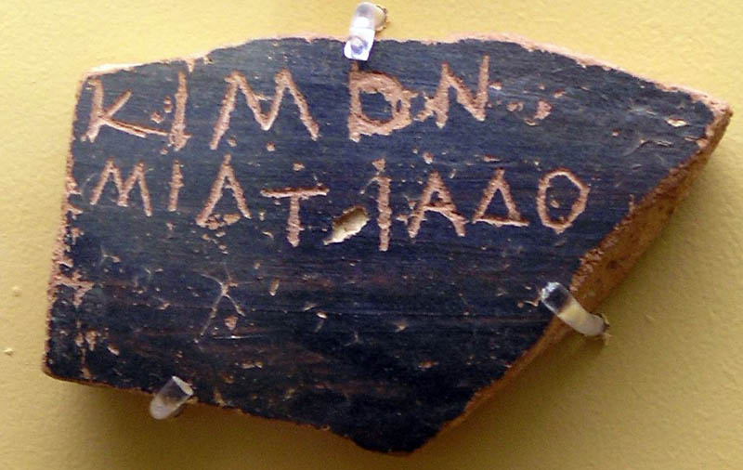
Change at Athens
461: Cimon ostracised for pro-Spartan stance (recalled 456)
462/1: rise of ‘democratic’ faction of Ephialtes and Pericles

Slide 16
The Reforms of Ephialtes
Power of Areopagus Council broken by taking away its roles; reduced to homicide court
Council of 500 runs daily administration; pay introduced for Council duty
People’s courts (dikasteria) become ‘guardians of the laws’
Political and legal affairs moved from Areopagus and Acropolis to Agora

Slide 17
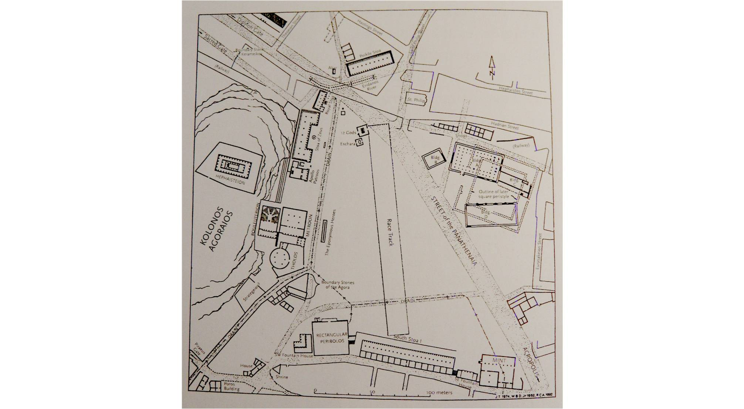

Slide 18
Progress?
Ephialtes (…) incited the masses to anger against the Areopagites, persuaded the people to diminish the Areopagus Council by decree and to put an end to their famous ancestral customs.
Diodorus 11.77.6
When Cimon sailed away again on military service, the demos got completely beyond control. They confounded the established political order of things and the ancestral practices which they had formerly observed, and led by Ephialtes they robbed the Areopagus Council of all but a few of the cases in its jurisdiction. They made themselves masters of the courts of justice, and plunged the city into unmitigated democracy.
Plutarch, Cimon 15.1-2

Slide 19
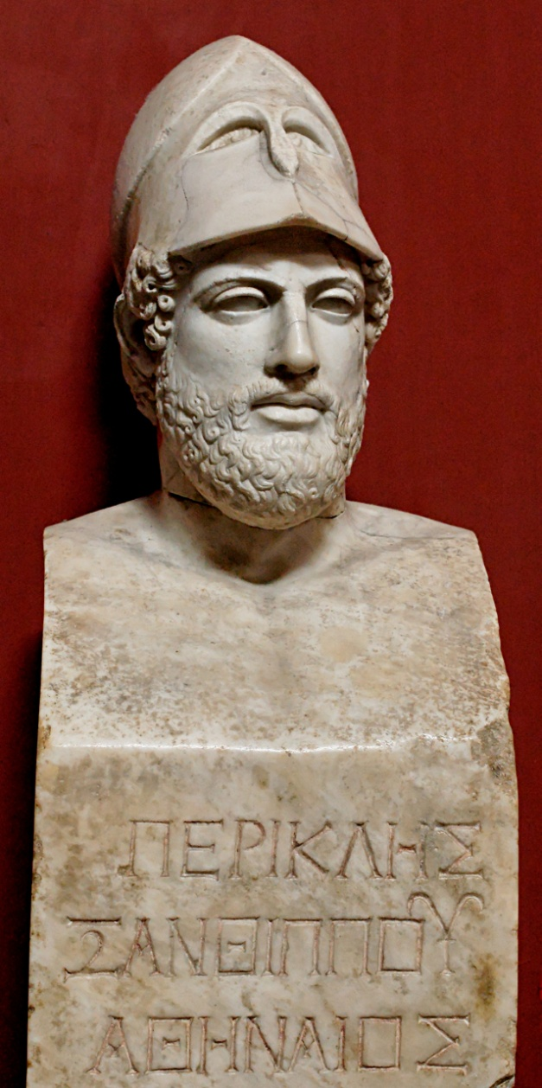
The rise of ‘radical’ democracy
Ephialtes assassinated (461/0); Pericles takes over
457: Archonship opened up to the zeugitai
Pericles introduces pay for jury service – ‘as a popular counter-measure against Cimon's wealth’ ([Arist.] Ath. Pol. 27.2)!

Slide 20
Democracy and Imperialism
450s: First Peloponnesian War, war against Aegina, expedition to Egypt (250 triremes; destroyed in 456)
458: Aegina taken & forced into the League
456: Boeotia conquered
456: completion of Long Walls

Slide 21
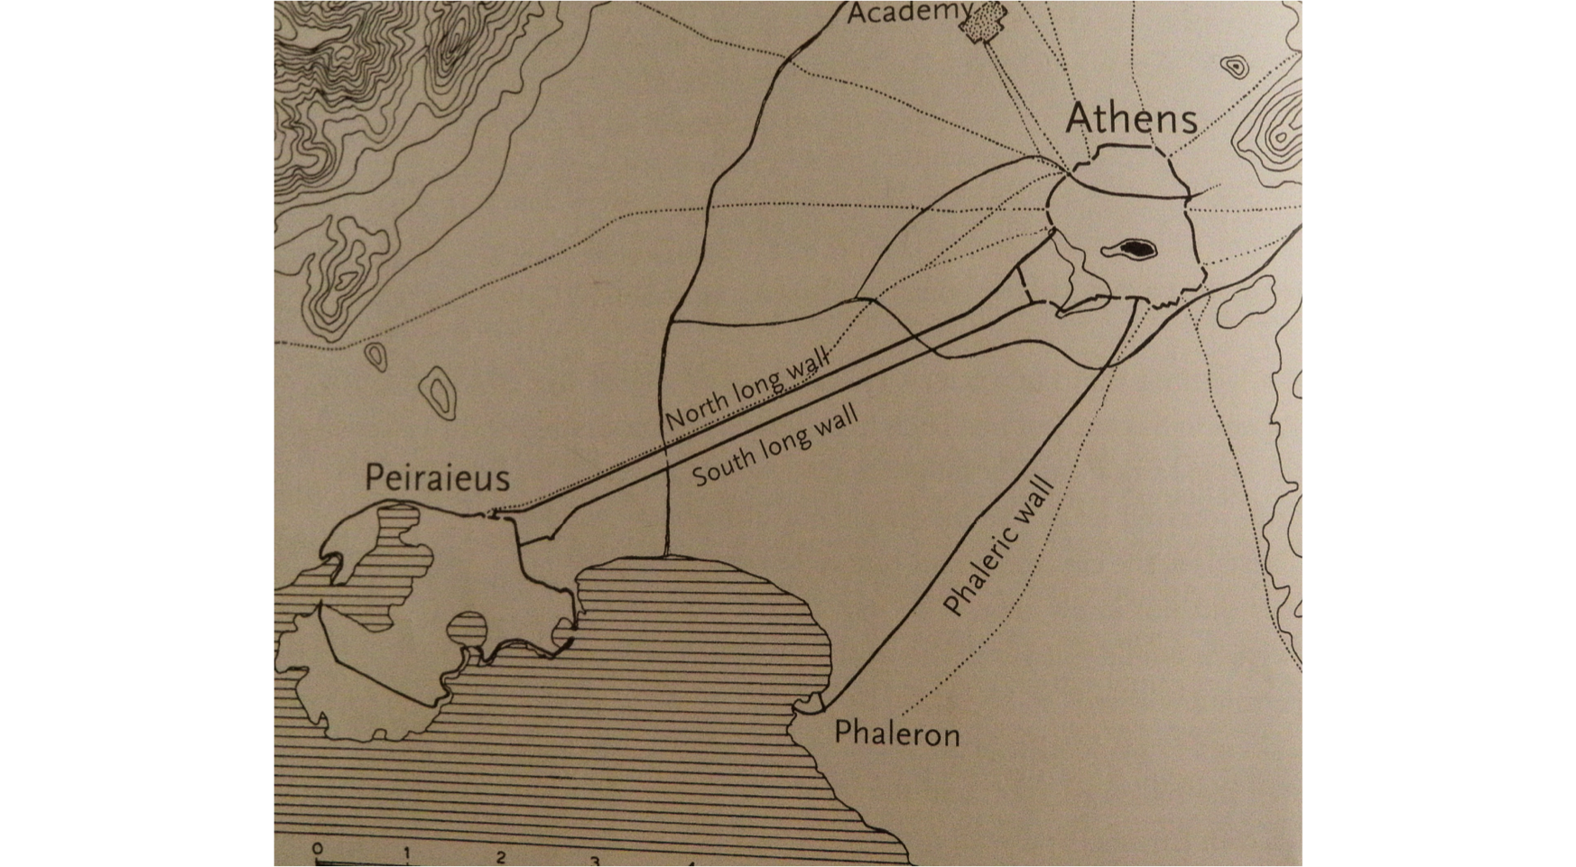

Slide 22
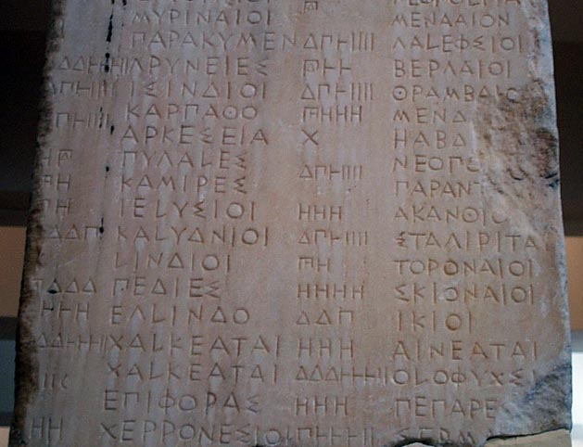
The Athenian Empire
454/3: League treasury moved from Delos to Athens. Tribute now made to Athena & kept on Acropolis
‘Allies’ become ‘subjects’
453: revolt of Erythrae;
Athens imposes democracy
By 446 all but Samos,
Lesbos & Chios pay tribute

Slide 23
The reign of Pericles
451: Pericles’ Citizenship Law: only those with 2 Athenian parents can be citizens (Cimon does not qualify!)
451/0: Cimon dies in Cyprus. Pericles supreme
443-430: Pericles elected general every year
‘In name it was democracy, but really it was rule by the foremost citizen’ (Thucydides 2.65)

Slide 24
The end of empire?
449/8: Peace of Callias; end of the Persian Wars
447-6: revolt of Boeotia, Megara, Euboea; Spartans threaten to invade
Pericles channels imperial tribute into Athens: building programme, cavalry
440: Samos revolts; reduced in 9-month siege at massive expense

Slide 25
The Imperial Democracy
Imperial tribute funds democratic offices: 1200 at home (including 500 Councillors), 700 abroad
Cleruchies and colonies extend Athenian strategic control and citizen numbers
Athenians draw pay from naval service, jury service
431: Athens has 60,000 adult male citizens & a silver reserve of 10,000 talents

