Slide 1
Democracy and Imperialism
Lecture 7: the arsenal of democracy

Slide 2
Society and politics of democratic Athens
Democracy (then and now) cultivates an ideology of equality and freedom for all citizens
Equal rights and freedom of speech hide differences within the citizen body (including unequal access to political and legal institutions)
Citizen equality is built on systematic exclusion of non-citizens, women, and slaves

Slide 3
The democracy at war
While they were under tyrannical rulers, the Athenians were no better in war than any of their neighbours, yet once they got rid of their tyrants, they were by far the best of all. This, then, shows that while they were oppressed, they were, as men working for a master, cowardly, but when they were freed, each one was eager to achieve for himself.
Hdt. 5.78
Where our rivals from their very cradles through painful discipline seek after manliness, at Athens we live exactly as we please, and yet we are just as ready to encounter every legitimate danger. In proof of this it may be noticed that the Lacedaemonians do not invade our country alone, but with all their allies; while we Athenians advance unsupported into the territory of a neighbour, and, fighting on foreign soil, usually vanquish with ease men who are defending their homes.
Thuc. 2.39.1-2

Slide 4
Key questions
What was the military basis of Athenian power?
How did the nature of its armed forces affect Athenian imperialist expansion?
Did democracy make Athens more effective in war?

Slide 5
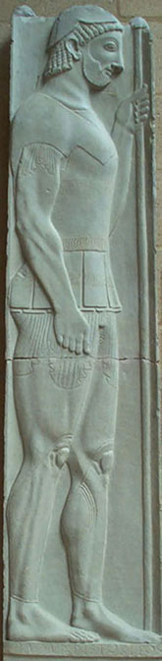
Warfare in Early Classical Greece
All Greek armies are citizen militias
No professional militaries; no military institutions or military budget
Defence is the duty of the citizen body in arms – plus resident foreigners (liable to serve) and slaves (attending their masters)

Slide 6
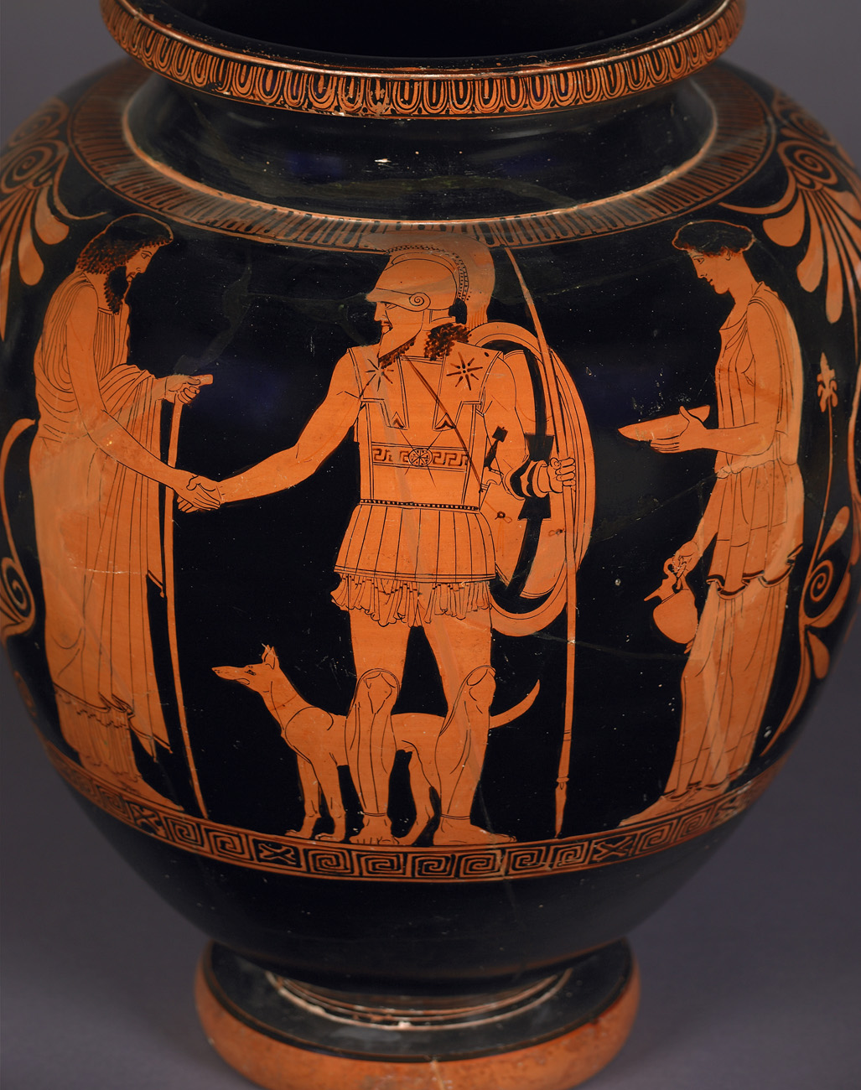

Slide 7
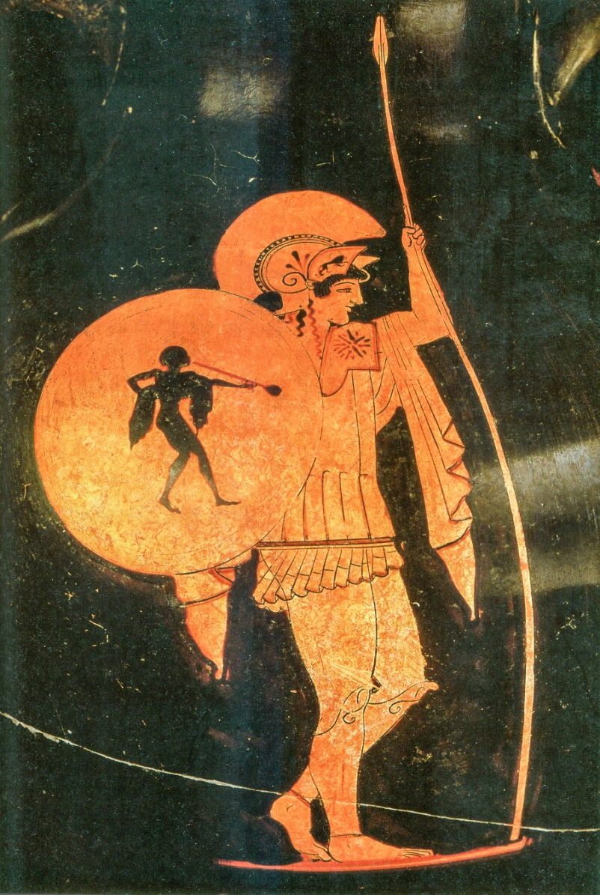
The hoplite
The essential citizen warrior according to polis ideology
Hoplitês (‘equipped one’) armed with large shield and thrusting spear. Term first seen in Pindar, c.470
Hoplites fight in large semi-regular formation called taxis (later phalanx)
Tactics: get stuck in

Slide 8
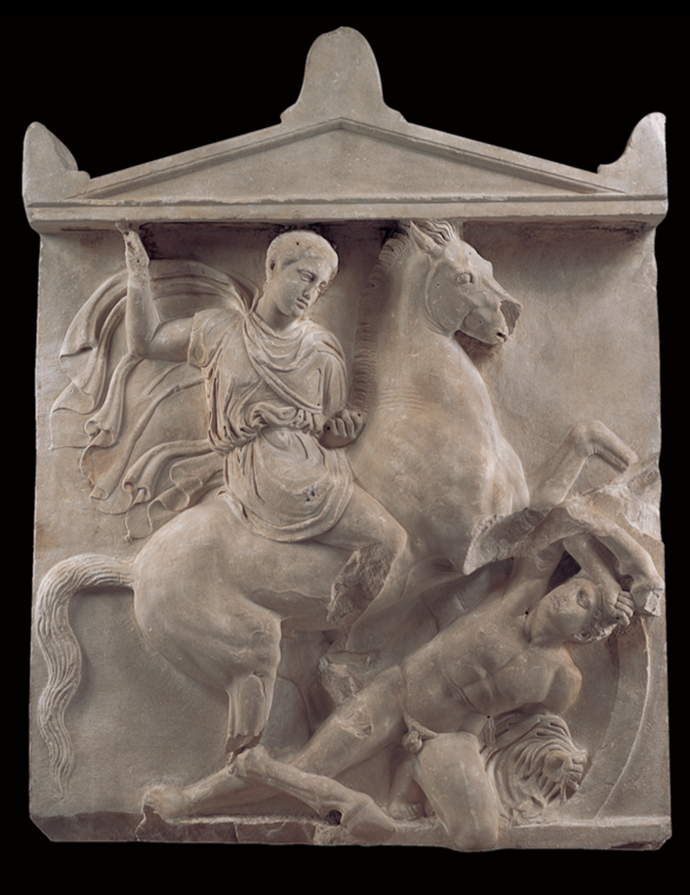
Cavalry
Wealthiest citizens serve as cavalry: glamorous, but politically suspect
Heavily armoured, armed with javelins and swords
Essential to protect hoplites against enemy cavalry and light infantry
Tactics: skirmish and charge

Slide 9
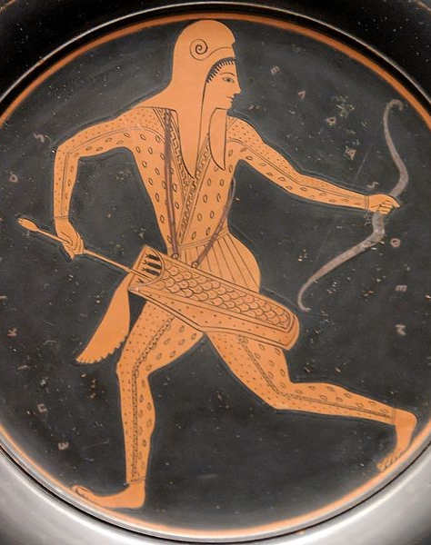
Light infantry
Recourse of the poor masses
Armed with what they could afford: javelins, bows, slings, rocks
Tactics: hit and run

Slide 10
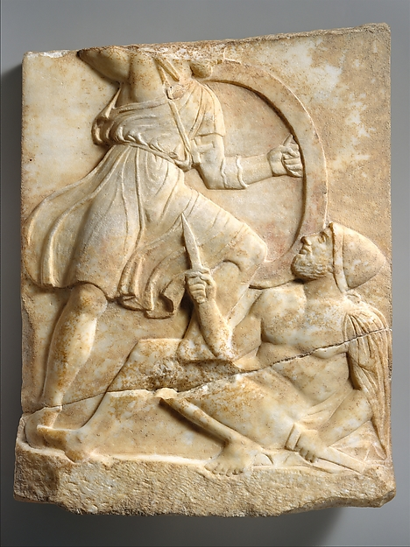
Waging war with amateur levies
Advantages
Large armies
Minimal expense
Commitment to the cause
Disadvantages
Troops of unreliable quality; no professional skill
Can only serve for a short time
High losses pose existential threat to polis

Slide 11
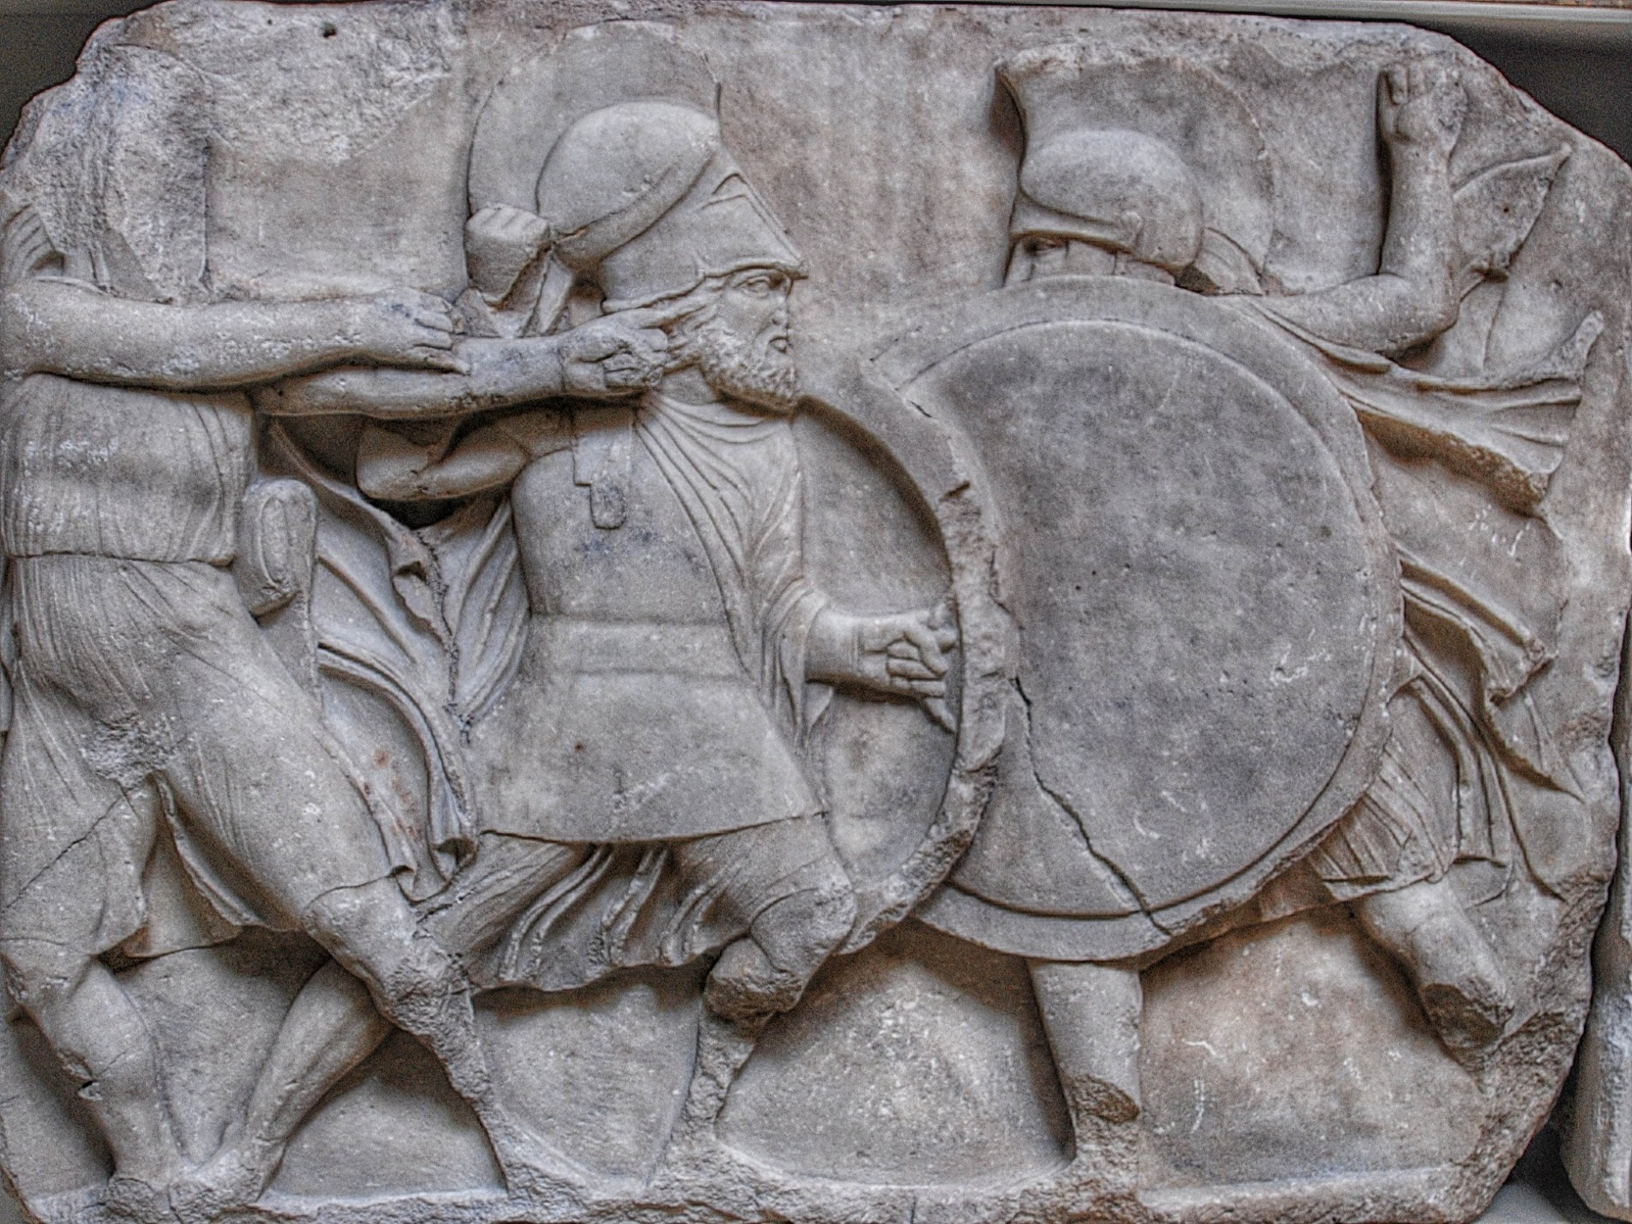
Athens at war

Slide 12
Who is in charge?
Archaic period: elected polemarch
After Cleisthenes: board of 10 elected strategoi (generals) support polemarch
Fifth century: polemarch loses his military role
Generals are all-purpose commanders assigned to missions by the Assembly

Slide 13
Raising the levy
Citizens called up by tribe using draft lists (katalogoi) based on citizen register
Solonic property classes determine required role: hippeis are horsemen, zeugitai are hoplites
Thetes exempt from draft ‘from the list’; serve only as volunteers or in pandemei/panstratiai levies

Slide 14
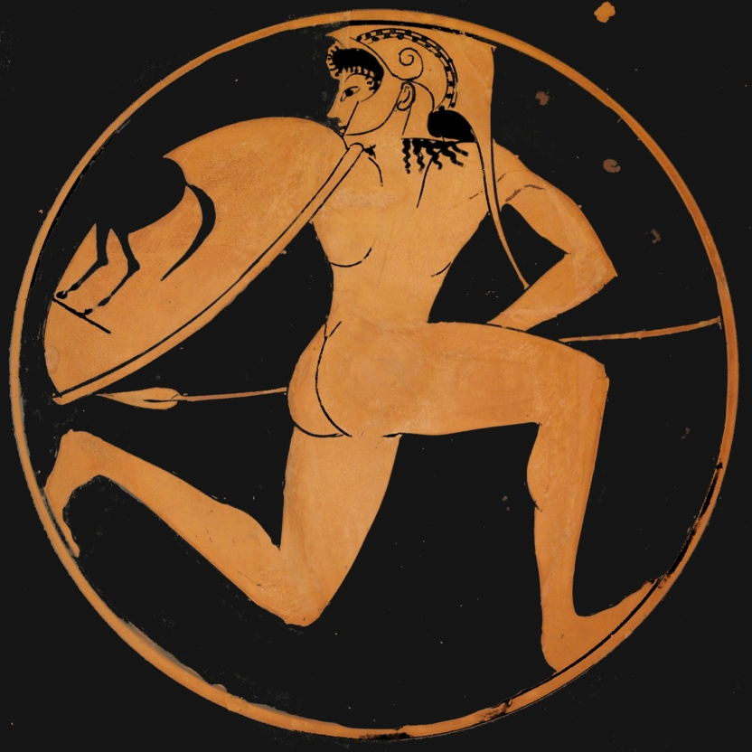
Laws against shirking military duty
Astrateia (draft dodging)
Lipotaxia (desertion)
Deilia (cowardice)
Generals had the authority to fine or imprison their men, but in practice laws were rarely enforced

Slide 15
An Imperial Militia
Early 450s: citizens on the lists become liable to mandatory service overseas
Introduction of pay for military service
Connected to opening up the archonships to the zeugitai in 457/6?

Slide 16
The Athenian armed forces
They had an army of 13,000 hoplites, besides 16,000 more in the garrisons and on home duty at Athens. This was at first the number of men on guard in the event of an invasion: it was composed of the oldest and youngest levies and the metics who had hoplite equipment. (…) Pericles also showed them that they had twelve hundred horse including mounted archers, with sixteen hundred archers unmounted, and three hundred triremes fit for service.
Thuc. 2.13.6-8

Slide 17
The hoplite body
Organised into 10 taxeis, one taxis for each tribe
Taxis split into unknown number of lochoi of several hundred men; no further unit subdivision
Citizens and metics served together in each taxis
No official unit drill or weapon training of any kind
‘The city does not publicly train for war.’
Xenophon, Memorabilia 3.12.5

Slide 18
The hoplites of Athens
But the Athenian infantry, which has the reputation of being very weak, has been deliberately so constituted: they consider that they are weaker and fewer than their enemies, but they are stronger, even on land than such of their allies as pay the tribute, and they think their infantry sufficient if they are more powerful than their allies.
Old Oligarch, Ath. Pol. 2.1
“Your men are by nature difficult to command.”
Thuc. 7.14.2
“When will they adopt the Lacedaemonian system of training, seeing that they not only neglect to make themselves fit, but make fun of those who take the trouble to do so? When will they reach that standard of obedience to their commanders, seeing that they think it an honourable thing to look down on their commanders?”
Xenophon, Memorabilia 3.5.15-16

Slide 19
The cavalry
96 horsemen under Solonic draft system; increased to 300 after Persian Wars; increased to 1000 + 200 mercenary horse archers c. 445
Growth in response to loss of Thessalian allies (457) or revolt of Boeotia (447)?
Celebrated in Parthenon frieze?
Organised into 10 phylai to go with hoplite taxeis
Metics excluded from cavalry service

Slide 20
The importance of cavalry
[Pericles] addressed himself to the defence of the city, and kept it as quiet as possible, though he constantly sent out cavalry to prevent raids on the lands near the city from ravaging parties of the enemy.
Thuc. 2.22.1-2
As the cavalry rode out daily on missions to Decelea and to guard the country, their horses were either lamed by being constantly worked upon rocky ground, or wounded by the enemy.
Thuc. 7.27.5
On board the ships he took 4,000 Athenian hoplites, and 300 cavalry in horse transports, then made for the first time out of old ships…
Thuc. 2.56.2

Slide 21
The light-armed
Thucydides: no organised light infantry before 424. But what about the 1600 archers?
Mass levies contain numberless citizen light-armed; specialist archers serve mainly with fleet
Increasing use of specialist light infantry mercenaries

Slide 22
The status of light infantry
“A man [Heracles] who has won a reputation for valour in his contests with beasts, in all else a weakling; who never strapped shield to arm nor faced the spear, but with a bow, the worst of weapons, was ever ready to run away. Archery is no test of manly bravery; no! he is a man who keeps his post in the ranks and steadily faces the swift wound the spear may plough.”
Euripides, Heracles 157-164
“[The Illyrians] might terrify an inexperienced imagination; they are formidable in size, their loud yelling is unbearable, and the brandishing of their weapons in the air has a threatening appearance. But when it comes to real fighting with an opponent who stands his ground, they are not what they seem. They have no regular order that they should be ashamed of deserting when hard pressed; flight and attack are with them equally honourable, and afford no test of courage.”
Thuc. 4.126.4-5

Slide 23
The importance of light infantry
As long as their archers had arrows left and were able to use them, they held out, the light-armed Aetolians retiring before the arrows; but after the commander of the archers had been killed and his men scattered, the hoplites, worn and hard pressed by the Aetolians with their javelins, at last turned and fled, and, falling into pathless gullies and unfamiliar places, they were wiped out.
Thuc. 3.98.1-2
Wherever there is a large multitude of [poor people], when civil war occurs the oligarchs often get the worst of the struggle; and a remedy for this must be adopted from military commanders, who combine with their cavalry and hoplite forces a contingent of light infantry. And this is the way in which the common people get the better over the well-to-do in outbreaks of civil war: being unencumbered, they fight easily against cavalry and hoplites.
Aristotle, Politics 1321a.15-21

Slide 24
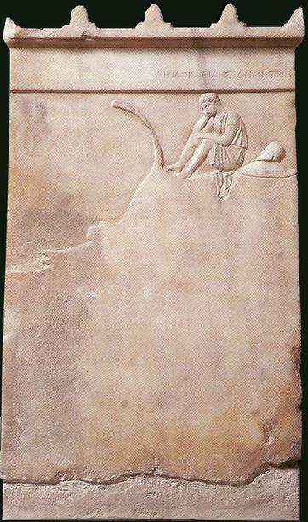
The deck-fighters
Epibatai (deck-fighters, ‘marines’) learn special skills needed to fight on triremes and as amphibious force
Social background unknown, possibly mixed
Status low, like light infantry; Plato (Laws 706b-c) argues Athens forfeited its moral character when it adopted the ways of ‘naval hoplites’

Slide 25
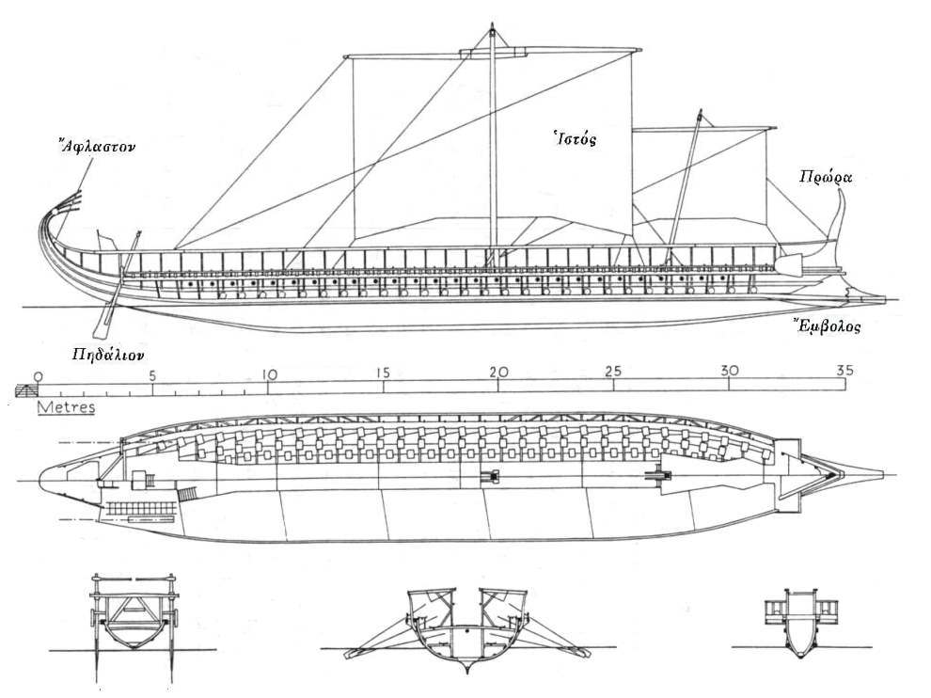
The instrument of empire

Slide 26
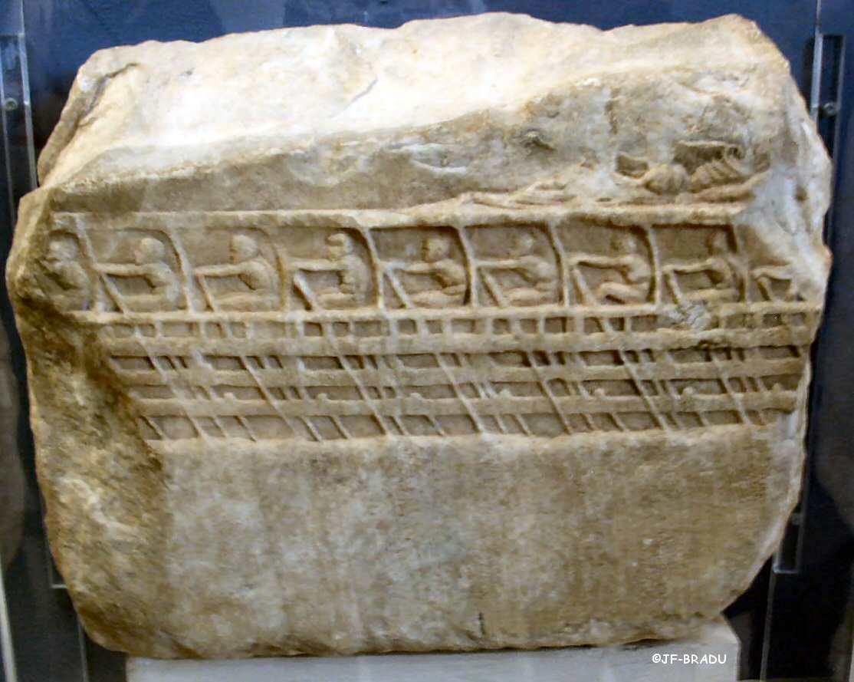
The trireme
Fast and powerful; dedicated warship
Crew: 170 rowers, dozens of sailors, 10 epibatai, 4 archers
No room for supplies or space to sleep

Slide 27
Trireme warfare
Trireme suitable for boarding and ramming
Mast and sails cleared for action; rowers and helmsmen control ship in battle
Tactics: periplous (encirclement) and diekplous (breakthrough?)
Numbers and crew experience are vital to success

Slide 28
Who rows?
Labour force drawn from poor citizens, metics, slaves, foreign mercenaries
Only state triremes (Paralus and Salamina) manned exclusively by citizens
Expert sailors (especially trireme helmsmen) become highly prized professionals

Slide 29
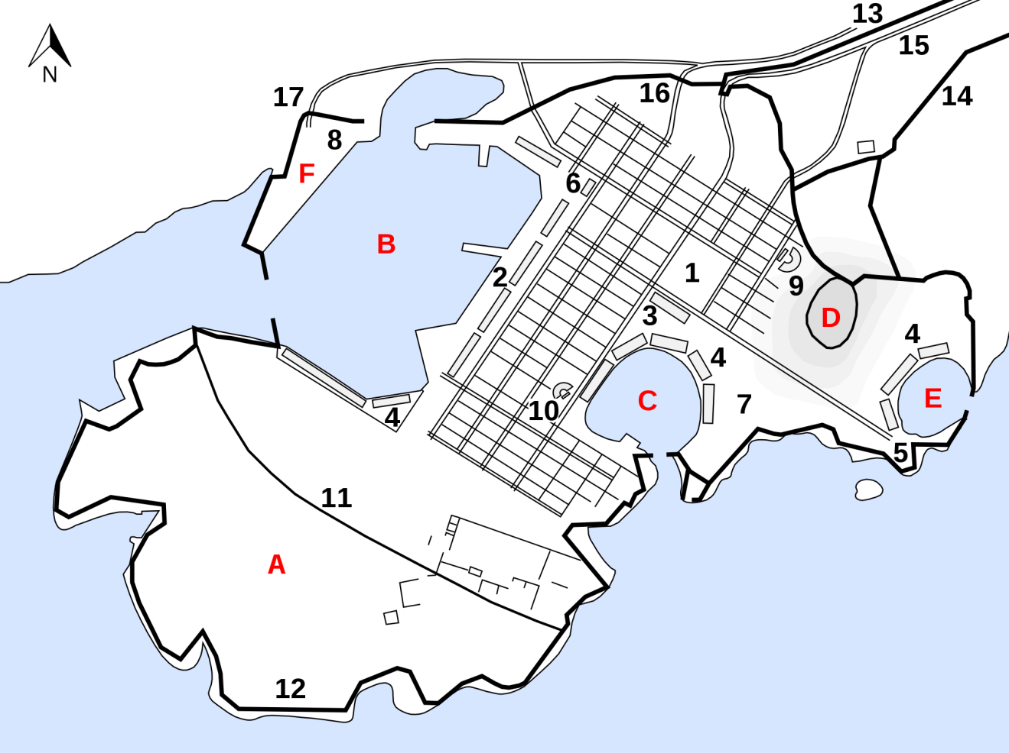
The infrastructure of the fleet
Athens builds up fleet of 300+ trireme hulls
Piraeus fitted
with shipsheds
to keep hulls dry
Only state
triremes paid by
Athens itself

Slide 30
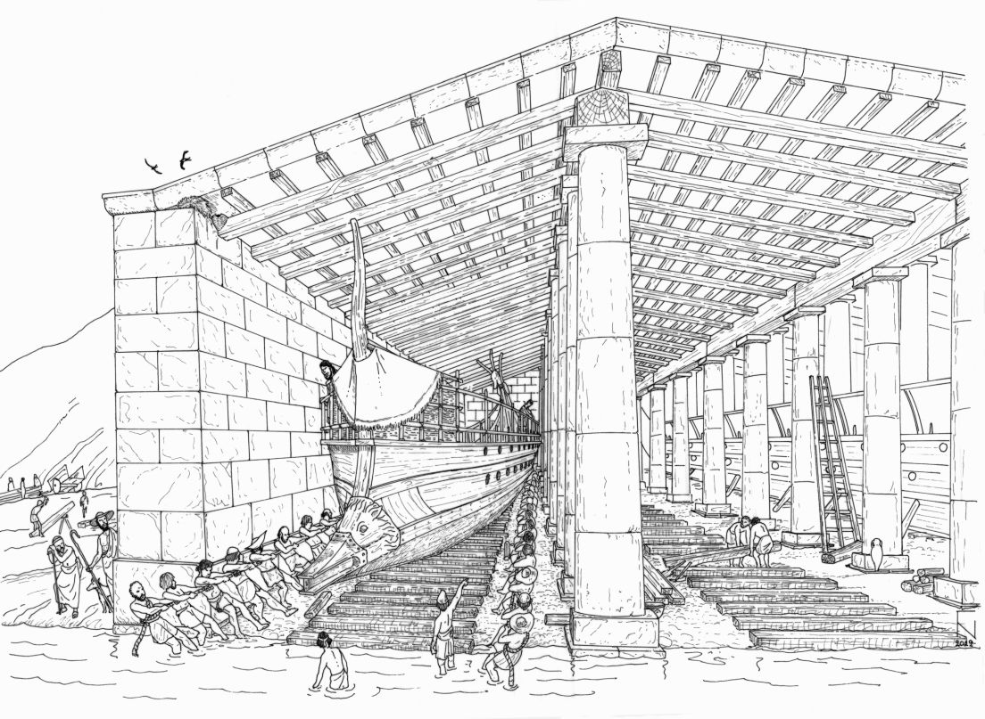

Slide 31
Paying for the fleet
Supply of crew and tackle (and captain of a trireme) was the duty of the trierarchs – a liturgy, state expense assigned by lot
Cost of trierarchy ran up to multiple talents; only wealthiest Athenians eligible
Imperial campaigns: redistribution of wealth?
Trierarchy system creates need for money

Slide 32
The self-sustaining empire
Terms of the Delian League mean only Athenian crews are constantly in service
Tribute means only Athenian state is able to sustain a large navy
Athenian poor (citizen, metic and slave) depend on pay for naval service – a population of mercenaries?

Slide 33
The arsenal of democracy
Throughout the fifth century, Athens relies on amateur citizen militia, just like the rest of Greece
However, influx of vast wealth enhances armed forces in every way: pay for service, standing support troops, mercenaries, fleet facilities
Athenian democracy is successful in war due to constant practice

