Slide 1
Democracy and Imperialism
Lecture 8: The Peloponnesian War

Slide 2
Athens’ armed forces
Athenian army and fleet are militia, large because Athens is large
Empire provides funds to expand and professionalise armed forces
Constant campaigning increases effectiveness of Athenian forces, especially fleet

Slide 3
The military situation in 431
Army: 24,000 hoplites, 1,200 cavalry, 1,600 archers
Fleet: 300 triremes
Funds: 6,000 talents stockpiled, yearly tribute of 600 talents
Long Walls connect city to Piraeus

Slide 4
Key questions
Why did Athens and Sparta go to war, and why did they do so specifically in 431?
How did Athenian democracy shape the course of the war?
How did Athenian imperialism shape the course of the war?

Slide 5
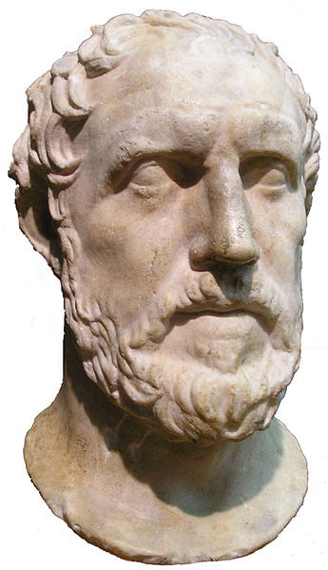
The causes of the war
To the question why they broke the treaty, I answer by placing first an account of their grievances and points of difference, so that no one may ever have to ask the immediate cause which plunged the Greeks into a war of such magnitude.
The truest cause, I think, is the one which was officially hidden: the growth of the power of Athens, and the fear which this inspired in Sparta, made war inevitable.
Thuc. 1.23.5-6

Slide 6
The long game
479: Athenians rebuild their city wall against Spartan wishes
478: Athenians take over anti-Persian alliance; Spartans acquiesce?
465: Sparta willing to support revolt of Thasos?
465/4: Sparta rejects Athenian aid against helot revolt
464-1: Athens breaks alliance with Sparta, forges new alliances with Argos, Thessaly, Megara

Slide 7
The First Peloponnesian War (460-446)
Sparta leads alliance against Athens, but only marches out twice
Athens mainly fights Corinth, Aegina, Boeotia
Initial success: Athens defeats Corinth, takes Aegina (458), Boeotia (456), Phocis (454), raids Peloponnese unopposed
Rebellion of Boeotia (447), Euboea and Megara (446); threat of Spartan invasion forces Athens to negotiate
Signing of Thirty Years’ Peace (446/5)

Slide 8
‘Grievances and points of difference’
435: Corcyra breaks with its mother city Corinth and forges alliance with Athens
432: Potidaea revolts from Athens; supported by volunteers from mother city Corinth
431: Aeginetans banished from Aegina
‘Megarian Decree’ bans Megarians from all ports and markets of the Athenian Empire

Slide 9
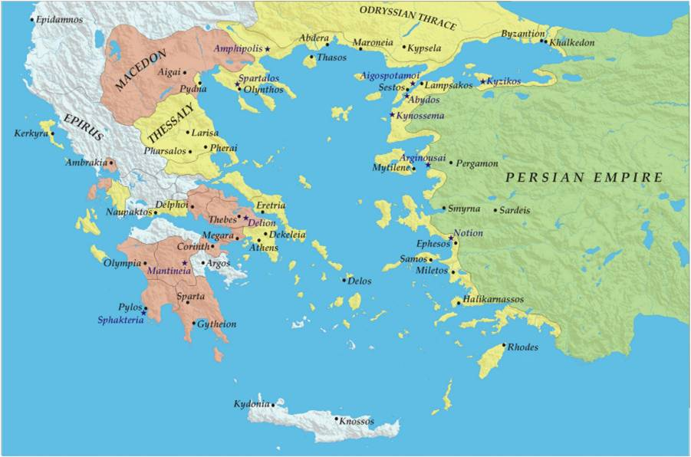

Slide 10
The war lobby at Sparta
Corinthians, Aeginetans and Megarians clamour for war
Pericles rejects all Spartan demands, dismisses envoys without hearing them
Final ultimatum: ‘Sparta wants there to be peace, and there will be, if you leave the Greeks independent’ (Thuc. 1.139.3)

Slide 11
The other truest cause
“There is one principle, Athenians, to which I hold through everything, and that is the principle of no concession to the Peloponnesians.”
Thuc. 1.140.1
Then Pericles, aflame with rage on his Olympian height, let loose the lightning, caused the thunder to roll, upset Greece and passed an edict (…) and from that time there was horrible clatter of arms everywhere.
Aristophanes, Acharnians 530-540
It does not seem probable that the war would have come upon the Athenians for any remaining reasons, if only they could have been persuaded to rescind their decree against the Megarians and be reconciled with them. And therefore, since it was Pericles who was most of all opposed to this, and who incited the people to stick to their policy toward the Megarians, he alone was held responsible for the war.
Plutarch, Life of Pericles 29.5

Slide 12
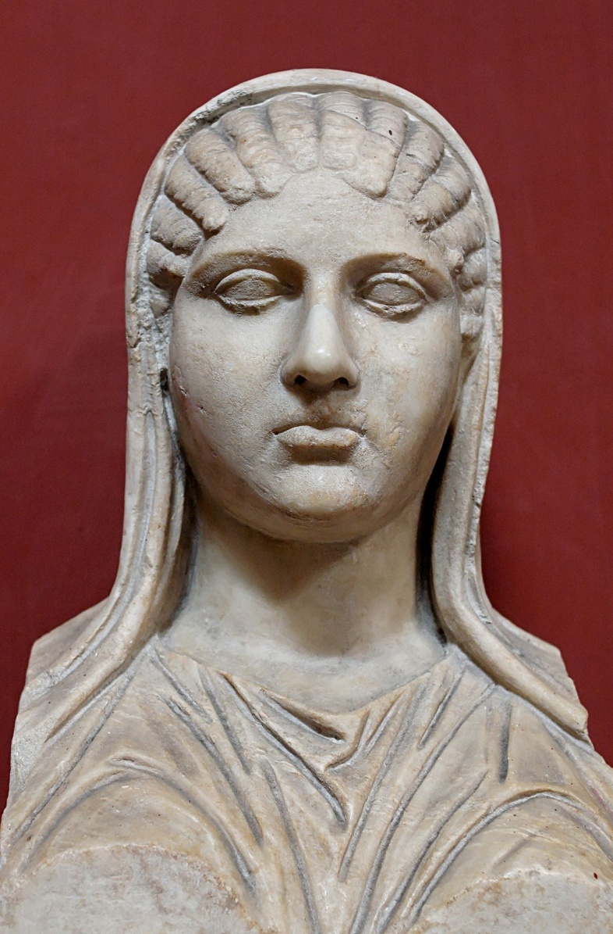
Pericles in trouble
Accused of embezzlement and corruption
Accused of atheism through association with philosopher Anaxagoras
Ridiculed for his relationship with Aspasia of Miletus
Accused of aiming for tyranny

Slide 13
Pericles the warmonger
To prevent all danger to himself, he threw out that little spark, the Megarian Decree, set the city aflame, and blew up the conflagration with a hurricane of war, so that the smoke drew tears from all Greeks both here and over there.
Aristophanes, Peace 609-610
But Pericles, knowing that during war the people have respect for noble men because of their urgent need of them (…) came to the conclusion that it would be to his own advantage to embroil the state in a great war, in order that the city, in its need of the ability and skill in generalship of Pericles, should pay no attention to the accusations being lodged against him.
Diodorus 12.39.3
He kindled into flame the threatening and smouldering war, hoping thereby to dissipate the charges made against him and take away the people's suspicions, since when great things happened, and great threats loomed, the city entrusted itself to him and to him alone.
Plutarch, Life of Pericles 32.3

Slide 14
The vote for war
Both sides vote to declare/accept termination of Thirty Years’ Peace
Sparta: protecting allies, defending reputation?
Athens: preserving and enlarging empire, solidifying status?

Slide 15
Democracy and imperialism
“We must believe that the tyrant city that has been established in Greece has been established against all alike, with a programme of universal empire, part fulfilled, part in contemplation; let us then attack and reduce it, and win future security for ourselves and freedom for the Greeks who are now enslaved.”
Thuc. 1.124.3 (the Corinthians to the gathered Peloponnesian League)
“What you are fighting against is not merely slavery as an exchange for independence, but also loss of empire and danger from the animosities incurred in its exercise. Besides, to recede is no longer possible, if indeed any of you in the alarm of the moment has become enamoured of the honesty of such an unambitious part. For what you hold is, simply put, a tyranny; to take it perhaps was wrong, but to let it go is unsafe.”
Thuc. 2.63.1-2 (Pericles to the Athenians)

Slide 16
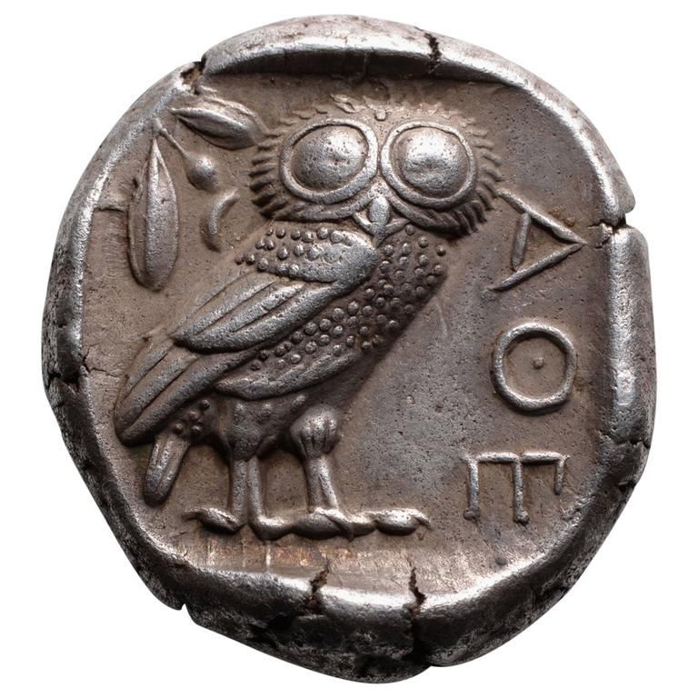
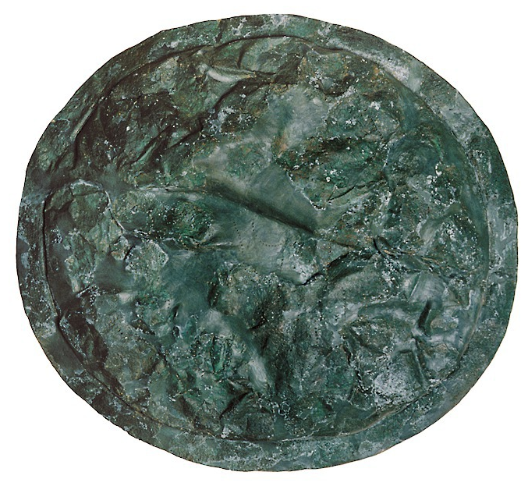
The Peloponnesian War

Slide 17
Pericles’ island strategy
“Suppose that we were islanders: can you think of a more impregnable position? Well, this in future should, as far as possible, be the way we think of our position. Dismissing all thought of our land and houses, we must vigilantly guard the sea and the city. No irritation that we may feel for the former must provoke us to a battle with the numerical superiority of the Peloponnesians.”
Thuc. 1.143.5
They were to prepare for the war, and to carry in their property from the country. They were not to go out to battle, but to come into the city and guard it, and get ready their fleet, in which their real strength lay. They were also to keep a tight rein on their allies—the strength of Athens being derived from the money brought in by their payments, and success in war depending principally upon good judgment and money.
Thuc. 2.13.2

Slide 18
The Archidamian War (431-421)
Archidamos of Sparta leads annual invasions of Attica, but Athenians do not march out
Athenians launch annual fleet raids around the Peloponnese, biannual invasions of Megarid
Plague in Athens (430-429, 427-6): Athenians depose Pericles and sue for peace, but Spartans refuse
Pericles dies (429/8)

Slide 19
All downhill from here?
He told them to wait quietly, to pay attention to their marine, to attempt no new conquests, and to expose the city to no hazards during the war, and doing this, promised them a favourable result. What they did was the very contrary, allowing private ambitions and private interests, in matters apparently quite foreign to the war, to lead them into projects unjust both to themselves and to their allies—projects whose success would only conduce to the honour and advantage of private persons, and whose failure entailed certain disaster on the country in the war. (…) More on a level with one another, and each grasping at supremacy, they ended by committing even the conduct of state affairs to the whims of the multitude. This, as might have been expected in a great and sovereign state, produced a host of blunders.
Thuc. 2.65.7-11

Slide 20
The proxy war
Periclean strategy moves conflict elsewhere: Potidaea, Aetolia, Mytilene, Sicily
425: Athenians defeat and capture Spartan force on Sphacteria. Spartans sue for peace, but Athenians refuse
424: Boeotians defeat Athenians at Delium. Spartans send force to Thrace to instigate revolt against Athens
422/1: Spartan expeditionary force defeats Athenians at Amphipolis

Slide 21
The inter-war phase
421: Peace of Nicias confirms status quo
420-418: Argos contests Spartan supremacy on the Peloponnese
416: Athens subjects Melos, a colony of Sparta
415-413: the Sicilian Expedition

Slide 22
The debate on Sicily (Thuc. 6.8-26)
Speeches by Nicias (against), Alcibiades (for), Nicias again (still against), until --
‘All alike fell in love with the enterprise. The older men thought that they would either subdue the places against which they were to sail, or at all events, with so large a force, meet with no disaster; those in the prime of life felt a longing for foreign sights and spectacles, and had no doubt that they should come safe home again; while the idea of the common people and the soldiery was to earn wages at the moment, and make conquests that would supply a never-ending fund of pay for the future. With this enthusiasm of the majority, the few that did not like it feared to appear unpatriotic by holding up their hands against it, and so kept quiet.’
Thuc. 6.24.3-4

Slide 23
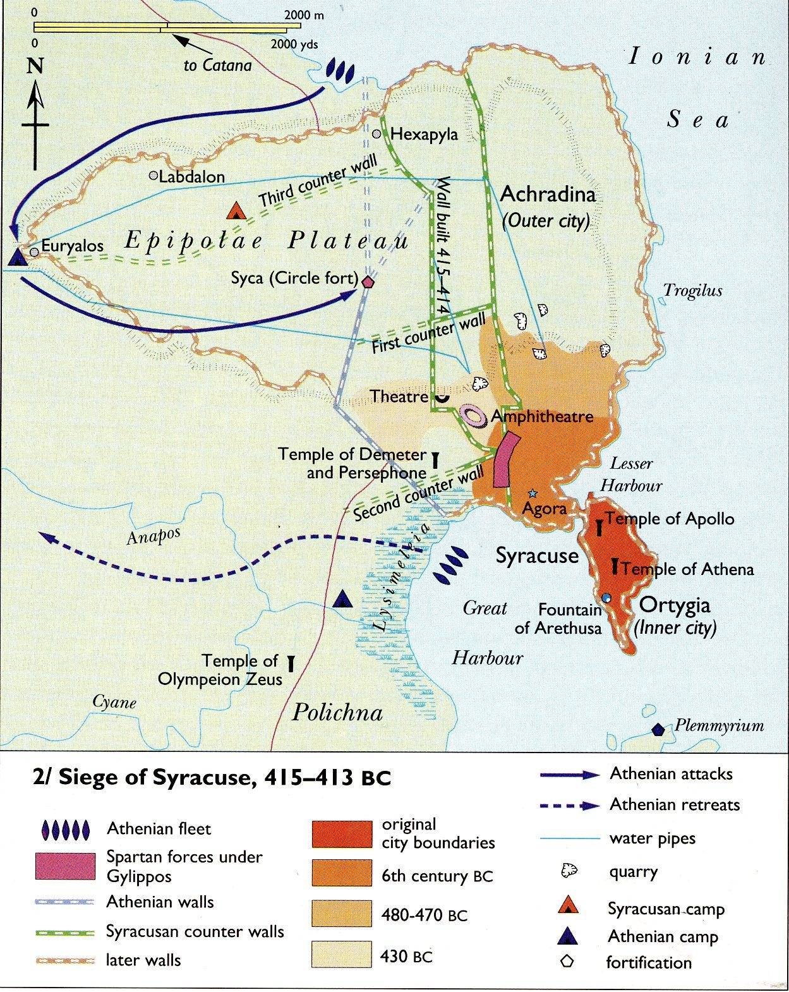
The siege of Syracuse
This was the greatest Greek achievement of any in this war, or, in my opinion, in Greek history; at once most glorious to the victors, and most disastrous to the conquered. They were all of them beaten in every way; all that they suffered was great; they were utterly destroyed, as the saying goes – their infantry, their ships, everything was annihilated, and few out of many came back home.
Thuc. 7.87.5-6

Slide 24
The Decelean War (413-404)
Agis of Sparta fortifies base at Decelea in Attica; Athens under siege
Spartans send fleet to Ionia and Hellespont to encourage revolts
411: panic at Athens; overthrow of democracy; oligarchy of the Four Hundred. Athenians sue for peace, but Spartans refuse
Sparta secures Persian funding

Slide 25
The war of the fleets
410-8: multiple victories restore Athenian influence, but Persian money allows Sparta to rebuild fleet each time
406: battle of Arginusae; Spartan fleet destroyed (again). Spartans sue for peace, but Athenians refuse
405: Athenian fleet captured at Aegospotami

Slide 26
The remorse of the imperialist
It was night when the Paralus arrived at Athens with tidings of the disaster, and a sound of wailing ran from Piraeus through the Long Walls to the city, one man passing on the news to another; and during that night no one slept, all mourning, not for the lost alone, but far more for their own selves, thinking that they would suffer such treatment as they had visited upon the Melians, colonists of the Lacedaemonians, after reducing them by siege, and upon the Histiaeans and Scionaeans and Toronaeans and Aeginetans and many other Greek peoples.
Xenophon, Hellenica 2.2.3

Slide 27
The end of the Athenian Empire
Athens starved into surrender (405-4)
Empire dissolved; Athenian fleet reduced to 12 triremes; Long Walls and walls of Piraeus torn down
Corinth and Thebes protest Spartan lenience, insist Athens must be destroyed
Spartans install puppet oligarchy of the Thirty

Slide 28
The defeat of Athens
Rise of Athenian status and influence affects mainly Sparta’s allies; Sparta eventually obliged to act
Thucydides accuses democracy of mishandling the war; actual track record more ambiguous
Athenian imperialism and profits of empire cause Athens to choose overreach every time

