Slide 1
Democracy and Imperialism
Lecture 9: democracy interrupted

Slide 2
The Periclean Peloponnesian War
Continued expansion of Athens at the expense of other Greeks provokes traditional hegemon Sparta
Course of war determined by democratic support for imperialism
Athenian power dismantled after Spartan victory, but Athens preserved

Slide 3
The oligarchic regimes of 411 and 403
What conditions and pressures led to the dissolution of democracy?
What specific elements of democracy did the oligarchs mean to correct?
How did the Athenians respond to the interruption of democracy?

Slide 4
The Simpsons
S04E12 Marge vs. the Monorail
(1993)

Slide 5
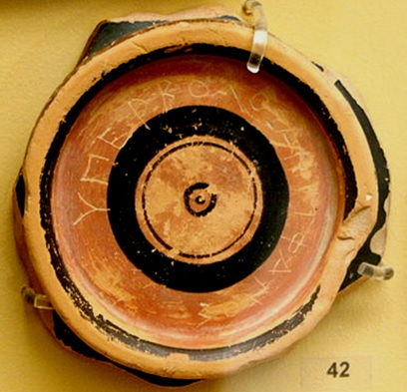
The trouble with people power
The power of rhetoric
Equal vote, unequal knowledge
‘The mob has spoken’
By the people, for the people?

Slide 6
Athenians Against Democracy
Pamphlets like that of the Old Oligarch provide fuel for anti-democratic thought
Socrates questions values & principles of democracy; many influential pupils (Alcibiades, Critias)
Cost of ongoing war fuels resentment against the demos
Call for return to ‘ancestral constitution’ of Cleisthenes

Slide 7
The abolition of democracy
“This [i.e. an alliance with Persia] we cannot have unless we have a more moderate form of government, and put the offices into fewer hands, and so gain the king's confidence, and forthwith restore Alcibiades, who is the only man living that can bring this about. The safety of the state, not the form of its government, is for the moment the most pressing question, as we can always change afterwards whatever we do not like.”
The people were at first highly irritated at the mention of an oligarchy, but upon understanding clearly from Peisander that this was the only resource left, they took counsel of their fears, and promised themselves some day to change the government again, and gave way.
Thuc. 8.53.3-54.1

Slide 8
Aims of oligarchy
Restriction of franchise to ‘those most able to serve the city with their money and their bodies’ (Thuc. 8.65.3; [Arist.] Ath.Pol. 29.5)
Ban on all expenses not related to the war
Abolition of pay for office
Peace with Sparta

Slide 9
The oligarchs seize power
Main popular leaders assassinated
Opposition silenced through fear
Council evicted from council chamber
120 youths ‘used whenever violence was needed’
It was no light matter to deprive the Athenian people of its freedom, almost a hundred years after the deposition of the tyrants, when it had been not only not subject to any during the whole of that period, but accustomed during more than half of it to rule over subjects of its own.
Thuc. 8.68.4

Slide 10
The Four Hundred
Installation of new Council of 400, chosen by the conspirators
Reduction of Assembly to 5,000 – convened only when called
Much else left as it is ([Arist.] Ath.Pol. 30-31)
Thucydides lists chief culprits: Antiphon, Peisander, Phrynichus, Theramenes

Slide 11
The opposition
Fleet at Samos rebels against government at home
Fleet deposes its generals and elects new ones, including Thrasyllus, Thrasybulus – and Alcibiades
Moderates of the Four Hundred, led by Theramenes, demand greater role for the Five Thousand
Phrynichus stabbed to death in the agora

Slide 12
The fall of the Four Hundred
Five Thousand demand recognition, march on Athens
Spartans liberate Euboea
Four Hundred deposed after just 4 months; Five Thousand installed as moderate oligarchy
When the news of what had happened in Euboea reached Athens a panic ensued such as they had never before known. Neither the disaster in Sicily, great as it seemed at the time, nor any other had ever so much alarmed them.
Thuc. 8.96.1

Slide 13
The Five Thousand
It was during the first period of this constitution that the Athenians appear to have enjoyed the best government that they ever did, at least in my time. For the fusion of the high and the low was effected with judgment, and this was what first enabled the state to raise up her head after her manifold disasters.
Thuc. 8.97.2
Athens seems to have been well governed during this critical period, although a war was going on and the government was confined to the hoplite citizens.
[Arist.] Ath.Pol. 33.2

Slide 14
Reactions: the decree of Demophantus (410)
“If anyone shall suppress democracy at Athens or hold any public office after its suppression, he shall become a public enemy and be killed with impunity; his goods shall be confiscated and a tithe given to the Goddess. No sin shall he commit, no defilement shall he suffer who kills someone like this or who conspires to kill him. And all the Athenians shall take oath by tribes and by demes over a sacrifice without blemish to kill someone like this.”
Andocides 1.96-97

Slide 15
Reactions: a constitution for Athens?
Laws of Athens: from Draco to Demophantus. Four Hundred show opportunity for abuse
Athens embarks on collection and review of laws, led by freedman Nicomachus (410-399)
Result: no ‘constitution’, but laws made public and systematic

Slide 16
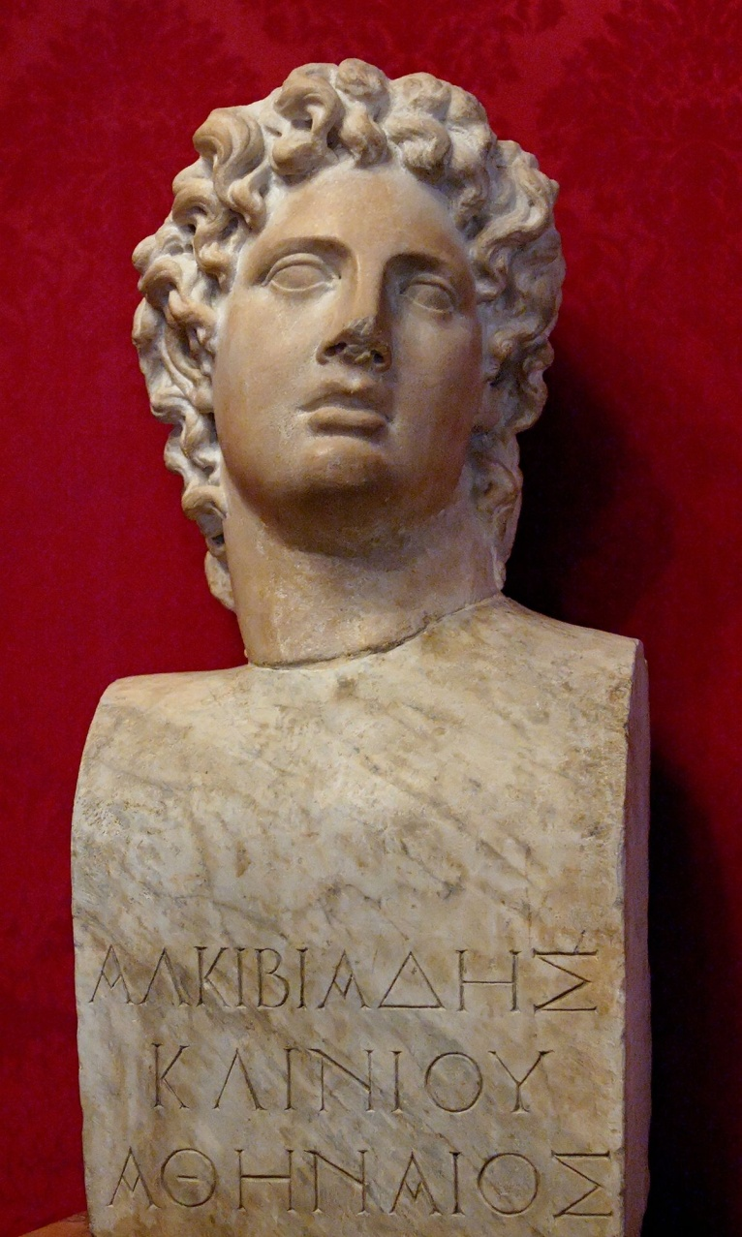
The aftermath
Five Thousand deposed, early 410; democracy restored
Alcibiades returns to Athens, but leaves again in 408
Athens defeated in 405-4; forced to recall exiles

Slide 17
The second abolition of democracy
The peace having been concluded on terms of their carrying on the government according to the ancestral constitution, the popular party endeavoured to preserve the democracy, but the notables who belonged to the hetaireia and those exiles who had returned after the peace were eager for oligarchy. (…) And when Lysander sided with the oligarchic party, the people were cowed and were forced to vote for the oligarchy.
[Arist.] Ath.Pol. 34.3
The Thirty had been chosen as soon as the Long Walls and the walls round Piraeus were demolished; although chosen, however, for the purpose of framing a constitution under which to conduct the government, they continually delayed framing and publishing this constitution, but they appointed a Council and the other magistrates as they saw fit.
Xen. Hell. 2.3.11

Slide 18
The Thirty
Regime propped up by the cavalry, 300 ‘whip-bearers’ and Spartan garrison
Reduction of Assembly to 3,000 – convened only when called
Dissolution of jury courts; restoration of powers to Areopagus Council
Theramenes executed for resisting hardline oligarchs under Critias

Slide 19
Critias’ reign of terror
The Thirty, thinking that now they could play the tyrant without fear, issued a proclamation forbidding those who were outside the roll [of 3,000 full citizens] to enter the city and evicted them from their estates, in order that they themselves and their friends might have these people's lands. And when they fled to Piraeus, they drove many of them away from there also, and filled both Megara and Thebes with refugees.
Xen. Hell. 2.4.1
But when they got a firmer hold on the state, they kept their hands off none of the citizens, but put to death those of outstanding wealth or birth or reputation, intending to put that source of danger out of the way, and also desiring to plunder their estates; and by the end of a brief interval of time they had made away with not less than fifteen hundred.
[Arist.] Ath.Pol. 35.4

Slide 20
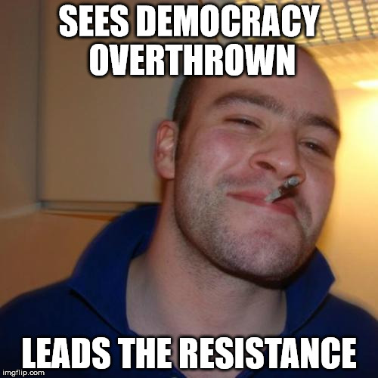
Good Guy Thrasybulus

Slide 21
The democratic insurgence
Thrasybulus invades Attica with 70 exiles; wins victory after victory; seizes Piraeus
Thirty defeated at Munichia in Piraeus; Critias and other key oligarchs killed
3,000 depose Thirty and install Ten, who call for Spartan aid
Spartans defeat Thrasybulus but force oligarchs to accept return of democracy
Thrasybulus declares general amnesty for all but the Thirty and the Ten

Slide 22
Reforging Athens
And, pledged as they were under oath, that in very truth they would not remember past grievances, the two parties even to this day live together as fellow-citizens and the commons abide by their oaths.
Xen. Hell. 2.4.43
The Athenians appear both in private and public to have behaved towards the past disasters in the most completely honorable and statesmanlike manner of any people in history.
[Arist.] Ath.Pol. 40.2

Slide 23
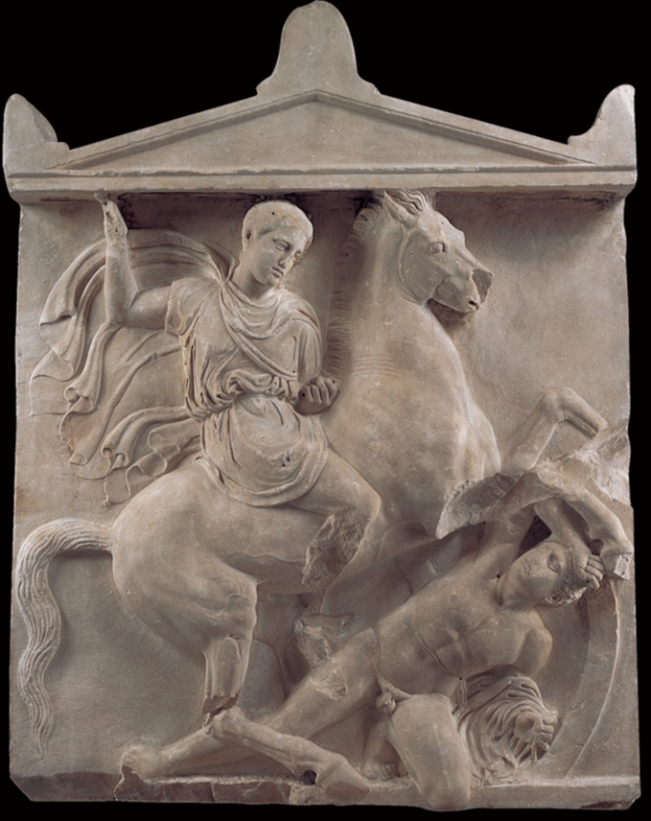
All is forgiven?
Thibron also asked from the Athenians three hundred cavalrymen (…) And the Athenians sent some of those who had served as cavalrymen in the time of the Thirty, thinking it would be a gain to the democracy if they should go abroad and die there.
Xen. Hell. 3.1.4

Slide 24
The 400, the 5,000, the 30 and the 10
Despite anti-democratic sentiments, oligarchies arose only out of pragmatism (411) or compulsion (403)
Oligarchs always aim to restrict the franchise, decrease spending & repress free speech
Athenian response: popular revolt, restoration of democracy as political system and ideology

