Slide 1
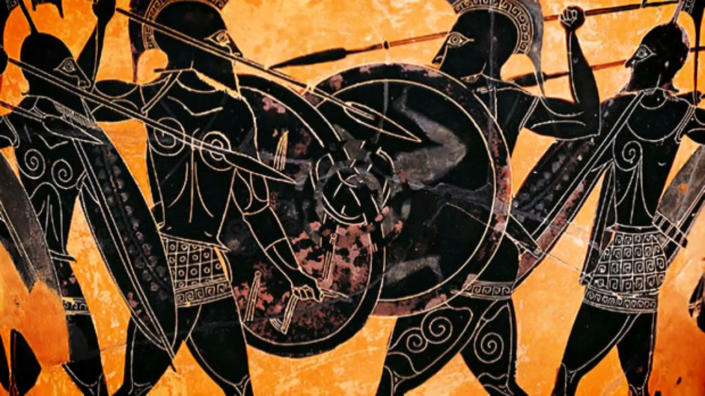
Athenian Imperialism
A GAME THEORETIC PERSPECTIVE guided by Thucydides

Slide 2
Athenian Imperialism is a consequence of:
Spartan inaction
Naval supremacy
Negotiation breakdown
  with Sparta
  with Melos
Conquest (If we have time)

Slide 3
So when the Spartans are called passive by the Corinthians, are they really lazy or just clever?
1.69.4
“For indeed, Spartans, you alone of the Greeks pursue a passive policy (hesuchazete)”

Slide 4
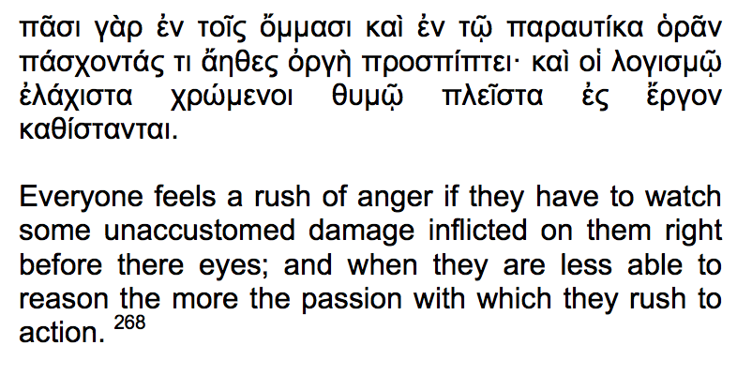
Archidamos’ exhortation before
1st invasion of Attica in 431BC

Slide 5
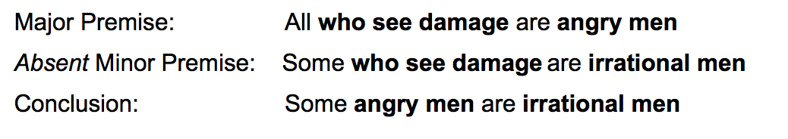
Simplifying the premises:

Slide 6
Angry
See Damage
Irrational

Slide 7
Rational
Irrational
Angry
See Damage

Slide 8
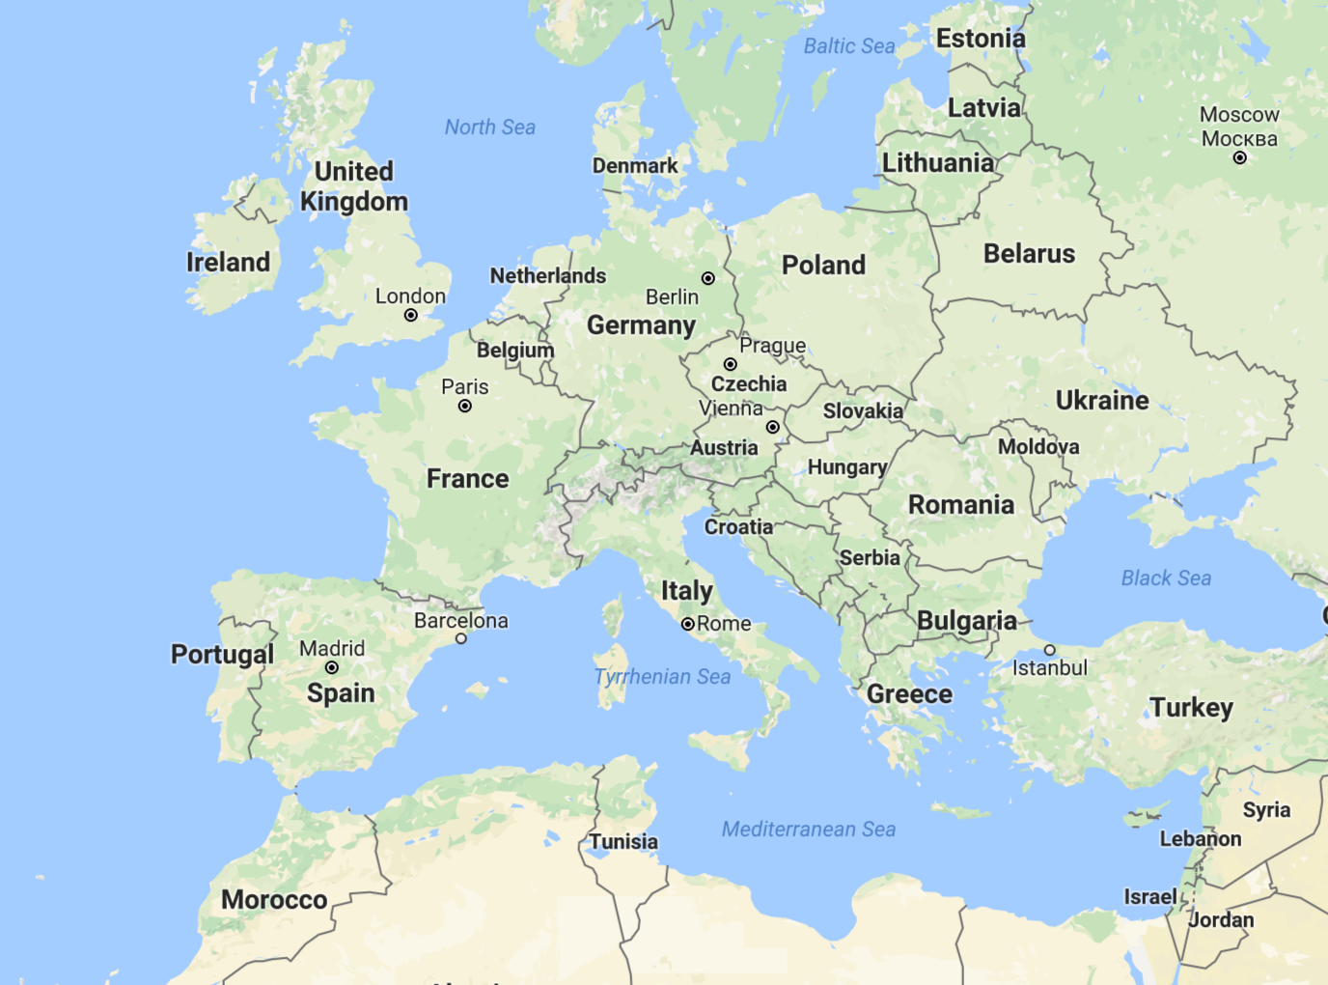
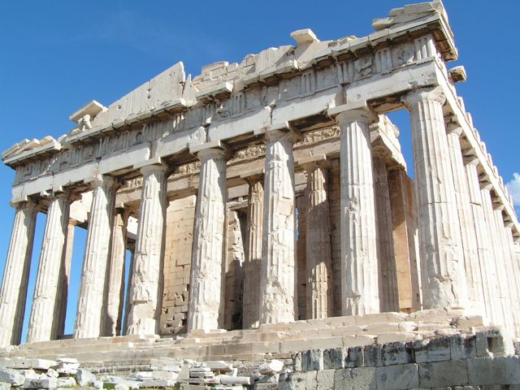
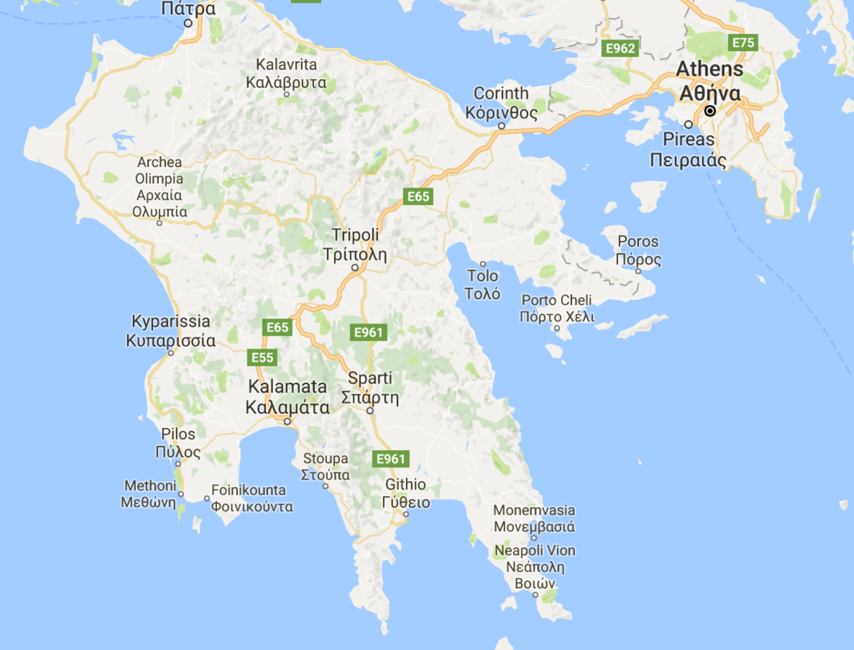
Notes:
in Ancient Greece... ignore the highways and you can feel transported... there (show temple)
Our story begins when the Spartans first marched on Athens in 431BC.
The Spartan King Archidamos marched his troops over land VERY SLOWLY and LEISURELY to Athens.

Slide 9
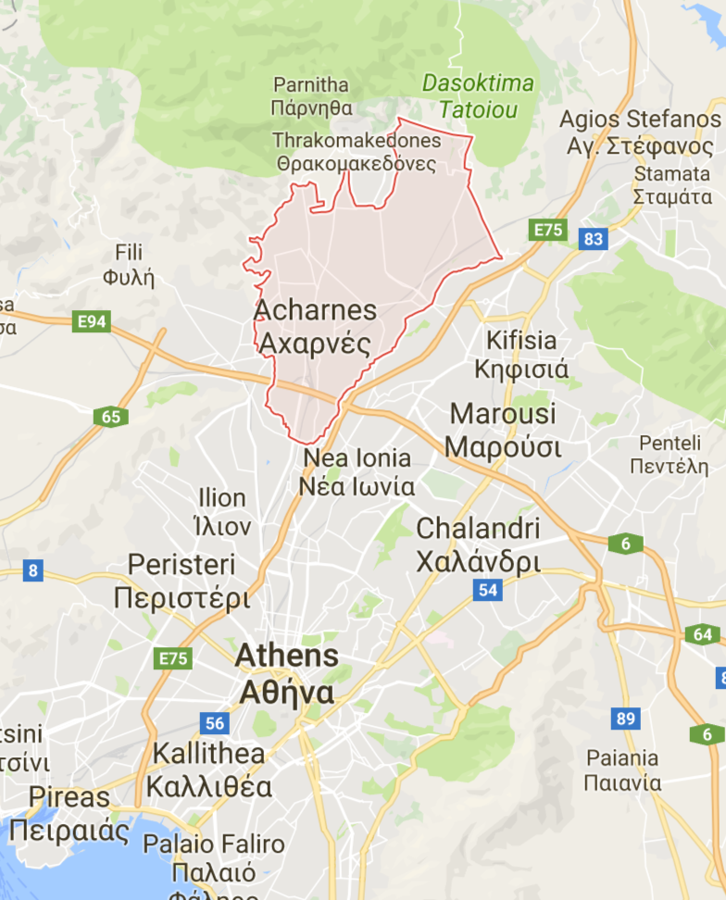
Notes:
After taking his time up through the Peloponnesus and then procrastinating around the isthmus of Corinth,
he entered Athenian territory and encamped in the largest district called Acharnai which overlooks all of the city of Athens.

Slide 10
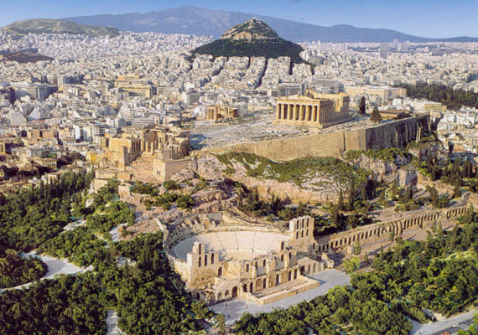
Notes:
Archidamos did this on purpose.
* From Acharnai, the Spartan’ troops would be completely visible to all the Athenians.
* All the urban dwellers and those people from the surrounding areas had taken refuge within the city walls. A large portion of these were Acharnians.
Archidamos had two choices: stay put or attack the city walls!

Slide 11
Why does A invade and not ravage?
81. Perhaps some one may be encouraged by the superior equipment and numbers of our infantry,¹ which will enable us regularly to invade and ravage their lands. [2] But their empire extends to distant countries, and they will be able to introduce supplies by sea. [3] Or, again, we may try-to stir up revolts among their allies. But these are mostly islanders, and we shall have to employ a fleet in their defence, as well as in our own. [4] How then shall we carry on the war? For if we can neither defeat them at sea, nor deprive them of the revenues by which their navy is maintained, we shall get the worst of it. [5] And having gone so far, we shall no longer be able even to make peace with honour, especially if we are believed to have begun the quarrel. [6] We must not for one moment flatter ourselves that if we do but ravage their country the war will be at an end. I fear that we shall bequeath it to our children; for the Athenians with their high spirit will never barter their liberty to save their land, or be terrified like novices at the sight of war.

Slide 12


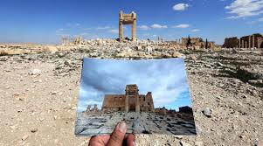
Archidamos’ preferences
d > e
>
Archidamos prefers to be PASSIVE than to be AGGRESSIVE no matter what the Athenians choose.
Notes:
*If he stays encamped waiting for the Athenians to come out to fight, his land army is unbeatable and he will win.
* If Archidamos chooses to launch a full invasion and attempts to take the city of Athens itself, he will fail.
BUT ALSO being Passive no matter what the Athenians wastes less energy of the troops and resources.
* He prefers to wait passively called d over attacking the city walls e. The preference for d is not so much passive but passive aggressive – don’t make me hurt you!

Slide 13
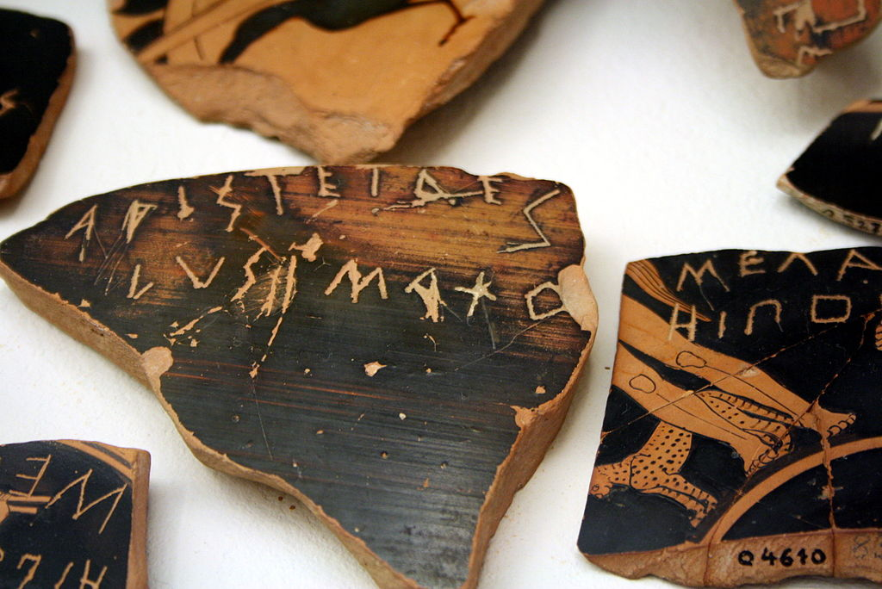
I am going to show you how the Athenians felt...
Do not tell your neighbor!!!
Notes:
When it came time to vote on whether to charge the enemy outside the walls or sit inside and watch, what do you think the Athenians voted to do?
* I am going to show you how the Athenians voted...
* Do not tell your neighbour!!!

Slide 14
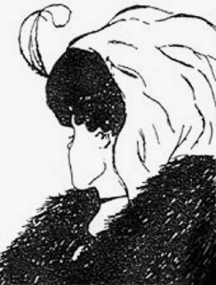
What do you see?
The Athenians were collectively indifferent like you!
= b
Notes:
Anatol Rapoport psychologist & game theorist used this image to explain differences in opinion.
The Athenians observe Archidamos faf about, burning their crops and destroying their property. This aroused the Acharnians to fury. The Acharnians were a very large part of the citizen body and these voted to attack, while the others voted to stay.
The Athenians were collectively indifferent between fighting or staying behind the city walls.
This was Archidamos’ brilliant Strategy of Indifference called b

Slide 15
2.21 - Prediction comes true
The Athenians, so long as the Lacedaemonians were in the neighbourhood of Eleusis and the plain of Thria, entertained a hope that they would come no further. They remembered how, fourteen years before the Lacedaemonian king, Pleistoanax the son of Pausanias, invaded Attica with a Peloponnesian army, and how after advancing as far as Eleusis and Thria he came no further, but retreated. And indeed this retreat was the cause of his exile; for he was thought to have been bribed. But when they saw the army in the neighbourhood of Acharnae, and barely seven miles from the city, they felt the presence of the invader to be intolerable. The devastation of their country before their eyes, which the younger men had never seen at all, nor the elder except in the Persian invasion, naturally appeared to them a horrible thing, and the whole people, the young men especially, were anxious to go forth and put a stop to it. Knots were formed in the streets, and there were loud disputes, some eager to go out, a minority resisting. Soothsayers were repeating oracles of the most different kinds, which all found in some one or other enthusiastic listeners. The Acharnians, who in their own estimation were no small part of the Athenian state, seeing their land ravaged, strongly insisted that they should go out and fight. The excitement in the city was universal; the people were furious with Pericles, and, forgetting all his previous warnings, they abused him for not leading them to battle, as their general should, and laid all their miseries to his charge.
20. In this first invasion Archidamus is said to have lingered about Acharnae with his army ready¹ for battle, instead of descending into the plain² [2] in the hope that the Athenians, who were now flourishing in youth and numbers and provided for war as they had never been before, would perhaps meet them in the field rather than allow their lands to be ravaged. [3] When therefore they did not appear at Eleusis or in the plain of Thria, he tried once more whether by encamping in the neighbourhood of Acharnae he could induce them to come out. [4] The situation appeared to be convenient, and the Acharnians, being a considerable section of the city and furnishing three thousand hoplites, were likely to be impatient at the destruction of their property, and would communicate to the whole people a desire to fight. Or if the Athenians did not come out to meet him during this invasion, he could henceforward ravage the plain with more confidence, and march right up to the walls of the city. The Acharnians, having lost their own possessions, would be less willing to hazard their lives on behalf of their neighoours, and so there would be a division in the Athenian counsels. [5] Such was the motive of Archidamus in remaining at Acharnae.

Slide 16


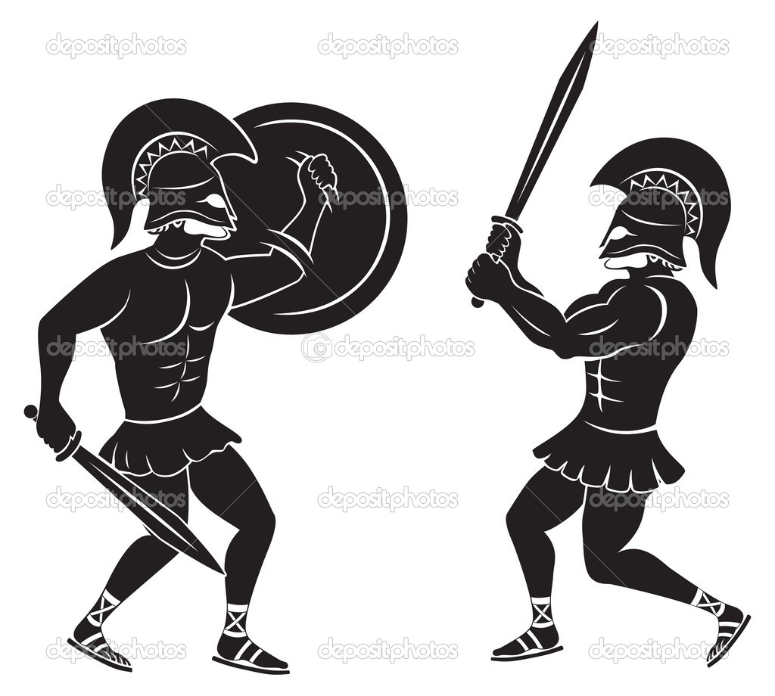
Athenians’ Preferences
a > b > c
> >
Notes:
if Archidamos should attempt to storm the walls, the Athenians should be passive called a instead of aggressive and attacking called c

Slide 17
Archidamos
Passive
Aggressive
d
e
Passive
b
a
Athenians
d
e
Aggressive
c
b
Notes:
Combine preferences in a Matrix and we get 4 potential outcomes! So what should the Athenians do?
Red are Athenian preferences, Blue are Archidamos’ preferences.
Fear motivated the Spartan attack, but it will be self-interest which will dictate their behaviour.

Slide 18
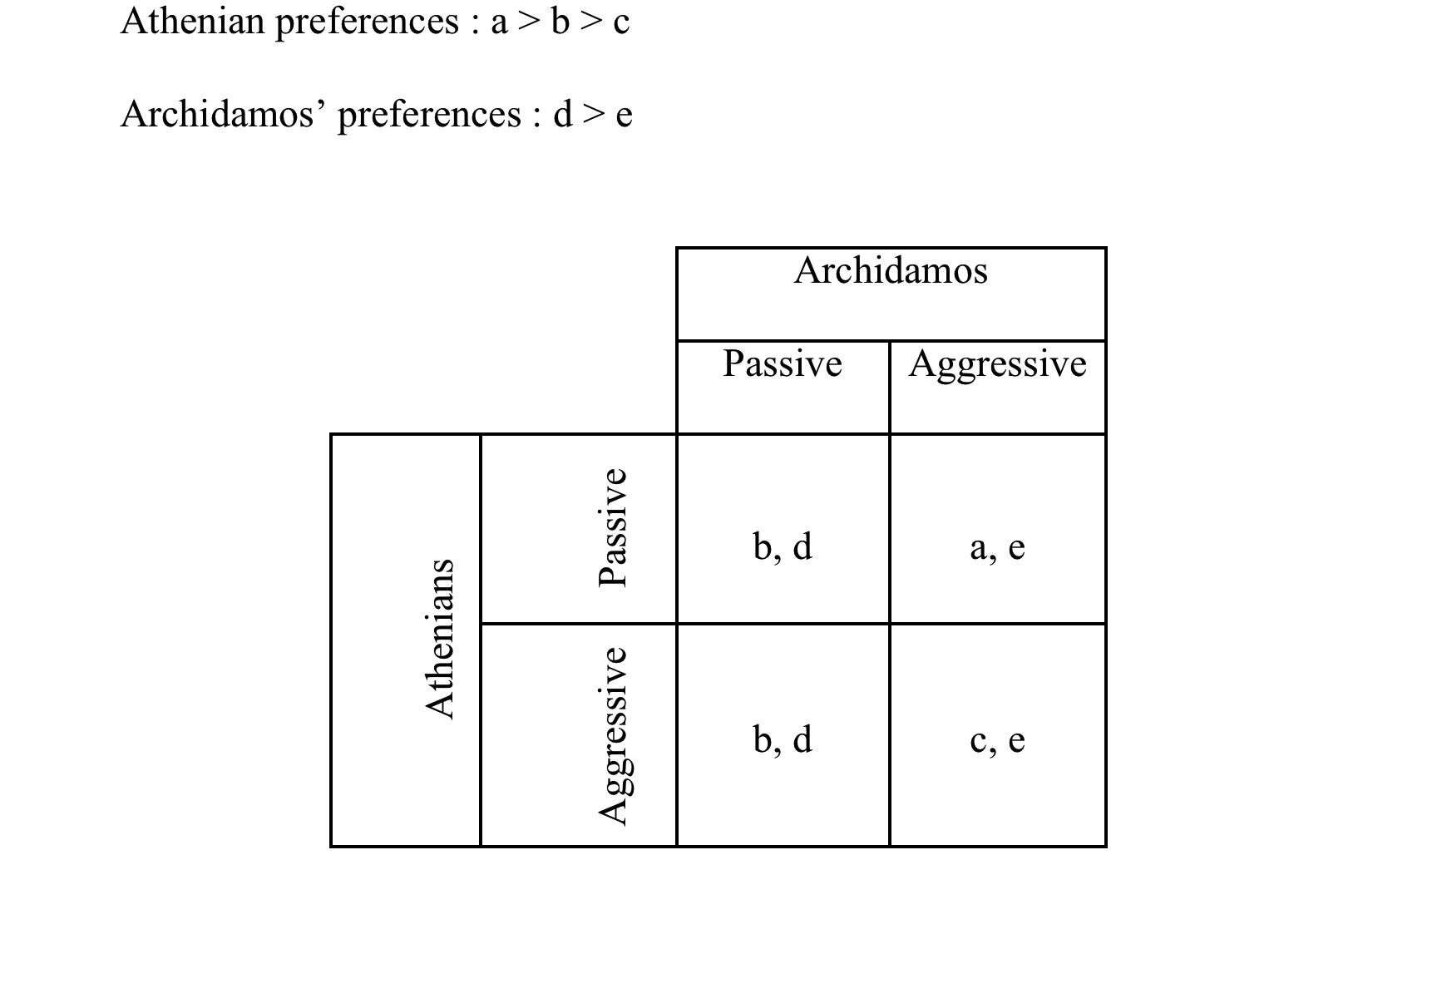
Athenian preferences: a > b> c
Archidamos’ preferences: d > e
Archidamos
Passive
Aggressive
*
d
e
Passive
b
a
Athenians
*
d
e
Aggressive
c
b
Notes:
Archidamos will always choose an action which is in his army’s best interest.
If Ath is Pass, Arch prefers to be P bc he is NOT exhausting his resources or troops.
If Ath is Agg, Arch prefers to be P bc again he does not want lose of life without taking the city.

Slide 19
The Athenians have a WEAKLY DOMINANT strategy:
Athenian preferences: a > b> c
Archidamos’ preferences: d > e
Archidamos
Passive
Aggressive
*
d
e
Passive
*
*
b
a
Athenians
*
d
e
Aggressive
*
c
b
Notes:
The Athenians who are voting democratically will also choose an action which is in their COLLECTIVE self interest.
If Arch is Pass, Ath are indifferent bc of the divided vote.
If Arch is Agg, Ath prefer to Pass bc they cannot defeat the Spartans on land.

Slide 20
NASH EQUILIBRIA
Archidamos
Passive
Aggressive
*
d
e
Passive
*
b
a
*
Athenians
*
d
e
Aggressive
*
c
b
Notes:
The intersect of self-interested choices are the likely outcomes.
Archidamos’ choice to remain passive created dissent, confusion and division among the Athenians.
Archidamos’ strategy of indifference almost made the Athenians come out and fight and they would have lost.

Slide 21
“Spartans, you alone of the Greeks pursue a passive policy”
CLEVER!
Notes:
Sooooo... THE CORINTHIANS ARE WRONG ... CLEVER!
Archidamos was able to create civil strife within Athens with minimal loss of life and expenditure of resources to himself.
de St Croix who was a Thucydides believed that the Spartans were dovish until

Slide 22
The Athenian Empire and Naval Power
fiscal policy:
Tribute: Athens moves treasury of Delian League from Delos to Athens 454/3BC – contributions in cash or ships
Liturgies (large public outlays):
trierarchy – citizen could act as captain or taxpayer
  instituted by Themsitocles in 483/2 reformed again in last decade of 5th c.
control of sea for protection and expansion of commercial interests
The invasion of Sicily in 415-413 was part of this expansion

Slide 23
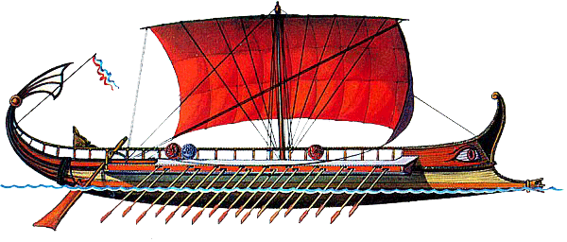
Great Harbour at Syracuse

Slide 24

What do you think the interaction looks like in game theory terms?
Great Harbour at Syracuse

Slide 25
( -1 )
( 1 )
( 1 )
( -1 )

Slide 26
Player 2
Ram
Backwater
Ram
( -1, 1 )
( 1, -1 )
Player 1
Backwater
( 1, -1 )
( -1, 1 )

Slide 27
( -1, 1 )
( 1*, -1 )
( -1, 1* )
( 1, -1 )
( 1*, -1 )
( -1, 1 )
( 1, -1 )
( -1, 1* )

Slide 28
( -1, 1* )
( 1*, -1 )
( 1*, -1 )
( -1, 1* )

Slide 29
Great Harbour at Syracuse

Slide 31
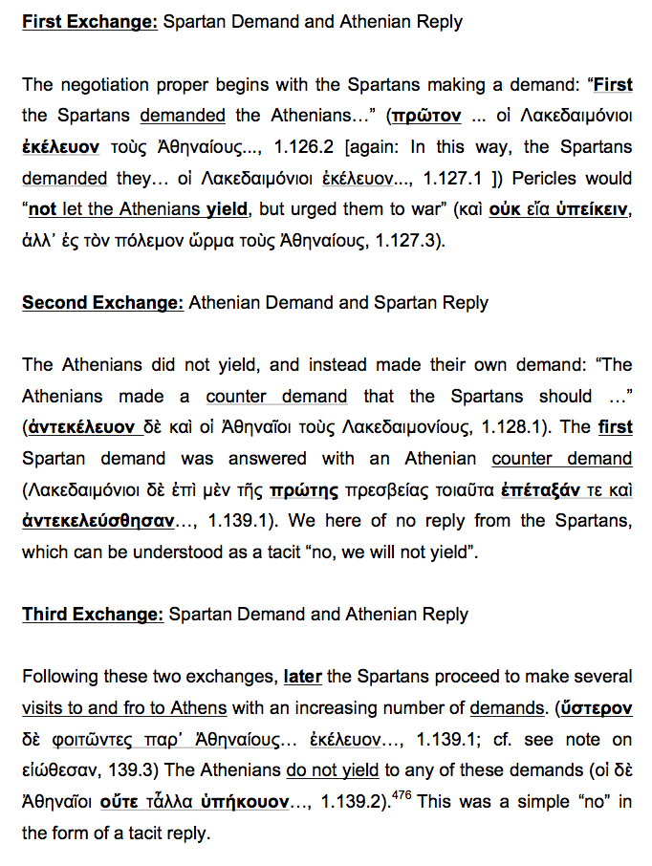
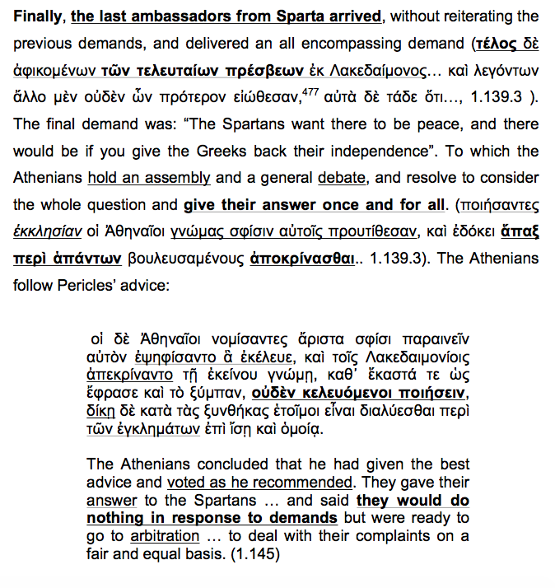
Final Exchange

Slide 32
Athens
Accept
Reject
Sparta
( 0, -x )
Accept
Reject
Athens
( -x, 0 )
Accept
Reject
Sparta
( 0, -y )
Accept
Reject
( -y, -y )
( E(War), E(War) )
Submit to Arbitration
War

Slide 33
Melian Dialogue
Melians
Accept
Reject
( x, 1-x )
( -1, 0 )

Slide 34
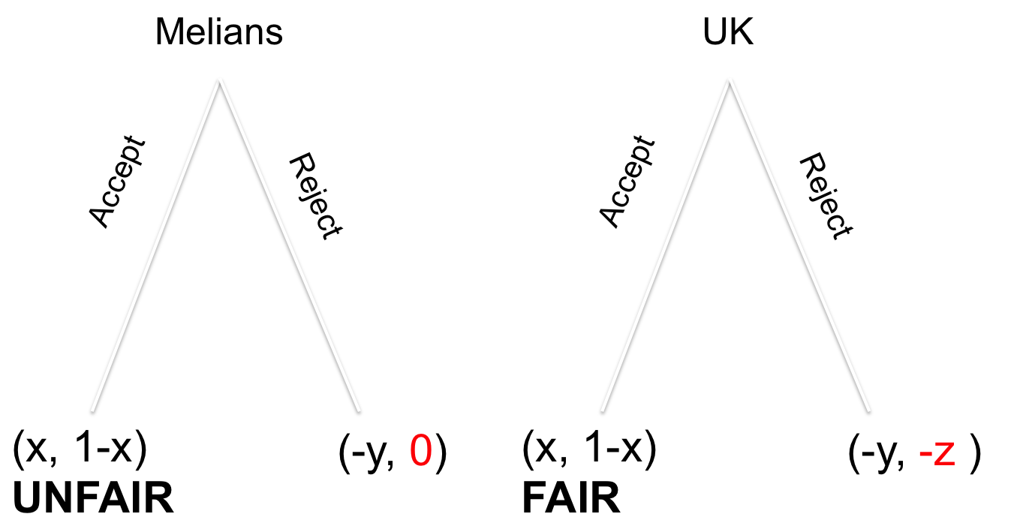
LHS is the Athenian view and RHS is the Melian view

Slide 35
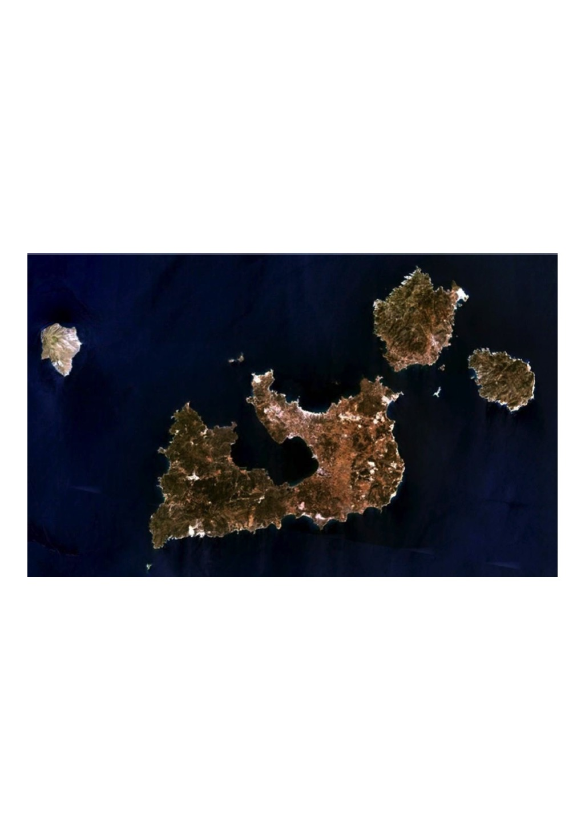
Melos
Notes:
Internal dissent can also emerge among allies within a league, just as it did in the case of the small island of Melos.
The Melians wanted to be left out of the Athenian league or empire.
The Athenian league like the European Union are coalitions which have member states who sometimes desire to exit the economic and political unions.

Slide 36
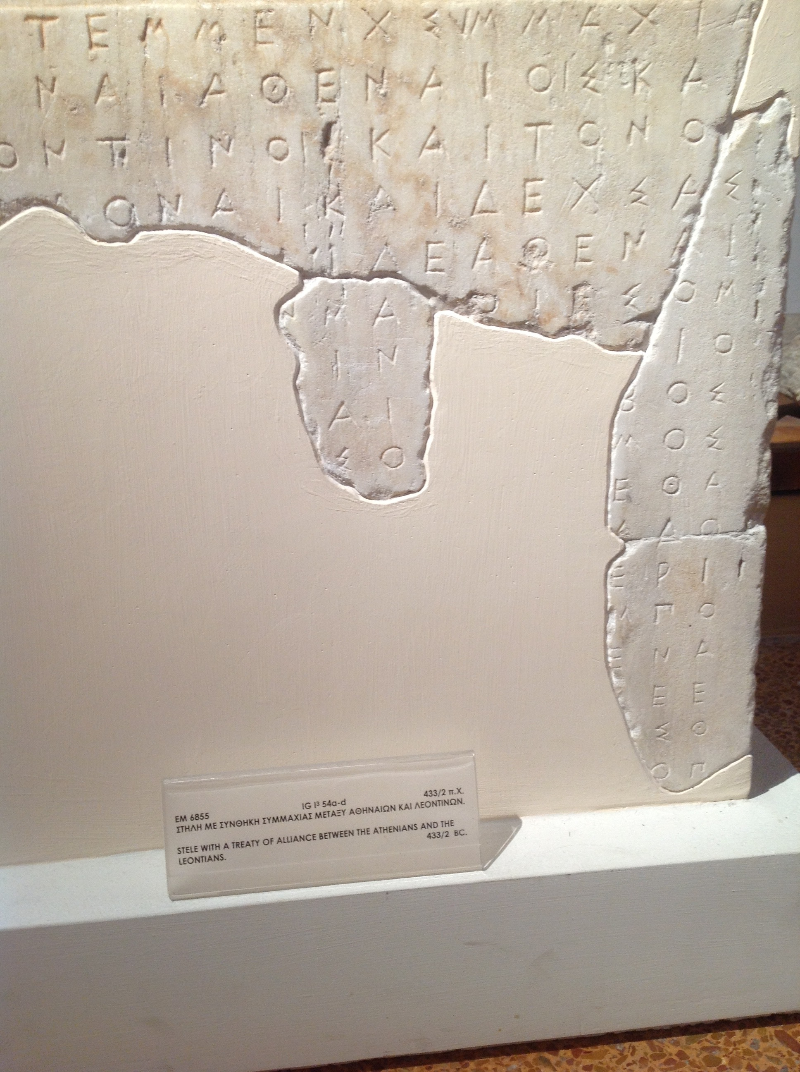
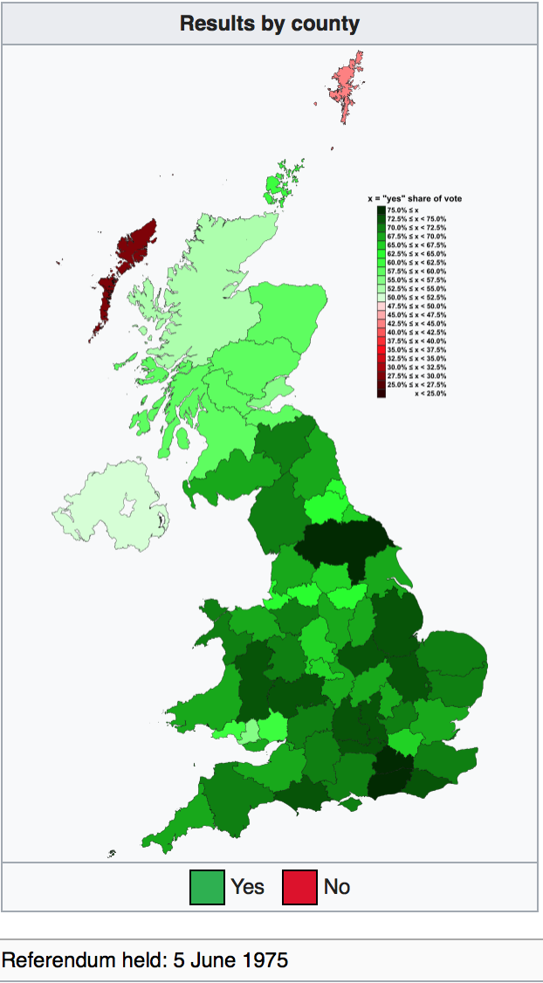
Melians
UK
Accept
Accept
Reject
Reject
UNFAIR
Negative
UNFAIR
Negative
Notes:
Therefore, the OTHER league states make them an offer to either reconsider or suffer the consequences. Rejecting that offer would be a major blow to the political economy of the “Exiters”, they all argue.
If they reject, the male citizens of Melos under the Athenian empire were told they would lose regulatory control over their city, all physical possessions, watch the enslavement of their women and children and, most importantly, lose their lives if they did not submit to paying the tribute due to Athens from its allies.
If the UK rejects, the European Commission told the UK that Brexit would entail losing access to the European single market, seriously damage the financial sector, losing a large chunk of national tax contribution from its European migrant workers and generally jeopardize national security through military alienation if they did not submit to paying the 8 to 9 billion £ in contributions to the Union and submitting to the ECJ.
The Melian negotiators and the UK PM both declared their conditions were an unfair offer!
Accepting an offer, in the case of the Melians, it would mean the surrender of government and payment of tribute in exchange for their lives.
Accepting an offer, in the case of the UK would mean the surrender of national security as it pertains to regulatory control and migrant inflow in exchange for the stability of the City’s financial sector. Jacob Nell, Chief Economist at Morgan Stanley is expecting that the EU will treat the city as a European public good because it is so important to Europe while the rest of the deal remains Hard or Soft.

Slide 37
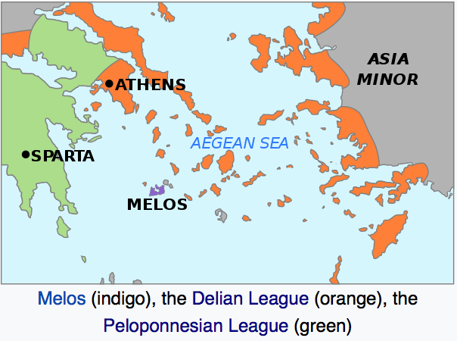
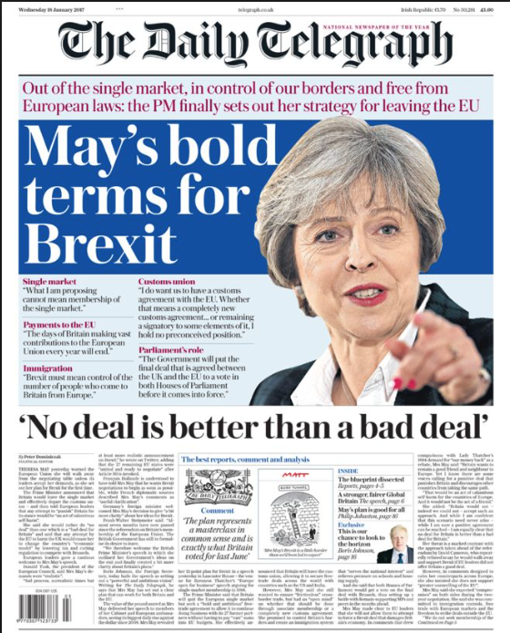

“judgments about justice are made between those with an equal power to enforce it otherwise possible actions are defined by what the strong do and the weak accept. (Athenians)
5.89
“fairness and justice for those in danger”
(Melians)
Notes:
* The Athenian empire and the EU are realists motivated by maintenance of power.
The Athenians argued that “possible actions are defined by what the strong do and the weak accept” You have to do what your told when you are small!
* The Melians and the Brits are idealists motivated by moral and ethical values of what is fair. The Melians appealed to justice and the gods, and the Athenians simply argued that they had jurisdiction.
* The UK PM Theresa May has been vilified time and time again for declaring that "no deal is better than a bad deal".
* This is very much in line with Yanis Varoufakis’ position vis-à-vis Europe’s offer in the Grexit crisis. He even published a book about it using this Athenian motto as a criticque to EU decision making. The UK wants justice or court autonomy, but the ECJ says it has to have jurisdictional control for any single market deal to happen. Whose to say who is stronger?
The Melians were unable to persuade the Athenians of the negative repercussions of going to war with them and were eventually defeated the men killed and the women and children enslaved. Relax, the analogy is not a strict one!!! Should May fail, we will perhaps see a regulatory blockade from the EU with deep economic consequences.

Slide 38
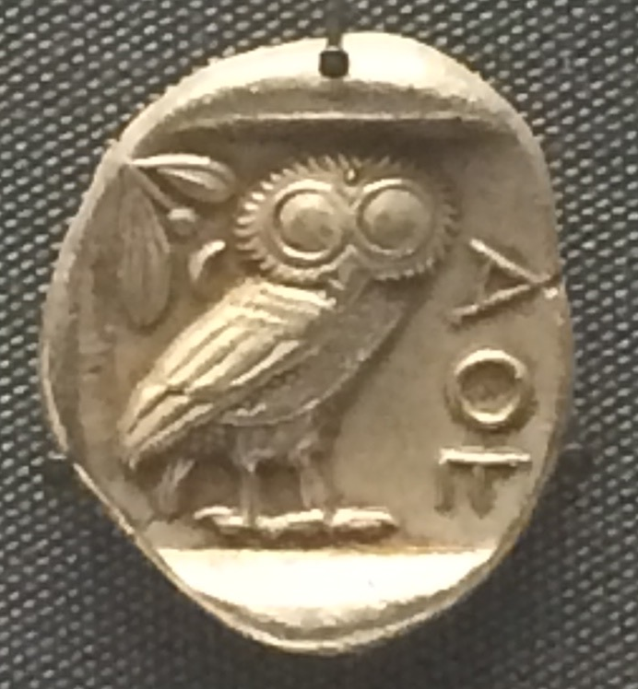
Strategy of Empire 1.76.2
“There is nothing remarkable or contrary to human behaviour in what we have done, just because we accepted an empire when one was offered and then declined to let it go, overcome by these strongest of all motives –
honour, fear & self-interest.”
Notes:
Thucydides sums up his definition of why people fight in one sentence. An Athenian embassy at Sparta tries to explain the drivers of human nature and the reason why they chose to expand and grow into an empire (1.76.2): “we accepted an empire when one was offered and then declined to let it go, because of – honour, fear & self-interest”
Honour is the need for fairness
Fear compels one to fight
Self-interest is a desire to acquire
I have deigned a mathematical model and translated it into a computer simulation that incorporates these three elements:
- fairness,
- necessity to fight &
- self-interest.

Slide 39
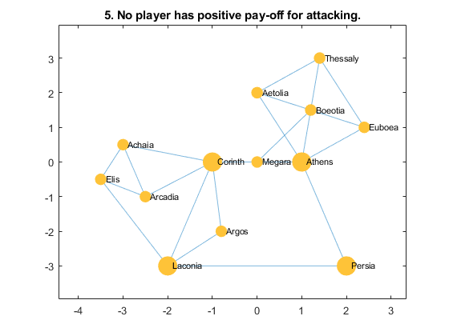
Fear = fight
Notes:
This is ancient Greece and the major city-states of the 5th century before Christ.
In a network scenario when each state must consider not one but many opponents simultaneously, simulations show that power parity or hegemony lead to stable states = where no one wishes to attack anyone else. In this simulation Sparta located in Laconia takes over everyone. This is unrealistic because we have scene hegemonic states take over vast territories but it is highly unlikely it is so easily accomplished.
Why is hegemony difficult? War is expensive.

Slide 40
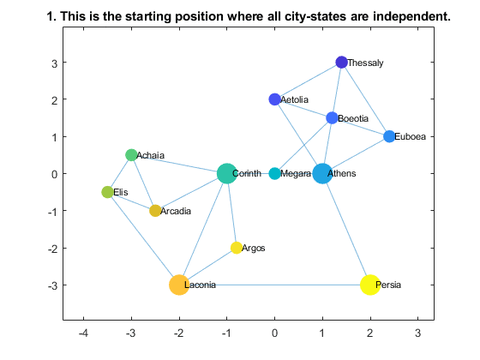

Self-interest = conquer (with costs of war)
Notes:
Thucydides writes that “war is a matter not so much of arms as of money” (1.83)
*The word used for money is dapane which literally means cost or expenditure.
In this simulation we add costs to each skirmish or battle fought between states, the states merge and form alliances and more easily reach stability through power parity.
You can see this as the size of the larger nodes shrink and the network settles within a similar level of resources. This makes the simulation of the war more realistic, the two league that form are the Delian League (blue) and the Peloponnesian league (brown) almost exactly. But if this is a stable state with power parity, why did the Peloponnesian war break out?

Slide 41
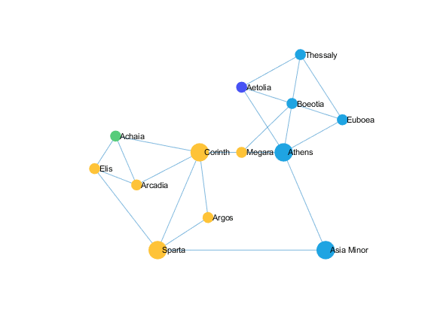
honour = desire for fairness (with “Exiters”)
Simulation with civil strife – keep it going for 100 ticks
Notes:
In this simulation we add Fairness!!!
If we add the possibility of civil strife and a state’s desire to break away from an alliance, war is continuous and unstoppable unless there is equality among the members of the alliance.
This simulation shows that the Spartan league reaches hegemony, as it historically did in 404BC with the fall of the Athenian empire, however defectors keep on cropping up indefinitely.
Thucydides tells an old story of the tyrant Hippias who feared he was going to be assassinated and as a result became violent. Change triggered his action to become aggressive. Thucydides believes that an agent’s change of character is like the change in Athens strength or the change in autonomy felt by the Melians under the empire. Change is the catalyst for conflict.

Slide 42
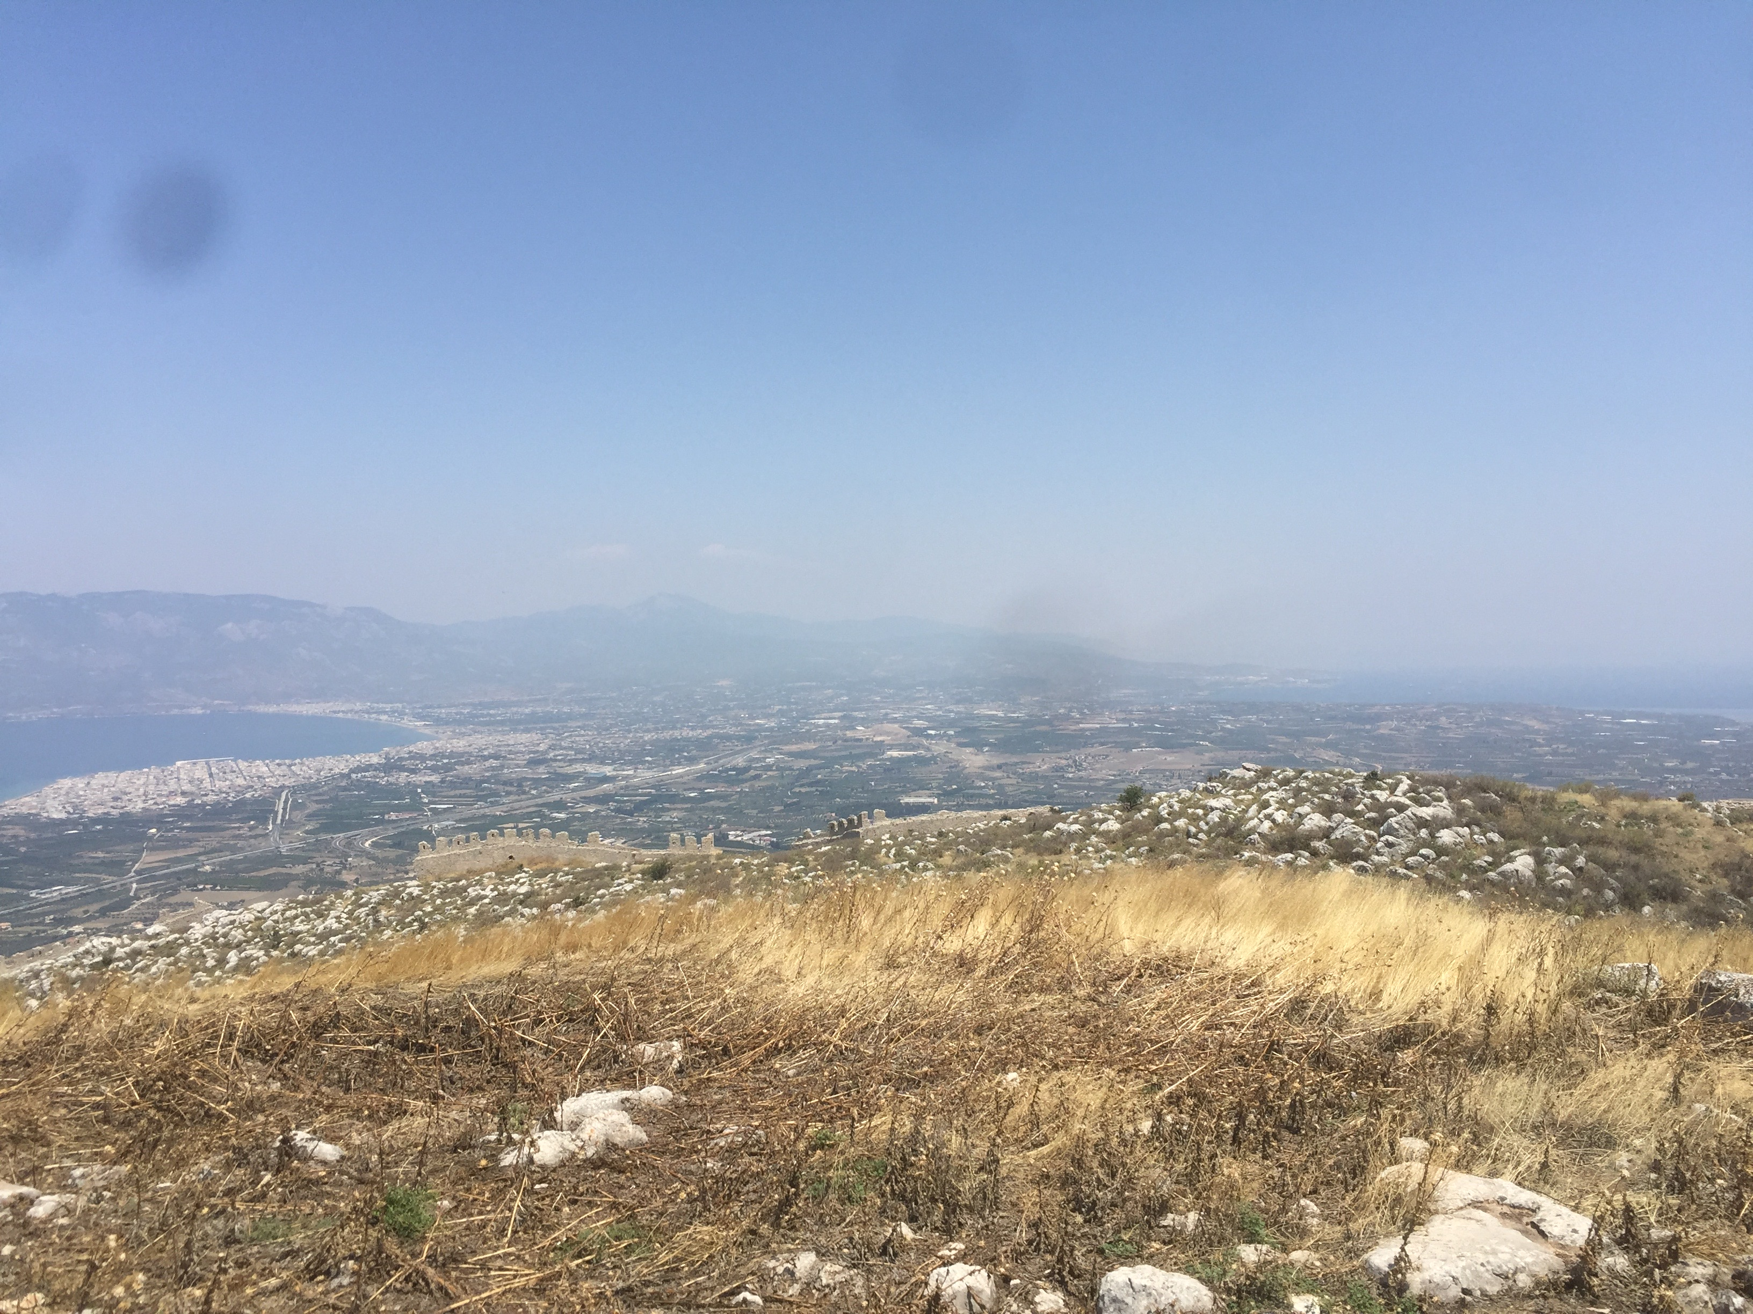
Military Finance during the Atheno-Peloponnesian War: state versus household
Institute of Classical Studies
Ancient History Seminar
12th of October, 2017
Notes:
View:
Acro Corinth, July 2017 (Point 9)
Corinthian gulf on the left and Saronic Gulf on the right
Entrance to Diolkos

Slide 43
War finance
Military power (dunamis) depends on Warships, Fortifications and especially Money.
Andoc. 3
Ar. Ach. 162–3
Ar. Av. 378–8
Ar. Lys. 170–6, 421–3, 488, 496
Ar. Plut. 112
Ar. Ran. 365
Dem. 4.40; 8.48; 9.40, 70–2; 13.10; 22.12–17
Lys. 13.46–8; 28.15

Slide 44
Temporary Demand and Supply Shock
Temporary Markets set up for passing armies:
  Thuc. 1.62.1; 6.44.2, 3; 8.95.4.
  X. An.4.8.8, 23.
  Ad hoc resale or theft of battlefield goods? (e.g. temples, on battle site) Modern parallel (e.g Baghdad, Afgahnistan)**
Permanent Demand and Supply
Permanent Markets in cities:
  large e.g. Athens, Corinth, Miletus, Delos
  small agorai: epigraphic evidence
    in Attic demes: e.g Besa, Deceleia, Eleusis, Erchia, Sounion
  regional markets: sometimes adjusted weight standards to facilitate exchange (Psoma, 2016)
  During War: Naval and weapon manufacturing (Gabrielson & van Wees)
Notes:
Harris 2016, 13.
** Black markets, meanwhile, have emerged throughout Afghanistan for the resale of equipment
donated by the international community to the Afghan government or pilfered from
international forces, in some cases leading to U.S.-provided military equipment being
sold to insurgent groups.
1 See, for example, Matt Millham, “Afghan Market Flourishing with Coalition Goods,” Stars and
Stripes, May 25, 2012; Martin Kuz, “Afghan Commander Suspected of Acting as Crime Boss,” Stars and
Stripes, Sept. 3, 2012.
2. Baghdad: https://link.springer.com/book/10.1007/978-1-4419-7946-9

Slide 45
Thuc. 1.83
‘Let no man think it cowardice that many states should hesitate to attack a single city. For they also have allies not less numerous than ours who pay tribute (chremata); and war is a matter not so much of arms as of money (hopla ... dapanes), for it is money alone that makes arms serviceable, especially when an inland opposes a maritime power. Let us therefore provide ourselves with money first, ...’

Slide 46
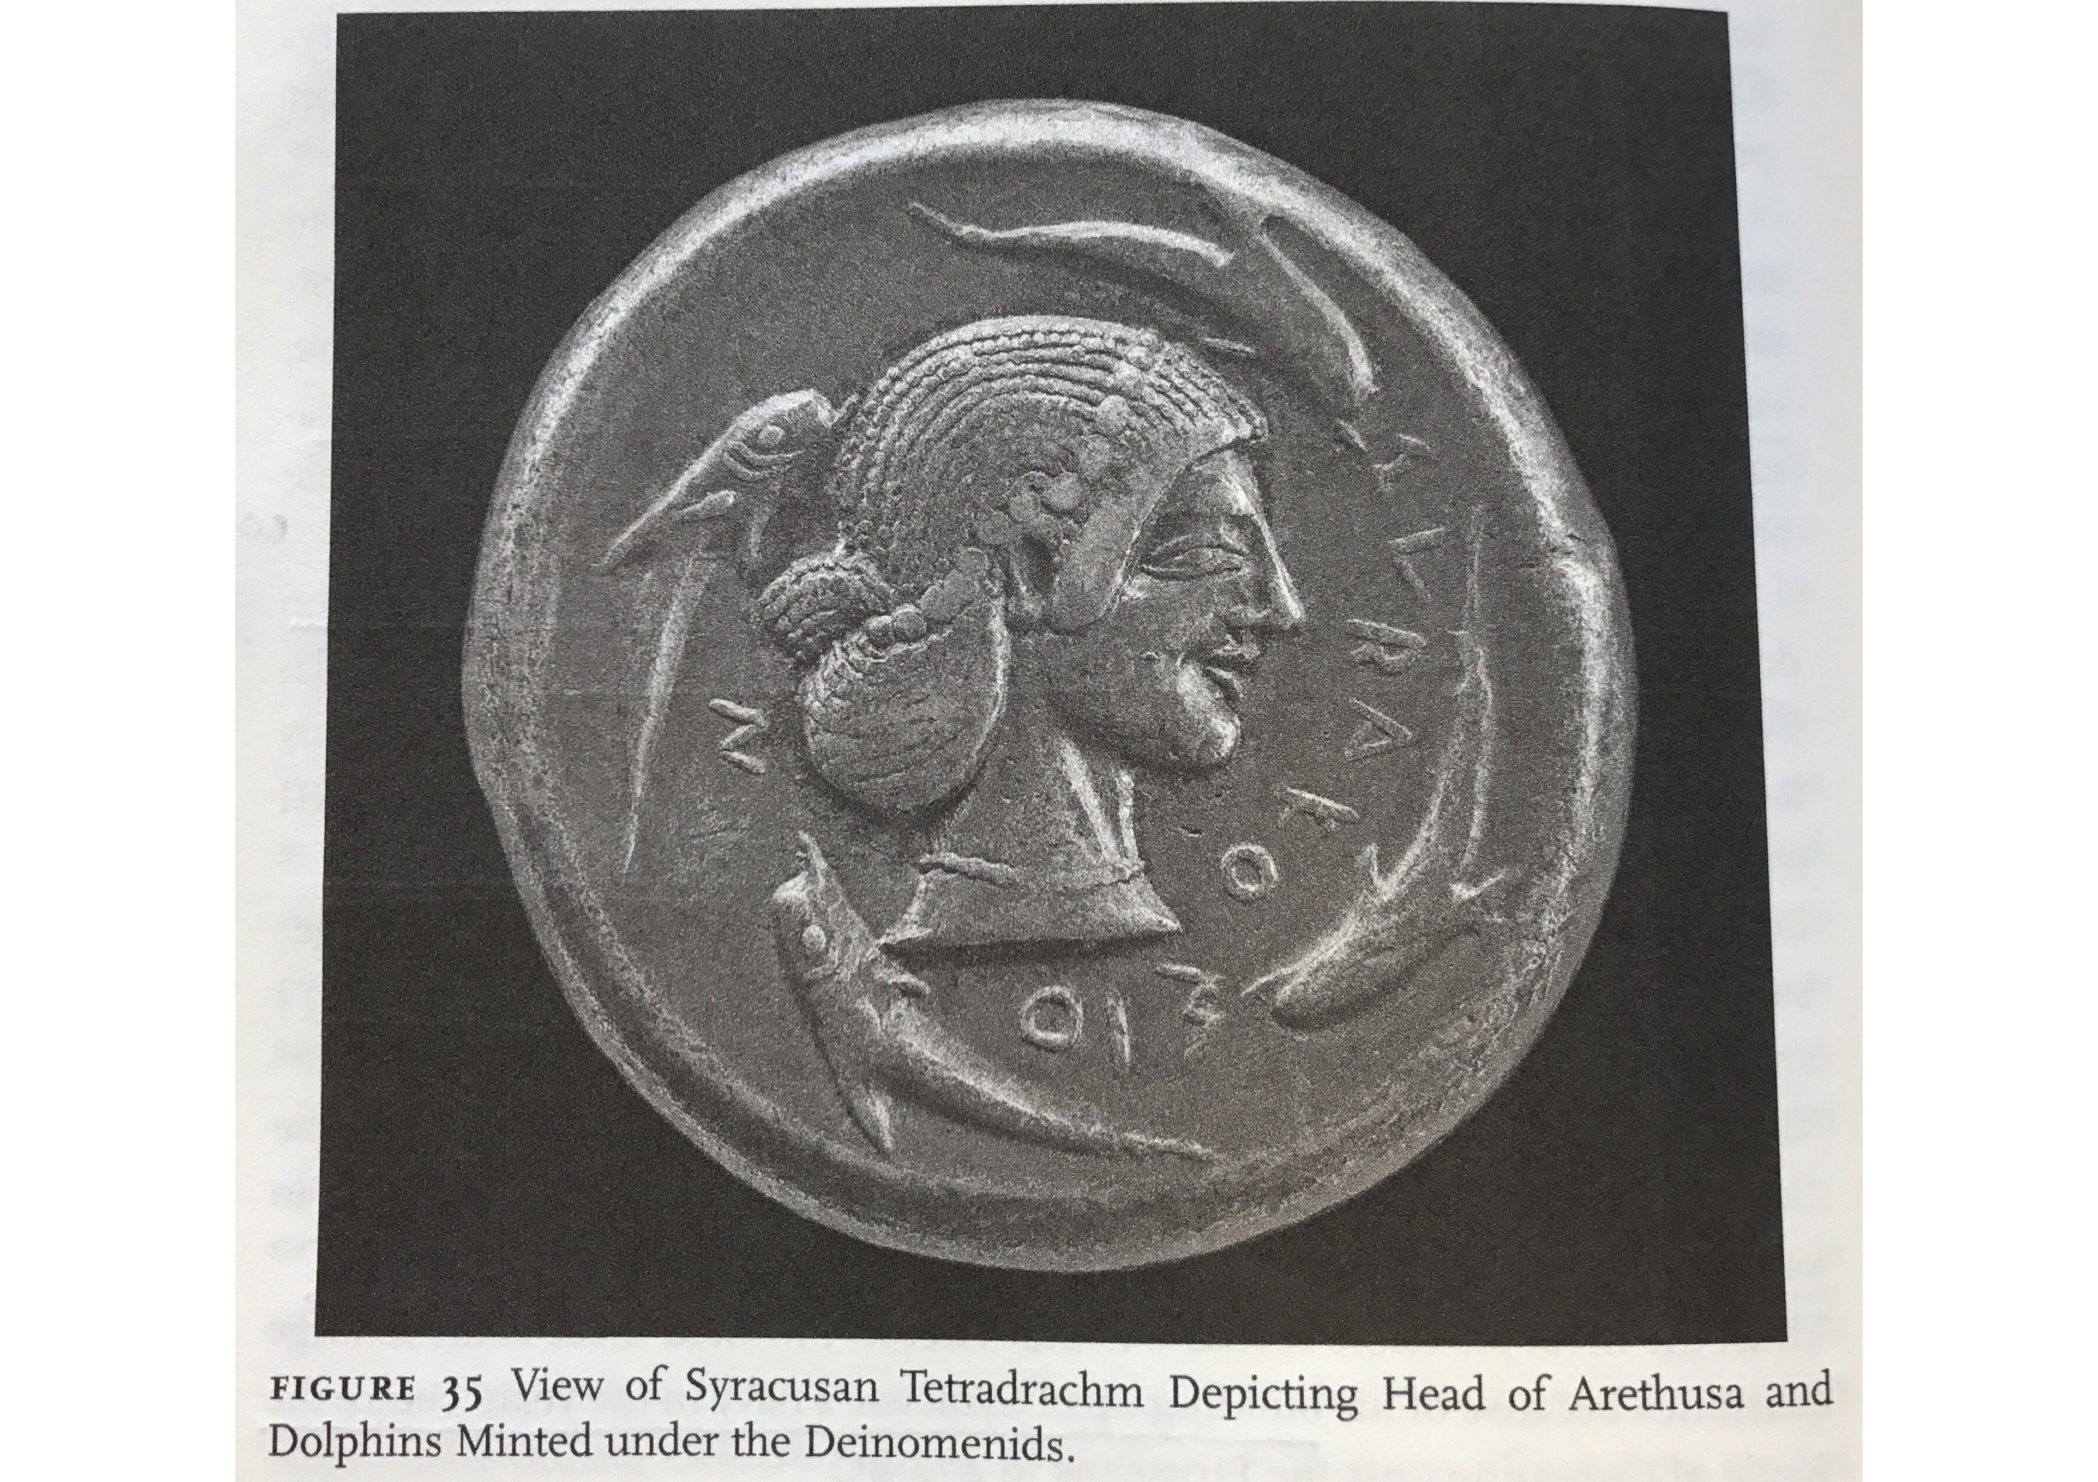
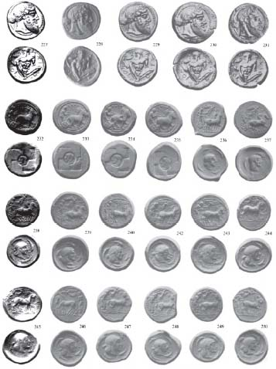
Randazzo Hoard
Notes:
Plate 10:
Naxos (227-31); Syracuse, Group 1, 1-2 (232-35); Group 2, 3-5 (236-50).
http://numismatics.org/digitallibrary/ark:/53695/nnan106629

Slide 47
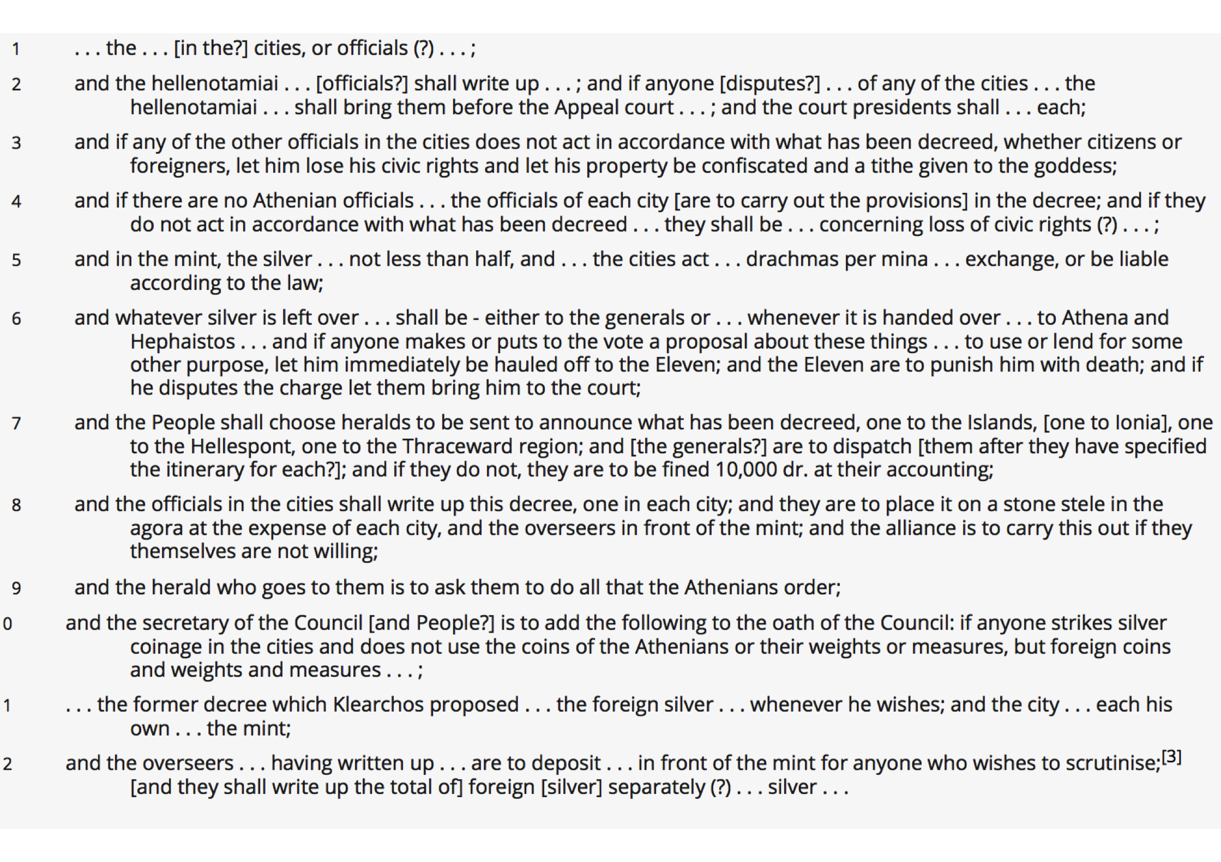
Decree enforces Ath. coins, weights & measures 414BC? (Ar. Birds 1040f.)
Notes:
OR 155 (translated text) /ML45

Slide 48
Thuc. 8.45 & 8.29
Henceforth becoming his adviser in everything, he cut down the pay from an Attic drachma to three obols a day, and even this not paid too regularly; and told Tissaphernes to say to the Peloponnesians that the Athenians, whose maritime experience was of an older date than their own, only gave their men three obols, ....
καὶ διδάσκαλος πάντων γιγνόμενος τήν τε μισθοφορὰν ξυνέτεμεν, ἀντὶ δραχμῆς Ἀττικῆς ὥστε τριώβολον καὶ τοῦτο μὴ ξυνεχῶς δίδοσθαι, λέγειν κελεύων τὸν Τισσαφέρνην πρὸς αὐτοὺς ὡς Ἀθηναῖοι ἐκ πλέονος χρόνου ἐπιστήμονες ὄντες τοῦ ναυτικοῦ τριώβολον τοῖς ἑαυτῶν διδόασιν, ... (45.2)
Summer was now over. The winter following Tissaphernes put Iasus in a state of defence, and passing on to Miletus distributed a month's pay to all the ships as he had promised at Lacedaemon, at the rate of an Attic drachma a day for each man. In future, however, he was resolved not to give more than three obols, until he had consulted the king; when if the king should so order he would give, he said, the full drachma. However, upon the protest of the Syracusan general Hermocrates （for as Therimenes was not admiral, but only accompanied them in order to hand over the ships to Astyochus, he made little difficulty about the pay）, it was agreed that the amount of five ships' pay should be given over and above the three obols a day for each man; Tissaphernes paying thirty talents a month for fifty-five ships, and to the rest, for as many ships as they had beyond that number, at the same rate.
ἐπειδὴ τὴν Ἴασον κατεστήσατο ὁ Τισσαφέρνης ἐς φυλακήν, παρῆλθεν ἐς τὴν Μίλητον, καὶ μηνὸς μὲν τροφήν, ὥσπερ ὑπέστη ἐν τῇ Λακεδαίμονι, ἐς δραχμὴν Ἀττικὴν ἑκάστῳ πάσαις ταῖς ναυσὶ διέδωκε, τοῦ δὲ λοιποῦ χρόνου ἐβούλετο τριώβολον διδόναι, ἕως ἂν βασιλέα ἐπέρηται: ἢν δὲ κελεύῃ, δώσειν ἔφη ἐντελῆ τὴν δραχμήν. Ἑρμοκράτους δὲ ἀντειπόντος τοῦ Συρακοσίου στρατηγοῦ （ὁ γὰρ Θηριμένης οὐ ναύαρχος ὤν, ἀλλ᾽ Ἀστυόχῳ παραδοῦναι τὰς ναῦς ξυμπλέων μαλακὸς ἦν περὶ τοῦ μισθοῦ） ὅμως δὲ παρὰ πέντε ναῦς πλέον ἀνδρὶ ἑκάστῳ ἢ τρεῖς ὀβολοὶ ὡμολογήθησαν. ἐς γὰρ πέντε ναῦς καὶ πεντήκοντα τριάκοντα τάλαντα ἐδίδου τοῦ μηνός: καὶ τοῖς ἄλλοις, ὅσῳ πλείους νῆες ἦσαν τούτου τοῦ ἀριθμοῦ, κατὰ τὸν αὐτὸν λόγον τοῦτον ἐδίδοτο. (29.1-2)

Slide 49
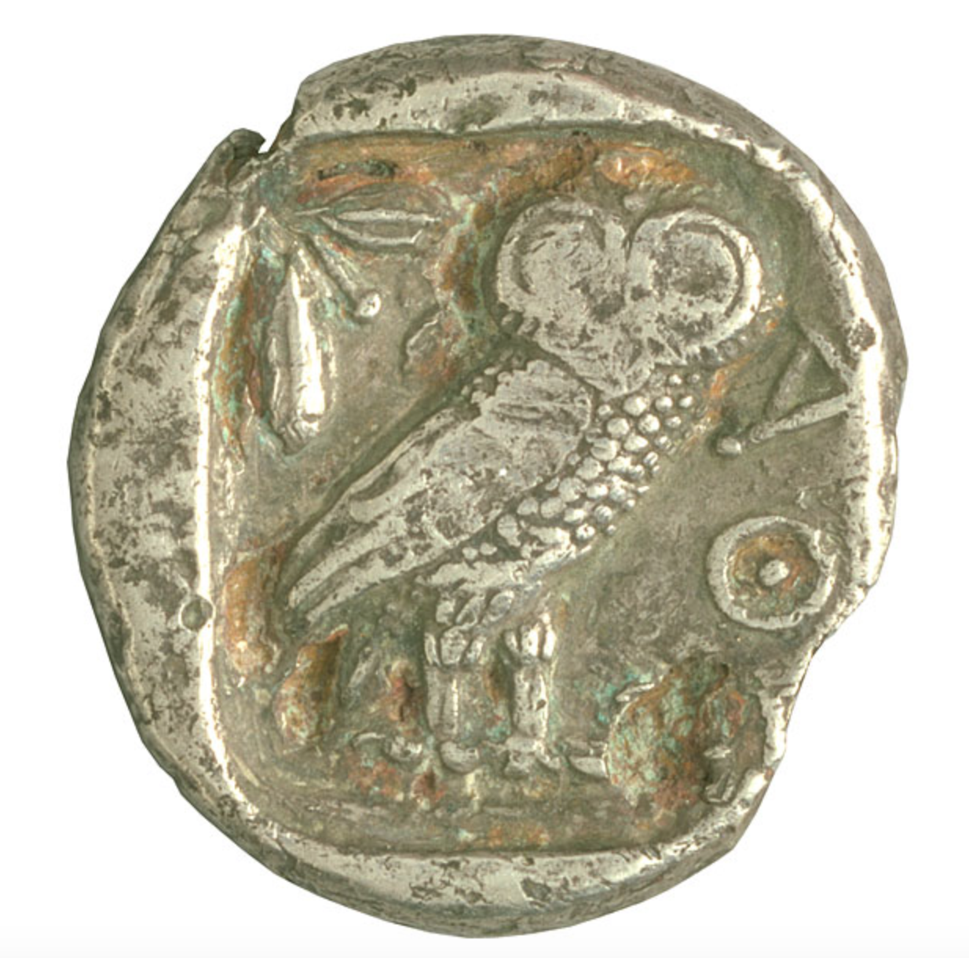
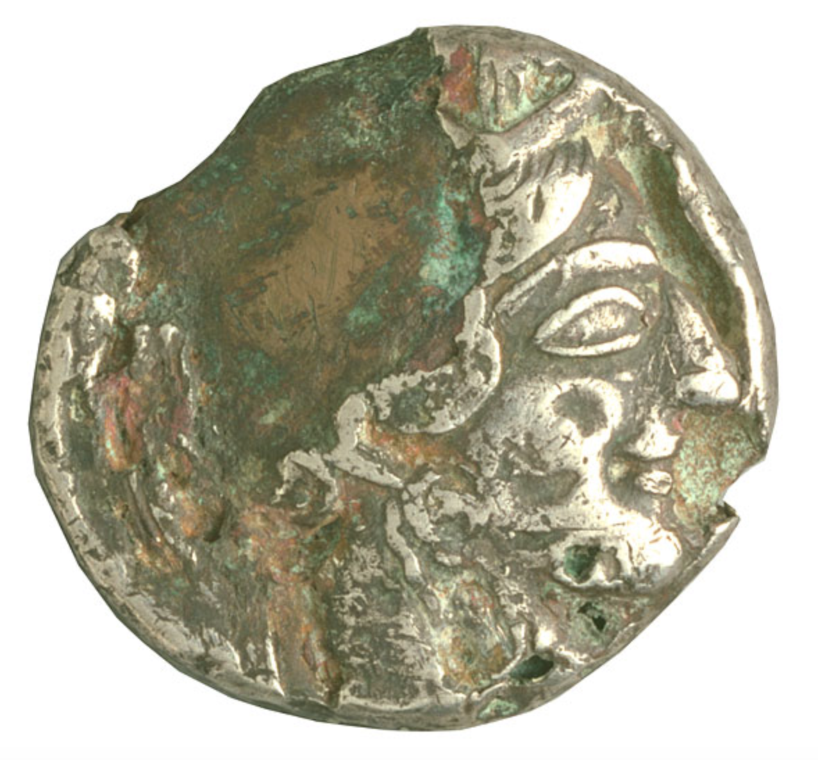
Piraeus Hoard silver plated Tetradrachm

Slide 50
Wages
432-430, a hoplite, his servant and a sailor - one d. p/day. (Thuc.3.17.4)
425, Thracian mercenaries two d. p/day (Ar. Ach.159,161)
Taxiarchs to Thrace – three d. p/day.(Ar.Ach.593-619).
420, to hoplites, light-armed soldiers and archers from Athens, Argos, Mantinea and Elis agree to provide - 3 Aiginetan Obols p/day & one Aiginetan d. to cavalry-men. (sitos = ration money or gross pay? Thuc.5.47.6, IG I³ 83.23-24)
415, Athenian sailors - one d. p/day & thranites - one d. p/day. plus some unknown extra amount by the trierarch. (Thuc.6.31.3,5).
415, peltasts and archers – four obols p/day. (IG I³ 93.32)
413, Thracian peltasts - one d. p/day. (Thuc.7.27.2)
412-411, Peloponnesian sailors in go from 1 Attic drachm a day to 3 obols (Thuc. 8.29.1-2, 45.2) The Chians paid Peloponnesian sailors three Chian tesserakostai apiece, for which the period is not specified by Thucydides (8.101.1).
408, Peloponnesian sailors - 3 obols p/day. & raises it to 4 obols.
Alcibiades pays Athenian sailors 3 obols. While Alcibiades tells Tissaphernes to pay three obols, Lysander wants to raise wages to 4 obols per day to attract Athenian rowers (Xen. Hell.1.5.4-7; Plut.Alc.35.5; Lys.6.5-6)

Slide 51
Athenian Society
Van Wees (2011) estimates that in Athenian Society c. 600BC
Hired Labor (psiloi) = 84% - farming was labour intensive
Leisured landowner = cavalry/ hoplite 15%
Working farmers (hoplites) = 1%
Distribution changes over the next 300 years – c. 320BC - Craftsmen appear in force!
Working Craftsmen = 15%
Hired Labor (psiloi) = 55%
Leisured landowner = cavalry/ hoplite 15%
Working farmers (hoplites) = 15%
What induced this change?
Notes:
H. van Wees, ‘Mass and elite in Solon’s Athens’ in Blok and Lardinois (eds.), Solon of Athens (2006), 351-89
H van Wees, ‘Demetrius and Draco’, JHS 131 (2011), 95-114

Slide 52
Aristophanes’ Peace 1198-213
Sickle-maker
Trygaeus, my best of friends, what a fine stroke of business (τἀγαθὰ
δέδρακας εἰρήνην ποιήσας) you have done for me by bringing back Peace! Formerly my sickles would not have sold at an obolus apiece, to-day I am being paid fifty drachmae for every one. And here is a neighbour who is selling his casks for the country at three drachmae each. So come, Trygaeus, take as many sickles and casks as you will for nothing. Accept them for nothing; it's because of our handsome profits on our sales (ἀφ᾽ ὧν γὰρ ἀπεδόμεσθα κἀκερδήναμεν )...
Trygaeus
... Ah! do you see that armorer (ὅπλων κάπηλος ) there coming with a wry face?
Armourer (Λοφοποιός)
Trygaeus, you have ruined me utterly (μ᾽ ὦ Τρυγαἶ ἀπώλεσας).
...
You have killed my business, my livelihood, and that of this poor lance-maker too. (ἀπώλεσάς μου τὴν τέχνην καὶ τὸν βίον, καὶ τουτουὶ καὶ τοῦ δορυξοῦ)

Slide 53
Aeneas Tacticus: Περὶ ὅπλων εἰσαγωγῆς (On Imported weapons)
Προνοεῖν δὲ καὶ τὰ ἐπὶ πράσει εἰσαγόμενα καὶ εἰς τὴν ἀγορὰν ἐκτιθέμενα ὅπλα τά τε ἐπὶ τῶν καπηλείων καὶ παντοπωλείων, ὧν ἀθροισθέντων πλῆθός τι γένοιτ̓ ἄν, ὅπως μηδενὶ ἕτοιμα ᾖ τῶν βουλομένων νεωτερίζειν: εὔηθες γὰρ τῶν μὲν ἀφικνουμένων ἀνδρῶν παραιρεῖσθαι τὰ ὅπλα, ἐν δὲ τῇ ἀγορᾷ καὶ ταῖς συνοικίαις ἀθρόα ὑπάρχειν σωράκους τε ἀσπιδίων καὶ ἐγχειριδίων κιβώτια. διὸ δεῖ τὰ εἰσαφικνούμενά τε καὶ ἠθροισμένα ὅπλα μὴ ἐκφέρεσθαί τε εἰς τὴν ἀγορὰν...
One ought also to take precautions in regard to the arms imported for sale and displayed in the market-place, likewise those in the small shops and the bazaars (since these, if gathered together, would make a considerable number), to prevent them from being ready at hand for anyone of those who desire to start a revolution. ... there are assembled in the market place and lodging-houses boxes of small shields and chests of daggers. Accordingly the imported and collected weapons should not be left in the market place and ... exhibited in bulk.

Slide 54
Plutarch, Vitae decem oratorum - Lysias
ἐπιθεμένων δὲ τῶν ἀπὸ Φυλῆς τῇ καθόδῳ, ἐπεὶ χρησιμώτατος ἁπάντων ὤφθη, χρήματά τε παρασχὼν δραχμὰς δισχιλίας καὶ ἀσπίδας διακοσίας πεμφθείς τε σὺν Ἑρμᾶνι ἐπικούρους ἐμισθώσατο τριακοσίους, δύο τ᾽ ἔπεισε τάλαντα δοῦναι Θρασυδαῖον τὸν Ἠλεῖον, ξένον αὐτῷ γεγονότα.
His goods were confiscated; ... and he fled to Megara and there lived. But when the citizens endeavored to return from Phyle, he also behaved himself very well, and appeared very active in the affair, having, to forward this great enterprise, deposited two thousand drachmae of silver and two hundred shields, and being commissioned with Hermas, he maintained three hundred men in arms, and prevailed with Thrasylaeus the Elean, his old friend and host, to contribute two talents.

Slide 55
Demosthenes, For Phormio
36.4
καθ᾽ ἃς ἐμίσθωσε Πασίων τὴν τράπεζαν τούτῳ καὶ τὸ ἀσπιδοπηγεῖον.
Pasion leased to the defendant the bank and the shield-factory.
36.11
εὐθὺς τοίνυν, ὦ ἄνδρες Ἀθηναῖοι, ὡς ἀφεῖσαν τουτονὶ τῆς μισθώσεως, νέμονται τὴν τράπεζαν καὶ τὸ ἀσπιδοπηγεῖον, καὶ λαβὼν αἵρεσιν Ἀπολλόδωρος αἱρεῖται τὸ ἀσπιδοπηγεῖον ἀντὶ τῆς τραπέζης. καίτοι εἰ ἦν ἰδία τις ἀφορμὴ τούτῳ πρὸς τῇ τραπέζῃ, τί δή ποτ᾽ ἂν εἵλετο τοῦτο μᾶλλον ἢ 'κείνην; οὔτε γὰρ ἡ πρόσοδος ἦν πλείων, ἀλλ᾽ ἐλάττων （τὸ μὲν γὰρ τάλαντον, ἡ δ᾽ ἑκατὸν μνᾶς ἔφερεν）, οὔτε τὸ κτῆμ᾽ ἥδιον, εἰ προσῆν χρήματα τῇ τραπέζῃ ἴδια.
As soon, then, as they had released the defendant from the lease, men of Athens, they at once divided between them the bank and the shield-factory, and Apollodorus, having the choice, chose the shield-factory in preference to the bank. Yet, if the plaintiff had any private capital in the bank, why in the world should he have chosen the factory by preference? The income was not greater; nay, it was less （the factory produced a talent, and the bank, one hundred minae）; nor was the property more agreeable, assuming that he had private capital in the bank.

Slide 56
Demosthenes, Against Stephanus
45.85
οὑμὸς ὑμῖν πατὴρ χιλίας ἔδωκεν ἀσπίδας, καὶ πολλὰ χρήσιμον αὑτὸν παρέσχε ...
My father gave you a thousand shields and made himself serviceable to you in many ways ...

Slide 57
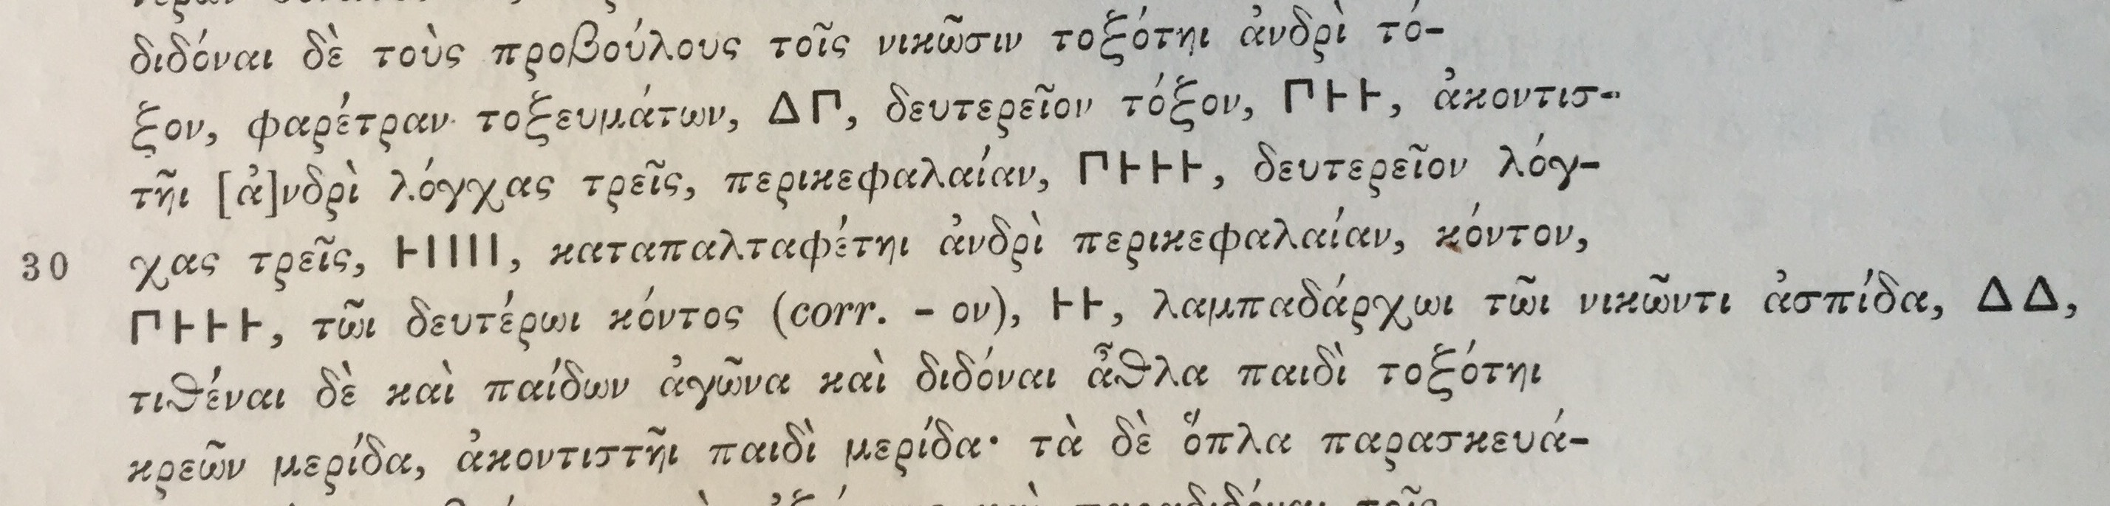
IG.XXII.5.647 ll.27-31

Slide 58
Demosthenes, For Phormio
36.11
οὔτε γὰρ ἡ πρόσοδος ἦν πλείων, ἀλλ᾽ ἐλάττων （τὸ μὲν γὰρ τάλαντον, ἡ δ᾽ ἑκατὸν μνᾶς ἔφερεν）, οὔτε τὸ κτῆμ᾽ ἥδιον, εἰ προσῆν χρήματα τῇ τραπέζῃ ἴδια.
The income was not greater; nay, it was less （the factory produced a talent, and the bank, one hundred minae）; nor was the property more agreeable, assuming that he had private capital in the bank.

Slide 59
Lysias, Against Eratosthenes 19
They had seven hundred shields of ours, they had all that silver and gold, with copper, jewellery, furniture and women's apparel beyond what they had ever expected to get; also a hundred and twenty slaves, of whom they took the ablest, delivering the rest to the Treasury; and yet to what extremes of insatiable greed for gain did they go, in this revelation that they made of their personal character!
καὶ ἔχοντες μὲν ἑπτακοσίας ἀσπίδας τῶν ἡμετέρων, ἔχοντες δὲ ἀργύριον καὶ χρυσίον τοσοῦτον, χαλκὸν δὲ καὶ κόσμον καὶ ἔπιπλα καὶ ἱμάτια γυναικεῖα ὅσα οὐδεπώποτε ᾤοντο κτήσεσθαι, καὶ ἀνδράποδα εἴκοσι καὶ ἑκατόν, ὧν τὰ μὲν βέλτιστα ἔλαβον, τὰ δὲ λοιπὰ εἰς τὸ δημόσιον ἀπέδοσαν, εἰς τοσαύτην ἀπληστίαν καὶ αἰσχροκέρδειαν ἀφίκοντο καὶ τοῦ τρόπου τοῦ αὑτῶν ἀπόδειξιν ἐποιήσαντο:
n.b. 700 (here) + 200 (Plutarch, Vitae) = 900 shields

Slide 60
Vertical Specialisation
Xenophon, Cyropaedia 8.2.5
ἐν δὲ ταῖς μεγάλαις πόλεσι διὰ τὸ πολλοὺς ἑκάστου δεῖσθαι ἀρκεῖ καὶ μία ἑκάστῳ τέχνη εἰς τὸ τρέφεσθαι: πολλάκις δὲ οὐδ᾽ ὅλη μία: ἀλλ᾽ ὑποδήματα ποιεῖ ὁ μὲν ἀνδρεῖα, ὁ δὲ γυναικεῖα: ἔστι δὲ ἔνθα καὶ ὑποδήματα ὁ μὲν νευρορραφῶν μόνον τρέφεται, ὁ δὲ σχίζων, ὁ δὲ χιτῶνας μόνον συντέμνων, ὁ δέ γε τούτων οὐδὲν ποιῶν ἀλλὰ συντιθεὶς ταῦτα. ἀνάγκη οὖν τὸν ἐν βραχυτάτῳ διατρίβοντα ἔργῳ τοῦτον καὶ ἄριστα δὴ ἠναγκάσθαι τοῦτο ποιεῖν.
For in small towns the same workman makes chairs and doors and ploughs and tables, and often this same artisan builds houses, and even so he is thankful if he can only find employment enough to support him. And it is, of course, impossible for a man of many trades to be proficient in all of them. In large cities, on the other hand, inasmuch as many people have demands to make upon each branch of industry, one trade alone, and very often even less than a whole trade, is enough to support a man: one man, for instance, makes shoes for men, and another for women; and there are places even where one man earns a living by only stitching shoes, another by cutting them out, another by sewing the uppers together, while there is another who performs none of these operations but only assembles the parts. It follows, therefore, as a matter of course, that he who devotes himself to a very highly specialized line of work is bound to do it in the best possible manner.
Labour mobility: X. Poroi 4.6
Notes:
Retail commerce: Shoe manufacturing and selling in Athens in early 4th c. Sounds like a Nike factory.
Changes in constants - Increase population puts pressure on manufacturing to specialize.
Firm and Household management:
Manufacturing
emergence of vertical specialisation (Harris, 2001, 2016)
Labour
Doctors (skilled), prostitutes (unskilled) (Loomis, 1998)
Incredible mobility - price can determine choice of object produced (Bresson, 2016: 15, 432) X. Poroi 4.6 : if too many bronze makers/ blacksmiths price goes down; if too much grain/wine price goes down – therefore people give up working land and turn to large-scale commerce, retail commerce or lending money at interest.
Banking
borrowing and lending - e.g. Isok. 17.12 pays out two customers “36,000 dr. in silver”( Cohen, 1992)
Full text:
"For just as all other arts are developed to superior excellence in large
cities, in that same way the food at the king's palace is also elaborately
prepared with superior excellence. For in small towns the same workman
makes chairs and doors and ploughs and tables, and often this same
artisan builds houses, and even so he is thankful if he can only find
employment enough to support him. And it is, of course, impossible for a
man of many trades to be proficient in all of them. In large cities, on the
other hand, inasmuch as many people have demands to make upon
each branch of industry, one trade alone, and very often even less
than a whole trade, is enough to support a man: one man, for
instance, makes shoes for men, and another for women; and there
are places even where one man earns a living by only stitching
shoes, another by cutting them out, another by sewing the uppers
together, while there is another who performs none of these
operations but only assembles the parts. It follows, therefore, as a
matter of course, that he who devotes himself to a very highly specialized
line of work is bound to do it in the best possible manner."

Slide 61
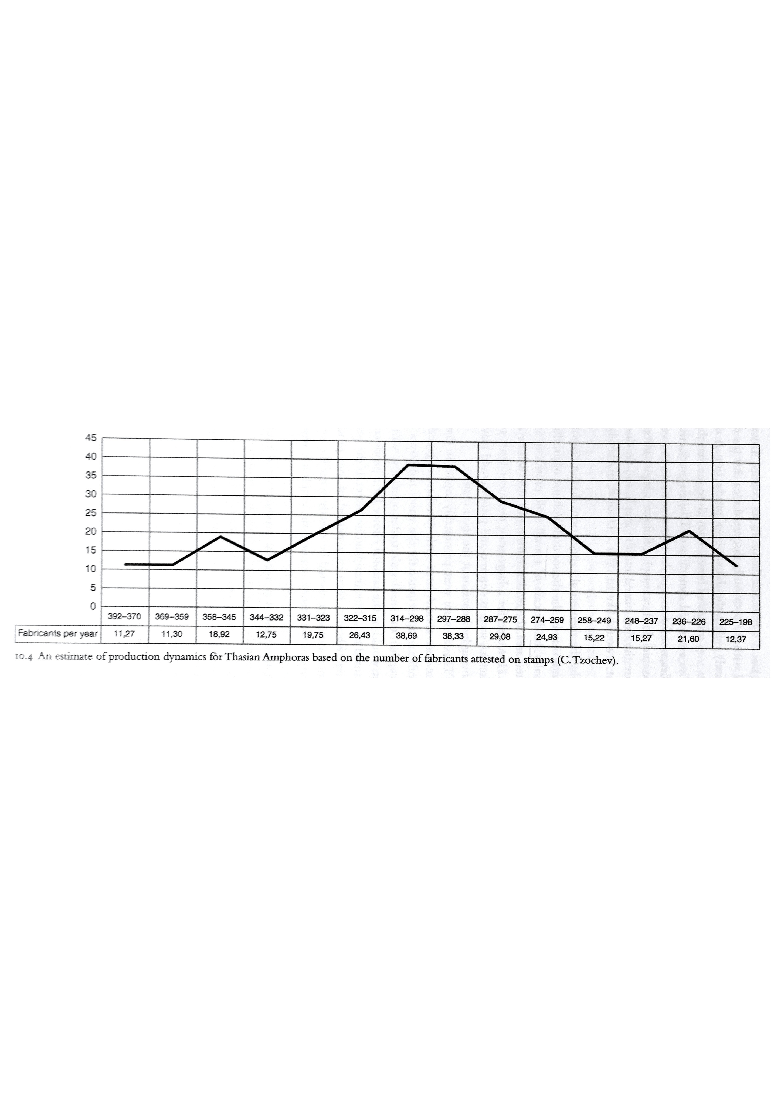
Thasian Amphora
Loss of Black Sea Market
Export to foreign markets:
Production and Transport of wine and wine containers
Here: “The number of production groups (fabricants) attested with a given annual official reflects the amount of labor engaged in amphora production for that year.” (Tzochev, 2016: 244)
Notes:
Estimates derived from:
Epigraphic
Literary evidence
Archaeological
Thasian amphora for export have a rich, varied and accessible pool of evidence - rare compared to other city-states.
E: Several inscriptions preserve documents on production and trade of Thasian wine.
L: literary evidence singles out the region as a place for sales of Thasian wine amphora (Dem. 35.34, Polybius 4.38), and of high quality (Salviat review)
A: Large number of stamped fragments spread about the eastern Mediterranean and Black Sea have been systematically recorded – excellent data-base. 28,000 fragments (Garlan, Debidour 1999) – consistent stamping for almost two and a half centuries- 4th to mid 2nd . Most significant importers were Athens, and larger communities of the North Aegean e.g. Abdera, Amphipolis, Maroneia and those in Macedonia, Egypt, Thrace and most of all in the Black Sea.
Animation 1: Thasian amphora were a Large scale-export to foreign markets (Osborne 1987:170)
From the proxy data, scholars make estimates on volume, frequency of stamping and chronology (deduced from names of officials).
These allow us to make extrapolations on production, and thus estimates of the sales dynamics and on the number of producers.
This helps us to visualise higher and lower demand for wine containers.
Animation 2: Looking at the graph, there was a decline in the number of producers in the latter half of 3rd c. BC. Tzochev believes this is bc of political and economic difficulties of many settlements in the area. Major importers Olbia, Histria and Cimmerian Bosporus suffered territorial raids and destruction. Callatis had difficulty recovering from war with Byzantium. Economic decay, impoverishment of local population lowered demand for expensive imported wine. Imports however did not stop and nor did imports of wine from other northern Aegean producers, which also may indicate that loss of market to competitors.
Economies of Scale -

Slide 62
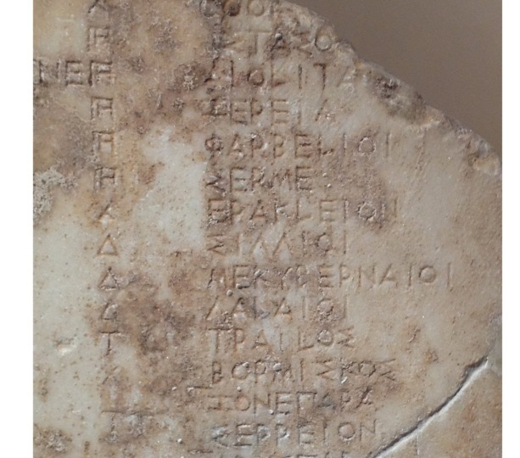
Game Theory (Bresson, 2016: 434)
Definition: A theory of choice with constraints – economic, cultural, political, religious, ...
Wrt our previous example of Thasian amphora: Competition was a concern which city-states attempted to regulate.
One way: Limitation of supply on the functioning of the market.
Pseudo-Aristotle, Economics: It happened that the Selymbrians needed money. Since among them there was a law that prohibited exporting grain bc a famine had taken place earlier, but they had grain from the preceding year, they decreed that individuals would deliver their grain to the city at a fixed price, each individual keeping for himself only one year’s supply. Then they issued an export license for this grain, after what seemed to them a suitable price.
City-state B
Prohibit Export
Export
City mkt adequately supplied & export only if price abroad higher
Safe risk aversion,
Risk famine
Prohibit export
City-state A
Both export better distribution of surplus, avoid famine consistently = qty of grain on mkt greater
Risk famine, Safe risk aversion
Export
Notes:
If A prohibits, B prefers to prohibit – bc doesn’t want to risk famine
If A exports, B prefers Export - bc prohibit would depress prices if the city-state produced surplus 2 years out of three, whereas with higher circulation prices would be more stable. However – no international mechanism to enforce cooperation!!
Both (prohibit, prohibit) and (export, export) are nash equilibria – a stable situation where neither player (no longer) desires to change his strategy.

Slide 63
Game Theory
The same idea applies to any export, even weapons
Arms Race
City-state B
Prohibit Export
Export
City Hoplites adequately supplied & export only if price abroad higher
Risk arming an enemy,
Risk famine
Prohibit export
City-state A
Risk arming an enemy, Safe risk aversion
Both export better distribution of surplus increased Possible risk of war = qty of weapons on mkt greater
Export
Notes:
If A prohibits, B prefers to prohibit – bc doesn’t want to risk famine
If A exports, B prefers Export - bc prohibit would depress prices if the city-state produced surplus 2 years out of three, whereas with higher circulation prices would be more stable. However – no international mechanism to enforce cooperation!!
Both (prohibit, prohibit) and (export, export) are nash equilibria – a stable situation where neither player (no longer) desires to change his strategy.

Slide 64
Prisoner’s Dilemma
Payoffs T > R > P > S
Temptation = One firm captures entire market
  first highest profit
Reward = share market at monopoly price
  second highest profit
Punishment = Compete on quantities
  third highest profit
Sucker’s Payoff = Sell at Monopoly price while opponent sells below and captures the entire market.
  lowest profit
Player 2
Cooperate
Defect
Cooperate
R , R
S , T*
Player 1
Defect
T* , S
P* , P*

Slide 65
Supply Quantities: Aristotle Politics 1.4.7-8
Thales then is reported to have thus displayed his wisdom, but as a matter of fact this device of taking an opportunity to secure a monopoly is a universal principle of business; hence even some states have recourse to this plan as a method of raising revenue when short of funds: they introduce a monopoly of marketable goods. There was a man in Sicily who used a sum of money deposited with him to buy up all the iron from the iron mines, and afterwards when the dealers came from the trading-centers he was the only seller, though he did not greatly raise the price, but all the same he made a profit of a hundred talents on his capital of fifty [talents]. When came to know of it he ordered the man to take his money with him but clear out of Syracuse on the spot, since he was inventing means of profit detrimental to the tyrant's own affairs. Yet really this device is the same as the discovery of Thales, for both men alike contrived to secure themselves a monopoly. An acquaintance with these devices is also serviceable for statesmen, for many states need financial aid and modes of revenue like those described, just as a household may, but in greater degree; hence some statesmen even devote their political activity exclusively to finance.
Θαλῆς μὲν οὖν λέγεται τοῦτον τὸν τρόπον ἐπίδειξιν ποιήσασθαι τῆς σοφίας: ἔστι δ᾽, ὥσπερ εἴπομεν, καθόλου τὸ τοιοῦτον χρηματιστικόν, ἐάν τις δύνηται μονοπωλίαν αὑτῷ κατασκευάζειν. διὸ καὶ τῶν πόλεων ἔνιαι τοῦτον ποιοῦνται τὸν πόρον, ὅταν ἀπορῶσι χρημάτων: μονοπωλίαν γὰρ τῶν ὠνίων ποιοῦσιν. ἐν Σικελίᾳ δέ τις τεθέντος παρ᾽ αὐτῷ νομίσματος συνεπρίατο πάντα τὸν σίδηρον ἐκ τῶν σιδηρείων, μετὰ δὲ ταῦτα ὡς ἀφίκοντο ἐκ τῶν ἐμπορίων οἱ ἔμποροι, ἐπώλει μόνος, οὐ πολλὴν ποιήσας ὑπερβολὴν τῆς τιμῆς: ἀλλ᾽ ὅμως ἐπὶ τοῖς πεντήκοντα ταλάντοις ἐπέλαβεν ἑκατόν. τοῦτο μὲν οὖν Διονύσιος αἰσθόμενος τὰ μὲν χρήματα ἐκέλευσεν ἐκκομίσασθαι, μὴ μέντοι γε ἔτι μένειν ἐν Συρακούσαις, ὡς πόρους εὑρίσκοντα τοῖς αὑτοῦ πράγμασιν ἀσυμφόρους: τὸ μέντοι ὅραμα Θάλεω καὶ τοῦτο ταὐτόν ἐστιν: ἀμφότεροι γὰρ ἑαυτοῖς ἐτέχνασαν γενέσθαι μονοπωλίαν. χρήσιμον δὲ γνωρίζειν ταῦτα καὶ τοῖς πολιτικοῖς. πολλαῖς γὰρ πόλεσι δεῖ χρηματισμοῦ καὶ τοιούτων πόρων, ὥσπερ οἰκίᾳ, μᾶλλον δέ: διόπερ τινὲς καὶ πολιτεύονται τῶν πολιτευομένων ταῦτα μόνον.
Notes:
Dionysius the elder tyrant of Syracuse 405-397BC who exiles him from Syracuse cf. Thucydides οἱ δ᾽ οὐκέτι ἔμειναν ἀλλὰ . . .
Thales speculator: while it was still winter that there was going to be a large crop of olives, so he raised a small sum of money and paid round deposits for the whole of the olive-presses in Miletus and Chios

Slide 66
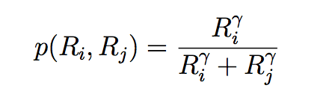
Contest Success Function: probability

Slide 67
gamma is technology
Your resources
Opponent
resources

Slide 68
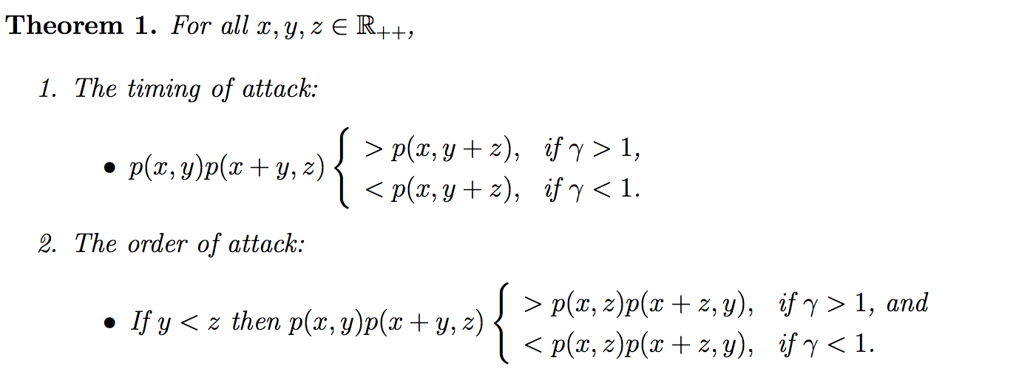
Timing or Order of attack
Rich-rewarding
Poor-rewarding
We only care about rich rewarding since technology was relatively similar for all players:
Timing: it is preferable to attack a sequence of two rulers rather than to wait for them to fight and merge and then attack them.
The second property is concerned with the issue of which of two opponents – rich or poor – to attack first. Again the answer turns on the value of gamma. it is better to attack the poor followed by the rich opponent

Slide 69
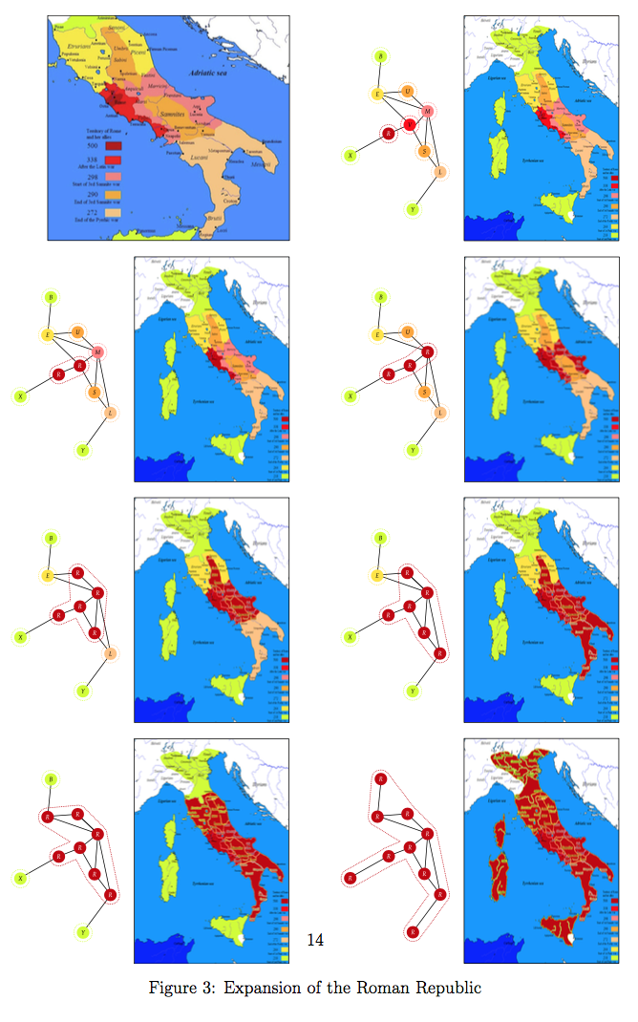
Ancient Historical example

Slide 70
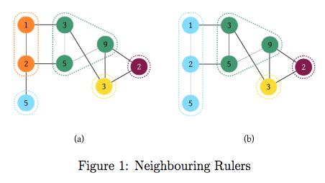
Sparta vs Athens

Slide 71
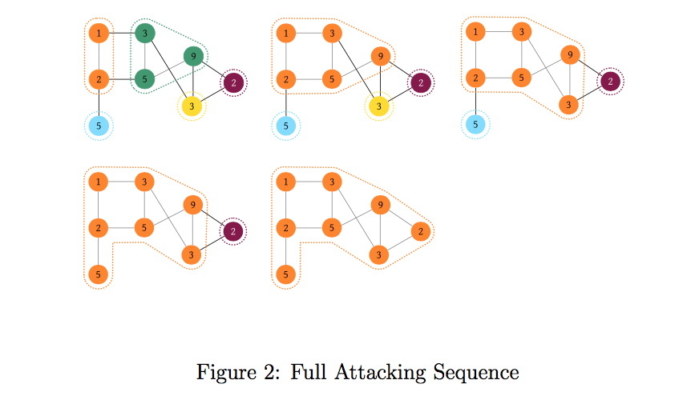
Full attacking sequence

Slide 72
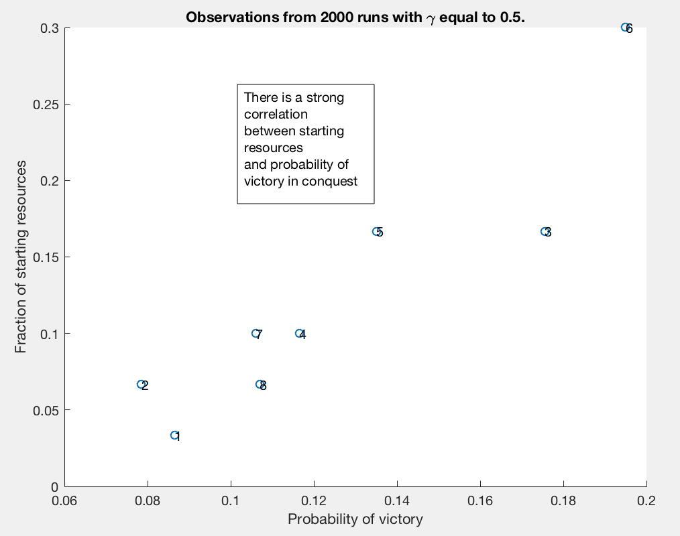
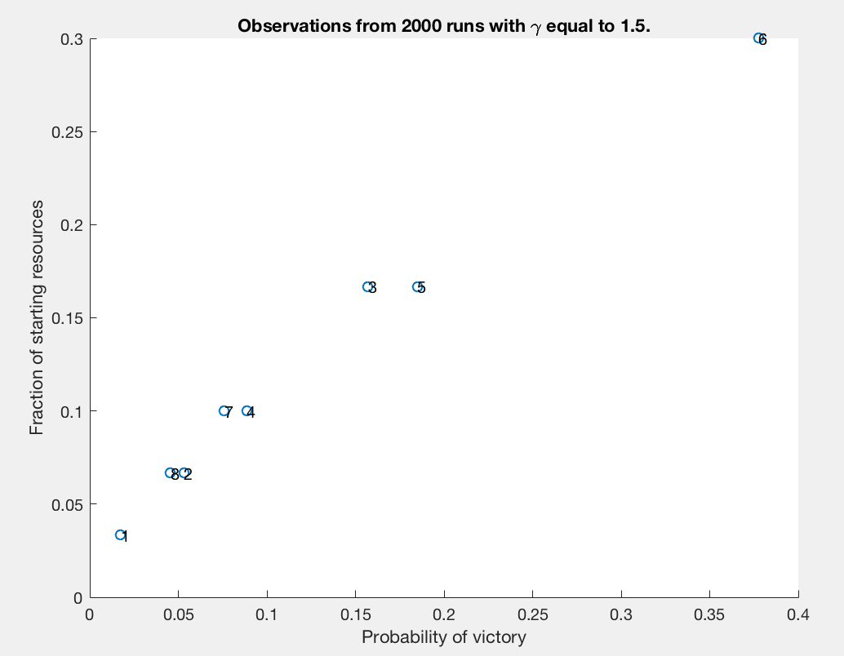
Probability of hegemony

Slide 73
Fear = fight
Notes:
This is ancient Greece and the major city-states of the 5th century before Christ.
In a network scenario when each state must consider not one but many opponents simultaneously, simulations show that power parity or hegemony lead to stable states = where no one wishes to attack anyone else. In this simulation Sparta located in Laconia takes over everyone. This is unrealistic because we have scene hegemonic states take over vast territories but it is highly unlikely it is so easily accomplished.
Why is hegemony difficult? War is expensive.

Slide 74
Self-interest = conquer (with costs of war)
Notes:
Thucydides writes that “war is a matter not so much of arms as of money” (1.83)
*The word used for money is dapane which literally means cost or expenditure.
In this simulation we add costs to each skirmish or battle fought between states, the states merge and form alliances and more easily reach stability through power parity.
You can see this as the size of the larger nodes shrink and the network settles within a similar level of resources. This makes the simulation of the war more realistic, the two league that form are the Delian League (blue) and the Peloponnesian league (brown) almost exactly. But if this is a stable state with power parity, why did the Peloponnesian war break out?

Slide 75
honour = desire for fairness (with “Exiters”)
Simulation with civil strife – keep it going for 100 ticks
Notes:
In this simulation we add Fairness!!!
If we add the possibility of civil strife and a state’s desire to break away from an alliance, war is continuous and unstoppable unless there is equality among the members of the alliance.
This simulation shows that the Spartan league reaches hegemony, as it historically did in 404BC with the fall of the Athenian empire, however defectors keep on cropping up indefinitely.
Thucydides tells an old story of the tyrant Hippias who feared he was going to be assassinated and as a result became violent. Change triggered his action to become aggressive. Thucydides believes that an agent’s change of character is like the change in Athens strength or the change in autonomy felt by the Melians under the empire. Change is the catalyst for conflict.
N.B. I might have mentioned to some of you about that there is some interest in setting-up a a reading group for Richard McElreath's Statistical Rethinking (see here). The volume is by far the best book on Bayesian statistic (actually on statistics in general) that I've ever come across and provides both an enjoyable epistemological journey (without too many equations!) and practical R skills for doing actually Bayesian stats. The purpose of the reading group is to have a venue for discussing each chapter from both the theoretical and practical point of view, but also to enforce ourselves to finish the book through peer pressure... But before booking rooms and kicking off I wanted to have a vague idea on how many we are and if you think this is something worth pursuing. One thing I want to stress is that although the book does not require any prior knowledge, knowing basics of R and why p-values can be evil would help. Basically, if this makes you giggle you are likely to enjoy the book and the reading group, but it's not a place where you ask how to run a t-test in R (unless it's not about this)
I suggest we have an informal coffee at the Foyer of the McD, say at 3pm next Monday the 23rd, to organise various things? In the meanwhile I would appreciate if you could: 1) forward this to everyone who you think might be interested; and 2) send me an email letting me know that you are interested so that I can make a mailing list.
All Best,
Enrico
---------------------------------------
Dr Enrico R. Crema
Fellow and Director of Studies in Archaeology, Fitzwilliam College
Lecturer in Computational Analysis of Long-Term Human Cultural and Biological Dynamics
Department of Archaeology

Slide 76
Bibliography
Acton, P. 2014. Poiesis. Manufacturing in Classical Athens, New York.
Archibald, Z.H., J. Davies, and G. Oliver. 2001. Hellenistic Economies. London.
Bresson, A. 2016. The Making of the Ancient Greek Economy: Institutions, Markets and Growth in the City-States. Princeton.
Cohen, E. E. 1992. Athenian Economy and Society: A Banking Perspective. Princeton.
Davies, J. K. 2005. ‘Linear and Non-linear Flow Models for Ancient Economies.’ In Manning and Morris 2005: 127-56. (esp. with Chapter 7 ‘Comment on Davies’ by Takeshi Amemiya)
Figueira, T. 1998. The Power of Money: Coinage and Politics in the Athenian Empire. Philadelphia.
Harris, E. 2002. ‘Workshop, Marketplace and Household The Nature of Technical Specialization in Classical Athens and its Influence on Economy and Society,’ in P. Cartledge, E. E. Cohen, L. Foxhall (eds), Money, Labour and Land: Approaches to the Economies of Ancient Greece, London: 67-99.
Loomis, W. T. 1998. Wages, Welfare Costs and Inflation in Classical Athens, Ann Arbor.
Manning, J.G. and I. Morris, eds. 2005. The Ancient Economy: Evidence and Models. Stanford, CA.
Mattingly, D.J. and J. Salmon. Economies beyond Agriculture in the Classical World. London: Routledge, 2001.
Moreno, A. 2007. Feeding the Democracy: the Athenian Grain Supply in the Fifth and Fourth Centuries BC, Oxford.
Osborne, R. 2004a. ‘Images of a Warrior. On a Group of Athenian Vases and their Public.’ In Marconi 2004: 41-54
Osborne, R. 2004b. ‘Workshop and the Iconography and Distribution of Athenian Red-figure Pottery: A Case Study.’ In Keay and Moser 2004: 78-94.
Osborne, R. 2007. ‘What Traveled with Greek Pottery?’ Mediterranean History Review 22: 85-95.
Pritchett, W. K. and Pippin, A. 1956. ‘The Attic Stelai: Part II’, Hesperia 25: 178-328.
Sanidas, G. 2013. La production artisanale en Grèce. Une approche spatial et topographique à partir des exemples de l’Attique et du Péloponnèse du VIIe au Ier siècle avant J.C. Collection archéologie et histoire 33. Paris: Comité des Travaux Historiques et Scientifiques.
Scheidel, W. and S. von Reden. 2002. The Ancient Economy. London.
Scheidel, W., I. Morris and R. Saller, eds. 2007. The Cambridge Economic History of the Greco-Roman World. Cambridge.
Tandy, D. 1997. Warriors into Traders: The Power of the Market in Early Greece. Berkeley.
Wees, H., van 2001. “The Myth of the Middle-Class Army: Military and Social Status in Ancient Athens” in War as Cultural and Social Force: Essays on Warfare in Antiquity ed. T. Bekker-Nielsen and L. Hannestad: 45-71.
Wees, H., van 2011. ‘Demetrius and Draco: Athens’ property classes and population in and before 317BC’ JHS 131, 95-114.
Wees, H., van 2013. Ships and Silver, Taxes and Tribute. New York.
Short bibliography for an advanced introduction to the Ancient Greek economy excluding primary literary sources and collections of epigraphic and archaeological sources.

