Slide 1
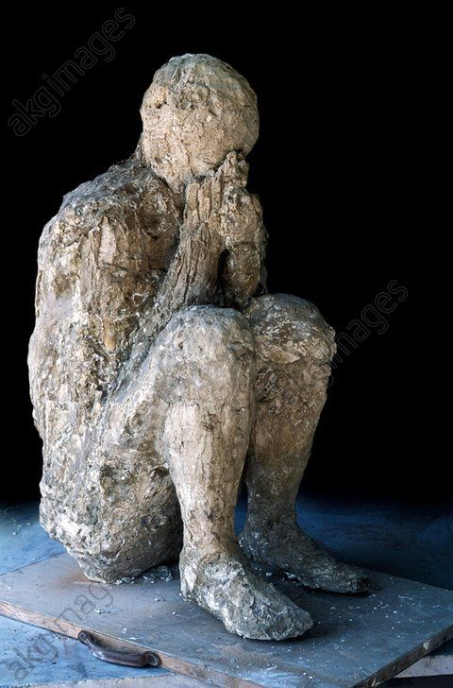
Lecture 1: Thinking about vulnerability, ancient and modern
The Vulnerable Body in Roman Literature and Thought

Slide 2
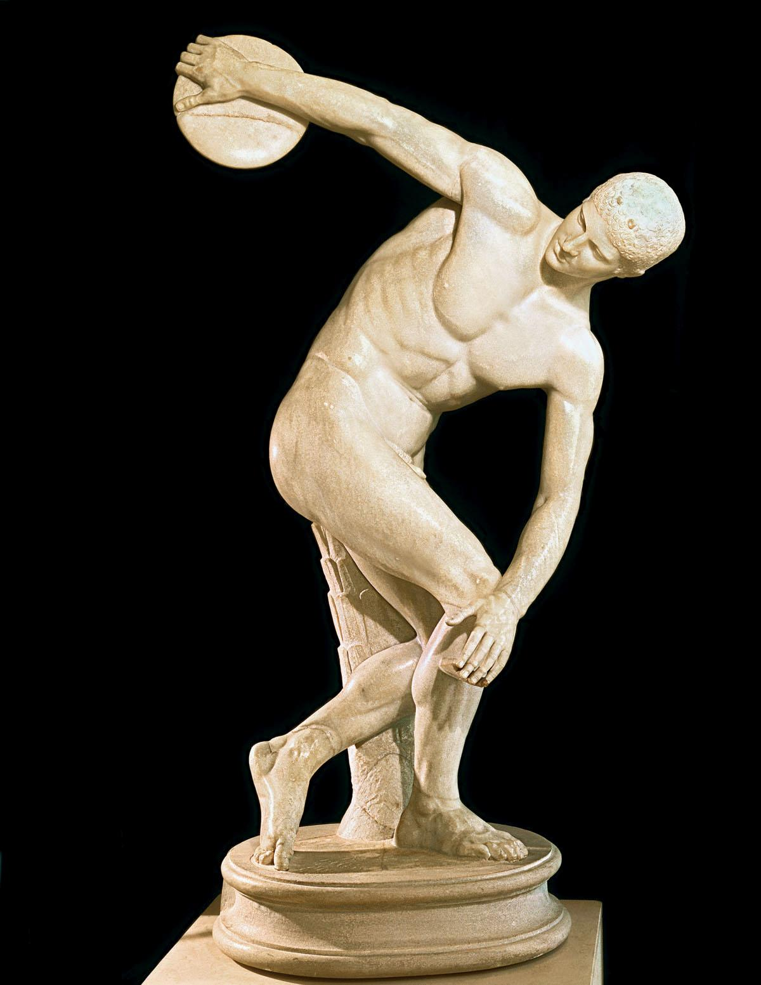
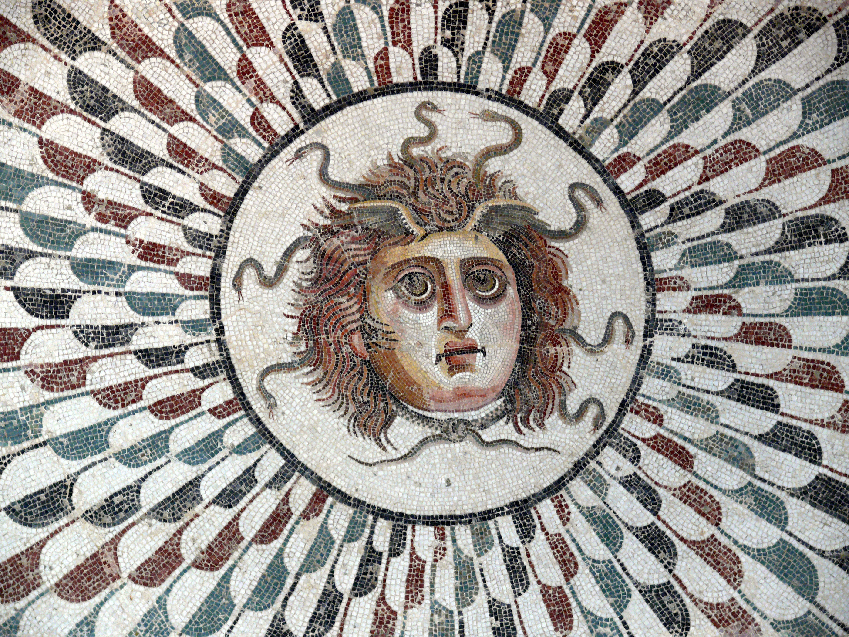
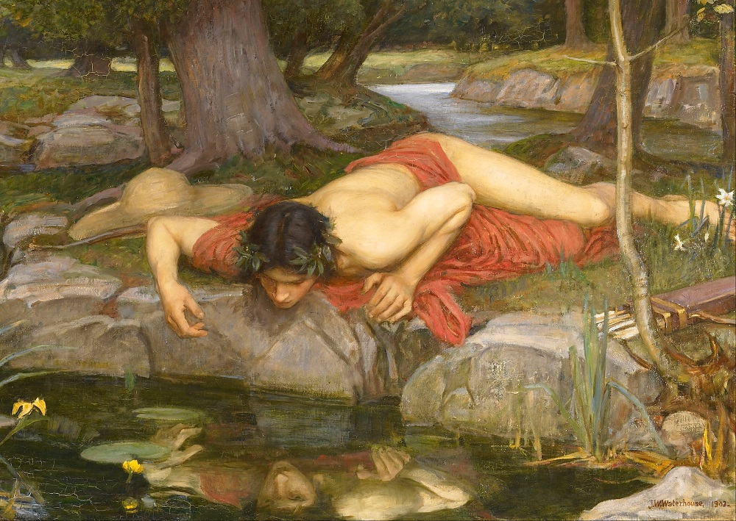
The beautiful, perfect ones

Slide 3
Opening questions
How normal, or normative, is vulnerability - now, as in the ancient world?
To what extent is Greco-Roman antiquity constructed in the modern imagination around representation of perfect, beautiful bodies?
What is at stake in emphasizing the normality or ubiquity of vulnerability, rather than imagining vulnerability as marking certain bodies in their(usually negative) difference from the healthy, upright, self-sufficient, non-disabled norm?

Slide 4


Does vulnerability in others elicit our sympathy/indifference/ disgust? Is it beautiful, or ugly, or both? Why? Do those views change as we get older?
To what extent is vulnerability associated with shame in our culture? Or even with other kinds of ‘weakness’ – moral, ethical, legal?
Is vulnerability gendered?

Slide 5
The hu-man subject
Free - enslaved
Adult - child
Impenetrable - penetrable
Invulnerable - vulnerable
Non-dependent - dependent
Western – Eastern/foreign /other
Male – female/gender- ambiguous or non- conforming

Slide 6

The (ancient Roman) principle of bodily integrity
M.Nussbaum, Women and Human Development (1999)
The top 10 ‘human capabilities’:
#3 = ‘The ability to move freely from place to place, having one’s boundaries treated as sovereign, i.e., to be able to secure against assault, including sexual assault, child sexual assault and domestic violence.’

Slide 7

Judith Butler Precarious Life (2004)
‘We cannot, however, will away this vulnerability. We must attend to it, even abide by it…’ (P.29)

Slide 8
‘In its radical openness, the vulnerable subject is always encountering and being encountered, moving towards and being moved by others. In that sense, the context where embodied selves move through cannot be reduced either to the rational mind moving the body or the body moving the mind, as dualistic epistemologies would argue. Instead, the embodied self is relational, for better or for worse.’
Urquiza Haas and Arturo Sánchez García. Conference Proceedings review 2013.

Slide 9

Vulnerable bodies in Latin literature
The torn, wounded, frightened warrior
The ‘soft’ elegiac lover
Girls and women
The ‘slave’, and the slave / Freedman
Satire’s bloated, abject bodies
The exile / politically oppressed
The abandoned, suicidal heroine
The tragic victims
The elderly

Slide 10
Are explorations of vulnerability germane to discourses of EMPIRE?
Or:
To what extent does making a spectacle of vulnerability sustain invulnerability as an ideal or fantasy?

Slide 11
Our vulnerable writers/ writers of vulnerability
Horace, 65-8BCE, ‘son of a freedman’.
Ovid,43BCE-c.17CE, ?darling? of Augustus, banished in 8CE
Phaedrus, c.15BCE-50CE, the ‘ex-slave/freedman’
Persius, c.34-62CE. (Friend of Seneca and Thrasea Paetus)
Seneca the Younger, c.4-65CE; exiled by Claudius, forced to suicide by Nero
Statius, 40/50-96CE.

