Slide 1
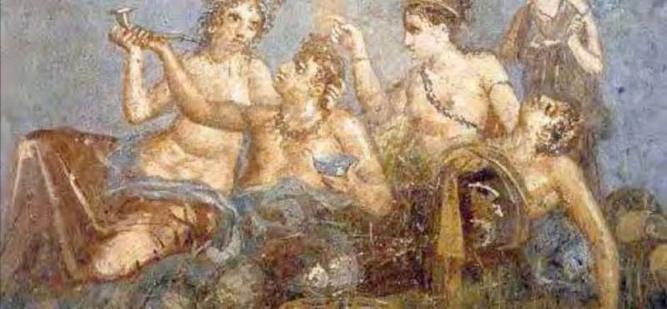
The elegiac poet-lover: power and libido in Ovid’s Amores
The Vulnerable body

Slide 2
Vulnera-bility
vulnus, (vulnera, n.pl.)
vulnerabilis
mollitia: softness, feebleness
imbecillitas: fragility, weakness

Slide 3
The free and the enslaved
/humiliated/vulnerable
Lucretius On the Nature of Things 4.1116-24, 1146-7:
‘Then the same frenzy returns, and once more the madness comes, when they seek to get what they desire, and can find no device to master the trouble: in such uncertainty they pine with their secret wound. They consume their strength and kill themselves with the labour. One lover lives depending on another. Duties are neglected, good reputations totter and grow sick. Wealth vanishes, and turns into Babylonian perfumes… To avoid being lured into the snares of love is not as difficult as it is to escape once you are caught in Venus’ trap.’

Slide 4
Cicero de Republica 3.37 (=Augustine Contra Julianum, 4.12.61)
‘But the different kinds of ruling and serving should be distinguished. For as the mind is said to rule the body, it is also said to rule desire, but it rules the body as a king his citizens or a father his sons. But desire rules as a master rules his slaves, in that it restrains and crushes them . . . masters tire out their slaves just as the best part of the mind, that is wisdom, exercises the flawed and weak parts of the same mind, such as desires, anger, and other disturbances . . .’
Seneca Ep.47.17: ‘Show me a man who isn’t a slave: some are slaves to sex, others to money, others to social prestige, all are slaves to hope and fear.’

Slide 5
Augustus, Res Gestae 1:
‘In my nineteenth year, on my own initiative and at my own expense, I raised an army with which I set free the state, which was oppressed by the domination of a faction. For that reason, the senate enrolled me in its order by laudatory resolutions, when Gaius Pansa and Aulus Hirtius were consuls (43 B.C.E.), assigning me the place of a consul in the giving of opinions, and gave me the imperium.’

Slide 6

The Roman love elegists
Gallus – 70-26BCE
Propertius 50/45-15BCE
Tibullus 55-19BCE
Ovid 43BCE-17CE

Slide 7
Cultus: the art of self-fashioning
See e.g.
Ovid Medicamina (‘Face Cosmetics’) lines 1-26.
Ars Amatoria (‘The Art of Love’) 1.505ff. (Don’t go so far as to use curling tongs, or wax your legs..)
Ars Amatoria 3.193ff.
And note the role of the slave-hairdresser in Ovid Amores Books 1 and 2 (1.11-12, 2.7-8)

Slide 8
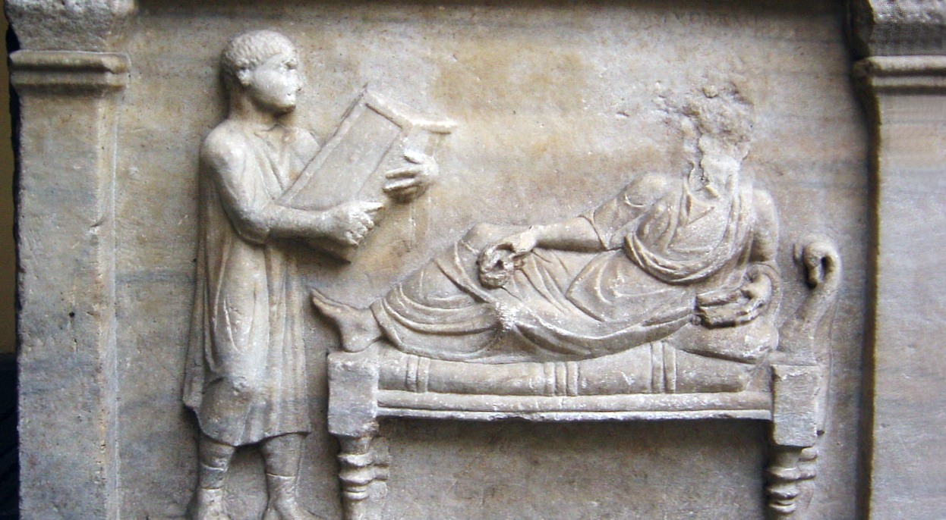
The pleasure and pain of sex reading

Slide 9
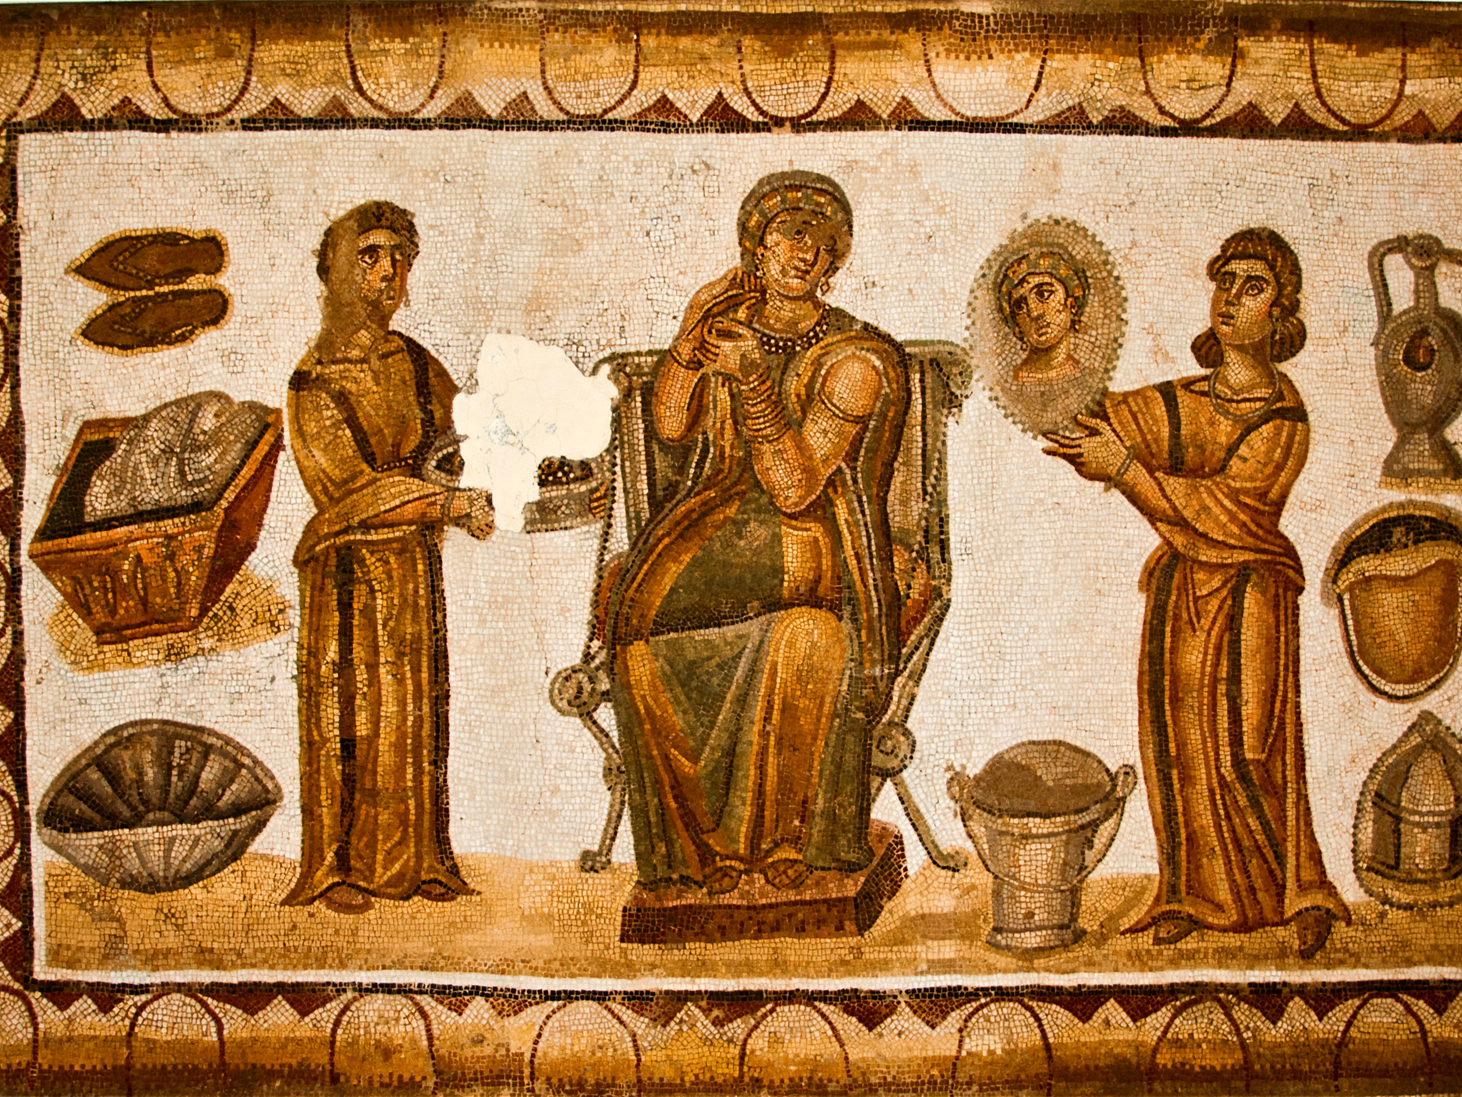
The body of the maid
Ov.Amores 2.7 and 2.8

