Slide 1
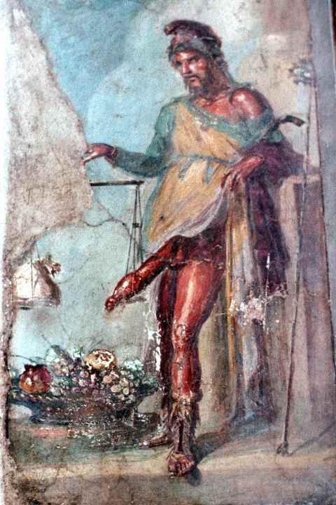
Ovid Amores 3.7 and the creative-erotic potential of impotence
The Vulnerable Body

Slide 2
Size matters?
3.1: 70 lines
3.2: 84 lines
3.3; 48 lines
3.4: 48 lines
3.5: 46 lines
3.6: 106 lines (central swell)
3.7: 84 lines (still big!)
3.8: 66 lines
3.9: 68 lines
3.10: 48 lines
3.11a: 32 lines
3.11b: 52 lines (84 in all)
3.12: 44 lines
3.13: 36 lines (flagging now)
3.14: 50 lines
3.15: 20 lines (burnt out)
Amores book 1: 15 Amores book 2: 19 Amores book 3: 15

Slide 3
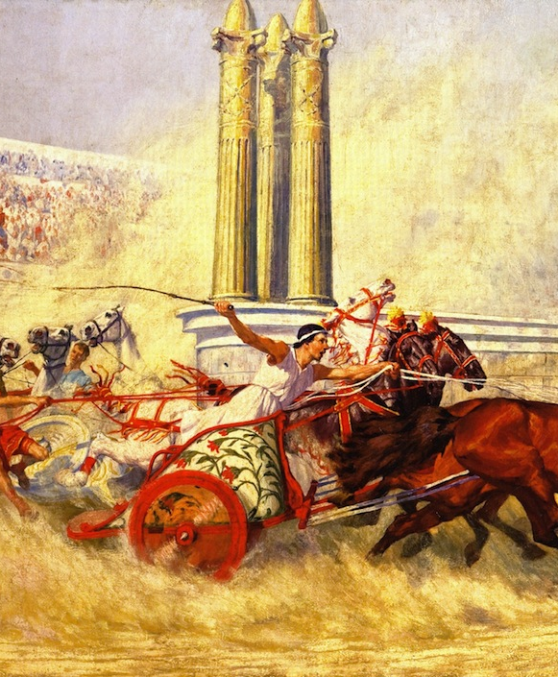
end points and turning posts at the races
Amores 3.2 (and 3.15)

Slide 4
Desire is always perverse
Am.3.4.17: nitimur in vetitum semper cupimusque negata (‘we always strive for what is forbidden and covet what is denied us.’)
Am.3.4.25-6: quiduid servatur cupimus magis, ipsaque furem / cura vocat. pauci quod sinit alter amat (‘Whatever is guarded we desire all the more, and care itself invites the thief.’)
3.4.31: iuvat inconcessa voluptas (‘Pleasure delights in the forbidden.’)
Am.3.4.29: nec proba fit, quam vir servat, sed adultera cara (‘She whom her husband guards is not made honest, but becomes instead a mistress much desired.’)

Slide 5
Might Augustan legislation against adultery (leges Iuliae, 23BCE) motivate/cause adultery?
Does the normative produce the subversive?

Slide 6
The circular structure of the elegiac couple(t)
Hexameter – pentameter
Epic - elegiac
Male - female
Success - failure
Expansion - limitation

Slide 7
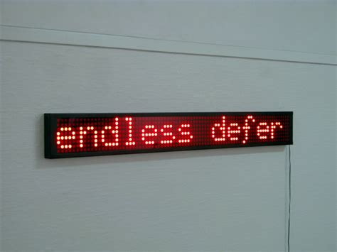
Jansen 2014,The Roman Paratext, p.280).
‘The edges of Ovid’s elegiac collections are marked by a method of structuring editorial meaning which emphasizes circularity, open-endedness, and renegotiating cultures of reading, …’

Slide 8

More amor, more mora
Am.3.7.80: nec mora (‘without delay’)
Remedia Amoris, 83-4
‘For delay adds strength: delay ripens the tender grapes and makes what was once young shoots strong crops’.
Remedia 91-2
‘Oppose beginnings/at the beginning; treatment is applied too late when troubles have grown strong through long delays.’

Slide 9
The toing and froing of desire
Phyllis at Remedia 55-6, 591-608
55-6: Phyllis would have lived, had she used my counsels / and taken more often the path she took nine times.
599ff: There was narrow path, overcast by the long shadows, by which she often went down to the sea. For the ninth time she trod that unhappy path!
Cf. Am.3.7.25-6: I remember Corinna requesting, and me supplying, nine times in one short night!

