Slide 1
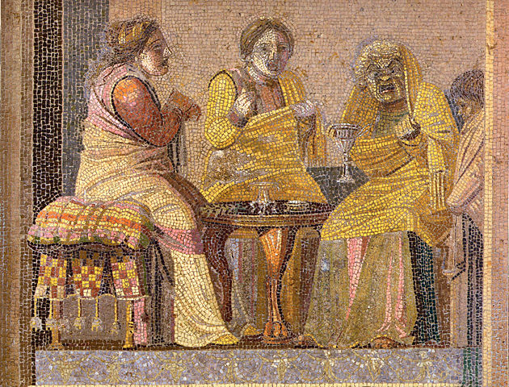
Vulnerable Body 4
Discordia and powerlessness: Horace’s penetrating Epodes

Slide 2

Quintus Horatius Flaccus, son of a libertus
Epode 15.11-15: ‘if there is any manliness in “Floppy” ’
Flaccus = flabby, feeble, flaccid

Slide 3
Key idea / question
Can Horace turn ‘impotence’ and social-cultural ‘inferiority’ into tools for a different kind of mastery?

Slide 4
Biography: Quintus Horatius Flaccus
(from his own poetry and Suetonius’ Vita Horatii)
Born 8 December 65BCE at Venusia (Sat.2.1.34-5)
Son of a freedman, but born free (Sat.1.6.8)
Once freed, father was a praeco (auctioneer) and coactor (rent-collector): see Sat.1.6.86-8
Father could afford to have his son educated in Rome (Sat.1.6.76-80), and in Athens (Epist.2.2.45), yet Horace says he turned to verse because of poverty (Epist.2.2.51-2)

Slide 5
In 44BCE, Horace joined the Republican cause (under M.Brutus), and in 42, fought on the losing side in the battle at Philippi.
Horace acquired the patronage of Pollio and Messalla (Sat.1.10.85), and made a living as a scriba quaestorius.
Success was secured with the patronage of the wealthy Maecenas, who at some point gifted him an estate in the Sabine hills (Sat.2.6.1-5, Epist.1.14.2-3). The Epodes are dedicated to Maecenas. Horace was also friends with Virgil and Varus, and was invited to become Augustus’ personal secretary (he declined).
Horace was an equestrian in status, and could have risen to senatorial rank.
He died suddenly in Rome on 27th November, 8BCE

Slide 6
The ‘libertus’ factor
... is key to understanding Horace’s investigations and poses of authority, modesty, and submission.
Horace experiments with a range of personae, veering between postures of superiority and victimhood

Slide 7
Unstable identities, unstable times
Key point:
Horace is writing in rapidly shifting political circumstances.
Epodes composed c.42-30BC, during Rome’s bloody transition from Republic to autocracy. 7 and 16 express horror at the renewal of civil war

Slide 8
The Epodes
‘iambic’ poetry
History of criticism: scholars pre-1990s often uncomfortable with poems’ violence, opacity and fleshiness. Tended to study book in bits; more holistic approach needed
Key features: polyphony, irregularity, odd juxtapositions, thematic variety (civil war, blackmail, indigestion, love)
Odd 17-poem structure, with ‘downward momentum’ (Porter 1995) NOT Virgil’s 10-poem Eclogues. Yet the book’s architecture is complex and in many ways neatly patterned.
Poems 1-10 = iambic trimeter + dimeter
ibis, (1.1)~exit (10.1) ~ exitus (17.81)

Slide 9
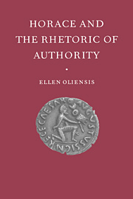
Oliensis, 1998
The 17-book poem, with its ‘unbalanced foot’ (incerto pede 11.20) is the epodic distich writ large…

Slide 10
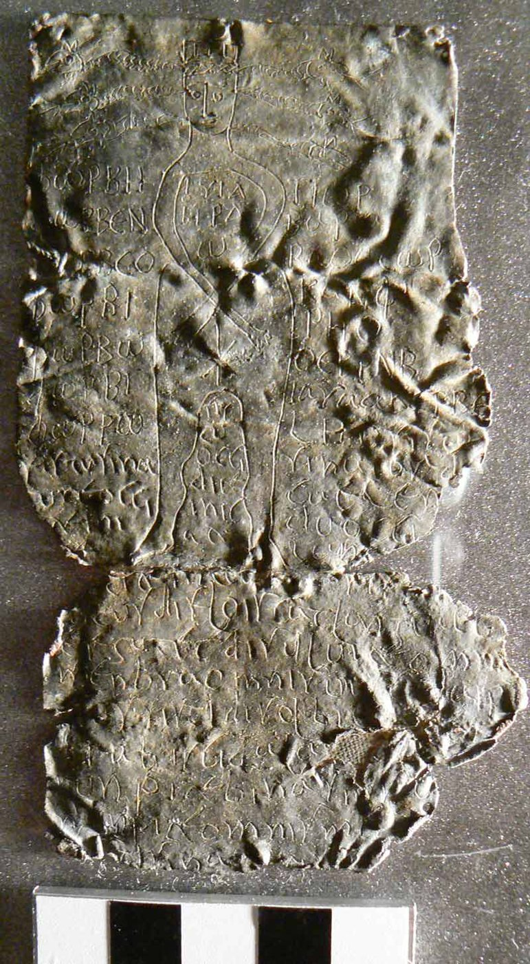
Epode = epodos, -i (m), Greek epōidos / epōide
‘sung over/after’, or song as spell/charm/
incantation

Slide 11
Key themes
Discordia - civil war, conflict generally
Roman male identity
Ideological (in)stability
The circularity of collective and individual trauma
Victimhood (iambus as ‘the poetry of abuse or blame’)
(The failure of) Roman amicitia
Poison and contagion

Slide 12
Horace’s literary models
‘the spirit of Archilochus’ (Epist.1.19). 7th-century Greek poet of Paros, c.680-645BCE. ‘Invented’ the iambic genre, Cf. Hipponax, Semonides.
Callimachus (Iamboi)
Catullus (c.84-54BCE): see his obscene/invective poems, e.g. 16, 29

Slide 13
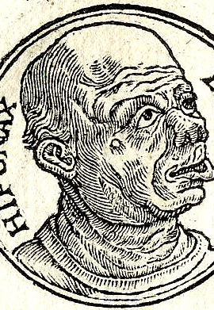
Ugly, misshapen iambic: mocking Hipponax
The face of Hipponax was notoriously ugly; on account of this they impudently exhibited a humorous likeness of him to a circle of laughing spectators. In anger at this Hipponax unsheathed such bitter verses that some believe he drove them to the noose. This is untrue, since later they made several statues in neighbouring islands, for example in Delos, and set under them verses to the effect that Chios was to be celebrated not only for its vines, but also for the works of the sons of Archermus.
Pliny the Elder, Natural History 36.4.12

Slide 14
The hard-soft iambic voice
Central dynamic of the Epodes:
the power to hurt and the vulnerability to others’ abuse (aggressor is himself a victim)
the fragility of virility: the poet often fashions himself as feckless, impotent, ‘toothless’

Slide 15
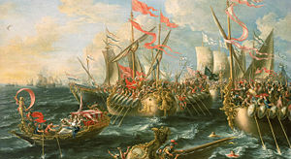
Epode 1: hearts and minds
‘Battle of Actium’ Lorenzo A. Castro, 1672

Slide 16
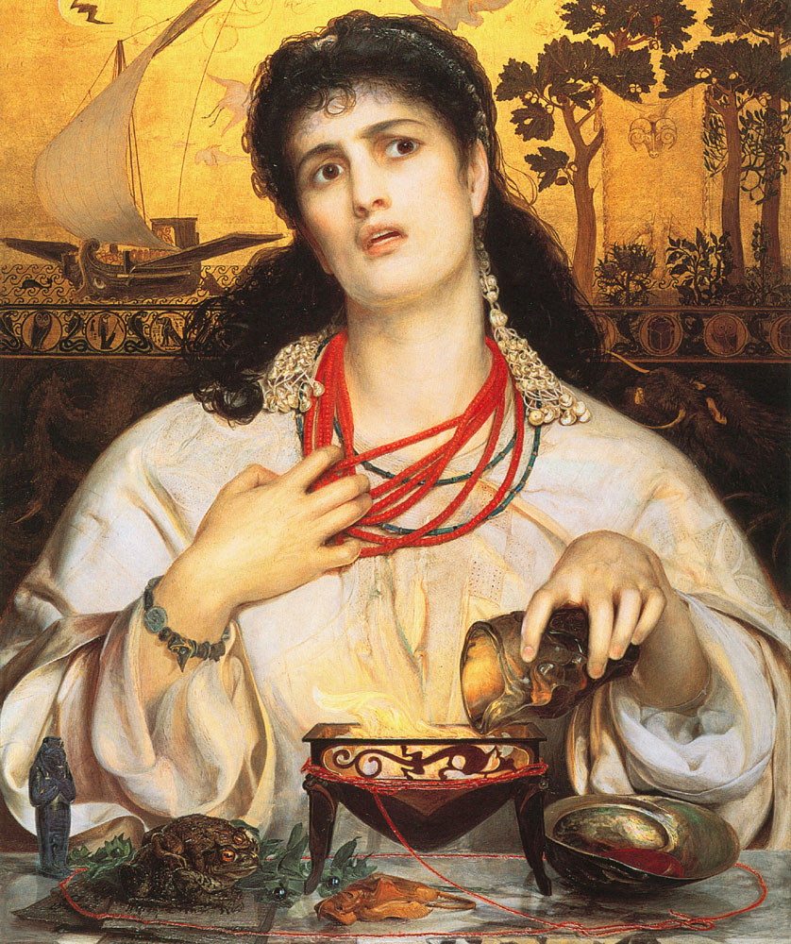
Epode 3: garlicky powerplay

