Slide 1
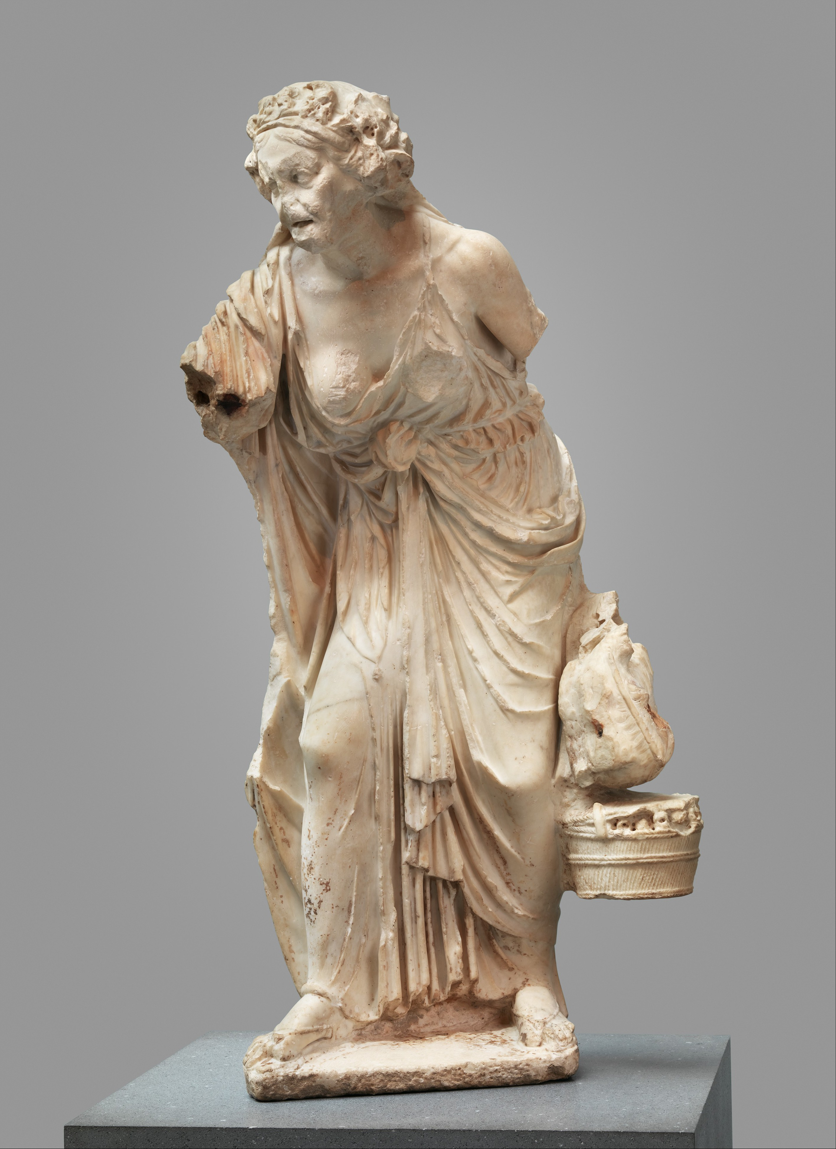
Discordia and powerlessness: Horace’s penetrating Epodes (II)
Vulnerable Body 5

Slide 2
The Epodes: key points so far
Horace makes the genre/form of iambic poetry inseparable from his own precarity as son of a freedman who was on the losing side in the civil wars.
Horace not an objective, distanced commentator on current events, but a compromised, traumatised participant.
The poet uses simile and metaphor to take up more or less powerful positions; he veers between male self-mastery/effeminate subjection.
Abuse poetry seems to both respond to that ‘victim status’ and perpetuate it, while of course trying to make victims of others
BODILY vulnerability is an ongoing theme: bodily weakness translates into and comes to stand for all kinds of other vulnerabilities.
Aggressive, abusive iambic given a new (mitigating?) frame in the Epodes: e.g. The playful, agonistic yet protective space of Maecenas’ villa (Epod.3)

Slide 3
Today’s lecture-seminar
How might we relate the ‘hag’ of Epod.8 and 12 to wider themes and recurring figures in the work?
Canidia the witch as the perverse ‘muse’ of Horatian iambic
Close reading of Epodes 8 and 12 as
? impotence poems ?

Slide 4
Canidia: witches and hags in the Epodes
Canidia embodies the iambic genre – or the threat it poses (to the poet’s own vulnerable masculinity?)
Etymologies/connected words: canities (white or grey hair, old age), canere (to sing), caninus (dog-like, snarling, biting), canis (dog).
Epodes 5, 17; Satires 1.8 (plus Epodes 3, 6, 8, 12, Sat.2.1, 2.8). Notice Canidia’s role at the end of the both the Epodes and the Satires.
Compare the biting, vengeful iambic poet at Epodes 6 (atro dente, 6.15; dens ater, 8.3); or the poet as canis acer at Epodes 8.6

Slide 5
Key points in summary
Wherever Canidia (or the old women resembling her) appear, male power, virility, bodily integrity and dignity are threatened.
The burning, aggressive lust of the old woman, and the threat of impotentia it implies, are themselves catalysts for iambic invective.
How to separate inspiration from repulsion?

Slide 6
Epodes 8 and 12
…reverse the scenario of Ovid Amores 3.7:
disgust replaces attraction;
the old, ugly matrona replaces the young, pretty one;
aggressive pride replaces feelings of shame and failure
But in both Am.3.7 and Epodes 12, the woman reprimands the poet-lover

Slide 7
The shape of POWER: iambic disequilibrium
Epode 8:
Son of a freedman vs. aristocratic matrona
Young male genitalia vs. dehumanized, animal-like old female body
Male bodily integrity vs. female penetrability/ incontinence
Male impotence vs. old woman’s power to bewitch
Male rhetorical power vs. female silence (her mouth should be differently occupied)
Horace’s vulgar iambic vs. old woman’s pretensions to literary-philosophical sophistication

Slide 8

          So – does gender trump class in the battle for rhetorical/oral supremacy?

Slide 9
Class war in Epodes 8 and 4
Oliensis on Epod.8: ‘Like the attack on the ex-slave in Epode 4, this poem tells us what Horace claims to be the body’s ugly truth.’
Epode 4: the rich freedman who now ploughs a 1000 acre estate, has a torso scarred by rope, and calloused legs from shackles.
Contrast Epode 8: the body of the rich matrona living in luxury betrays her underlying lowness

Slide 10
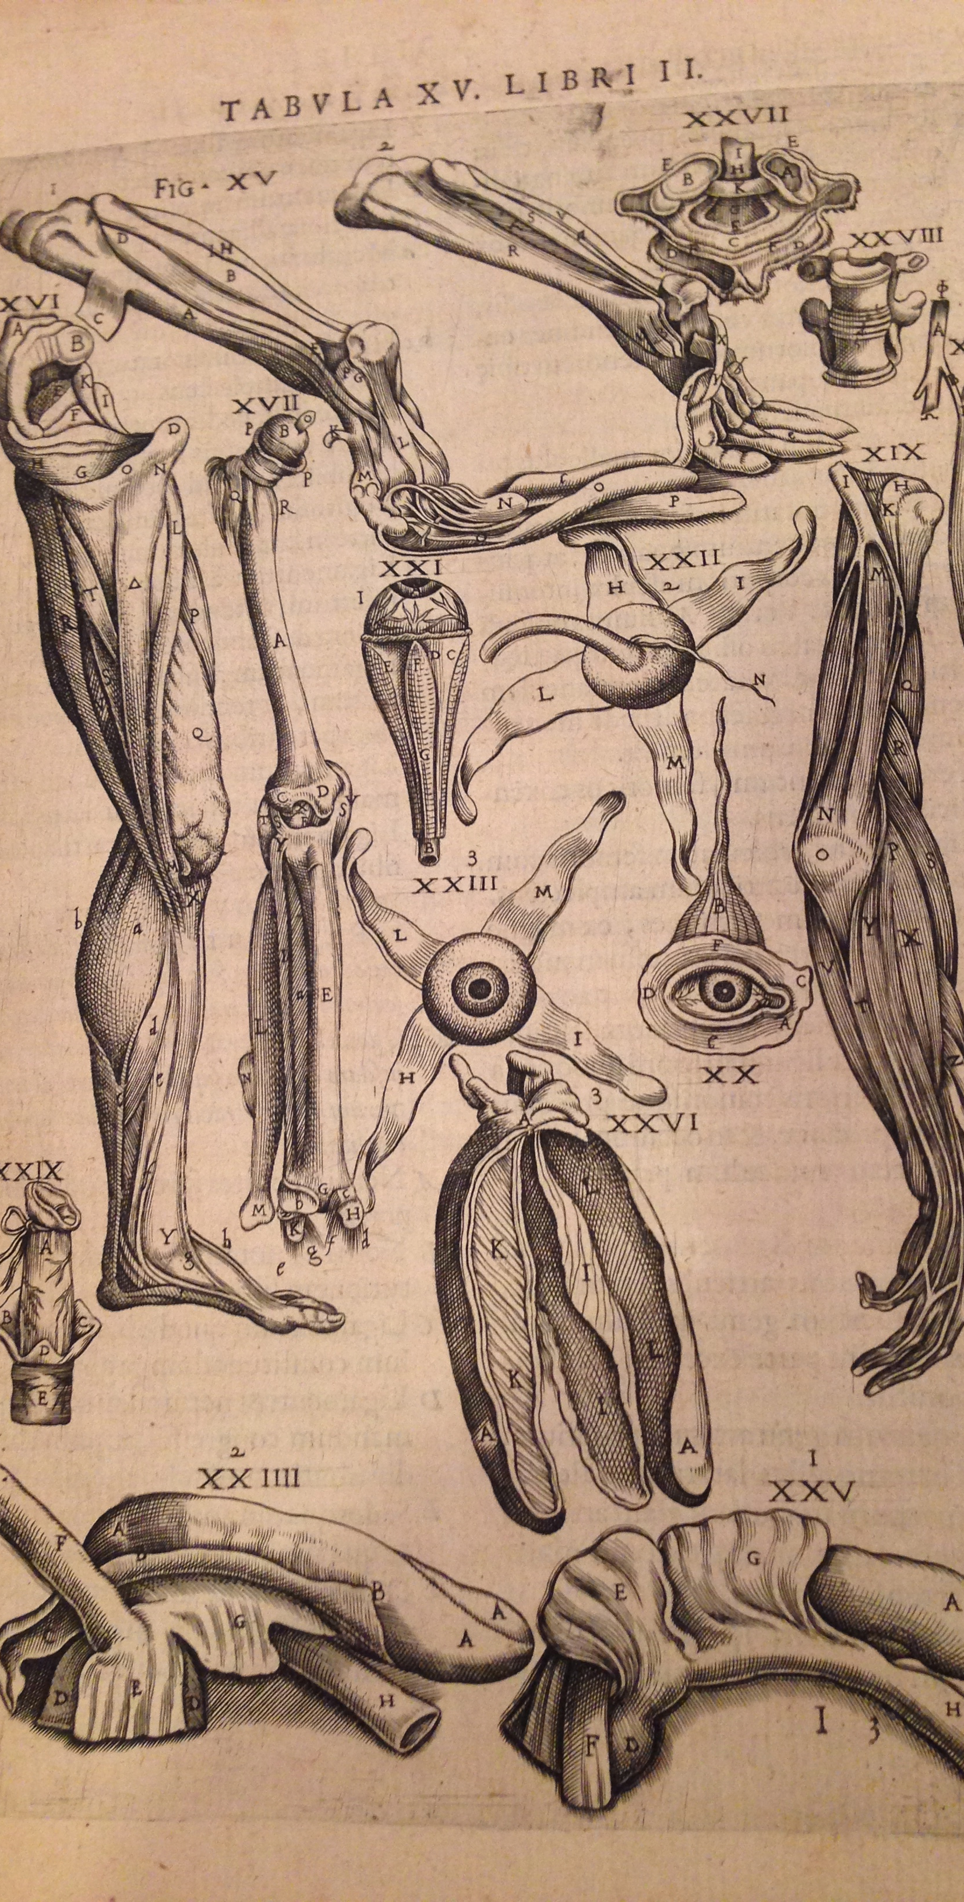
Poem as body, body as poem: Epode 8
Notice how Horace uses the longer iambic trimeter to emphasize unattractive swelling or heaviness (tumentibus v.9; rotundioribus v.13)
Lines 9-10 reproduce the woman’s ugly body in the shape of ‘unbalanced’ iambic.
In lines 5-6, the ‘gaping’ of the woman’s anus is mapped onto the page in the wide separation (hyperbaton) of turpis (‘vile’) and podex (arsehole)
In the same poem, notice also how mentions of male impotence or lack of arousal occur in the shorter line (iambic dimeter), e.g. v.2, v.18

Slide 11
Epode 12: tit for tat
Old woman ‘replies’ to Epode 8, addressing the poet-lover with savage threats.
It is her overwhelming, powerful desire that takes centre stage, not the poet’s lack of arousal.
She has the last word, and compares the poet to a hunted animal (lamb, deer).

Slide 12
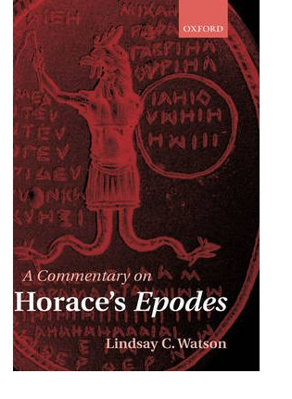
Questions for discussion
‘To apply the term ‘impotence’ to Epodes 8 and 12 is something of a misnomer’ (Watson p287). Discuss. Are these poems about impotence?

Slide 13
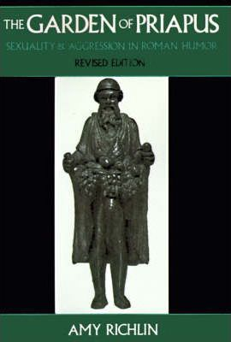
More questions for discussion
Watson p386: ‘It is evident that the primary function of such beast-analogies, when applied to sexually active women, is not, as Richlin has claimed, to dehumanize their subject, but rather to intimate that female lust is animal-like in character: that is to say, dangerous, intemperate and insensate…’ Do you agree?
What is the effect of the poet-lover being compared to an animal (lamb, deer) in the final lines of Epode 12?

