Slide 1
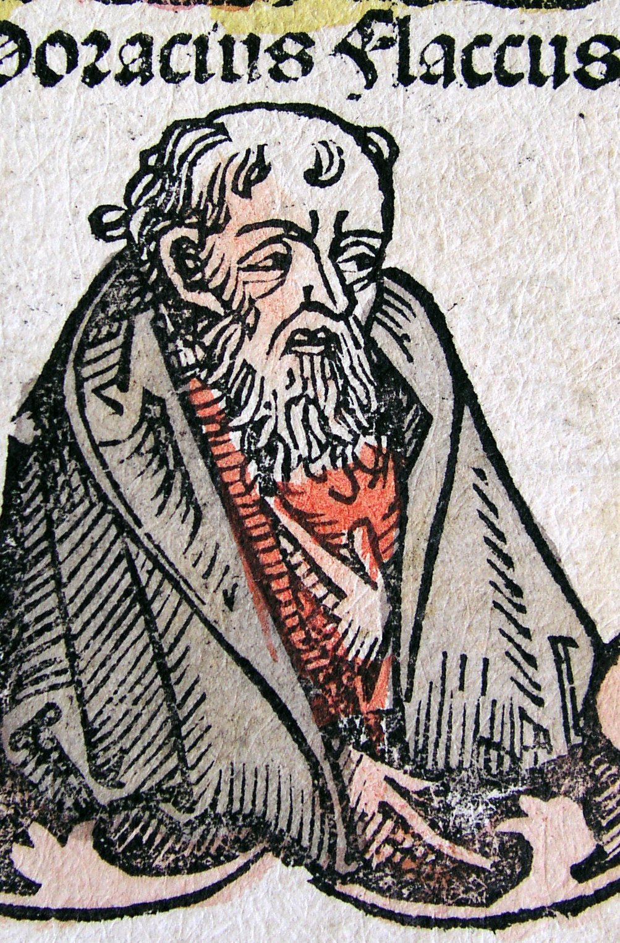
Satire’s bodies:
Horace’s ‘pedestrian muse’
Vulnerable Body 6

Slide 2
Key question [re.Horace]: to what extent can poses of social inferiority in the Roman world be expedient, even politically and creatively empowering?
Might we perceive this phenomenon in the context of modern artistic production? What kind of positive associations are attached to the ‘underdog’?

Slide 3
Roman verse Satire: food, fullness, miscellany
satura – satur – satis – lex per saturam
*
satura quidem tota nostra est
‘satire, indeed, is all ours’
Quintilian 10.1.49

Slide 4
Satire in Latin, thus far
ENNIUS (239-169BCE). Only 31 lines survive, metre varies.
VARRO (i.e. M.Varro Reatinus 116-27BCE)
VARRO OF ATAX (82-35BCE)
LUCILIUS: floruit 130-103BC: hexameter verse satire. 1300 lines from 30 books survive. Horace’s ‘father-figure’ and foil.
HORACE: Satires Book 1 published c.36-35BCE; book 2 c.30BCE

Slide 5
The body of Horace’s Satires
Metre: hexameter, but not as we know it?
Book 1: 10 poems (cf. Virgil’s Eclogues, 42-39BCE)
- Battle of Actium (31BC) -
Book 2: 8 poems (but 2.3 very long, 326 lines)
The Satires define themselves by negation:
NOT fiery, over-extended, ‘muddy’, freedom-fighting Lucilius (Horace’s Satires are ‘literary’, ‘tight-lipped’, even ?‘remarkably unsatirical’?)
NOT the asymmetrical, spiky, 17-poem Epodes (or vice versa)

Slide 6
Self-fashioning and social progress through poetry?
Poetry about poetry? (libello, ‘little book’ is the last word of Satires book 1)
The Satires are also ‘a unique cultural document, a blueprint for how to survive in uncertain times and an individual view of one man’s formation and emergence on the cusp between republic and empire’ (Gowers 2012, p1)

Slide 7
Sermo (‘conversation’)
Sat.1.4.40ff:
First I will take my own name from the list of such as I would allow to be poets. For you would not call it enough to round off a verse, nor would you count anyone a poet who writes, as I do, lines more akin to prose (sermoni propriora).’

Slide 8
Epist.2.1.250-57
‘As for me, I should not prefer my “chats” (sermones) that crawl along the ground (repentis per humum) to the story of great exploits (res gestas), the tale of distant lands and rivers, of forts on mountain tops, of barbaric realms, of the ending of wars under your auspices throughout the world, of bars that close on Janus, guardian of peace, and of that Rome who under your sway has become a terror to the Parthians – if only I had power equal to my longing.’

Slide 9
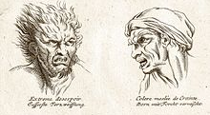
Grotesque bodies: moral as physical flaws
The Satirist’s own leaky/blemished body: Sat.1.5.7-8, 1.8.46, 1.6.66-7

Slide 10
Physiognomy and the Horatian grotesque
Aristotle, Prior Analytics 2.27:
It is possible to infer character from features, if it is granted that the body and the soul are changed together by the natural affections: I say "natural", for though perhaps by learning music a man has made some change in his soul, this is not one of those affections natural to us; rather I refer to passions and desires when I speak of natural emotions. If then this were granted and also that for each change there is a corresponding sign, and we could state the affection and sign proper to each kind of animal, we shall be able to infer character from features.

Slide 11
Satires 1.2: key point
‘The poem illustrates one of the chief paradoxes of the genre: moralizing poetry is potentially besmirched by its filthy subject matter’. (Gowers 2012)

Slide 12
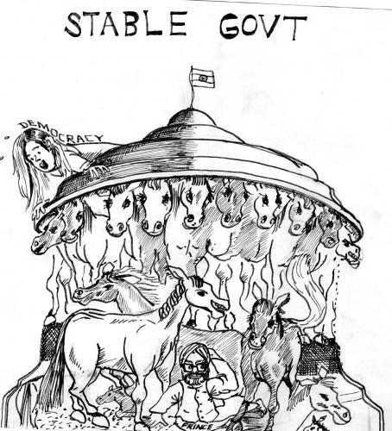
Satire 1.1: strong and stable?
Moderation and purity, or messy restlessness?
A brand new voice for Roman verse satire, or a self-parodying agglomeration of clichés’?
What kind of (paradoxical) blueprint for Roman satire?

Slide 13
Setting limits, and overstepping them
Satires 1.1.120: iam satis est / ‘Now that’s enough’
Satires 1.2: begins in spirit of flamboyant excess. Code of ‘simplicity’, ‘purity’ and ‘decorum’ in…adultery! Moderation = freedwomen (ease of access to their bodies)!

Slide 14
Sex and class
In Sat.1.2, Horace is pinpointing ‘the most vulnerable chinks in the armour of the ruling class – the sexual transgressions of its womenfolk, and the humiliation of the men who turn a blind eye to those transgressions.’ (Gowers 2012, p89, paraphrased)

Slide 15
Takes one to know one?
‘this is another triumphant demonstration of the outsider’s invulnerability’ (Gowers on Sat.1.2: p89)
But…
‘Satire itself requires the immoral body as the fons et origo of its own speech.’ (Gunderson 2005 ‘The libidinal rhetoric of satire’)

Slide 16
Writing the (satirist’s) body
Sat.1.6.64: vita ac pectore puro (with a pure life and heart)
Sat.1.5.7-8: ‘Here, thanks to the water, which was disgusting, I declare war against my stomach, and wait impatiently while my companions dine.’
Sat.1.5.29-30: ‘Here I put black ointment on eyes, being lippus (sore or watery-eyed, suffering from conjunctivitis). Meanwhile Maecenas arrives and Fonteius Capito, a man without flaw, so that Antony has no closer friend.’
Sat.1.6.65-7: ‘if the flaws that mar my otherwise sound nature are minor and few in number, even as you might find fault with moles spotted over a good-looking person…’

Slide 17
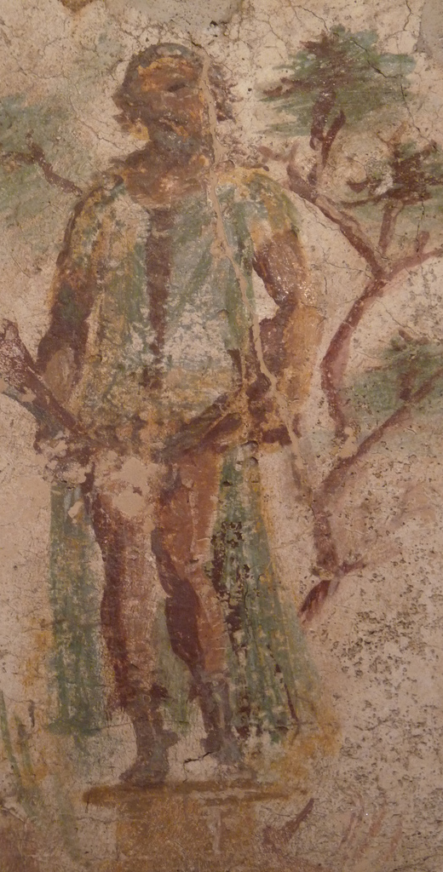
Sat.1.8: the poet as (avenging ‘victim’) Priapus
vv.1-3: ‘I was once a fig-wood stem, a worthless log, when the carpenter, undecided whether to make a stool or a Priapus, chose that I be a god’
vv.40-7: ‘Why tell each detail….how I shuddered at the words and deeds of the two Furies, through not unavenged. For as loud as the noise of a bursting bladder was the crack when my fig-buttock split. Away they ran into town.’

Slide 18
Satires 1.4: when is enough enough?
Lines 105ff.: defining Horace’s place in a satirical tradition - a new, biological, auto-biographical genealogy for satire?
Genetic fathers replace literary ones?
An ‘aristocracy of virtue’ (Habinek) replaes social pedigree?

Slide 19
Nothing to see here: defensive manoeuvres in Sat.1.4
Sermones are not real poetry; no force, no passion, no bite; no one reads this!
Take away the beat and rhythm, change the word order, and you’ll see it’s just chit-chat, not epic poetry that can do any harm. I am NOT Lucilius!!!
I’ll prove it with this example: take a slice of Ennius (father of Roman epic, a real poet, unlike me). Dismember the verse, and you’ll still find the limbs of a poet! I am NOT Ennius! I am a lowly, harmless, unliterary satirist!

Slide 20
Ennius Ann.225-6 (Sk)
Postquam Discordia taetra
Belli ferratos postis portasque refregit.
Imitated by Virgil at Aen.7.622 (Belli ferratos rumpit Saturnia postes)
How epic can you get? War, grandiose diction, alliteration, metaphor…
Or how unpoetic can you get?
So how epic, or how ‘poetic’, is Horatian satire? Is it really so harmless?

