Slide 1
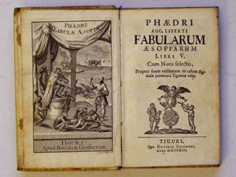
Phaedrus and the underdog
Vulnerable Body 8

Slide 2
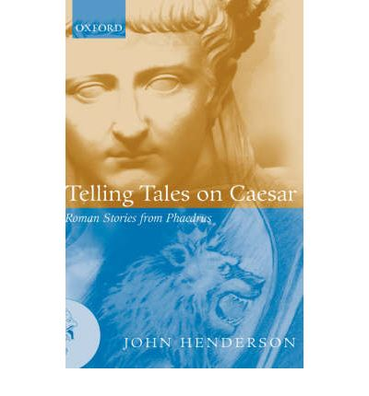
A poet on the margins

Slide 3
A passive ‘translator’ of Aesop?
Phaedrus styles himself as heir to Aesop, and most of his fabellae are Aesopic stories featuring animals and plants.
Yet he also overtly Romanises Aesop, dealing with themes such as Roman law, Roman public figures, emperors, politics and cultural life.
While Aesop wrote in prose, Phaedrus writes in iambic verse (mostly iambic senarii).

Slide 4
Key point
Writing fable comes to be associated with (performing) a low social status, and with inferiority and vulnerability of all kinds.
The prologue to Fables book 3 (34-7) sees the origin of the form in slaves’ desire to express what they cannot say explicitly (to their masters).

Slide 5
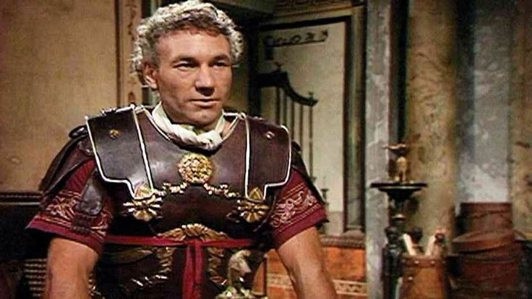
A victim of Sejanus?

Slide 6
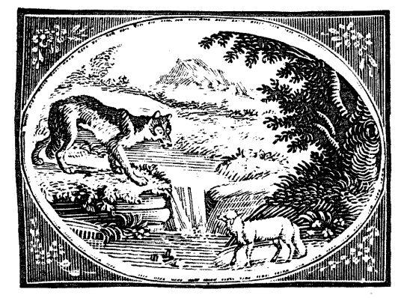
The wolf and the lamb, 1.1

Slide 7
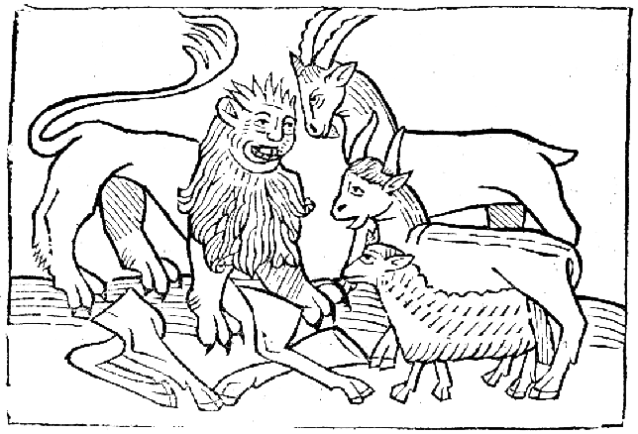
The cow, the goat, the sheep and the lion (1.5)

Slide 8
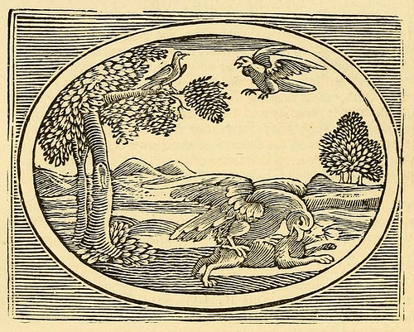
The sparrow and the hare (1.9)

Slide 9
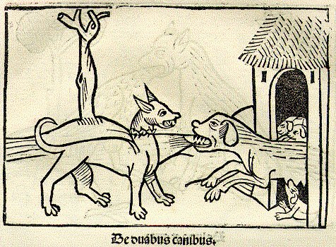
The dog and her puppies (1.19)

Slide 10
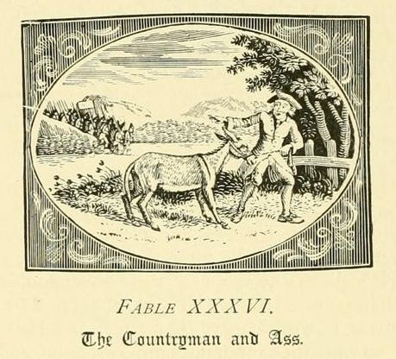
The ass and the shepherd (1.15)

Slide 11
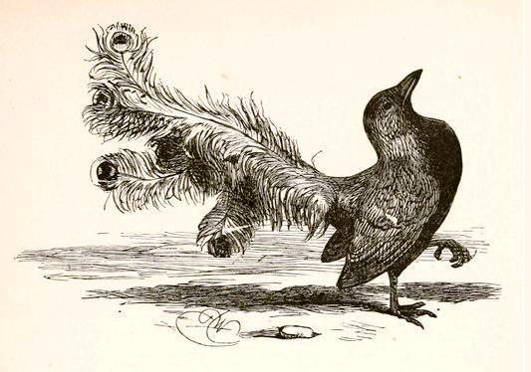
The jackdaw and the peacock (1.3)

Slide 12
‘Bifocal hermeneutics’
As a freedman, Phaedrus can write ‘from below’
Yet as a man of letters, a poet of learning and sophistication, he can also speak from the opposite perspective, ‘from above’.

Slide 13
The poet’s body
‘Slavery is to freedom as incontinence is to self-control and emotions are to bodily appetite; the slave is to the master as body is to mind, as woman is to man, as child to father.
W.Fitzgerald, Slavery in the Roman Imagination

Slide 14
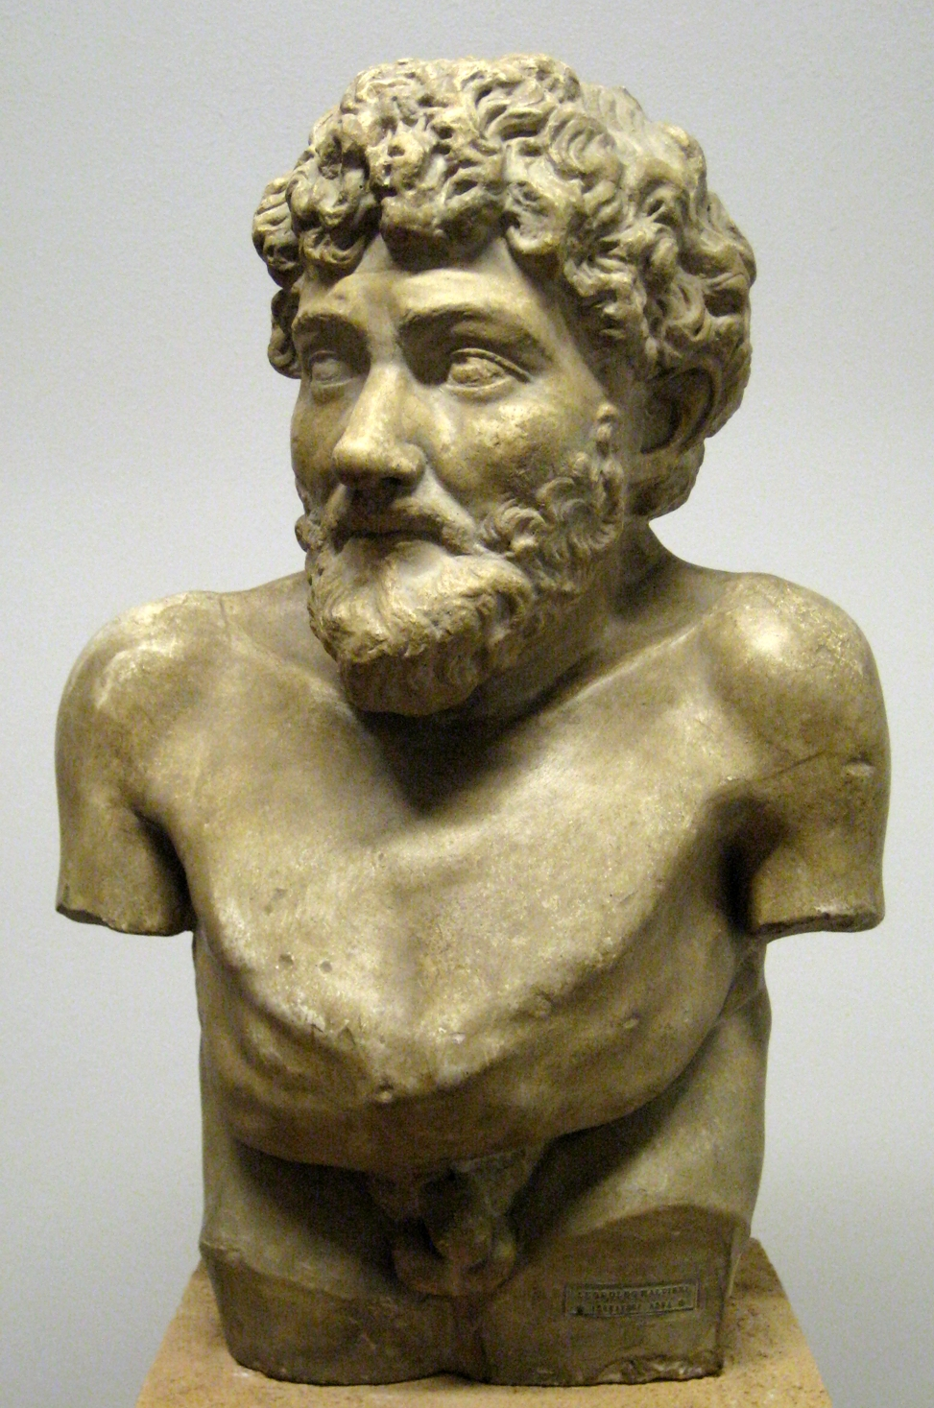
Aesop’s vulnerable body
“Aesop was of loathsome aspect, worthless as a servant, potbellied, misshapen of head, snub-nosed, swarthy, dwarfish, bandy-legged, short-armed, squint-eyed, liver-lipped — a portentous monstrosity.”
Opening lines of The Life of Aesop (2nd century fictional biography). See Daly, Lloyd W., translator. “The Aesop Romance.” Anthology of Greek Popular Literature. William Hansen, editor. Indiana University Press, Bloomington: 1998.

Slide 15
Key questions…
Are the Fables really just light reading, or is their lightness a veil for risky, subversive political commentary and performance?
To what extent are the fables performances of power? Can there be any real transfer of power to those who are genuinely vulnerable or socially marginalized?
What is the role of humour in all this? And how much power is the reader granted to ‘enable’ the voice of the slave, the freedman, or the person in the gutter, to rise up and sound out, authentically and authoritatively?

Slide 16
Do we get a brave new insight into imperial Roman culture through Phaedrus, or are these fables just tweaked versions of the same old stories?
Is being a slave, or slave-like, just a literary trope, shorthand for all things ‘Aesopic’? (cf. Champlin)
And what would be the point of (an aristocratic?) Phaedrus experimenting in the poetry of the low, the ugly, the vulnerable and the powerless?

Slide 17
Prologue to book 3
This is where Phaedrus pulls together his central auto-biographical storyline.
Most extensive of prologues at 63 lines.
Puts complex, layered identity of author centre-stage (Phaedri is the first word).
Through Eutychus, Phaedrus negotiates with his audience: do we come with prejudices? Do we want to continue reading/listening?

