Slide 1
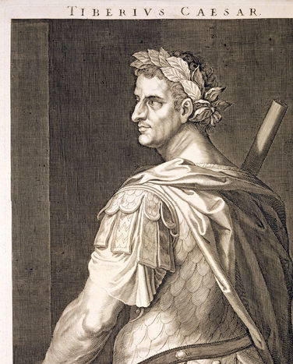
Phaedrus and Tiberius: servility, power, humiliation
Vulnerable Body 10

Slide 2
Recap – ongoing questions
What is the relationship between constructions of vulnerability in imperial Latin texts, and the material reality of vulnerability in imperial Rome?
How are cultural constructions of male citizen invulnerability dependent on affirming vulnerability in others?

Slide 3
The strengths of “vulnerability”
Speaking and writing from a perspective presented as non-normative.
Presenting the wit, originality or iconoclastic impact of a ‘smaller’, ‘weaker’ genre.
Experimentation with form.
Self-positioning and political manoeuvring.
Power-play (not least, with audience)

Slide 4
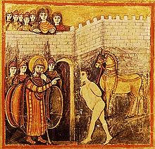
Sinon: ‘come of it what may…’
(illustration from the 5thc. Vergilius Romanus)

Slide 5
Telephus (Epilogue to Bk 3)
A son of Hercules
Ruler of Mysia who repelled the Greek expedition when it mistook the kingdom for Troy.
In the battle that ensued, he was wounded by Achilles’ spear; an oracle told him only Achilles spear would cure him.
Telephus went to Agamemnon disguised as a beggar, kidnapped Orestes and blackmailed the Greeks to help him; according to an oracle the Greeks would never reach Troy without Telephus’ guidance.
Telephus was healed by the rust from Achilles’ spear, and in return guided the Greeks to Troy.

Slide 6
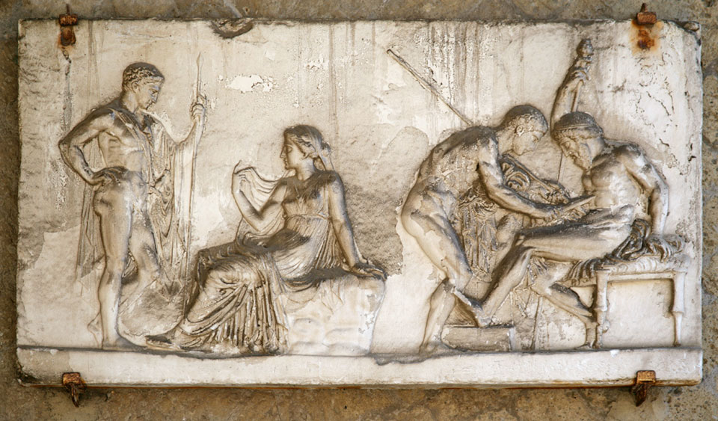
Telephus
Relief, Herculaneum 1st c.CE

Slide 7
Ennius Telephus fr.340
[spoken by Telephus the king, dressed as a beggar]
Palam muttire plebeio piaculum est
‘It is sacrilege for a man of low birth to mutter in public.’

Slide 8
Question for discussion
What is the significance, do you think, of the fact that Phaedrus speaks through (Virgil’s) Sinon and (Ennius’) Telephus at the beginning and end of book 3 of the Fables? Think about genre, ethnicity, class, and bodily vulnerability.

Slide 9
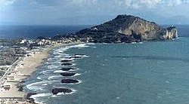
Tiberius at Misenum: Phaedrus 2.5

Slide 10
Phaedrus 2.5: how to flatter an emperor?
Date: unknowable, but probably before Tiberius’ death in 37CE.
Tiberius is in ‘retreat’ from 26CE.
Was Phaedrus really part of the palace retinue?
How removed are we to see this ‘country retreat’ from the paranoid politics of court life, run by Sejanus?
What is the moral of this story?

