Slide 1
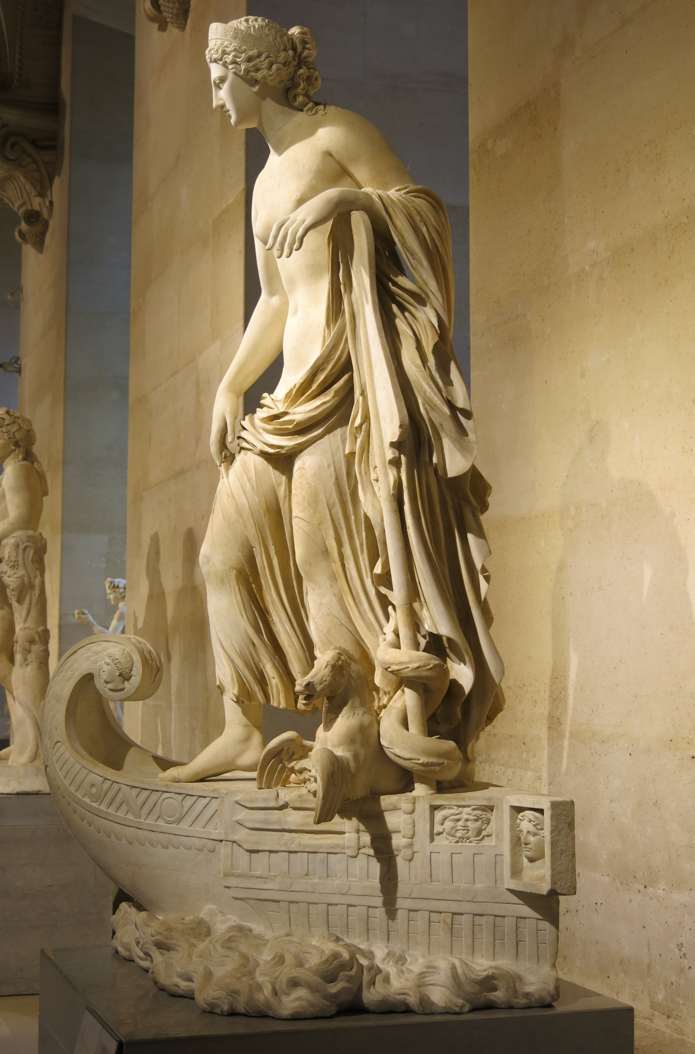
The mother’s story:
Statius’ Achilleid
Vulnerable Body Term 2, lecture 10

Slide 2
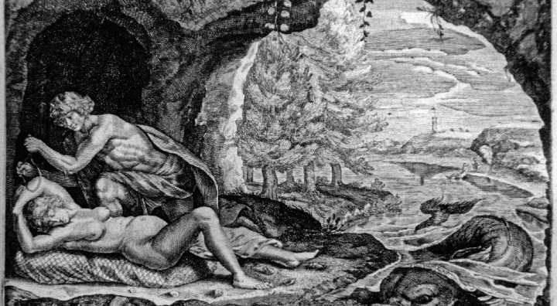
Peleus and Thetis (1677 engraving)

Slide 3
What does epic (warfare) look like from the point of view of a mother?
[nb: this partly depends whose mother we are talking about: Thetis plays a very different role to that played by Venus, mother and protector of Aeneas in Virgil’s Aeneid, who will himself ‘play Achilles’ in the final duel with Turnus]

Slide 4
A plan backfires…
In hiding Achilles on Scyros (apparently a female, pastoral, elegiac idyll), Thetis creates the circumstances in which Achilles can mimic his mortal, rapist father, Peleus.
Achilles’ revelation of his biological sex and his rape of Deidamia are the first in a series of events which will ensure he leaves the island for the oceans and battlefields of war.

Slide 5


Becoming a man in imperial Rome
One is not born, but becomes, a man (?)
Masculinity must be continually reiterated and performed

Slide 6
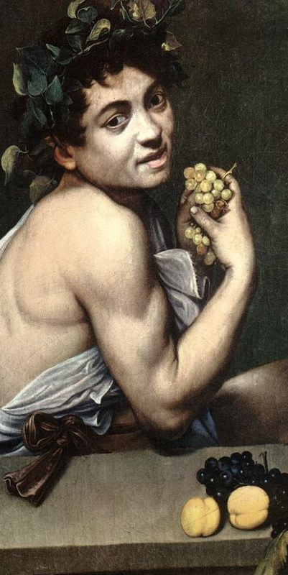
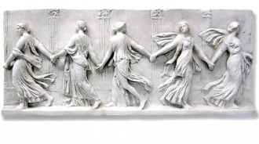
‘Here there are only the wands of Bacchus’ (Achilleid 1.393)

Slide 7
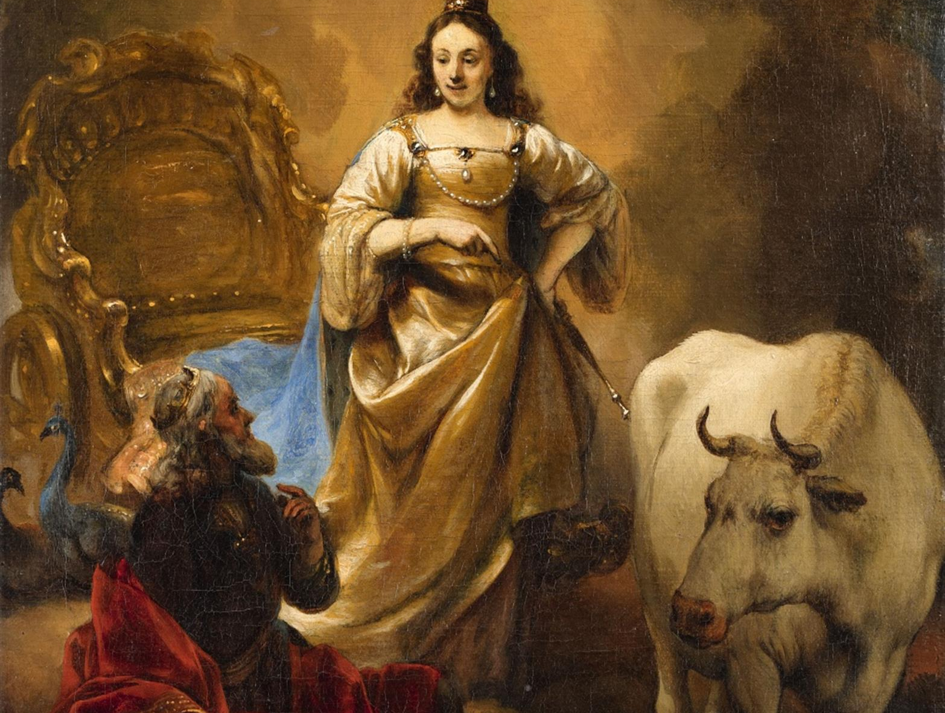

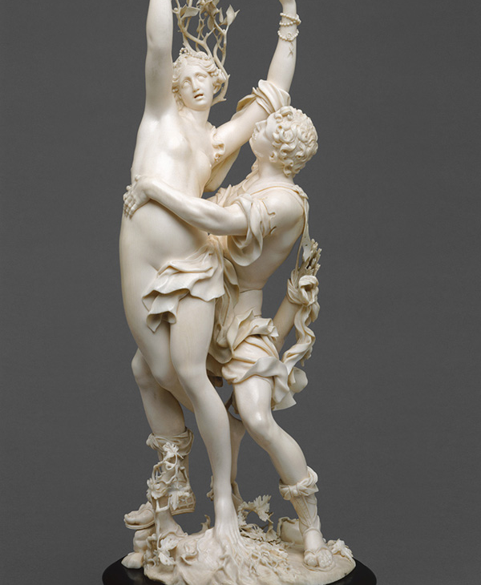
Primus amor:
Apollo and Daphne (right)
Jupiter, Juno and Io (above)
[handout 3b]

Slide 8
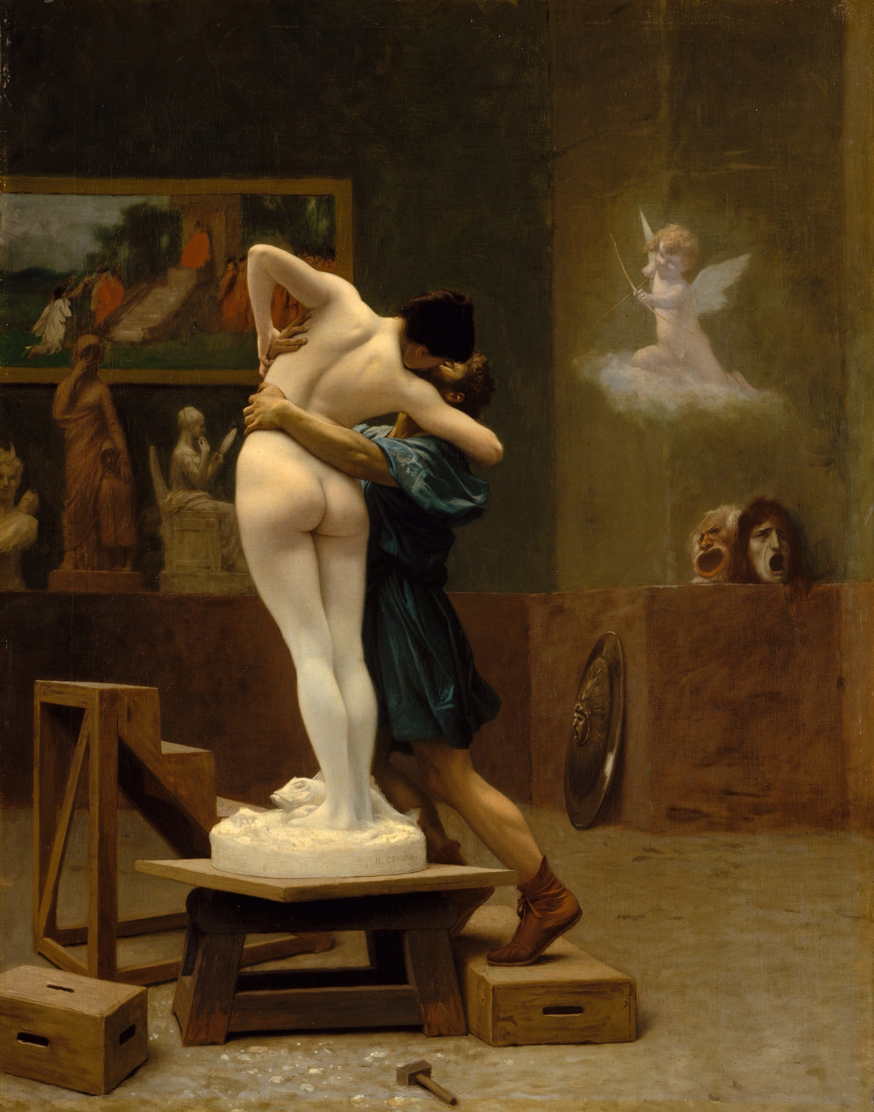
Thetis as Pygmalion?
(J.-L.Gerome, Pygmalion and Galatea, 1890)

Slide 9
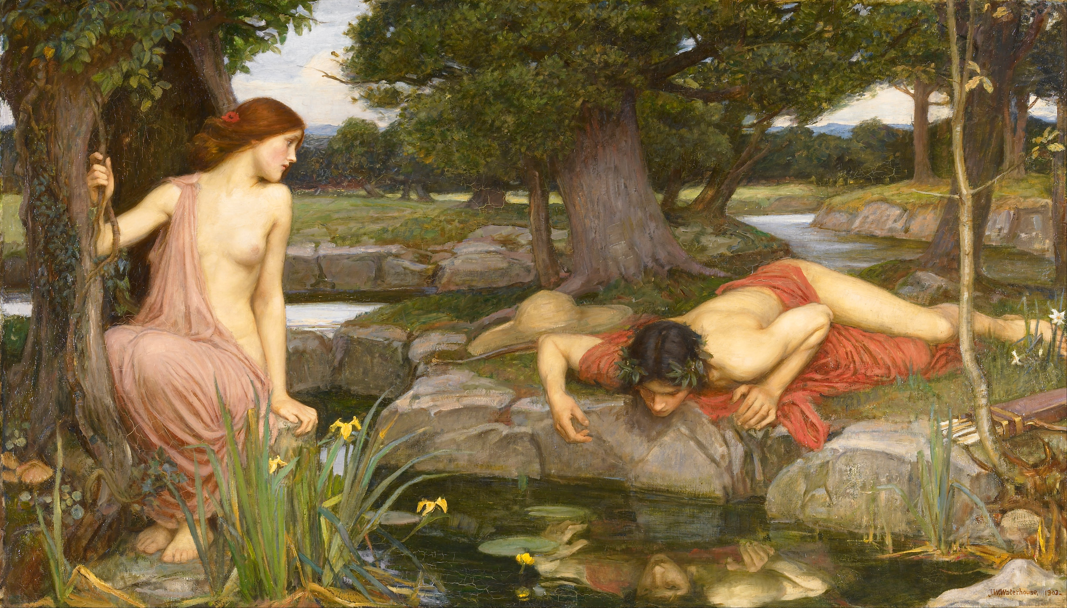
Or as Ovid’s Echo?
(John William Waterhouse 1903)

Slide 10
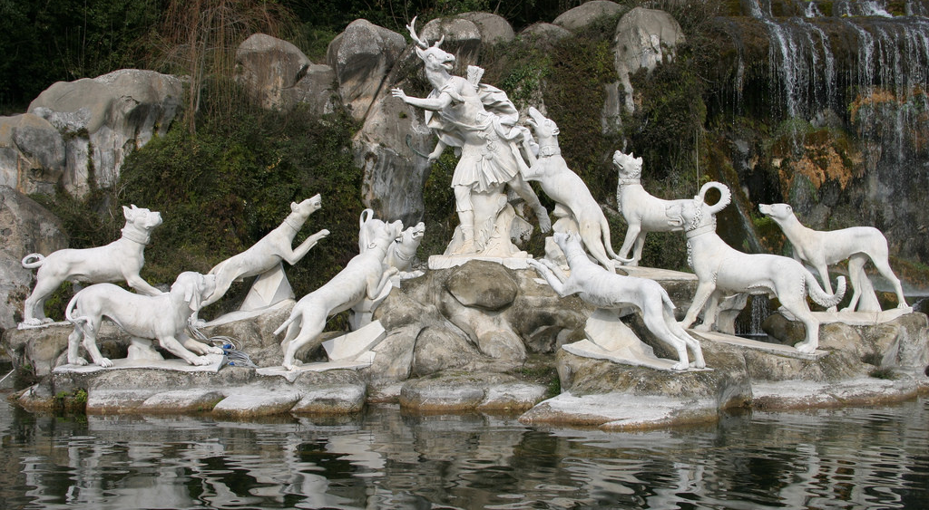
Achilles as Ovid’s Actaeon?

Slide 11
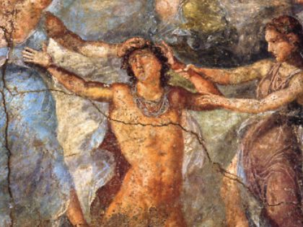
Achilles as (not) Pentheus / Acteon?

Slide 12
Seminar discussion of Ach.1.640ff.
Look at how Statius’ account of the rape differs from Ovid’s in Ars Amatoria 1.689ff.
How does Statius respond to Ovid’s account: what is different, and to what effect?
Consider what happens to Thetis’ voice, and who her perspective is represented in this passage.
Do you think Statius’ Achilles fully succeeds in ‘becoming a man’ by raping Deidamia?
How does Statius’ poem get us thinking about the interplay between biological sex, and gender?

