Slide 1
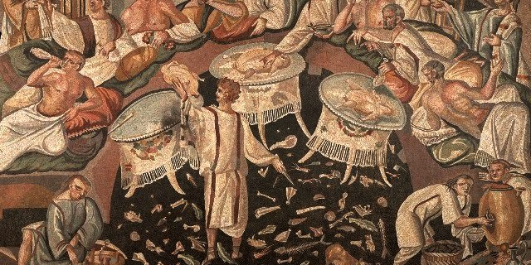
Stuffed bellies and bad taste:
Persius and the poem made flesh
The Vulnerable Body
Term 2, Lecture 2

Slide 2
Revision question
How does Roman verse satire (or, so far, Horace) represent and deal with BODIES?
Key Latin words:
satura – satur - satis

Slide 3
Horace’s Satires – key revision points
Horace’s lowly ‘conversations’ (sermones) are bound up with the physical body of the poet himself, with its ‘marks’, weaknesses, family DNA, and with the bodies he associates with or desires…
E.g. Recall how he rewrites the genealogy of satire as his own family traditions in Sat.1.4, and defines his moral and poetic ‘moderation’, as well as social status as son of a freedman, by the types of women he sleeps with in Sat.1.2

Slide 4
Often, the poet’s fictional body is just as vulnerable and messy as the bodies he vilifies.
For example: speaking as the wooden Priapus statue in Sat.1.8, the poet succeeds in policing the new political landscape (in the form of Maecenas’ villa), but by bending over backwards and farting at the witches, causing his fig-wood bottom to split open.

Slide 5
Vulnerability in writing/reading
Does it take one to know one?
Are satirists/comedians who undermine themselves especially powerful, convincing, or appealing?

Slide 6
Persius’ prologue: the scazon
Note the ‘limp’ (dragging long syllables) at the end of the line:
Nec fonte labra prolui caballino
u – / u – / u – / u – / u – – –
Cf. Catullus 8: miser Catulle, desinas ineptire

Slide 7
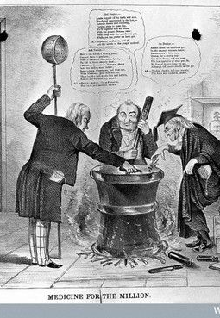
It all boils down to….
decoctius = ‘something more boiled down’ (Sat.1.125)
Concentrate? Potion? Medicine?
Strong-tasting and pungent?
A new (Stoic) take on the aesthetic of brevitas, or brevity?

Slide 8
‘Persius is hard to read. He
wants it that way’.
(A.Cucchiarelli, The Cambridge Companion to Roman Satire)

Slide 9
Persius the Stoic satirist
A return to Zeno’s Stoic principles – concise, unfrilly rhetoric?
But ironic distance from Stoic doctrine?

Slide 10
Persius: the central paradox
The message of the Satires is that we should harden up, live properly (recte vivere), stop being soft (mollitia is a key word).
Yet our ‘textbook’ immerses us in a poetic world that is grotesque and over-rich, that is all about bending boundaries, contagion, odd juxtaposition…

Slide 11
So do the Satires give us indigestion, rather than offering us a detox diet?

Slide 12
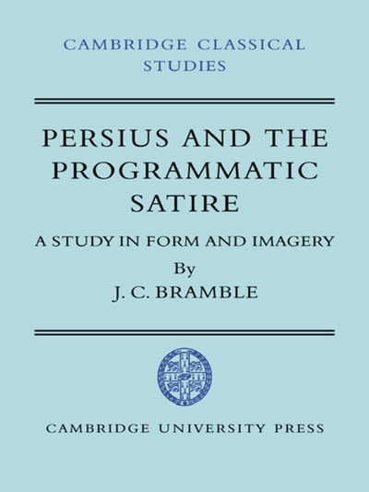
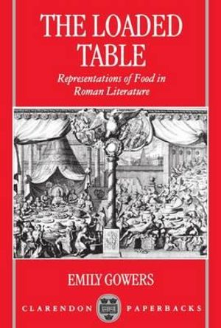
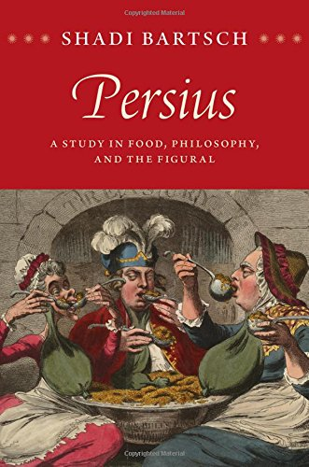
Two contrasting views

Slide 13
Gowers (1993) 124, 185:
‘The muse of satire was none other than the bloated bodies, protuberant guts, and messy stews that are the chief objects of the satirist’s abuse….The fat stomachs, distended with tripe, that fill Persius’ pages not only embody moral laxity and crass sensibilities; they are also walking figures of the text itself.’
Bartsch (2015) 62-3:
‘We can mount a better defense of our satirist than this…. What Persius threatens to do is to cook the mass in his pot some more, to “concoct” it into something that can be digested and will distribute nourishment properly to those who read it. We recall that one of Seneca’s injunctions on reading/digestion was that too many foodstuffs not be sampled at once, precisely because this would interfere with digestion… Persius’ Satires both raise this problem and promise to resolve it: they will render those rich dishes into something more simple.’

Slide 14
The ‘prologue’
That’s not how I suddenly become a poet,
By wetting my lips in the Hippocrene,
Or dreaming on the twin peaks of Parnassus.
I leave the Muses, and Pirene’s pale
Spring, to those with busts to which
A crown of ivy clings; a semi-pagan
bring my song to the bards’ holy rites.
What teaches the parrot to squawk: ‘Hello!’
And urges the magpie to try human speech?
It’s that master of arts, and dispenser of skills,
Hunger, expert at trying out sounds nature denies.
For if there’s the gleam of a hope of crafty gain,
You’ll hear crow-poets and magpie-poetesses
Singing in praise of Pegaseian nectar.

