Slide 1
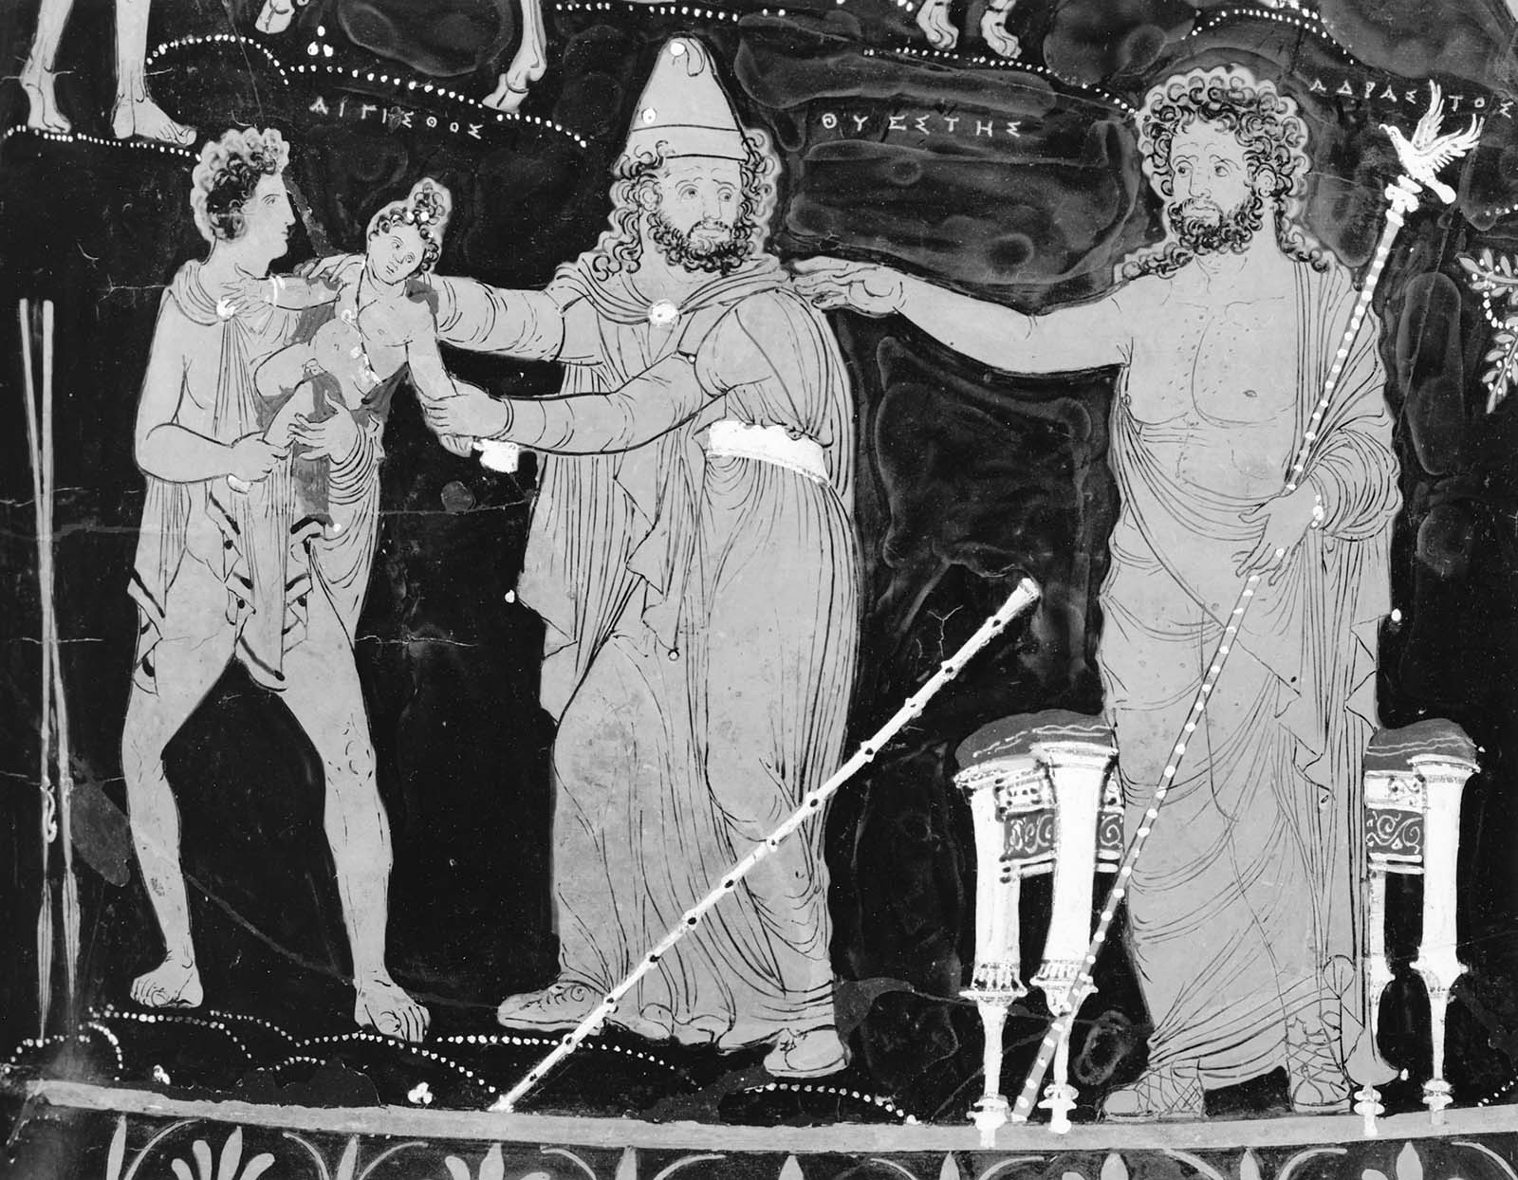
Beyond tragic vulnerability: Seneca Thyestes (II)
The Vulnerable Body
Term 2, lecture 5

Slide 2
The battle for invulnerability: a zero-sum game?
Atreus will never be the monstrous, self-sufficient Stoic he wants to be, because the problem of paternity and desire has not been resolved.
His relationship with Aerope gives the lie to his male independence and invulnerability.
Aerope’s unpolicable sexual behaviour and emotions, and therefore Atreus’ fragile and contingent patriarchal authority, rumble beneath the surface of the play.

Slide 3
The sterile male body
The punishment of Thyestes makes grotesquely clear that men do not possess the generative power that women do. Thyestes may be doubled over with ‘labour pains’, yet there will be no birth, only the still-birth of dismembered bodies (via the two orifices that again remind Thyestes that he does not have the reproductive organs of a woman).
The male body in the play is sterile, death-like. There will be no ‘revelation’ in birth, no emerging from the darkness of the body’s interior into the light of day. Even that process, which is also the basic mechanism of tragedy, is confounded.

Slide 4

WOMAN
Terrible avenger
The origin of life
Creative genius
Passive earth
Shame
Atreus, in order to be all powerful, faces a paradox. He must both NOT be a woman and appropriate/parody a female power to control reproduction and birth.

Slide 5
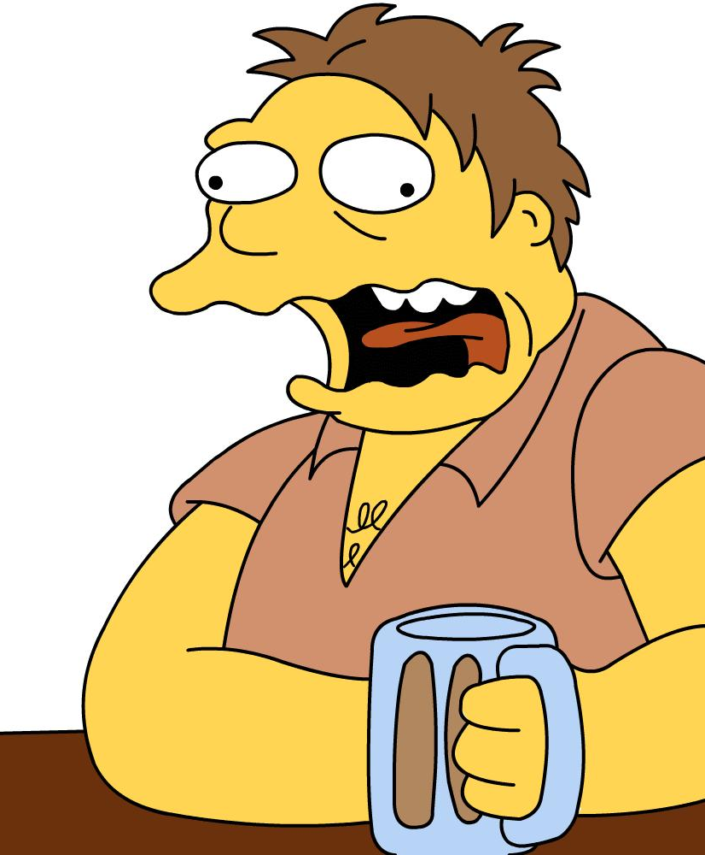
Eructat (Thy.911)

Slide 6
Meltzer, ‘Dark wit and black humor in Seneca’s Thyestes’ (p314):
‘The contrast between 'civilized' luxury and barbaric crudeness is clear. Atreus describes a gleeful, drunken Thyestes burping contentedly as he reclines, barely able to keep his head up. Eructat, placed at the beginning of line 911, has a powerful impact. Thyestes’ belch lifts Atreus into the throes of exaltation as he rejoices in his victory. The soaring emotion of his exclamation, o me caelitum excelsissimum…contrasts the preceding sentence, eructat. At the beginning of the speech Atreus joyfully claimed that he walked with his head level with the stars (885-6). Thyestes’ burp makes Atreus’ apotheosis complete.’

Slide 7
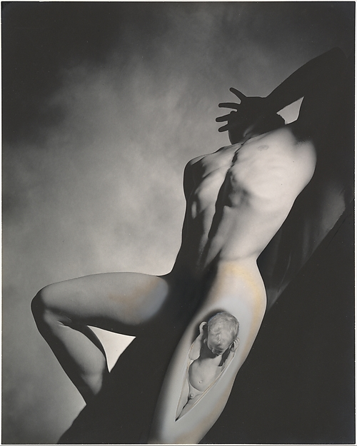
George Platt Lynes 1939
(The second birth of Dionysus), at The Met

Slide 8
