Slide 1
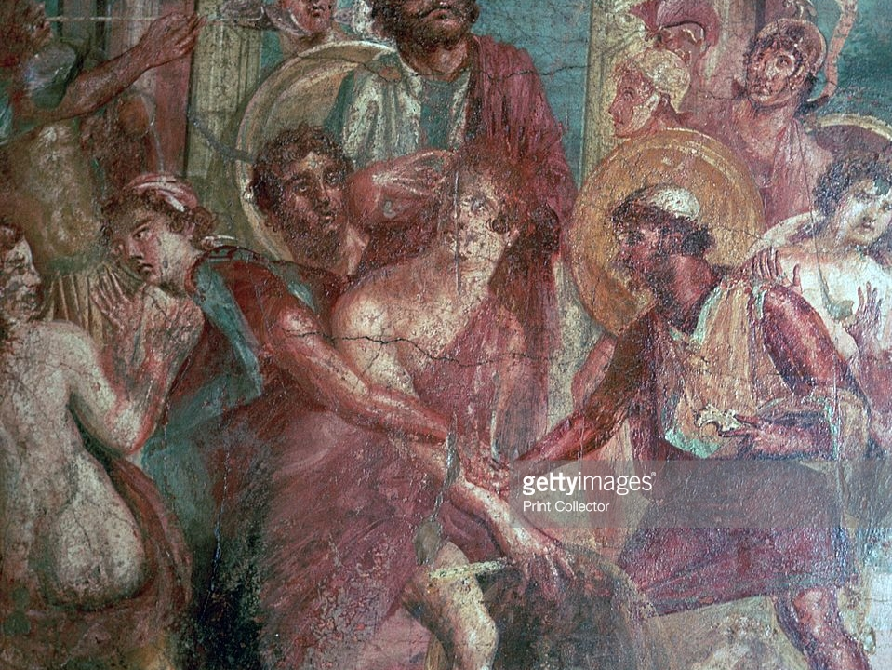
Achilles’ heel: Statius’ Achilleid
Vulnerable Body T2, week 9

Slide 2
Publius Papinius Statius
Born between 45 and 61 in Naples
Father became known as poet and rhetorician (in the Silvae, Statius writes that he composed prose versions of Homer).
Statius had a number of wealthy patrons, including the emperor Domitian. Wrote the Silvae, the Achilleid, and the Thebaid, a great epic on mythic civil war in the house of Oedipus.
All three works triangulate and interact with one another in interesting ways. Silvae 4/7 (handout 8) suggests that the two epics were composed in parallel

Slide 3
A prequel (and sequel?) to the Iliad?
Highly renowned are the warrior’s deeds in Maeonian song, but more remains untold:
suffer me – for such is my desire – to recount the whole story of the hero, to summon him forth from his hiding-place in Scyros with the Dulichian trumpet, and not to stop short at the dragging of Hector, but to lead the youth through the whole tale of Troy.
Achilleid 1.3-7

Slide 4
*Key idea*
At the core of Statius’ plot is the problem of Achilles’ and Thetis’ vulnerability, and the project of attempting to mitigate or erase this vulnerability

Slide 5

Interrogating the epic tradition
Achilleid an ‘unepic’ epic?
Key influences: Ovid’s ‘neo-Callimachean’ epic, the Metamorphoses; Alexandrian ‘epyllion’, such as Apollonius’ Argonautica, and Latin experiments in epyllion such as Catullus 64.
Statius’ Achilles is ambiguously gendered, but also figures an ambiguous genre (a hybrid of epic and elegy?)

Slide 6
Achilles’ hybridity / ambiguity
Ephebe (boy-man)
Divine-human (semideus)
Human-beast (semiferus)

Slide 7
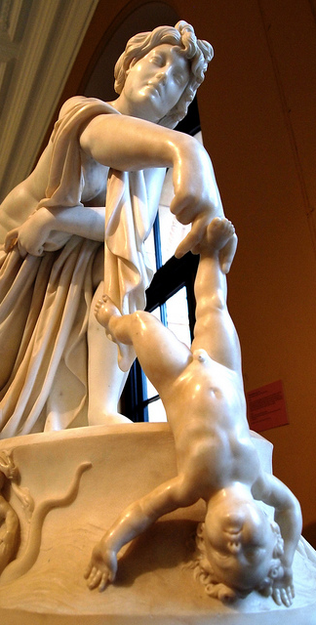
Achilles’ vulnerability is a source of great anxiety for Thetis in two ways:
She risks losing her son in war
He is a constant reminder of her being raped by Peleus, and having her own divine powers overcome.

Slide 8
Achilleid Theteid
Thetis’ ambitions are in direct opposition to the teleology of militaristic epic.
She wants to paralyse and reroute epic, temporally and spatially.
Scit cetera mater (Ach.2.167)

Slide 9

Critical assessments
See handout 9

Slide 10
Thetis’ ‘persuasion’ (Achilleid 1.247-82)
If dressing as/becoming a girl was good enough for:
Hercules
Bacchus
Jupiter
Caenis / Caeneus

Slide 11
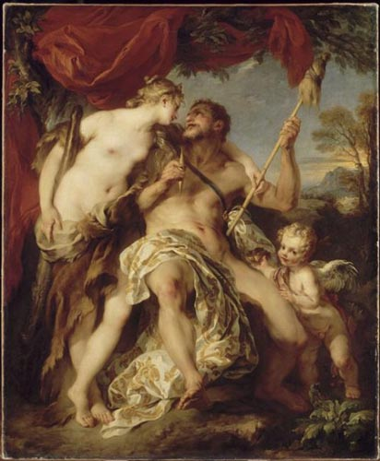
Hercules and Omphale

Slide 12
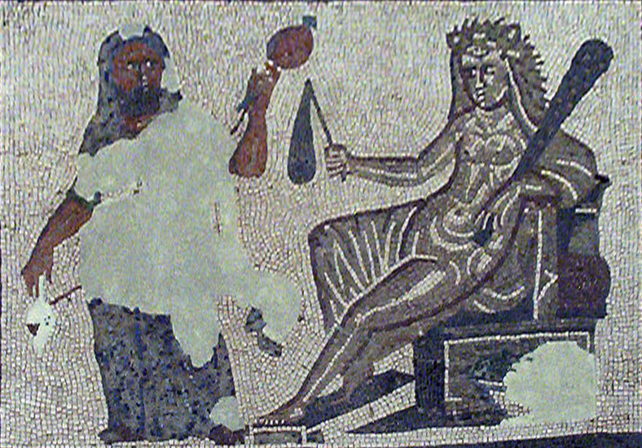

Slide 13
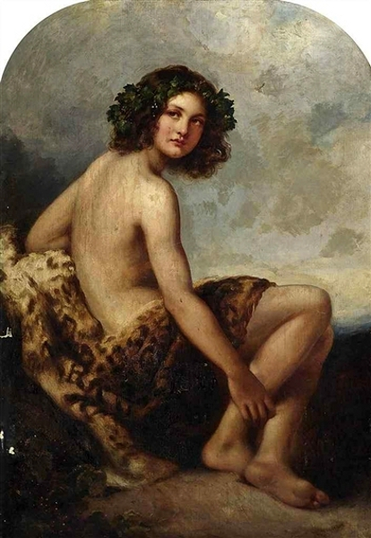
The young Bacchus

Slide 14
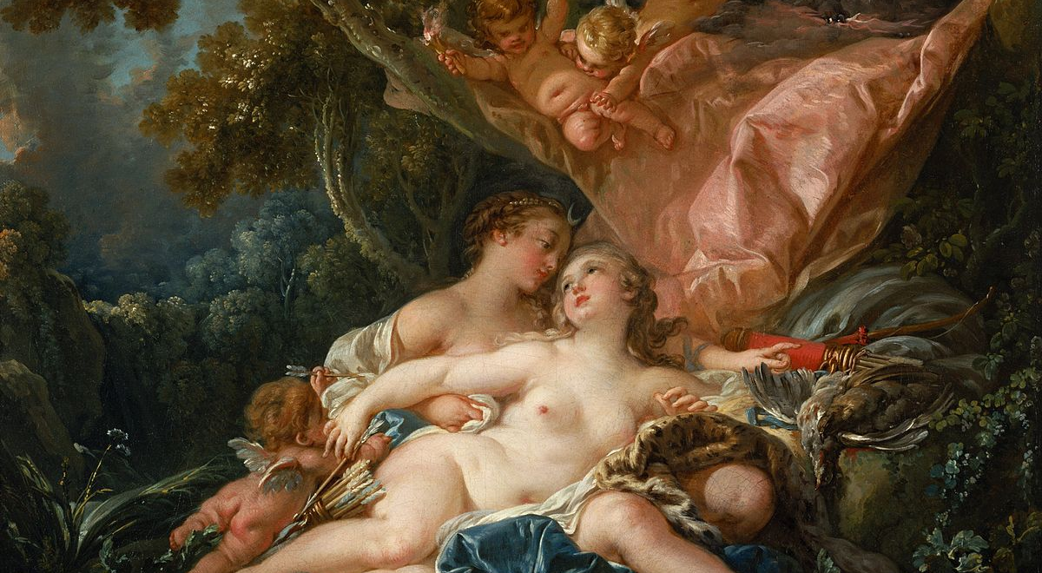
Jupiter dressed as Diana

